Slide 1



    Unit -2-
    Going Green

Slide 2
    Listen & Discuss
    Pair Work

Slide 3

Goals
Explain the main idea of Going Green
1
List some ways to GO GREEN
2
Learn more ways of being environmentally responsible
3
Use the new words to complete the sentences
4
Answer some questions correctly .
5

Slide 4


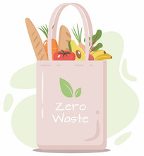
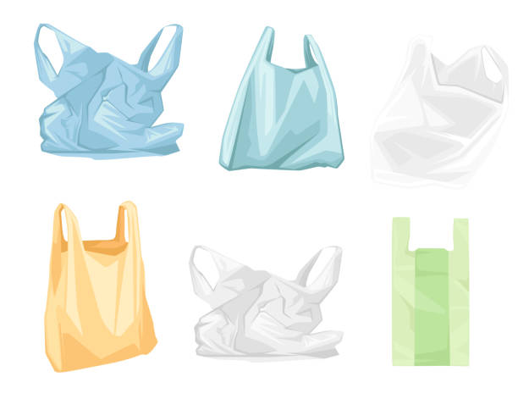
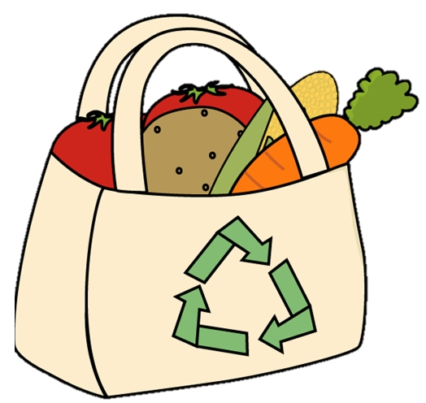

What does it mean to go green?
To do things in a way that protects the natural environment

Slide 5
I bring my own bag when I go to the supermarket.

Slide 6
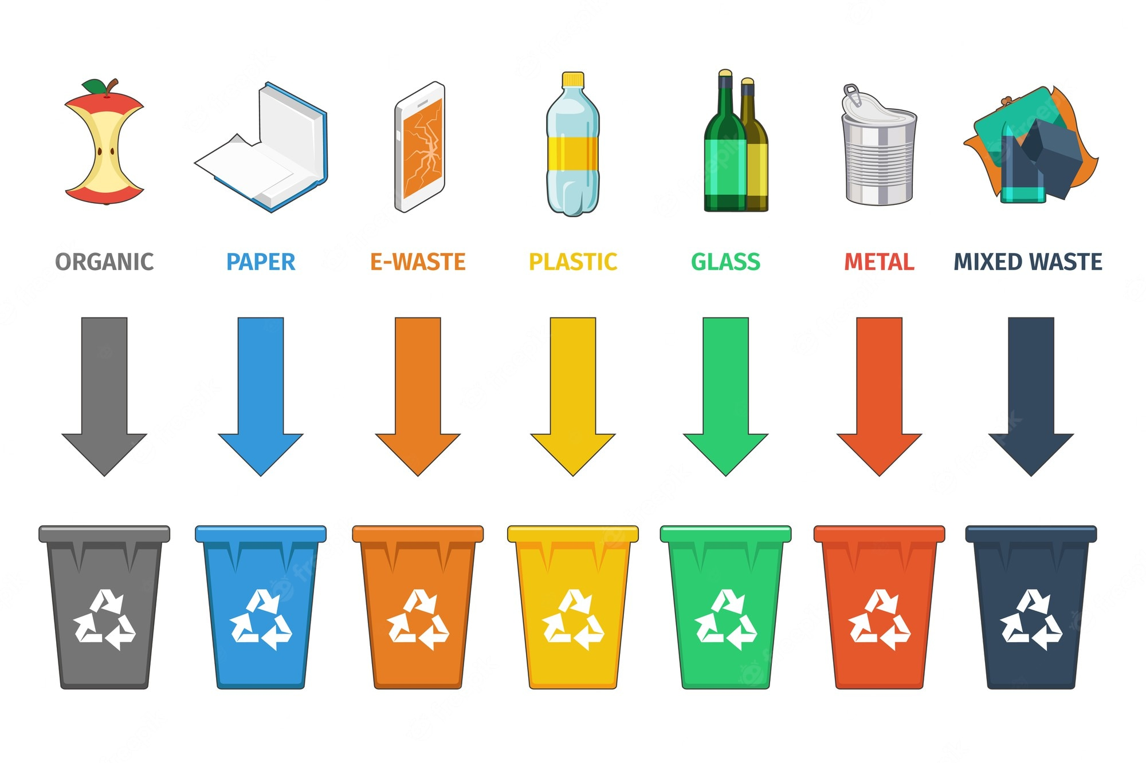
I put glass bottles in the recycling bin
Why do you do these things?
(to protect the environment)

Slide 7

What does this green symbol mean ?
The three arrows
represent

Slide 8
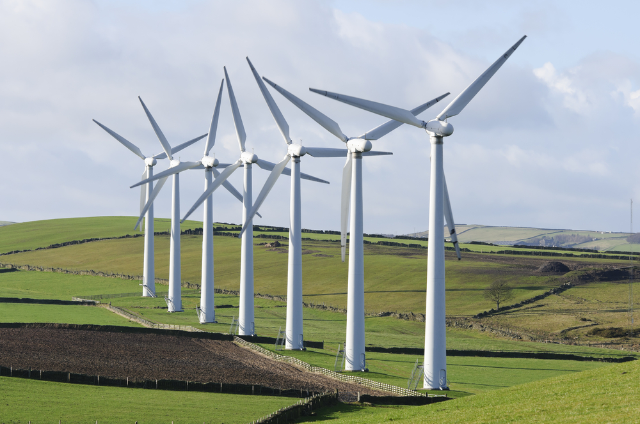
What do you think this is?
Are there any wind farms near where we live?

Slide 9

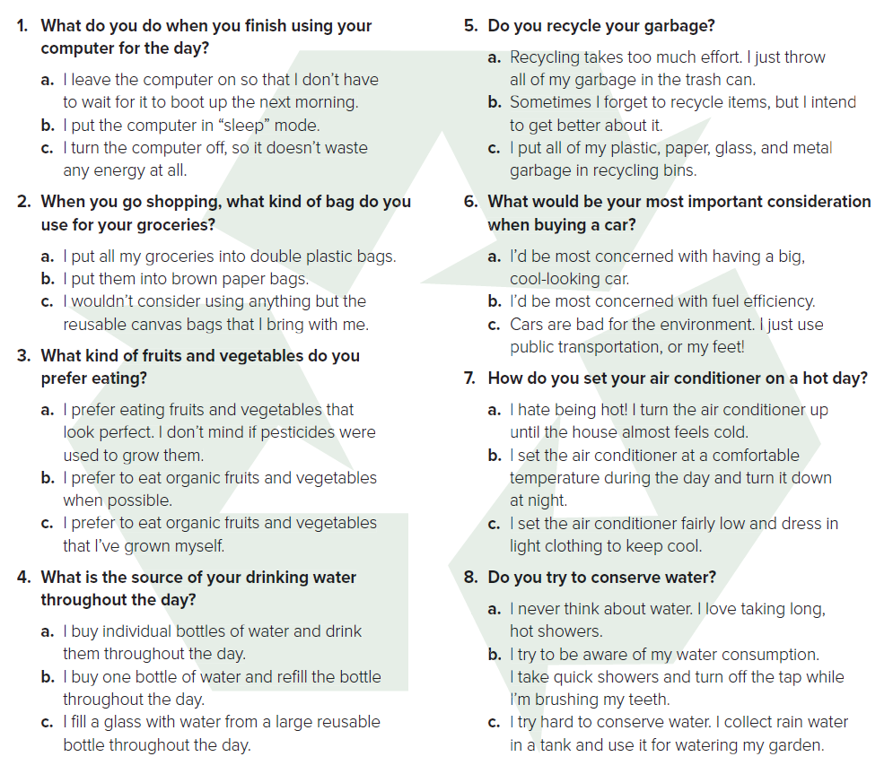



Questionnaire
Listen and read along

Slide 10

Questionnaire
Read & Circle your answer

Slide 11

“Go Green”
…. some ways?
using renewable energy
Conserving water
turning devices off after using
Recycling garbage
Eating organic
Reduce using plastic
Sitting AC fairly low

Slide 12
. Are there any recycling laws in our community?
. How do people heat and/or cool their homes?
. Where does our electricity come from? How is it produced?
4. Can you buy organic fruits and vegetables around here?
What does our school do to be “green”?
. What kind of bags do most people use in the grocery stores here?
. Is pollution from cars and other vehicles a problem?
. Do many people in the city have their own gardens?

Slide 13
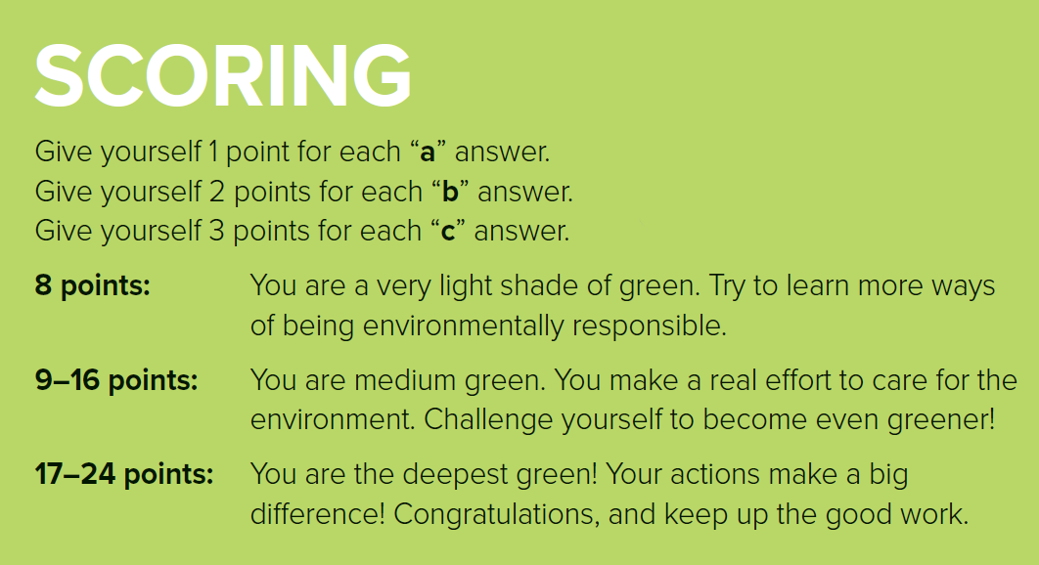

Questionnaire
Read & Circle your answer

Slide 14
Find a word that means
start up a computer
The food you buy at a supermarket or similar store
you can use it again
A place for throwing away garbage
a place to store water)

Slide 15
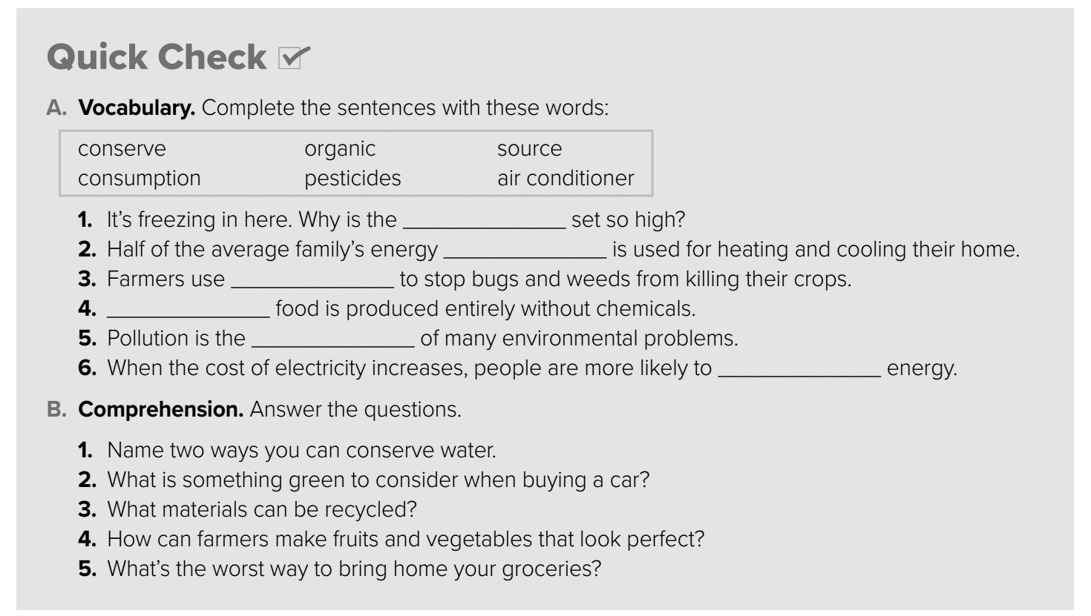
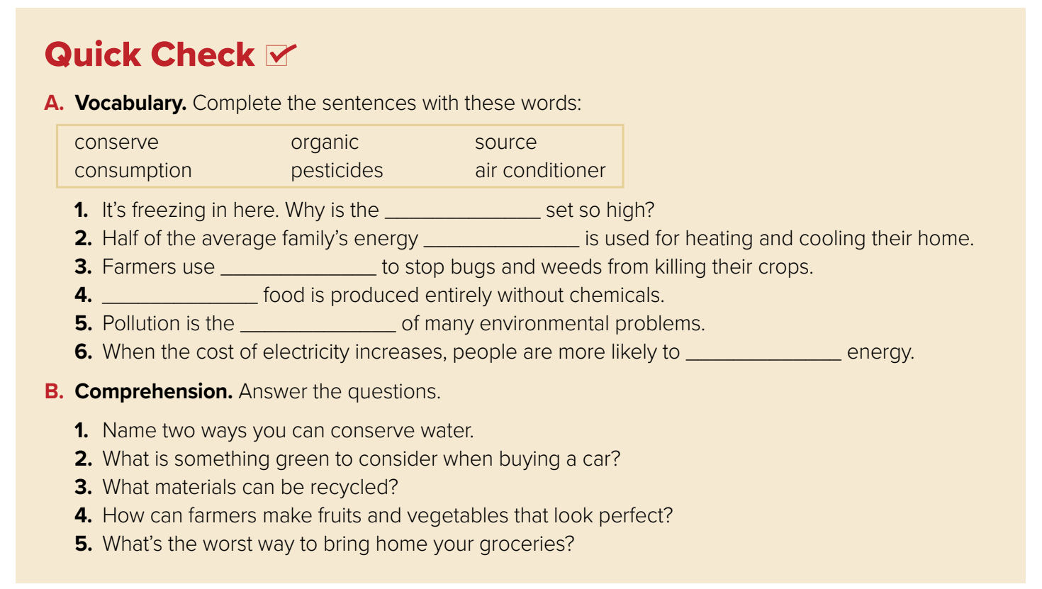
air conditioner
consumption
pesticide
Organic
source
conserve

Slide 16
1- collect rainwater for use; not leave the water running;
take quick showers .
2- fuel efficiency
3- plastic, paper, glass, and metal
4- They can use pesticides.
5- in plastic bags .

Slide 17
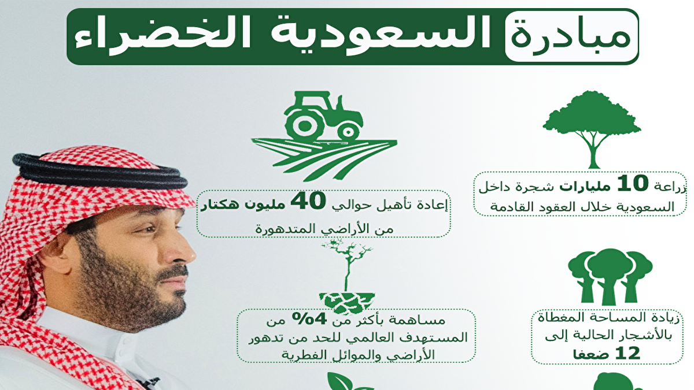

Slide 18


Slide 19


