Slide 1



Slide 2

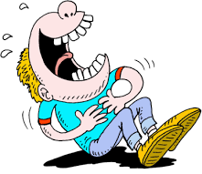
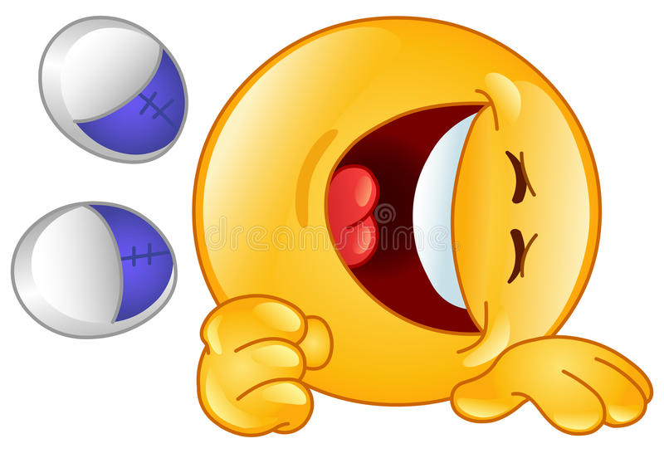
Laugh Out Loud

Slide 3
11 Form, Meaning & Function

Slide 4
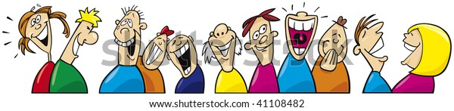
]
03
01
02
Express criticism
Express regrets
Express
wishes

Slide 5
Expressing Wishes, Regret and Criticism
Such…That / So…That
Can’t, Could, Couldn’t, Must, May, or Might

Slide 6
Expressing Wishes, Regret and Criticism

Slide 7
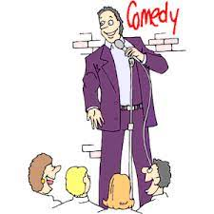

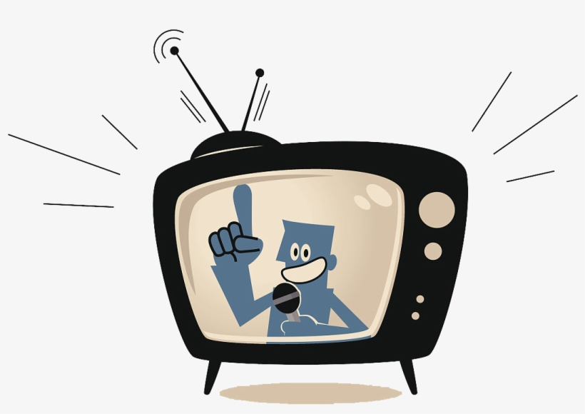
In the past
I didn’t see the TV comedian
I couldn’t get the joke.
I switched off before The ending the end of the TV show.

Slide 8

In the past
I wish I had seen the TV comedian. Everyone thought he was so funny
I didn’t see the TV comedian
Use wish for things that happened in the past that you now regret
I wish I had been able to get the joke.
I need to improve my English.
I couldn’t get the joke.
I wish I hadn’t switched off before the end of the TV show.
.The ending was supposed to be very good
I switched off before The ending the end of the TV show.

Slide 9

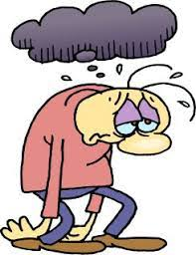
In the Present
I am not a big fan of his jokes.
I feel down today.
The comedian can’t make people laugh.

Slide 10
In the Present
I wish I found his jokes funny.
I am not a big fan of his jokes.
Use wish and if only for things you want to happen now or in the future but which you know probably won’t happen
I wish I didn’t feel down today. I wish I could cheer up.
I feel down today.
The comedian can’t make people laugh.
The comedian wishes he could make people laugh.

Slide 11
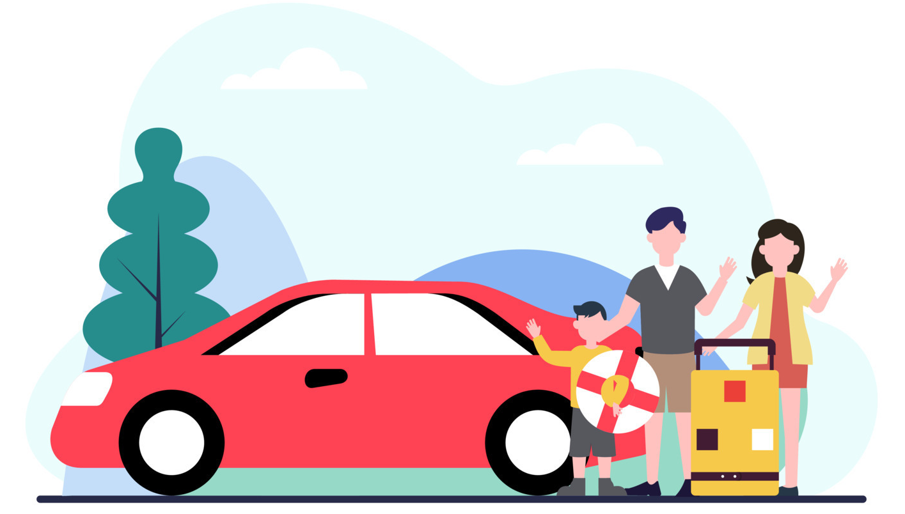

In the Future
He won’t lend me his car.
My brother will leave for college soon.

Slide 12
In the Future
He won’t lend me his car.
I wish he would lend me his car.
My brother will leave for college soon.
If only he would stay

Slide 13
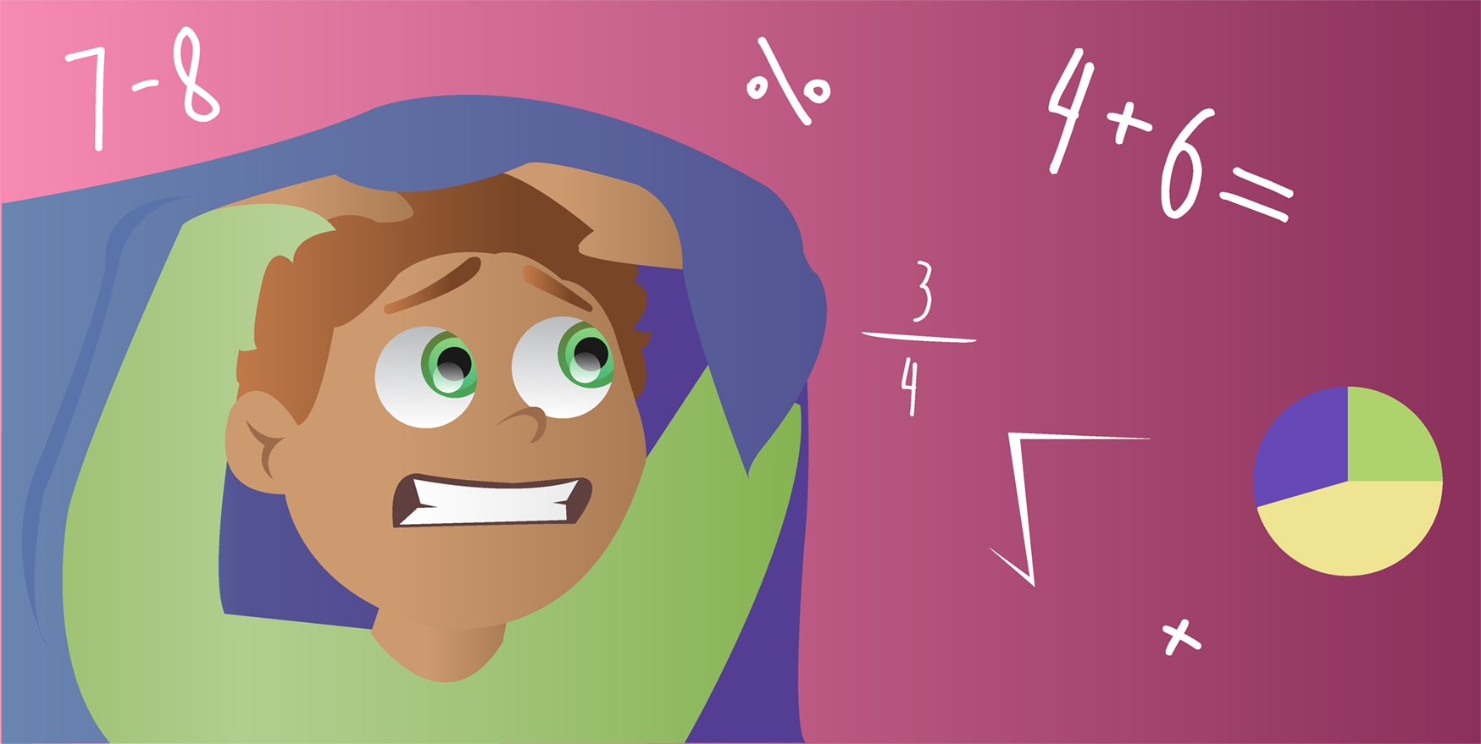
Practice
I’m not good at math.
I wish I was/were better at math.

Slide 14
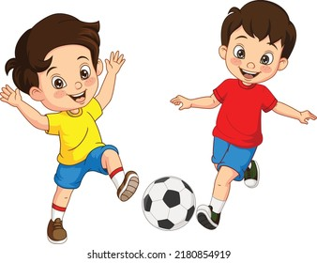
Practice
I couldn’t go to the football game last weekend
(I wish I could have gone to the football game last weekend.)

Slide 15
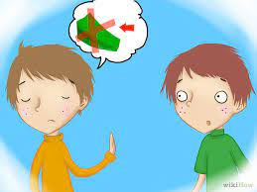
Practice
My friend won’t lend me any money
(I wish my friend would lend me some money.

Slide 16


Expressing Criticism
I wish he wouldn’t use his cell phone in class.
I wish the children would stop interrupting

Slide 17
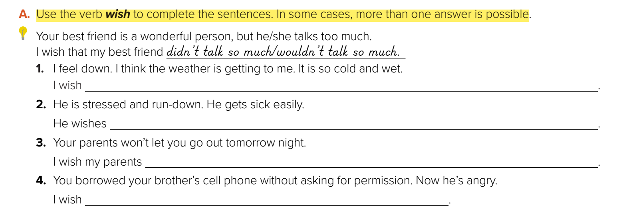
it wasn’t so cold and wet. /// I wasn’t so down.
he wasn’t so run-down and stressed. /// he wouldn’t get sick so easily
would let me go out tomorrow night
I hadn’t taken my brother’s cell phone without asking permission

Slide 18
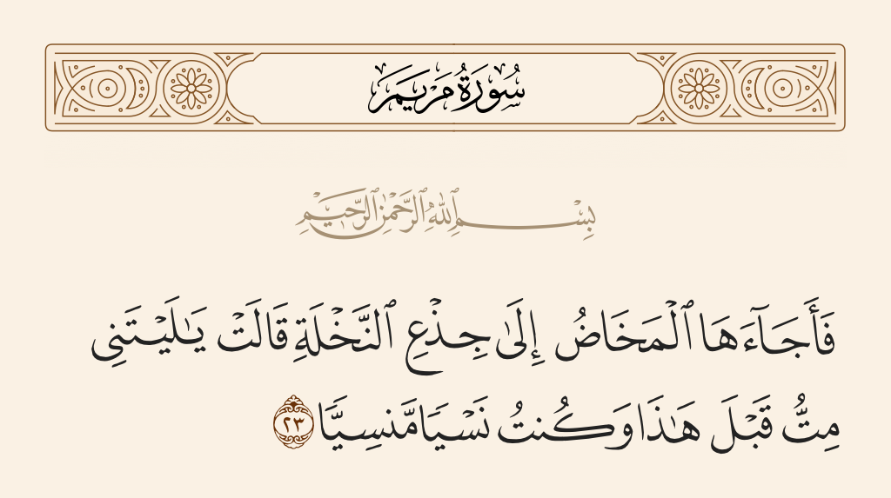

Slide 19
Such…That / So…That

Slide 20
The new TV sitcom is such a funny show that everyone in my class watches it.
such + adjective + noun + that
The comedian was so amusing that he had everyone in stitches. We laughed so much that we had tears in our eyes
so + adjective or adverb + that

Slide 21
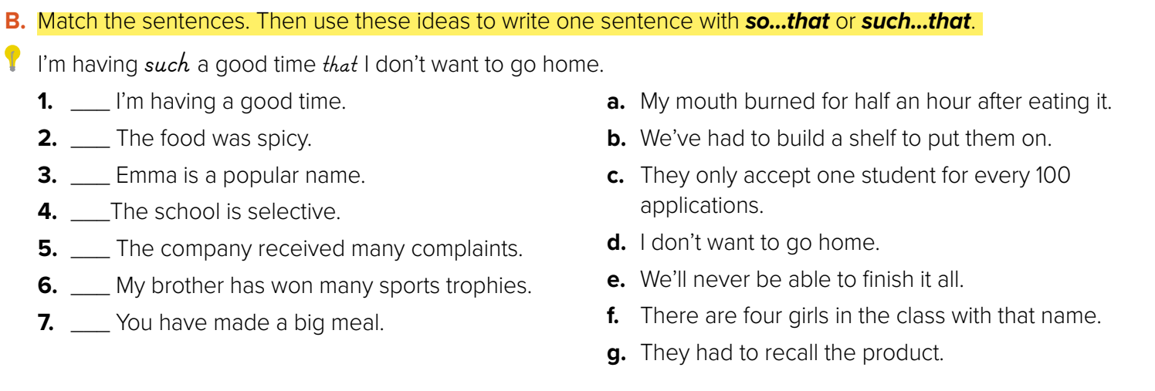
d
a
f
c
g
b
e

Slide 22
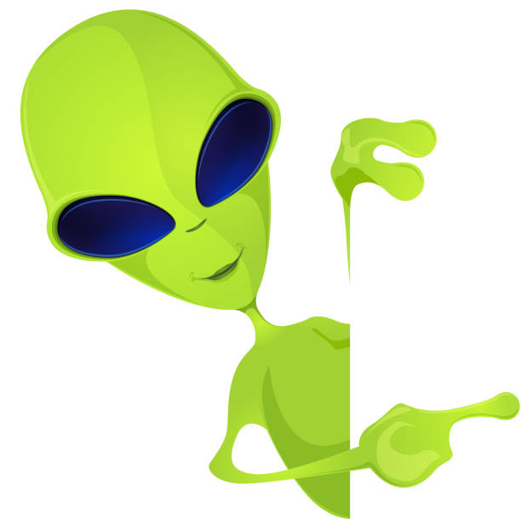
The story about the green aliens can’t be true. It might be a prank. It must be April 1st! (present)
The story about the green aliens can’t have been true. It might have been a prank. It must have been April 1st! (past)
Can’t, Could, Couldn’t, Must, May, or Might

Slide 23
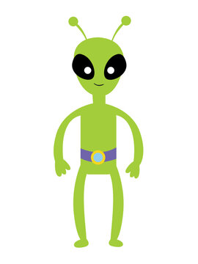
The story about the green aliens can’t be true. It might be a prank. It must be April 1st! (present)
The story about the green aliens can’t have been true. It might have been a prank. It must have been April 1st! (past)

Slide 24
Use can’t, must, may, or might to make suppositions, to speculate about something, and to draw conclusions.
Use must to say we are sure of something.
Use can’t or couldn’t to say that we think something is impossible.
Use may, might, or could to say that something is possible.
The story about the green aliens can’t be true. It might be a prank. It must be April 1st! (present)
The story about the green aliens can’t have been true. It might have been a prank. It must have been April 1st! (past)

Slide 25
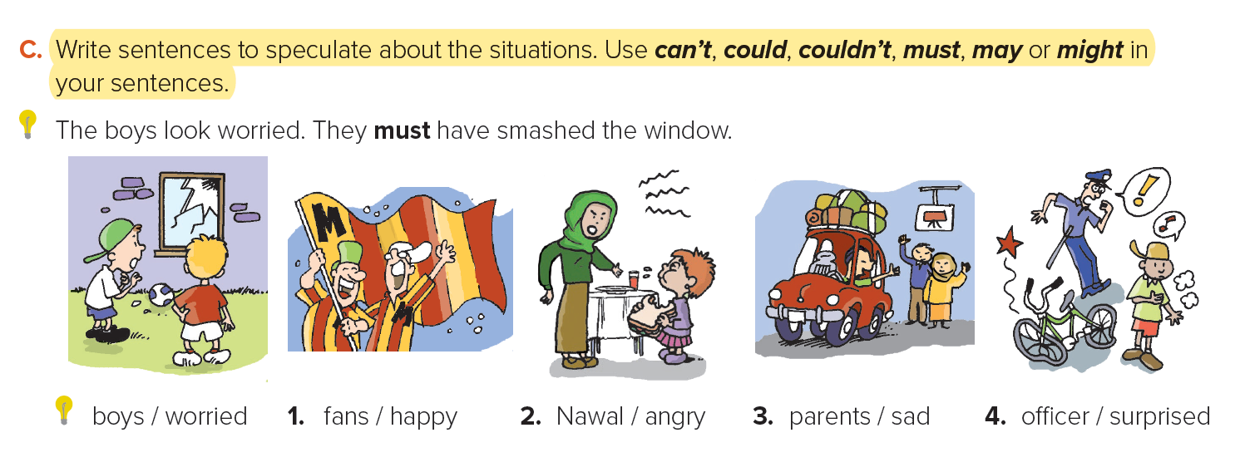

sure / smash 1) sure / win 3) sure / do 4) sure / traveling 5) possible / crash
They look worried.
They must have smashed the window.
1. The fans look happy. .
2. Nawal looks angry
3. His parents are sad.
4. The officer is surprised.
Their team must have won the game.
The boy must have done something terrible.
He must be traveling for a long time.
The boy might have crashed into him.

Slide 26


