Slide 1

Revision of Speaking & Listening Skills.
https://t.me/yeswecan4

Slide 2
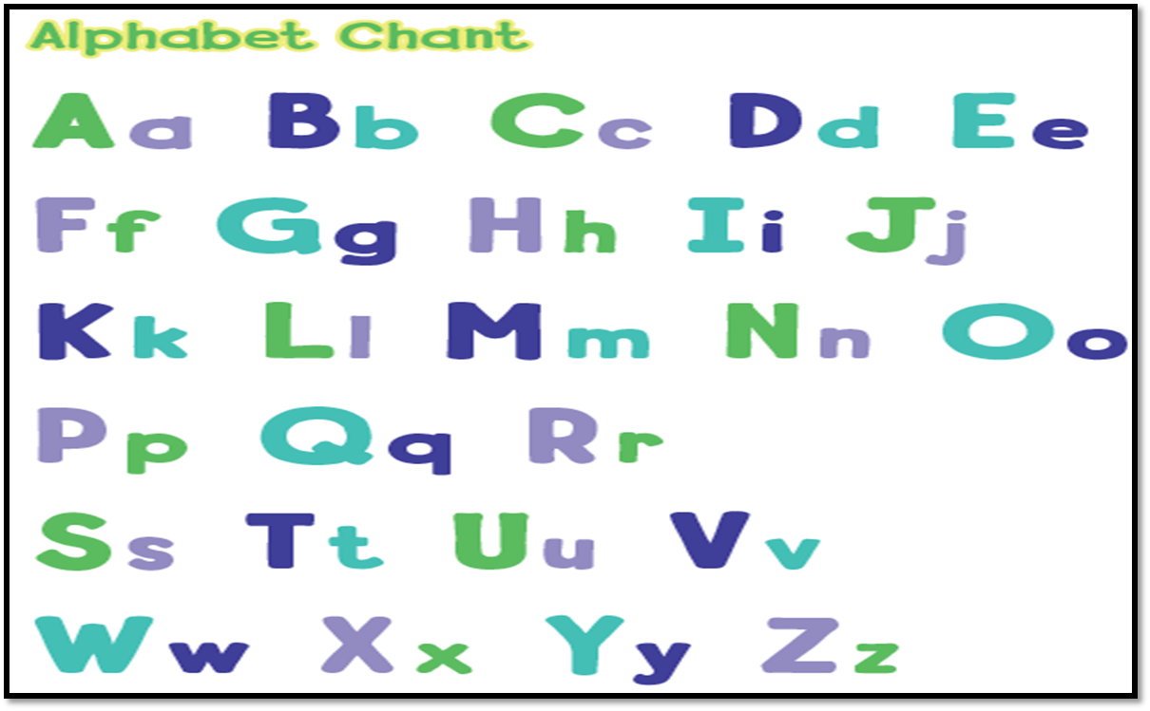
I can recognize and produce the sounds of the English alphabet
https://t.me/yeswecan4

Slide 3
I can recognize short and only some long vowels ( a – e – o – i )
Long a
take
name
rainbow
https://t.me/yeswecan4

Slide 4
I can recognize short and only some long vowels ( a – e - o )
Long e
green
knees
ears
https://t.me/yeswecan4

Slide 5
I can recognize short and only some long vowels ( a – e – o - i )
Long i
fine
line
nice
https://t.me/yeswecan4

Slide 6
I can recognize short and only some long vowels ( a – e – o - i )
Long o
close
nose
Safroot
https://t.me/yeswecan4

Slide 7
I can recognize and match sounds to letters
https://t.me/yeswecan4

Slide 8
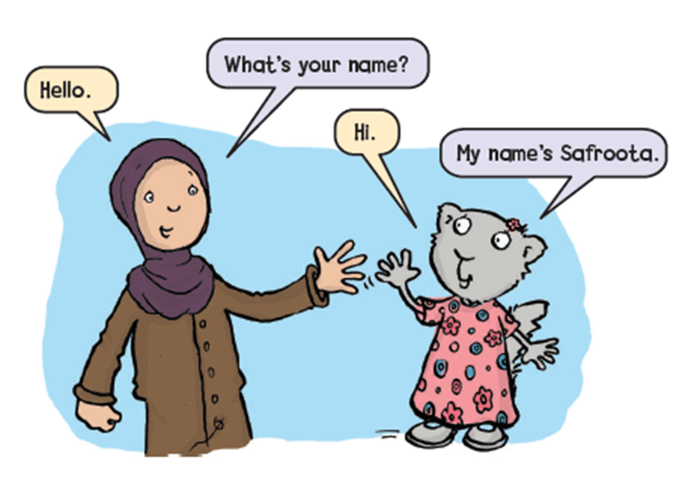
I can participate verbally and nonverbally in short simple activities
https://t.me/yeswecan4

Slide 9
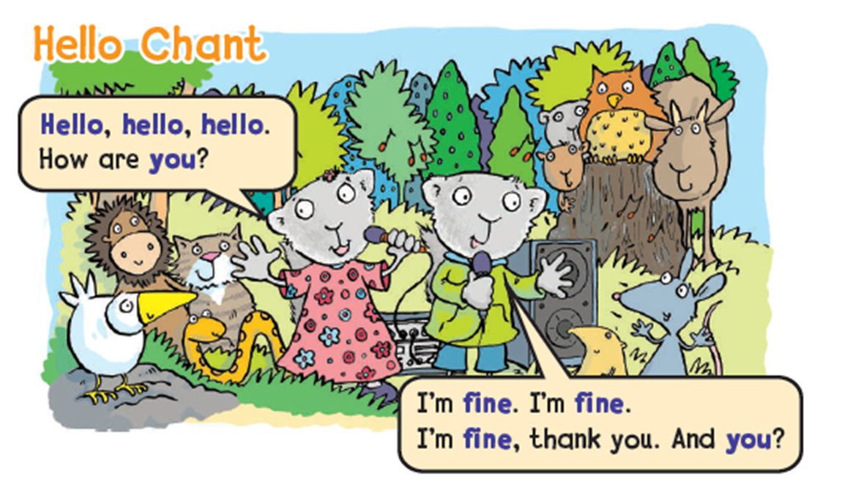
I can participate verbally and nonverbally in short simple activities
https://t.me/yeswecan4

Slide 10
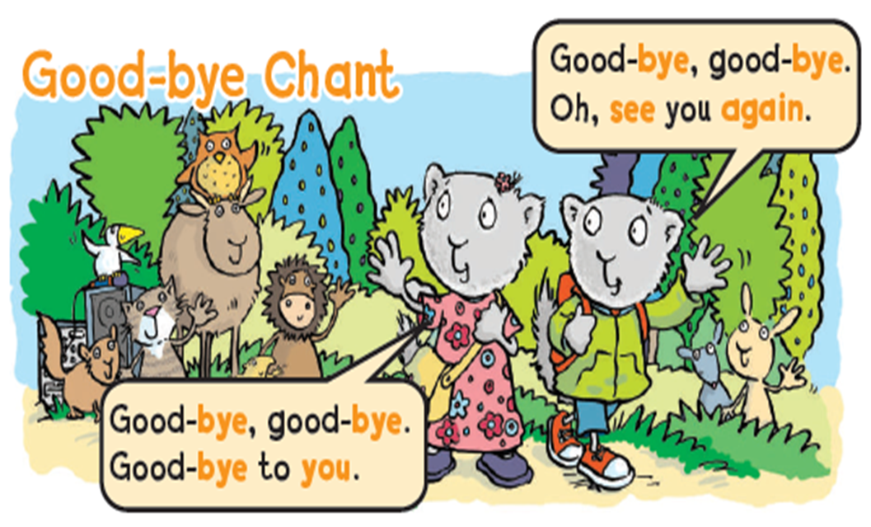
I can participate verbally and nonverbally in short simple activities
https://t.me/yeswecan4

Slide 11
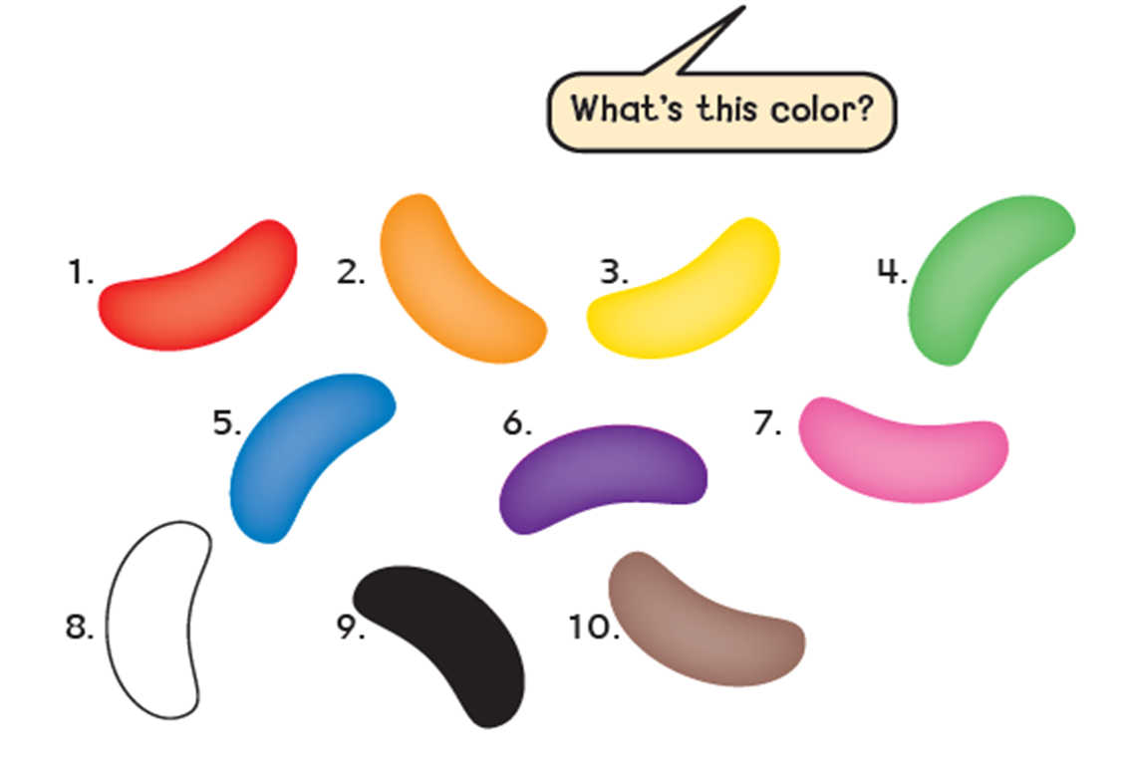
I can participate verbally and nonverbally in short simple activities
https://t.me/yeswecan4

Slide 12
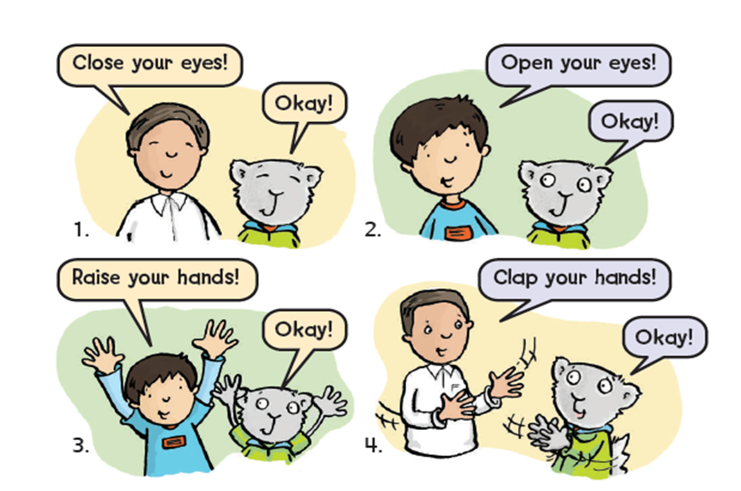
I can participate verbally and nonverbally in short simple activities
https://t.me/yeswecan4

Slide 13
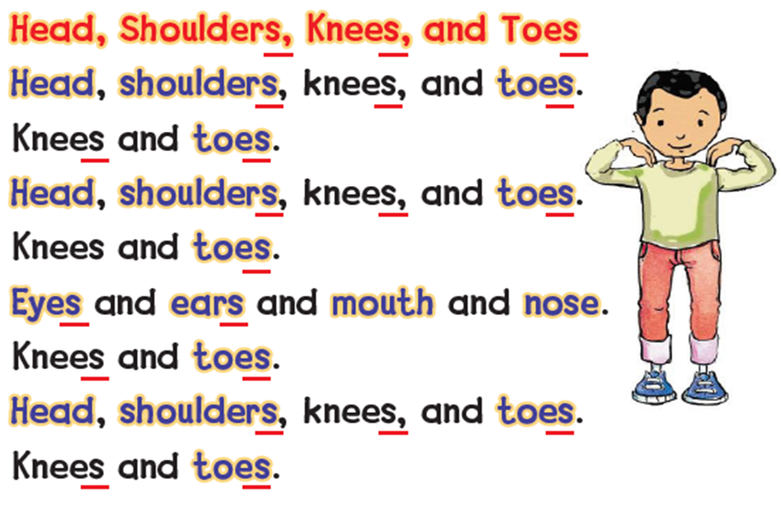
I can participate verbally and nonverbally in short simple activities
https://t.me/yeswecan4

Slide 14
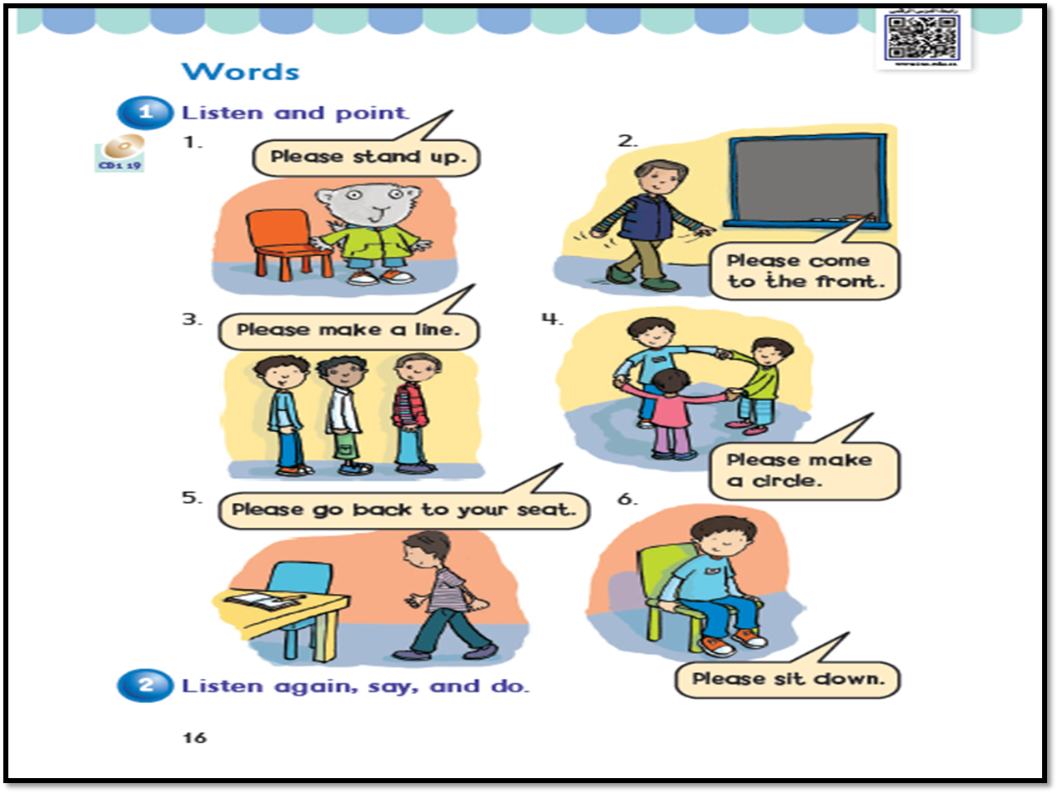
I can participate verbally and nonverbally in short simple activities
https://t.me/yeswecan4

Slide 15
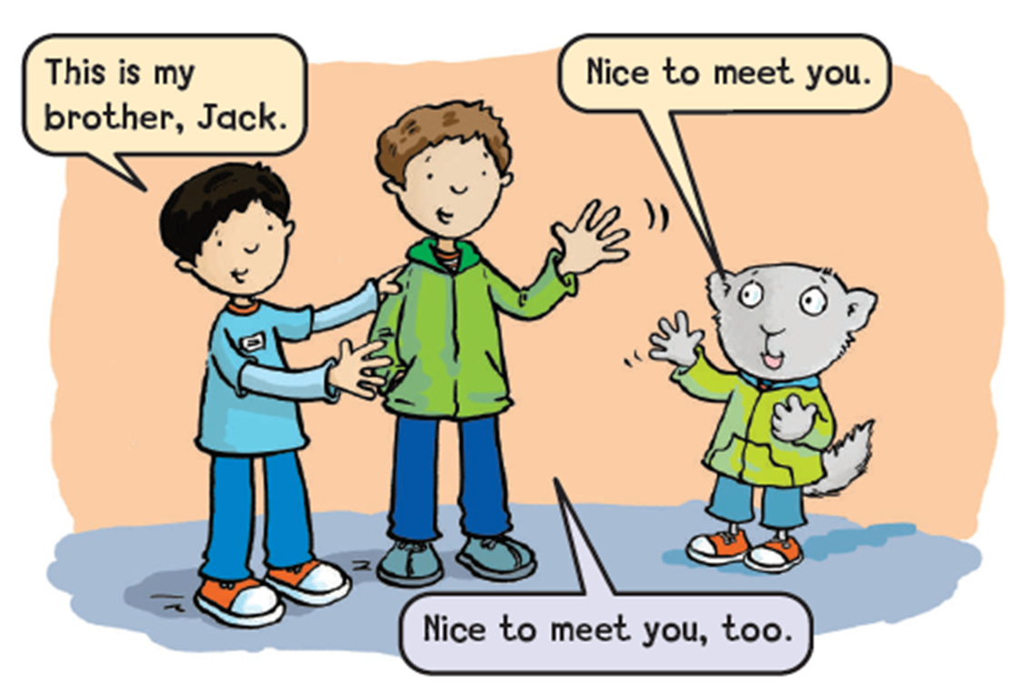
I can participate verbally and nonverbally in short simple activities
https://t.me/yeswecan4

Slide 16
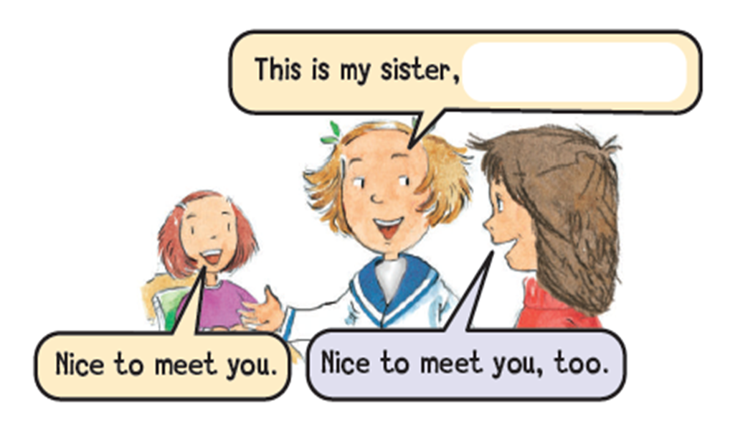
I can participate verbally and nonverbally in short simple activities
https://t.me/yeswecan4

Slide 17
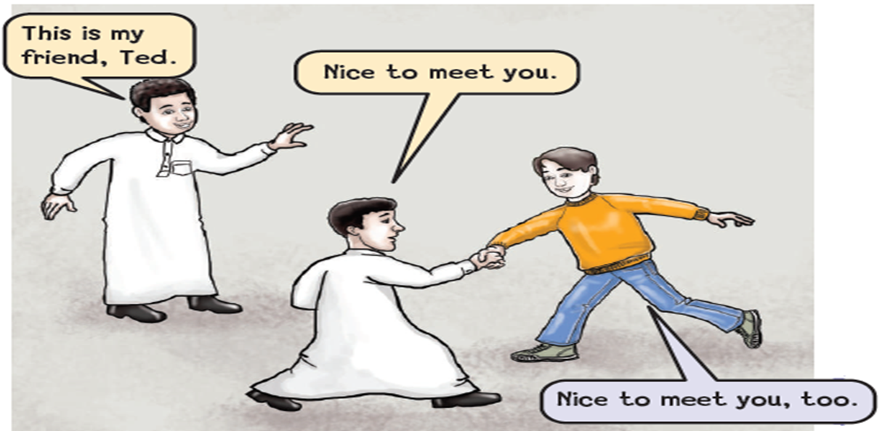
I can participate verbally and nonverbally in short simple activities
https://t.me/yeswecan4

Slide 18
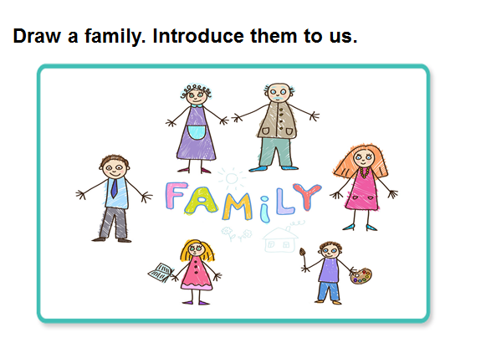
I can participate verbally and nonverbally in short simple activities
https://t.me/yeswecan4

Slide 19
I can recognize intonation patterns of statements and questions
Hello
What`s your name ?
Please stand up !
https://t.me/yeswecan4

Slide 20
I can ask and respond to basic questions about personal information
What`s your name ?
How are you ?
https://t.me/yeswecan4

Slide 21

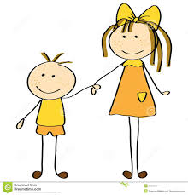

I can recognize and use indefinite articles ( a – an – this – that )
This
This is my sister, Anfal.
This is yellow.
https://t.me/yeswecan4

Slide 22
I can recognize and use indefinite articles ( a – an – this – that )
That
That is my sister, Anfal.
That is yellow.
https://t.me/yeswecan4

Slide 23


I can recognize and use indefinite articles ( a – an – this – that )
a
a bag
a pencil
https://t.me/yeswecan4

Slide 24


I can recognize and use indefinite articles ( a – an – this – that )
an
an apple
an orange
https://t.me/yeswecan4

Slide 25
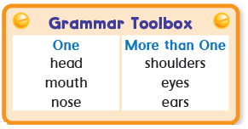
I can recognize and apply regular plural formation.
https://t.me/yeswecan4

Slide 26
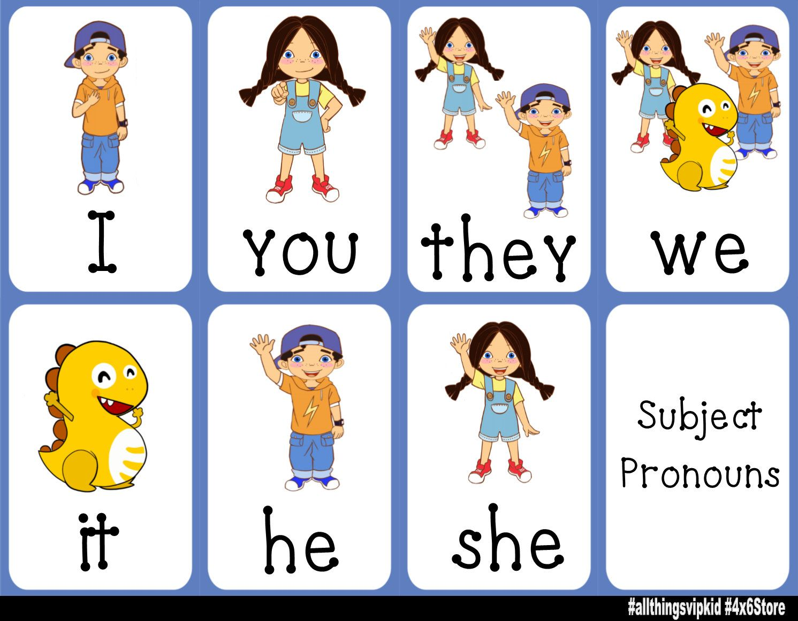
I can recognize and apply subjective pronouns ( I, You, He, She, It ).
https://t.me/yeswecan4

Slide 27
I can identify main colors .
https://t.me/yeswecan4

Slide 28



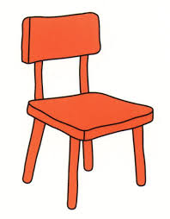

I can identify and talk about classroom objects.
https://t.me/yeswecan4

Slide 29
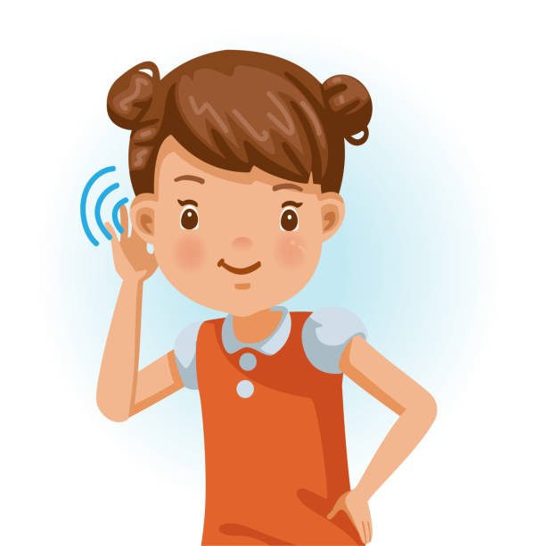
I can be willing to listen to short recoded materials.
https://t.me/yeswecan4

Slide 30
Teacher : Anfal Al-Ghamdi
@englishanfal
https://t.me/yeswecan4

