Slide 1

Unit 5
Do You Really Need It?
Grammar
Mega Goal 3.2
Done by : Entisar Al-Obaidallah

Slide 2

Lesson Objectives
01
04
02
05
03
06
Identify
Practice
Adverb clauses correctly
Using :Where, wherever, and everywhere correctly
Use
Complete
Because, because of, since, and now that (In order) to and so that
The sentences with their own words correctly
Combine
Apply
Sentences using Conditional sentences with when, if, even if, in case, only if, and unless
The rules to do the exercises correctly

Slide 3

Open
Your student’s book
p. ( 70 )

Slide 4

01.
Adverb Clauses

Slide 5
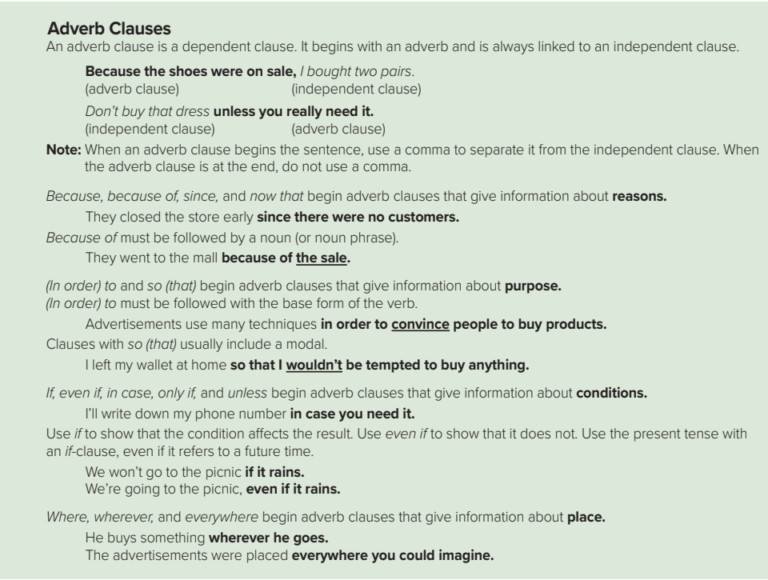

Slide 6

What is an adverb clause ?
➔An adverb Clause is a dependent clause. It begins with an adverb and is always linked to an independent clause.
Example:
Which is dependent clause, and which is independent clause?
Because the shoes were on sale , I bought two pairs.
adverb
dependent clause
independent clause
(It is not a complete sentence.)
(It is a complete sentence.)
This dependent clause is an adverb clause. How do you know this?
➔ It begins with the adverb” because”.

Slide 7
Another Example
Which is dependent clause, and which is independent clause?
Don’t buy that dress unless you really need it.
independent clause
adverb
dependent clause
(It is a complete sentence.)
(It is not a complete sentence.)
This dependent clause is an adverb clause. How do you know this?
➔ It begins with the adverb” unless”.

Slide 8

➔When an adverb clause begins the sentence, use a comma to separate it from the independent clause.
➔When the adverb clause is at the end, DO NOT use a comma.

Slide 9
Adverbs of …
Reason
Purpose
Condition
Place
Because
In order to
if
where
Because of
So that
Even if
wherever
since
In case
anywhere
Now that
Only if
unless

Slide 10
Adverb clauses of Reason usually started with the following conjunction
because
Because of
since
Now that
Examples
Subordinating conjunction
subject
verb
I teach English because I love it
Adverb clause
Subordinating conjunction
Verbal phrase
subject
They didn’t come to school since it was raining
Adverb clause

Slide 11
Because of : it must be followed by a noun or (noun phrase).
Subordinating conjunction
noun
Examples
They went to the mall because of the sale
Adverb clause
Subordinating conjunction
noun
I couldn’t sleep because of the noise
Adverb clause

Slide 12
Adverbs of …Purpose
In order to
So that
( In order to ) must be followed with the base form of the verb.
Clauses with (so that) usually include a modal verb
Examples
I go to Makkah in order to do Umrah
I wore warm clothes so that I wouldn't be cold.

Slide 13
Adverb clauses of Purpose tells us about the purpose of the verb in the main clause . It usually started with the following conjunction
In order to
So that
Examples
Subordinating conjunction
verb
noun
I studied all night in order to pass the exam
Adverb clause
So that: is paired with a subject & a modal verb such as:could , would , can and will
Subordinating conjunction
subject
Modal verb
I give Sara my phone number so that she could call me
Adverb clause

Slide 14
Adverb clauses of Condition usually started with the following conjunction
if
Even if
In Case
only if
unless
Subordinating conjunction
subject
verb
Examples
My father promised to buy me a bike if I pass the test
Adverb clause
Subordinating conjunction
subject
verb
We will go out if it rains
Adverb clause

Slide 15
Adverbs of …Condition
Even if
if
Use if to show that the condition affects the result.
Use the present tense with an if-clause, even if it refers to a future time.
Example:
We won’t go to the picnic if it rains.
Use even if to show that the condition DOESN’T affect the result.
Example:
We’re going to the picnic, even if it rains.

Slide 16
Adverb clauses of place usually started with the following conjunction
Where
Wherever
Everywhere
Anywhere
Subordinating conjunction
Examples
subject
verb
I am coming to meet you where we met last week
Adverb clause
Subordinating conjunction
subject
verb
You can place it wherever you want
Adverb clause

Slide 17
Open
Your student’s book
p. ( 71)

Slide 18
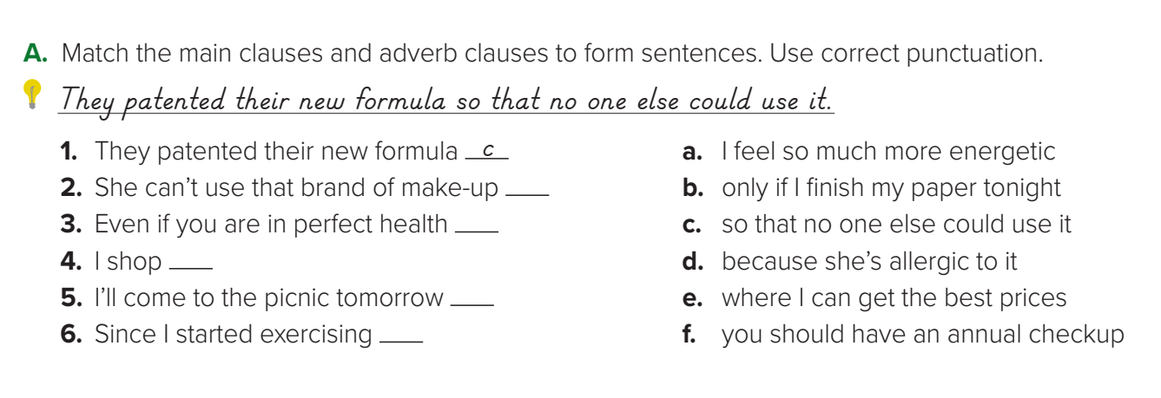
d
f
e
b
a

Slide 19
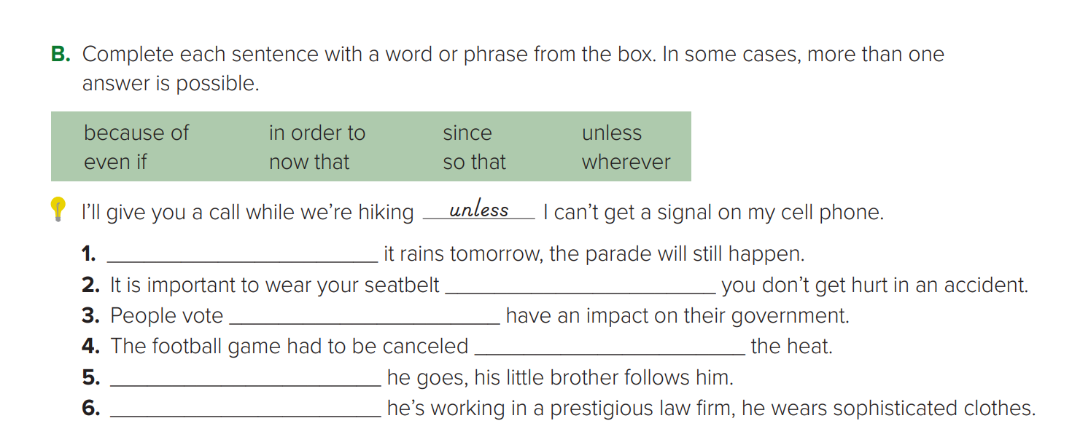
Even if / Unless
so that
in order to
Because of
Wherever
Because / Since / Now that

Slide 20
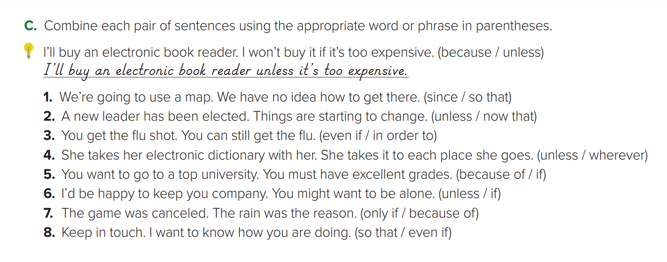
1. Since we have no idea how to get there, we’re going to use a map.
2. Now that a new leader has been elected, things are starting to change.
3. Even if you get the flu shot, you can still get the flu.
4. She takes her electronic dictionary with her wherever she goes.
5. If you want to go to a top university, you must have excellent grades.
6. I’d be happy to keep you company unless you want to be alone.
7. The game was cancelled because of the rain.
8. Keep in touch so that I know how you are doing

Slide 21


Saudi Arabia Effort’s in regulating digital advertisements on social media platforms

Slide 22
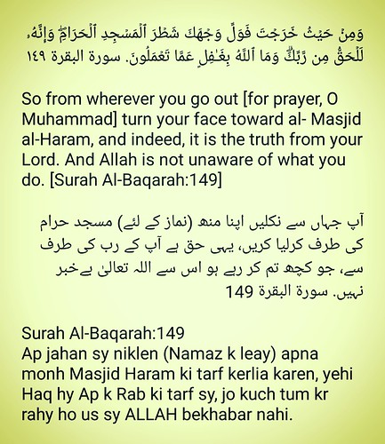
Adverbs in
The Holy Quran

Slide 23
Homework
Workbook , exercise (D) .,
P. (270)

Slide 24

THANKS

