Slide 1


Welcome to class
T.

Slide 2

3
Unit 5

Slide 3





workbook
Pages 171 , 172
ثالث
workbook
Pages 51 , 52

Slide 4
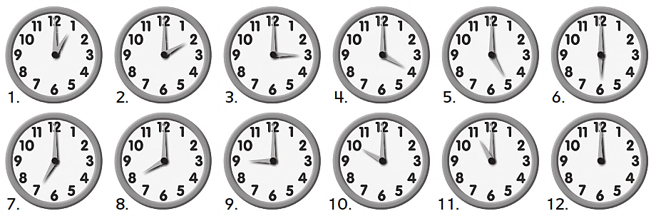

Slide 5
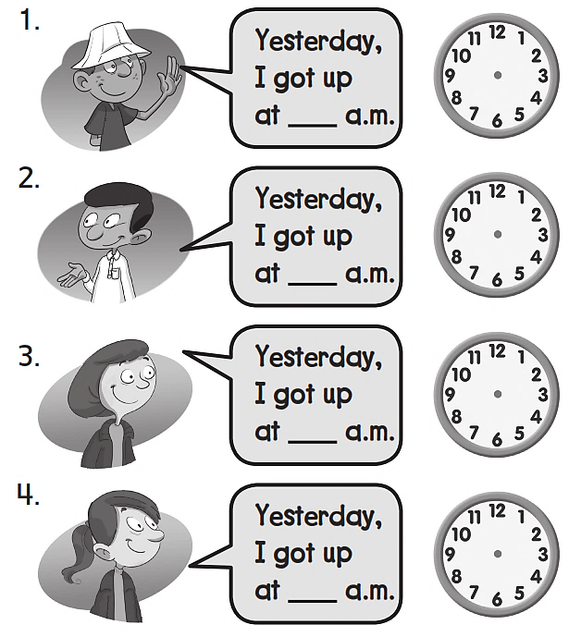
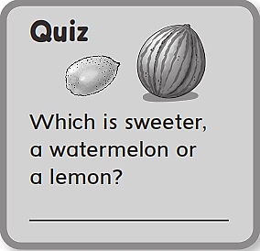
7
6
5
9
A watermelon

Slide 6

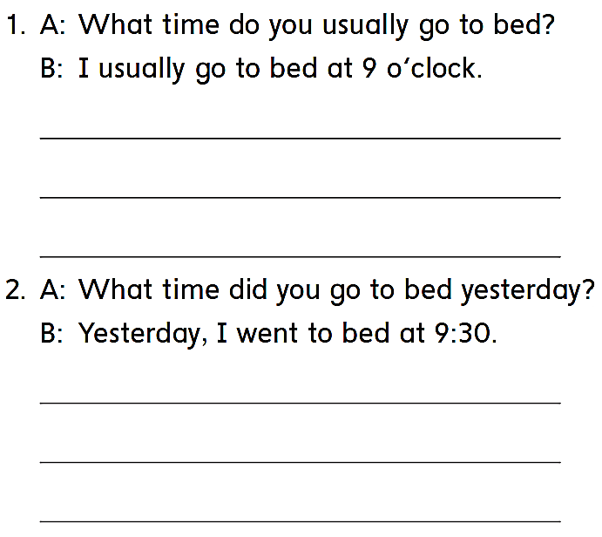
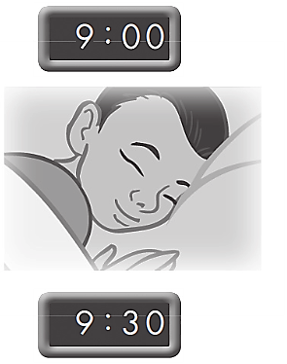
I usually go to bed at 9 o’clock
I usually go to bed at 9 o’clock
I usually go to bed at 9 o’clock
Yesterday , I went to bed at 9:30
Yesterday , I went to bed at 9:30
Yesterday , I went to bed at 9:30

Slide 7
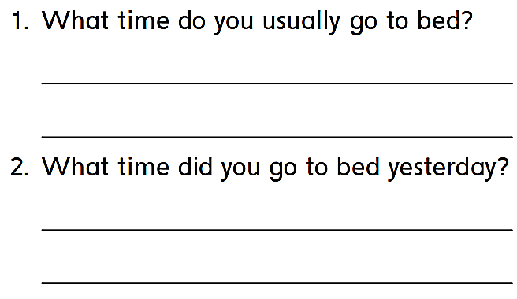
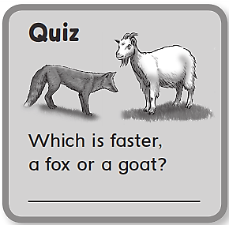
I usually go to bed at nine o’clock
Yesterday, I went to bed at ten o’clock.
A fox

Slide 8
رابع – خامس – سادس
workbook
Pages 173 , 174
ثالث
workbook
Pages 53 , 54

Slide 9

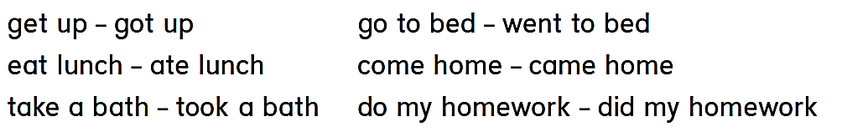


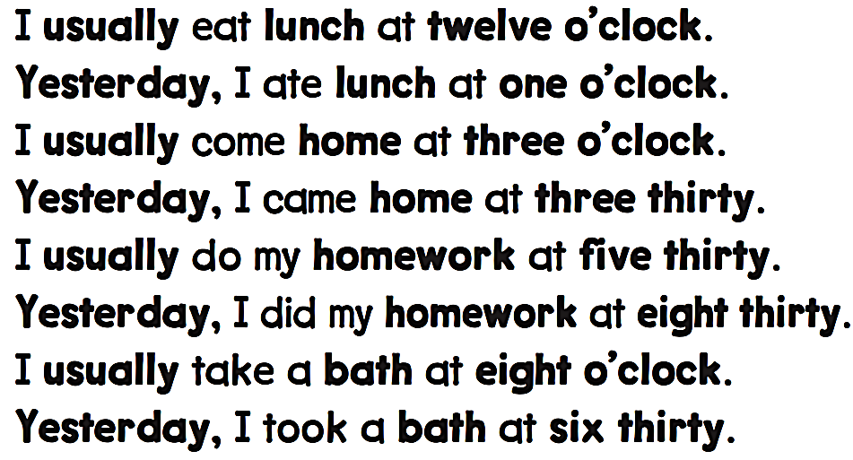

Slide 10

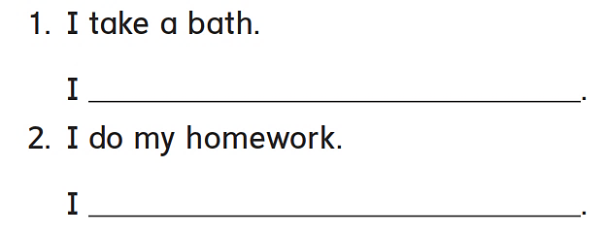
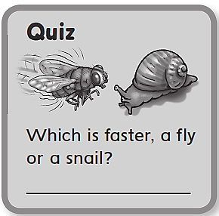
took a bath
did my homework
A fly

Slide 11

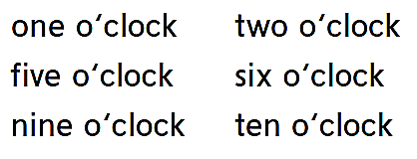
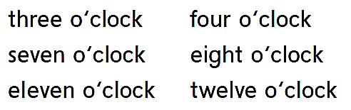

Slide 12
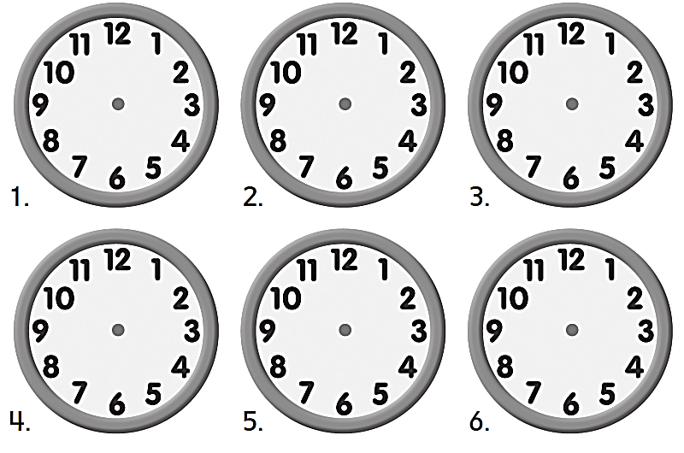

Slide 13

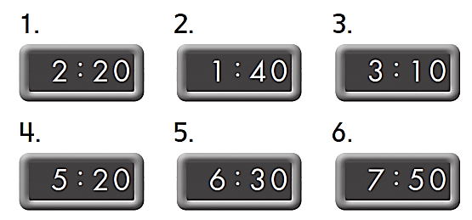
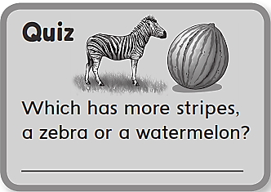
A zebra

Slide 14
workbook
Pages 175 , 176
ثالث
workbook
Pages 55 , 56

Slide 15
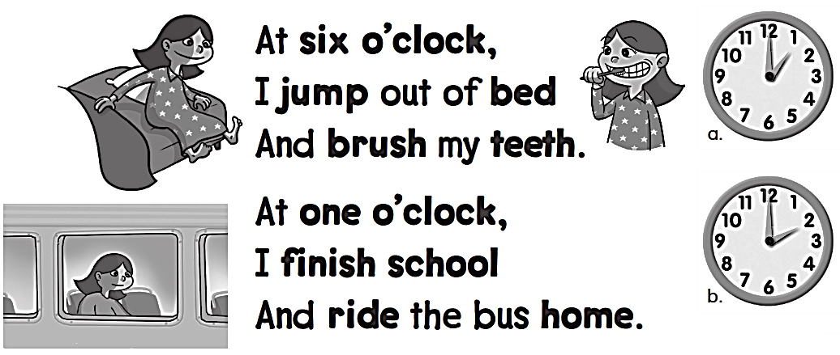
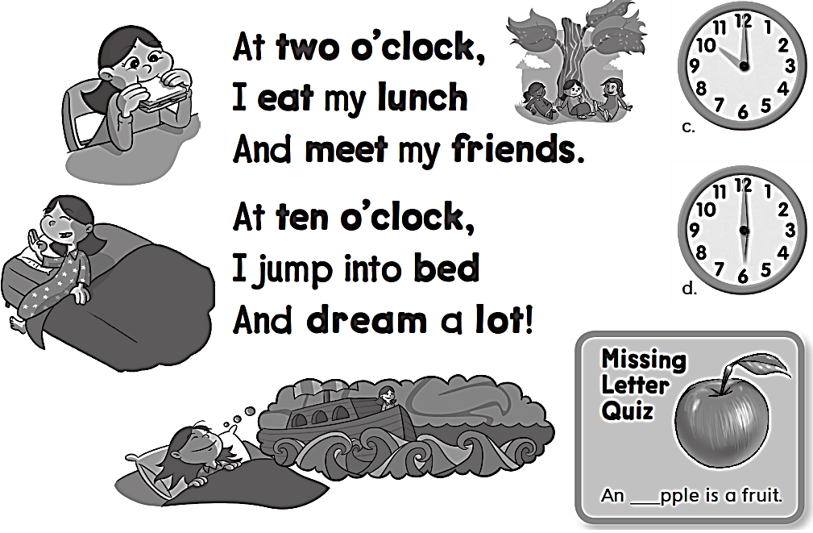
a

Slide 16
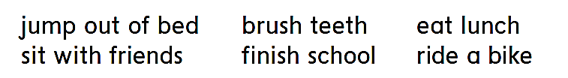
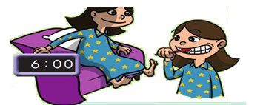



Slide 17
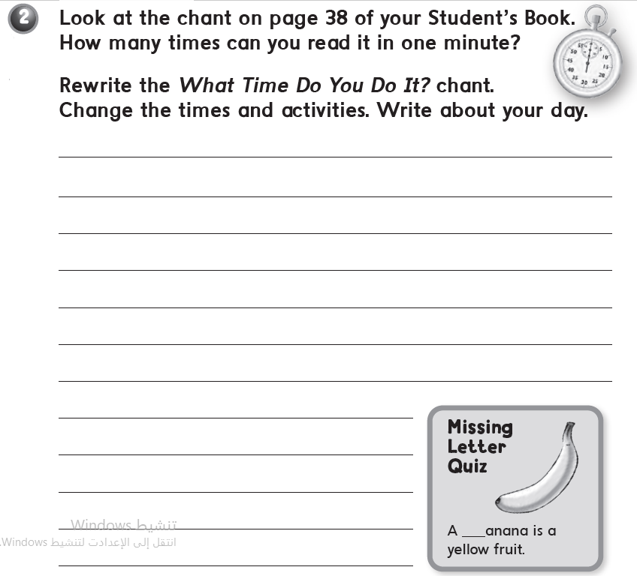
انظر لكتاب الطالب ص 38 كم مرة تستطيع قراءة الجمل ؟
أعد كتابة الجمل مرة أخرى , اكتب الجمل عن نفسك انت وغير الوقت والأنشطة
لتناسب انشطتك اليومية
b

Slide 18
workbook
Pages 177 , 178
ثالث
workbook
Pages 57 , 58

Slide 19

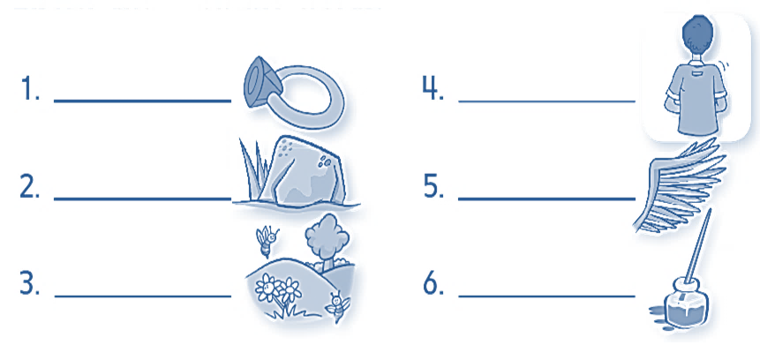
Ring
Back
Rock
Wing
Spring
Ink

Slide 20
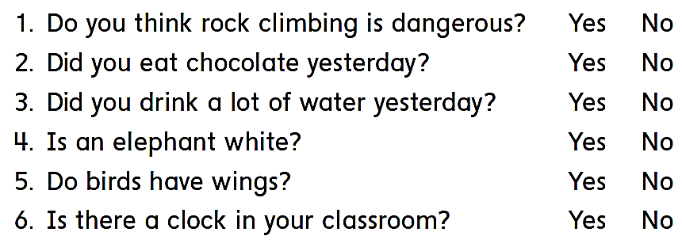

Slide 21
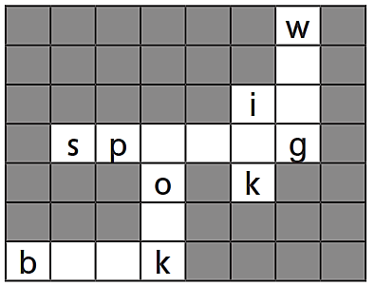
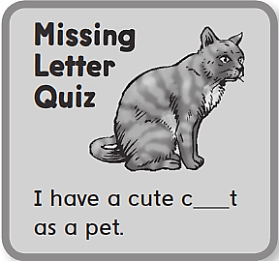
i
n
r i n
c
a
o o

Slide 22
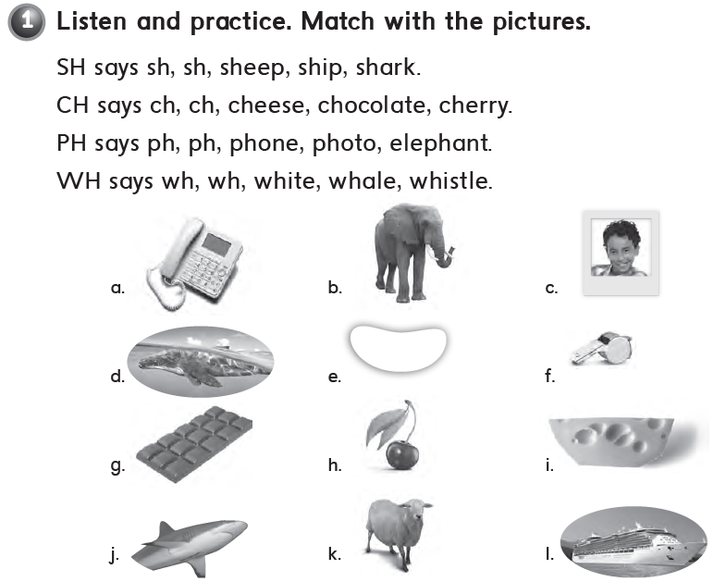
k – l – j
i – g – h
a – c – b
e – d – f

Slide 23
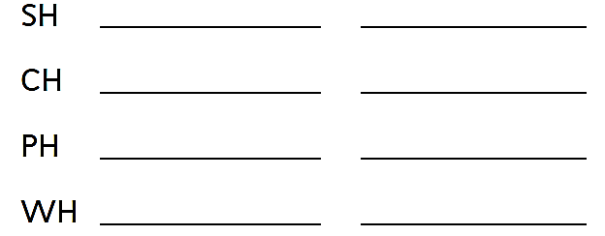
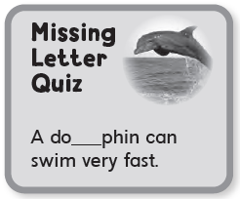
shark
ship
cheese
chocolate
phone
photo
whale
white
l

Slide 24


