Slide 1
Welcome to class
T.

Slide 2
3
Unit 6

Slide 3
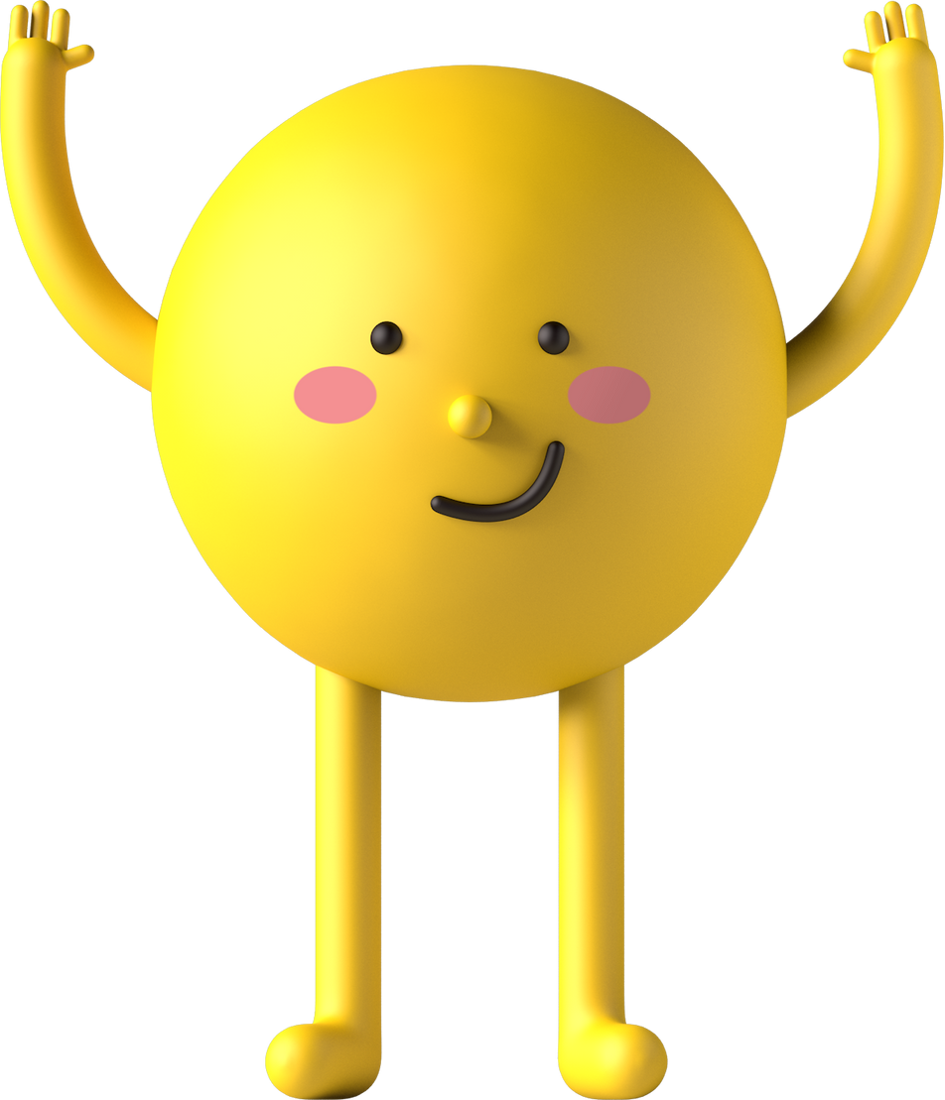
رابع – خامس - سادس
workbook
Pages 179 , 180
ثالث
workbook
Pages 59 , 60

Slide 4
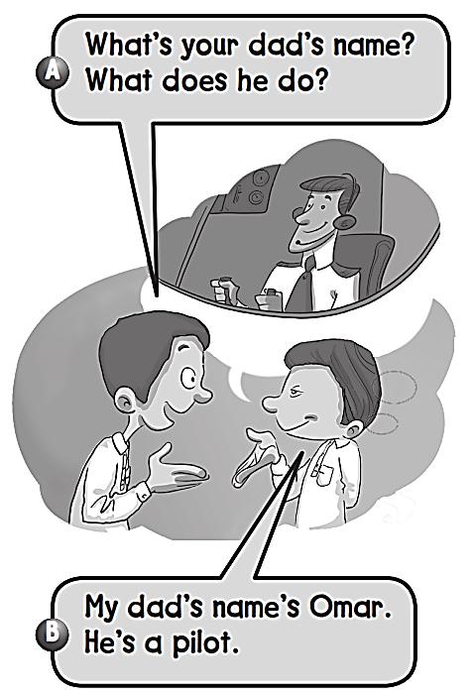
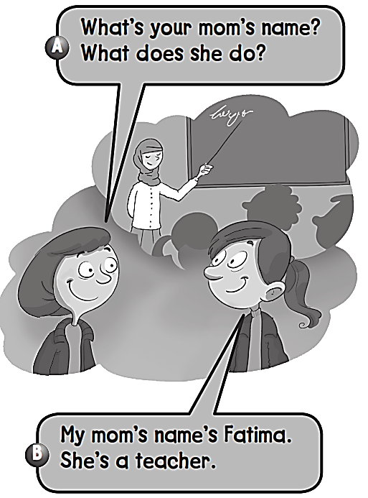

Slide 5
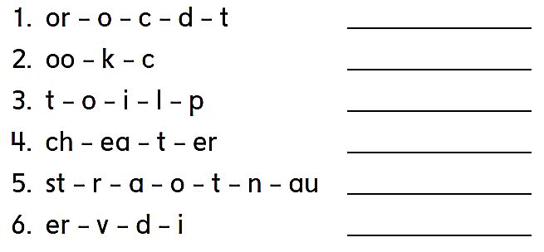
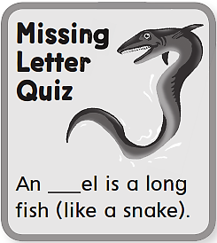
Doctor
Cook
Pilot
Teacher
Astronaut
Diver
e

Slide 6
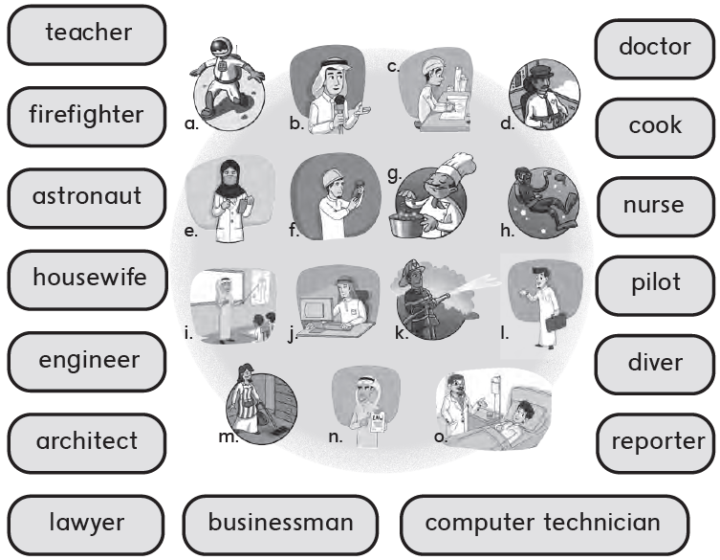
i
o
k
g
a
e
m
d
f
h
c
b
n
l
j

Slide 7
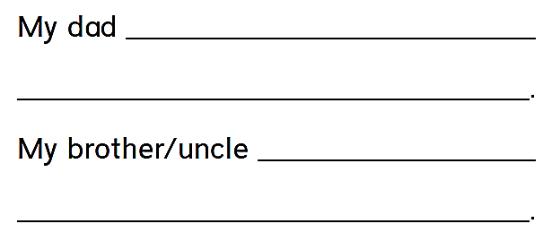
is a doctor .
He helps sick people .
is a pilot .
He flies planes .
F

Slide 8
رابع – خامس – سادس
workbook
Pages 181 , 182
ثالث
workbook
Pages 61 , 62

Slide 9
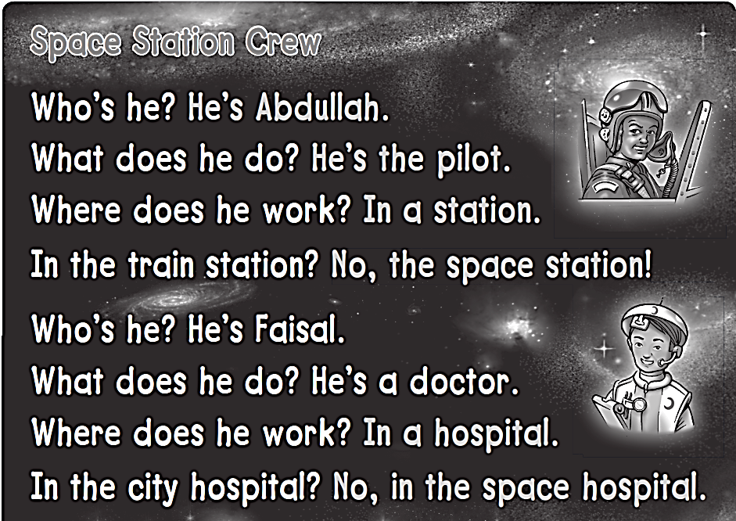
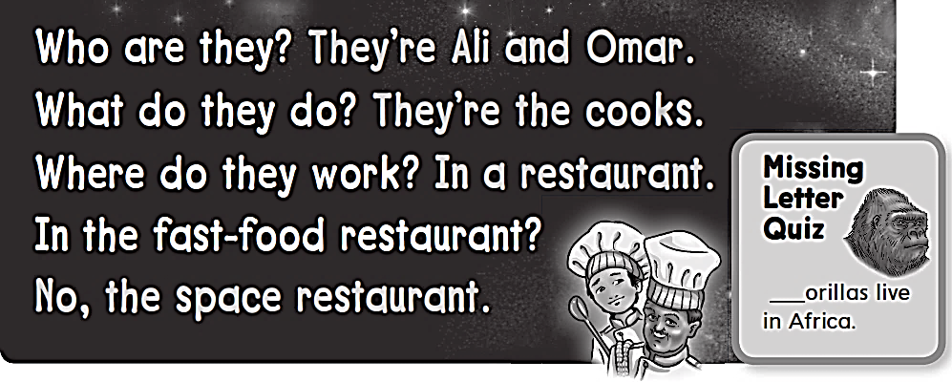
G

Slide 10
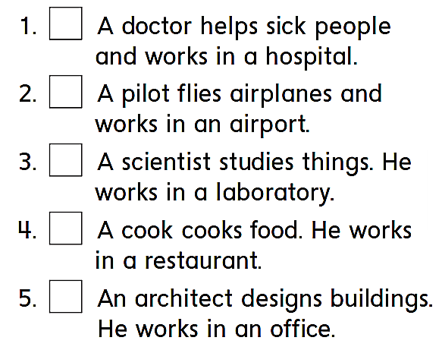
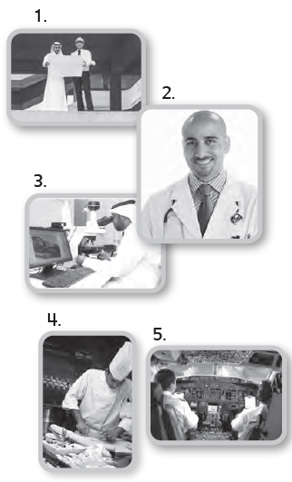
2
5
3
4
1

Slide 11
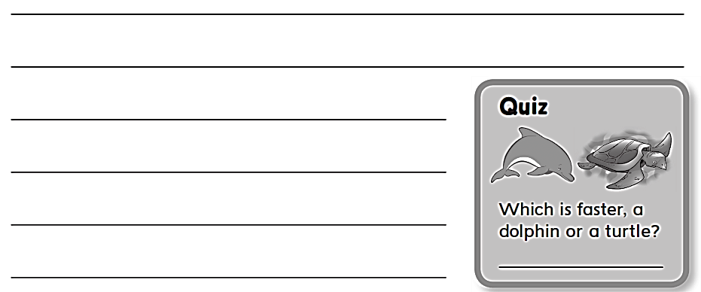
اختر 3 وظائف ثم اكتب جمل عنها كما في التمرين السابق
رقم 1
A dolphin

Slide 12
رابع – خامس – سادس
workbook
Pages 183 , 184
ثالث
workbook
Pages 63 , 64

Slide 13
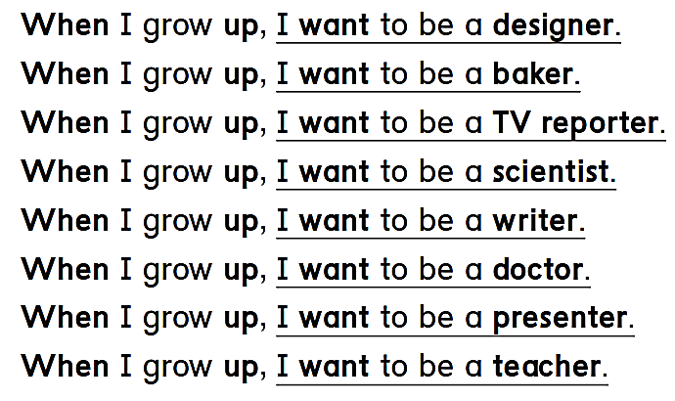
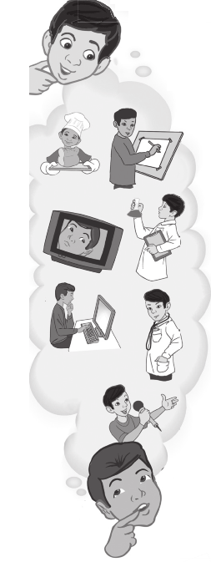

Slide 14
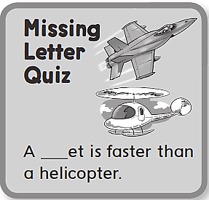
I want to be a designer .
I want to be a baker .
I want to be a TV reporter.
I want to be a scientist.
I want to be a writer.
I want to be a doctor.
I want to be a presenter.
j
I want to be a teacher.

Slide 15
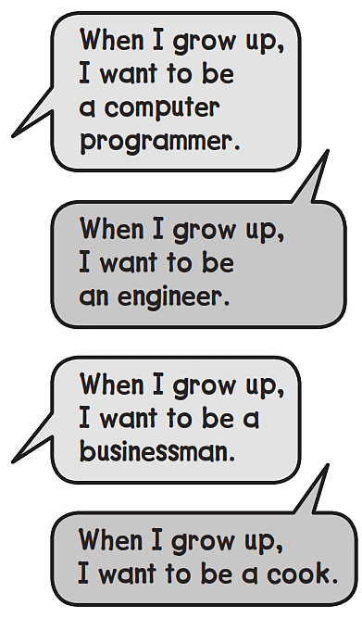
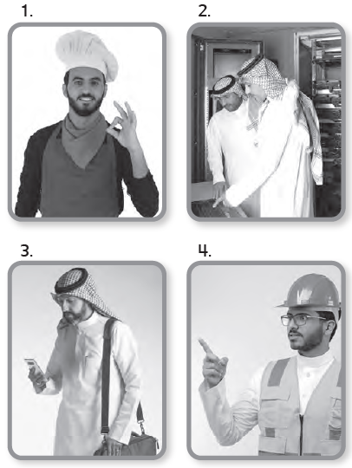
2
4
3
1

Slide 16
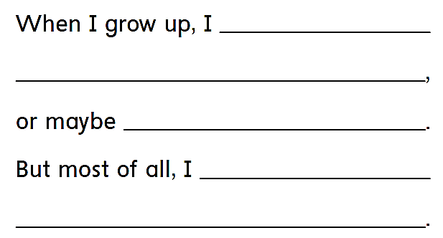
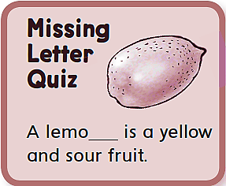
want to be a designer .
I want to be a writer.
I want to be a designer .
n

Slide 17
رابع – خامس – سادس
workbook
Pages 185 , 186
ثالث
workbook
Pages 65 , 66

Slide 18
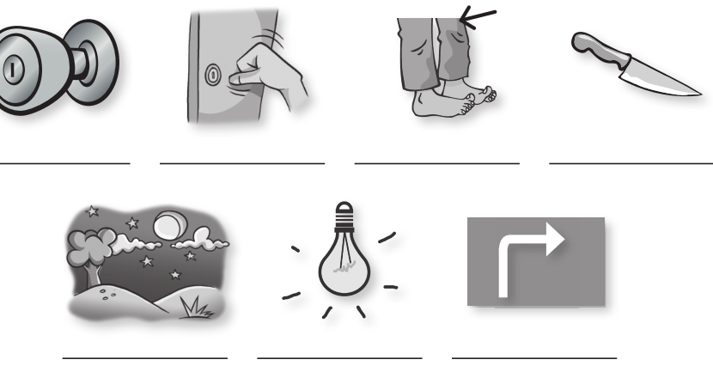
knob
knock
knee
knife
night
light
right

Slide 19
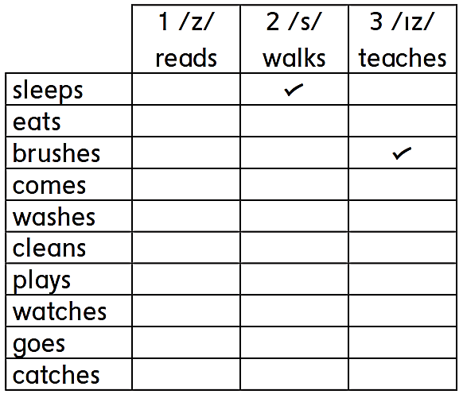
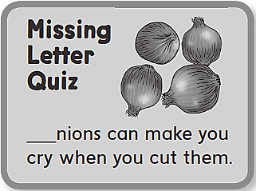
O

Slide 20
I like to count the stars at night .. Ten at a time,
Ten, twenty, thirty, forty, fifty, sixty, seventy, eighty, ninety,
ONE HUNDRED!

Slide 21
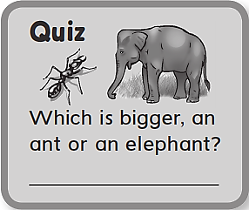
An elephant

