Slide 1
Welcome to class
T.

Slide 2
3
Unit 8

Slide 3
رابع – خامس – سادس
workbook
Pages 195 , 196
ثالث
workbook
Pages 75 , 76

Slide 4
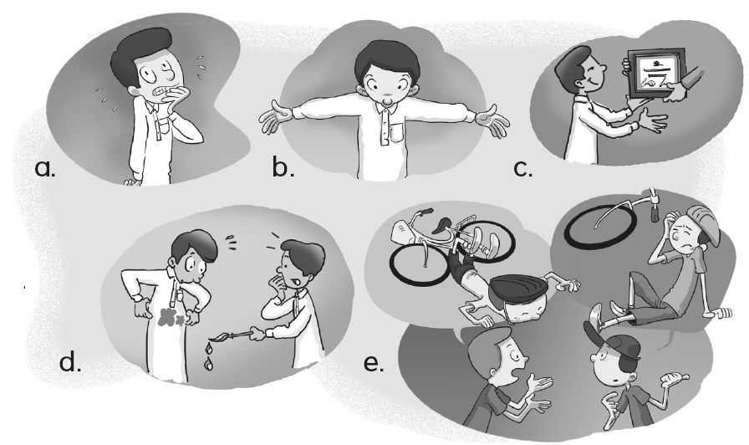
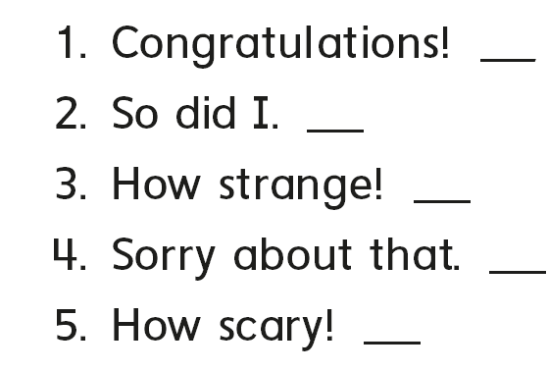
c
e
b
d
a

Slide 5
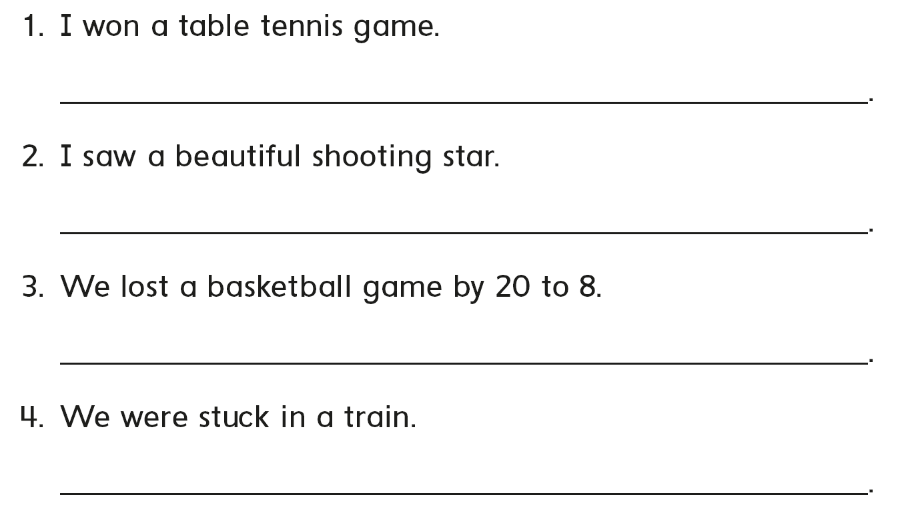
Congratulations!
So did I
Sorry to hear that
How scary

Slide 6
B
C
A

Slide 7
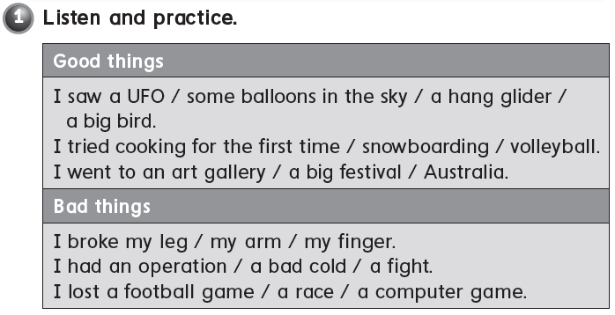

Slide 8
I saw a rainbow
I learned swimming
I lost a basketball game
I broke my arm

Slide 9
C
2019
B
A
It is 2020 this year . Last year was……………

Slide 10
رابع – خامس – سادس
workbook
Pages 197 , 198
ثالث
workbook
Pages 77 , 78

Slide 11
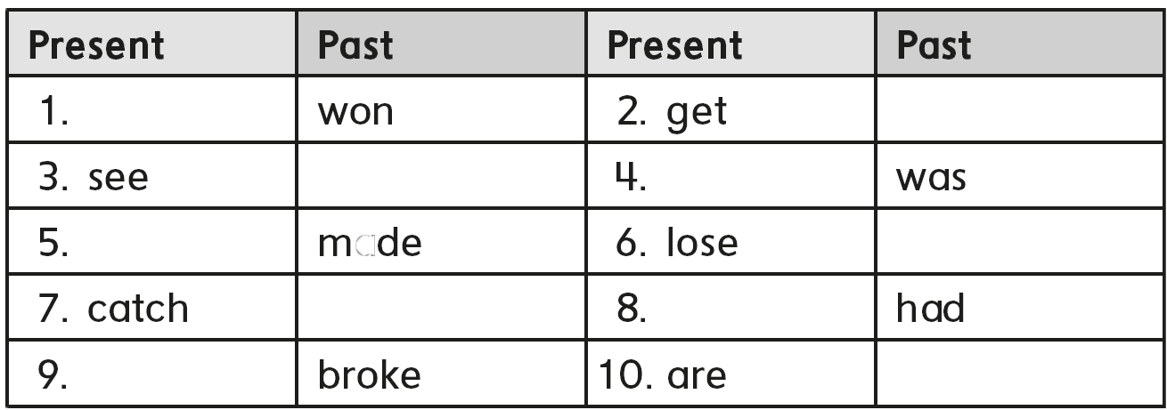
Win
got
Saw
is
Make
Lost
Caught
has
break
Were

Slide 12
I was happy
I was excited
I was sad
I was worried
I was scared

Slide 13
A
C
B

Slide 14
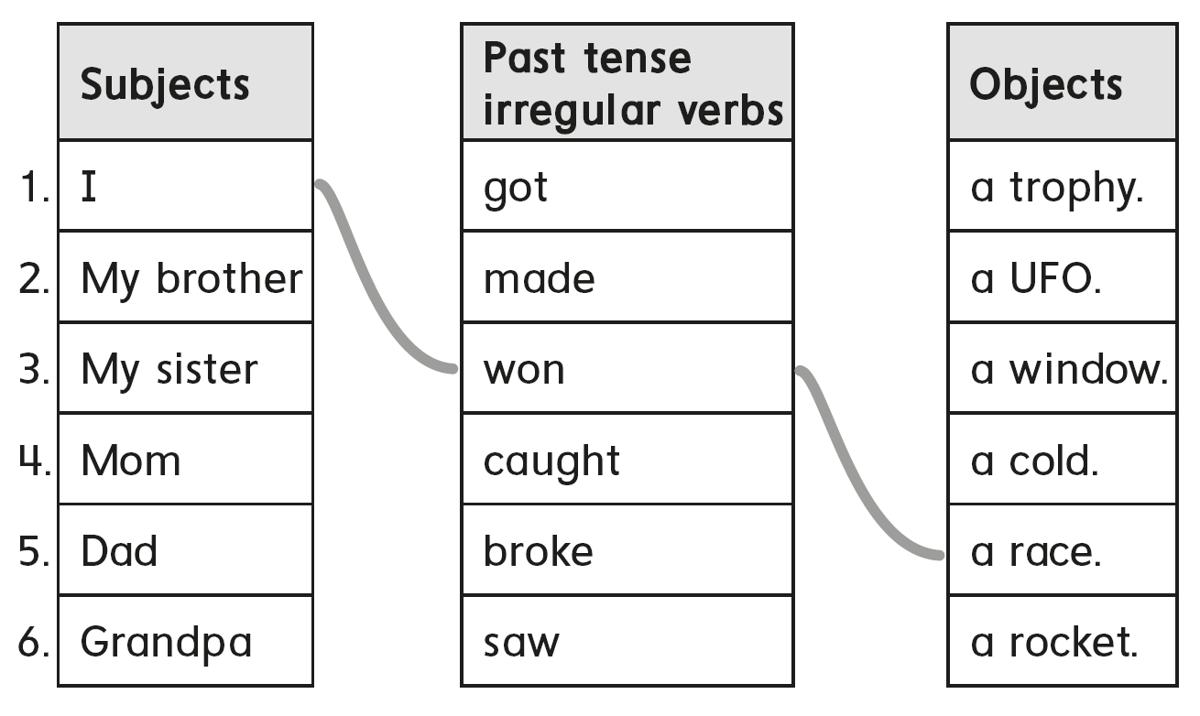

Slide 15
I saw a shooting star yesterday
I played basketball last week.
I broke my laptop , last month.
I went to Dubai , last year.

Slide 16
B
C
A

Slide 17
رابع – خامس – سادس
workbook
Pages 199 , 200
ثالث
workbook
Pages 79 , 80

Slide 18
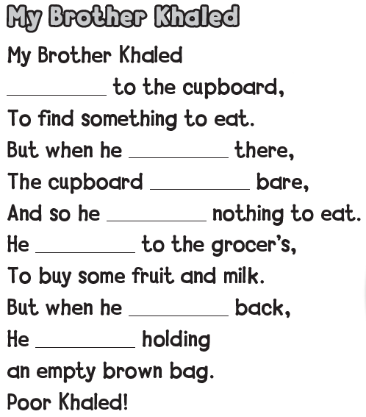
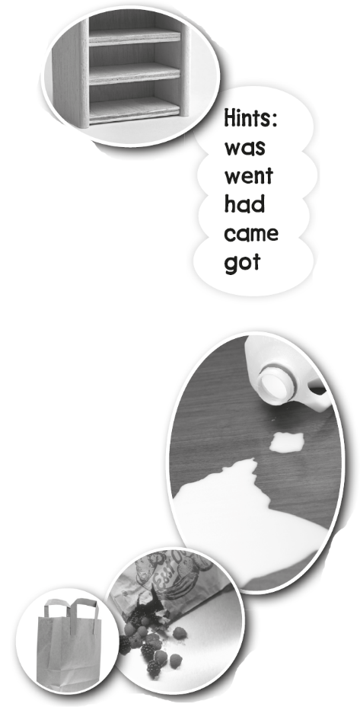
went
got
was
had
went
came
was

Slide 19
B
C
A

Slide 21
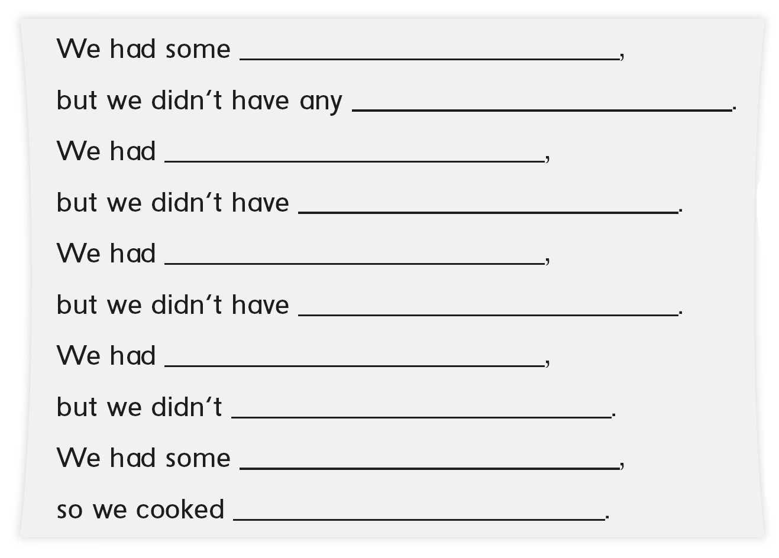
chicken
onions
some rice
any cheese
some tomato
any pepper
some oil
have any cheese
some potato
kabsa

Slide 22
C
A
B

Slide 23
رابع – خامس – سادس
workbook
Pages 201 , 202
ثالث
workbook
Pages 81 , 82

Slide 24
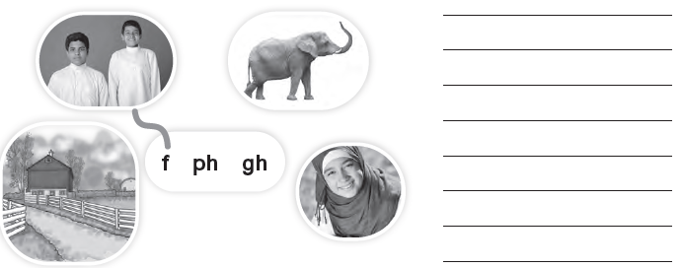
friends
elephant
laugh
farm

Slide 25
2
4
3
fish
phone
tough
fruit
photo
enough
father
elephant
rough

Slide 26
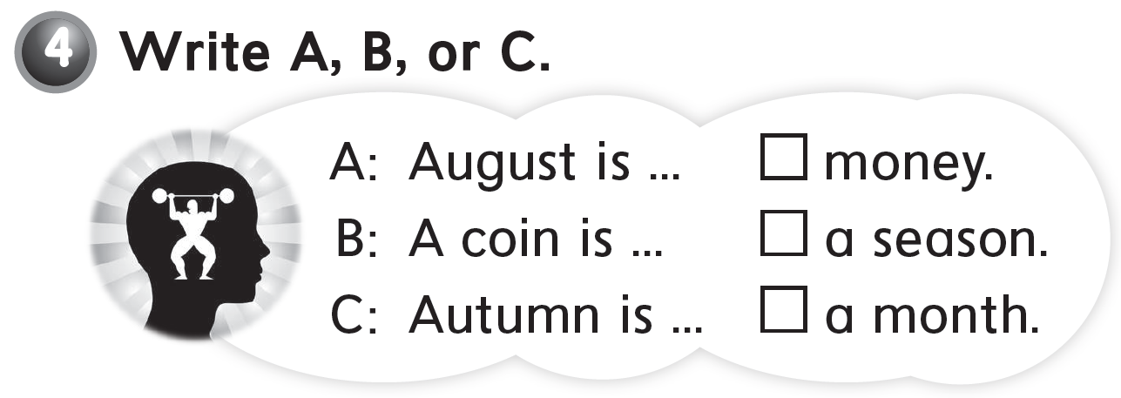
B
C
A

Slide 27
we
our
us
my
them
our
me
he
her
us

Slide 28
We went to an adventure park
My brother an I played with our friends
We got pizza
B
C
A

