Slide 2
Head, shoulders action chant
Clap along
Singing walrus action chant
Follow the rules

Slide 3
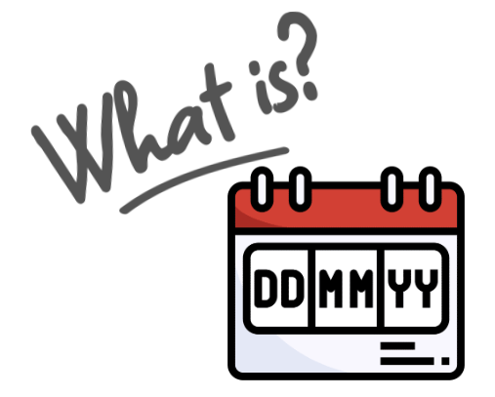

Slide 5
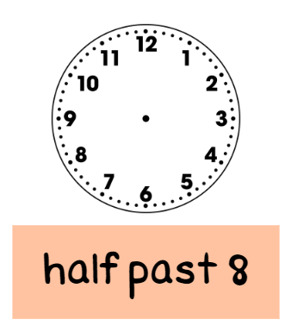

Slide 6
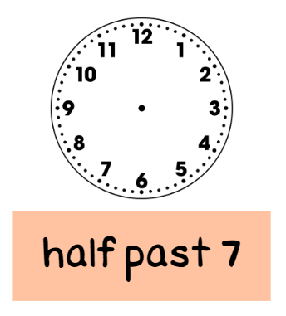

Slide 7
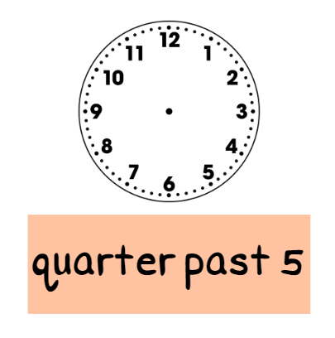

Slide 8
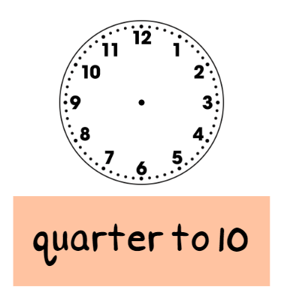

Slide 9
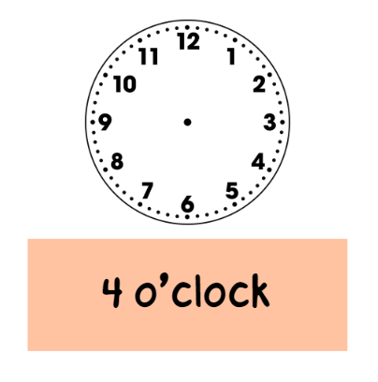

Slide 10
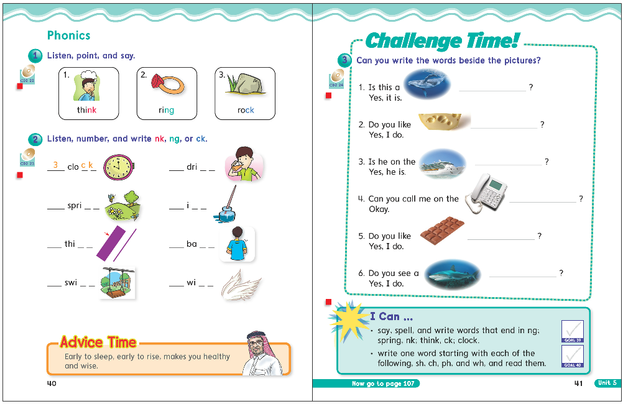
40
41

Slide 13
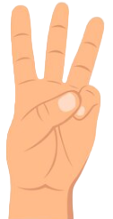
1 nk
2 ng
1 nk
3 ck
3 ck
2 ng
2 ng

Slide 14
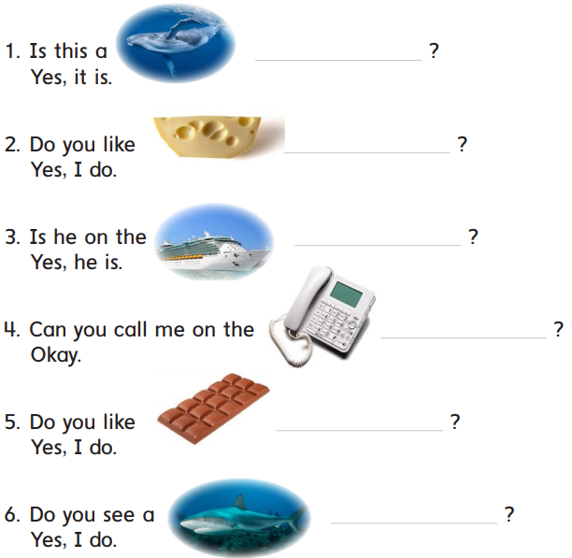

Slide 15
whale
cheese
ship
phone
chocolate
shark

Slide 16
sh
wh
nk
ck
ng
ch
ph
digraphs

Slide 19
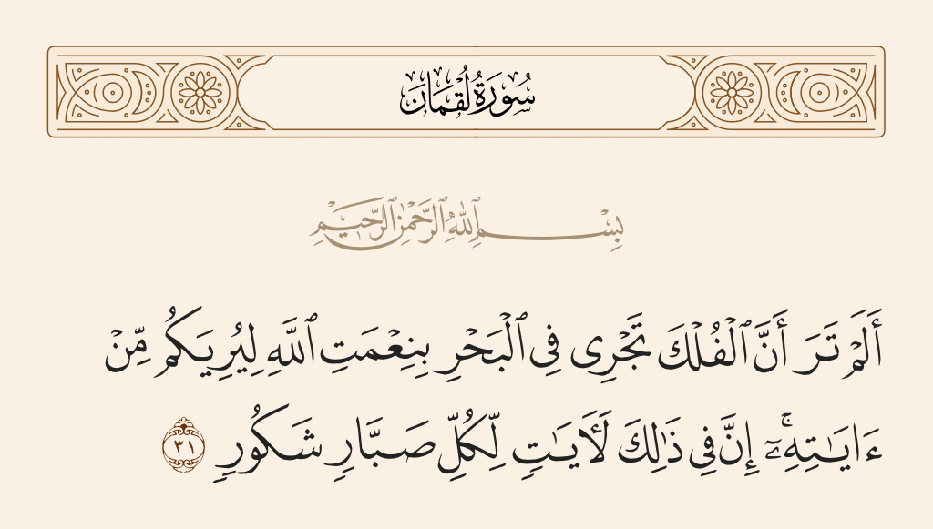

Slide 20
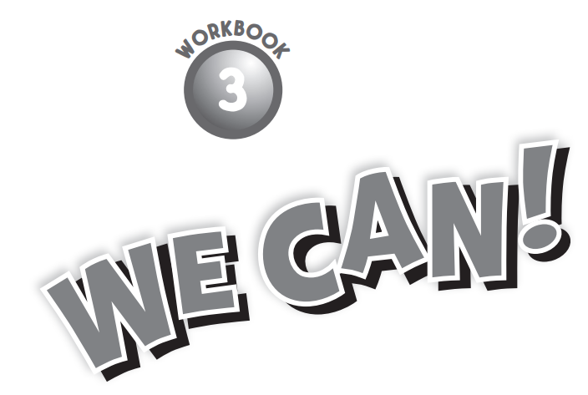

Slide 21
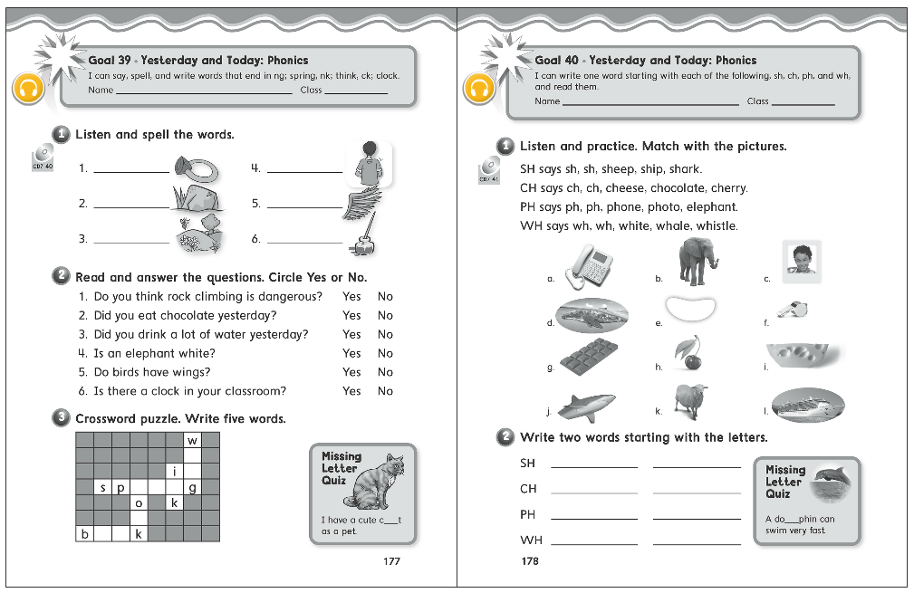

Slide 22
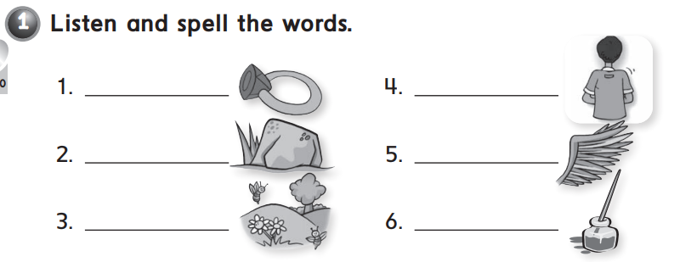
ring
back
rock
wing
spring
ink

Slide 23
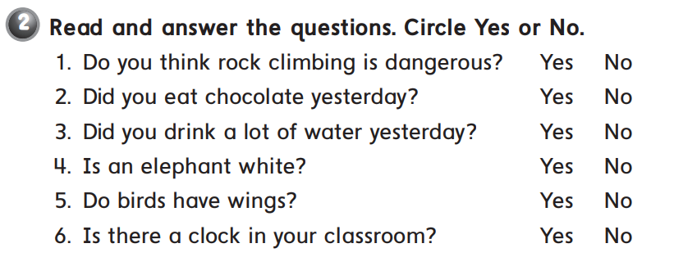

Slide 24
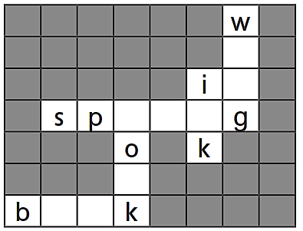
i
n
r i n
c
o o

Slide 25
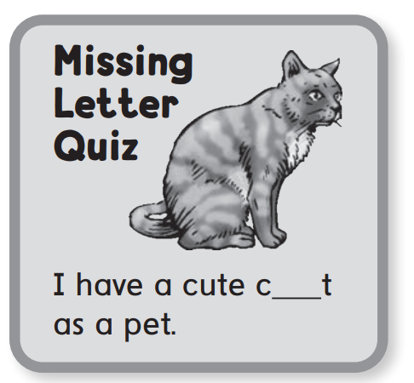
a

Slide 26
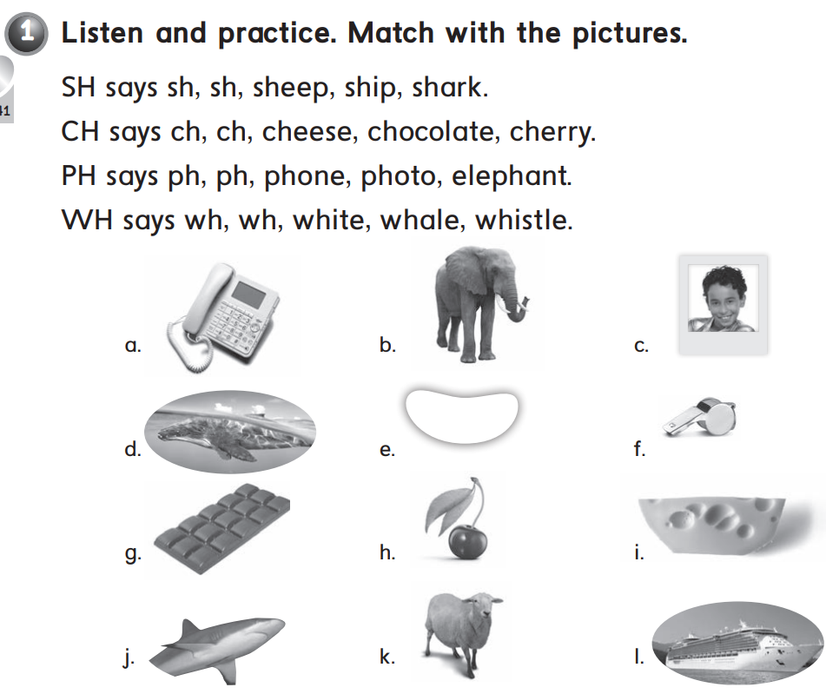
k – l – j
i – g – h
a – c – b
e – d – f

Slide 27
shark
ship
cheese
chocolate
phone
photo
whale
white

Slide 28
l

