Slide 1
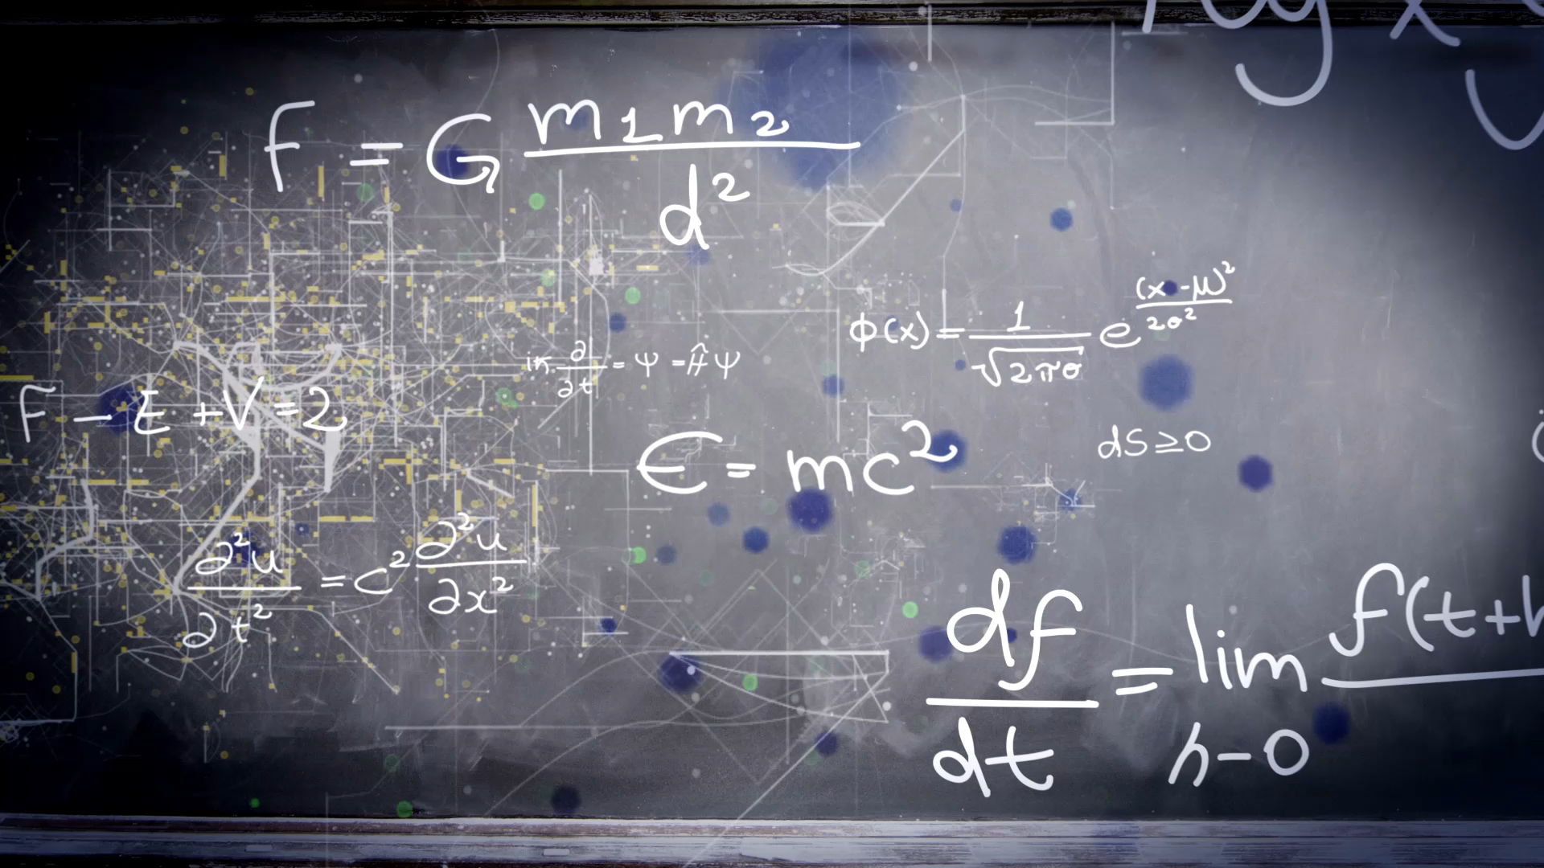
Unit 6
What was it like?
Workbook pages (209 – 212)

Slide 2
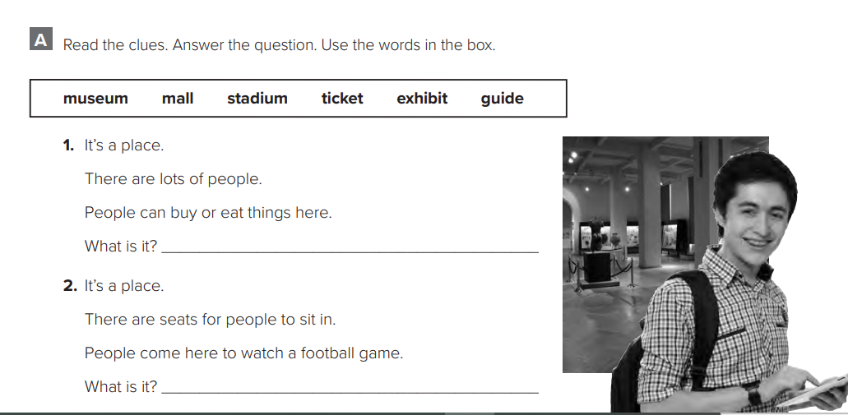
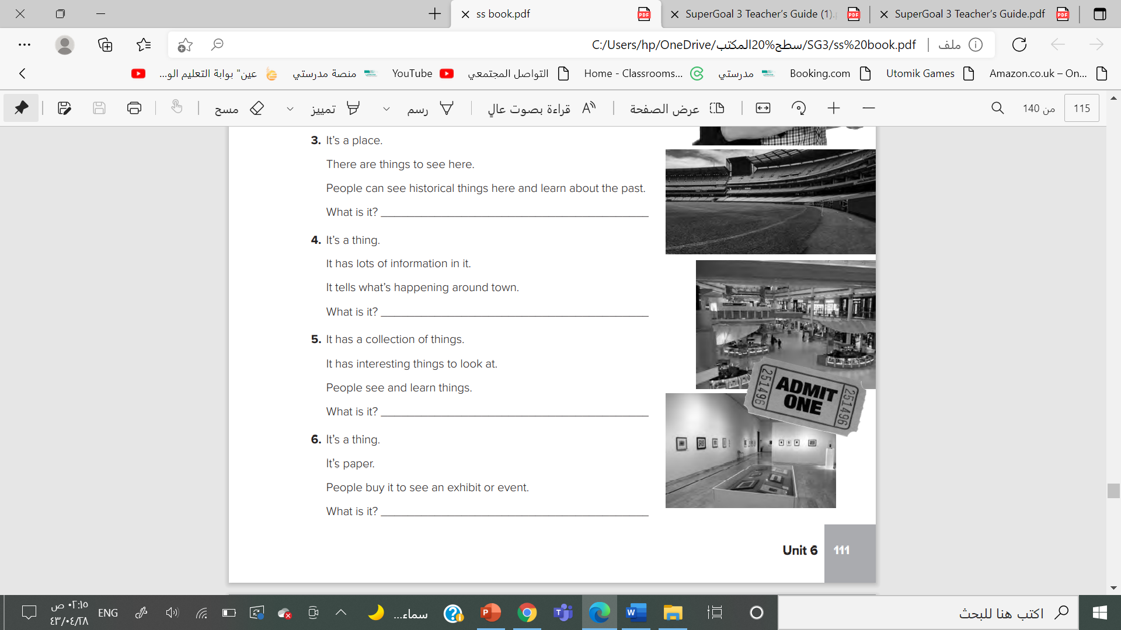

p.209
it’s a mall.
It’s a stadium.
It’s a museum.
It’s a guide

Slide 3

p.209
It’s an exhibit
It’s a ticket

Slide 4
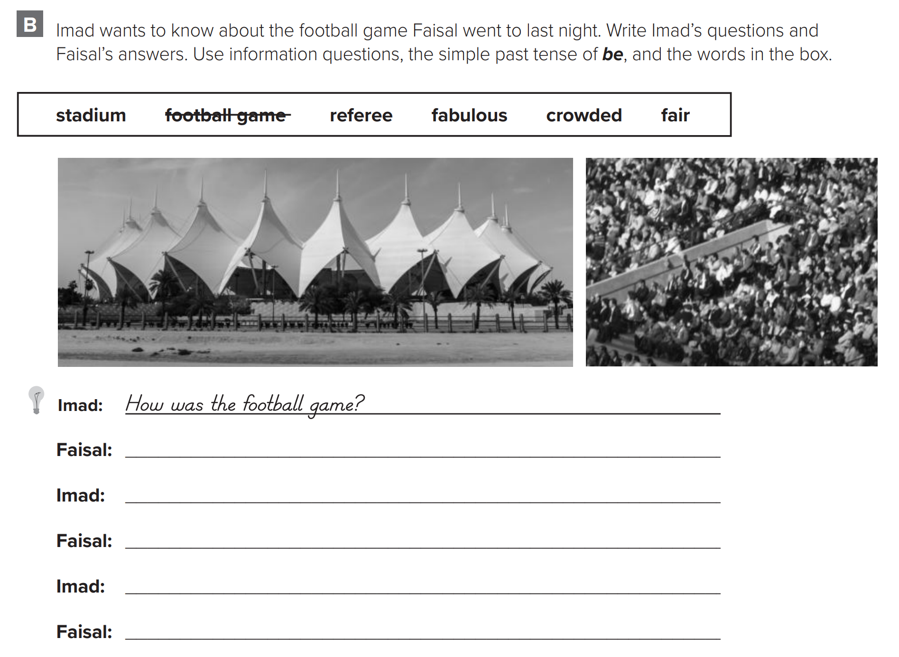

p.210
It was fabulous.
How was the stadium?
It was crowded.
How was the referee like?
He was fair.

Slide 5
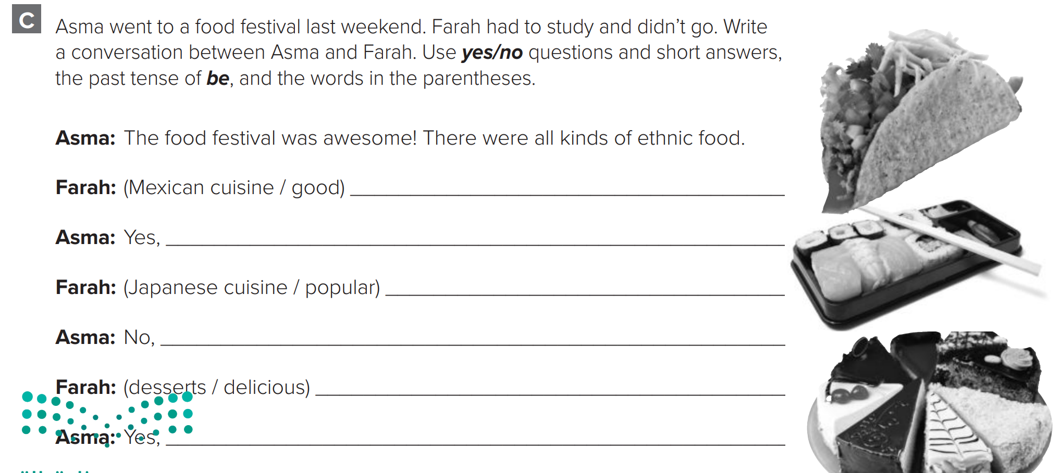

p.210
Was Mexican cuisine good ?
it was.
Was Japanese cuisine popular?
it wasn’t.
Were the desserts delicious?
they were.

Slide 6
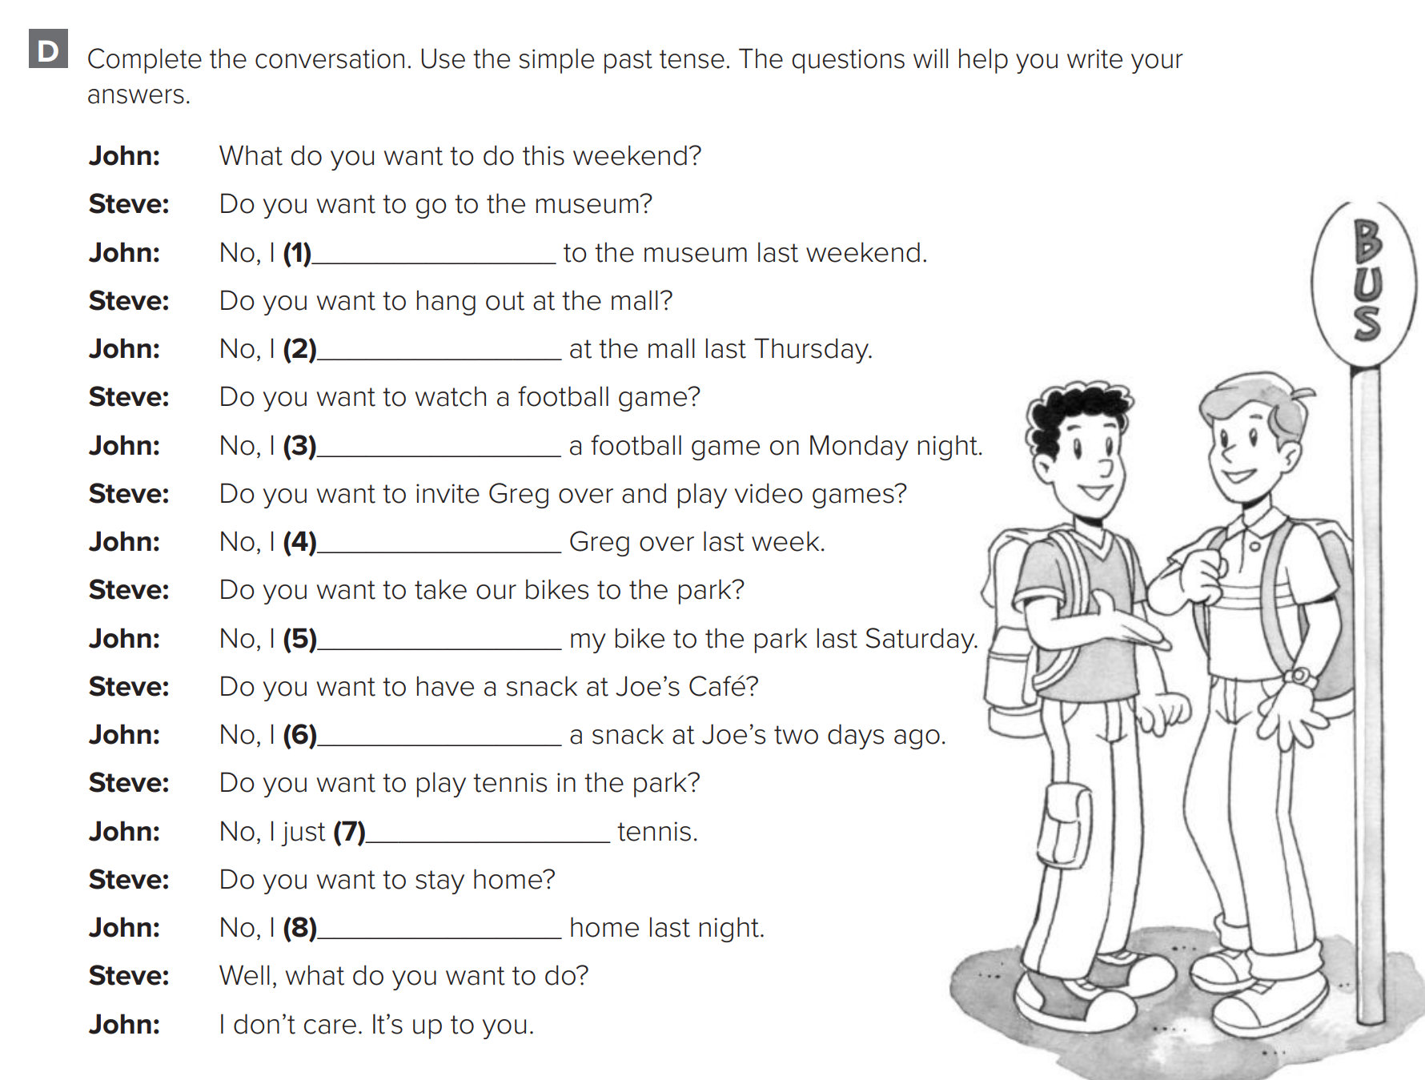

p.211
went
hanged out
watched
invited
took
had
played
stayed

Slide 7
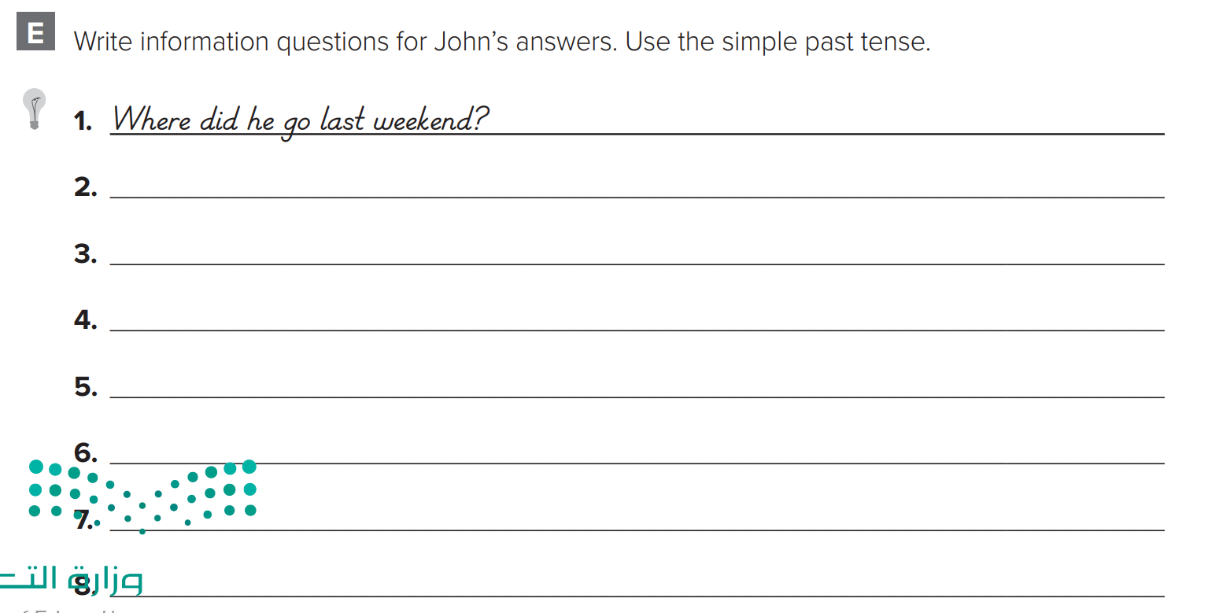
p.211
What did he do last Thursday?
What did he watch on Monday night?
Who did he invite over last week?
Where did he take his bike on Sunday?
What did he have at Joe’s two days ago?

Slide 8
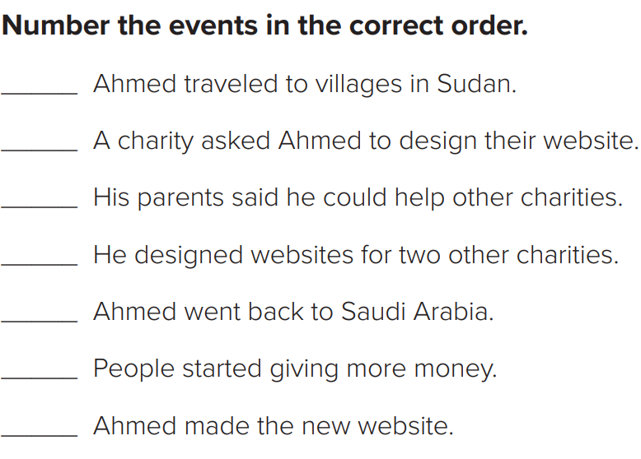
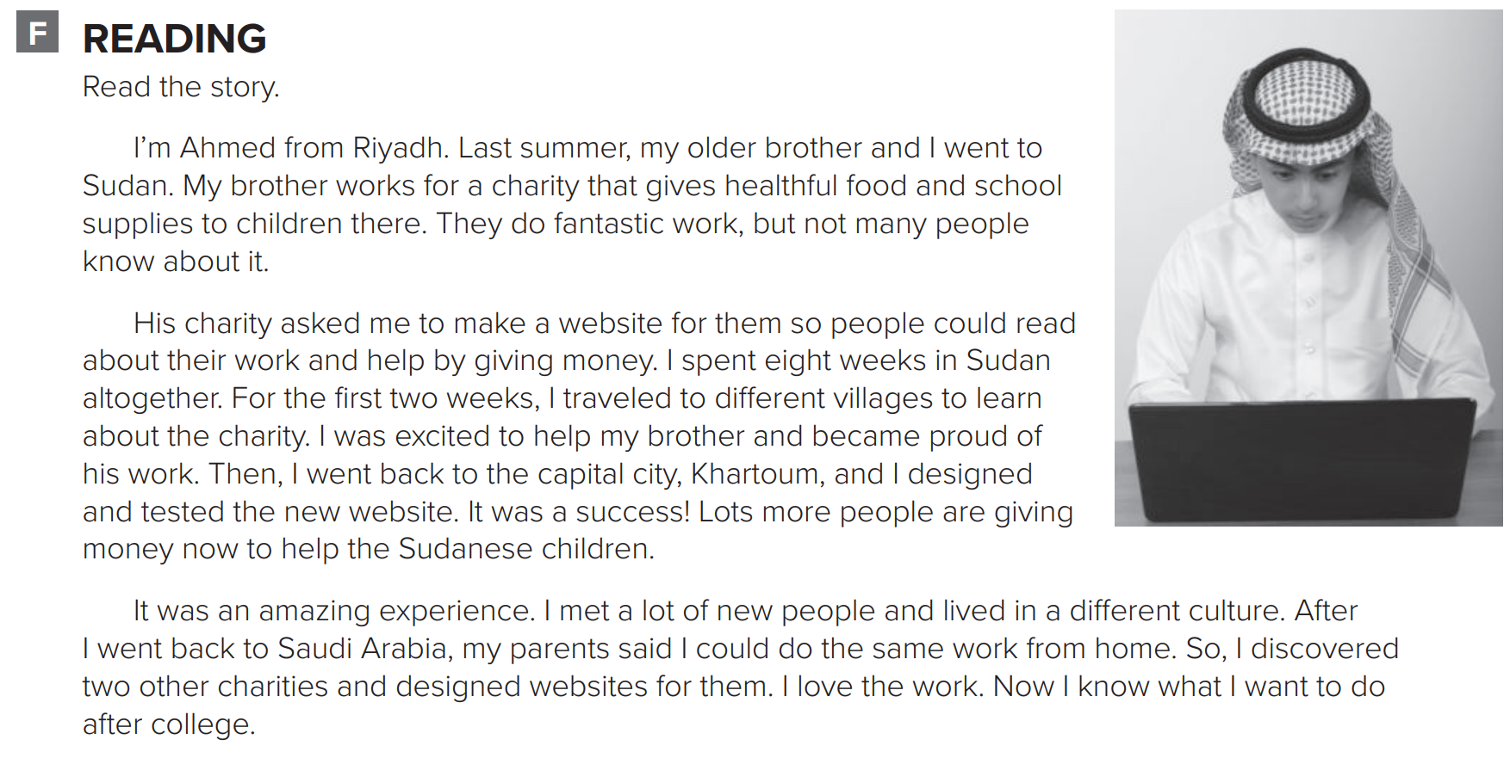

p.212
2
1
6
7
5
4
3

Slide 9
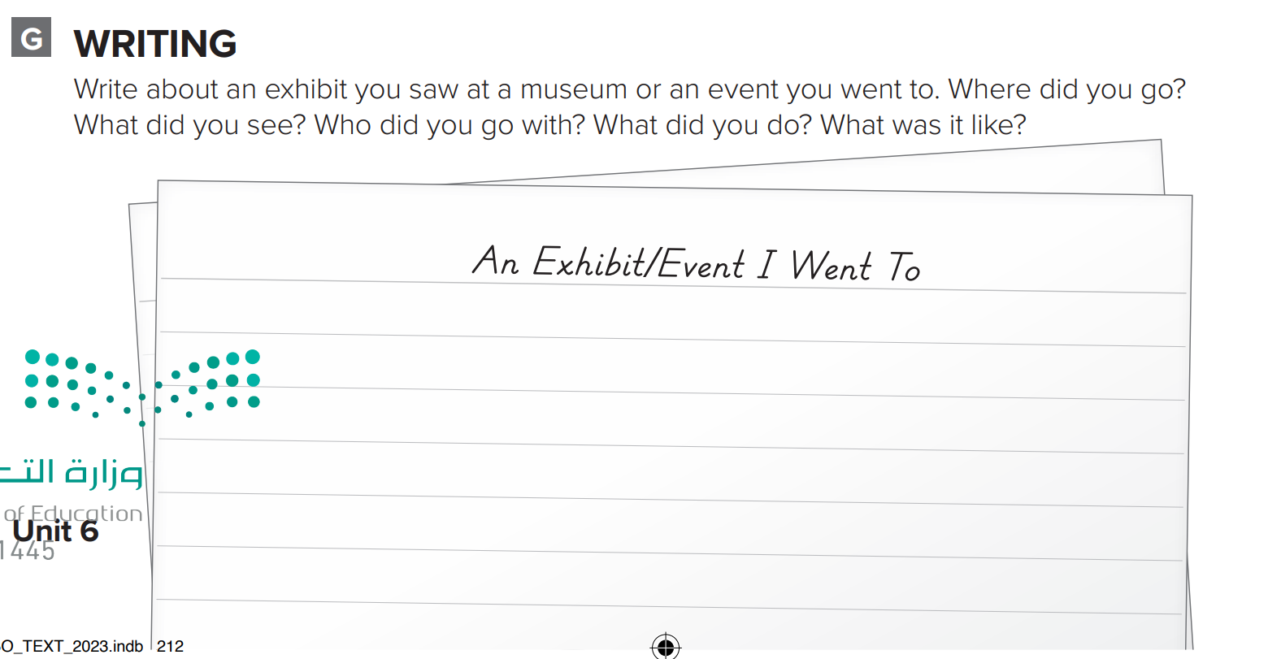
p.212
I went to the Museum of Natural History. I saw a great exhibit there. It was an exhibit of Egyptian mummies. There were three mummies in their gold coffins. There were rooms from the tombs, too. I went with my friends Ali and Tariq. We walked through the rooms and looked at the mummies. It was awesome.

