Slide 3
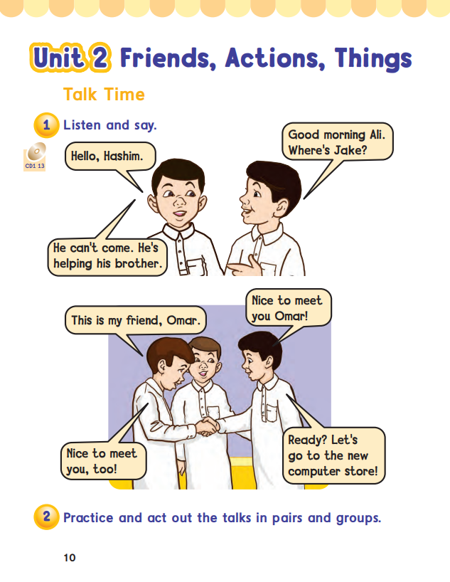
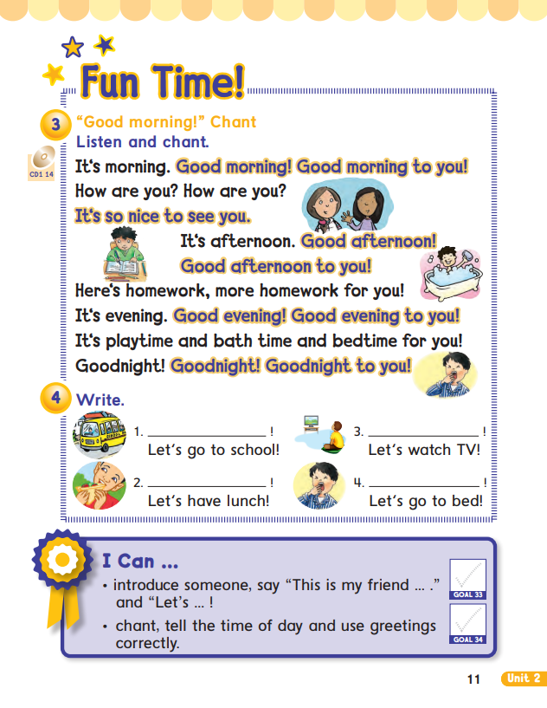
10
11

Slide 4
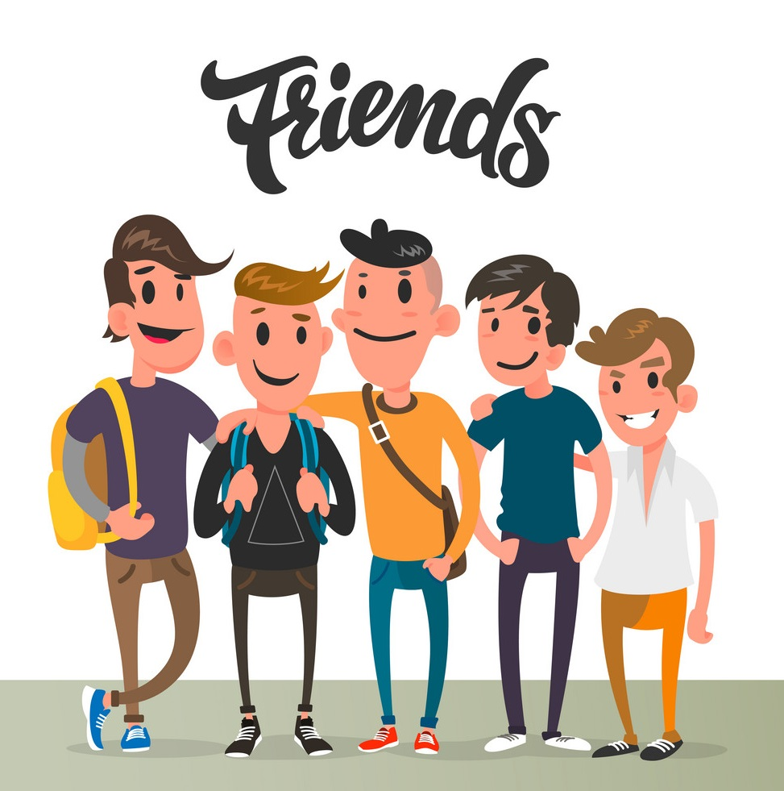
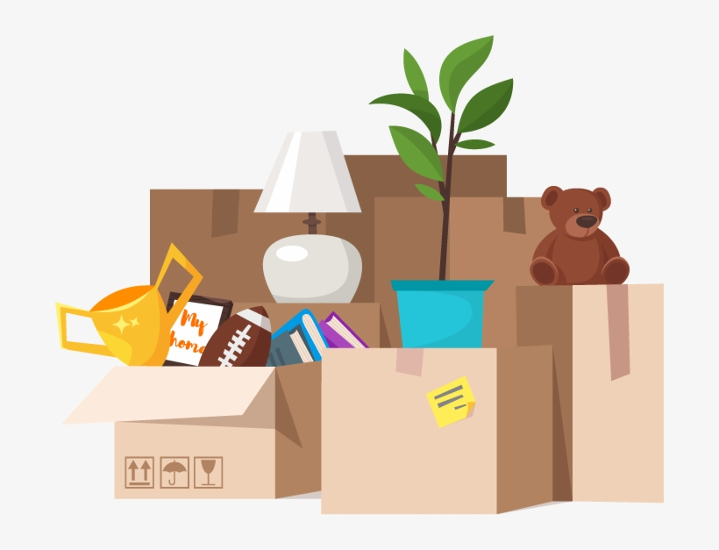
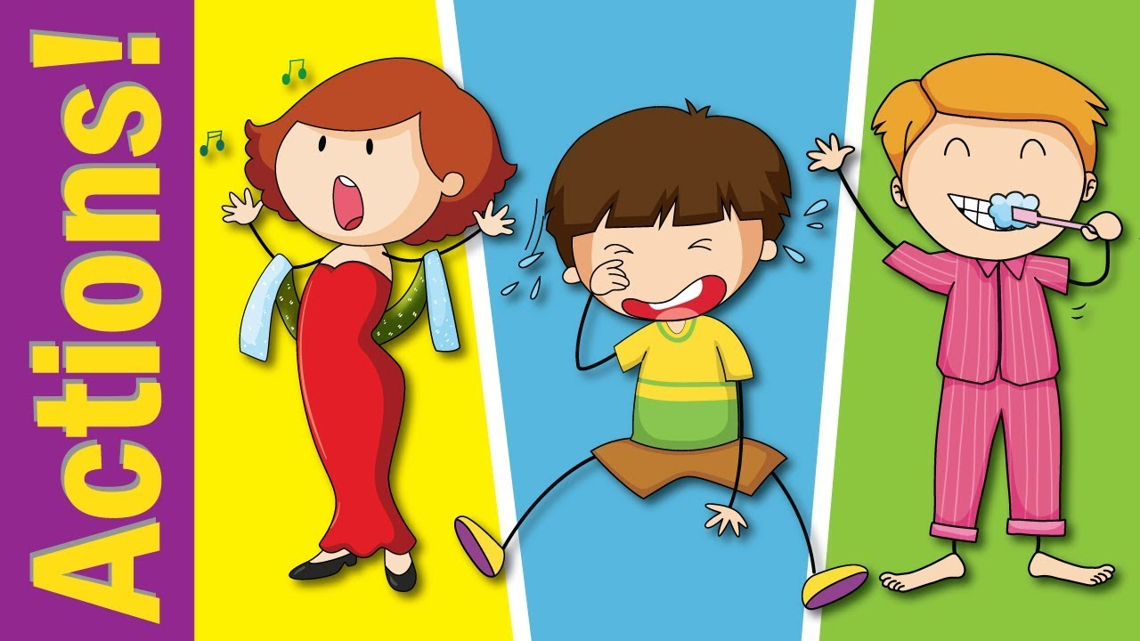

Slide 5
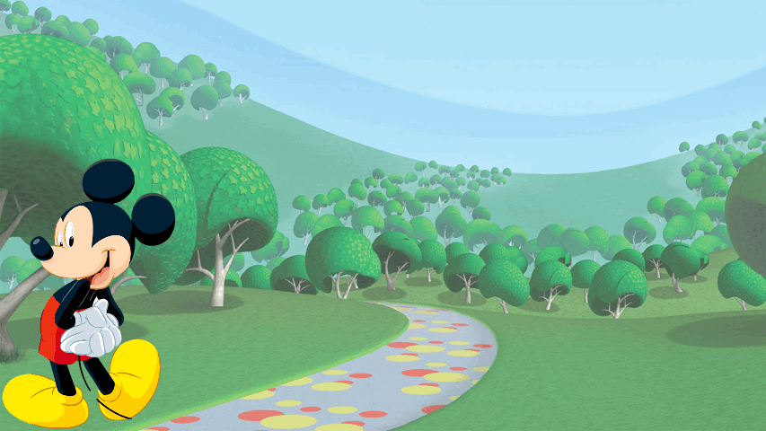
Let’s play with
start

Slide 6
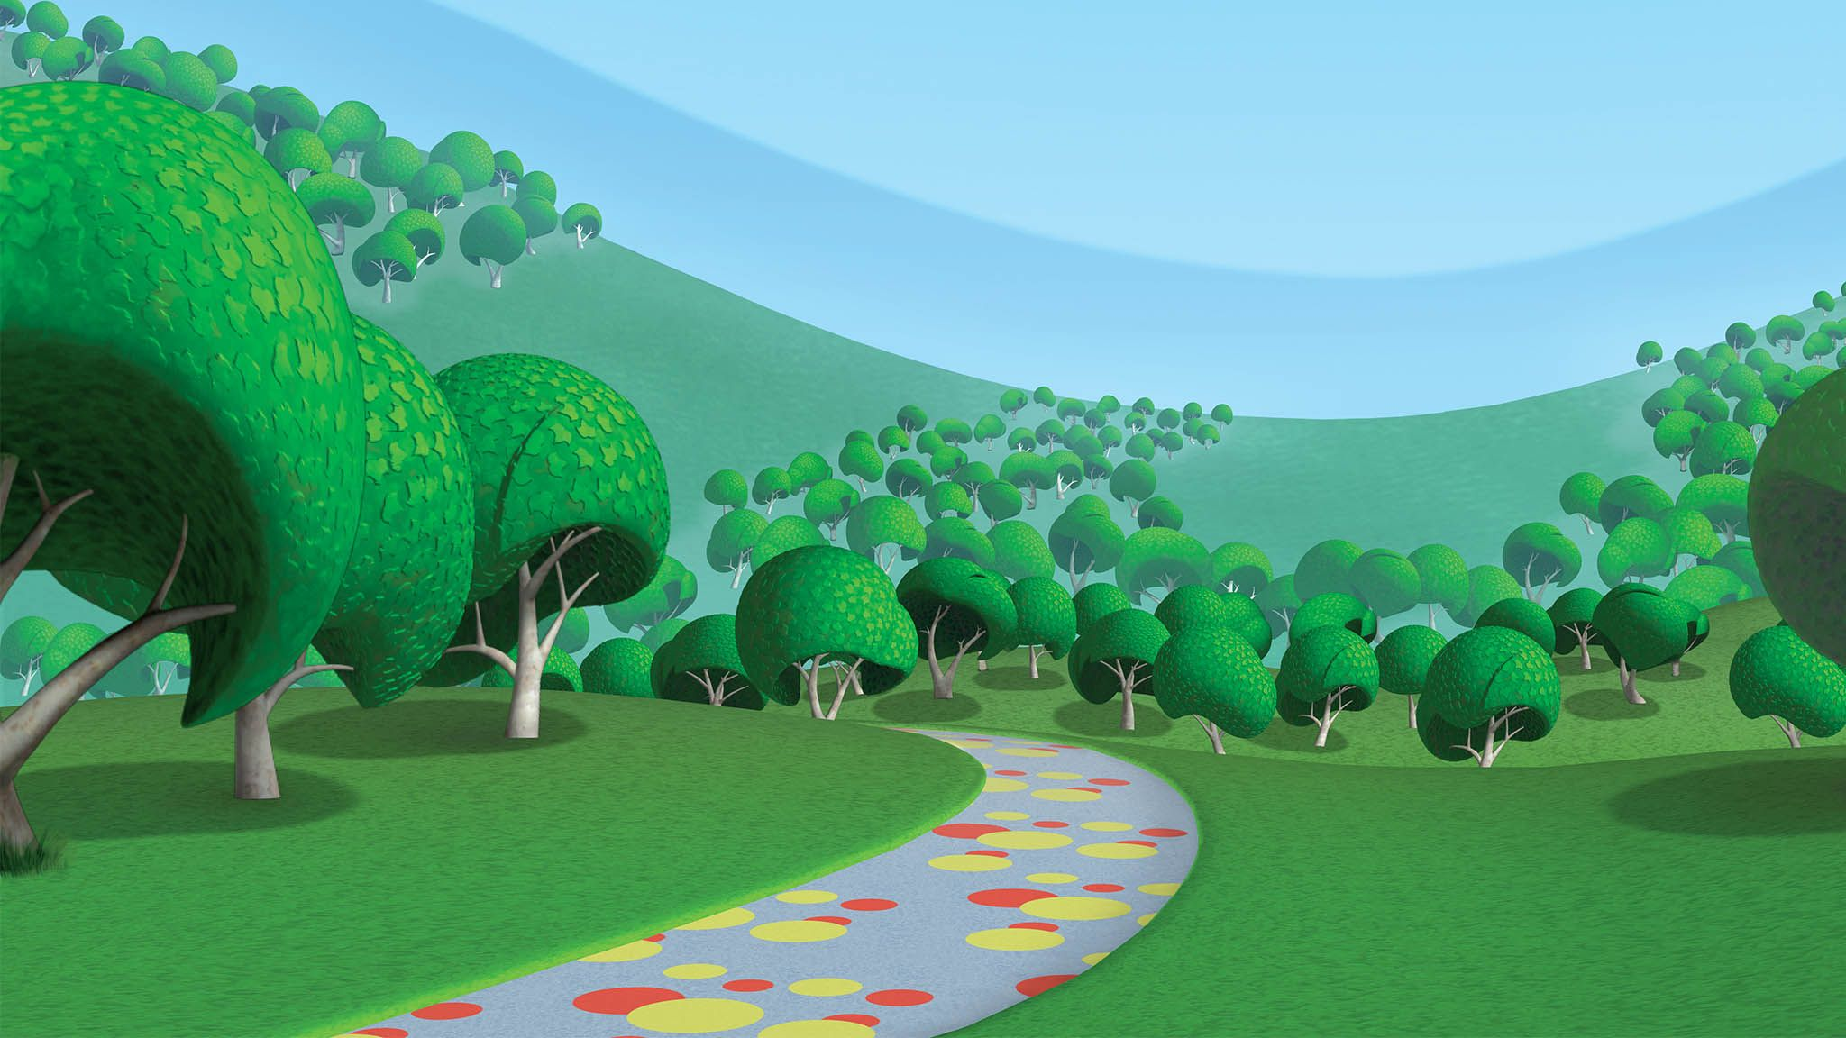
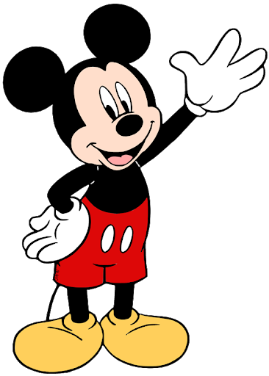
انتهت اللعبة
How old are you?
1
2
3
The snake is ……….
The end sound in boxes is ….

Slide 8
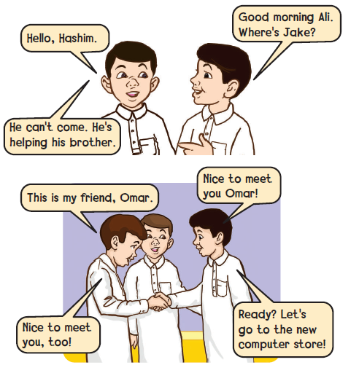
1
Listen and say

Slide 9
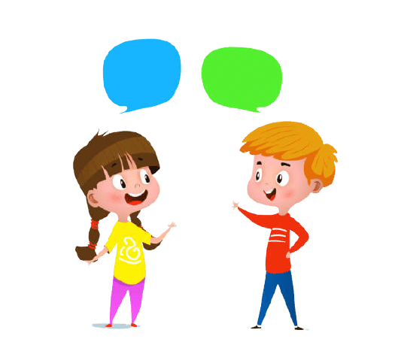
2
Practice and act out the talks in pairs and groups
Hello
Hi

Slide 10
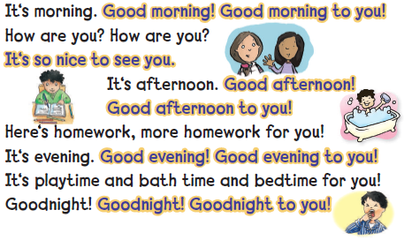
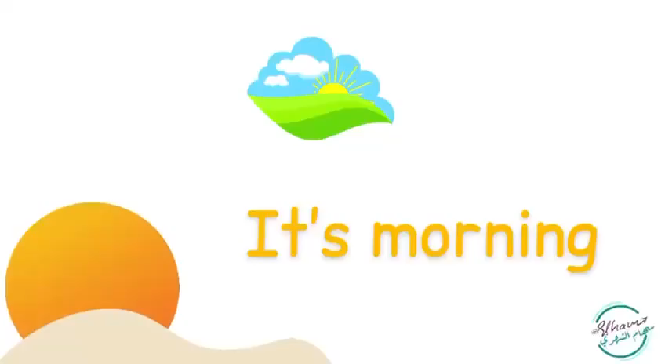
3
“ Good Morning ! ” chant
Listen and chant

Slide 11
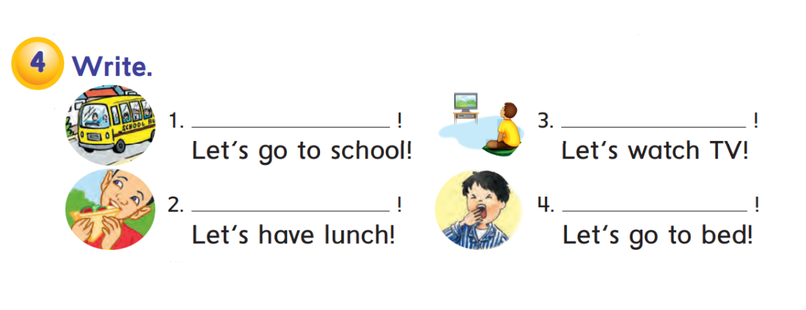
Good morning
Good evening
Good afternoon
Good night

Slide 13
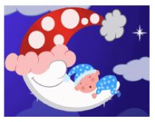
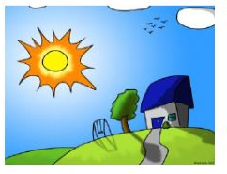
1
Good morning
3
Good night
Good afternoon
2
4
Good evening

Slide 14
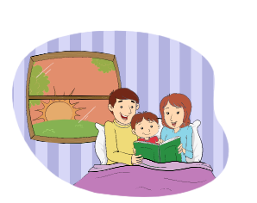
At what time does they read the book?

Slide 15
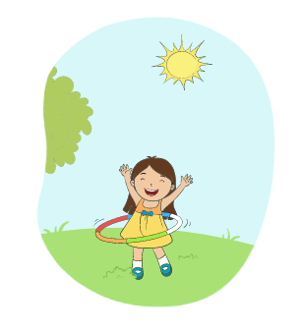
At what time does she go to the park?

Slide 16
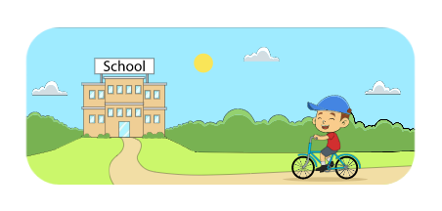
At what time does he go to school?

Slide 17
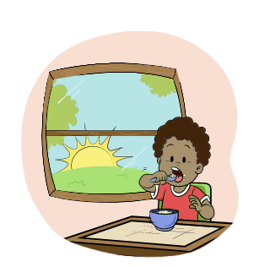
At what time does he eat the breakfast?

Slide 19
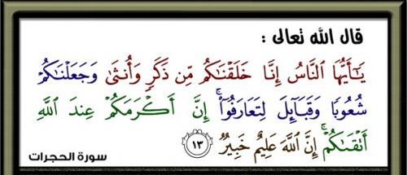

Slide 20
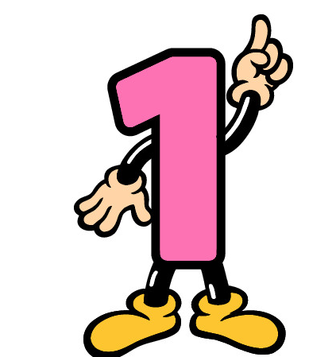
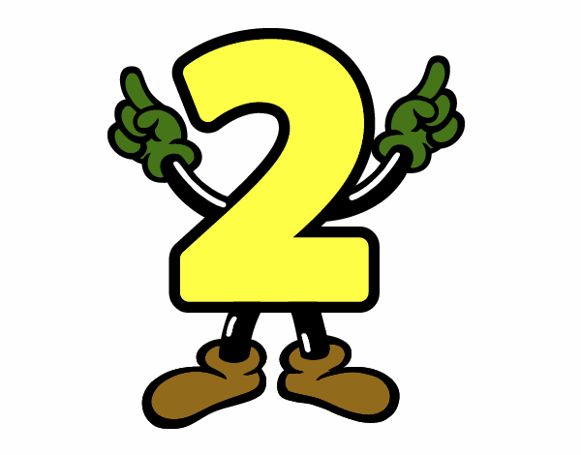
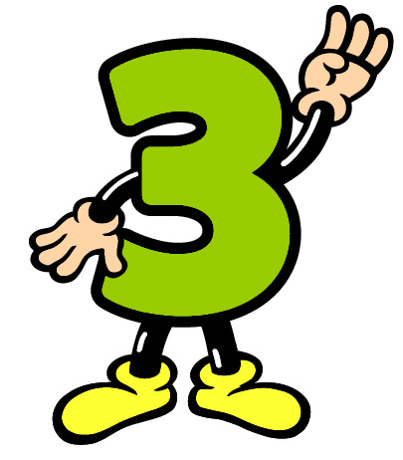
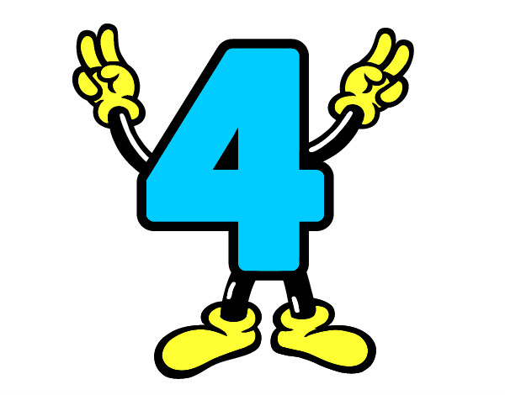

Slide 21
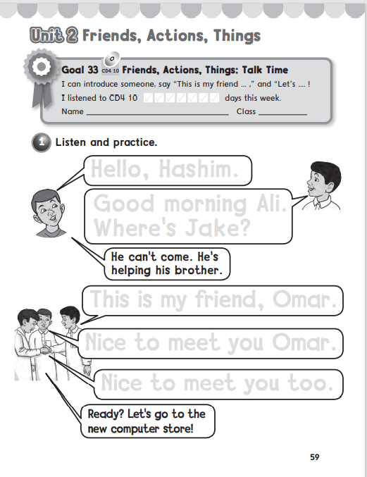
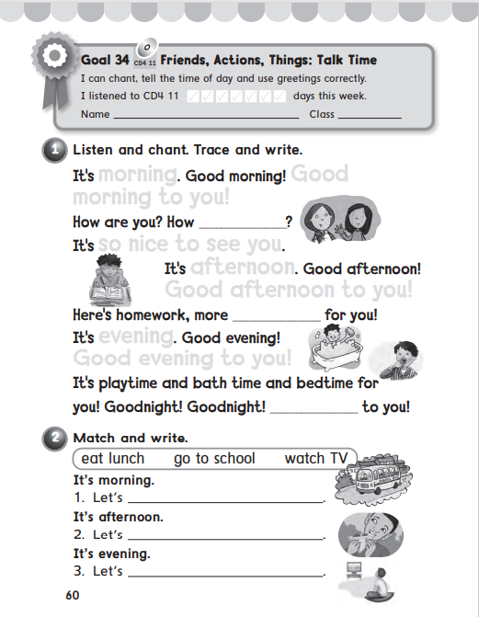
59
60

Slide 22
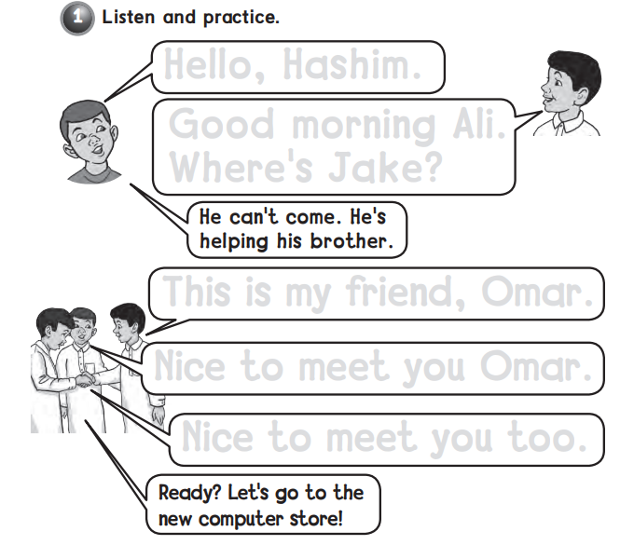
Hello , Hashim
Good morning Ali .
Where’s Jake ?
This is my friend Omar
Nice to meet you Omar .
Nice to meet you too .

Slide 23
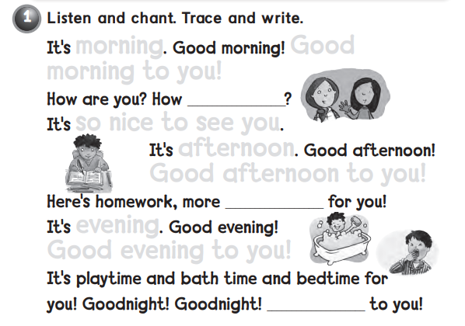
morning Good
morning to you !
are you
so nice to see you
afternoon
Good afternoon to you !
homework
evening
Good evening to you !
Goodnight

Slide 24
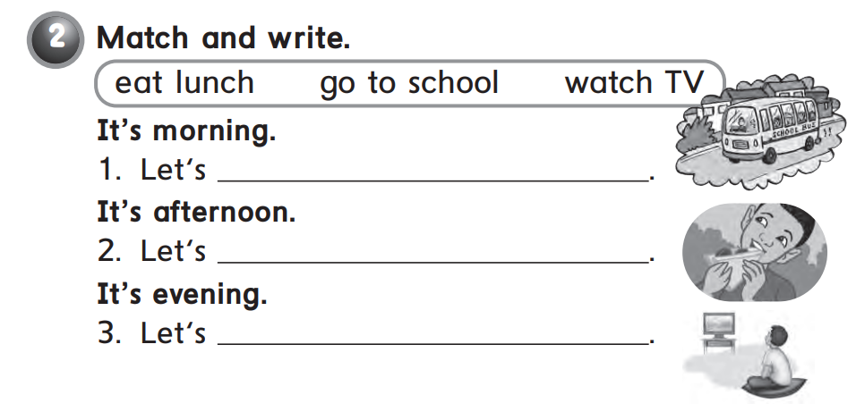
go to school
eat lunch
watch TV

