Slide 1
Super Goal 3

Slide 2


Unit 6

Slide 3

Page 203

Slide 4
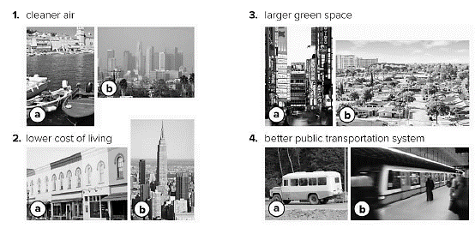

Slide 5

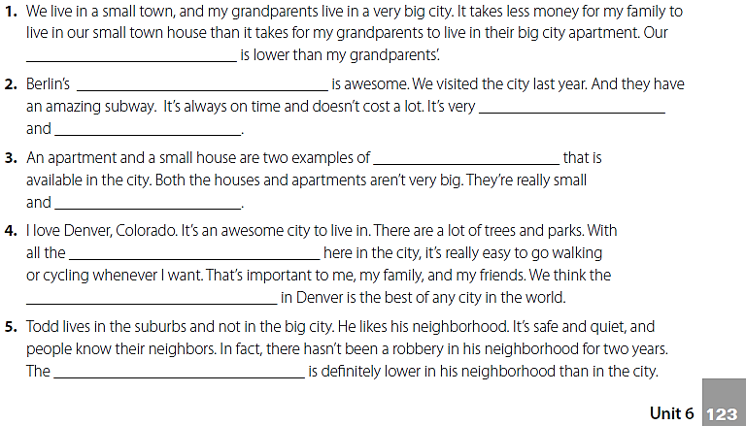
cost of living
public transportation system
punctual
efficient
housing
cozy
green spaces
quality of life
crime rate

Slide 6
Pages 204 – 206

Slide 7

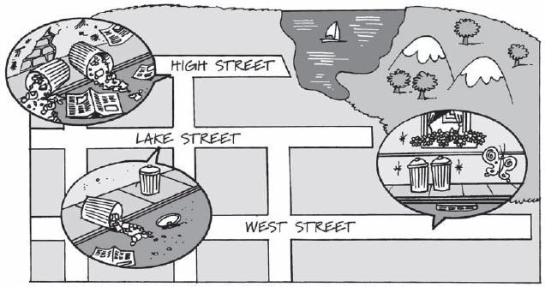
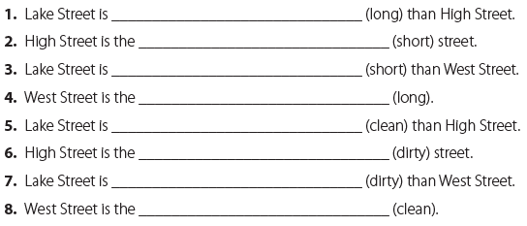
longer
shortest
shorter
longest
cleaner
dirtiest
dirtier
cleanest

Slide 8
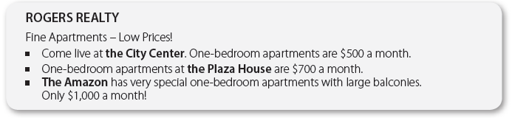
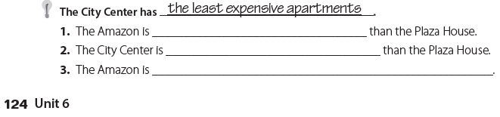
more expensive
less expensive
the most expensive

Slide 9

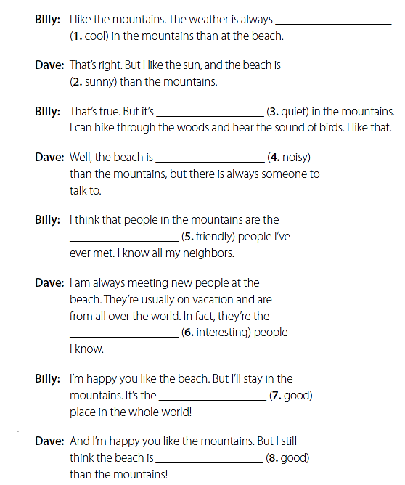
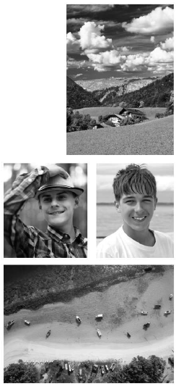
cooler
sunnier
quieter
noisier
friendliest
most interesting
best
better

Slide 10
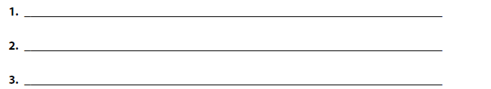
I prefer to live in the mountains because the weather is cooler .
I prefer to live in the mountains because the air is cleaner .
I prefer to live in the mountains because the people are friendlier .

Slide 11
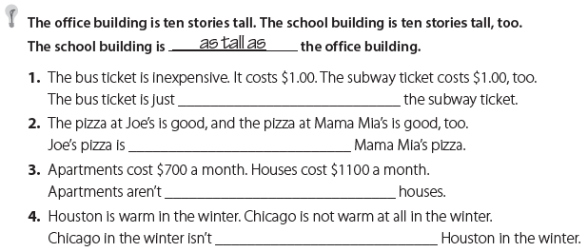
as expensive as
as good as
as expensive as
as warm as

Slide 12
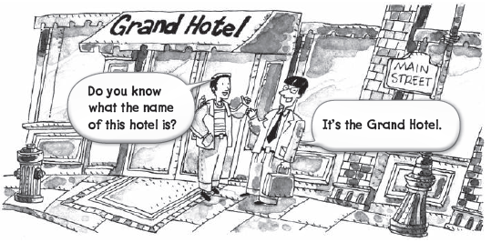
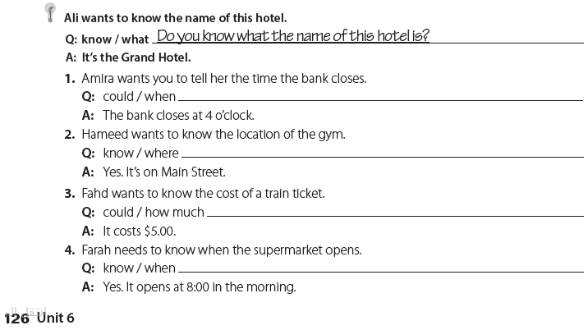
Could you tell me when the bank closes ?
Do you know where the gym is ?
Could you tell me how much a train ticket costs ?
Do you know when the supermarket opens ?

Slide 13
Page 207

Slide 14

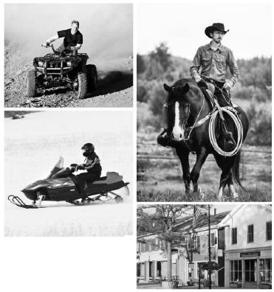
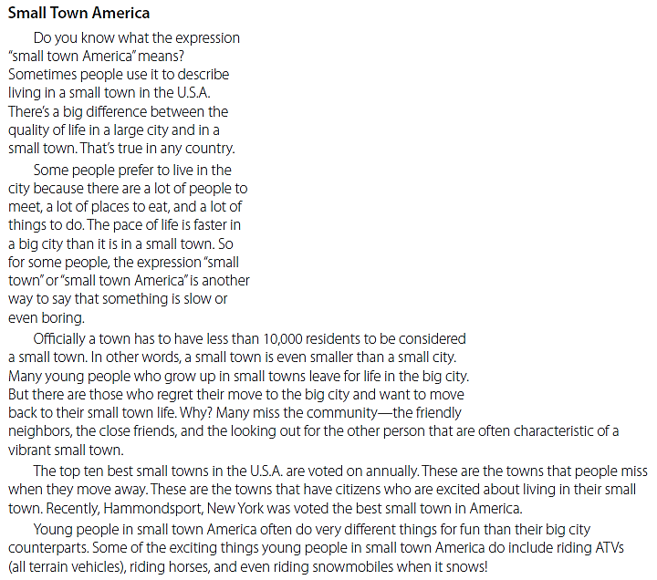

Slide 15
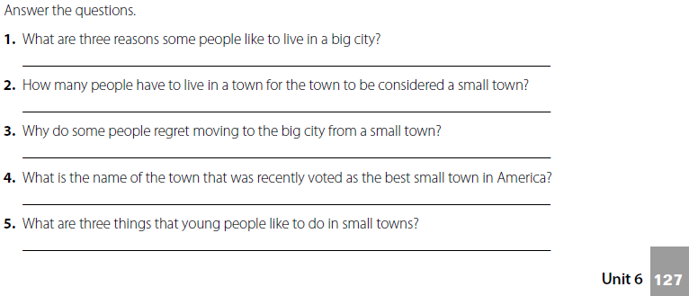
There are a lot of people to meet, a lot of places to eat, and a lot of things to do.
Less than 10,000 people .
because they miss the community of a small town .
Hammondsport , New York .
Riding the ATVs , horses , and the snowmobiles .

Slide 16
Page 208

Slide 17

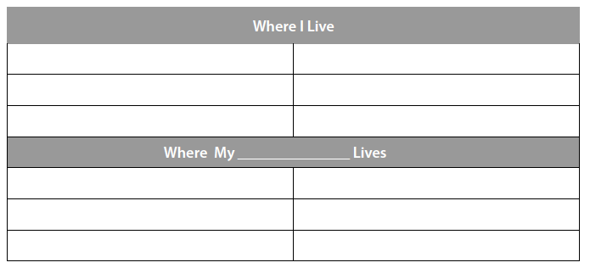
تحدث عن المكان الذي تسكن فيه
تحدث عن المكان الذي يسكن فيه صديقك

Slide 18

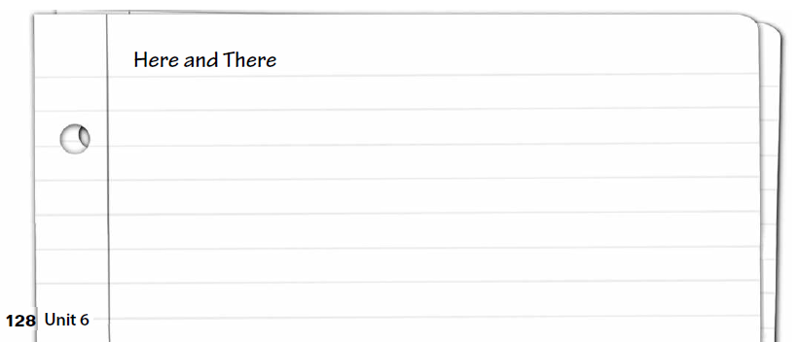
قارن بين المكان الذي تسكن فيه والمكان الذي يسكن به صديقك

Slide 19
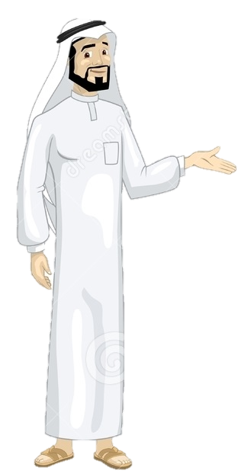
Have a nice day
See you next class

