Slide 1
Super Goal 3

Slide 2

Unit 5

Slide 3

Page 197

Slide 4

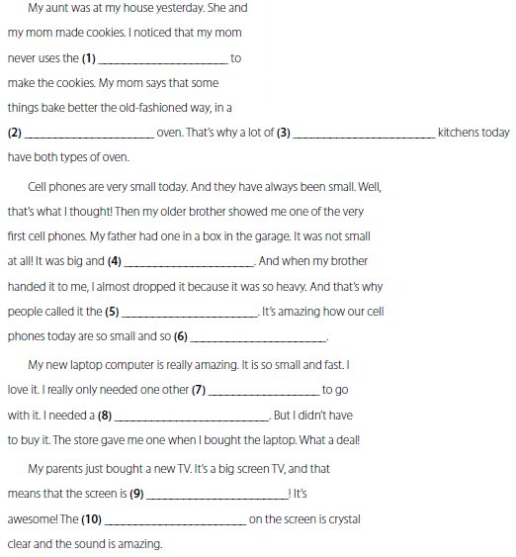
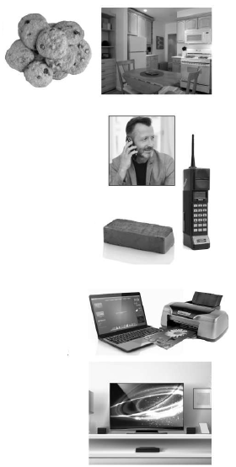
microwave oven
conventional
household
clumsy
brick
light
device
printer
huge
image

Slide 5
Pages 198 – 200

Slide 6
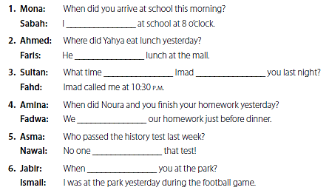
arrived
ate
did
call
finished
passed
were

Slide 7

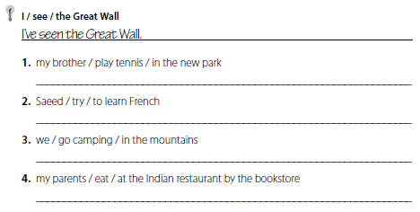

My brother has played tennis in the new park .
Saeed has tried to learn French .
We have gone camping in the mountains .
My parents have eaten at the Indian restaurant by the bookstore .
1. Has your brother played tennis in the new park ?
2. Has Saeed tried to learn French ?
3. Have you gone camping in the mountains ?
4. Have your parents eaten at the Indian restaurant by the bookstore .

Slide 8
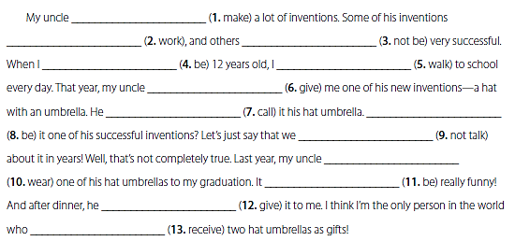
has made
have worked
have not been
was
walked
gave
called
was
haven’t talked
wore
was
gave
has received

Slide 9

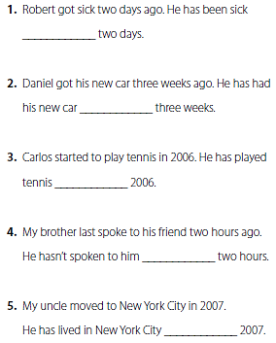
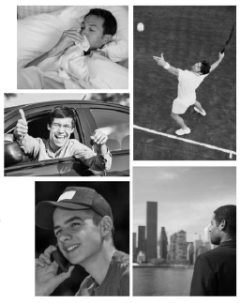
for
for
since
for
since

Slide 10
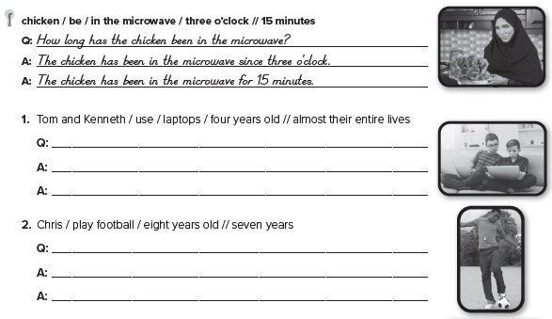
How long have Tom and Kenneth used laptops ?
Tom and Kenneth have used laptops since they were four years old .
Tom and Kenneth have used laptops for almost their entire lives .
How long has Ali played football ?
Ali has played football since he was eight years old .
Ali has played football for seven years .

Slide 11
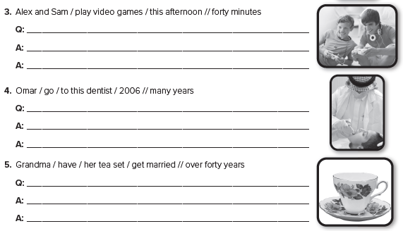
How long have Alex and Sam played video games ?
Alex and Sam have played video games since this afternoon.
Alex and Sam have played video games for four hours.
How long has Omar gone to this dentist ?
Omar has gone to this dentist since 2006 .
Omar has gone to this dentist for many years .
How long has Grandma had her tea set ?
Grandma has had her tea set since she got married .
Grandma has had her tea set for over forty years .

Slide 12
Page 201

Slide 13
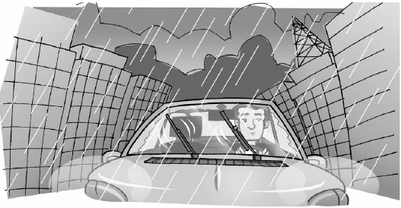
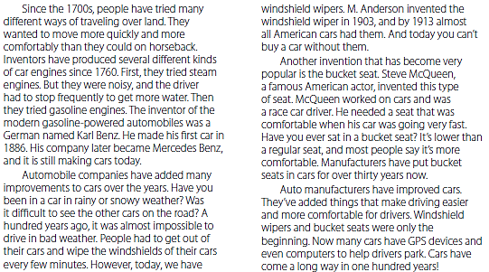

Slide 14
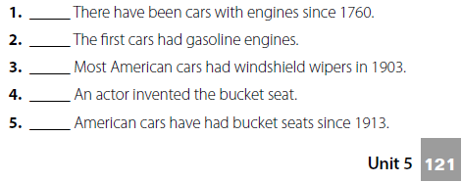
T
F
F
T
F

Slide 15
Page 202

Slide 16
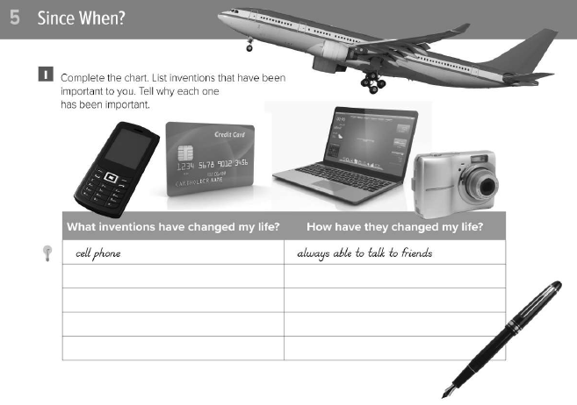
ما هي الاختراعات التي غيرت حياتك
كيف غيرت حياتك

Slide 17

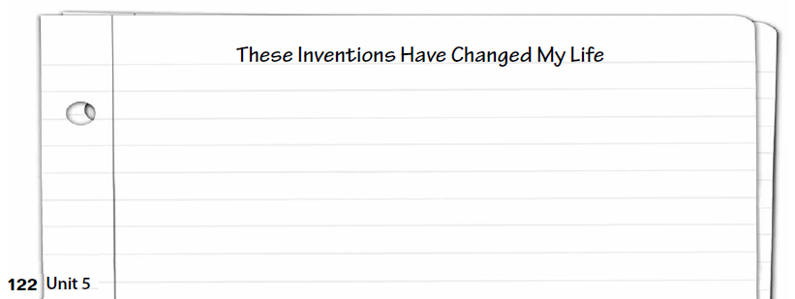
تحدث عن الاختراعات التي غيرت حياتك

Slide 18
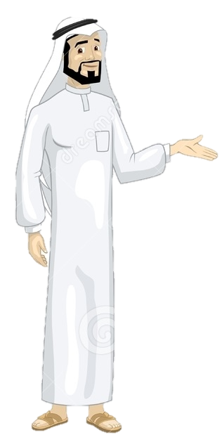
Have a nice day
See you next class

