Slide 1
Super Goal 3

Slide 2
Unit 5

Slide 3
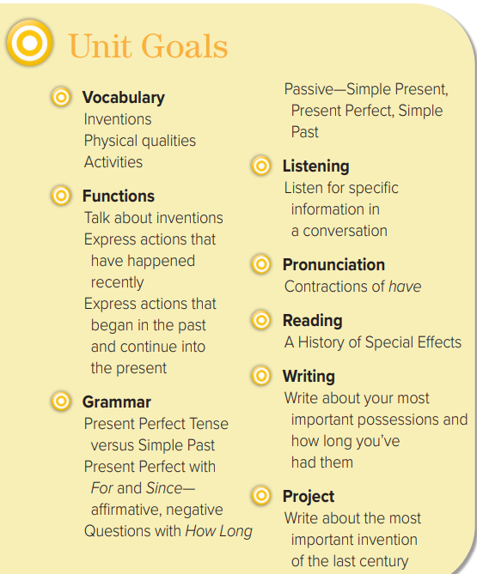

Slide 4
The objectives of the lesson :
At the end of this session, the students will be able to :
Use passive voice for past tense correctly
Transform regular sentences into passive

Slide 6
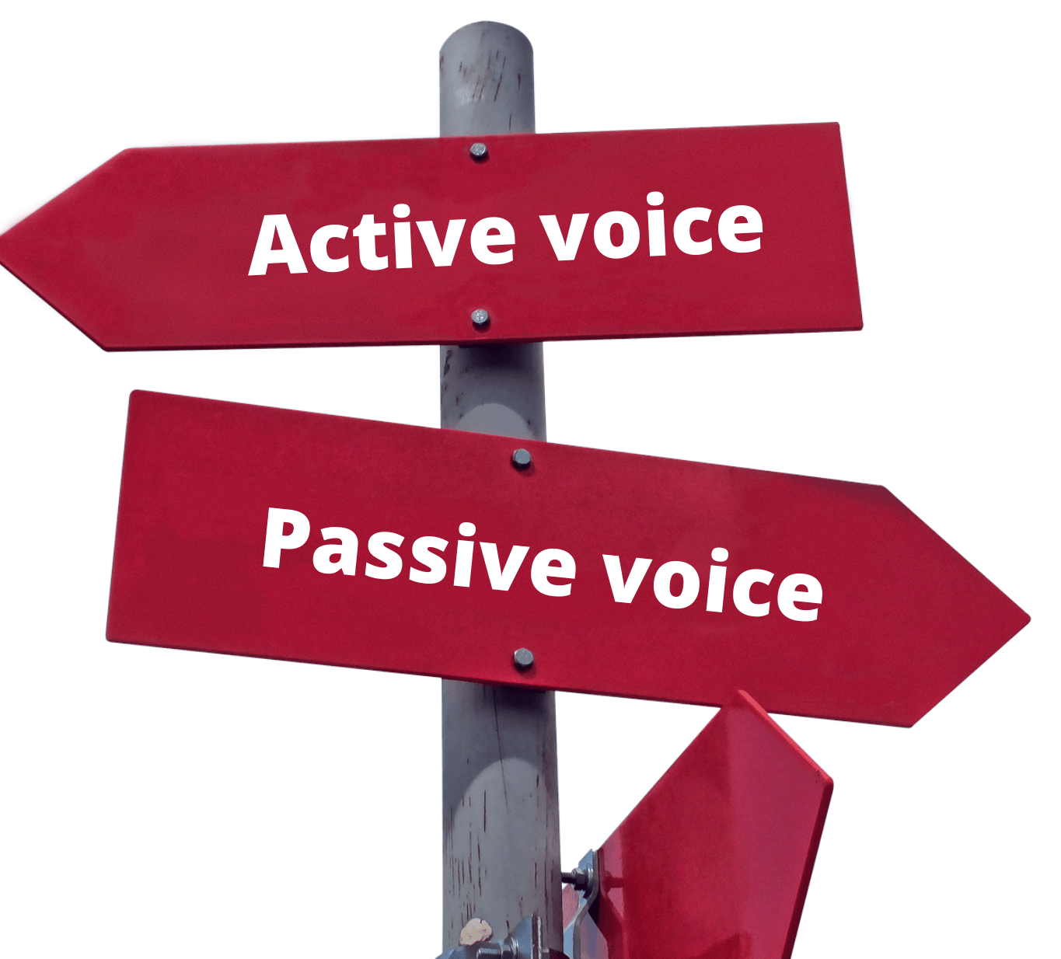
Examples
Saudi Arabian people celebrate National Day on September 23rd.
(National Day is celebrated by Saudi Arabian people on September 23rd.)
The cat has eaten the fish.
(The fish has been eaten by the cat.)
Ancient Egyptians built the Pyramids.
(The Pyramids were built by ancient Egyptians.)

Slide 7
When we use Passive…
Use the passive when …
1- we are interested in the action rather than the people who do the action (agent / doer).
2- we don’t know exactly the agent (doer)
3- it is understood who did the action

Slide 9
Let’s Practice
Change into passive!
Sami receives a letter .
A letter was received by Sami.

Slide 10
Let’s Practice
Change into passive!
Amal made the cake.
The cake was made by Amal.

Slide 12
The first car was made by Karl Benz in 1886.
2. Cars are produced all over the world today.
3. Many changes have been made in our city.
4. Was penicillin discovered by Alexander Fleming?

Slide 13
5. The documentary was filmed in a desert oasis.
6. Were you invited to the graduation ceremony?
7. English is spoken all over the world.
8. The digital camera was invented by Steven Sasson in 1975.

Slide 14
Word processors have replaced typewriters.
2. This restaurant serves all entrées with rice and salad.
3. Did the Wright brothers fly the first airplane?
4. People in the Middle East have used soap for nearly 5,000 years.
5. Cell phones and computers have changed the way we communicate.
6. Saudi Arabia produces roughly thirteen percent of the world’s oil.
7. Al-Zahrawi wrote an encyclopedia of medical practices in 1000.
8. Da Vinci designed many flying machines, but he never built them.

Slide 15
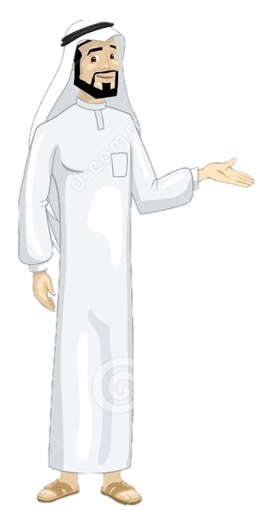
Have a nice day
See you next class

