Slide 1


Slide 2



    Unit -2-
    Going Green

Slide 3
    Grammar

Slide 4
    Gerunds After
    Verbs
    Infinitives After Verbs

Slide 5

Goals
1
Explain the reason for using infinitive or gerunds
2
Demonstrate the idea of gerund .
3
Use the gerunds after the correct verbs .
4
Use infinitives after the correct verbs .
5
Choose the correct verb for a sentence
Rewrite a sentence using gerund or infinitive .
6
7
Write a sentence according to a picture .

Slide 6


Slide 7
    Gerunds After
    Verbs

Slide 8

We’re eating more organic fruits now.
I prefer eating organic foods.
Present progressive
Gerunds

Slide 9
Gerunds are
The -ing form of a verb.
They act like nouns
Answer the question what.
I recommend turning off the lights when you leave the room.
Our class enjoys learning about ways to help the environment.

Slide 10
We use gerunds after certain verbs, such as:
advise enjoy intend quit begin finish
keep recommend can’t stand go like
start consider hate love stop continue
imagine prefer suggest

Slide 11
    Infinitives After Verbs

Slide 12
An infinitive is
to + the base form of a verb.
infinitives act like nouns
answer the question what
Don’t forget to reuse that plastic container.
Do they intend to buy a hybrid car?

Slide 13
We use infinitives after certain verbs, such as:
agree continue intend offer start
ask* decide learn plan try attempt
expect* like prefer want* begin forget
love promise can’t stand hate need*
remember

Slide 14
*These verbs can be followed by an object before the infinitive
ask* expect* want* need*
They want to plant a garden.
They want us to plant a garden

Slide 15
Circle the correct verb forms. Sometimes both the gerund and the infinitive are possible.
• Do you want (1. having / to have) a positive impact on the environment? I suggest
(2. giving / to give) these steps a try:
• Do you hate (3. throwing / to throw) away old clothes in the garbage? Consider (4. giving / to give) clothes that no longer fit you to other people who can wear them.
• Quit (5. using / to use) disposable batteries. Begin (6. using / to use) rechargeable batteries.
• Learn (7. buying / to buy) products with less packaging. Attempt (8. buying / to buy) large containers of water, juice, and soda instead of individual serving-size containers.
• Learn (9. avoiding / to avoid) creating trash whenever possible. For example, when ordering food, avoid (10. taking / to take) any unnecessary utensils and napkins.
• Start (11. making / to make) a shopping list before you go shopping. This will help you stop (12. buying / to buy) things you don’t need on impulse.
• Keep (13. reusing / to reuse) your supermarket bags.

Slide 16
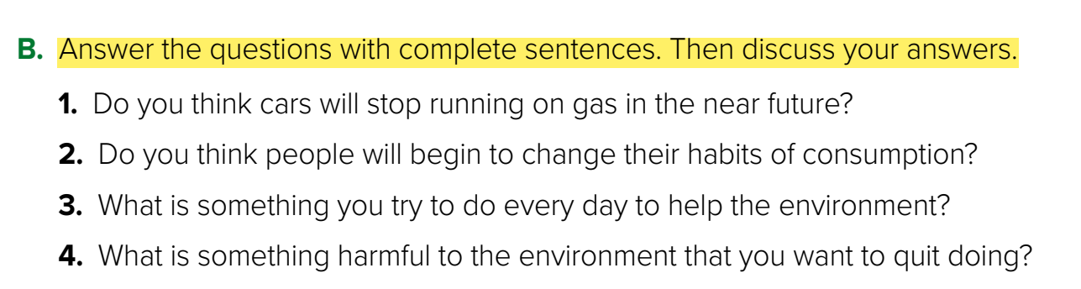
1. I think that in the near future cars will stop running on gas.
2. I think that people will begin to change their habits of consumption.
3. Every day I try to remember to recycle trash.
4. I would like to quit smoking.

Slide 17
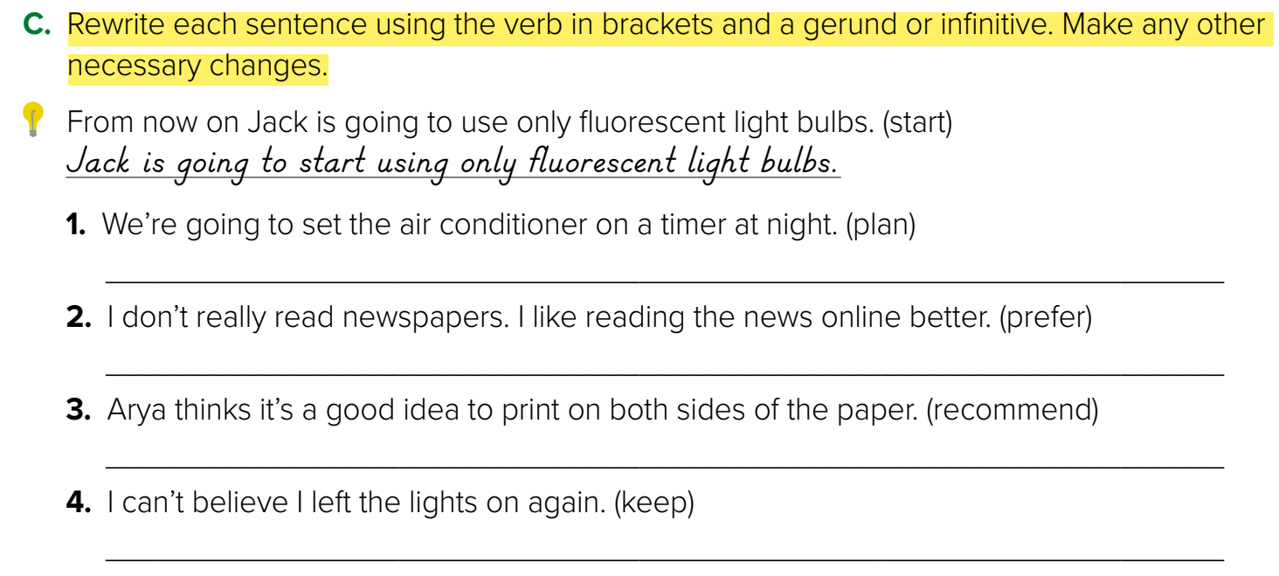
We plan to set the air conditioner on a timer at night
I prefer reading the news online to reading newspapers.
Arya recommends printing on both sides of the paper.
I can’t believe I kept leaving the lights on.

Slide 18



Quiz Time

Slide 19



