Slide 2
Head, shoulders action chant

Slide 3
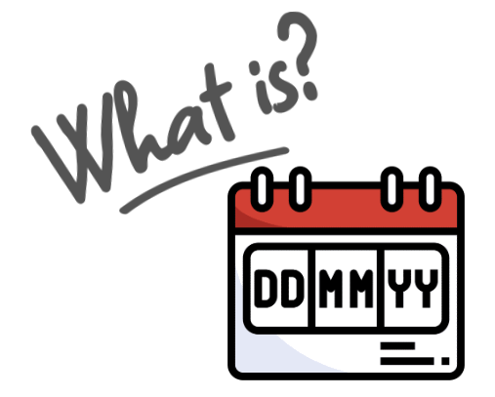

Slide 4
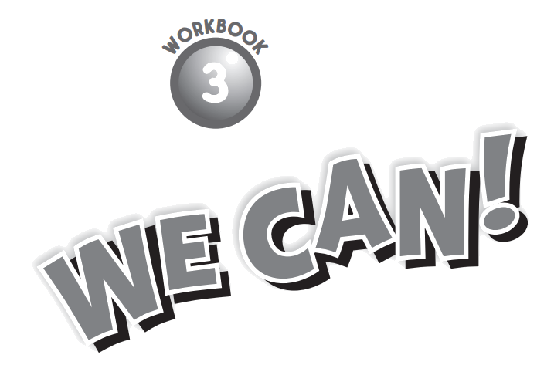

Slide 5
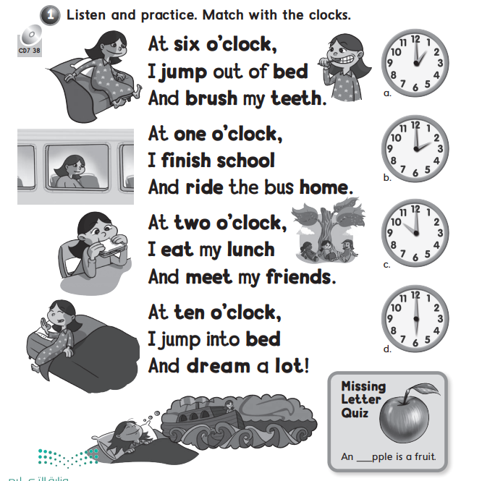

Slide 6
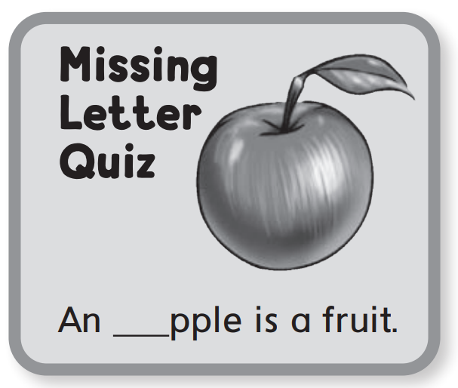
a

Slide 8
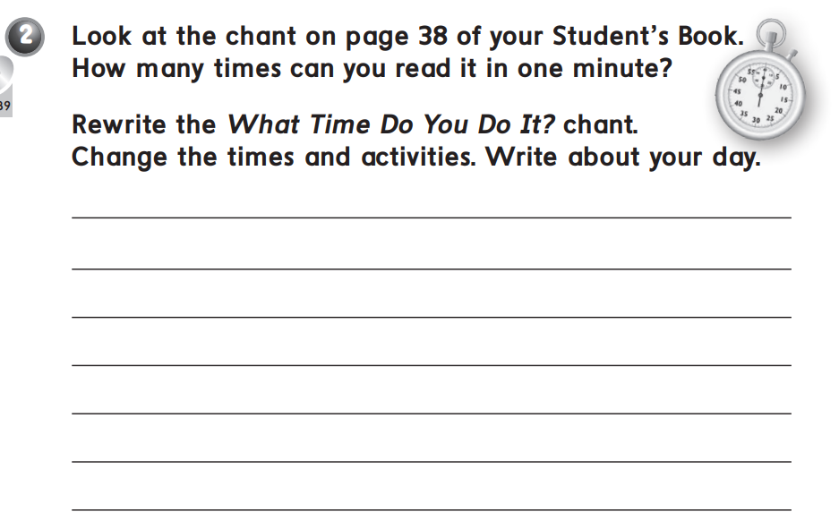
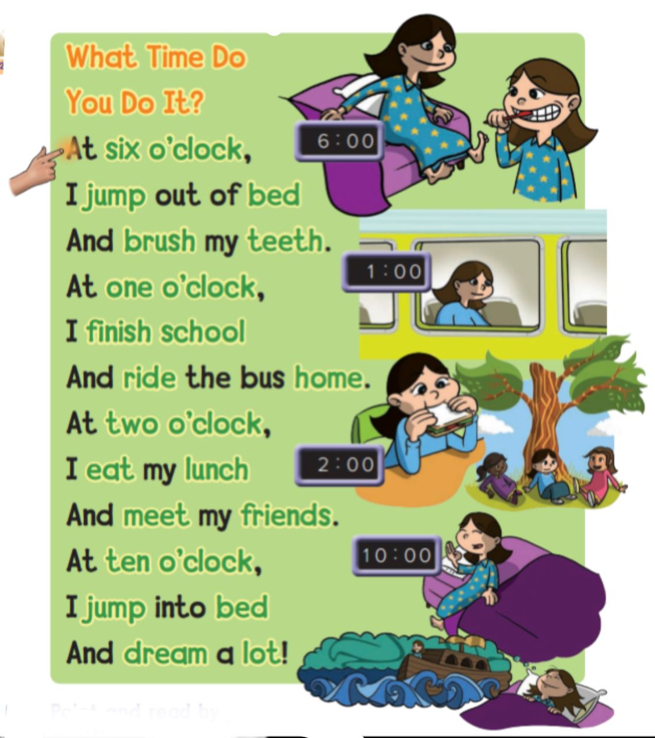

Slide 10
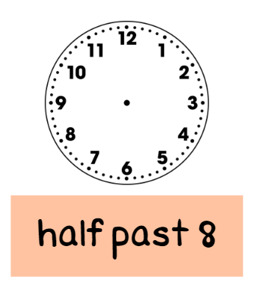

Slide 11
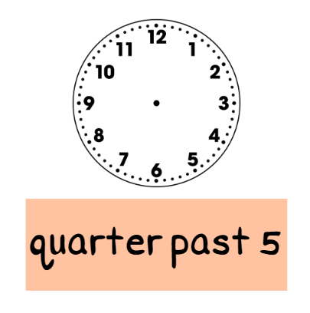

Slide 12
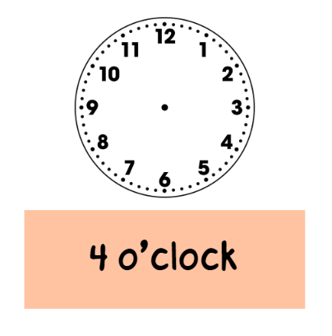

Slide 13
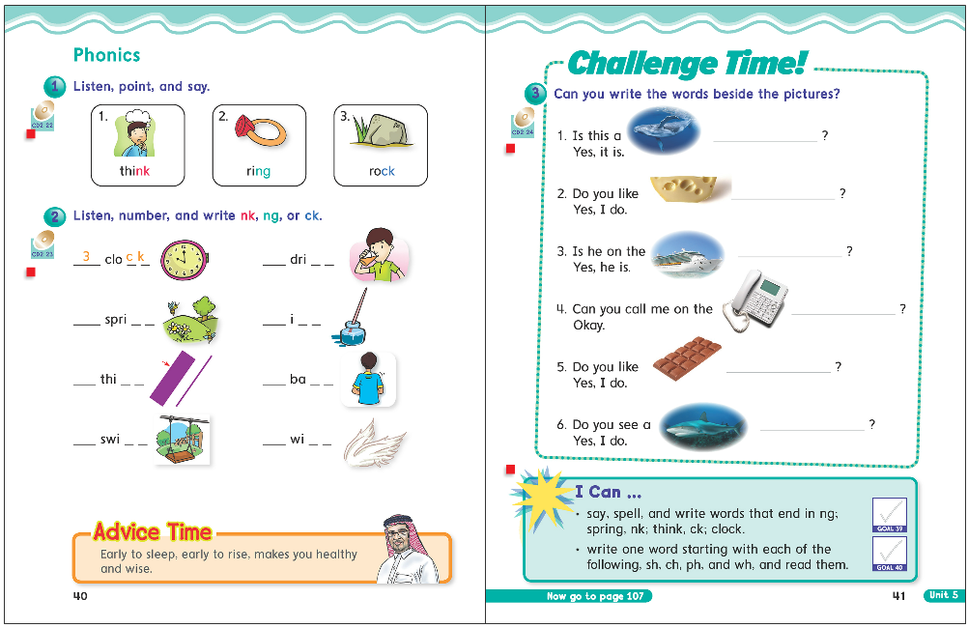
40
41

Slide 15
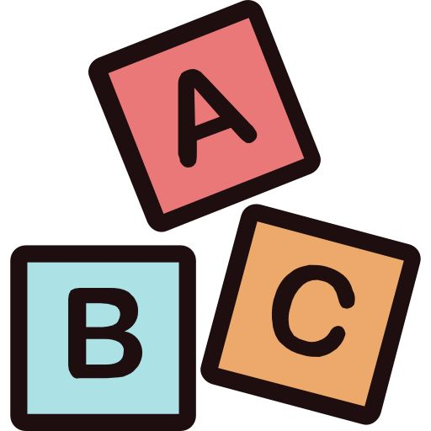
ng
ck
nk

Slide 17
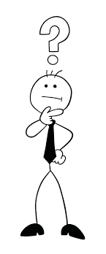
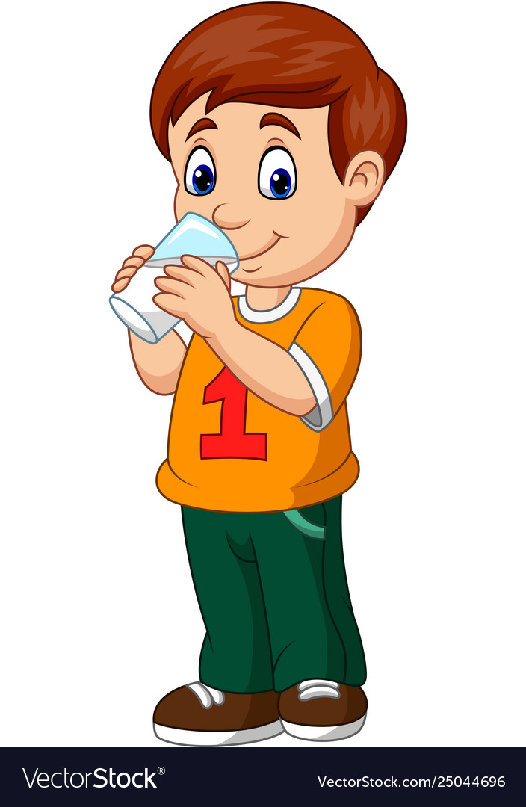
ng
ck
nk
Think
Drink

Slide 19
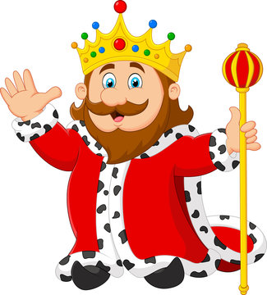
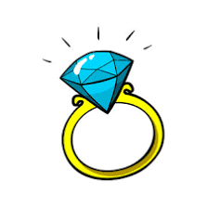
ng
ck
nk
Think
King
Drink
Ring

Slide 21
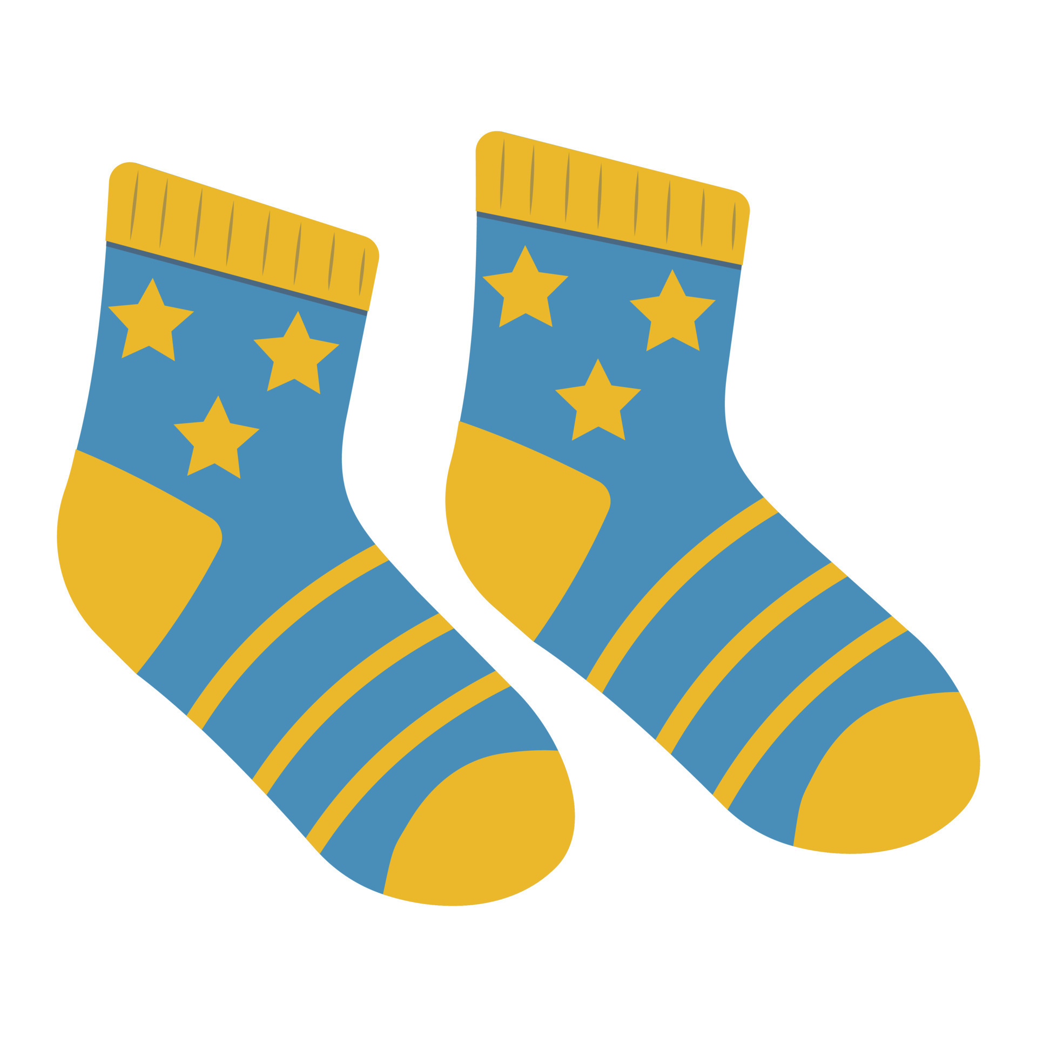
ng
ck
nk
Think
Lock
King
sock
Drink
Ring

Slide 23
1 nk
2 ng
1 nk
3 ck
3 ck
2 ng
2 ng
Page 39

Slide 25
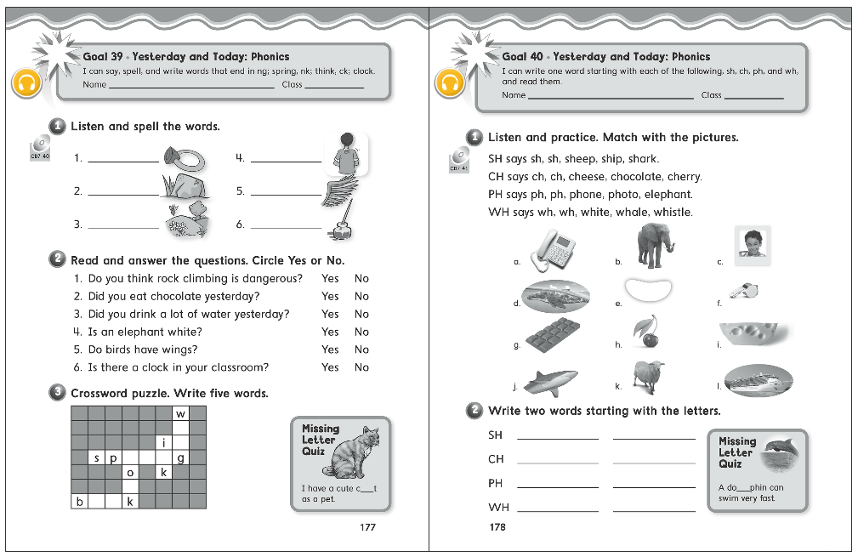

Slide 26
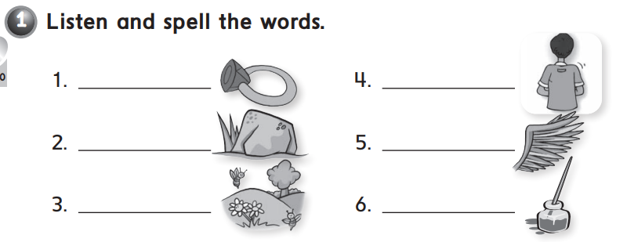
ring
back
rock
wing
spring
ink

Slide 27
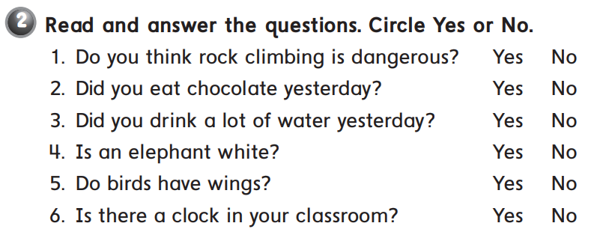

Slide 28
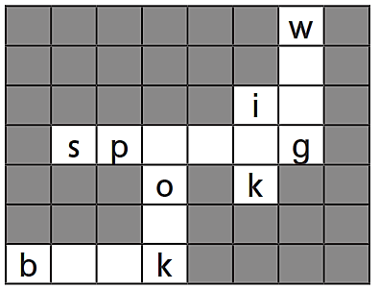
i
n
r i n
c
o o

Slide 29
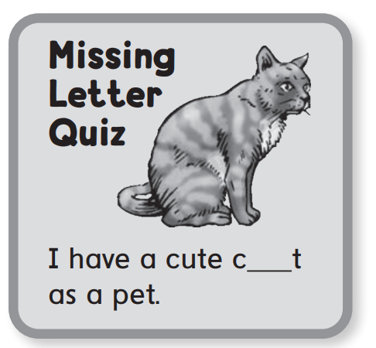
a

Slide 30
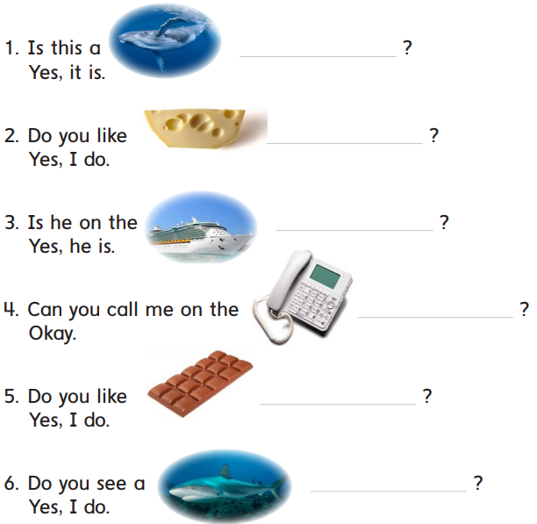

Slide 31
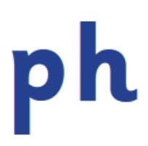
whale
cheese
ship
phone
chocolate
shark

Slide 32
sh
wh
nk
ck
ng
ch
ph
digraphs

Slide 34
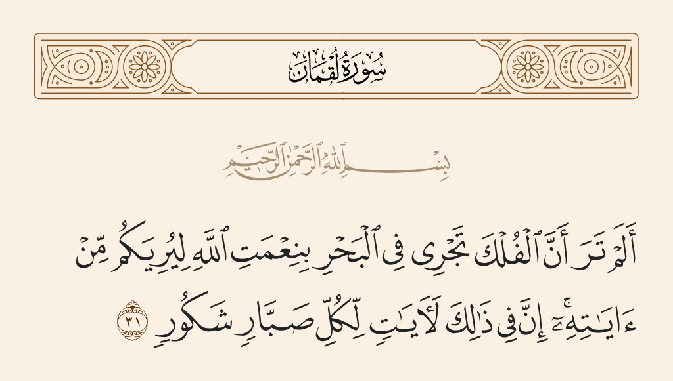

Slide 35
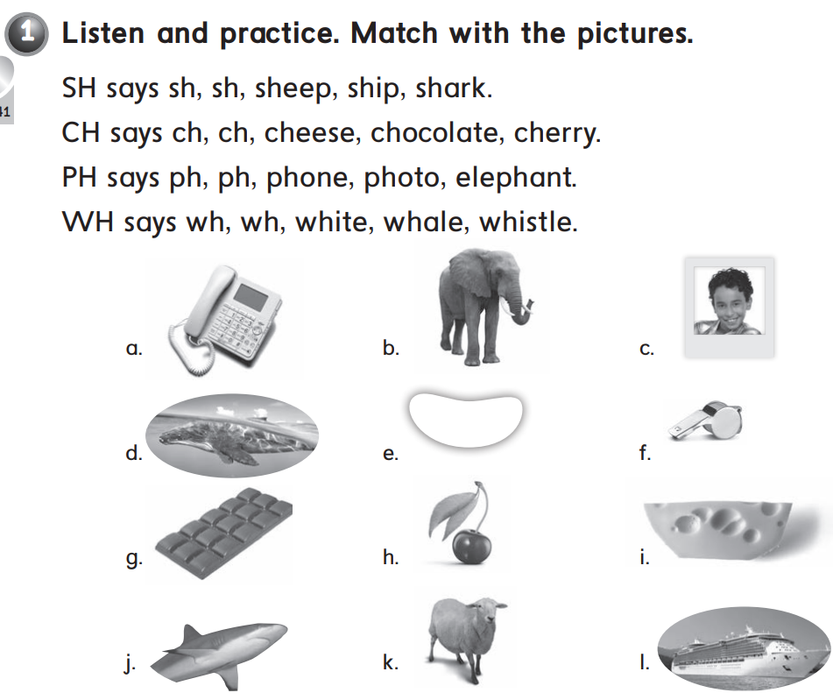
k – l – j
i – g – h
a – c – b
e – d – f

Slide 36
shark
ship
cheese
chocolate
phone
photo
whale
white

Slide 37
l

