Slide 1
Unit6
The Gender Divide
Listen & Discuss
Mega Goal 3.2
Done by : Entisar Al-Obaidallah

Slide 2

Lesson Objectives
Differentiate
Give
Between genders through answering
True - False questions
Personal thoughts about each gender based on character
Answer
Complete
comprehension questions about the studies
The sentences with suitable words

Slide 3
Warm Up!

Slide 4




Do you know the meaning of “ Gender” ?
Gender : it is commonly used for a person's sex ( male or female)
Men & boys
Women & girls
Male
Female

Slide 5

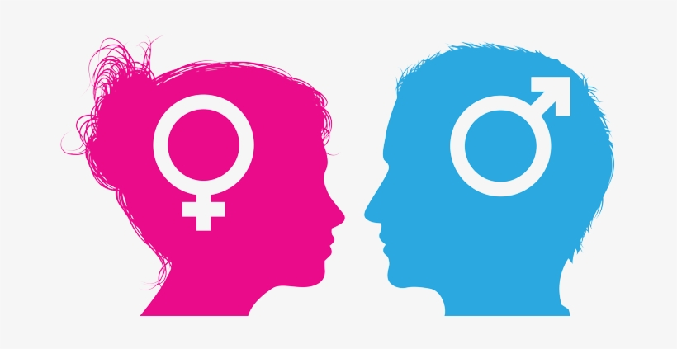
So, What do you think this UNIT will be about??
Differences between men and women

Slide 6


Open your student’s book p. (82)

Slide 7
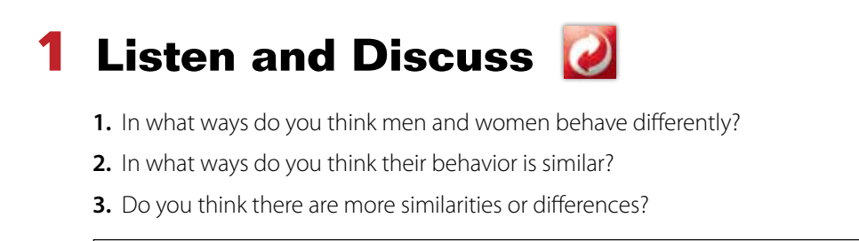
Listen
&
Discuss

Slide 8

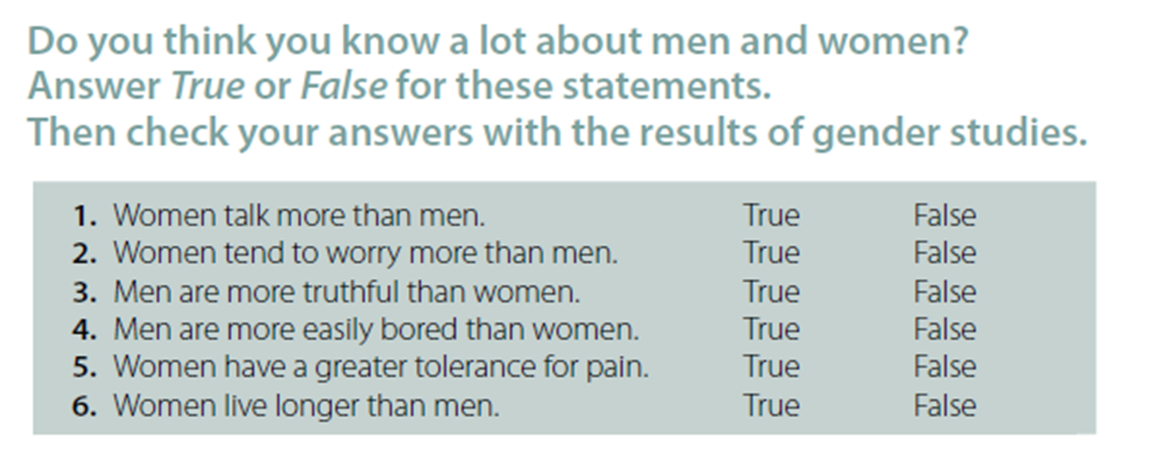

Your answer should reflect your opinion

Slide 9
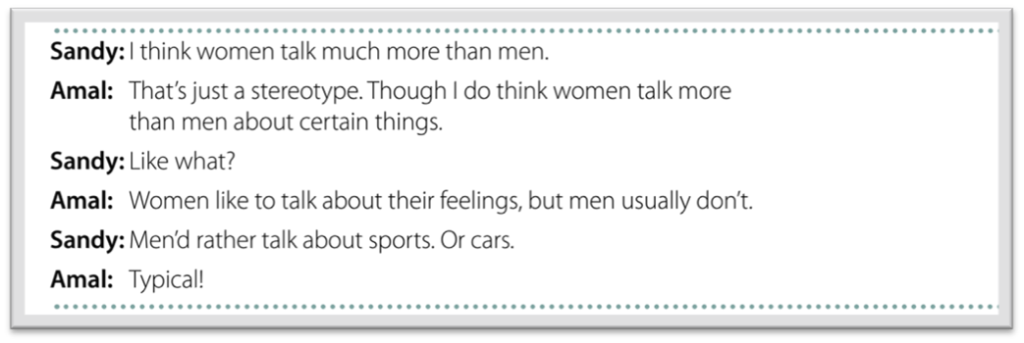
What is the meaning of “ stereotype” ?
a mistaken belief or idea many people have about a thing that is based on how they look on the outside , which may be untrue

Slide 10
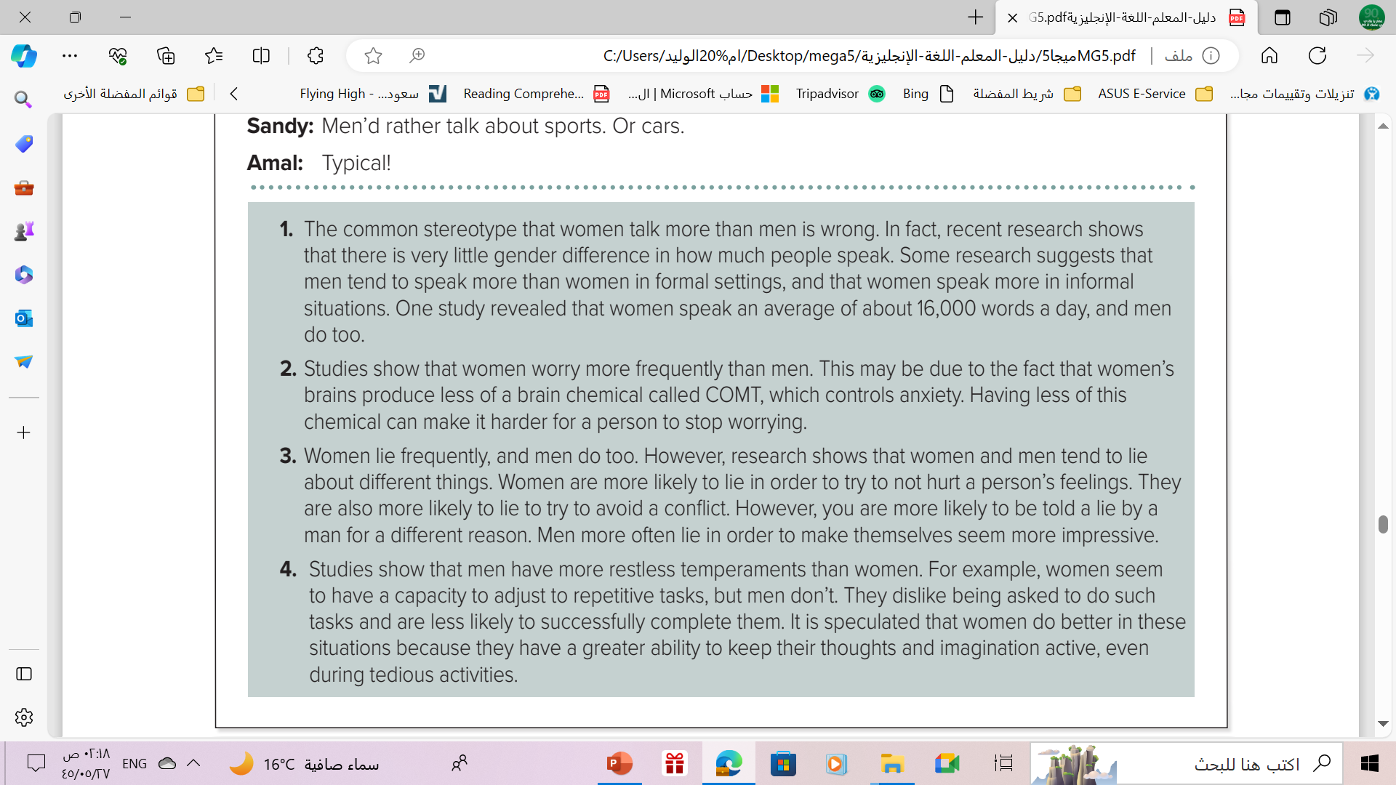
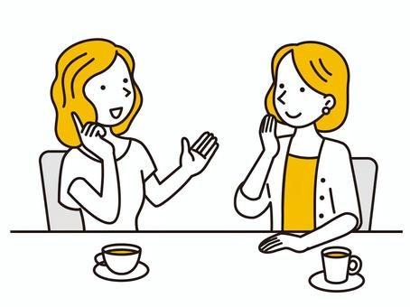

1- In what type of settings do women tend to speak more?
In informal situations.

Slide 11
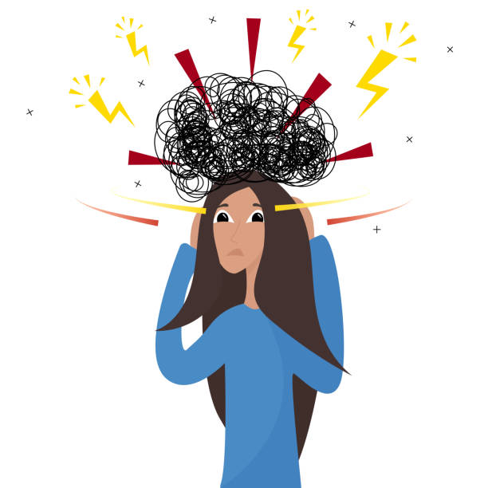
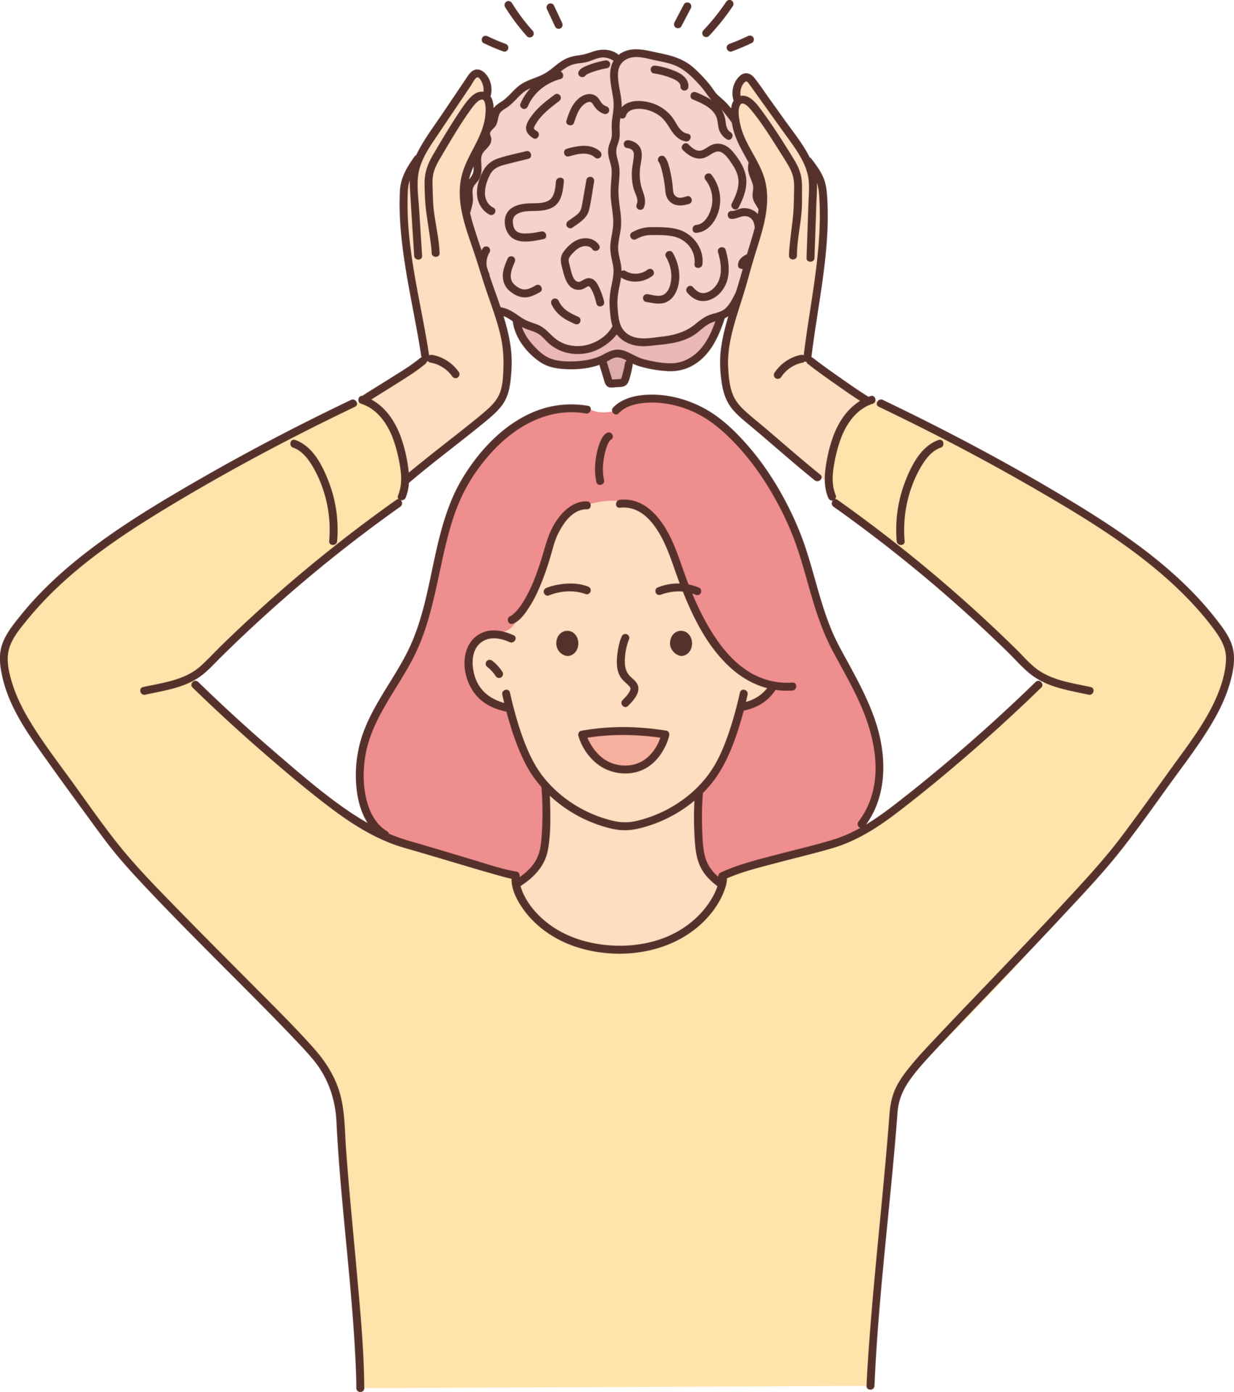
Listen and Answer
What causes women to worry more than men?
due to the fact that women’s brains produce less of a brain chemical called COMT, which controls anxiety.

Slide 12
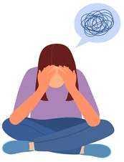

What things do women tend to lie about?
What things do men tend to lie about
Women tend to lie to avoid hurting another’s feelings.
Men tend to lie to make themselves look more impressive.

Slide 13

What might explain women’s ability to deal with repetitive tasks better than men?
It is possible that women are better at
keeping their thoughts and imaginations active.

Slide 14
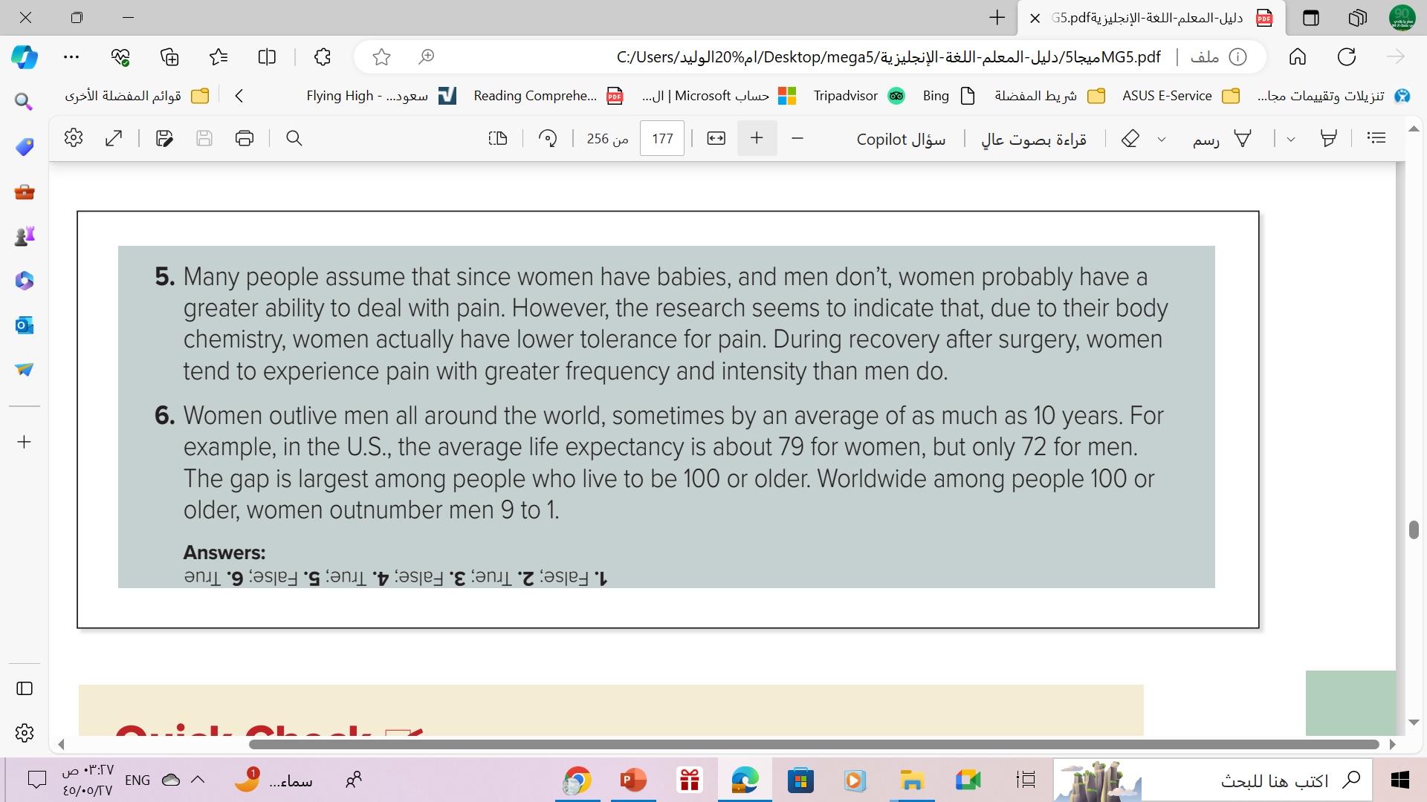
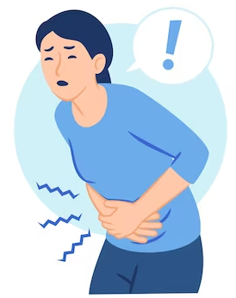
Show displeasure
Why do women have lower tolerance for pain??
due to their body chemistry

Slide 15
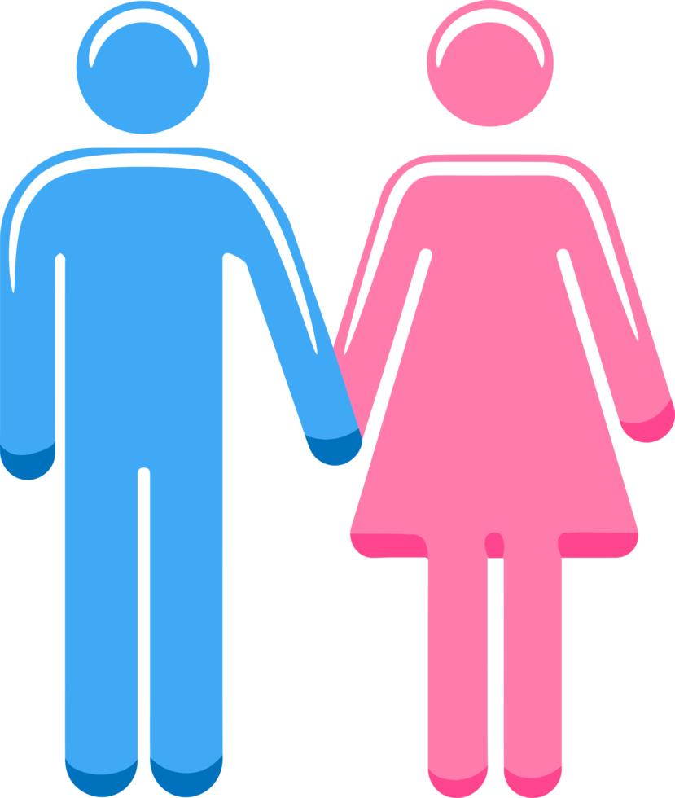
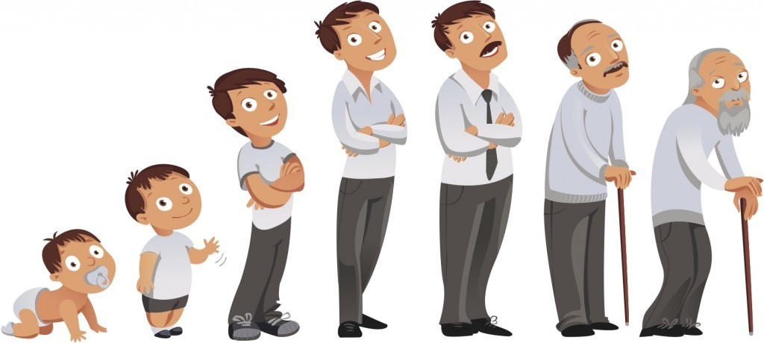
Which gender has the longer life expectancy?
Women outlive men all around the world, sometimes by an average of as much as 10 years.

Slide 16
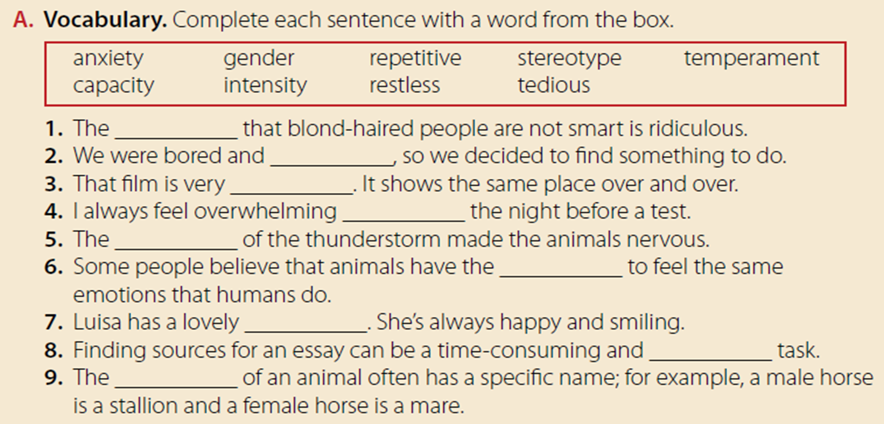
Quick Check
stereotype
restless
repetitive
anxiety
intensity
capacity
temperament
tedious
gender

Slide 17
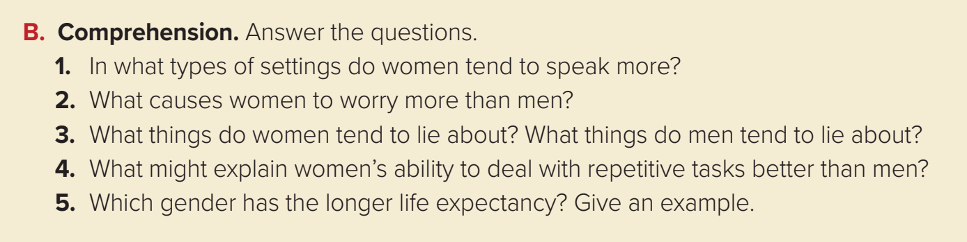
Quick
Check

Slide 18
Comprehension
1. Women tend to speak more in informal settings.
2. Women’s brains produce less of a chemical that controls
anxiety than men’s brains do.
3. Women tend to lie to avoid hurting another’s feelings.
Men tend to lie to make themselves look more impressive.
4. It is possible that women are better at keeping their
thoughts and imaginations active.
5. Women have a longer life expectancy than men. In the U.S. ,
the life expectancy for women is 79, but for men it is 72.

Slide 19
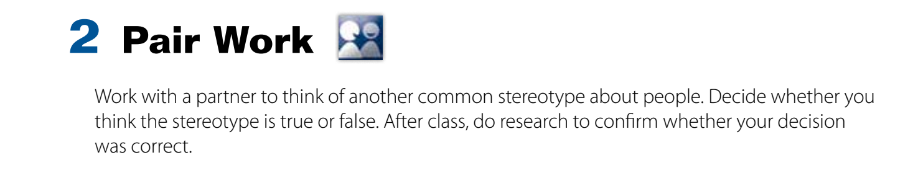
Pair Work

Slide 20

From The Holy Qura’an

Slide 21
Homework
Workbook p. (279) ,
exercise (A-B)

Slide 22

Thanks

