Slide 1
Unit 6
The Gender Divide
Conversation+ Listening
Mega Goal 3.2
Done by: Entisar Al-Obaidallah

Slide 2
Lesson Objectives
01.
02.
03.
04.
05.
06.
Read
Answer
Practice
The conversation for specific information
Some comprehension questions about the conversation
Using “ Real Talk” in correct sentence
Listen
Practice
Match
for specific information in a discussion about young/ new and experienced drivers
Rising and falling intonaion on tag question
The words with the correct meaning

Slide 3
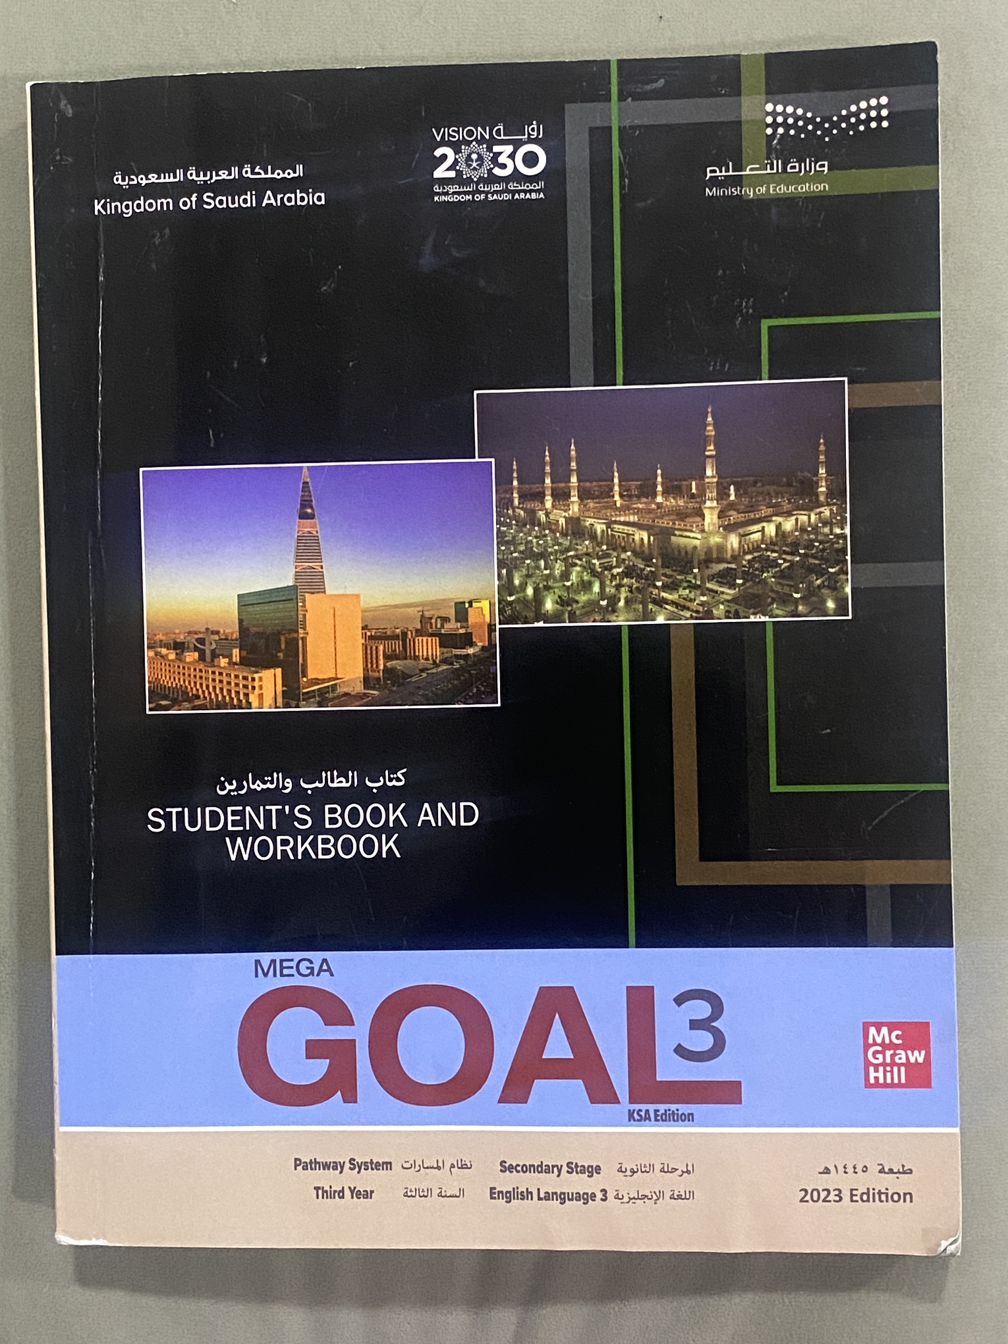
Open
Your student’s book ,
p. (86)

Slide 4
01
Conversation

Slide 5
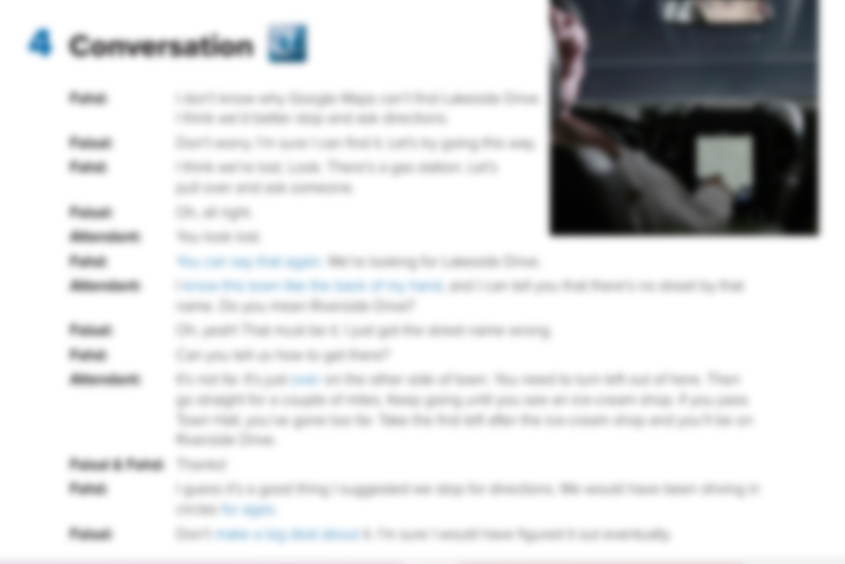


Listen & Read along

Slide 6

Before Reading
What do you see?
a driver using a GPS for finding directions
What do you think this conversation about?
It is about Google Maps
How many people are there ?
Three

Slide 7


When Fahd says, “You can say that again”, how does he feel?
He is a bit annoyed
When Faisal says, “Don’t make a big deal about it”, how does he feel?
He is annoyed and doesn’t want
to talk about it anymore

Slide 8
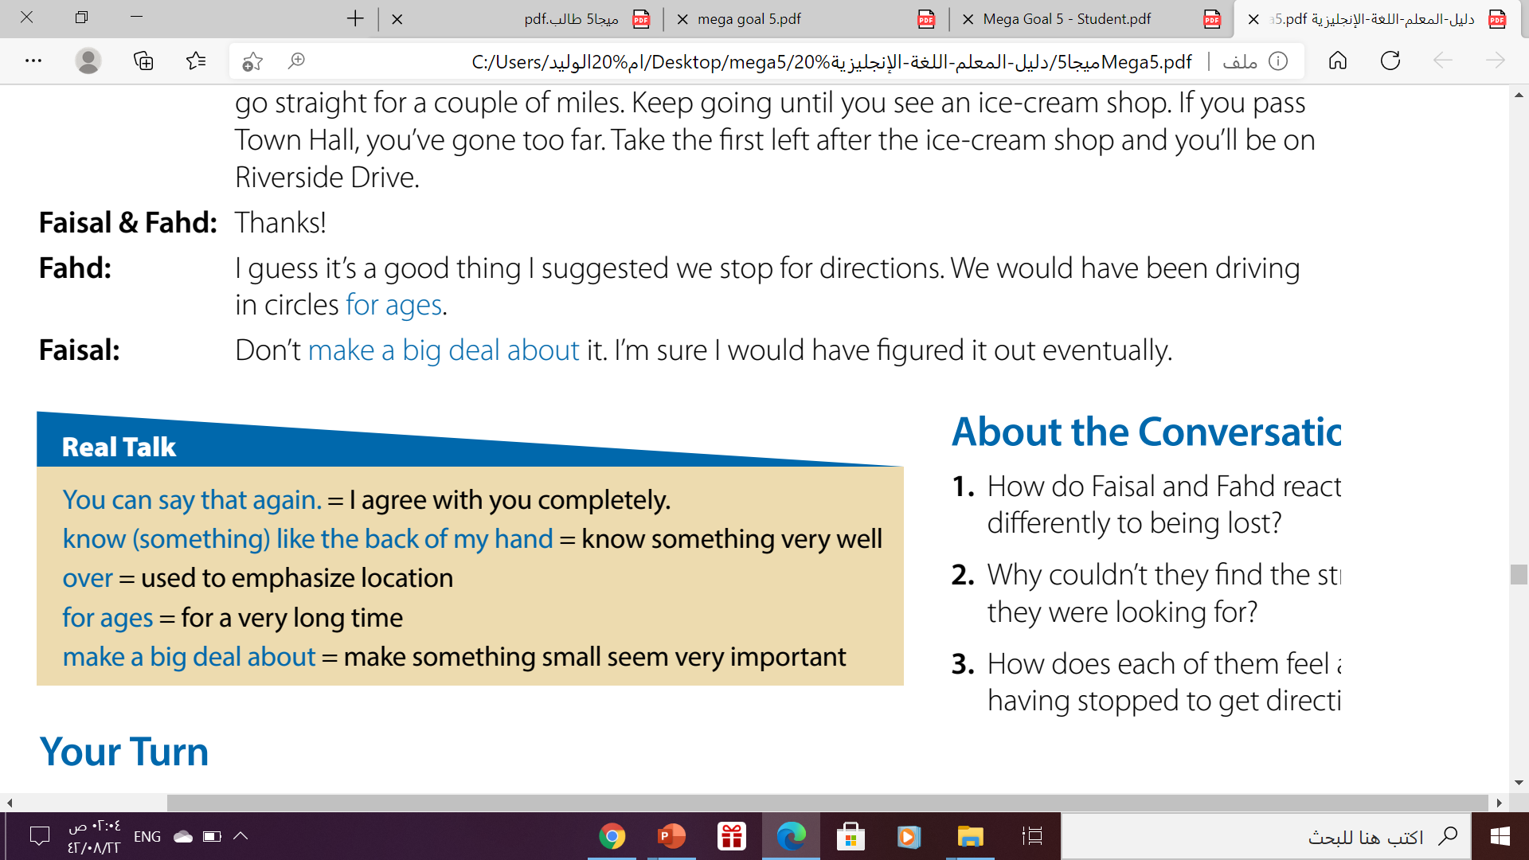
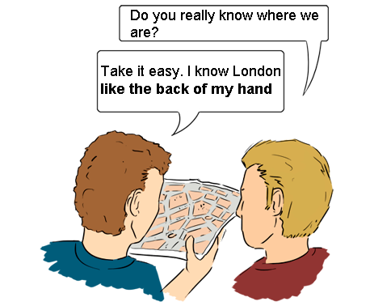


Read the words and their meaning:

Slide 9

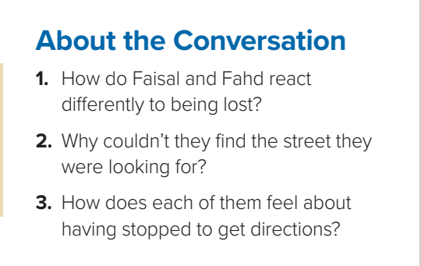
1. Fahd wants to stop and ask for directions, but Faisal doesn’t.
2. They were looking for the wrong street name.
3. Fahd is glad that they stopped, but Faisal isn’t.

Slide 10
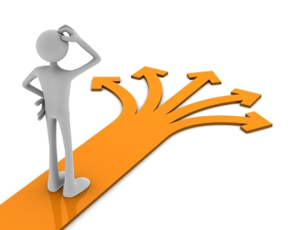
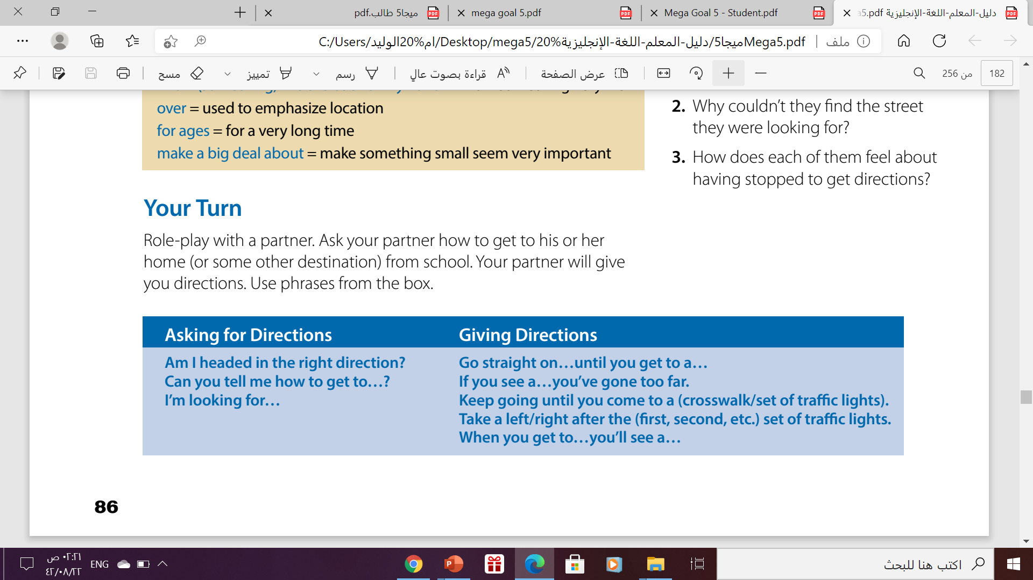
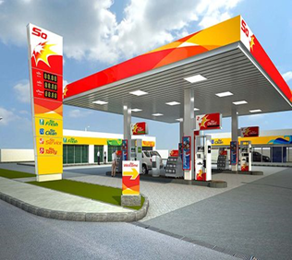
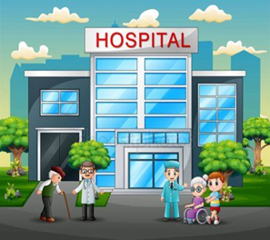
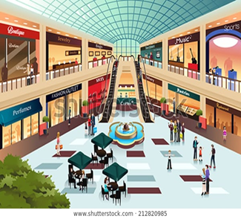

Your Turn

Slide 11
Open
Your student’s
book ,p. (87)

Slide 12
02
Listening

Slide 13
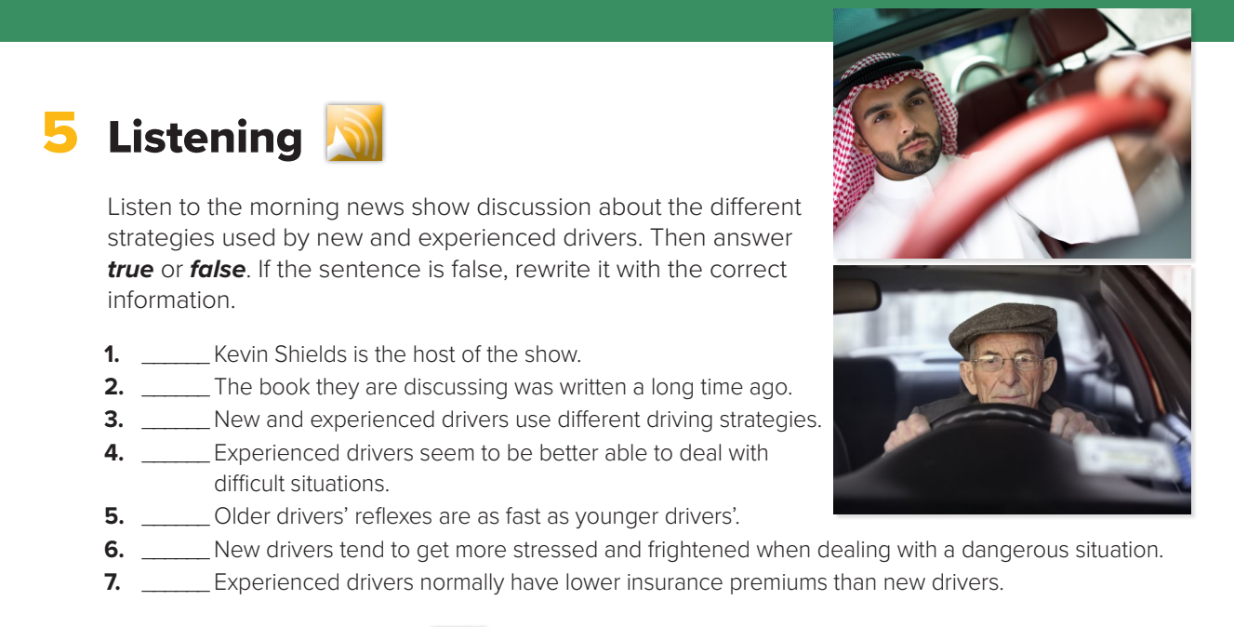
False
False
True
True
False
True
True

Slide 14
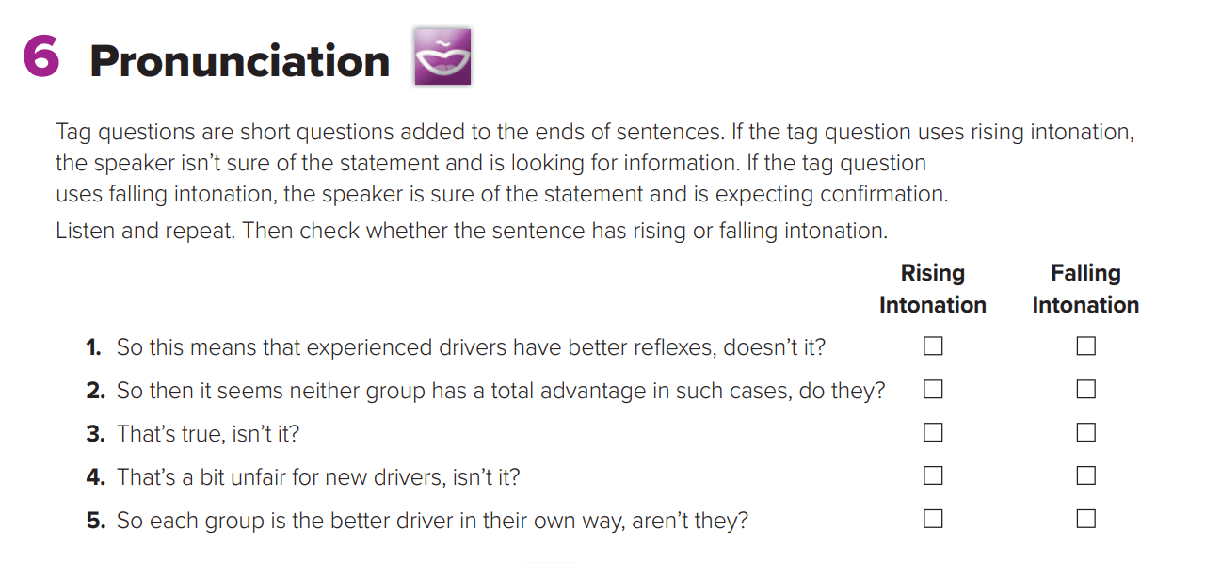


Slide 15
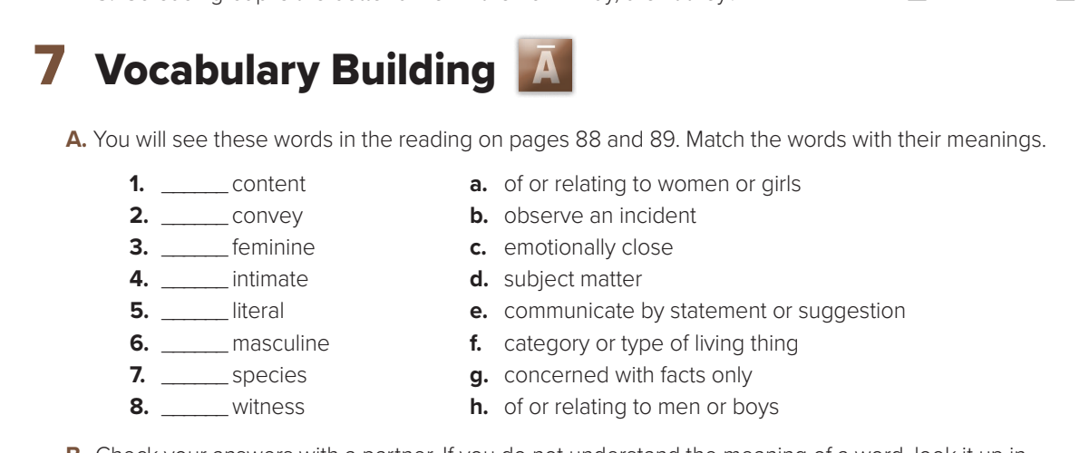
d
e
a
c
g
h
f
b

Slide 16
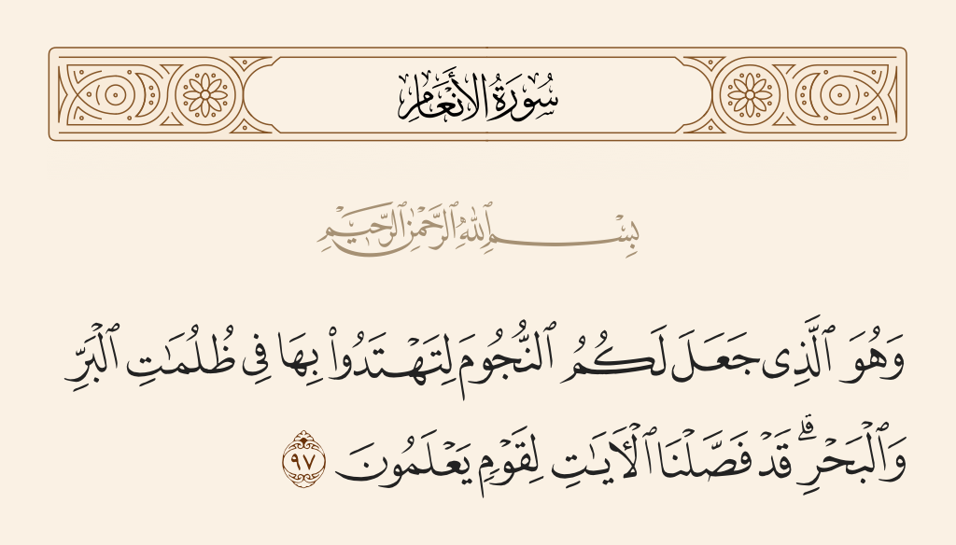
From The Holy Qura’an

Slide 17
Homework
Workbook p.(282) ,
exercise ( G )

Slide 18

Thanks !

