Slide 1
Unit 6
The Gender Divide
Reading
Done by: Entisar Al-Obaidallah

Slide 2
I
II
Differentiate
Deduce
Lesson Objectives
III
IV
Read
Answer
Between men and women in the way of communication
The meaning of the new words correctly
The text for specific information
Some comprehension questions about the passage

Slide 3


Open
Your student’s book , p.( 88 )

Slide 4
I
Before Reading

Slide 5

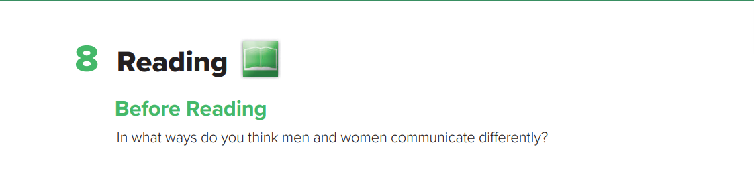
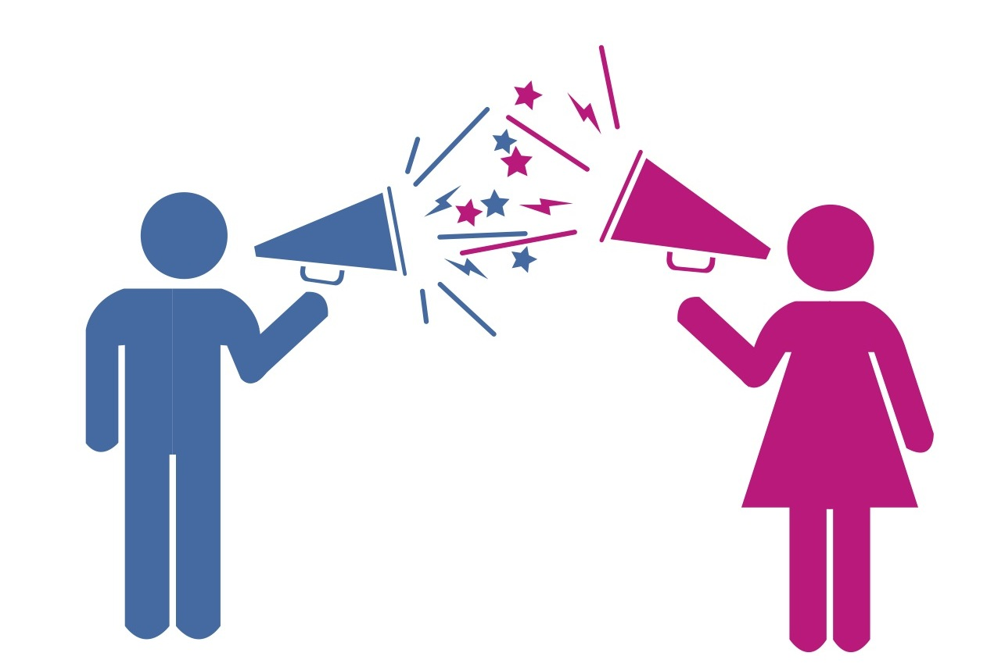

Warm up

Slide 6
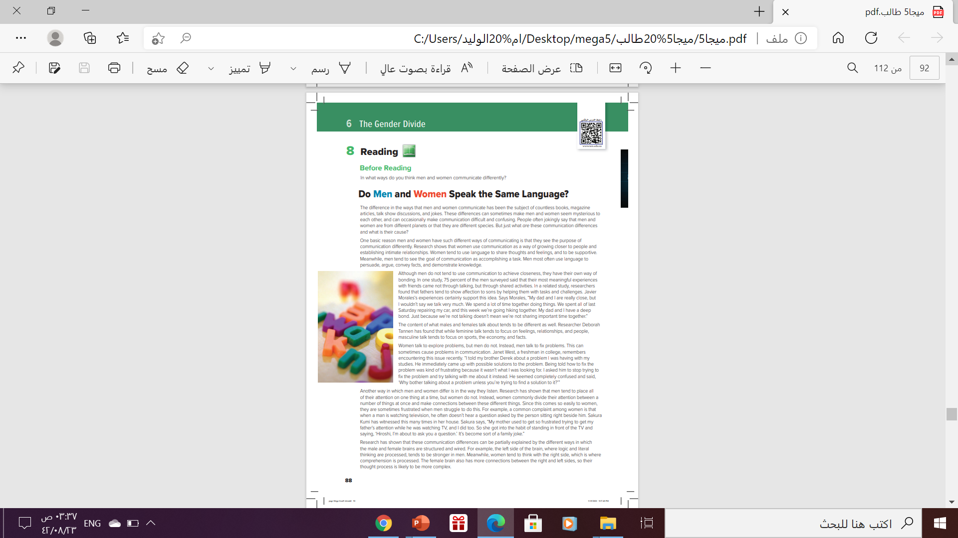
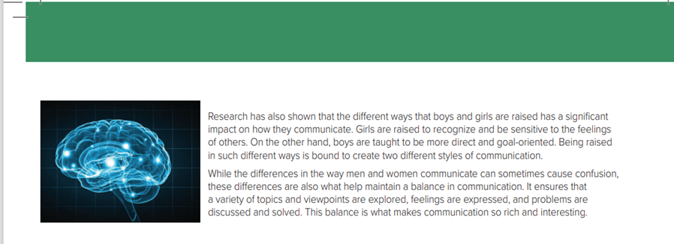
Scanning
8
1
9
2
3
What is the title of the passage?
4
5
How many paragraphs are there ?
6
How many pictures are there ?
7
Two

Slide 7




Listen & Follow along

Slide 8

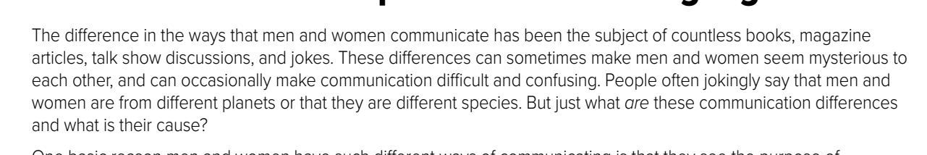


Paragraph
1
How is the content of men’s and women’s conversations different?
They talk about different things

Slide 9
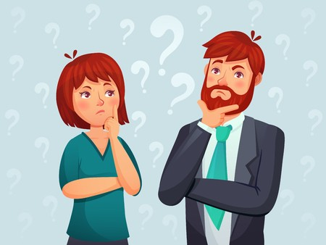
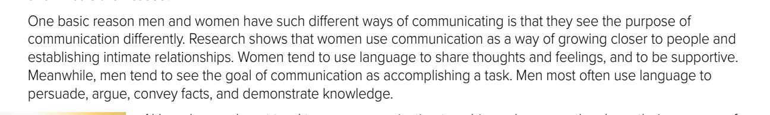
Women see communication as a way of establishing intimacy.
Men use communication to accomplish a task.
What do women see as the purpose of communication? What about men?
Paragraph
2
What do men use language to convey
Facts

Slide 10
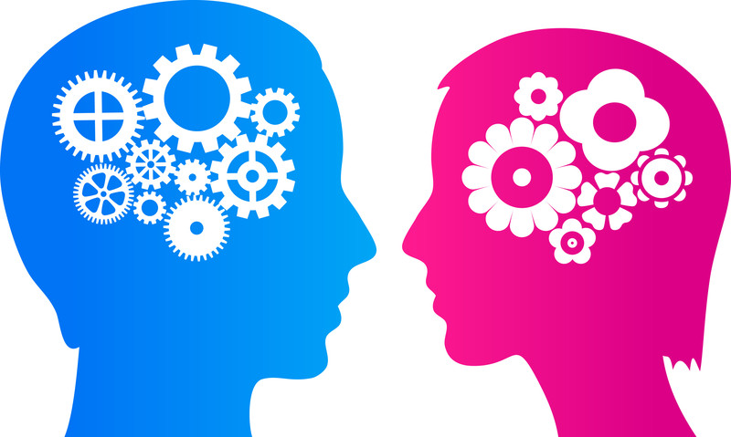
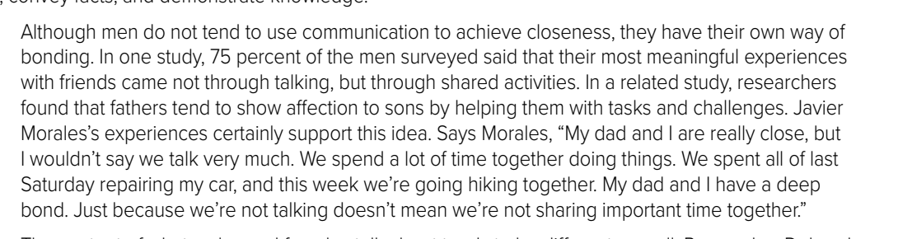
Paragraph
3
How are men most likely to bond with others?
Men often bond through shared activities.

Slide 11
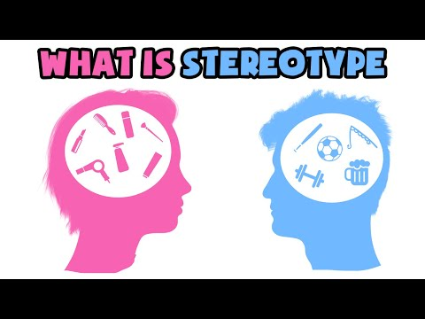
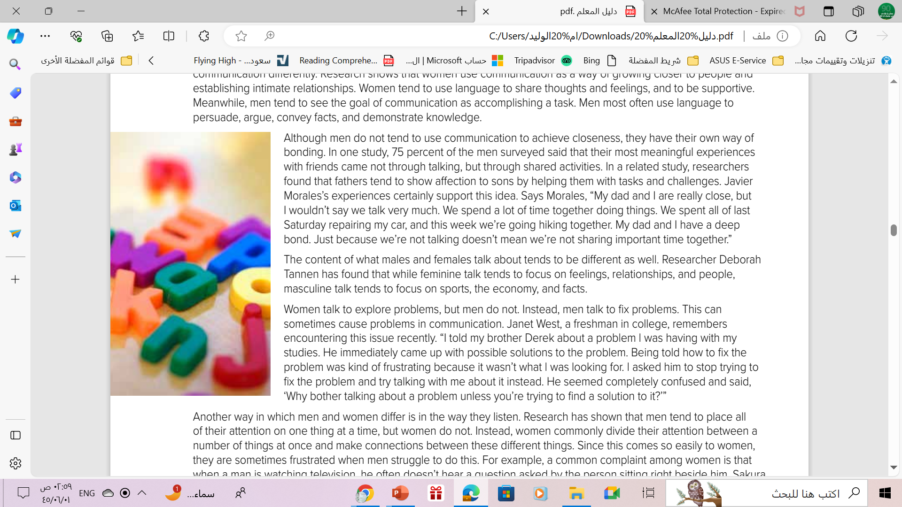
Paragraph
4
How does the content of men and women’s talk tend to differ ?
Men often talk about sports, the economy, and facts.
Women often talk about feelings, relationships, and people.

Slide 12
Paragraph
5
How do men and women approach problems differently?
Women talk to explore problems, but men talk to solve problems.

Slide 13
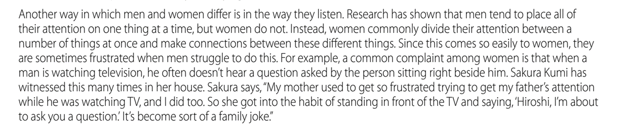
Paragraph
6
What has Sakura Kumi witnessed?
She has witnessed her father not hearing a question asked him because he is watching TV

Slide 14
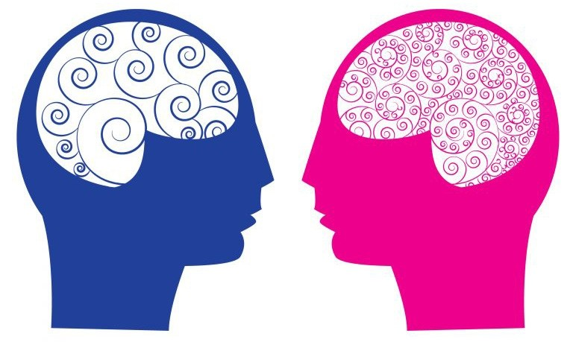
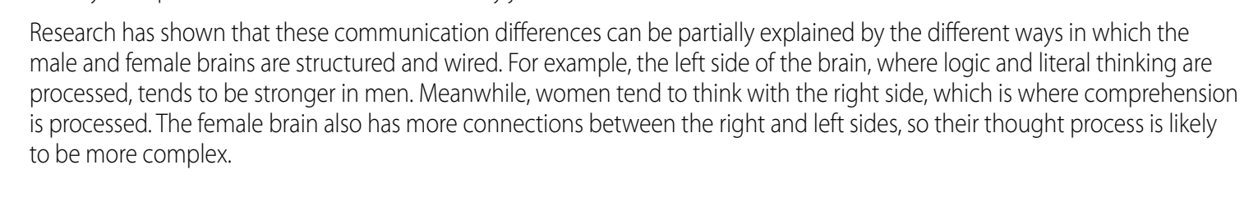
Paragraph
7
What causes men and women to communicate differently?
Male and female brains are wired differently, and men and women are raised to behave differently.

Slide 15
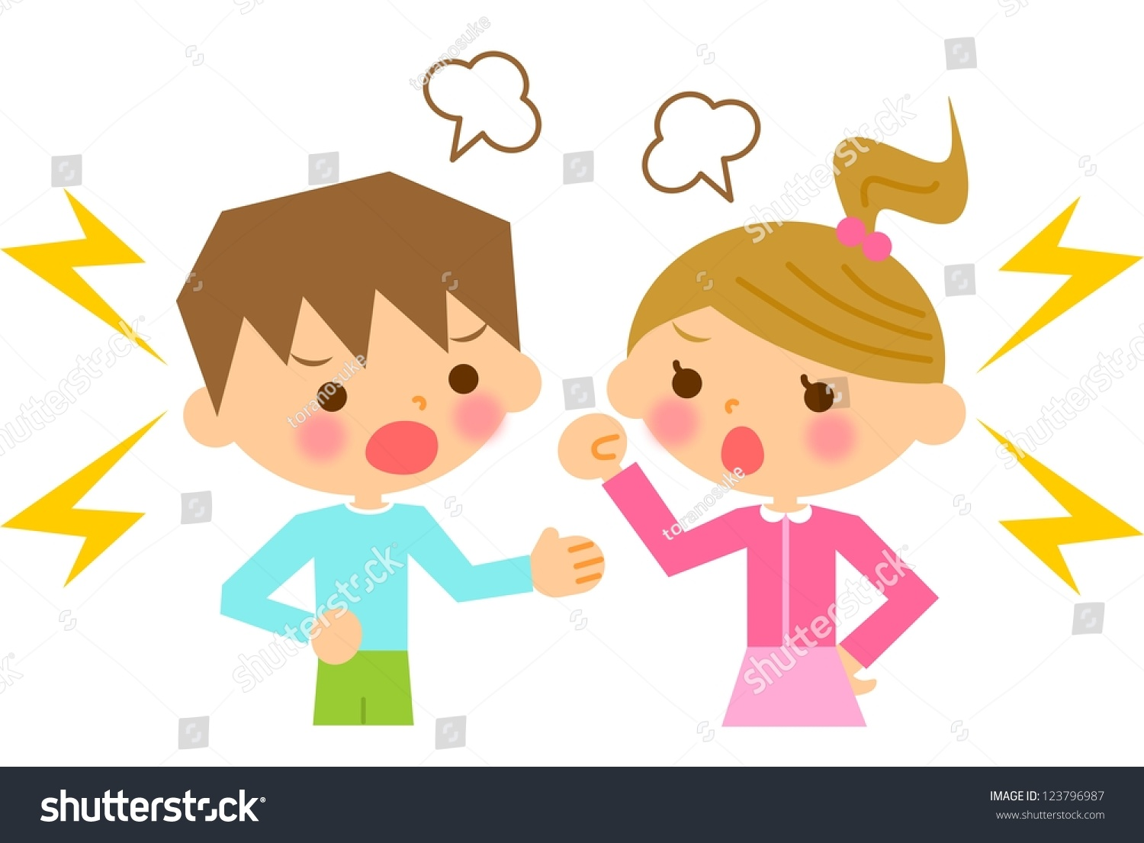
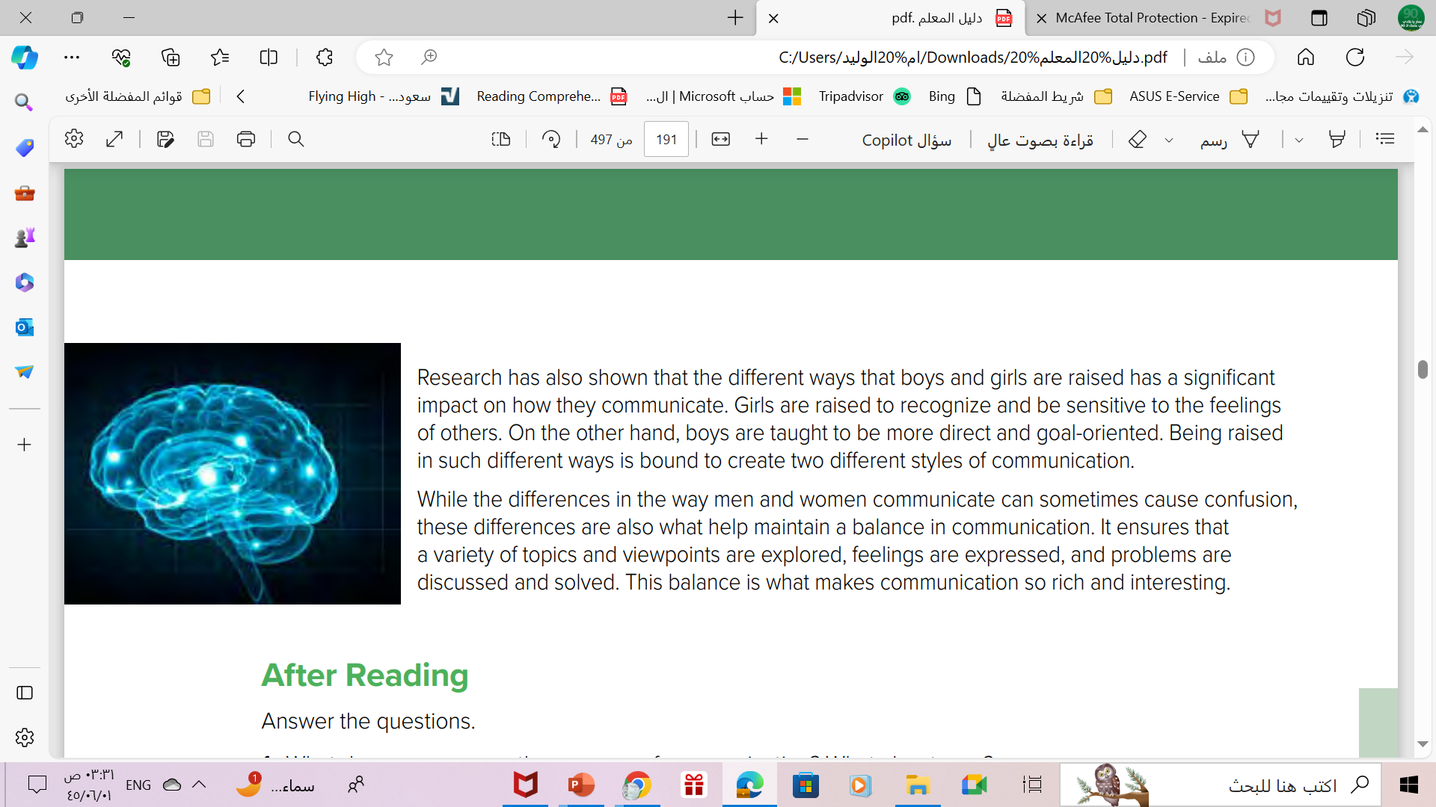
Paragraph
8
How are girls raised?
Girls are raised to recognize and be sensitive to the feelings of others.

Slide 16
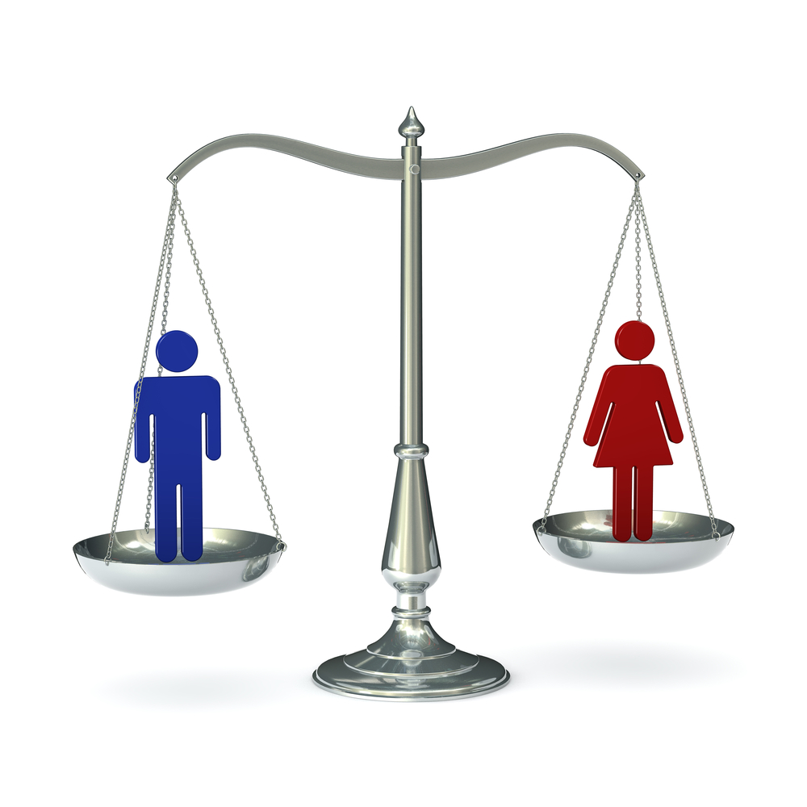
Paragraph
9
What is the benefit of a balance in communication between men and women?
This balance is what makes communication so rich and interesting

Slide 17
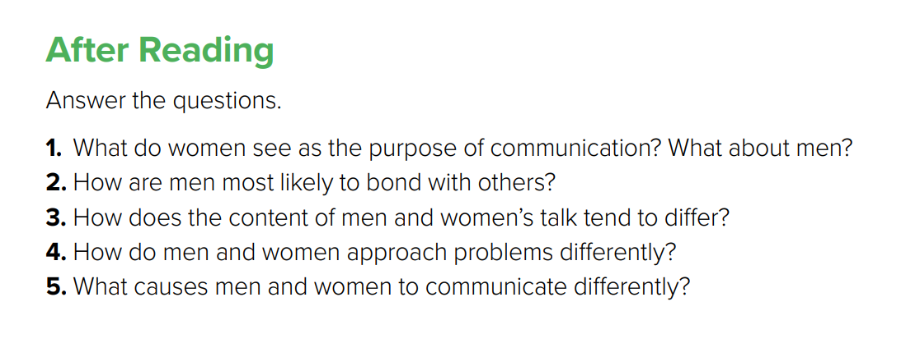
1. Women see communication as a way of establishing intimacy.
Men use communication to accomplish a task.
2. Men often bond through shared activities.
3. Men often talk about sports, the economy, and facts.
Women often talk about feelings, relationships, and people.
4. Women talk to explore problems, but men talk to solve problems.
5. Male and female brains are wired differently, and men and women are
raised to behave differently

Slide 18
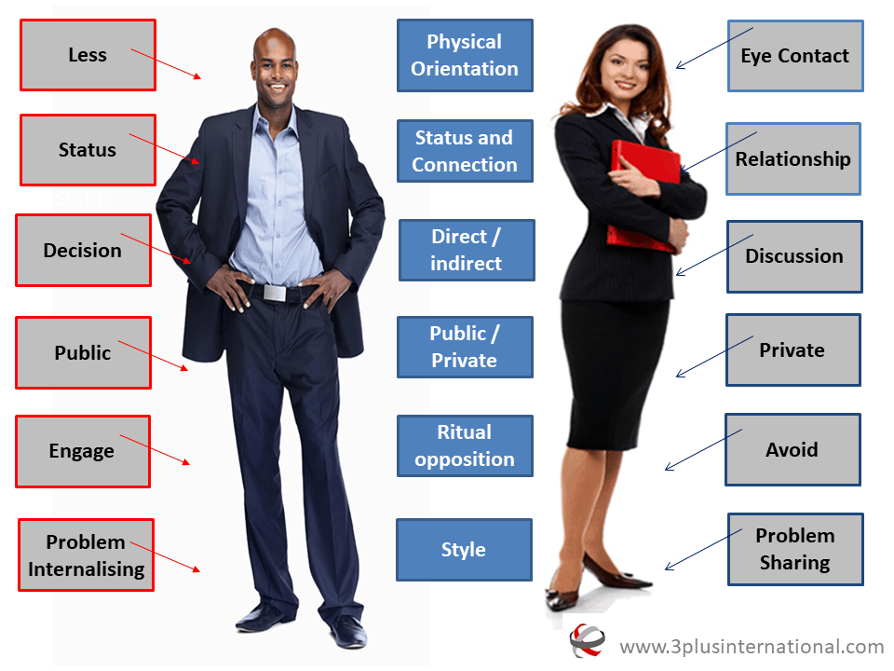

Slide 19
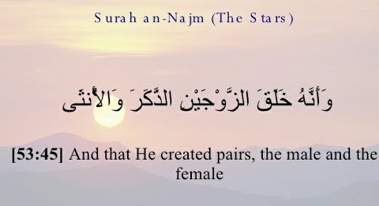
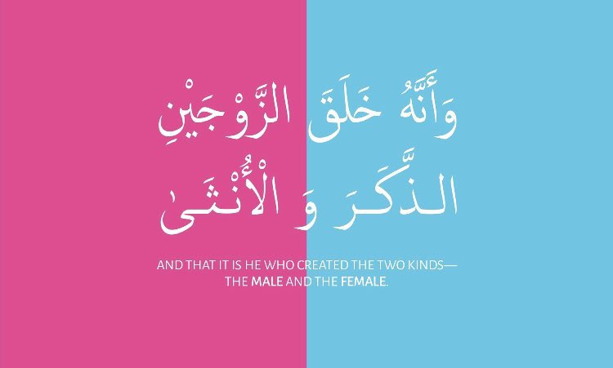
From The Holy Qura’an

Slide 20
Homework
------------------------------------------------------------------------------------------------------------------------------
Workbook P. (283) , exercise ( i )

Slide 21

Thanks!

