Slide 1
We can 1
hello

Slide 2


Slide 3




Slide 4
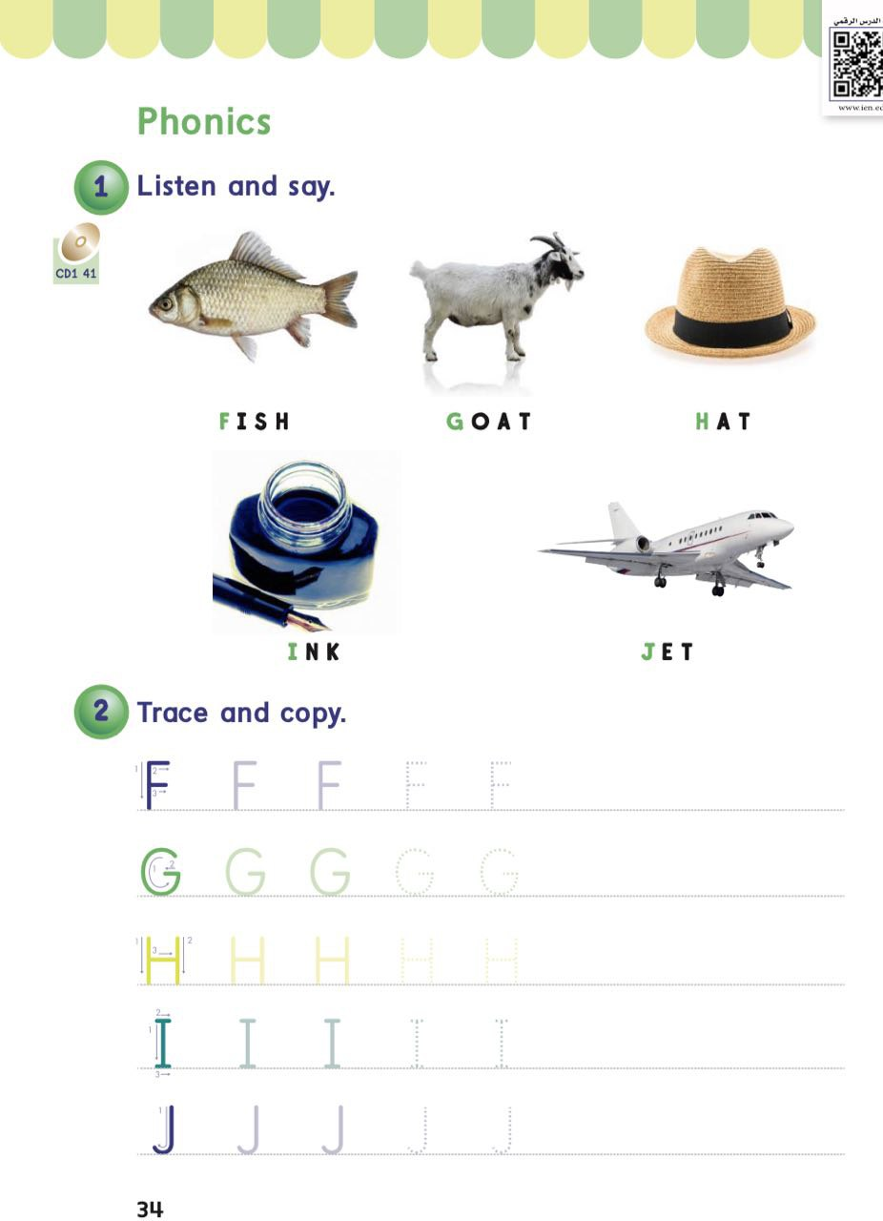
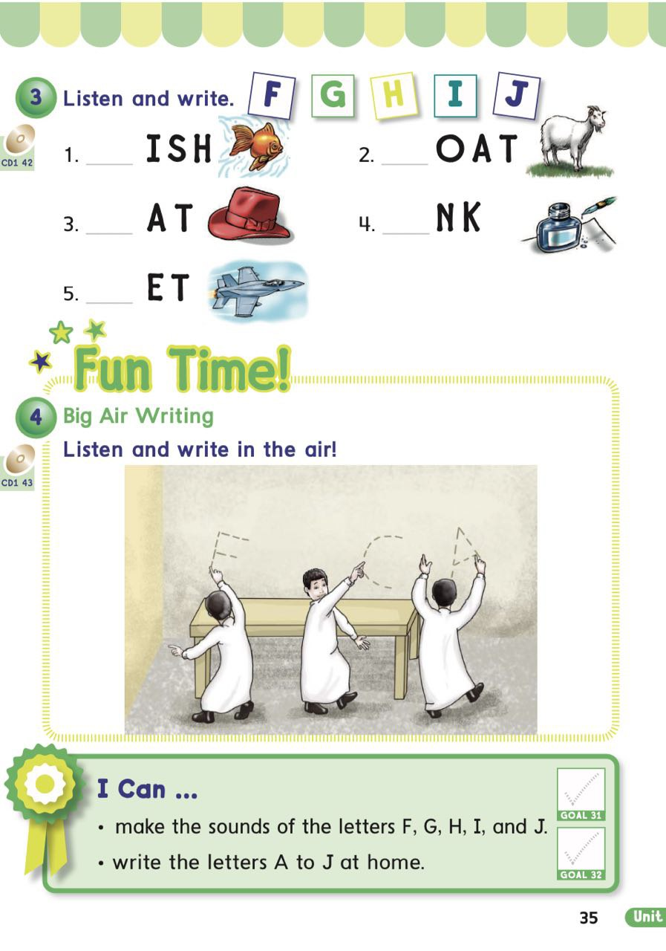

Slide 5

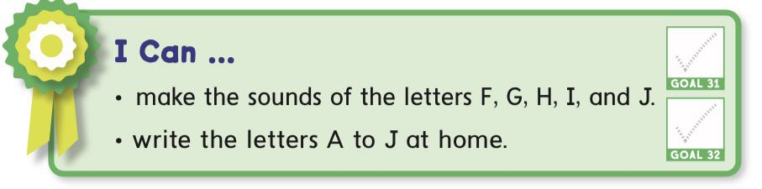

Slide 6

shapes

Slide 7
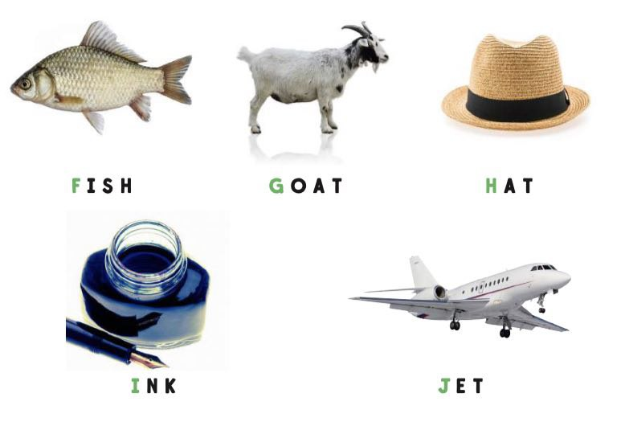

Slide 8


Slide 9




Slide 10


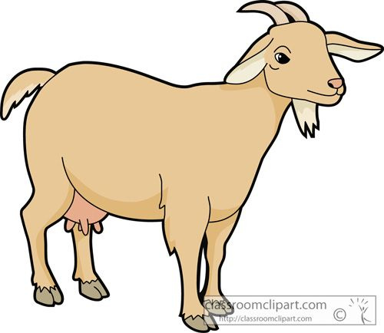

Slide 11




Slide 12




Slide 13




Slide 14


Slide 15
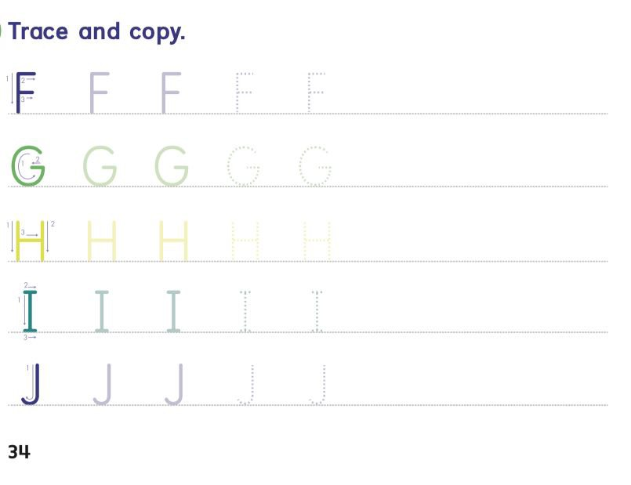

Slide 16
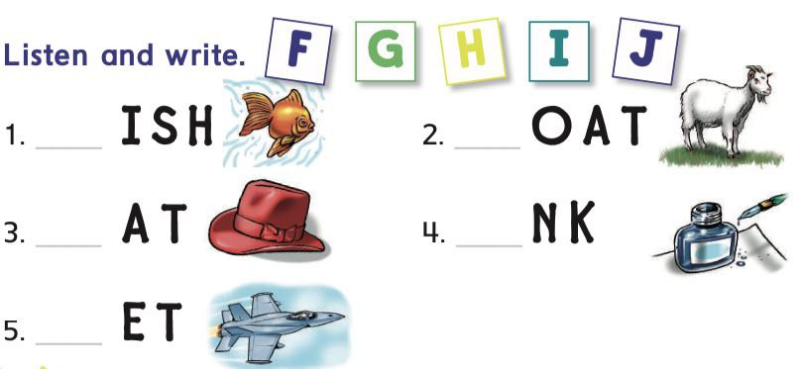

Slide 17


Slide 18





Press at one shape

Slide 19

What’s the first letter of the word

Slide 20
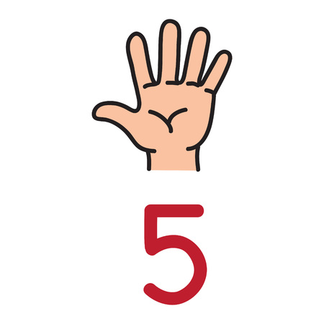

What’s the first letter of the word

Slide 21

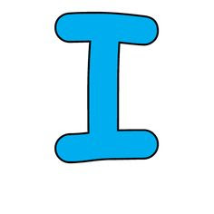
What’s the first letter of the word

Slide 22

What’s the first letter of the word

Slide 23

What’s the first letter of the word

Slide 24



Slide 25



Slide 26


Slide 27


Slide 28
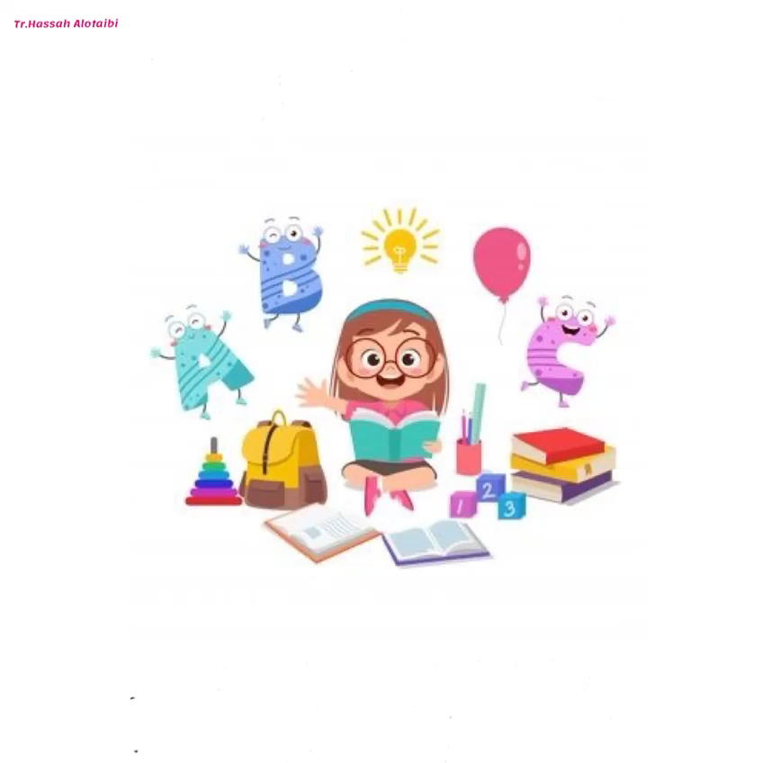

Slide 29


Slide 30


Slide 31

Open your book pages 93&94

Slide 32
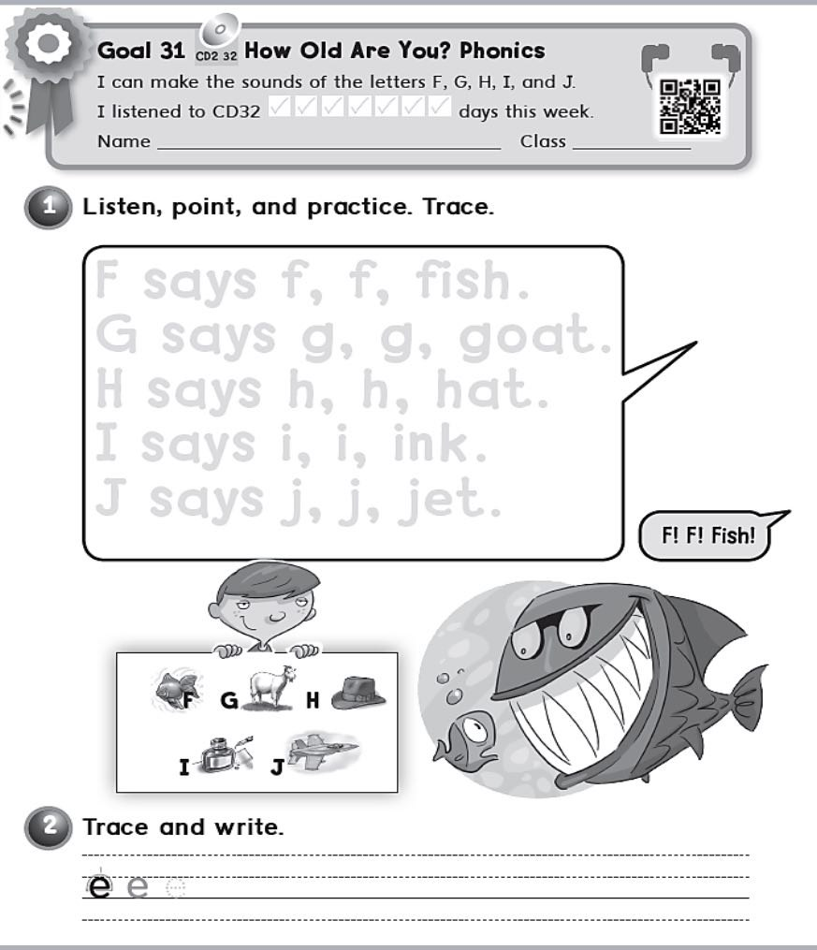

Slide 33
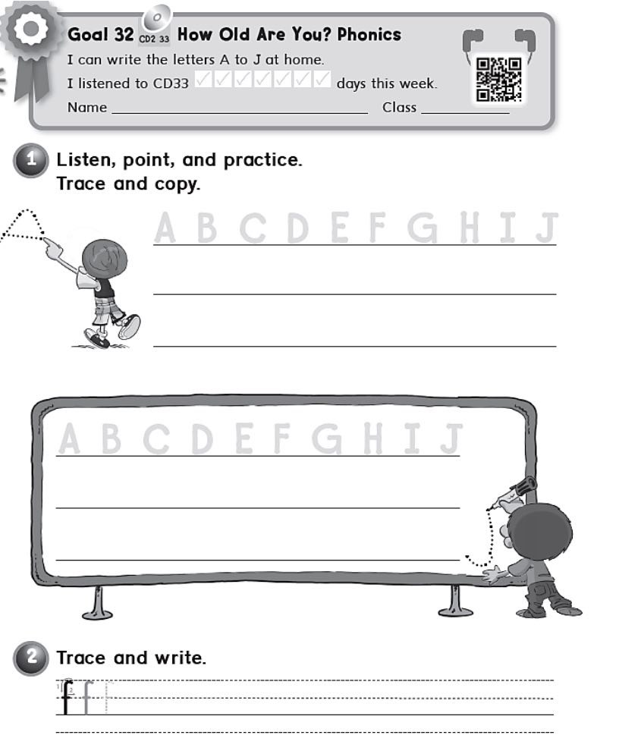

Slide 34

Home work at

