Slide 1

U 7 READING
TR. NORA KHALID

Slide 2
Goals:
- To read “so you want to be cool” using pronoun reference.
To answer questions about the passage.
To mention some ideas to be cool.

Slide 3
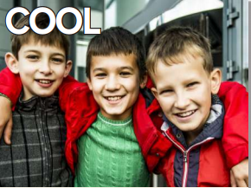
How old are the people
in the picture?
What do teens often want to be?

Slide 4
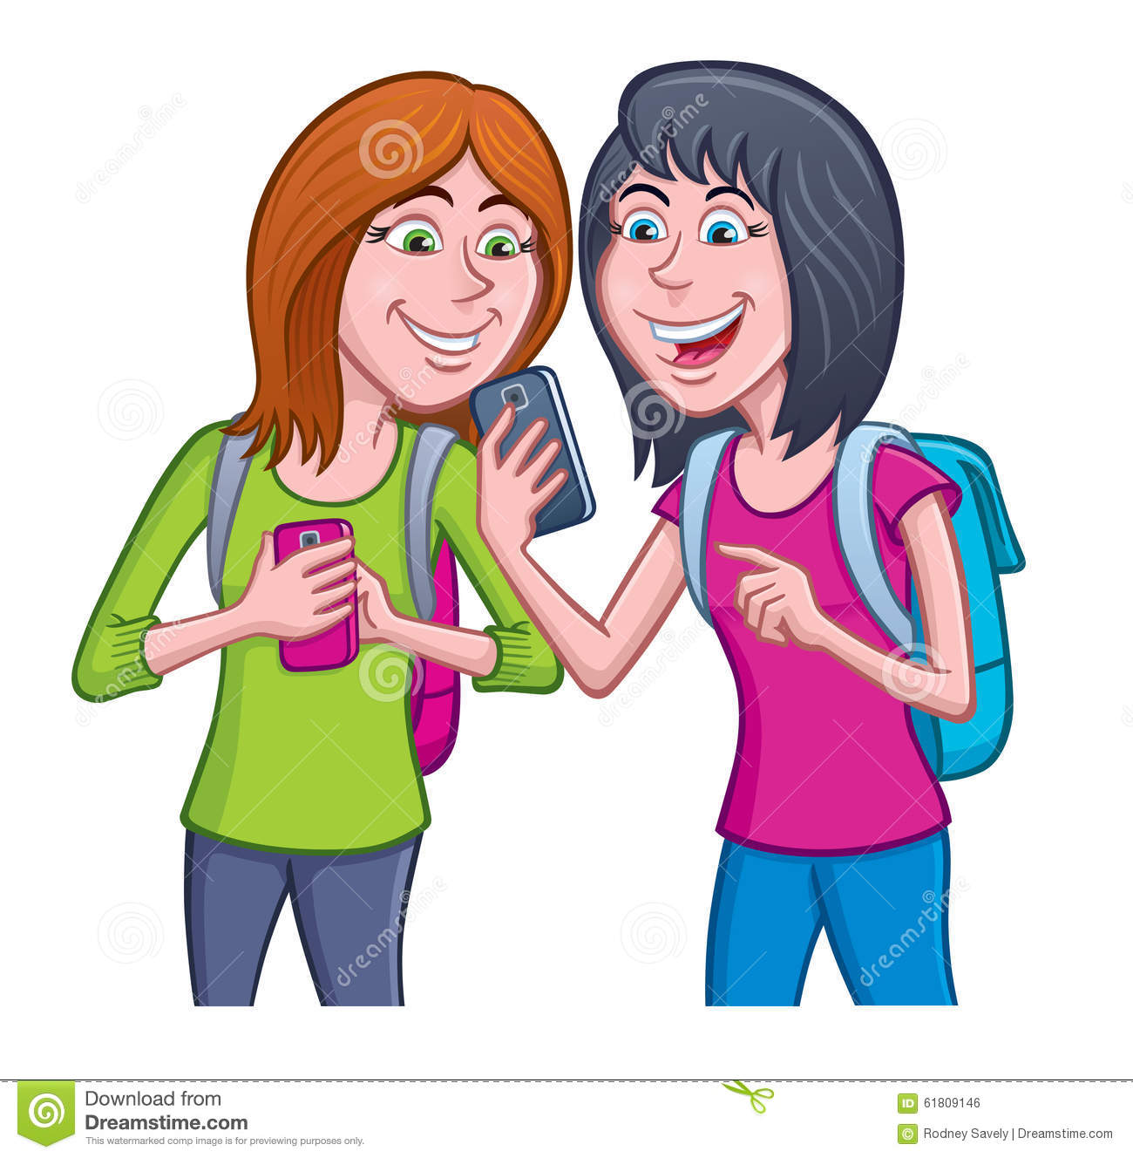
What does
“ teens” mean?

Slide 5
What does it mean to be “cool”?

Slide 6
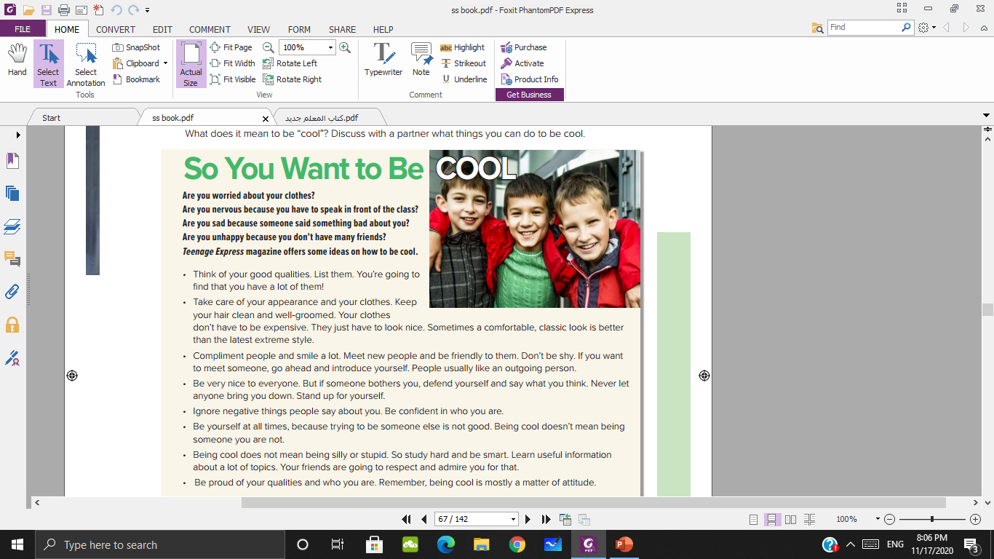


Slide 7

Note:
pay attention to pronoun reference when you read.

Slide 10
What does "quality” mean?

Slide 11
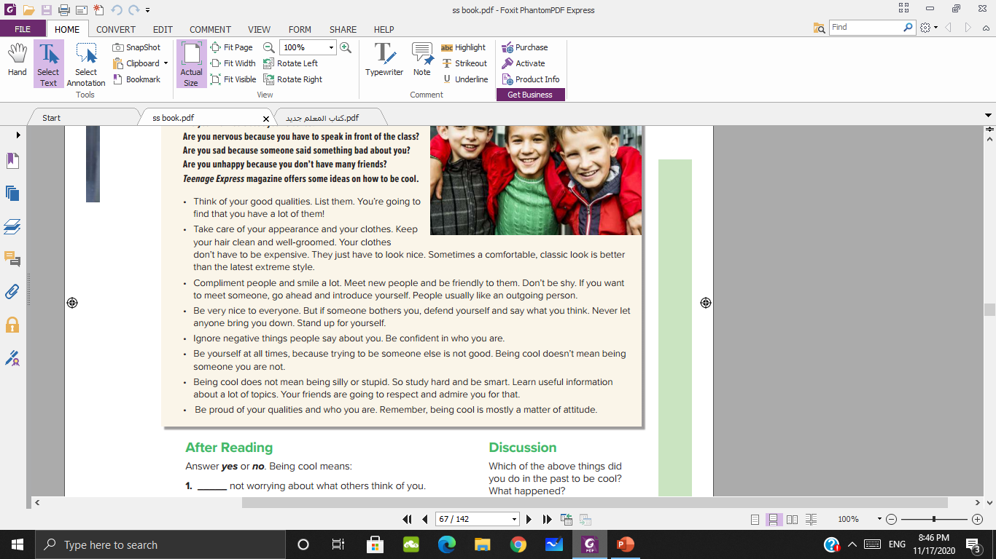
What things should I take care of them?
Should clothes be expensive?

Slide 12

How I should treat people?
How can I do if someone bothers me?

Slide 13

What if people say negative things about you?
Is being cool mean being someone else?
Is being cool mean being silly or stupid?

Slide 14
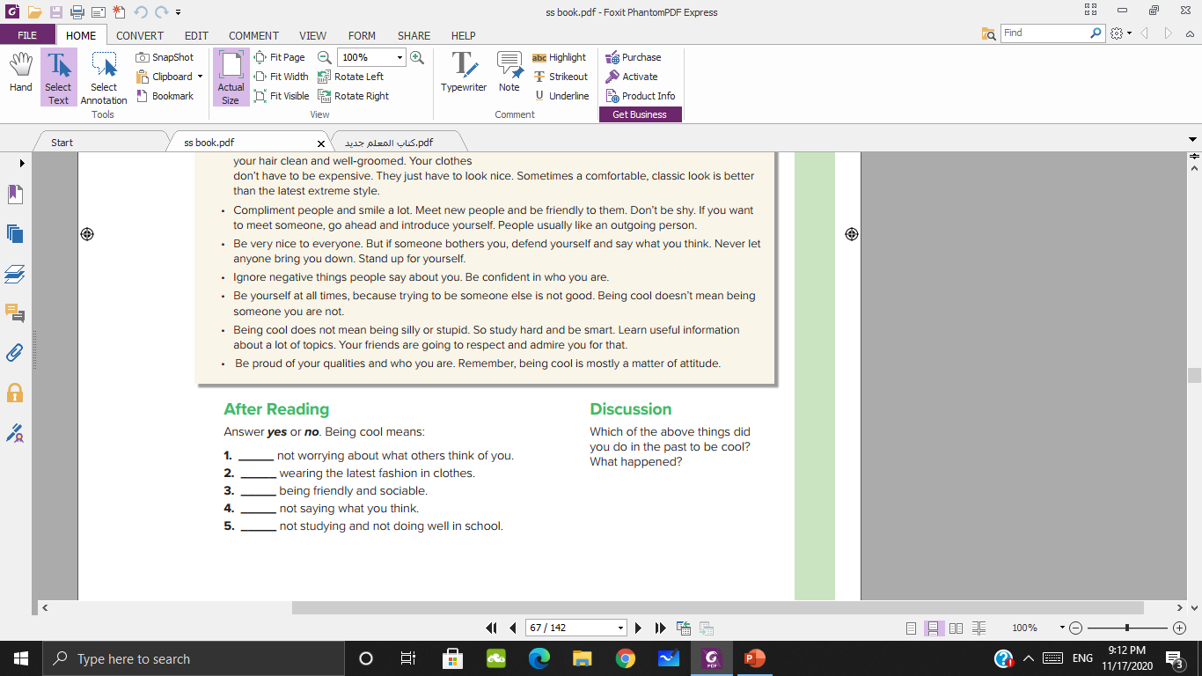
Yes
No
Yes
No
No

Slide 15
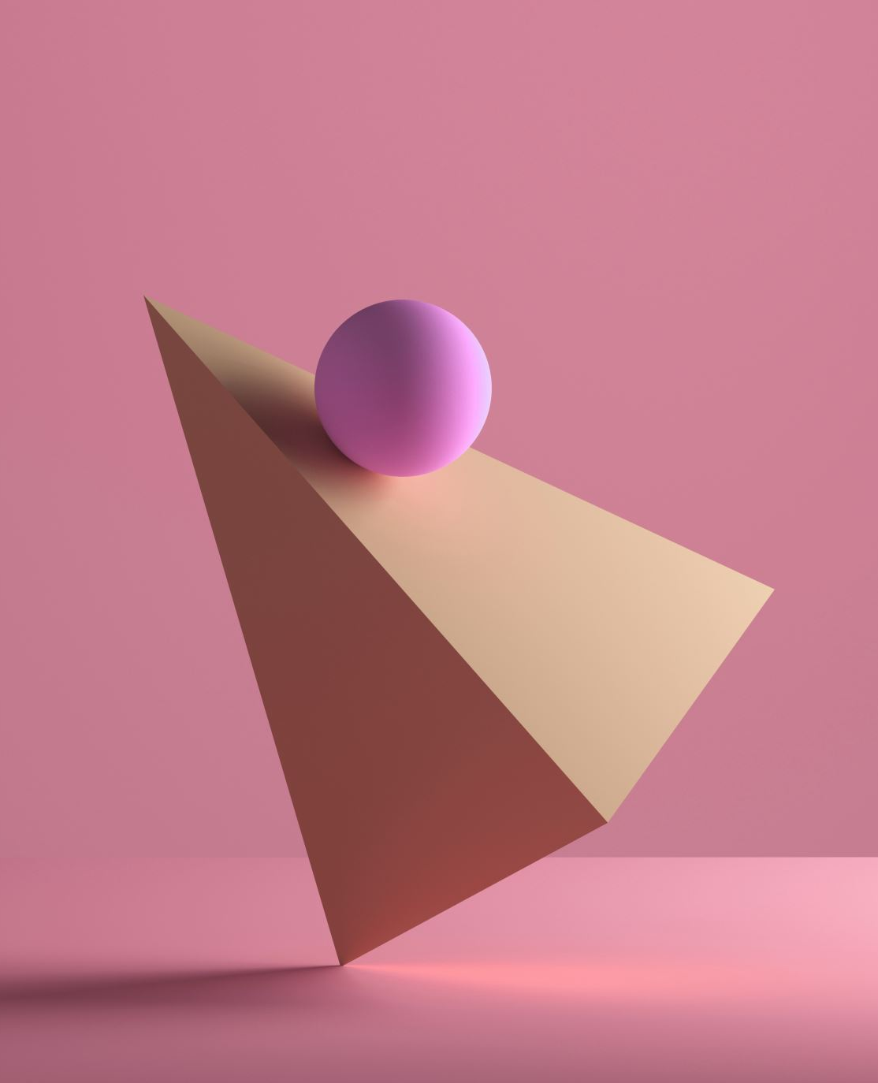
Do you have another ideas to be cool?

Slide 16


