Slide 1



Welcome to class
T.
Mohamad
Zaid

Slide 2
Day
Monday
Date
17th Jun 2022
Subject
We can 6
Unit
1 Fun on the Weekend
Lesson
2 Grammar in Action

Slide 3

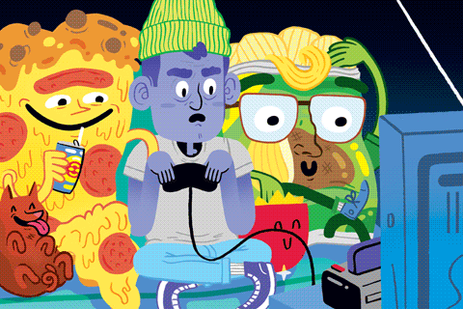

Revision for the previous lesson :
What did he do ?
What did they do ?
4. He kicked a ball
4. They played a computer game

Slide 4


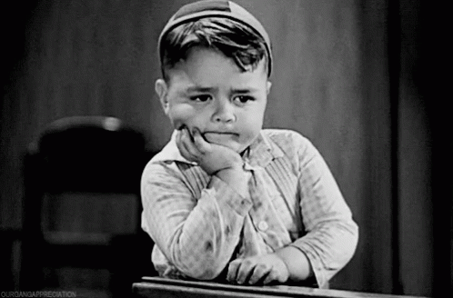
Revision for the previous lesson :
That is ……………
That’s scary
That's boring
That’s great

Slide 5





PAGEs 4 , 5

Slide 6


Objectives
By the end of this lesson I can :
say two things that I did over the weekend.
say the past from of six regular verbs.

Slide 7


Slide 8

Listen and practice .
I practiced
We practiced
You practiced
You practiced
He /She practiced
They practiced

Slide 9
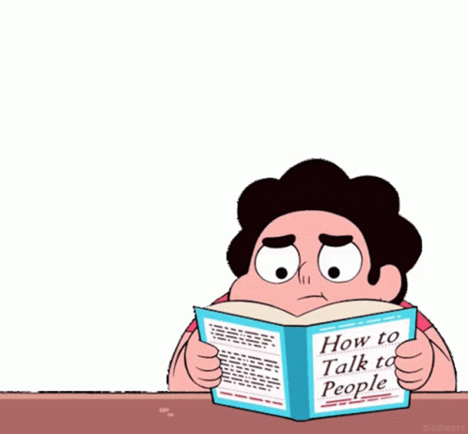


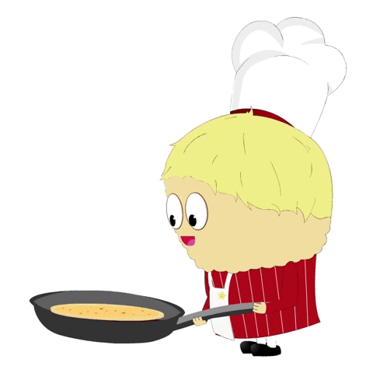
Listen and chant Past Tense Regular Verb Chunks .
1. practiced, practiced I practiced my English.
2. watched, watched You watched a DVD.
3. cooked, cooked She cooked breakfast.

Slide 10
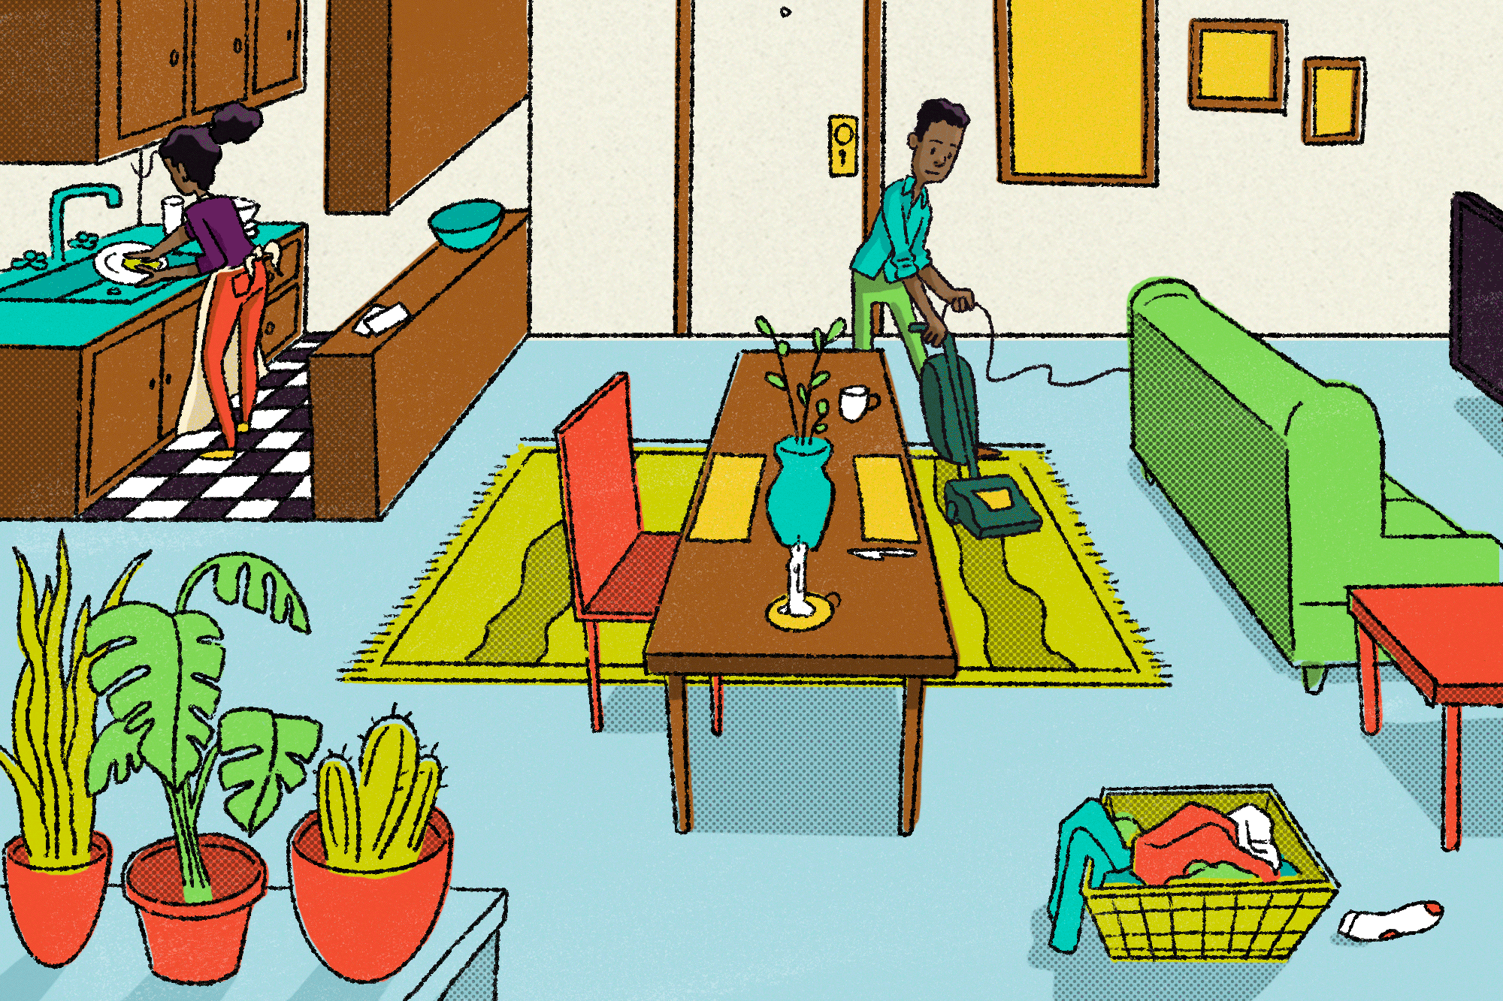

Listen and chant Past Tense Regular Verb Chunks .
4. kicked, kicked He kicked a ball.
5. cleaned, cleaned They cleaned the house.
6. stayed, stayed We stayed at home.

Slide 11


Listen and chant Past Tense Regular Verb Chunks .
7. played, played You played outside.
8. studied, studied You studied a little.

Slide 12
Listen and practice . Then do it in pairs .
Regular verbs
for ed say / t/
for ed say/ d/
Practice - practiced
Clean - cleaned
Watch - watched
Stay - stayed
Cook - cooked
Play - played
Kick - kicked
Study - studied

Slide 13


Verb game .can you write and play the verb game and beat a partner?
cooked
practiced
played
watched
kicked
studied
stayed
cleaned

Slide 14

Verb game 2 .can you write and play the verb game and beat a partner?
cooked
practiced
played
watched
kicked
studied
stayed
cleaned

Slide 15



Goal Check

Slide 16
Write the past form of the following :
1.practice
1.practiced
2. cook
2. cooked
3. kick
3. kicked
4. study
4. studied

Slide 17
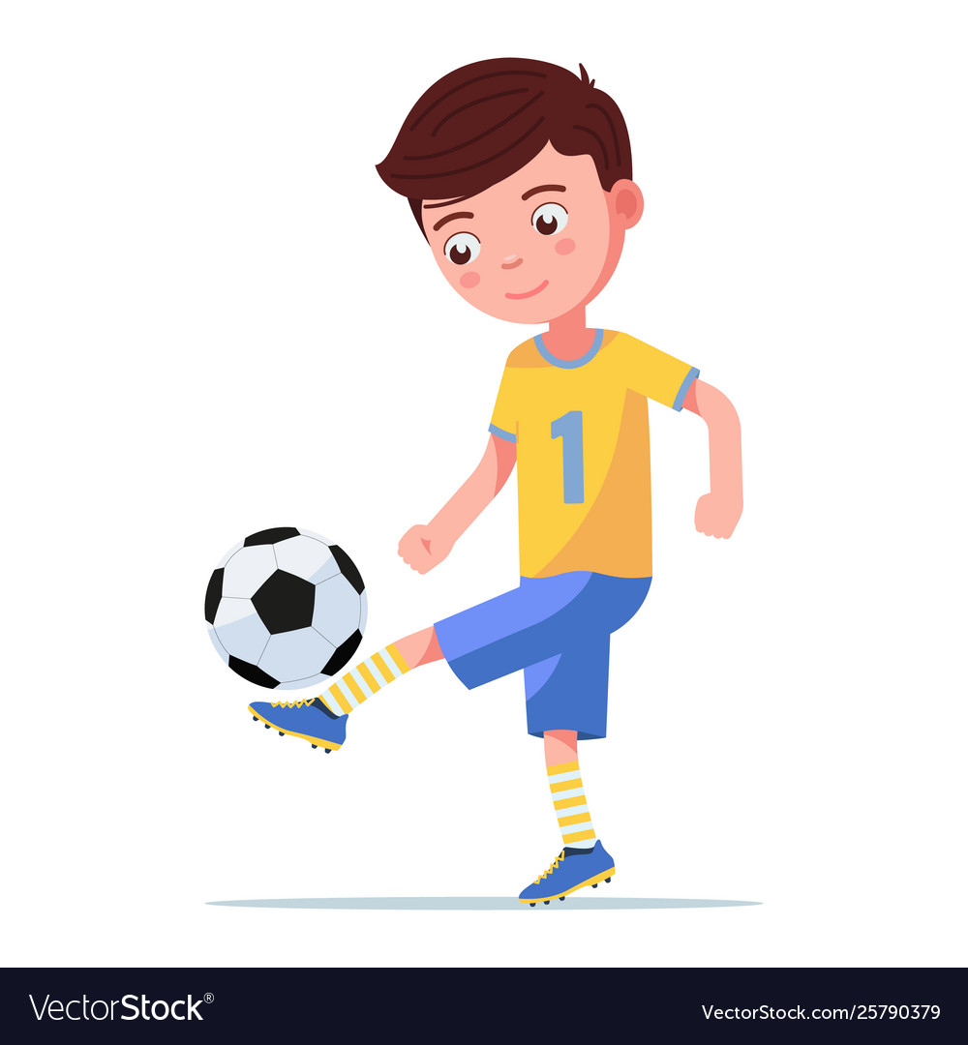
What did he do over the weekend ?
He kicked a ball.
He played football.

Slide 18


What did they do over the weekend ?
1
2
3
They watched TV.
They cleaned the house.
They cooked breakfast .

Slide 19



https://www.liveworksheets.com/worksheets/en/English_as_a_Second_Language_(ESL)/Sentence_structure/Unt1-l1_pu1542128qj

Slide 20


Open your workbook
Pages 73 , 74

Slide 21


Home work at

Slide 22



إنتاج معرفي
Let’s learn a sentence or more DAILY

Slide 23


Slide 24



Slide 25



