Slide 1
7 Everyone Makes Mistakes
Reading
P. 102 - 103

Slide 2
1.
1.
AGENDA
2.
2.
3.
3.
Read
A text about happy mistakes
Answer
Comprehension questions
Speaking
In pairs/groups

Slide 3
Warp-up

Slide 4
Read & Explain
The Proverb
Example
Being caught that traffic jam was a blessing in disguise. If I hadn’t missed the flight, I would have been in that plane when it crashed.
Blessing in disguise

Slide 5
Read & Learn
The Proverb
Meaning
Blessing in disguise
Something that appears to be bad at first, but it results in something very good at the end.

Slide 6
Vocabulary
01

Slide 7
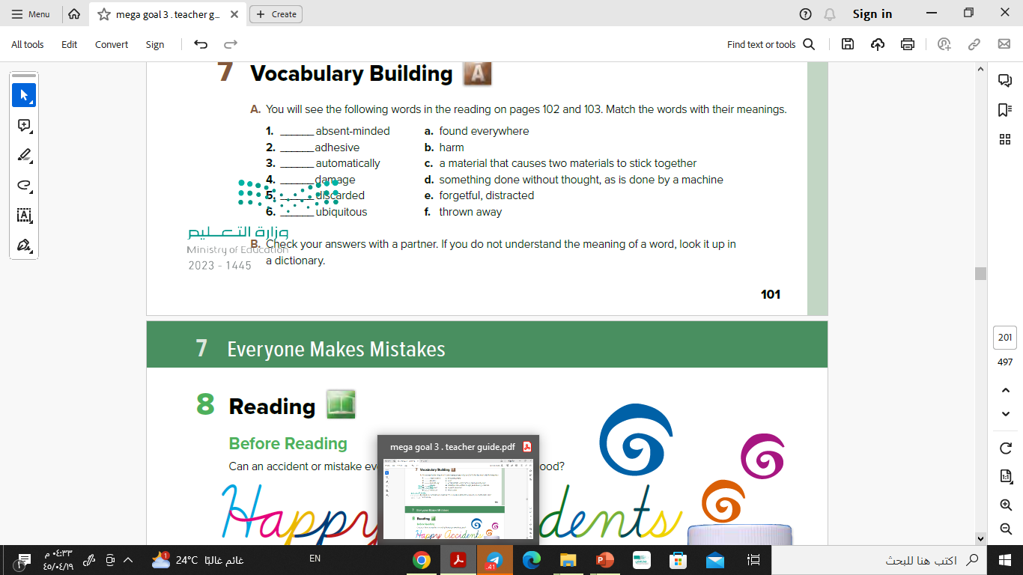
Vocabulary Building
P. 101
e
c
d
b
f
a

Slide 8
Reading
02

Slide 9
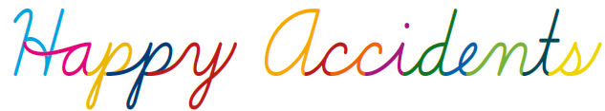
Title

Slide 10
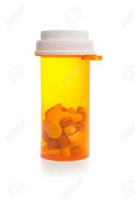
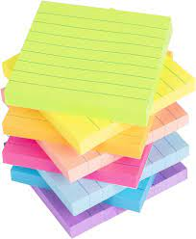
Scan the pictures

Slide 11
Pre-reading Vocabulary

Slide 12

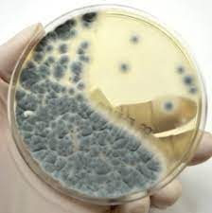
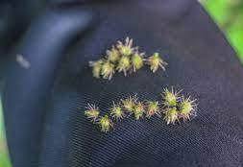
What are these?
Antibiotic
Mold
Burrs seed-sacs

Slide 13
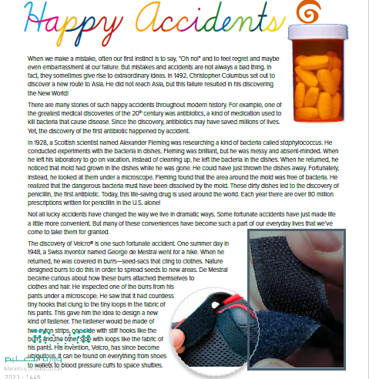

Listen & read along

Slide 14
Reading Task
Read again. Work with your group to fill the following chart for each story.
Who made the mistake/accident?
What was the mistake/accident?
How it ended up to something good?

Slide 15
Reading Task
The Story of Penicillin
Who made the mistake/accident?
What was the mistake/accident?
How it ended up to something good?
Alexander Fleming
He didn’t clean his dishes in the lab, so he left by mistake the bacteria in the dishes. He noticed the mold had grown on the dishes. After looking at then under a microscope, he found that the area around the mold was free of bacteria. Bacteria was dissolved by the mold.
These dirty dishes led to the discovery of
penicillin, the first antibiotic.

Slide 16
Reading Task
The story of Velcro®
Who made the mistake/accident?
What was the mistakel accident?
How it ended up to something good?
George de Mestral
When he returned home after a hike, he was covered with burrs seeds. He became curious about how these burrs attached themselves to clothes and hair. He inspected one of the burrs from his pants under a microscope. He saw that it had countless tiny hooks that clung to the tiny loops in the fabric of his pants.
He designed a new kind of fastener. It is made of two nylon strips, one side with stiff hooks like the burrs and the other side with loops like the fabric of his pants.

Slide 17
Reading Task
The Story of Post-it™ Notes
Who made the mistake/accident?
What was the mistakel accident?
How it ended up to something good?
Spencer Silver
He was working in a research laboratory, trying to create a strong adhesive. He created a new adhesive that stuck to objects, but it could also easily be lifted off them. Because the adhesive was so weak, he thought it was a failure. Few years later, his co-worker used his adhesive to keep scraps of paper from falling from the book. It worked.
Post-it Notes were introduced in 1980, and quickly became an essential office product around the world.

Slide 18
03
After Reading

Slide 19
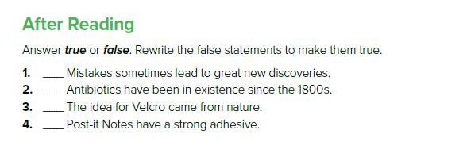
T
F
1928
T
F
weak

Slide 20
04
Speaking

Slide 21
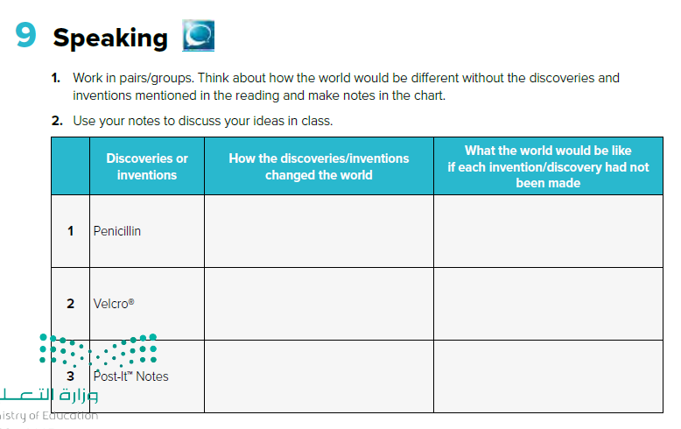

Slide 22
Have a Nice Day!

