Slide 1

Unit 7
It’s a Good Deal , Isn’t It ?
Grammar
Page 70, 71

Slide 2


Tag
Questions
Negative
Questions
Be
able to

Slide 3

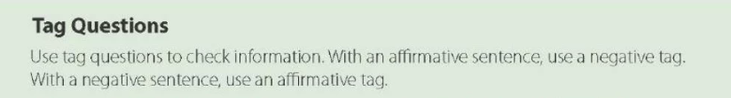

Slide 4


Yes/ No
Wh
Tag
Kinds of Questions

Slide 5
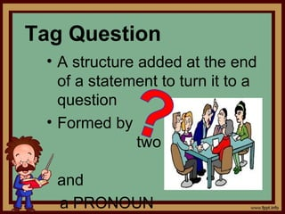
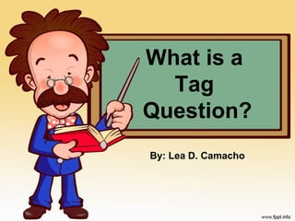
a helping verb
and
a pronoun

Slide 6
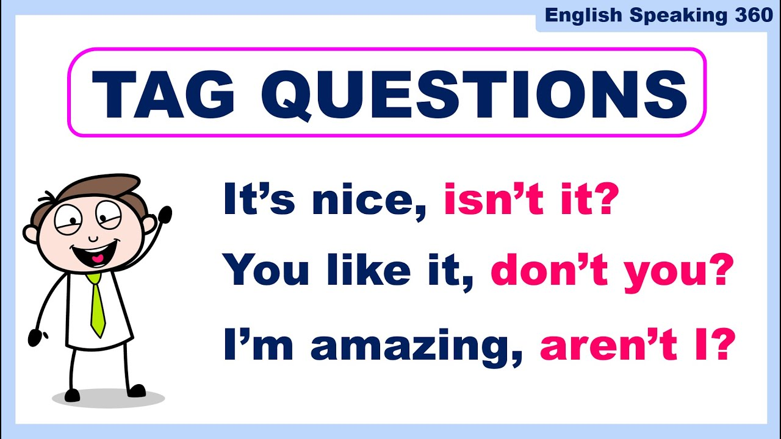

Slide 7
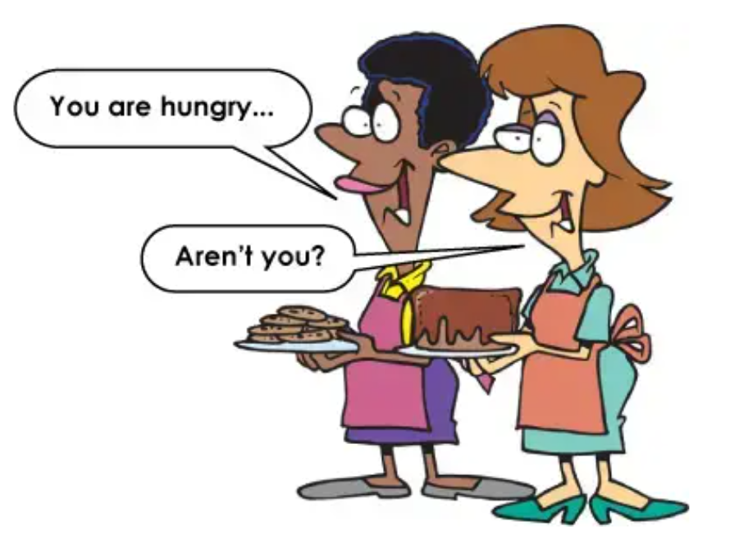

Yes, I am

Slide 8
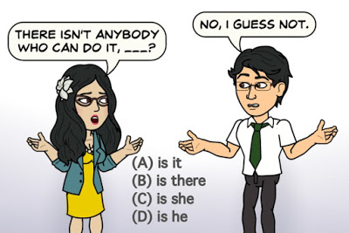



Slide 9

A. Check information. Complete the tag questions.
These toys are in good condition, _____ ____?
2. You’ve had garage sales before, ______ ___?
3. He didn’t buy that fan, ___ ___?
4.They weren’t able to sell the tools, _____ ___?
5.She found a set of nice crystal glasses, ____ ___?
6. That vacuum cleaner works OK, ______ ___?
7. We have lots of bargains here today, ___ ___?
8.This lawn mower is really high-tech, ___ ___?
aren’t they
haven’t you
did he
were they
didn’t she
doesn’t it
don’t we
isn’t it

Slide 10

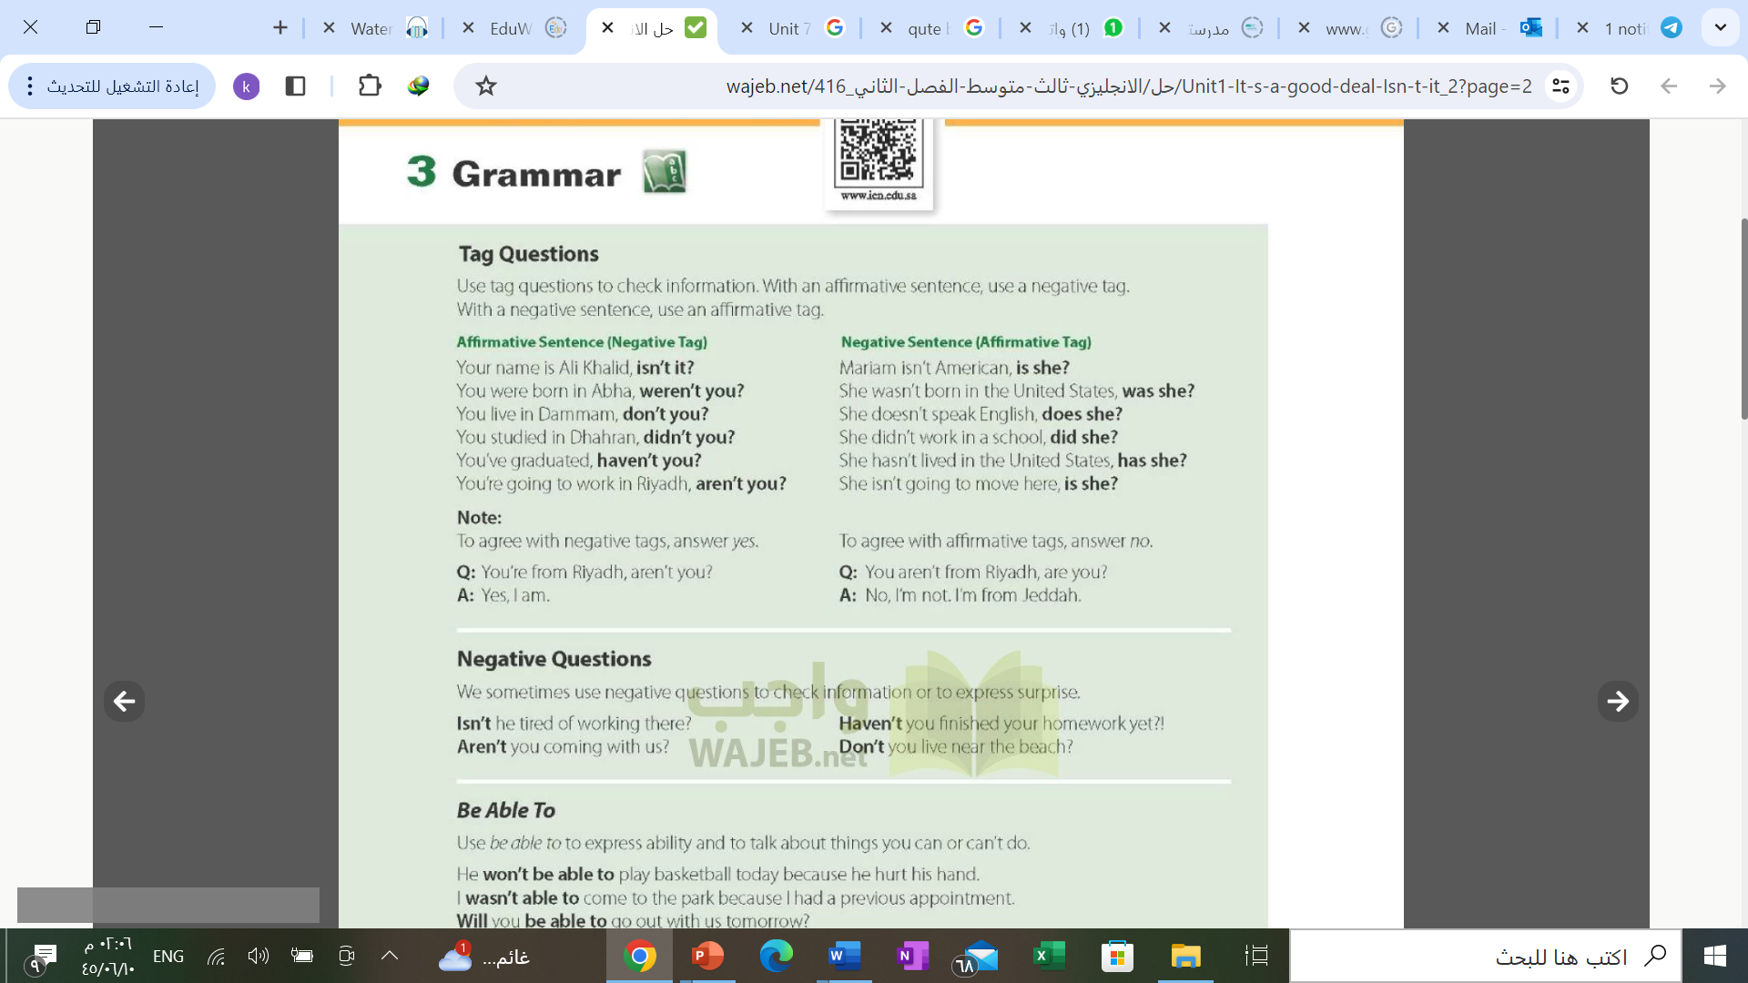

Slide 11
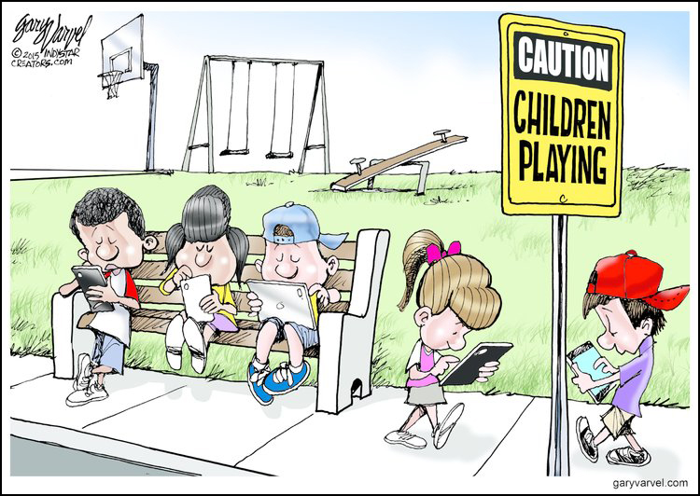
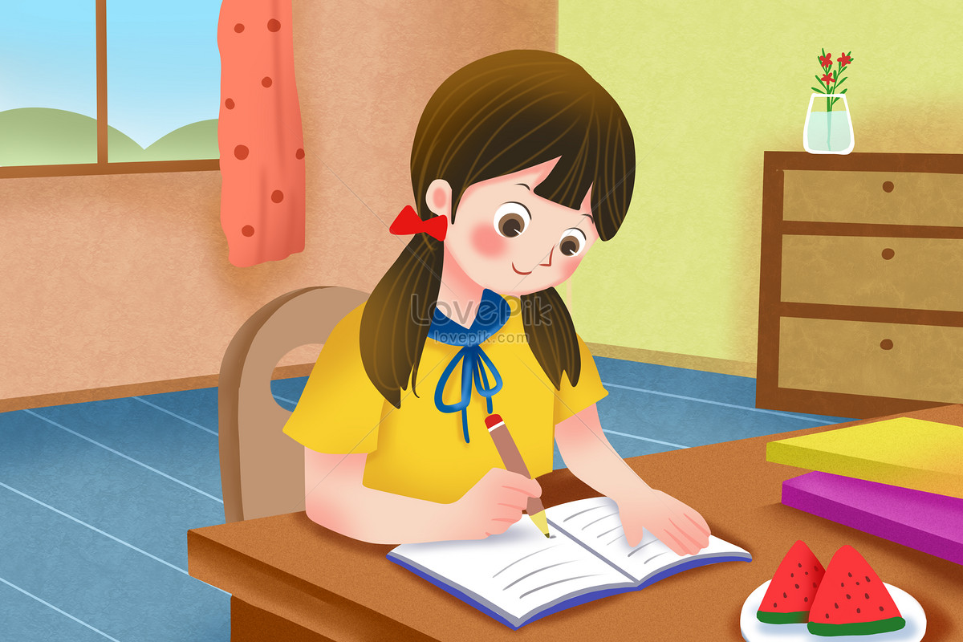
Aren’t they addict to cell phones ?
Haven’t you finished your homework yet ?

Slide 12
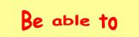


Slide 13
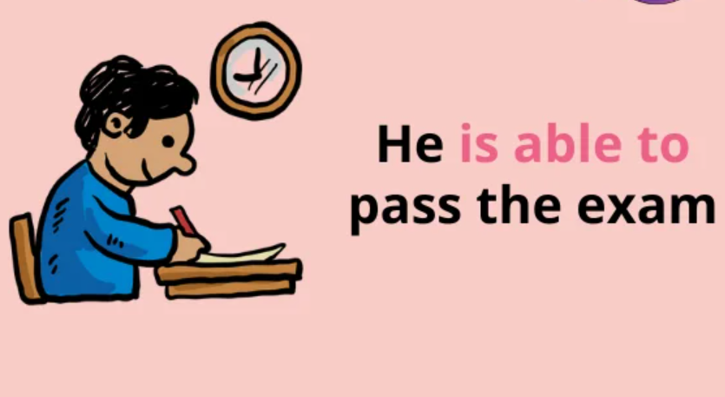
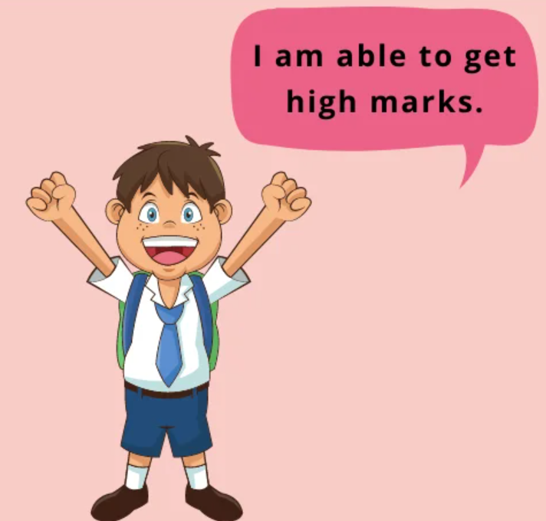
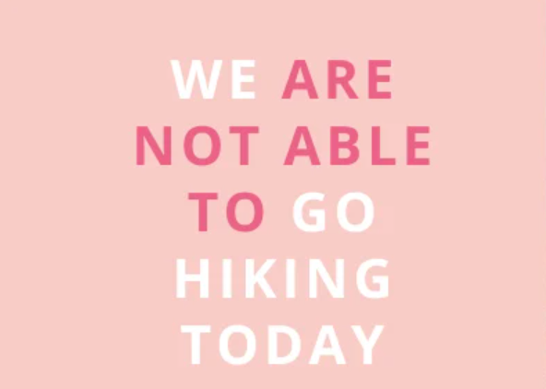


Slide 14
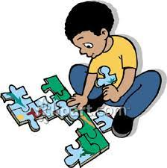
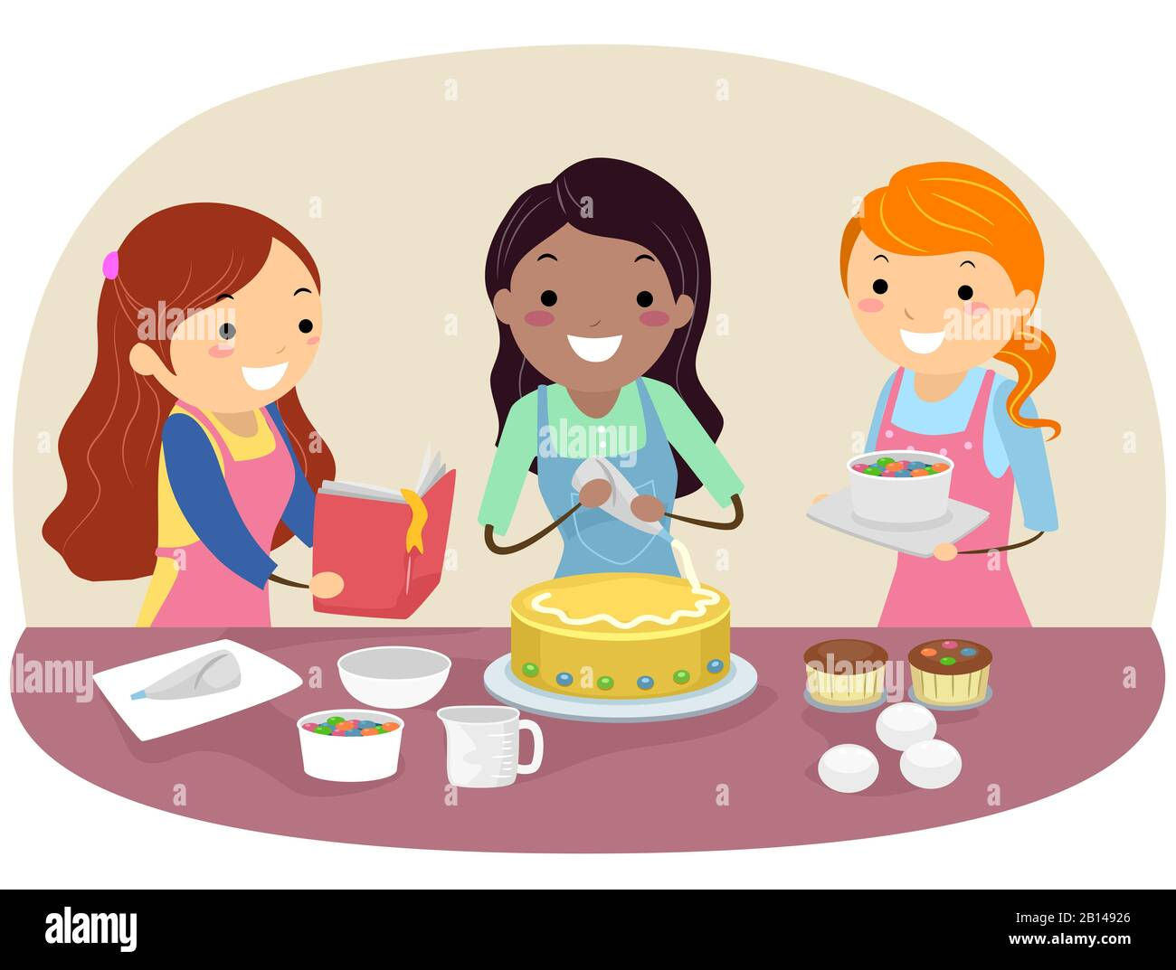
I wasn’t able to do the puzzle myself
We were able to bake a delicious cake

Slide 15
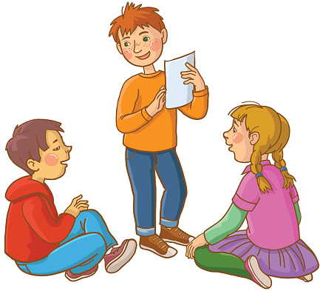
Will you be able to guess what I’ve drawn ?

Slide 16


Work Book page
210: C
211 : D , E
212 : G
Tr.Kholud

Slide 17
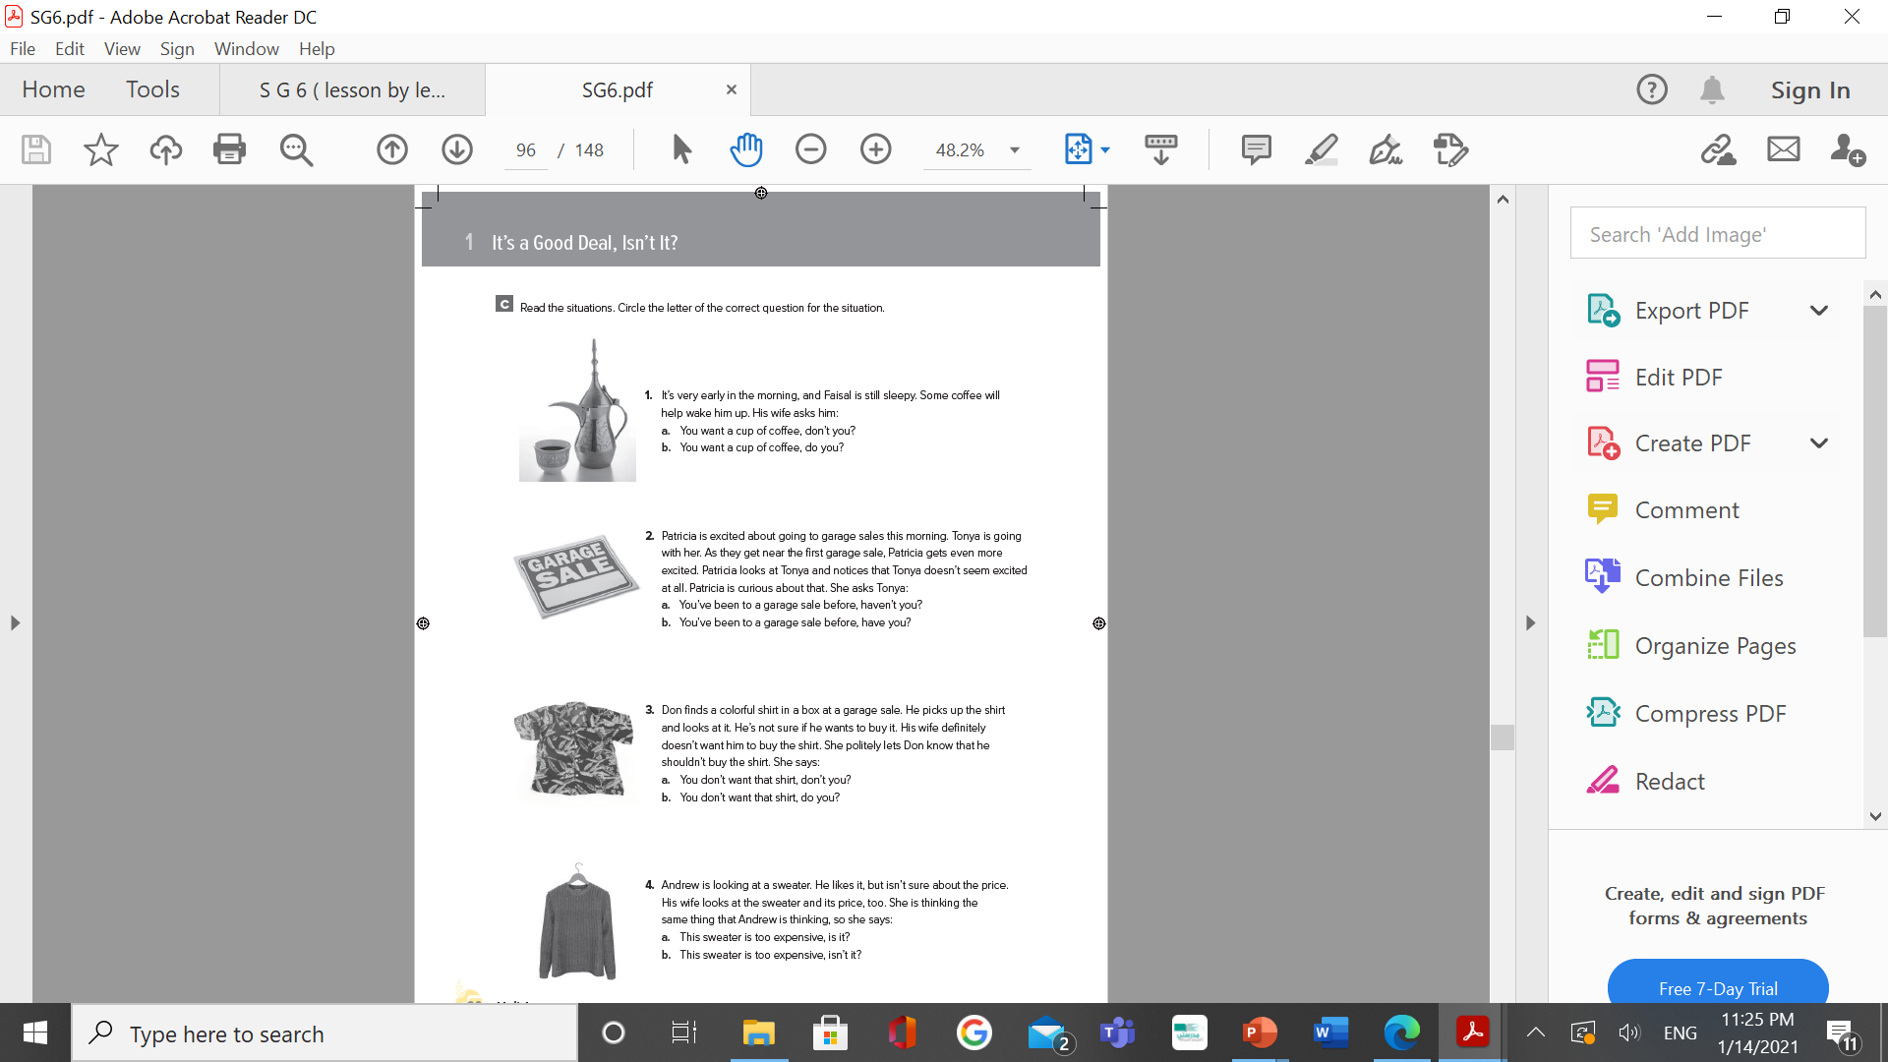
W. B. p. 210

Slide 18
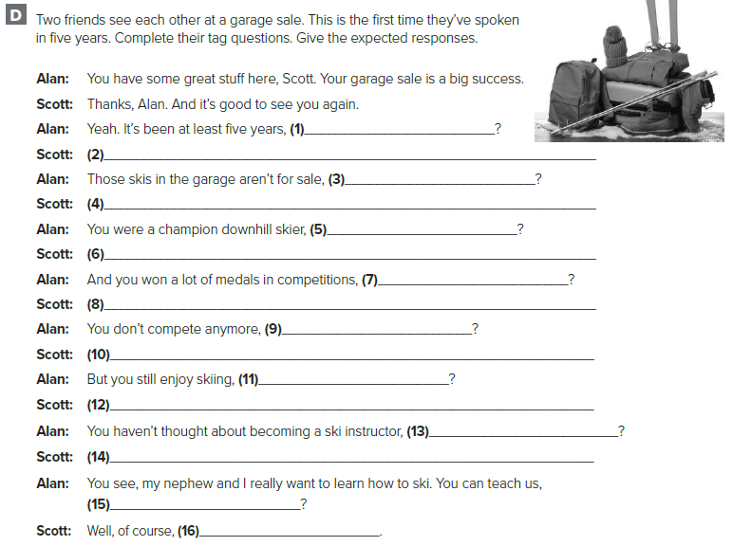
hasn't it
Yes , it has .
are they
W. B. p. 211
No , they aren΄t
weren't you
Yes , I was
didn’t you
Yes , I did
do you
No , I don΄t
don΄t you
Yes , I do
have you
No . I haven΄t
can΄t you
I can

Slide 19
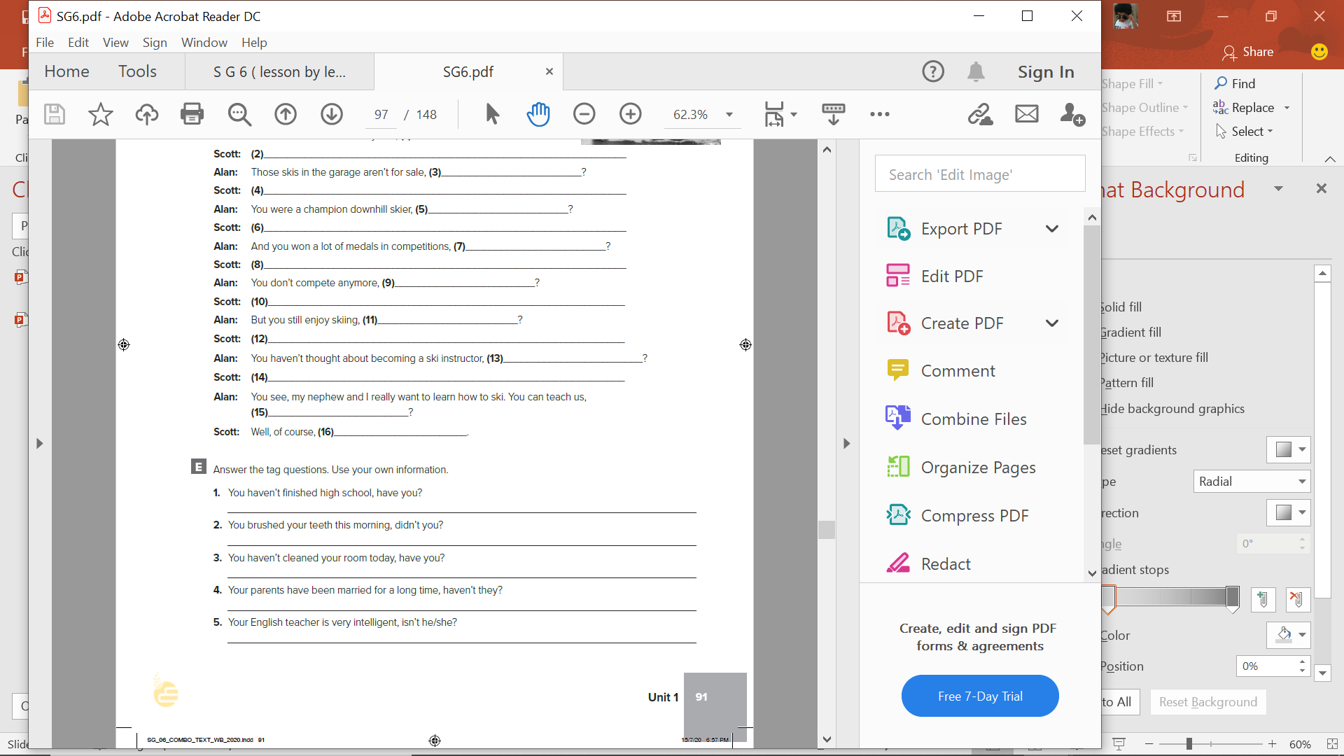
W. B. p. 211
No , I haven΄t
Yes , I did
Yes , I have
Yes , they have
Yes , she is

Slide 20
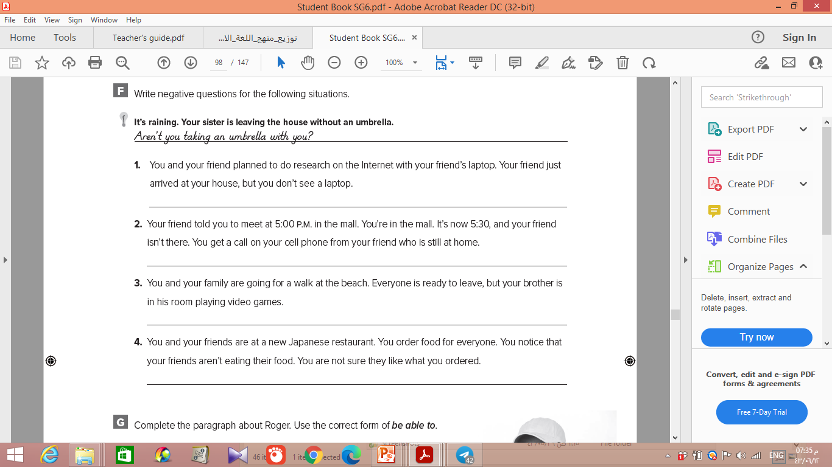
W. B. p. 212
Didn’t you bring your computer?
2. Haven’t you left yet?
3. Aren’t you coming with us?
4. Don’t you like your food?

Slide 21
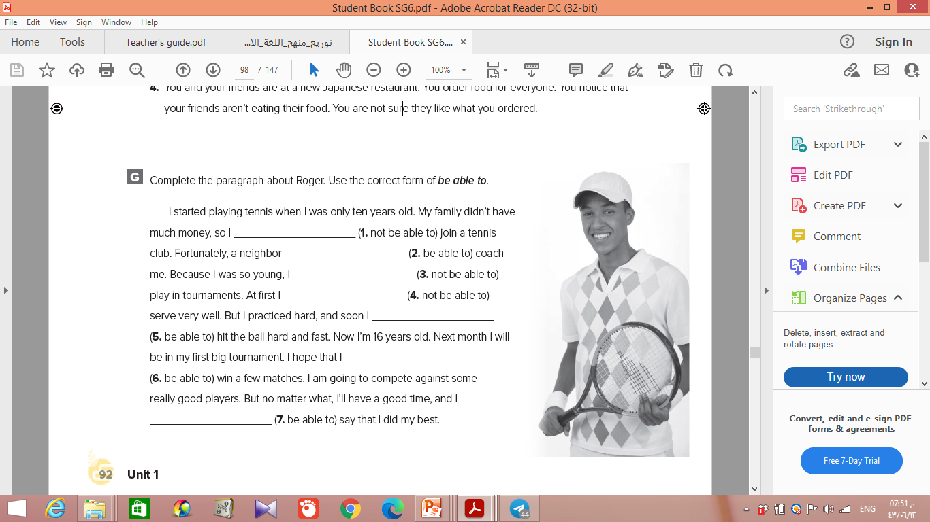
W. B. p. 212
wasn’t able to
was able to
wasn’t able to
wasn’t able to
was able to
will be able to
will be able to

