Slide 1
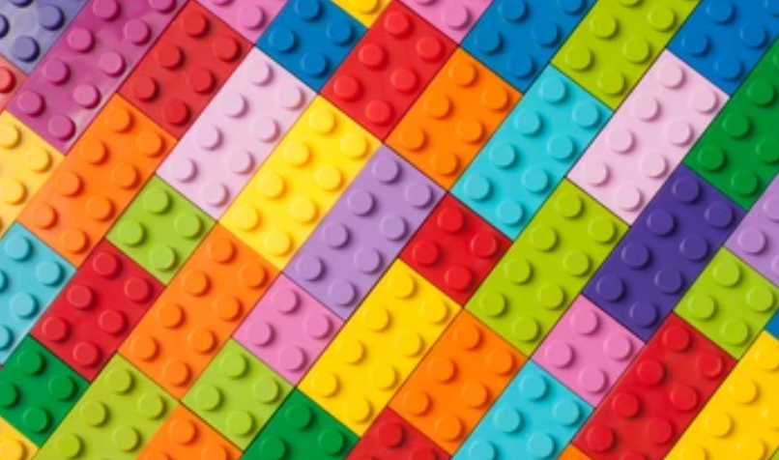
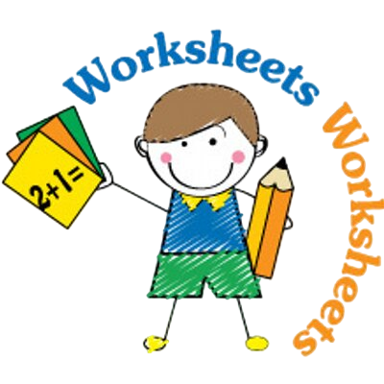

Slide 2
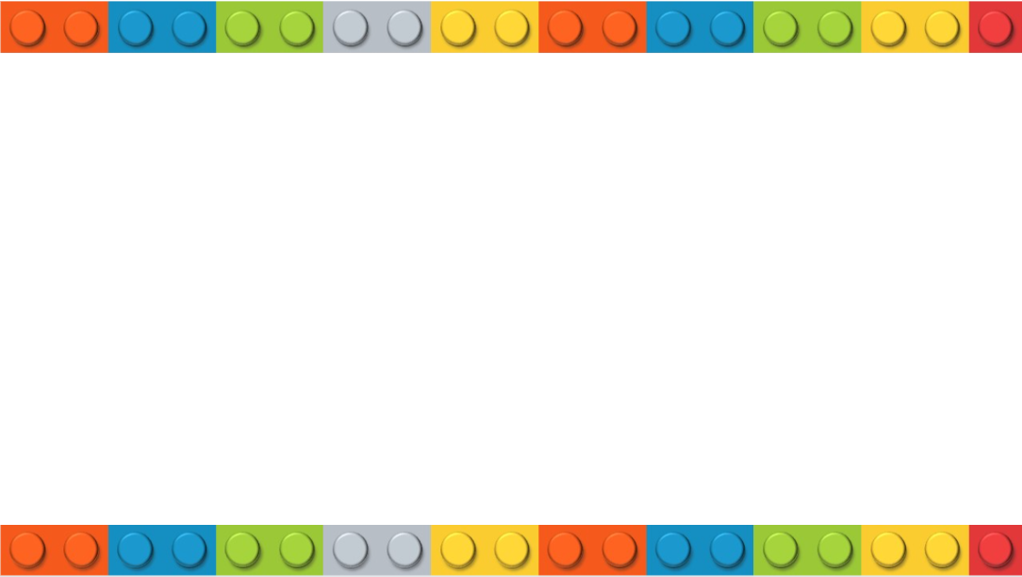

Slide 3
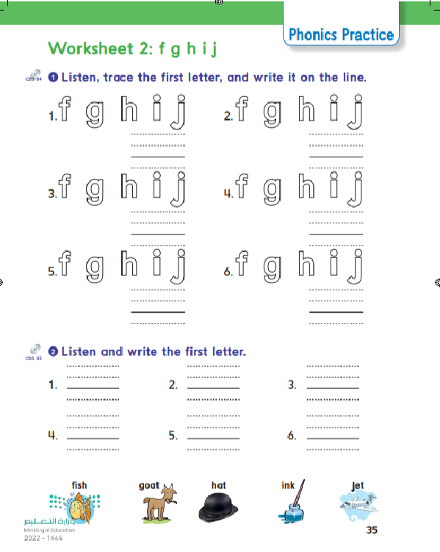
35

Slide 5
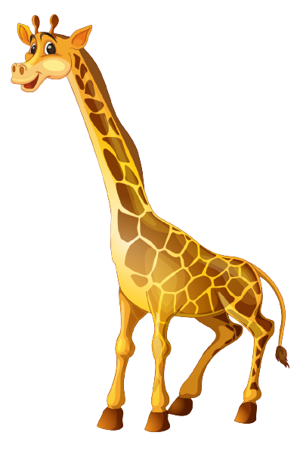
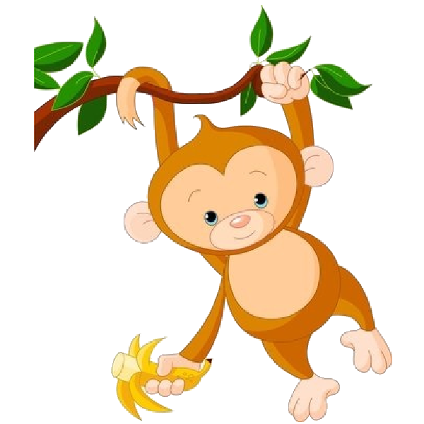
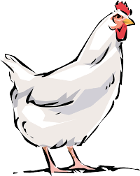

Slide 6
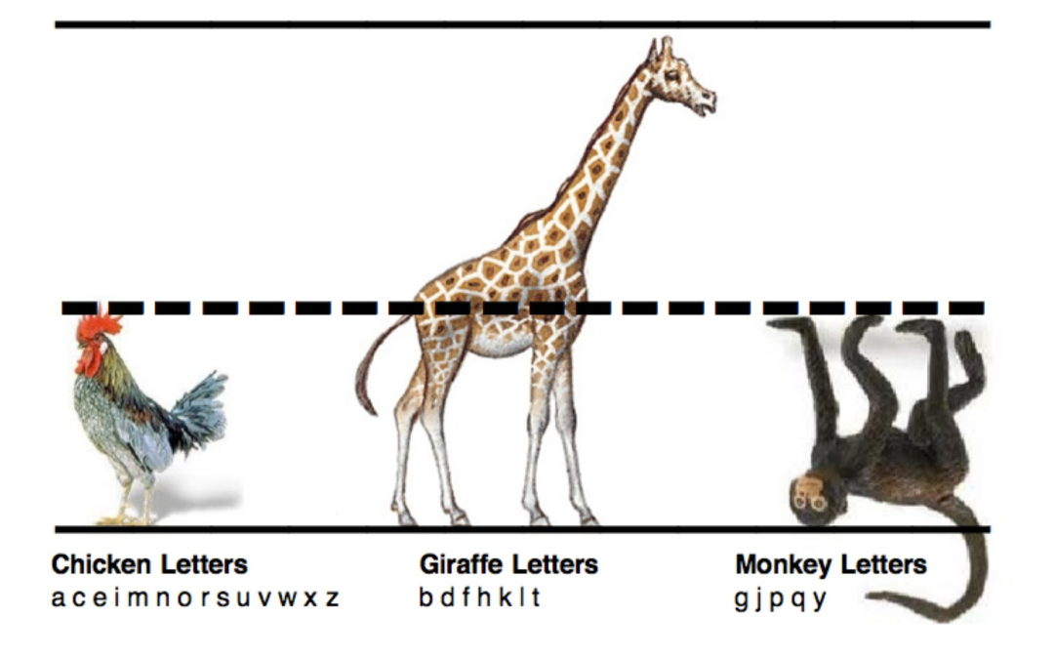

Slide 7
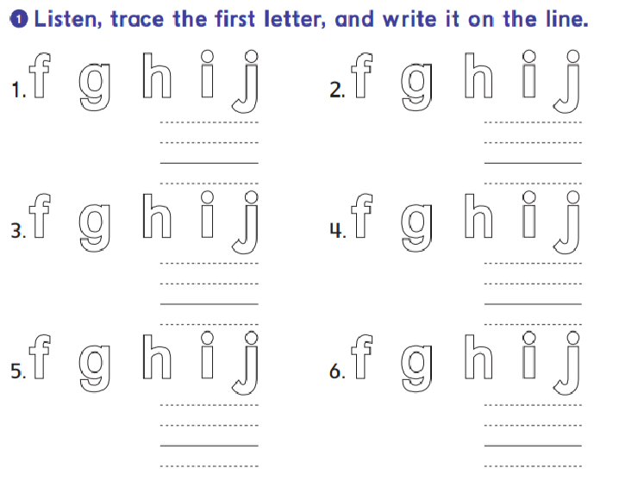
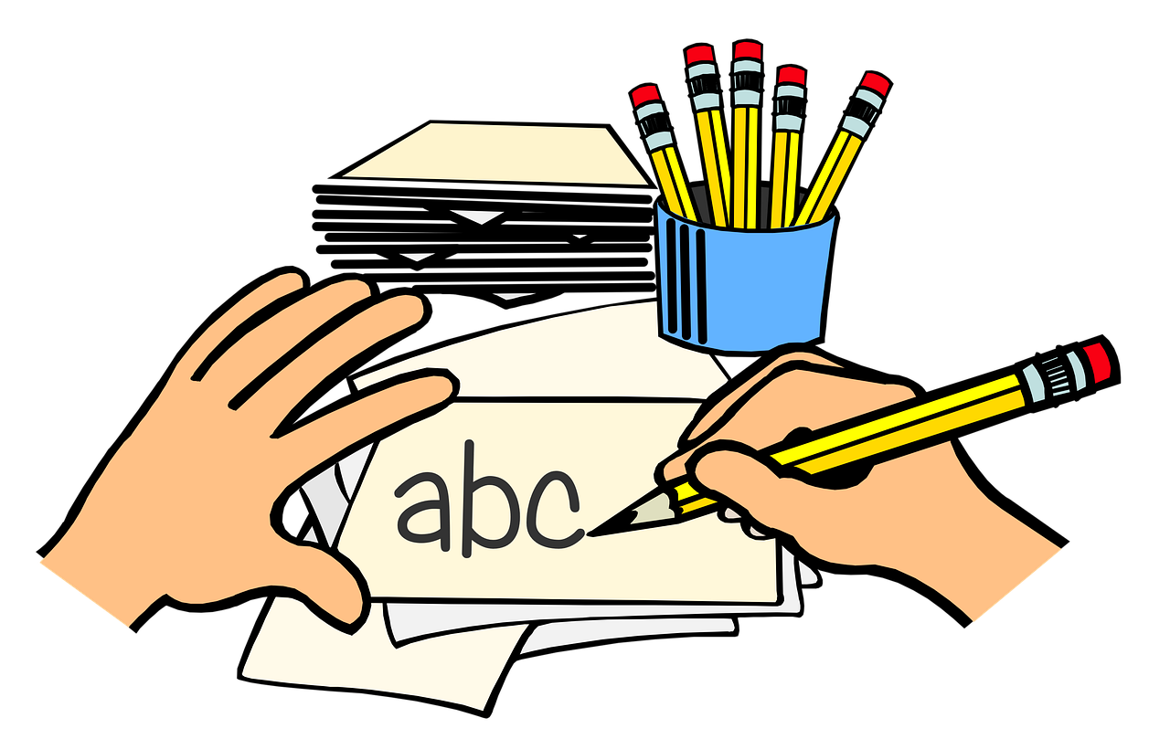
i
j
i
j
g
f
g
f
h
j
h
j

Slide 8
f
h
j
i
f
g

Slide 9
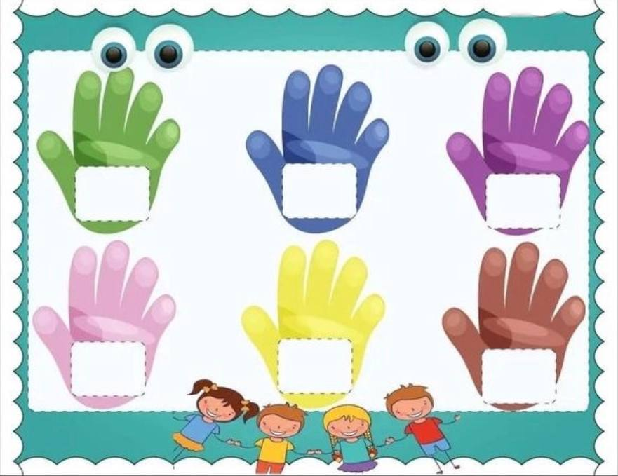
High five the correct word
a
j
g
f
h
i
*Two students game. Teacher says randoms letters from the picture and the first student put his hands on it win

Slide 10
High five the correct word
G
F
A
H
I
J
*Two students game. Teacher says randoms letters from the picture and the first student put his hands on it win

Slide 11
High five the correct word
J
g
f
a
H
I
*Two students game. Teacher says randoms letters from the picture and the first student put his hands on it win

Slide 12
High five the correct word
F
i
e
j
G
H
*Two students game. Teacher says randoms letters from the picture and the first student put his hands on it win

Slide 14
