Slide 1
Unit 7
Fun on the weekend
Find out time

Slide 2
بسم الله الرحمن الرحيم
Day:
Date:

Slide 3
Learning Objectives
Use regular verbs in statements
Use past simple tense to tell about states that happened in the past
Build up questions and answers about weekend

Slide 4
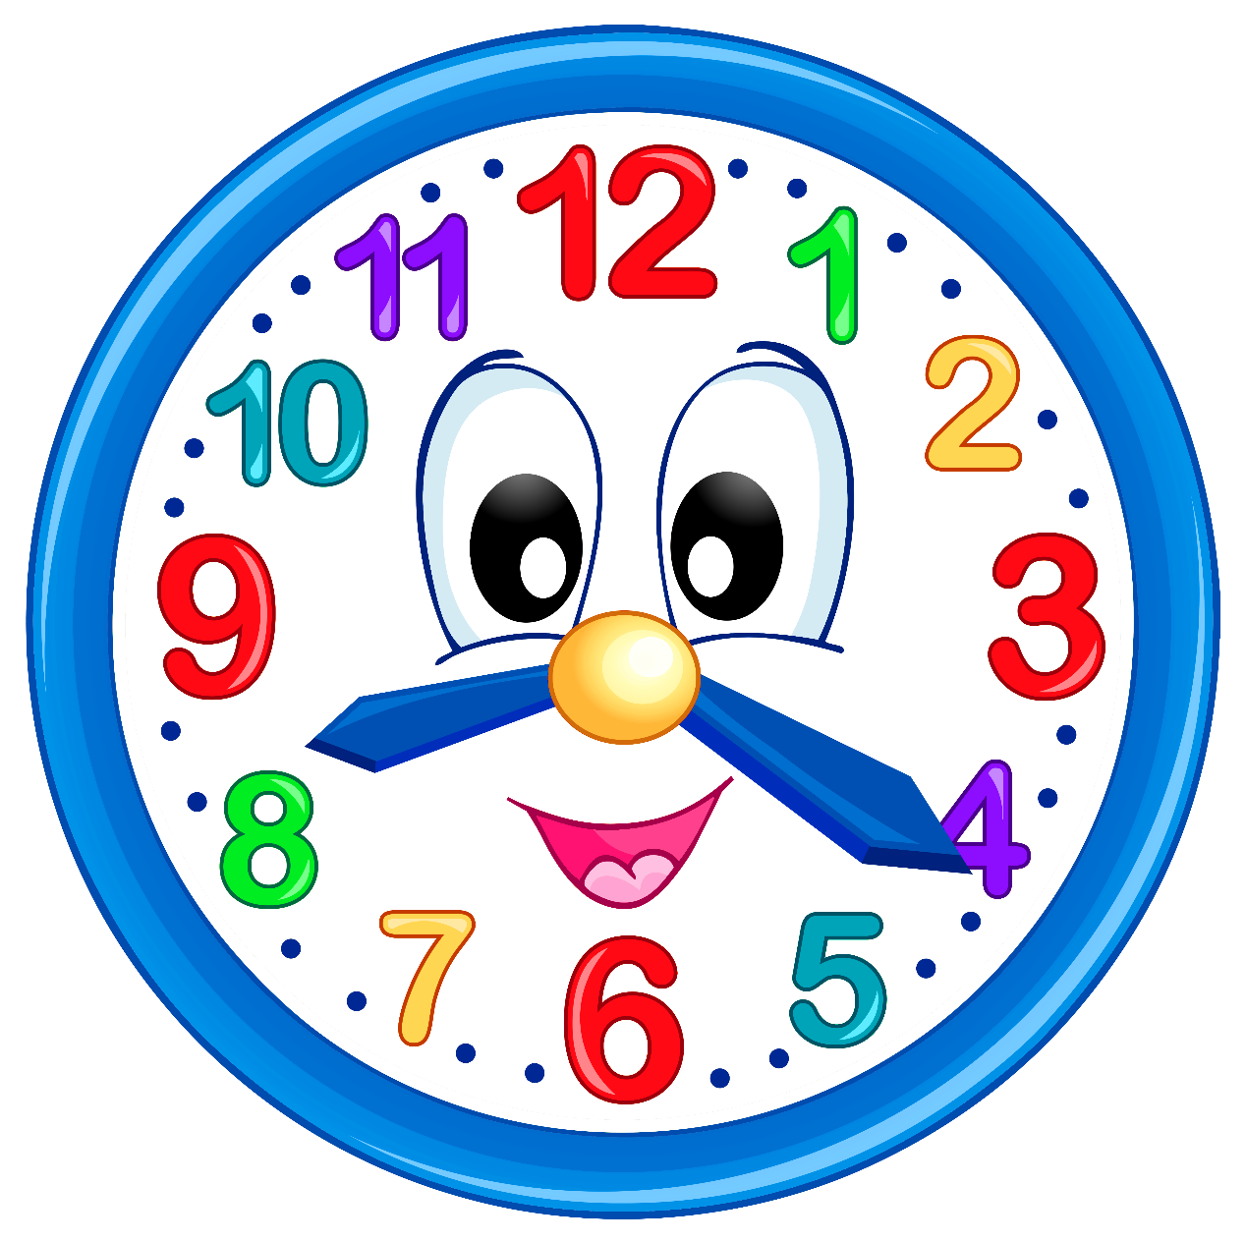
What time is it?

Slide 5
Revision

Slide 6
Warm up

Slide 7
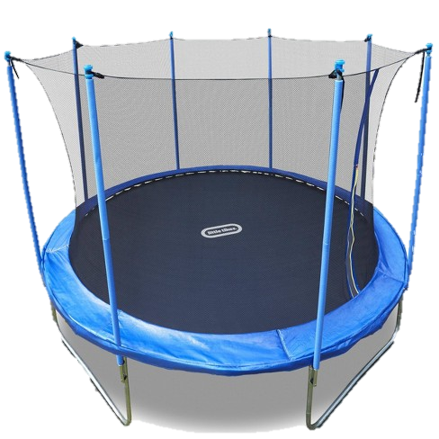
trampoline

Slide 8
DVD

Slide 9
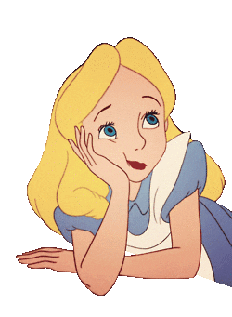
That’s boring.

Slide 10
That’s great.

Slide 11
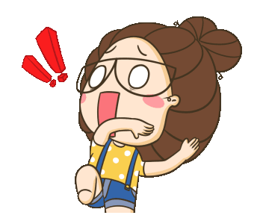
That’s scary .

Slide 12
That’s okay.

Slide 13
That’s fantastic.

Slide 14
Page 50

Slide 15
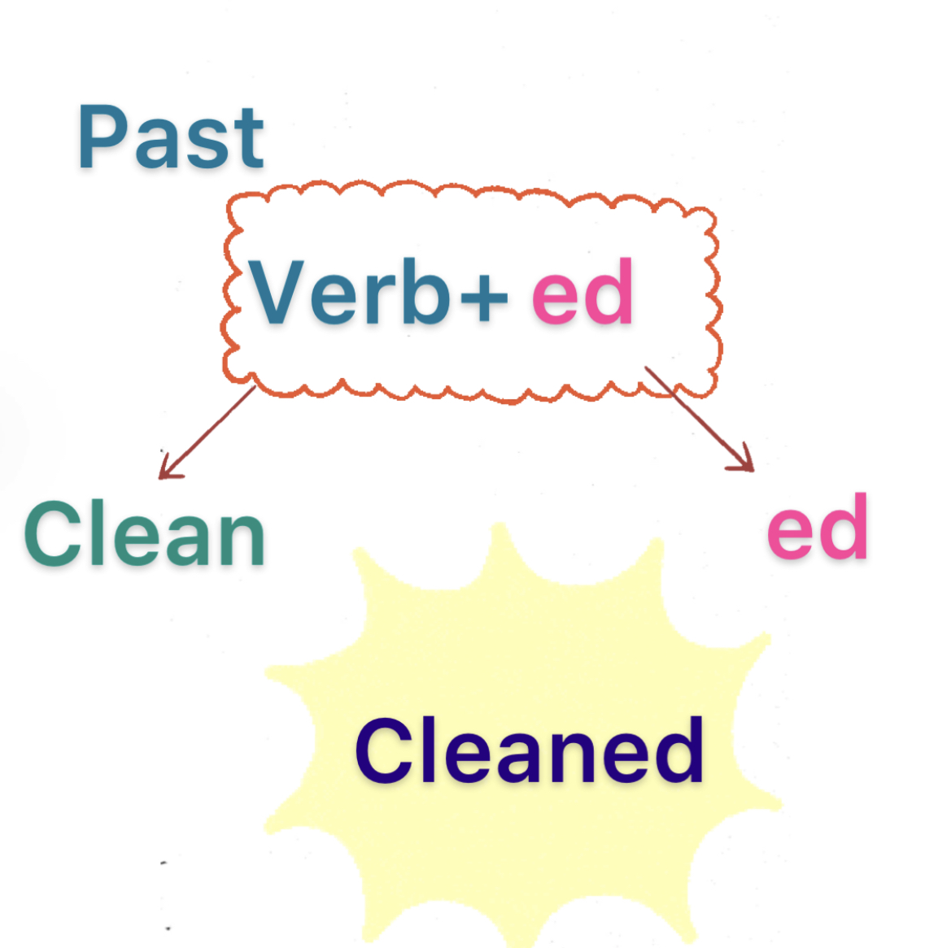

Slide 16
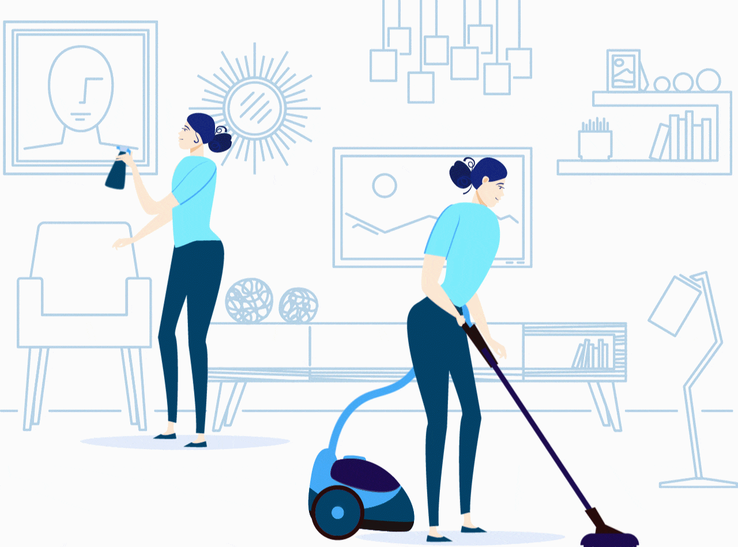
clean
ed

Slide 17
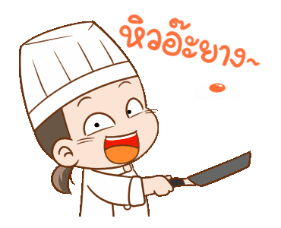
cook
ed

Slide 18
ed
watch

Slide 19
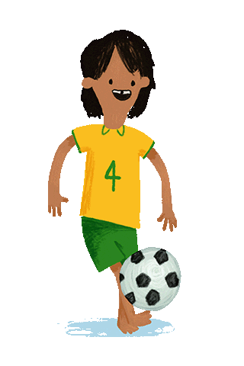
kick
ed

Slide 20
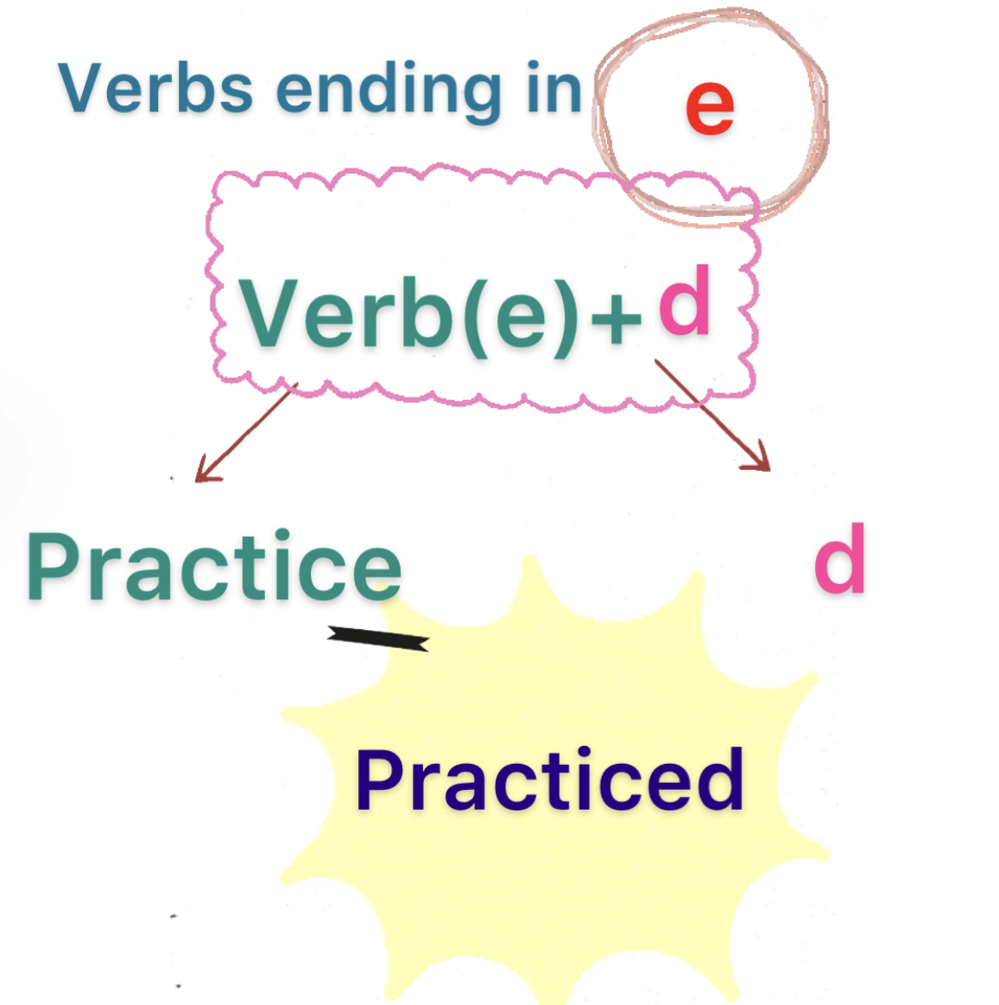

Slide 21
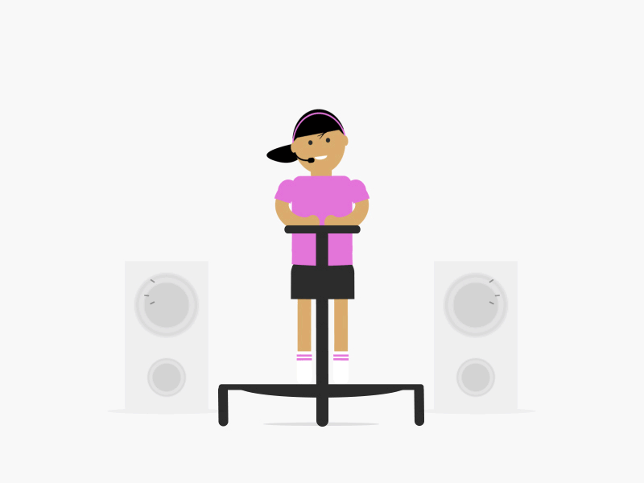
practice
d

Slide 22
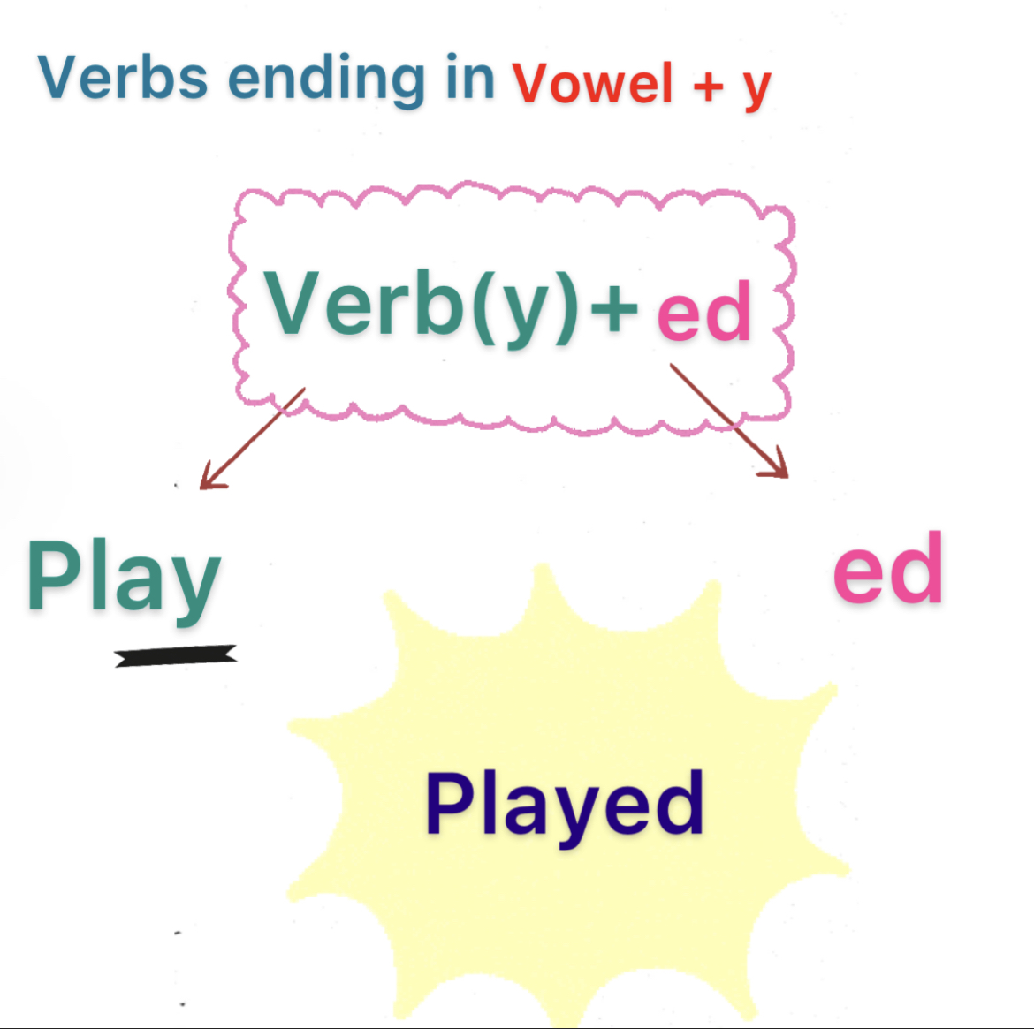

Slide 23
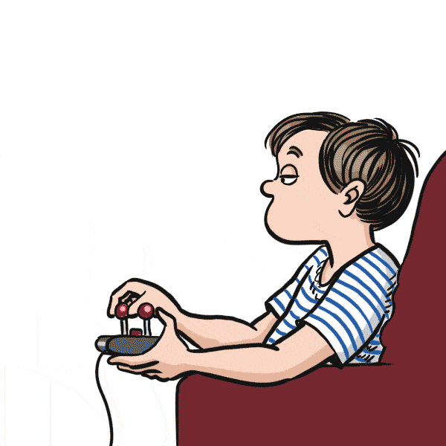
play
ed

Slide 24
stay
ed

Slide 25
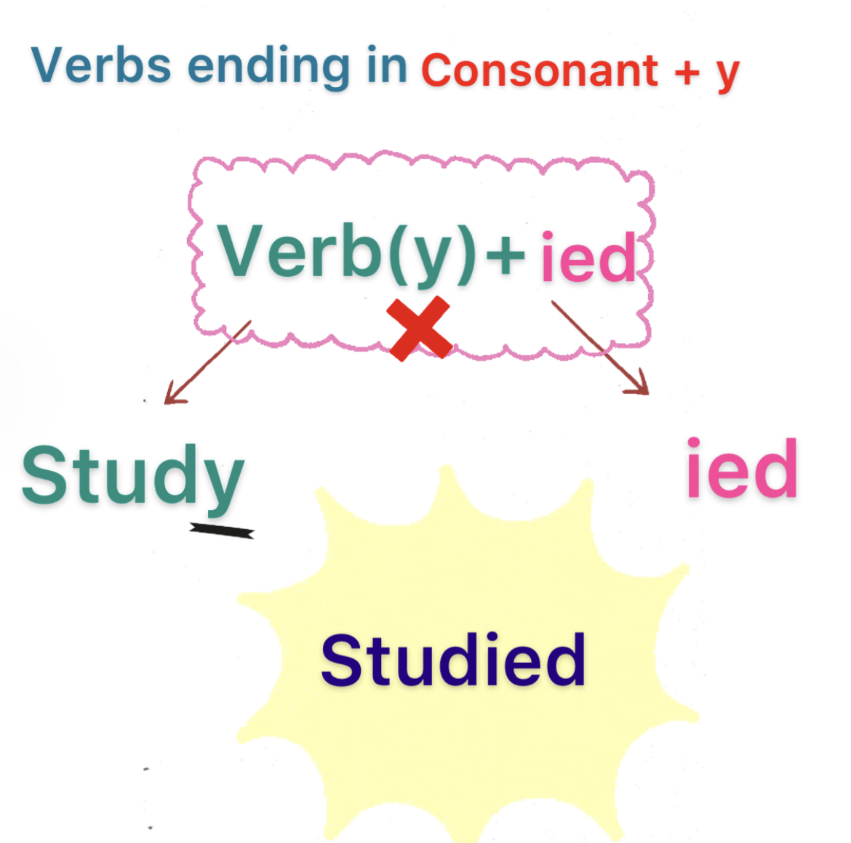

Slide 26
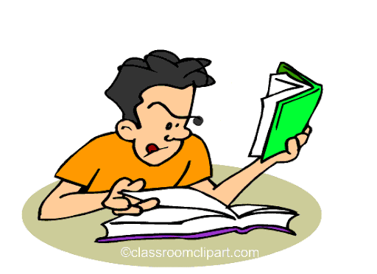
y
stud
ied

Slide 27
Page 51

Slide 28
Page 51

Slide 29
Notebook
Page 10

Slide 30
Notebook
Page 10

Slide 31
Notebook
Page 10

Slide 32
Practice

Slide 33
Homework
Pages 187 & 188

Slide 34
Page 187
cleaned
boring
spoke with my friends
Fantastic
great
played

Slide 35
Page 187
B
A
C

Slide 36
Page 188

Slide 37
Page 188
That’s scary
That’s boring
That’s okay
That’s great
That’s fantastic

Slide 38
Page 188
B
A
C

