Slide 1
Unit 7 Where do you live?
Workbook pages (213 – 216)

Slide 2
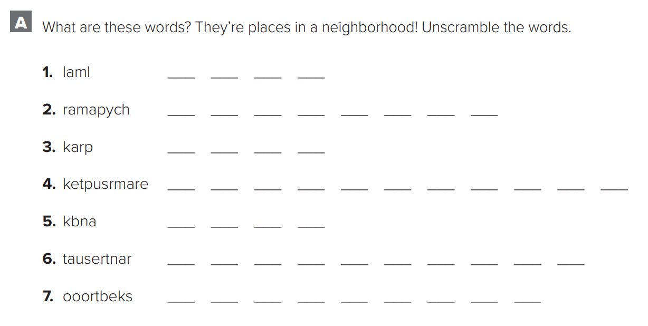
p.213
m
a
l
l
p
h
a
r
m
a
c
y
p
a
r
k
s
u
p
e
r
m
a
r
k
e
t
b
a
n
k
r
e
s
t
a
u
r
a
n
t
b
o
o
k
s
t
o
r
e

Slide 3
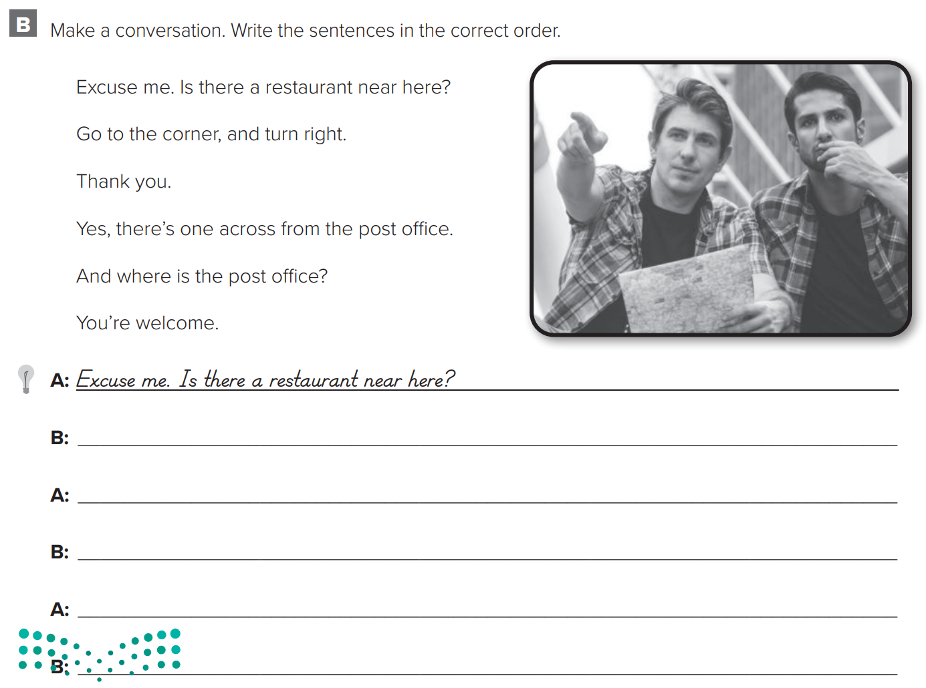
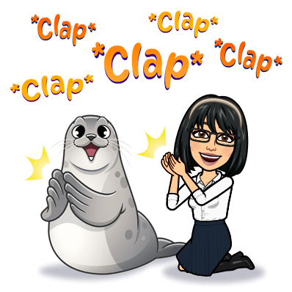
p.213
Yes, there’s one across from the post office
And where is the post office?
Go to the corner, and turn right.
Thank you
You’re welcome

Slide 4
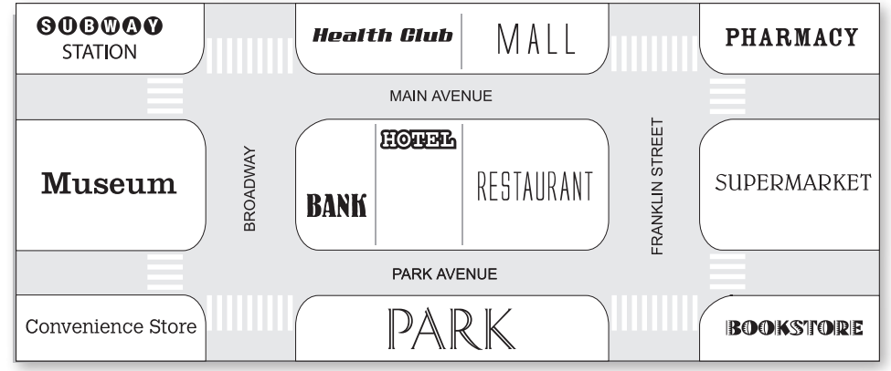
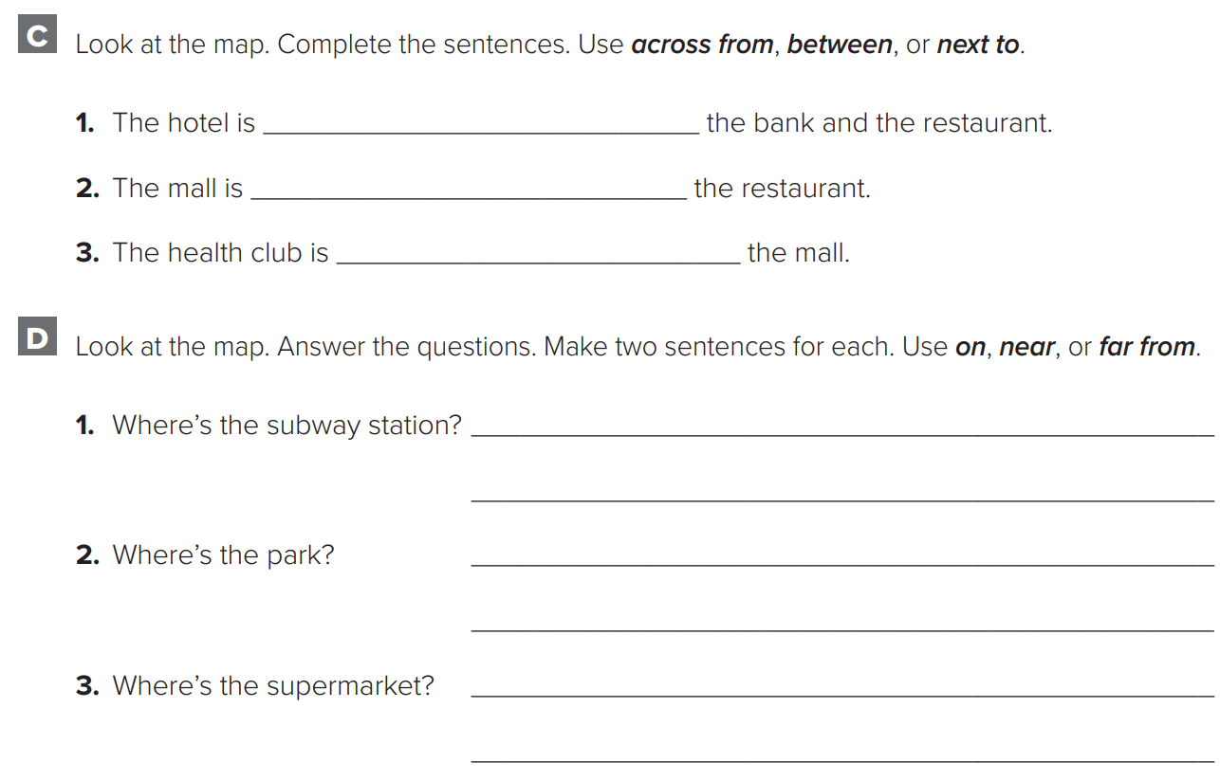
p.214
between
across from
next
The subway station is far from the bookstore.
The subway station is on Main Avenue.
The park is near the bank.
The park is on the Park Avenue.
The supermarket is far from the museum.
The supermarket is near the bookstore.

Slide 5
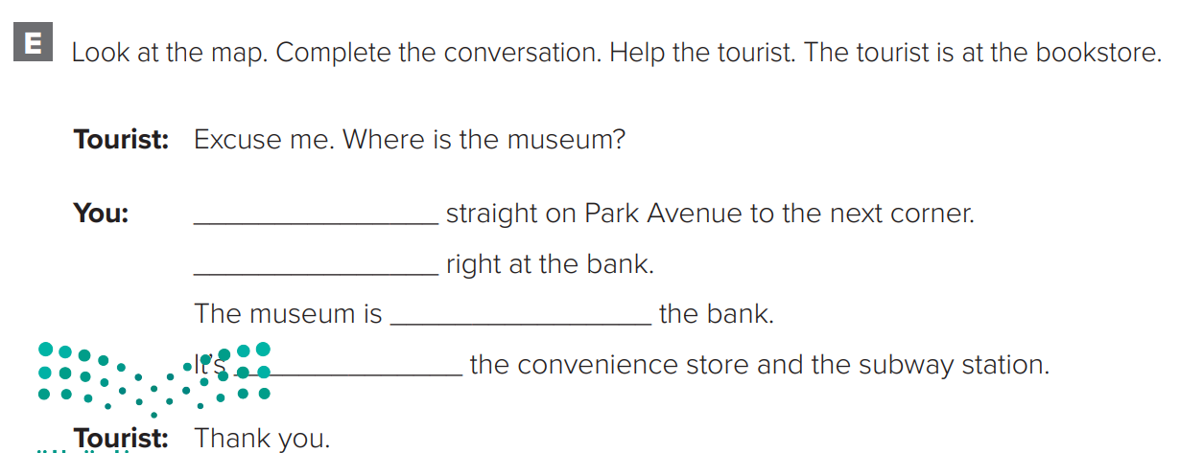
p.214
Go
Turn
across from
between

Slide 6
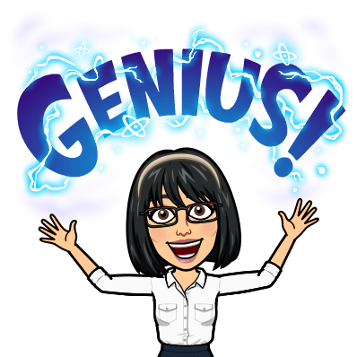
p.215
in
on
on
in
on

Slide 7
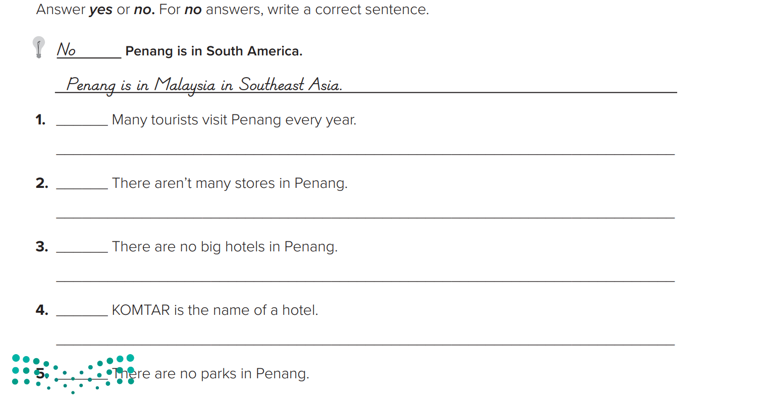
p.215
yes
no
There are over 200 stores
no
There are big hotels
no
It’s the name of the shopping mall
no
There are many beautiful parks

Slide 8
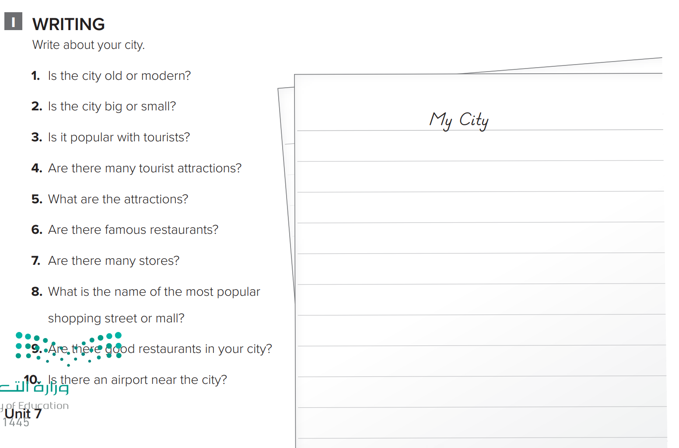
p.216
My city is very old. It is a small city. It is popular with tourists. There are a lot of tourist attractions. There are a lot of museums. There are more than a 100 stores in my city. There are shopping malls. There are very good restaurants in the city. Al-Baik is a good famous restaurant. There is an airport, but it is far from the city.

