Slide 1

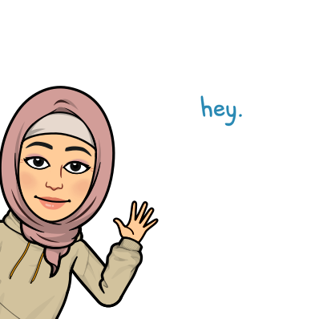
Good Morning

Slide 2

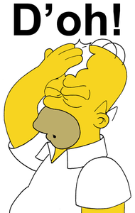

Mega goal.3.2
Everyone Makes Mistakes
Conversation

Slide 3
Objectives:
Use the "real talk" phrases in new sentences
Use "apologizing phrases" in a conversation
Jan
Feb
Mar
Apr
May
Jun
Jul
Aug
Sep
Oct
Nov
Dec
Jan
Feb
Mar
Apr
May
Jun
Jul
Aug
Sep
Oct
Nov
Dec
Answer questions about the conversation
Respond to an apology correctly

Slide 4

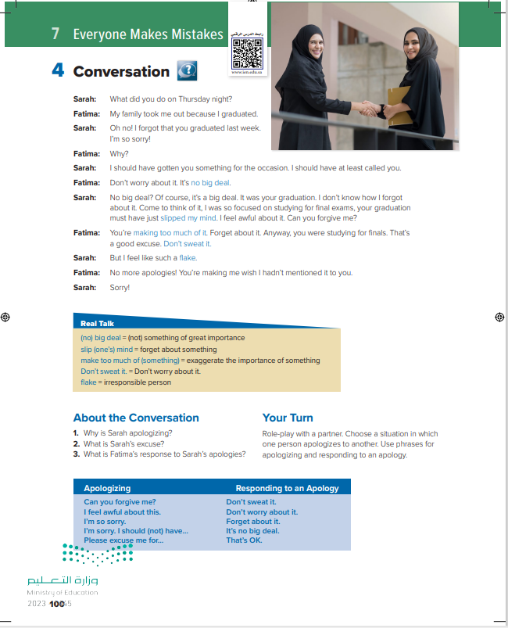
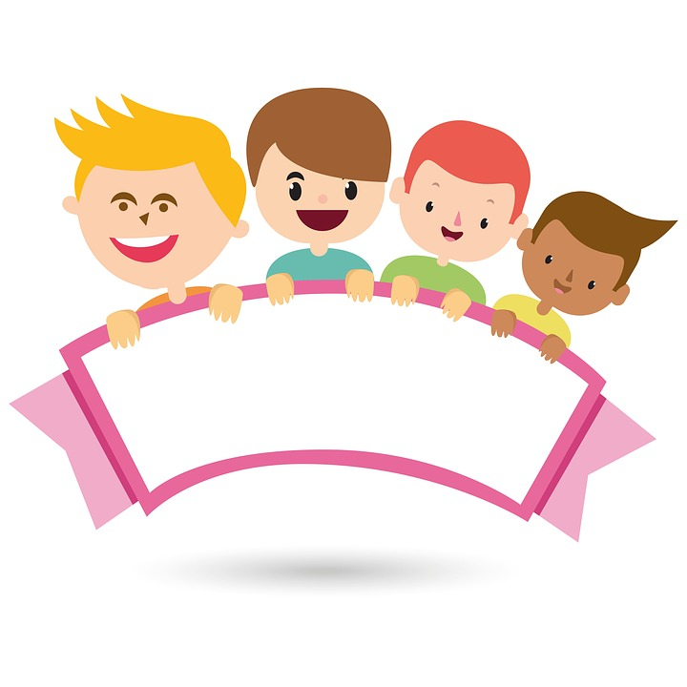
What can you see?
Students Book
P.100

Slide 5
What can you see?
Two young women shaking hands
What do you think happened?

Slide 6


What do you think happened?
listen with books closed
Sarah forgot about her friend Fatima’s graduation.

Slide 7
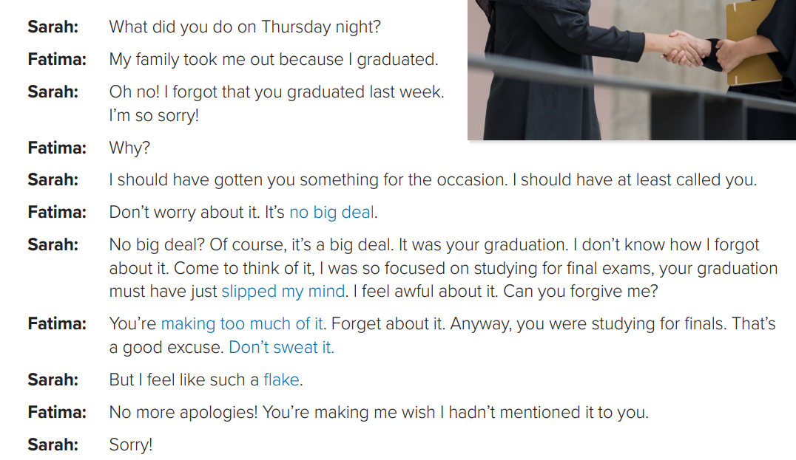
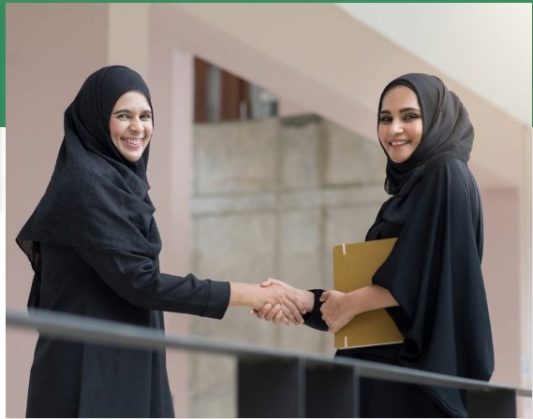
listen & Read Along

Slide 8
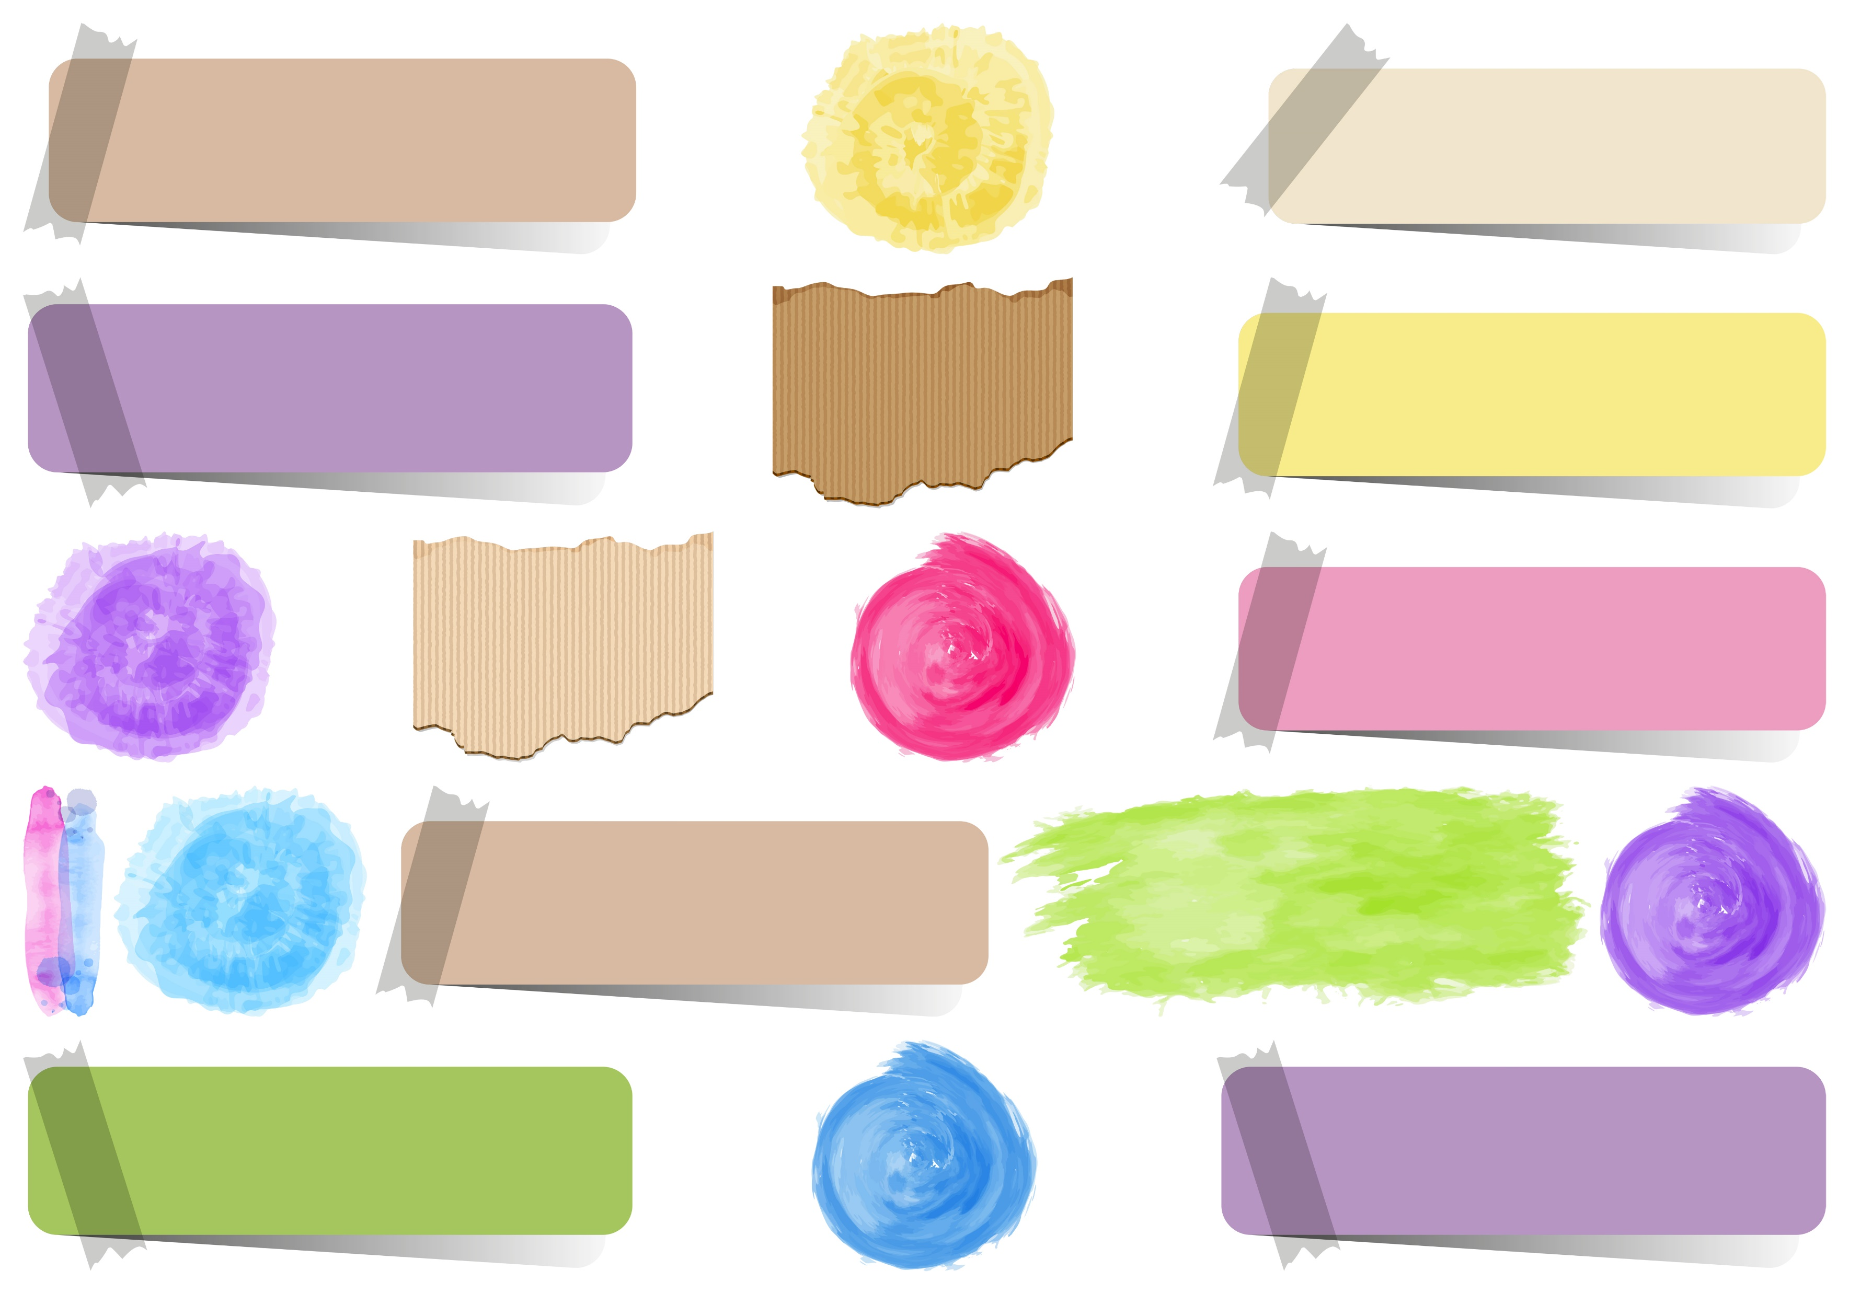
Whose graduation was it?
(Fatima’s)
What did she do for her graduation?
How does Sarah feel?
She feels very bad that she forgot about it

Slide 9
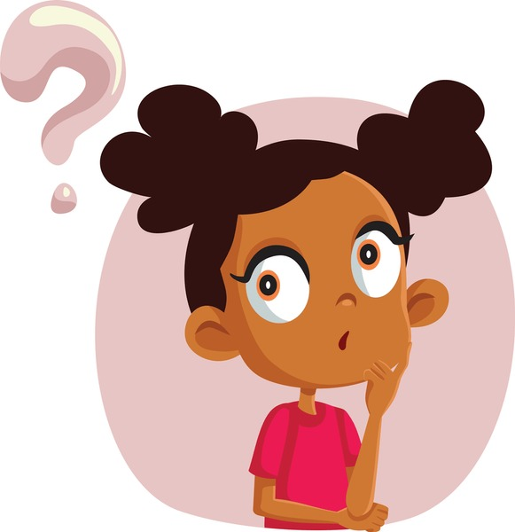
Who says…….?
means that she is not upset that Sarah forgot her graduation. This may not be true but Fatima doesn’t want Sarah to feel bad
Means that she knew about Fatima’s graduation, but somehow forgot about it at the last minute
means that it isn’t important enough for Sarah to keep apologizing for
means that she doesn’t want Sarah to talk or worry about it anymore
Means that she feels dumb for not remembering Fatima’s graduation

Slide 10
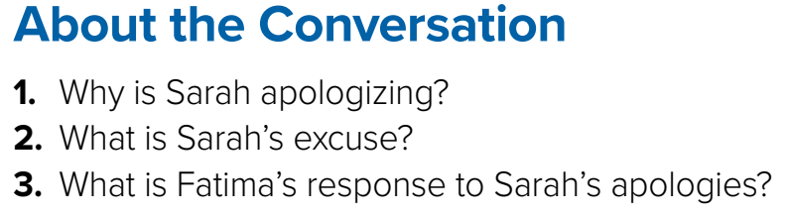
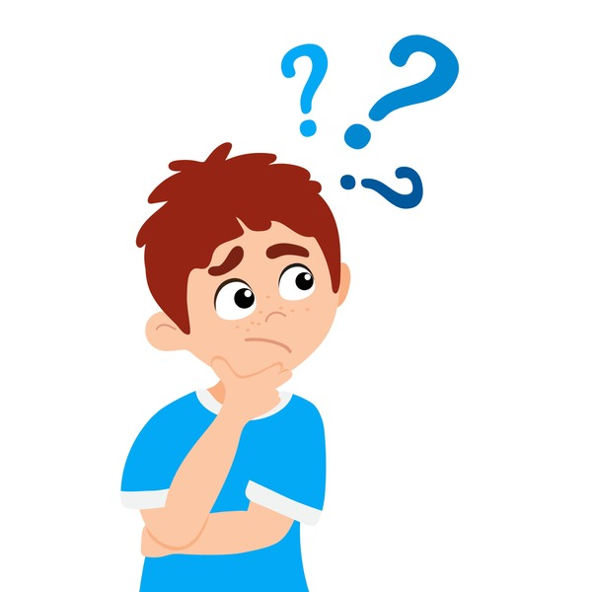
1. She’s apologizing for forgetting Fatima’s graduation day.
2. Sarah was focused on studying for final exams.
3. Fatima doesn’t mind. She tells Sarah not to worry about it.

Slide 11

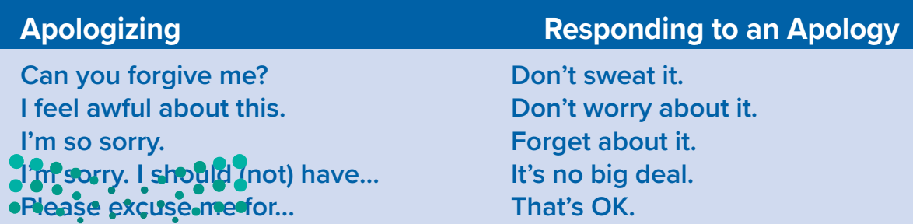
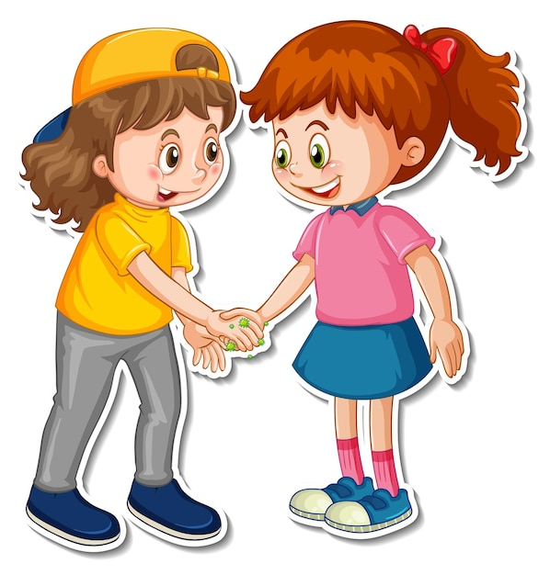
Role-play with a partner. Choose a situation in which one person apologizes to another. Use phrases for apologizing and responding to an apology.

Slide 12

Funding
Hissah Alotaibi​

