Slide 1


Good Morning

Slide 2



Mega goal.3.2
Everyone Makes Mistakes
Grammar

Slide 3
Objectives:
Express past options with "could have
Express an expected action with "was/were supposed to
Form a passive sentence in the past
Jan
Feb
Mar
Apr
May
Jun
Jul
Aug
Sep
Oct
Nov
Dec
Jan
Feb
Mar
Apr
May
Jun
Jul
Aug
Sep
Oct
Nov
Dec
Write conclusions about the past with "must have
Suggest uncertainty about the past with "might/may have
Write about mistakes made in the past with "should have

Slide 4
Modals in the Past
Passive Modals in the Past

Slide 5
Modals in the Past

Slide 6


You should use this content
What is..?
should
Modals
may,
might,
could
must,
(be) supposed to
should,

Slide 7


May Have/Might Have
Could Have
Could have + past participle
May/Might have + past participle
Do you think I could have left my cell phone at your house?
He could have been a doctor if he hadn’t made the mistake of dropping out of school
I lost my cell phone. I may have left it at school.
You might have dropped it at the restaurant.
used in
1.to talk about the past with uncertainty,
2. to talk about an option in the past that was not taken.
used to suggest uncertainty or possibility about the past

Slide 8
Must Have
Should Have
Must have + past participle
Should have + past participle
I got lost on the way here. I must have taken a wrong turn somewhere.
You should have apologized for your mistake.
They should have arrived by now
used
to talk about to talk about mistakes made in the past or expectations that have not been met.
used for drawing conclusions about the past

Slide 9

Was/Were Supposed To
Was/Were supposed to + base verb
Practice Makes It Perfect
The football game was supposed to start at 1:00, but it was postponed because of the rain.
Where were you last night? You were supposed to help me with my essay.
used to express that an expected action didn’t happen.

Slide 10
Practice Makes It Perfect

Slide 11
A. Circle the correct modal in the past to complete each sentence
1.I have a sore throat. I (should have / may have) caught your cold.
2. He (wasn’t supposed to / shouldn’t have) know about the business deal, but he found out by accident.
3. You have a big smile on your face in all the vacation pictures. You (should have / must have) had a great time.
4. I don’t know where she is, but she was very tired. She (should have / may have) gone to bed.
5. I (must have / should have) paid more attention in English class. Now I’m completely confused about the grammar.
6. I (must have / shouldn’t have) ordered that new laptop. It was way too expensive.
7. Did you get the package? It (was supposed to / must have) arrive by today.
8. You (may not have / should not have) said that. Now you’ve hurt your friend’s feelings.

Slide 12
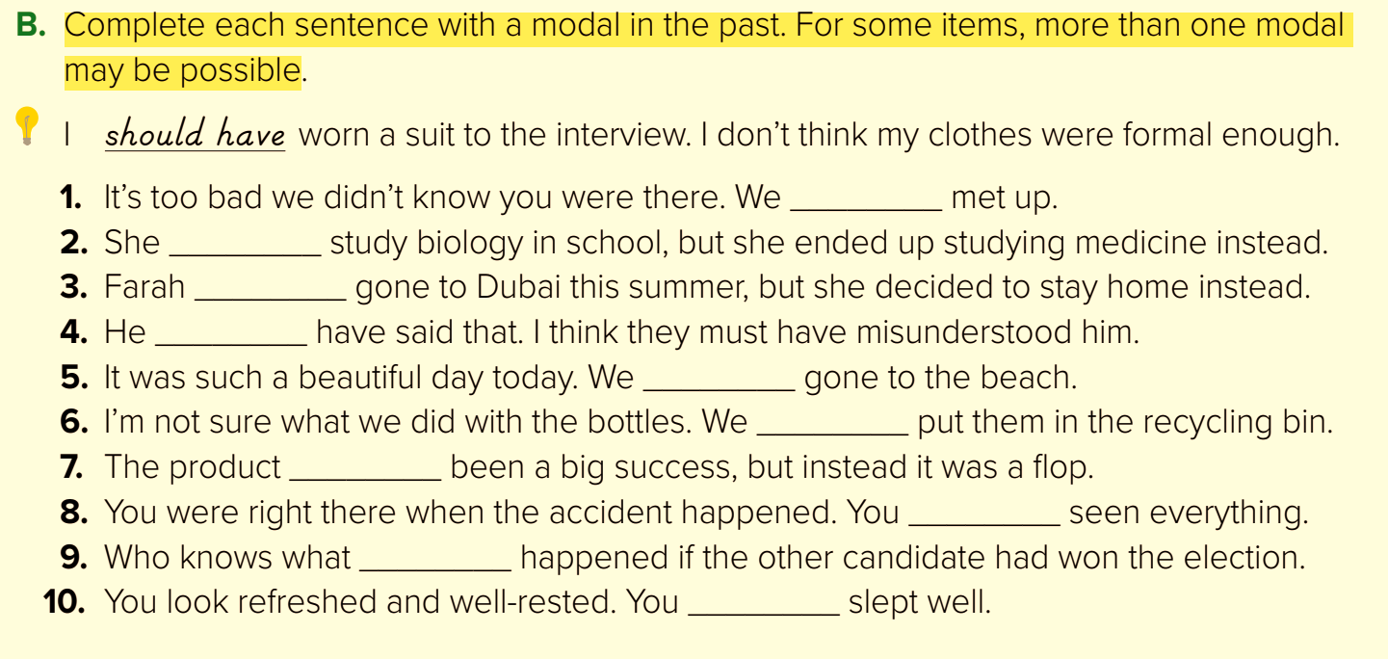
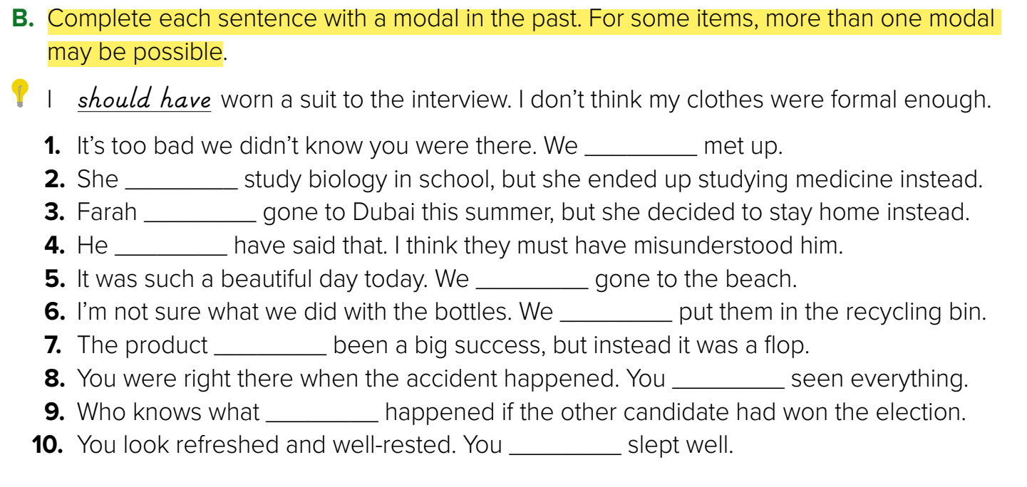
could have/might have
was supposed have
could have
couldn’t have
should have/could have
might have/may have
should have
must have/should have
might have/could have
must have

Slide 13
Passive Modals in the Past

Slide 14

Passive
active
The money could have been given to the poor
[We could have given the money to the poor.
The package should have been sent a week ago
[We should have sent the package a week ago

Slide 15
Passive modals in the past are used to give opinions about events and situations that happened in the past
Passive
Subject + Modal + have been + V.p.p
Practice Makes It Perfect
The money could have been given to the poor
The package should have been sent a week ago

Slide 16
Practice Makes It Perfect

Slide 17
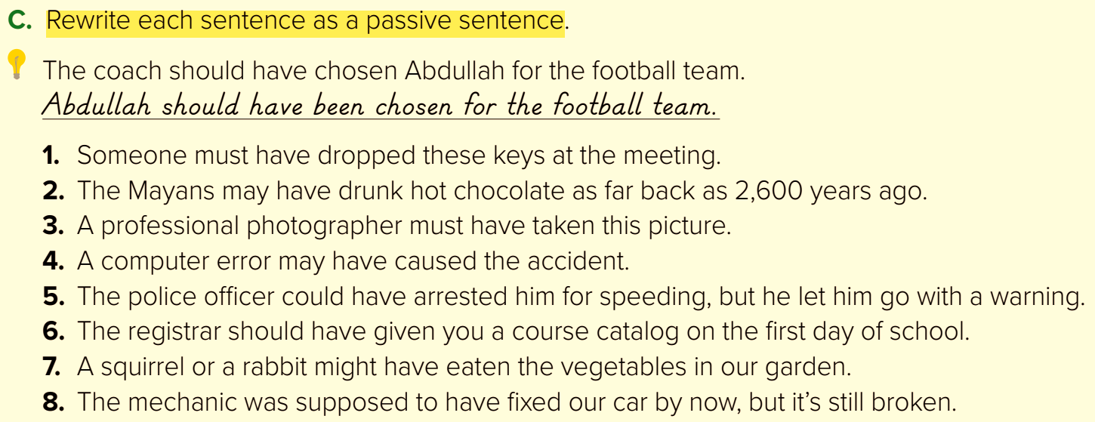
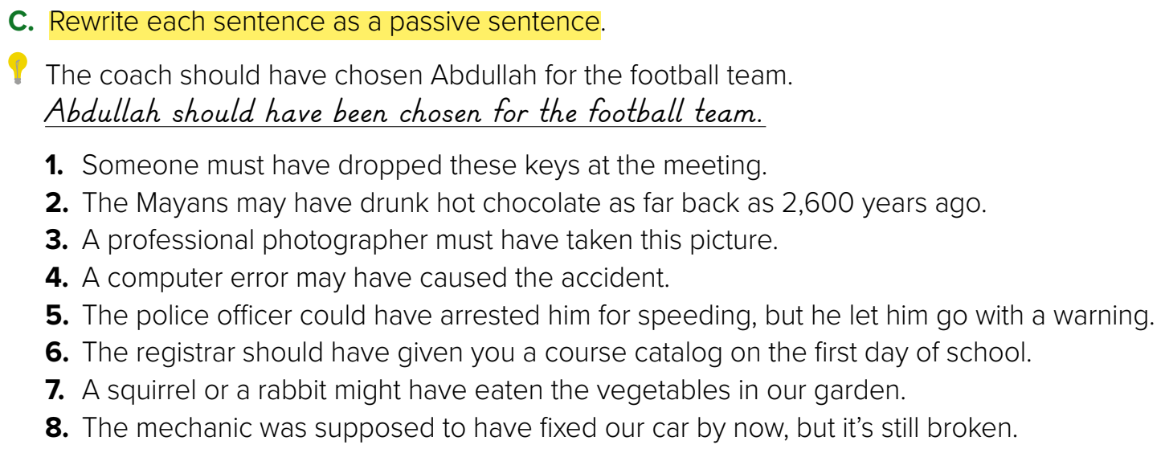
1.These keys must have been dropped at the meeting.
2. Hot chocolate may have been drunk by the Mayans as far back as 2,600 years ago.
3. This picture must have been taken by a professional photographer.
4. The accident may have been caused by a computer error.

Slide 18
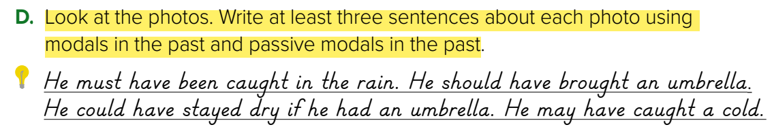

A. He must not have been expecting the good news. It might have been a surprise to him. The good news may have been given to him by his parents.
B. He must have just missed his train. He might have had a job interview. He should have gotten to the station earlier.
C. He might have forgotten something important. Whatever he forgot must have been important. He should have written it down.
D. The cup must have been made of ceramics. Somebody might have dropped it accidentally. It may have fallen out of a cabinet.

Slide 19

Funding
Hissah Alotaibi​

