Slide 1
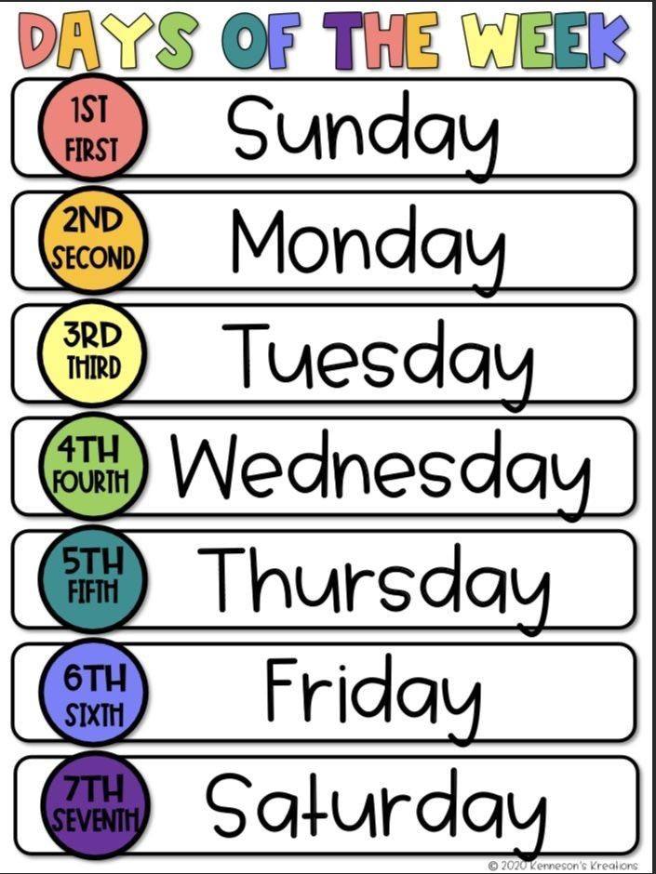



What’s the day today?
Notes:
ا

Slide 2
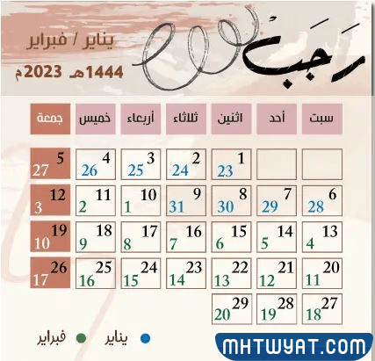
What’s the date today?

Slide 3
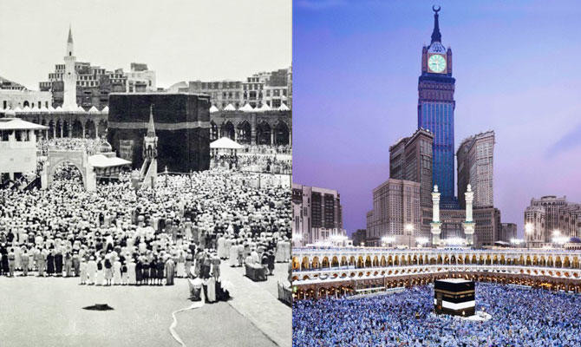
Past
Present

Slide 4
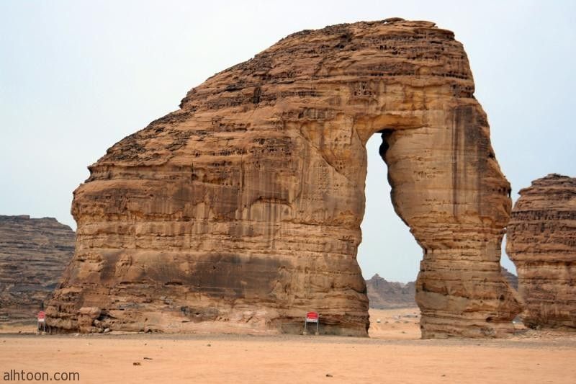
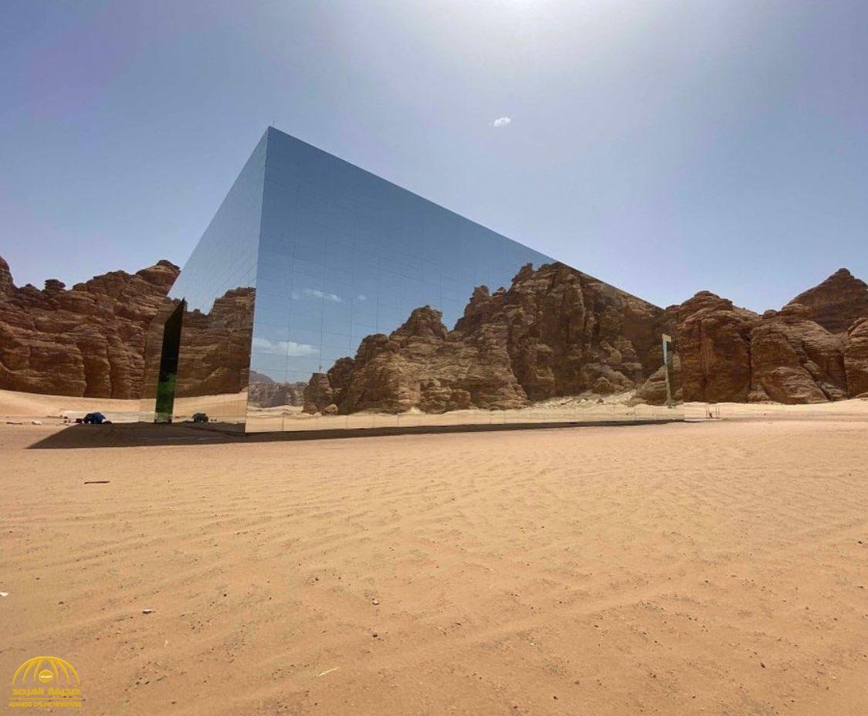
Past
Present

Slide 5


Slide 6


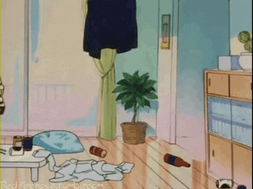



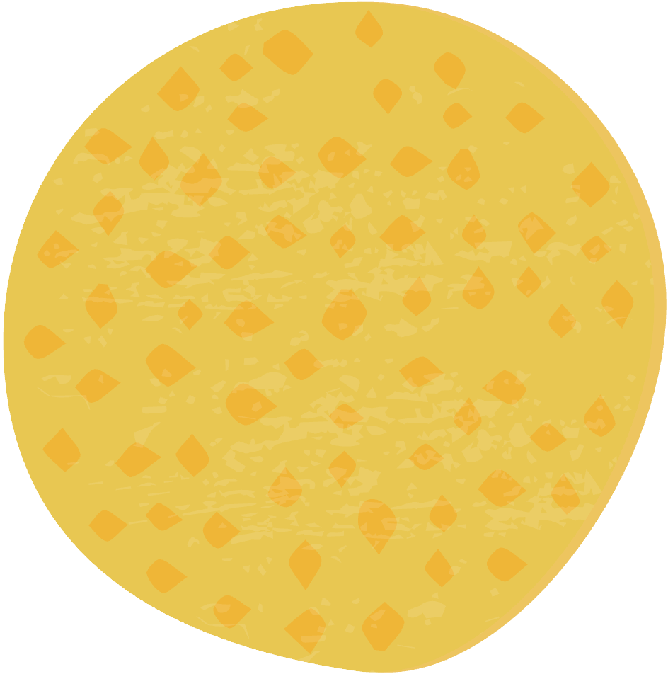

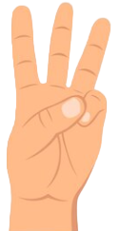


What did you do over the weekend?
01
I cleaned my room .
Objectives
02
I watched TV.
Conclusions
Contact
03
I clean my room .

Slide 7

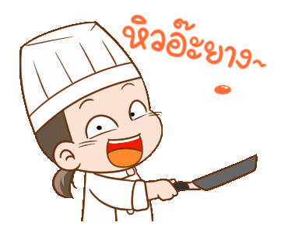
What did she do over the weekend?
01
She kicked a ball.
Objectives
02
She cooked the dinner
Contact
03
She cooks the dinner

Slide 8

What did he do over the weekend?
01
He played football.
Objectives
02
He watched a movie .
Contact
03
He watches a movie .

Slide 9


Slide 10
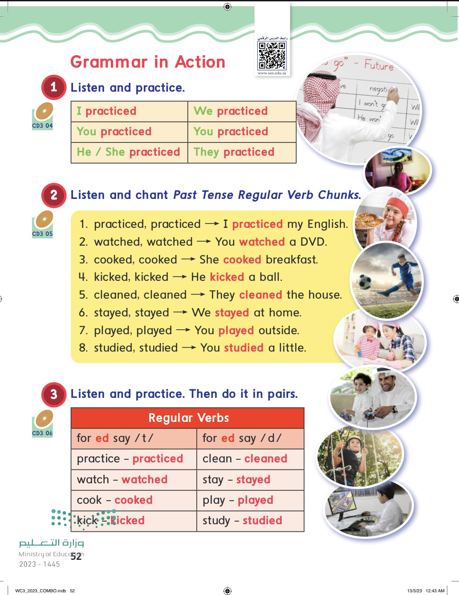
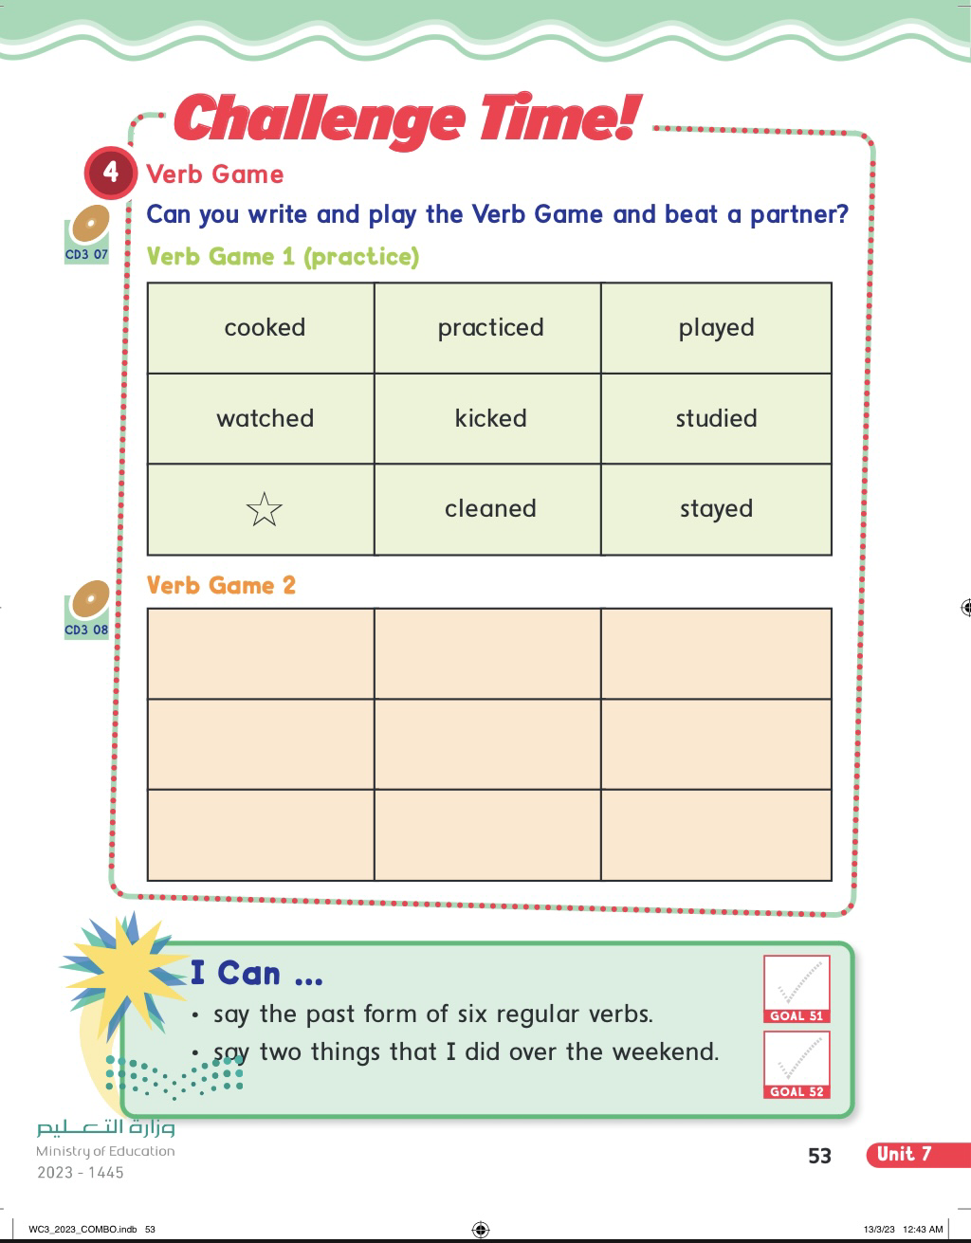

Slide 11
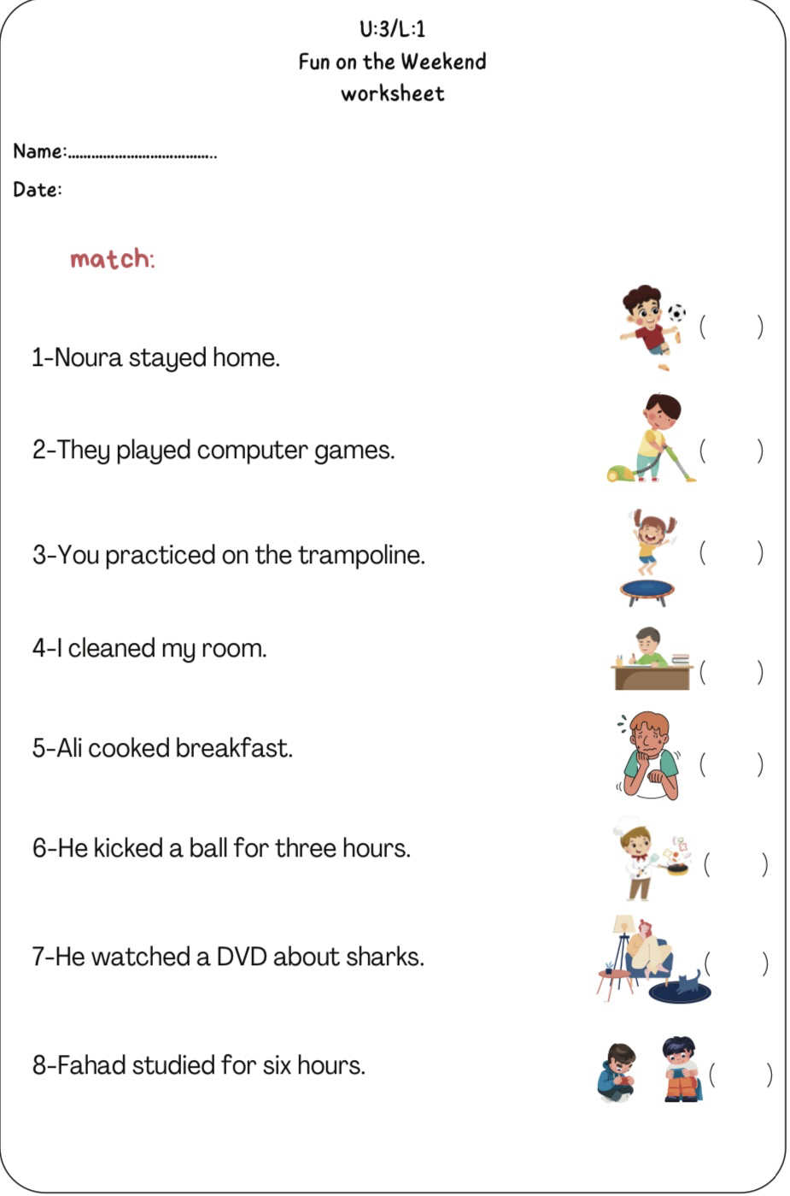

Slide 12
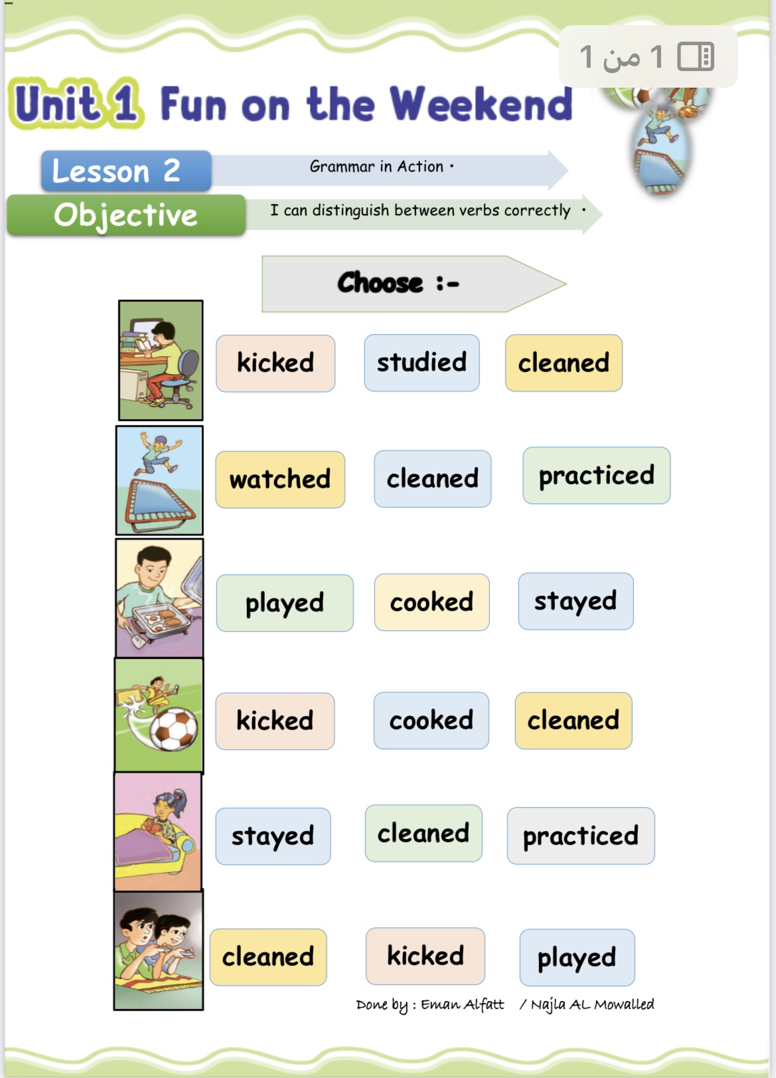

Slide 13

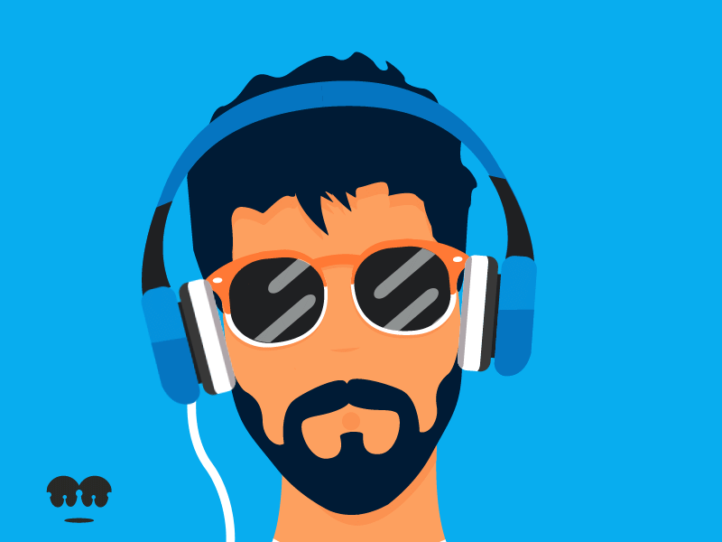
Listen and practice .
I practiced
We practiced
You practiced
You practiced
He /She practiced
They practiced

Slide 14
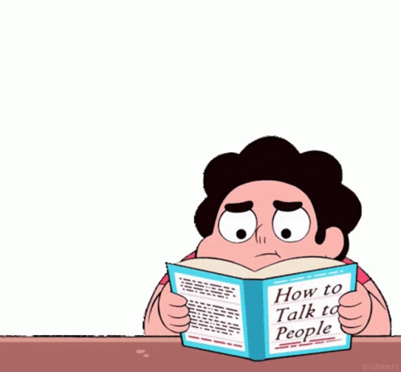

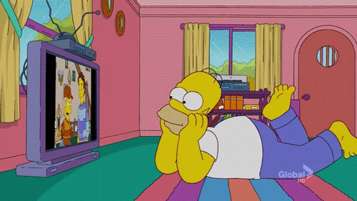
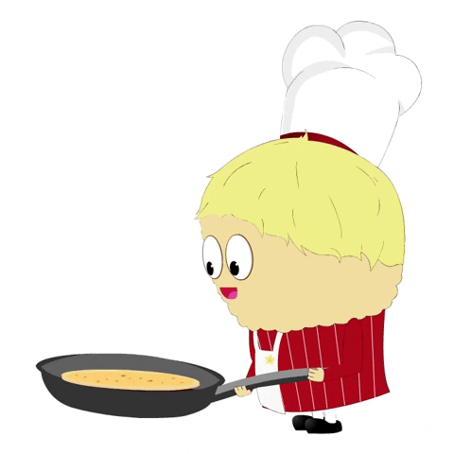
Listen and chant Past Tense Regular Verb Chunks .
1. practiced, practiced I practiced my English.
2. watched, watched You watched a DVD.
3. cooked, cooked She cooked breakfast.

Slide 15
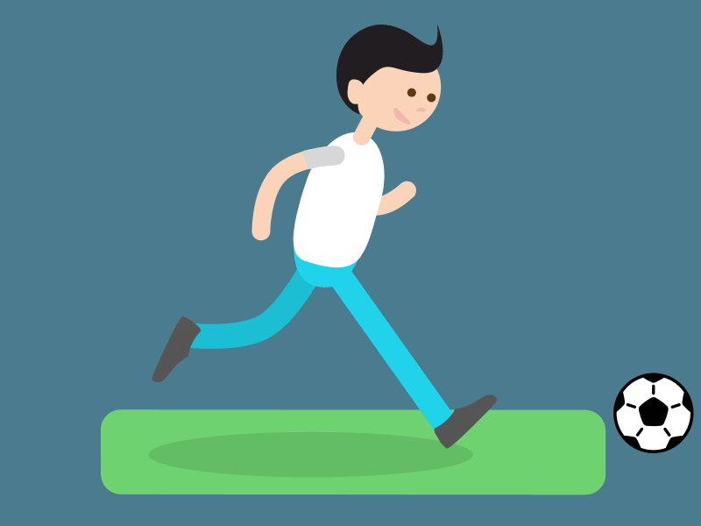
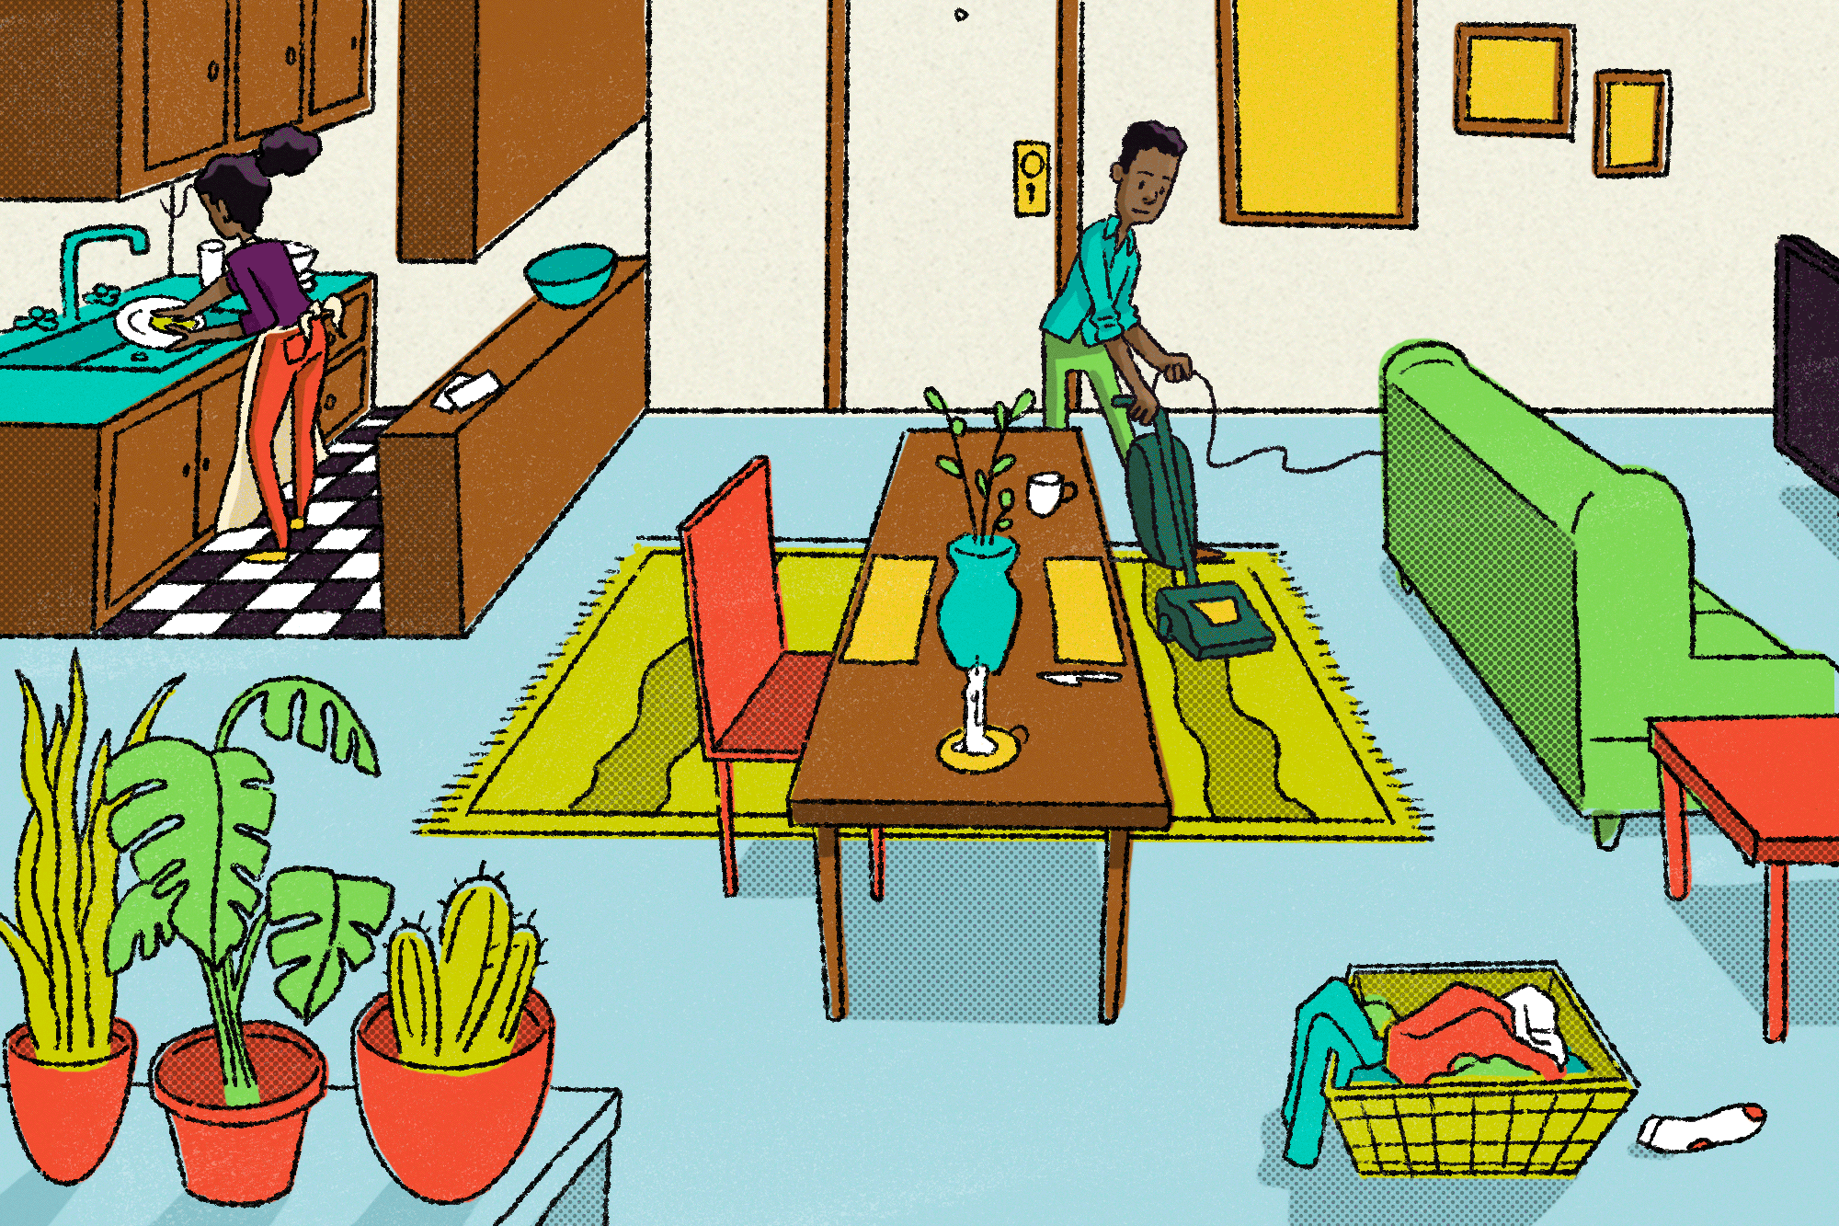

Listen and chant Past Tense Regular Verb Chunks .
4. kicked, kicked He kicked a ball.
5. cleaned, cleaned They cleaned the house.
6. stayed, stayed We stayed at home.

Slide 16
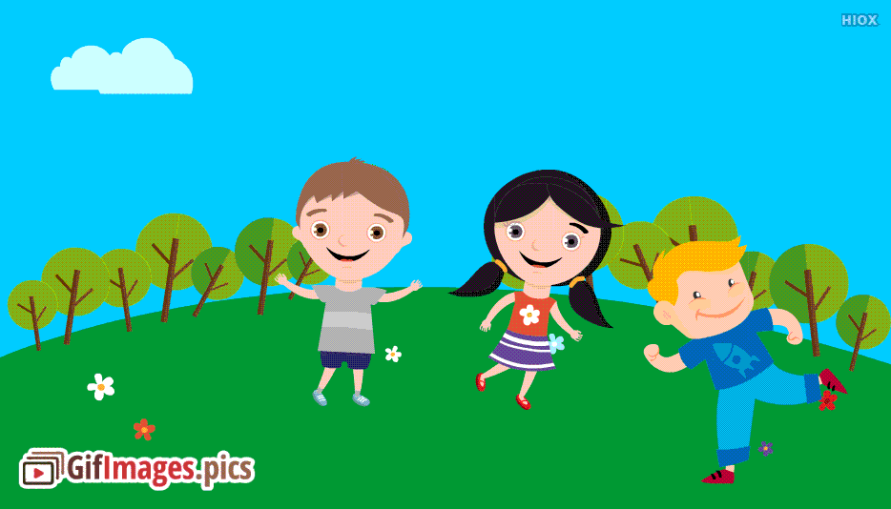
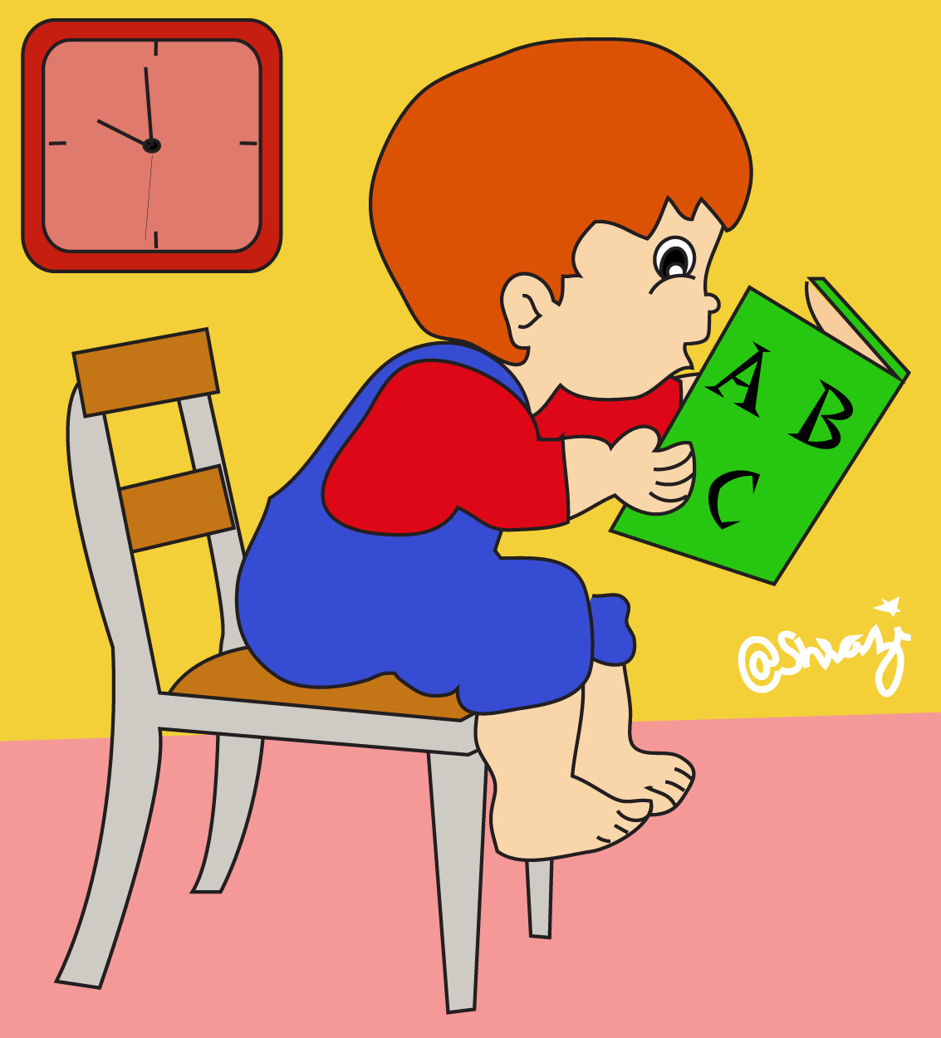
Listen and chant Past Tense Regular Verb Chunks .
7. played, played You played outside.
8. studied, studied You studied a little.

Slide 17

Listen and practice . Then do it in pairs .
Regular verbs
for ed say / t/
for ed say/ d/
Practice - practiced
Clean - cleaned
Watch - watched
Stay - stayed
Cook - cooked
Play - played
Kick - kicked
Study - studied

Slide 18
Choose the correct sound
Played
- /d/
- /t/

Slide 19
Choose the correct sound
cooked
- /d/
- /t/

Slide 20
Choose the correct sound
stayed
- /d/
- /t/

Slide 21
Choose the correct sound
watched
- /d/
- /t/

Slide 22


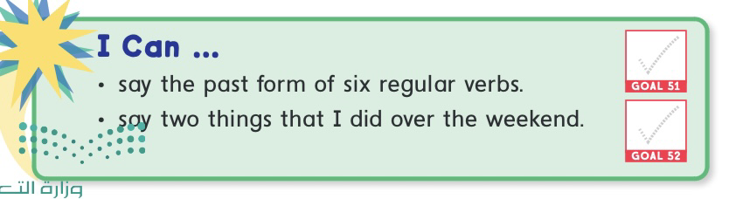

Slide 23

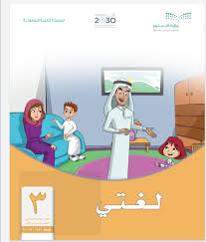
Did you study about past in other school subjects?

Slide 24
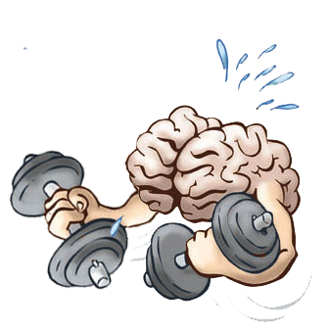

Slide 25
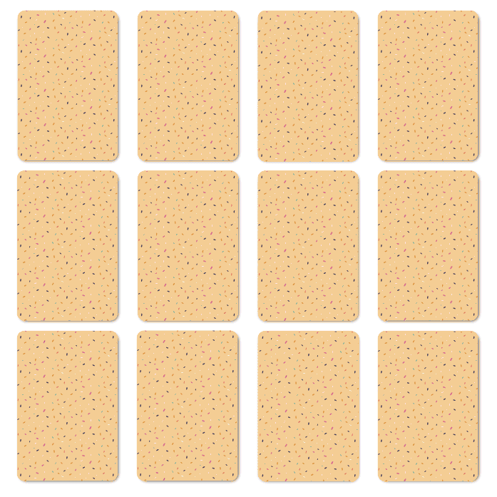

Slide 26
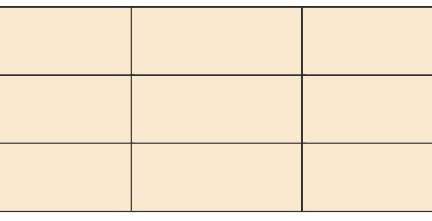
cooked
Played
kicked

Slide 27
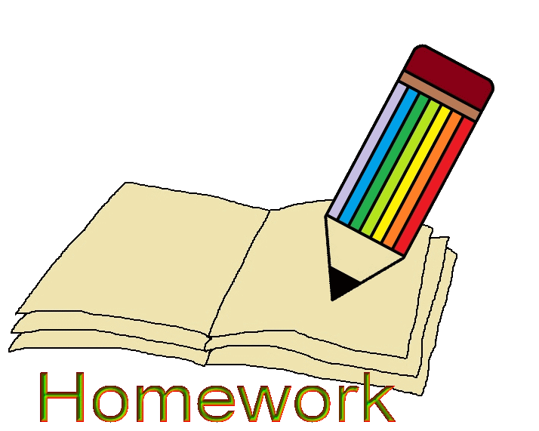

Slide 28
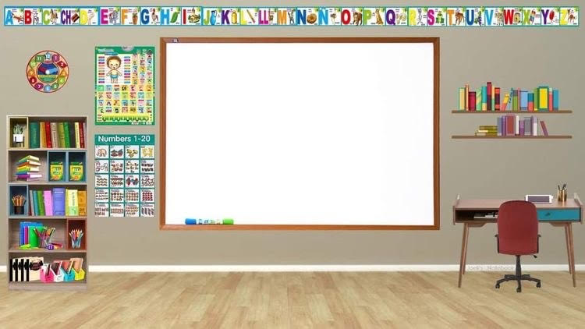
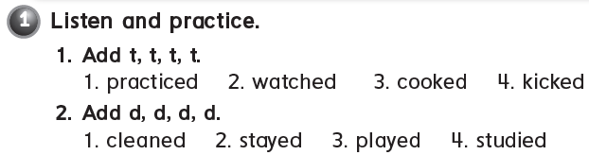

73

Slide 29

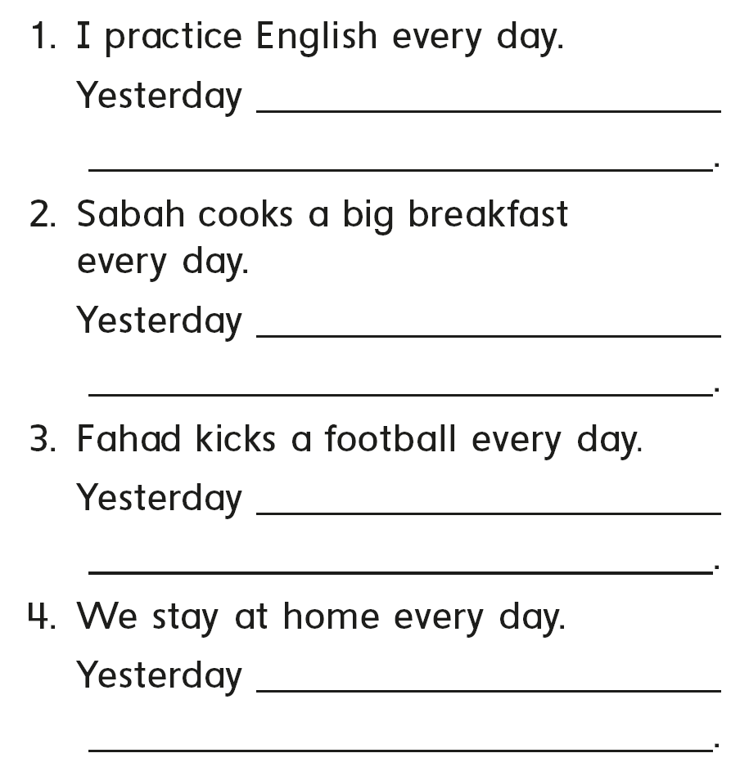
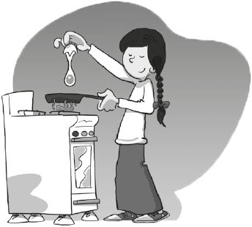
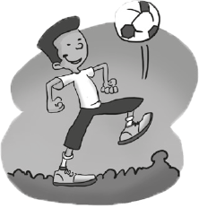
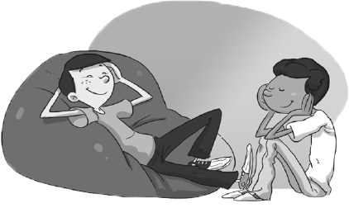
I practiced English
she cooked a big breakfast
he kicked football
stayed home
73

Slide 30

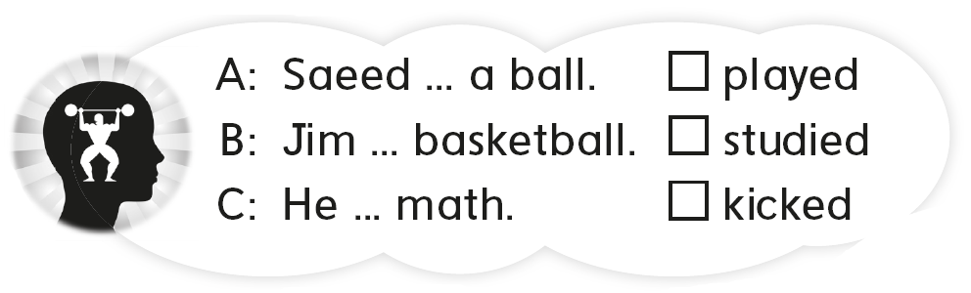
B
C
A
73

Slide 31

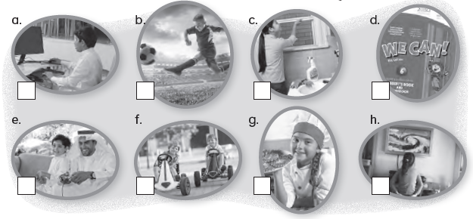
8
4
5
1
6
7
3
2
74

Slide 32
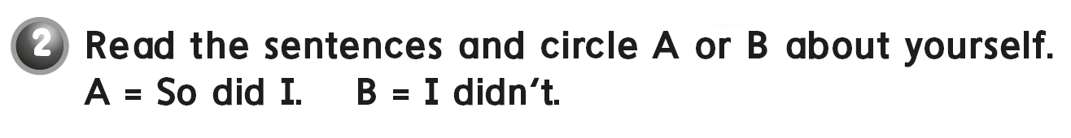
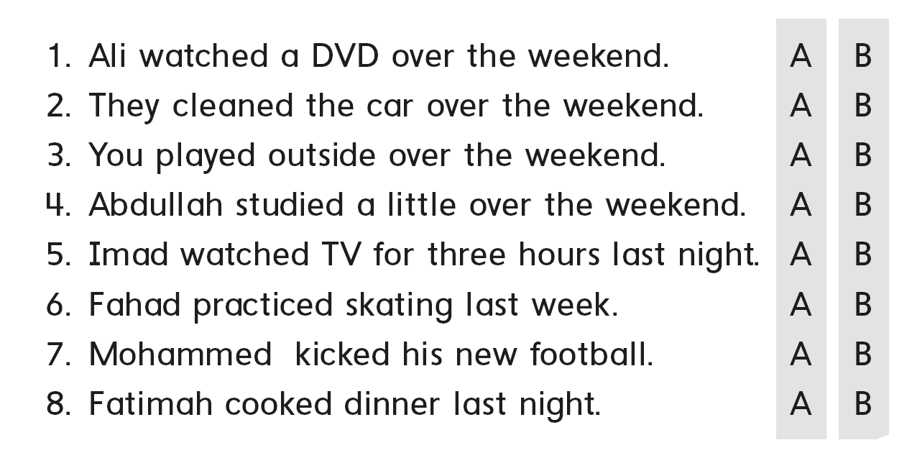
74

Slide 33

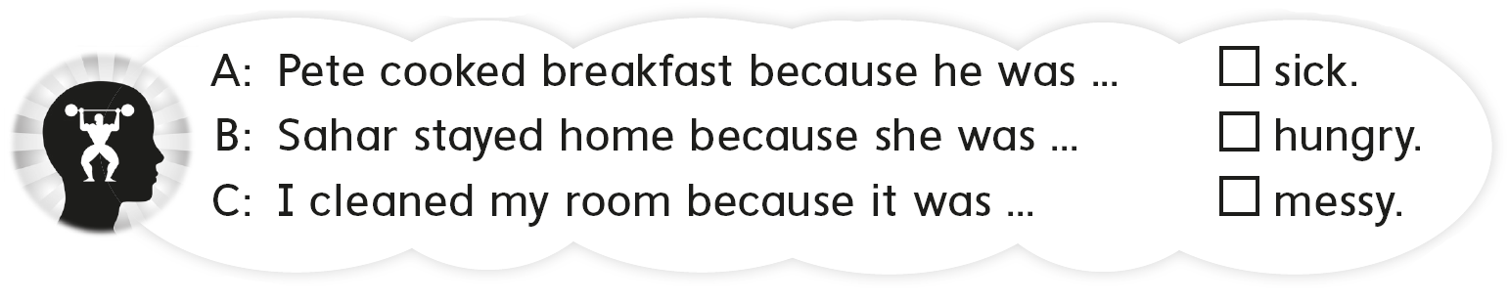
B
A
C
74

