Slide 1

Unit 7
Fun on the weekend
Grammar in Action

Slide 2




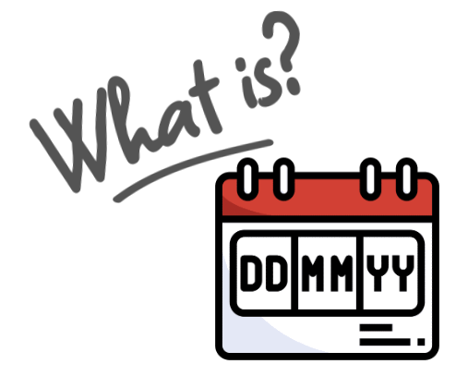




Slide 3

Homework

Slide 4
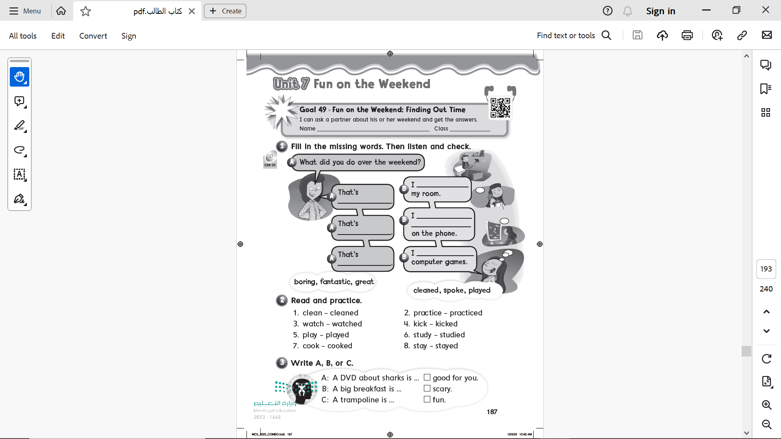

Page 187
cleaned
boring
spoke with my friends
Fantastic
great
played

Slide 5
Page 187
B
A
C

Slide 6
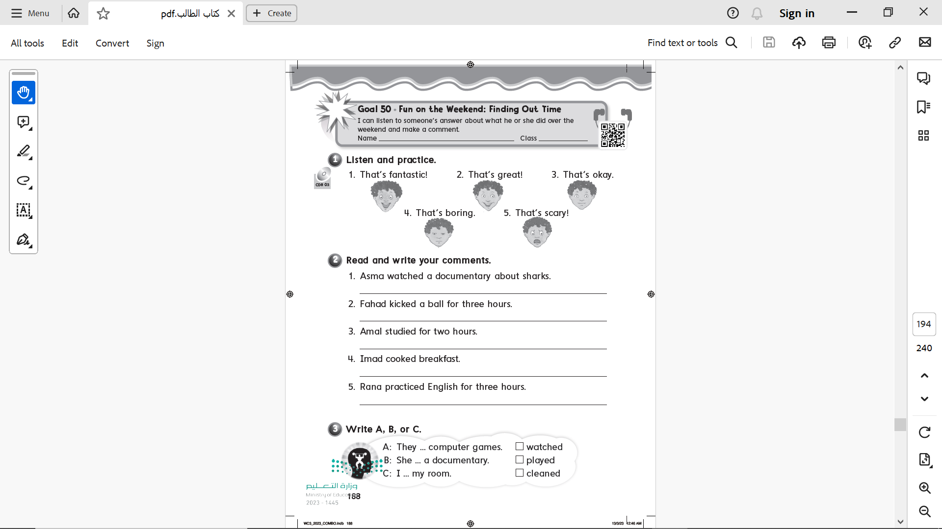
Page 188

Slide 7
Page 188
That’s scary
That’s boring
That’s okay
That’s great
That’s fantastic

Slide 8
Page 188
B
A
C

Slide 9
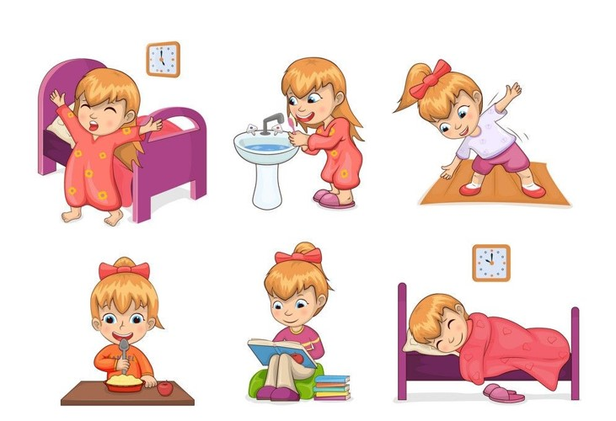
What did you do over the weekend?
Warm up

Slide 10






Slide 11
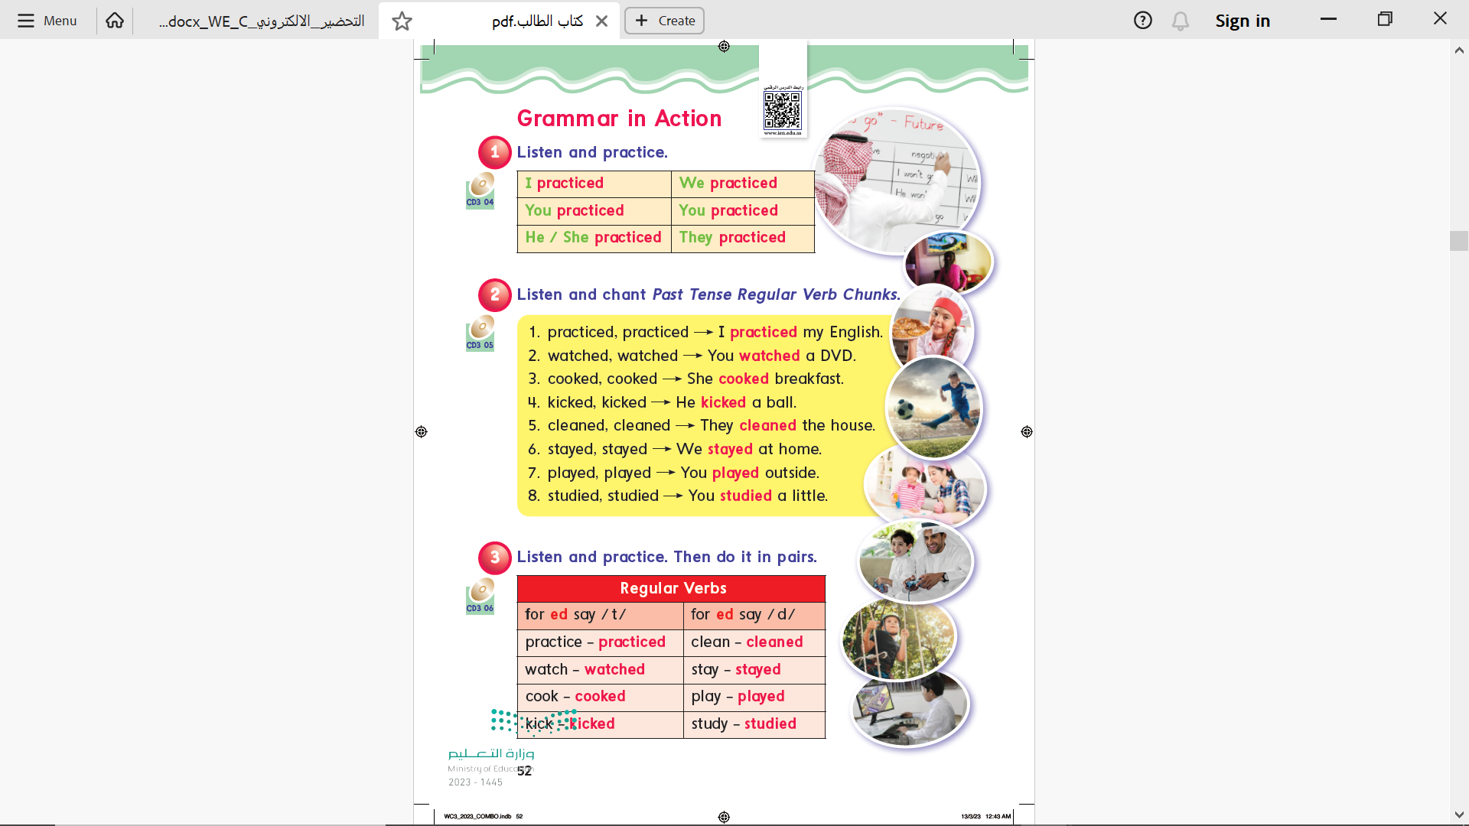
Page 52

Slide 12
Page 52

Slide 13
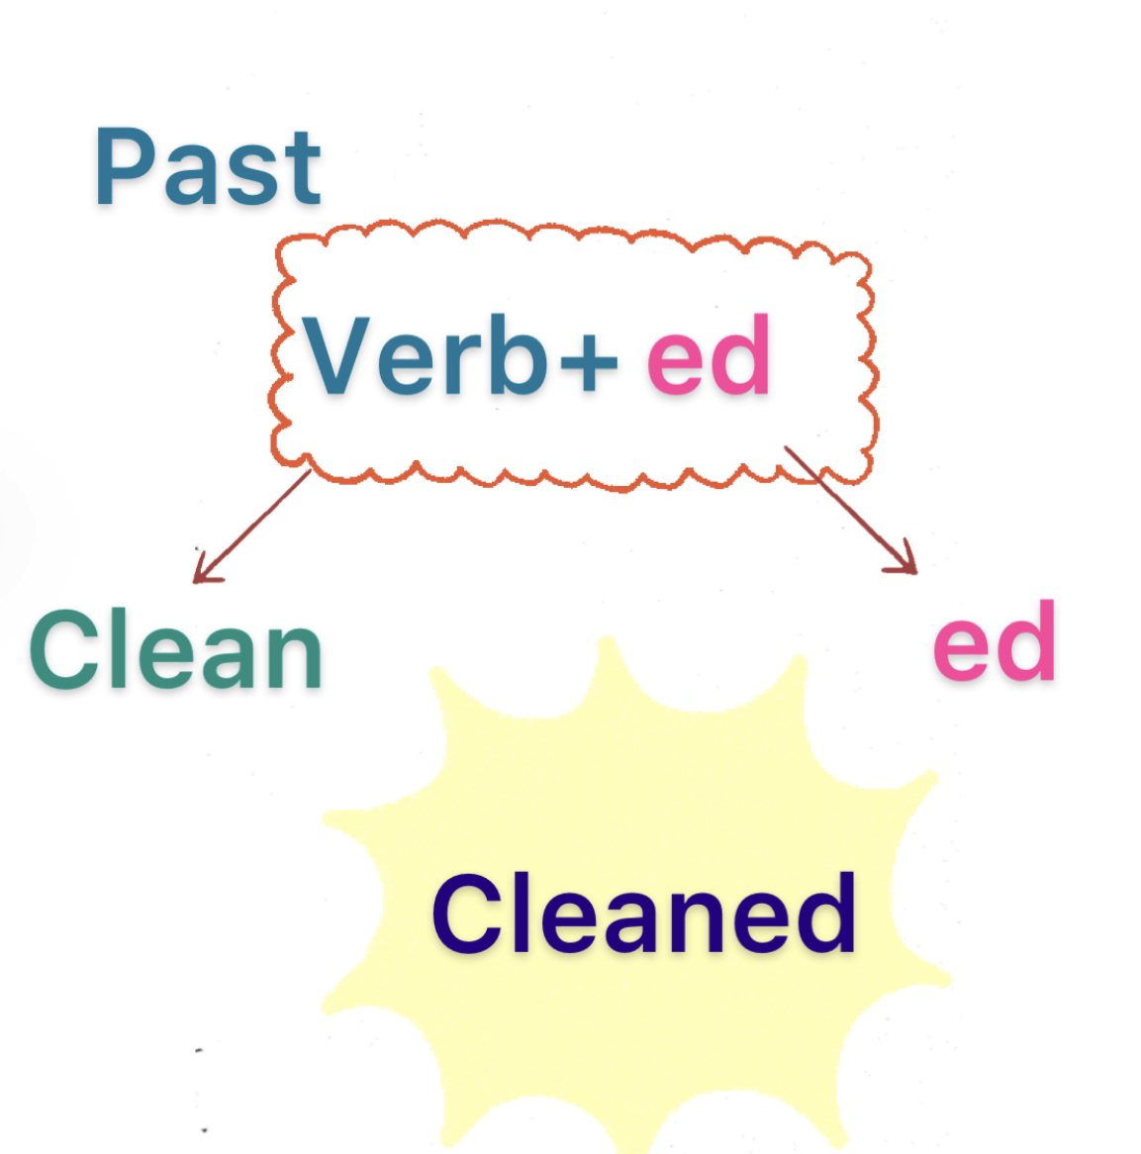

Slide 14
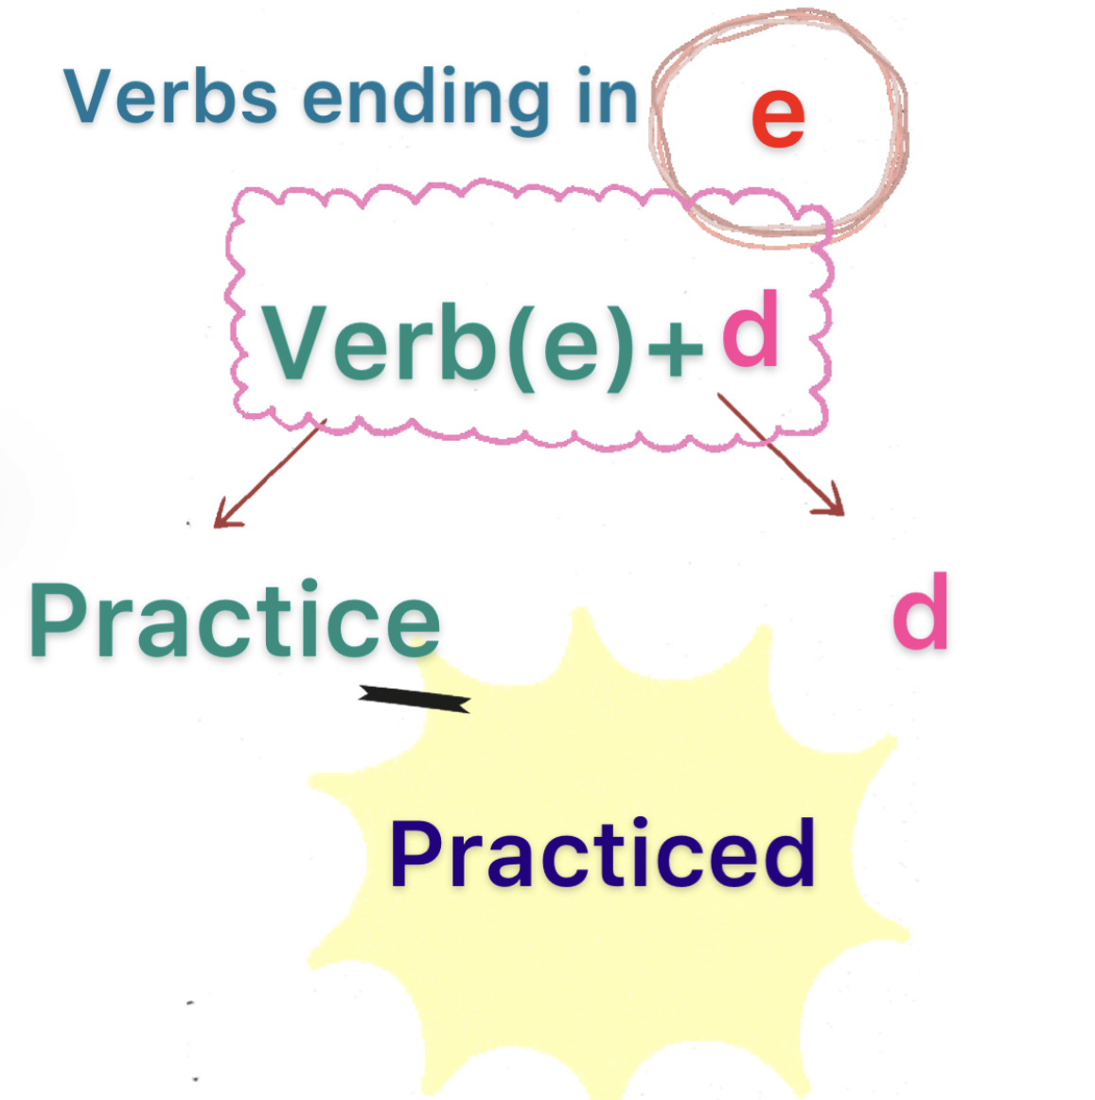

Slide 15
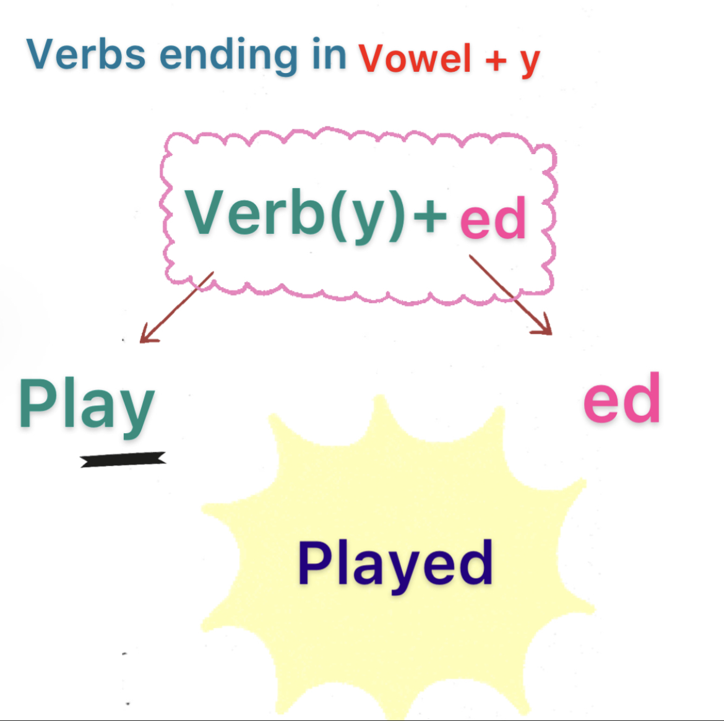

Slide 16
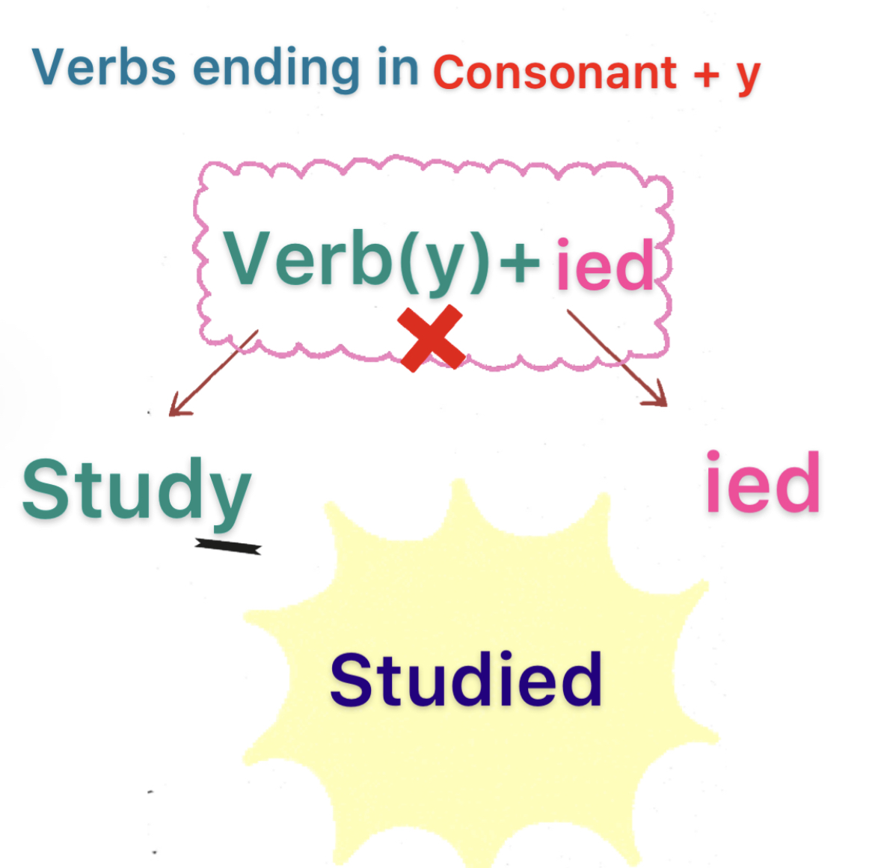

Slide 17
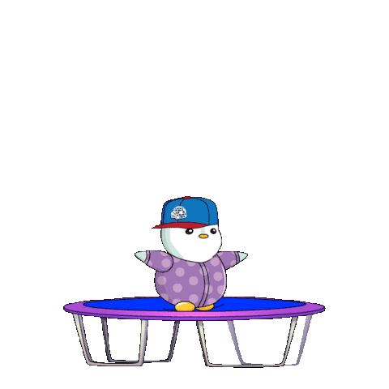
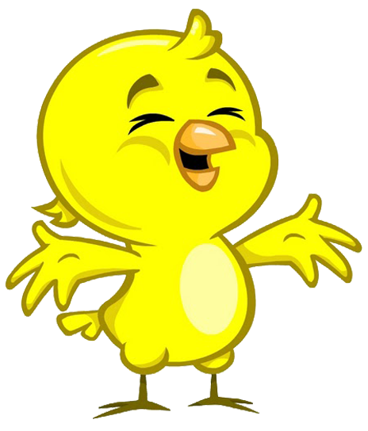
What did you do over weekend ?
Practice
ed
ied
d
es
أحسنت إجابة صحيحة

Slide 18
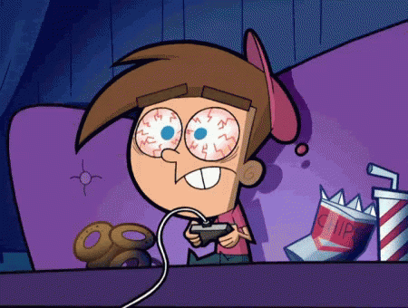
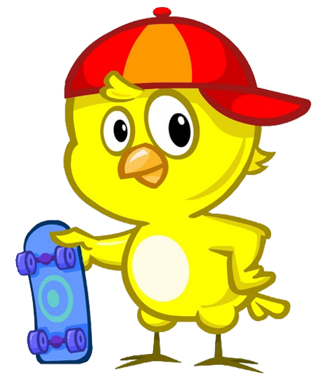
What did you do over weekend ?
computer game
I
play
ed
ing
ied
d
أحسنت إجابة صحيحة

Slide 19
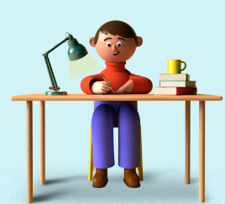
What did you do over weekend?
I
study
ed
ied
S
d
أحسنت إجابة صحيحة

Slide 20
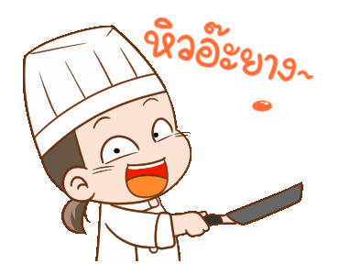
What did you do over weekend ?
She
Cook
ied
ed
d
ing
أحسنت إجابة صحيحة

Slide 21
Page 52

Slide 22
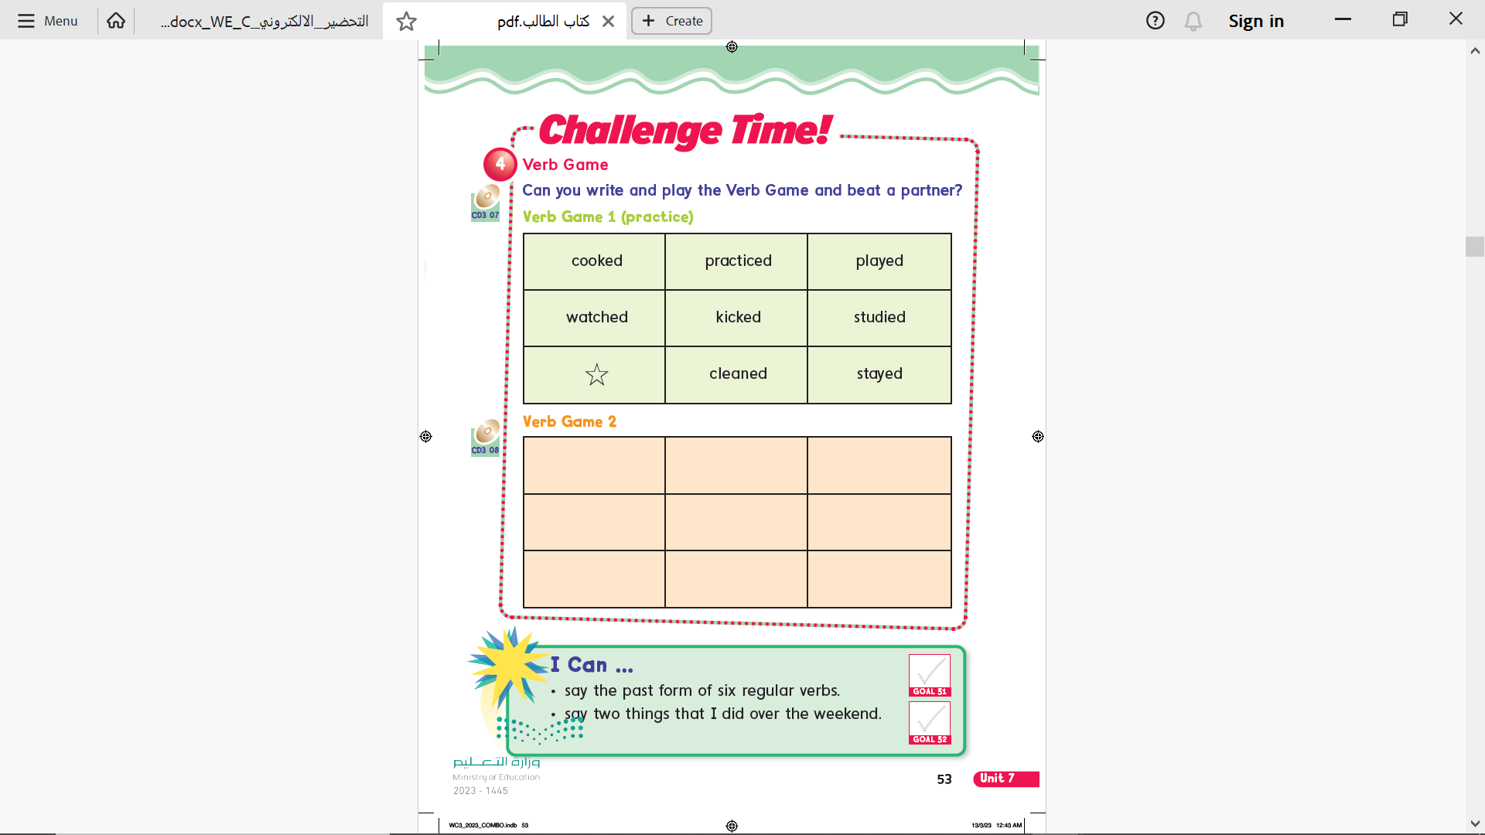
Page 53
cooked
practiced
played
watched
kicked
studied
cleaned
stayed

Slide 23
Page 53

Slide 24
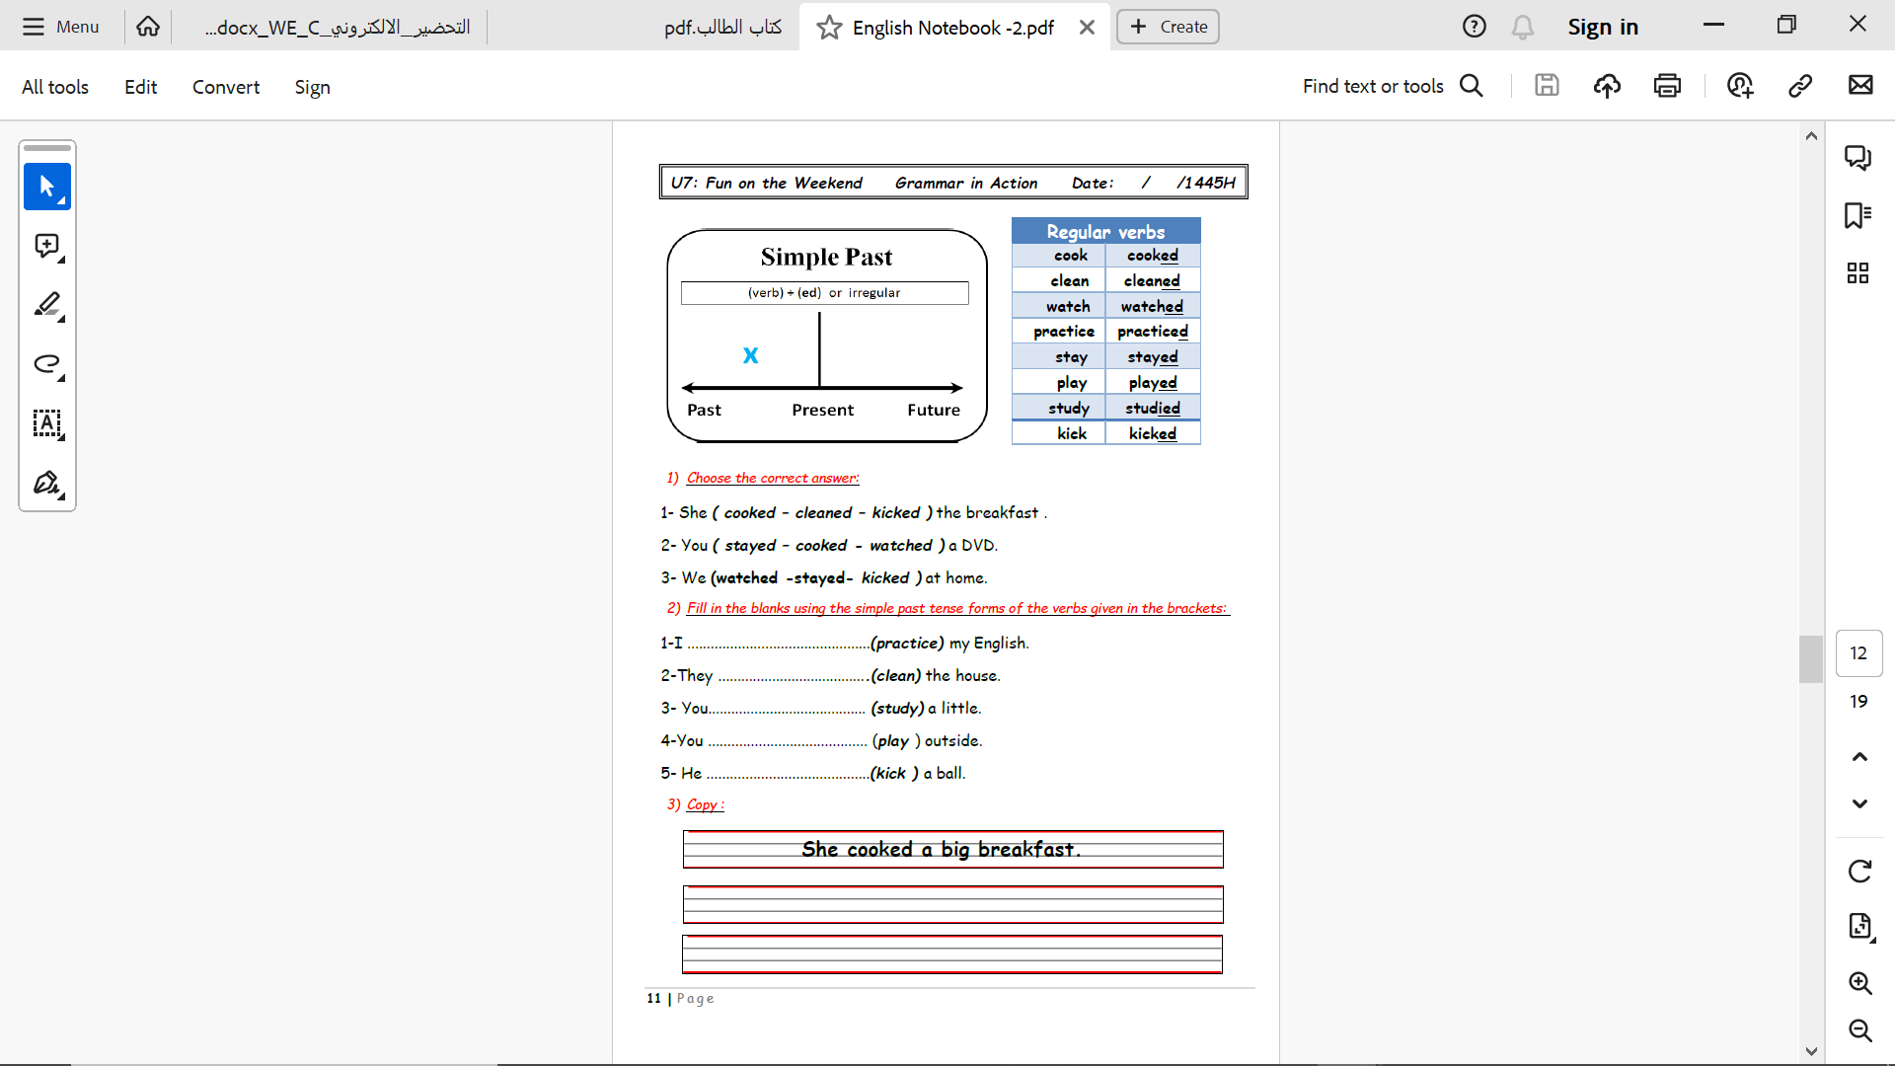
Notebook
Page 11

Slide 25
practiced
cleaned
studied
played
kicked
Notebook
Page 11

Slide 26
Notebook
Page 11

Slide 27
Homework
Pages 189 & 190

Slide 28
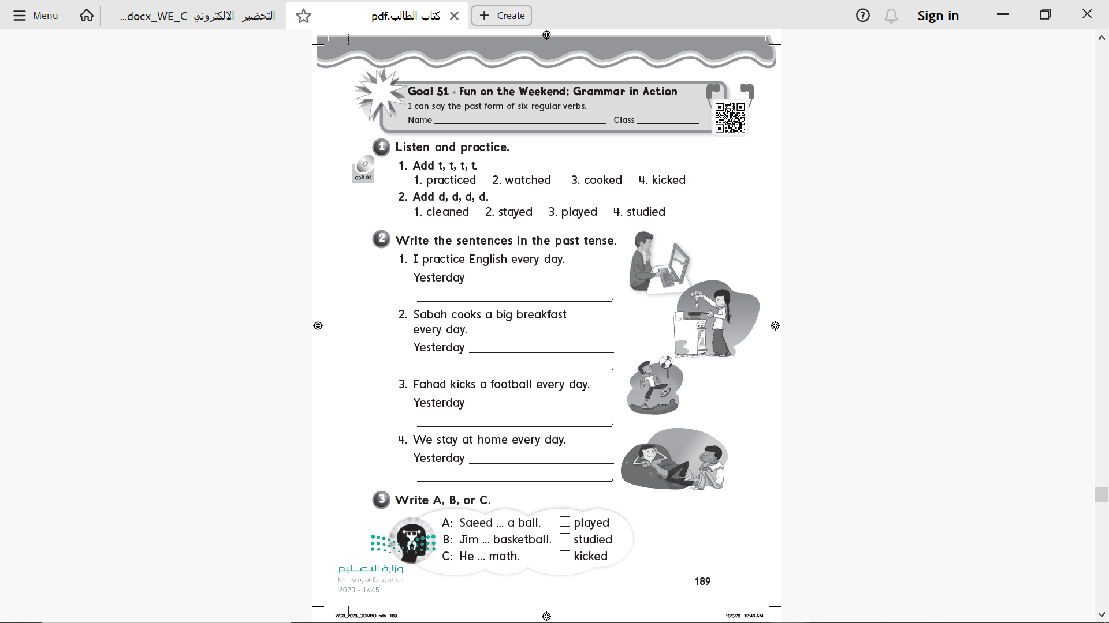
Page 189

Slide 29
Page 189
I practiced English
she cooked a big breakfast
he kicked football
We stayed home

Slide 30
Page 189
B
C
A

Slide 31
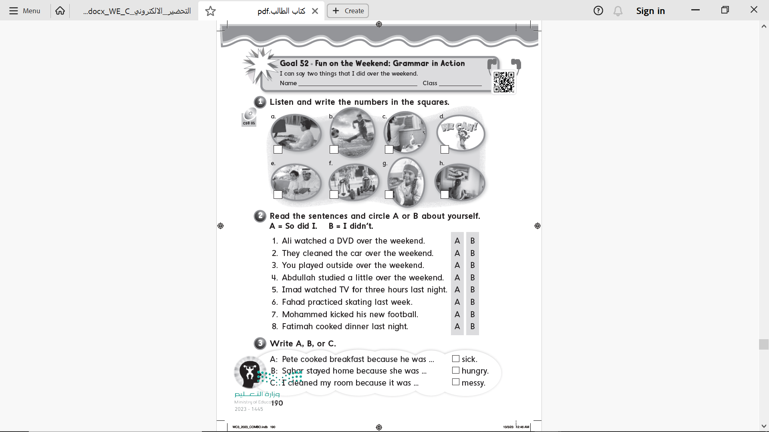
Page 190
8
4
5
1
6
7
3
2

Slide 32
Page 190

Slide 33
Page 190
B
A
C

