Slide 1

Unit 7
Fun on the weekend
Rythms and Reading

Slide 2




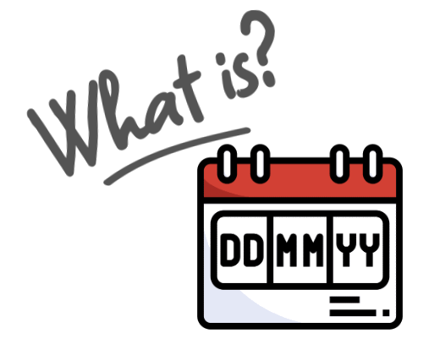




Slide 3

Homework

Slide 4
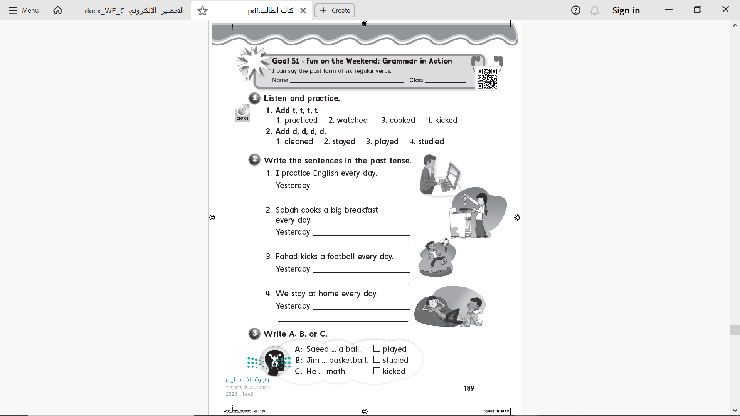

Page 189

Slide 5
Page 189
I practiced English
she cooked a big breakfast
he kicked football
We stayed home

Slide 6
Page 189
B
C
A

Slide 7
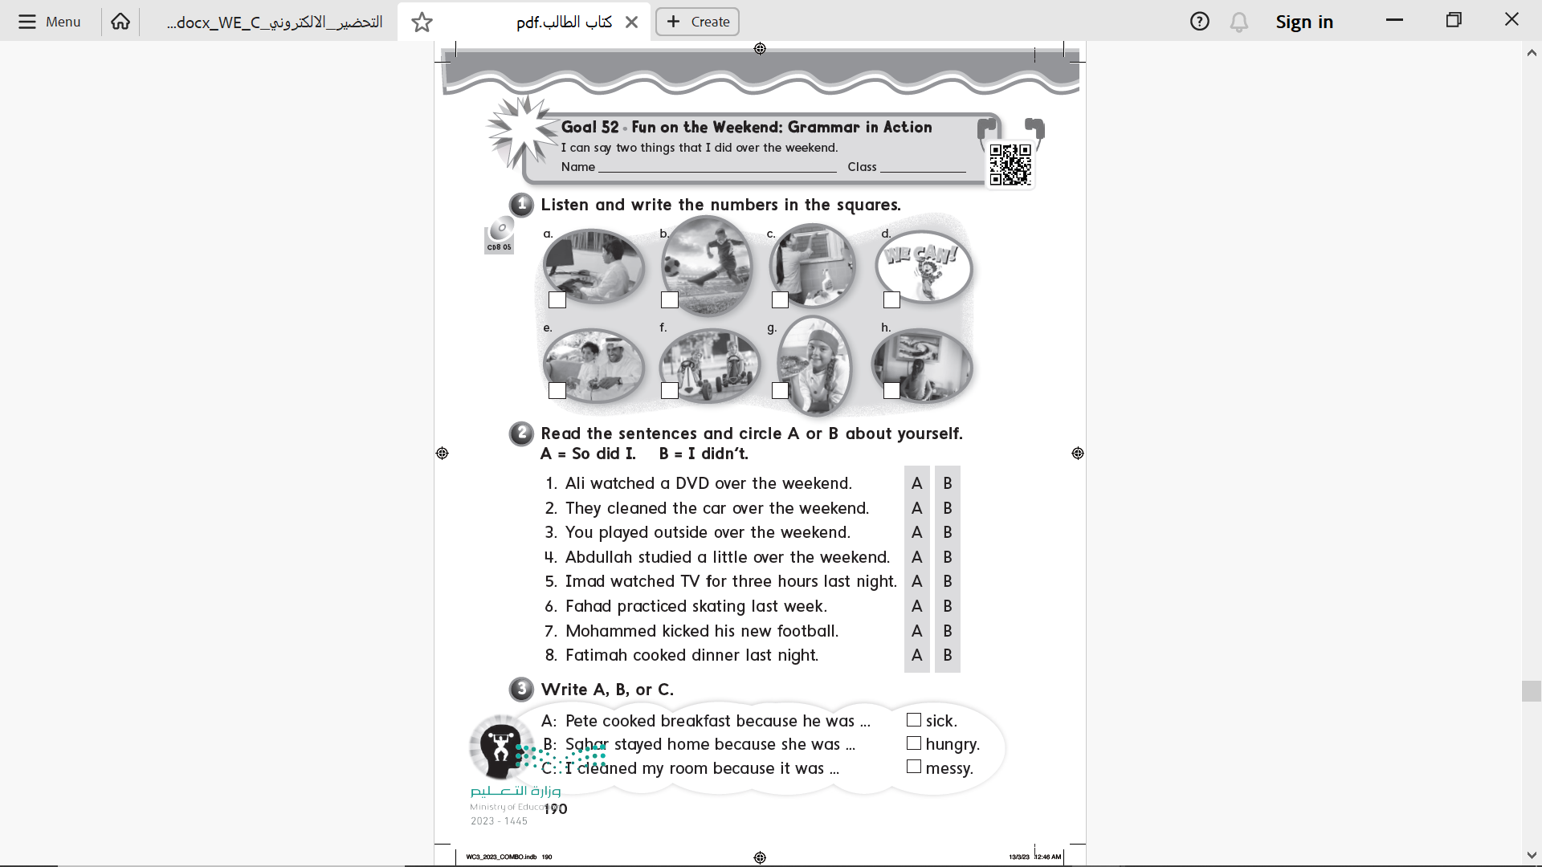
Page 190
8
4
5
1
6
7
3
2

Slide 8
Page 190

Slide 9
Page 190
B
A
C

Slide 10



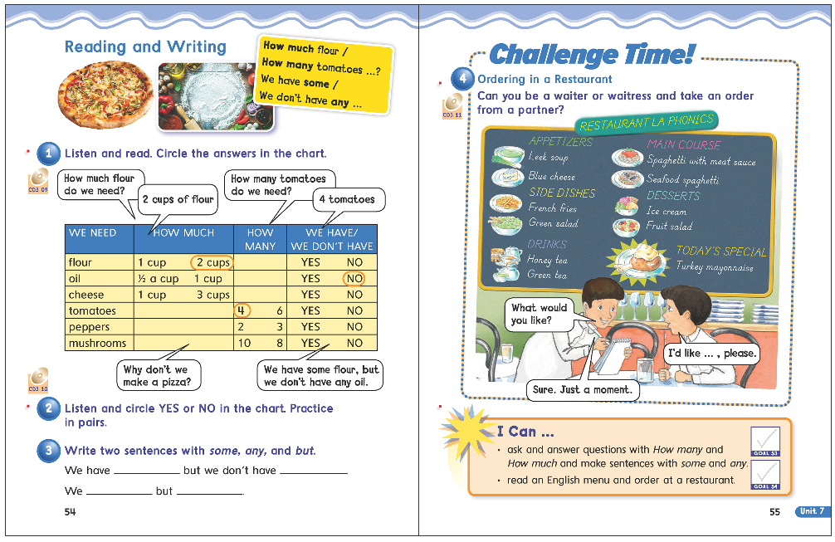

54
55

Slide 11








Slide 12
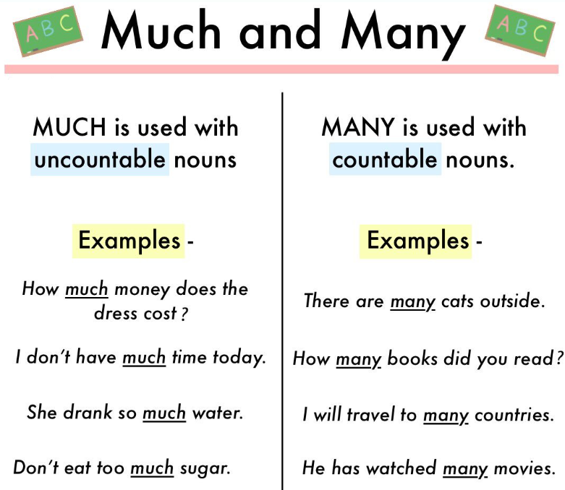
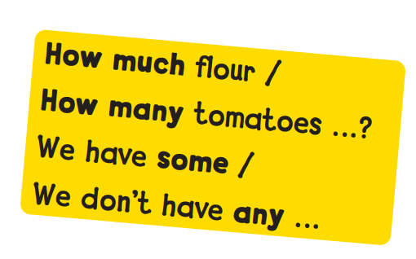

Slide 13







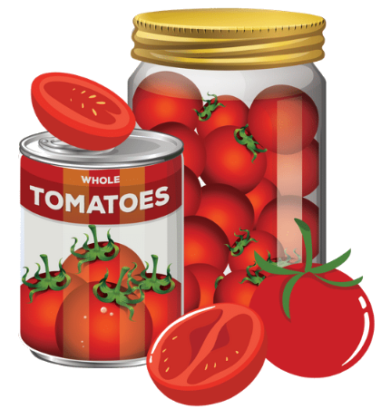
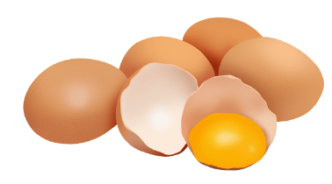



Slide 14
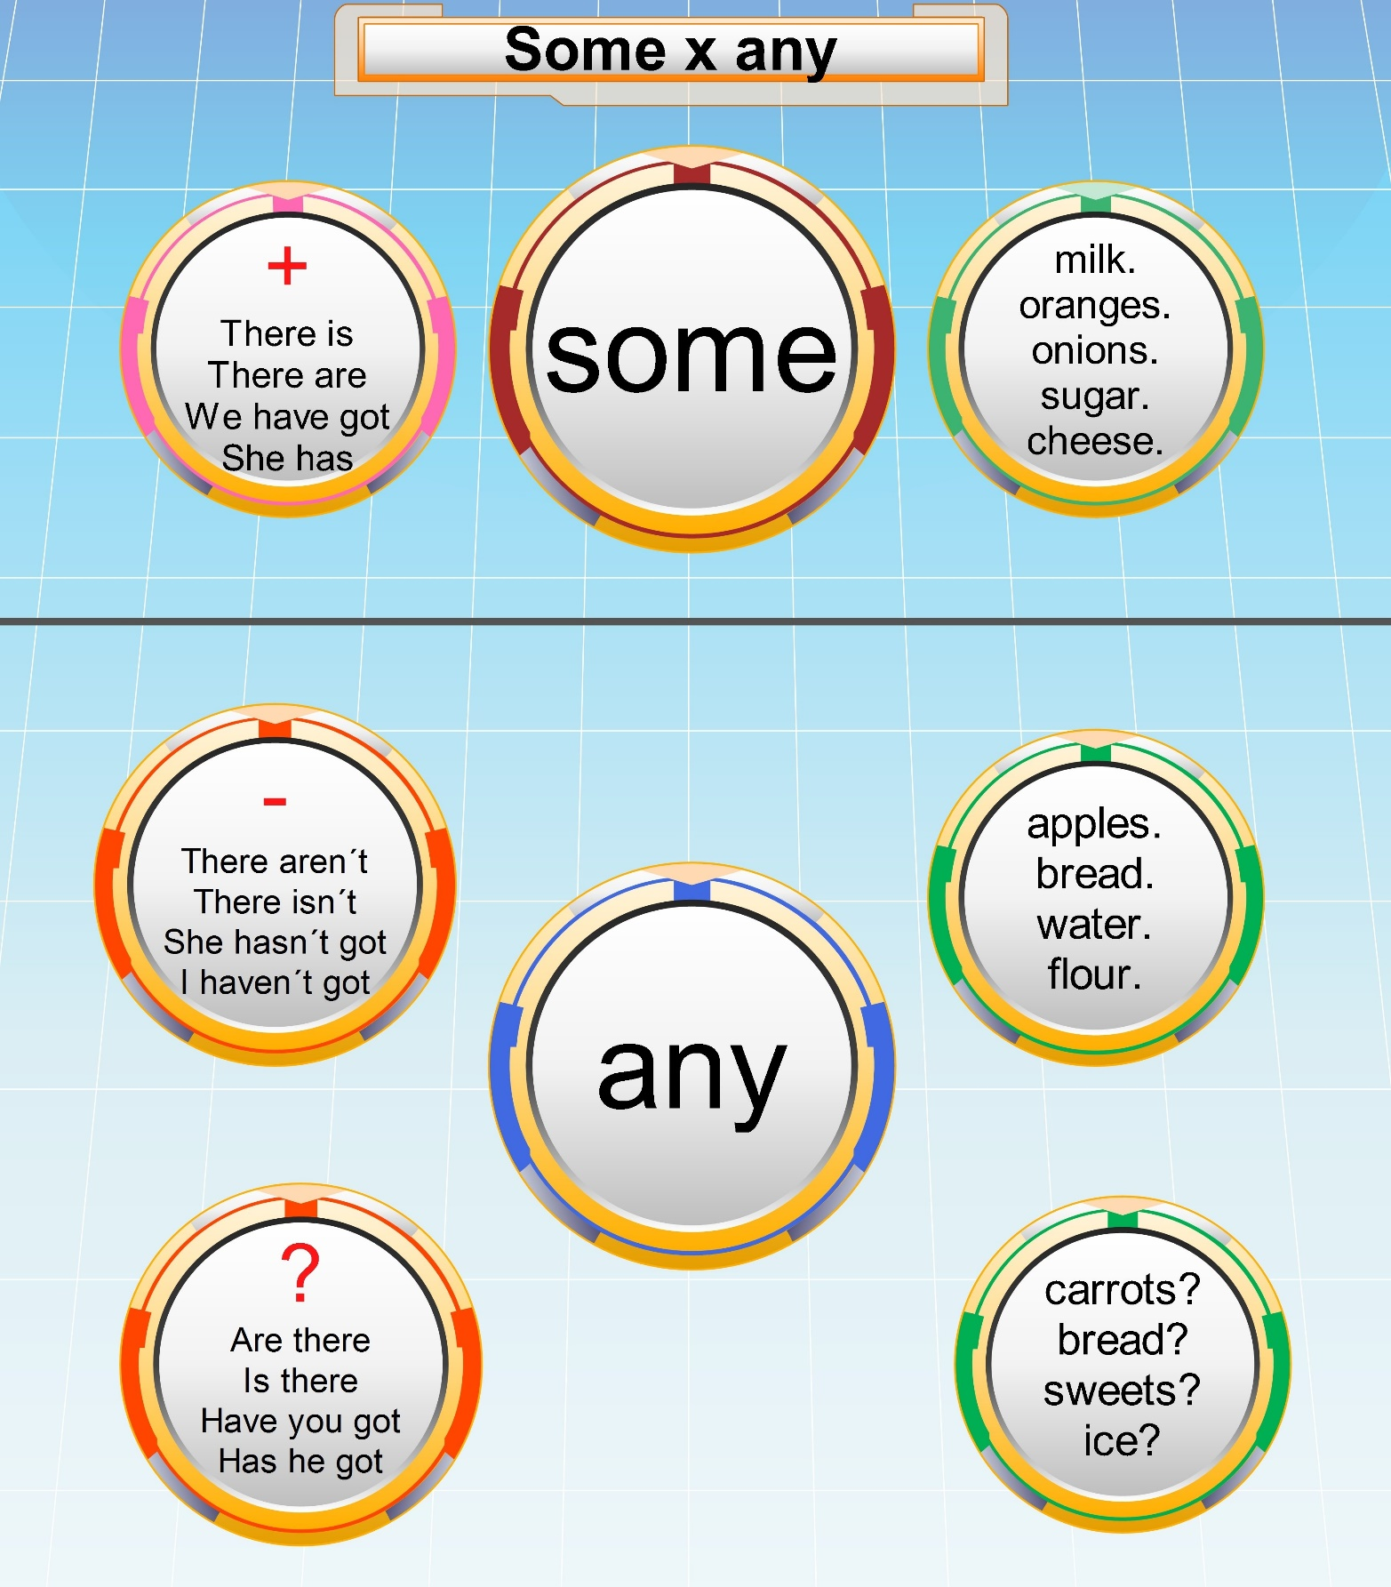

Slide 15




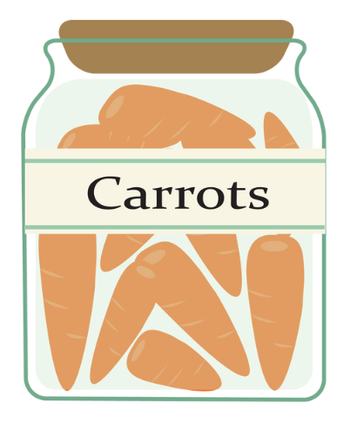
some
any
any
some

Slide 16
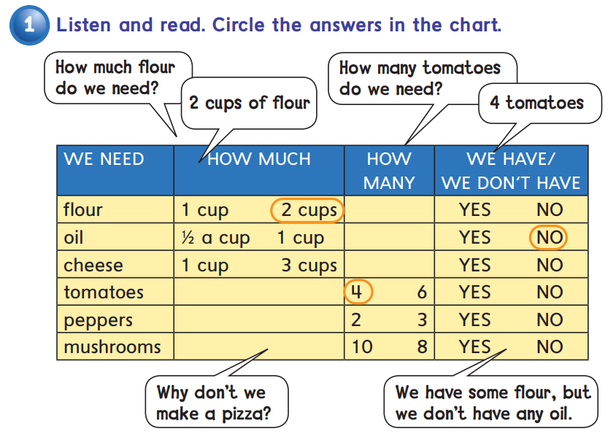


Slide 17



Slide 18


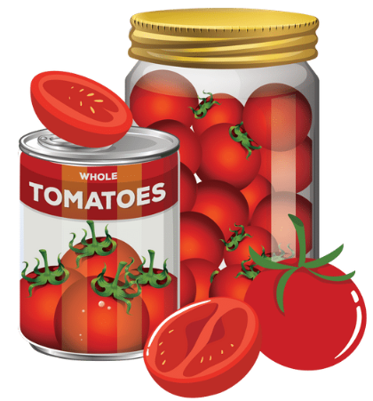


some flour
any oil
some ………
any ………

Slide 19
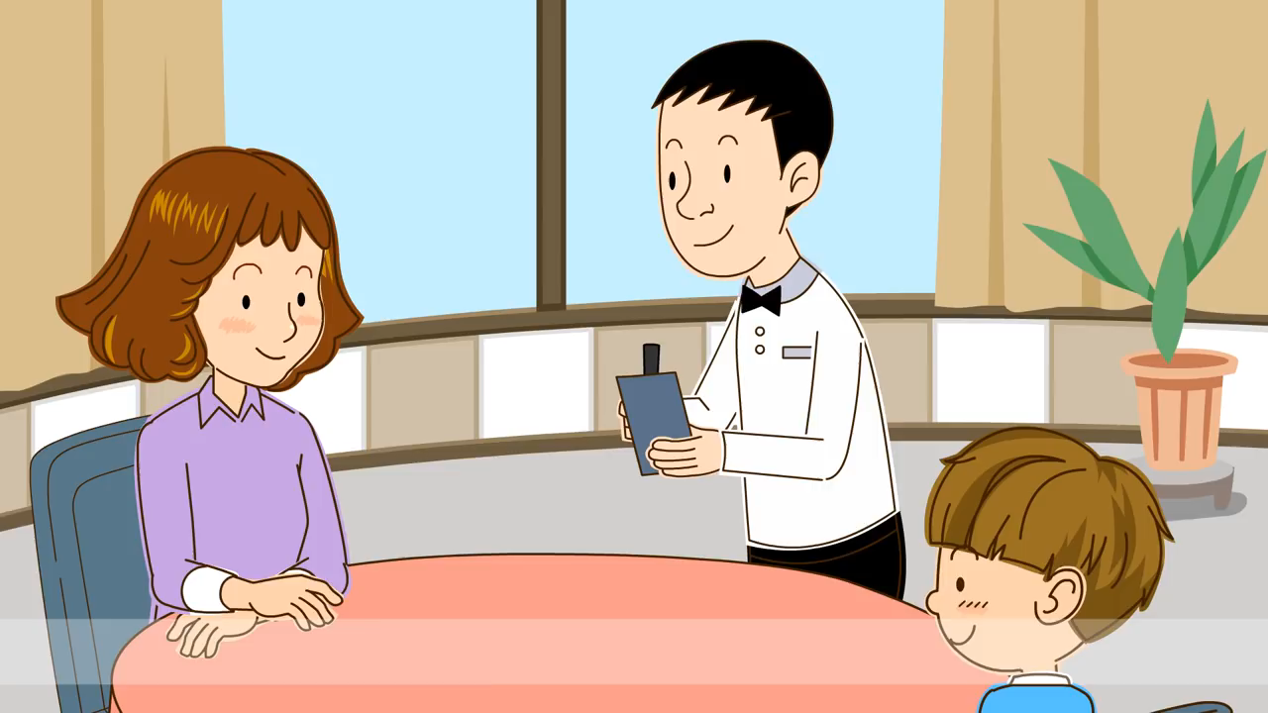

Slide 20


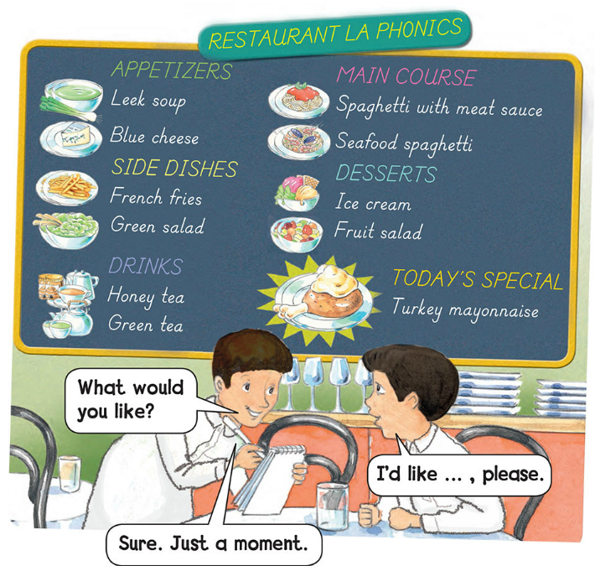

Slide 21


Slide 22
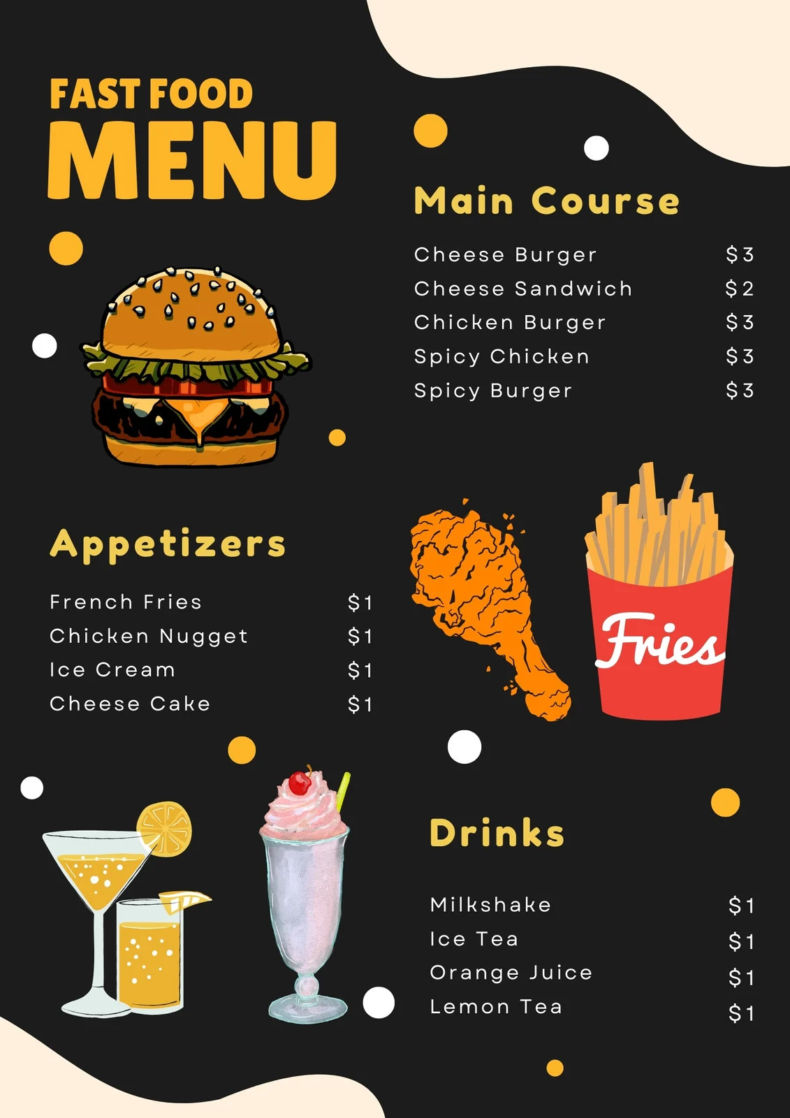



Slide 23
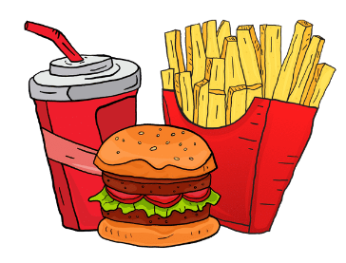
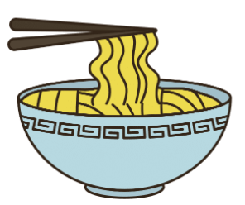
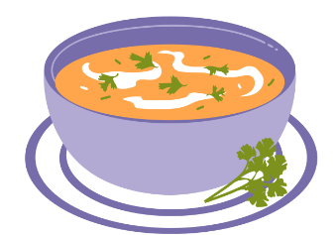


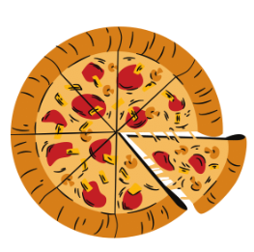
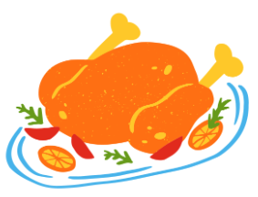
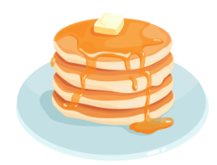
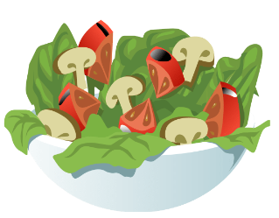

Slide 24


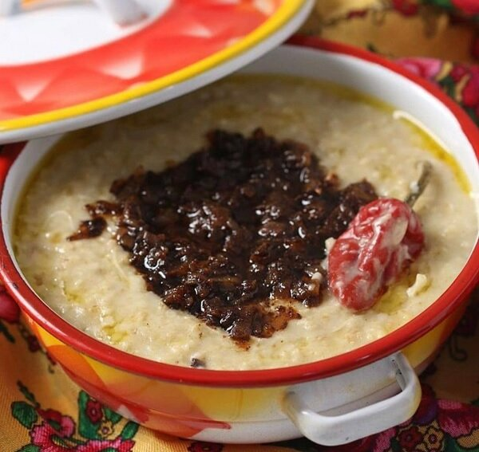


Slide 25
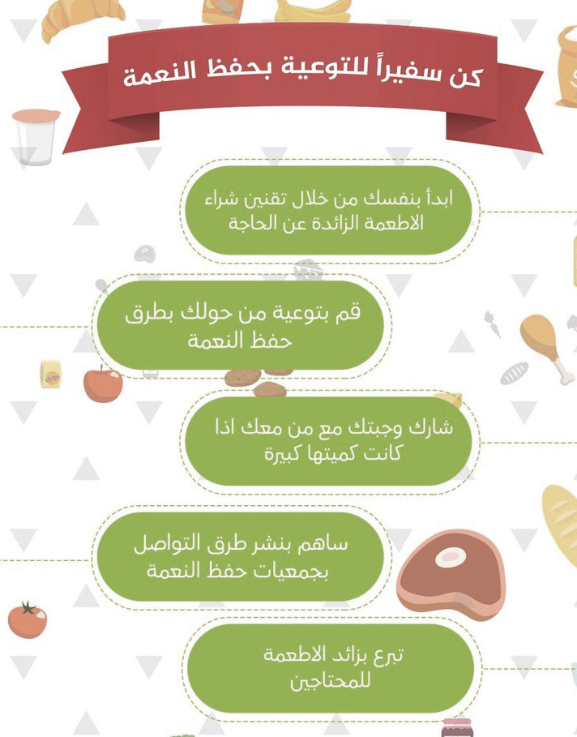


Slide 26


Slide 27
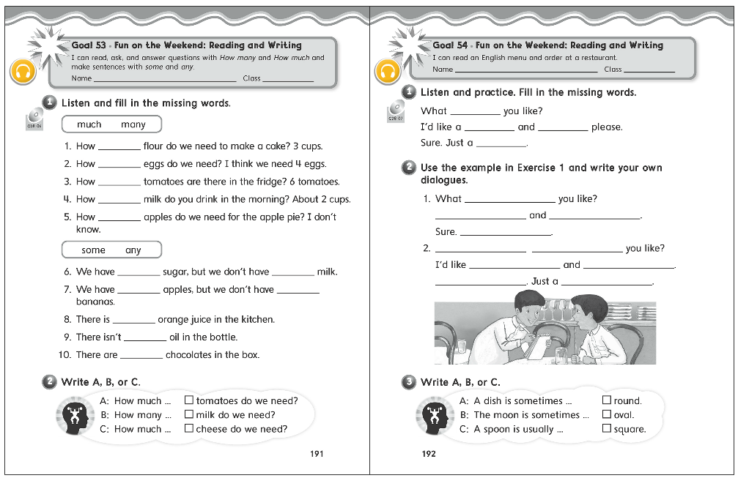
191
192

Slide 28
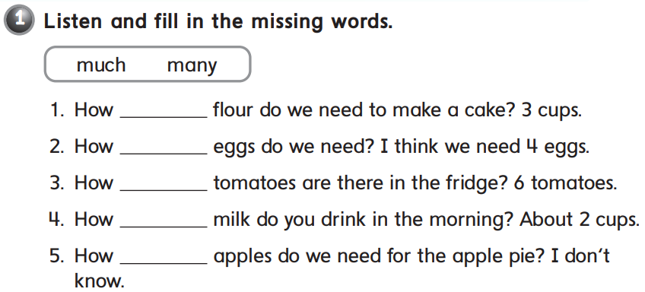
much
many
many
much
many

Slide 29
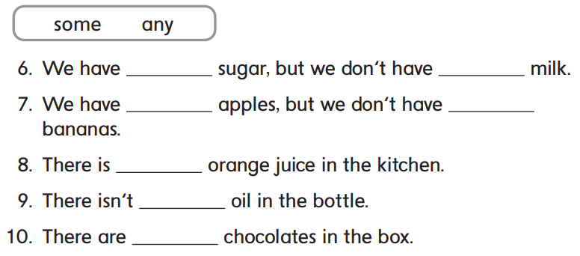

some
any
some
any
some
any
some

Slide 30


B
A
C

Slide 31


would
burger
fries
moment

Slide 32
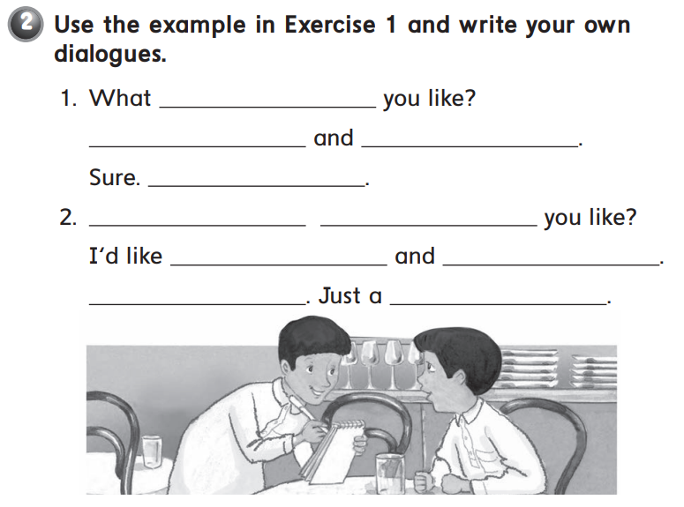
would
I’d like kabsa
soda please
Just a moment
What
would
pizza
a salad please
sure
moment

Slide 33


B
C
A

Slide 34
Thank you!

