Slide 1
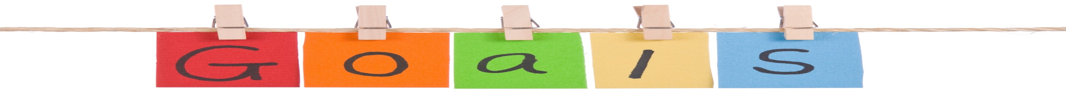
Use possessive adjectives and possessive pronouns.
Ask questions by using “whose”.
Differentiate between one and ones.
Use “too” correctly.
Listen to complete information in an ad.
Pronounce Linking adjacent sounds.

Slide 2


Possessive Adjectives
&
Possessive pronouns

Slide 3
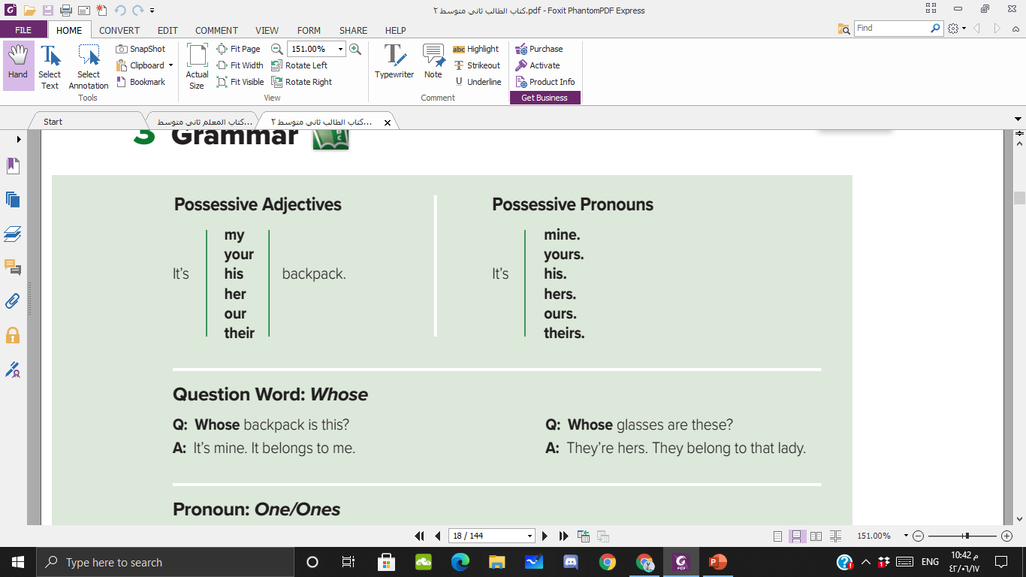

I
You
He
She
We
They

Slide 4
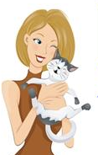




I`ve got a cat.
Possessive Adjective
Possessive Pronoun
It`s my cat.
It`s mine.

Slide 5
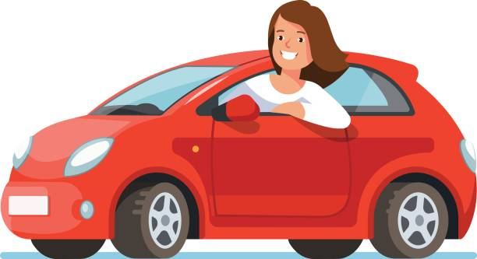




She has got a car.
Possessive Adjective
Possessive Pronoun
It`s her car.
It`s hers.

Slide 6
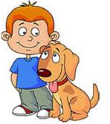
He has got a dog.
Possessive Adjective
Possessive Pronoun
It`s his dog.
It`s his.

Slide 7


It has got a bow.
Possessive Adjective
Possessive Pronoun
The bow its .
It`s its bow.

Slide 8

You `ve got a laptop.
Possessive Adjective
Possessive Pronoun
It`s your laptop.
It`s yours.

Slide 9
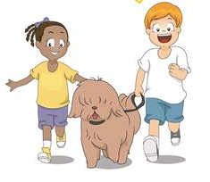
We `ve got a dog.
Possessive Adjective
Possessive Pronoun
It`s our dog.
It`s ours.

Slide 10

They `ve got a book.
Possessive Adjective
Possessive Pronoun
It`s their book.
It`s theirs.

Slide 11
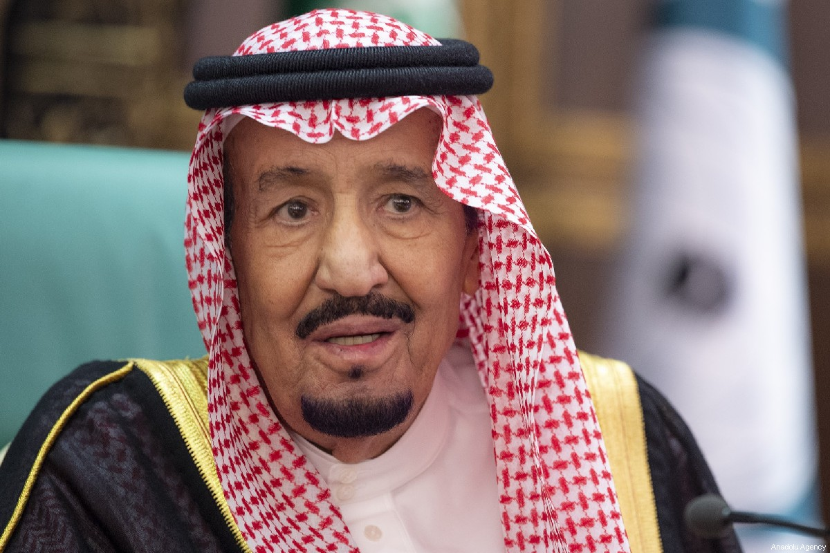
What is his name?
His name is King Salman

Slide 12
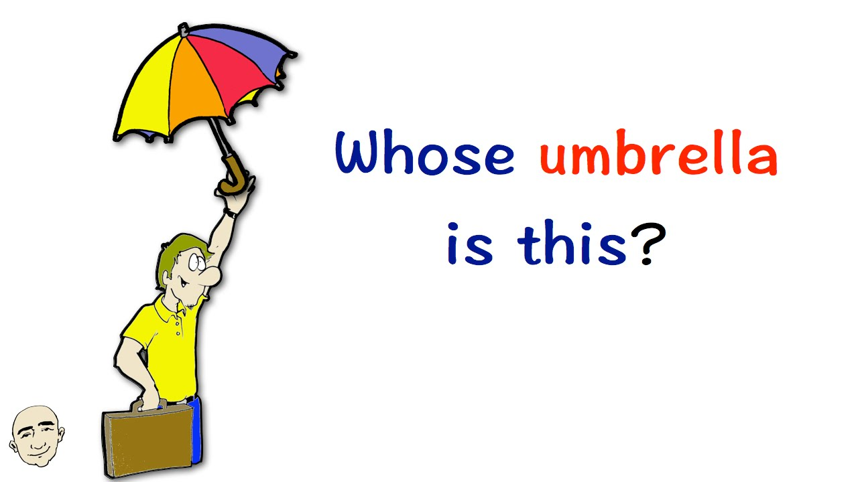
Whose
Whose is a possessive pronoun.
Use it when you’re asking (or telling) to whom something belongs.

Slide 13
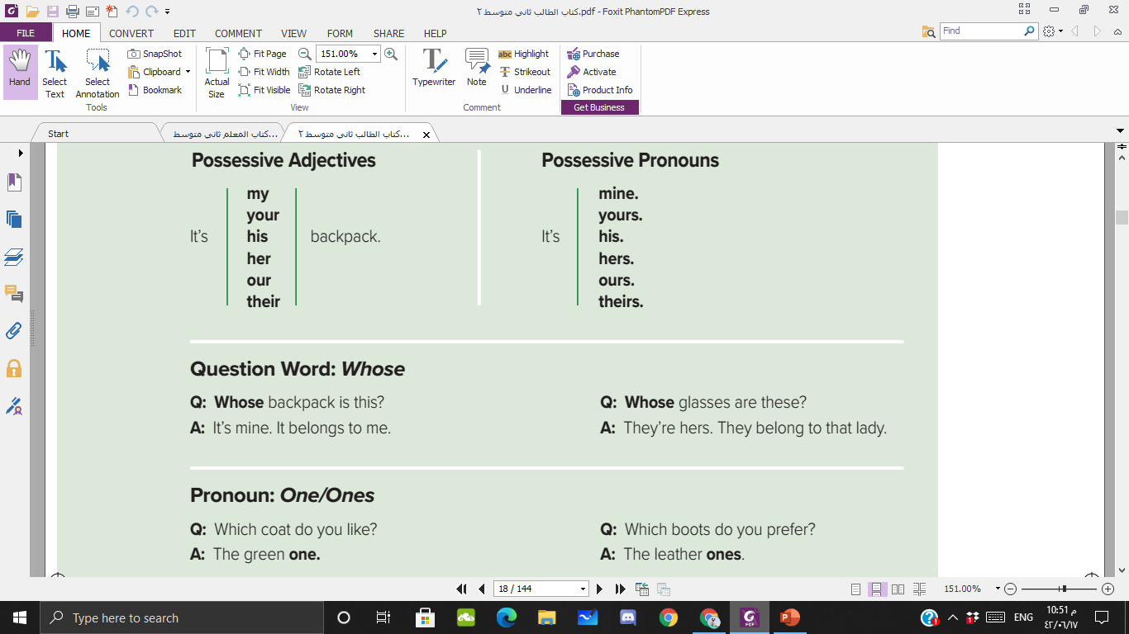

Slide 14

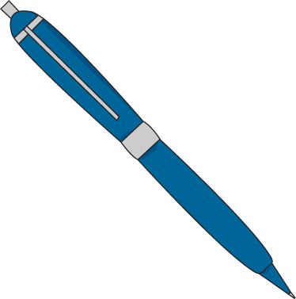
structure
singular
plural
Whose + noun + is + it/this ?
Whose + noun + are + they/these ?
Whose pen is it ?
Whose pencils are they ?
Whose pen is this ?
Whose pencils are these ?

Slide 15





The use of one/ones
We use one/ones instead of repeating a countable noun.
singular
plural
one
ones
John has three cars – a red car and two blue cars.
John has three cars – a red one and two blue ones.

Slide 16
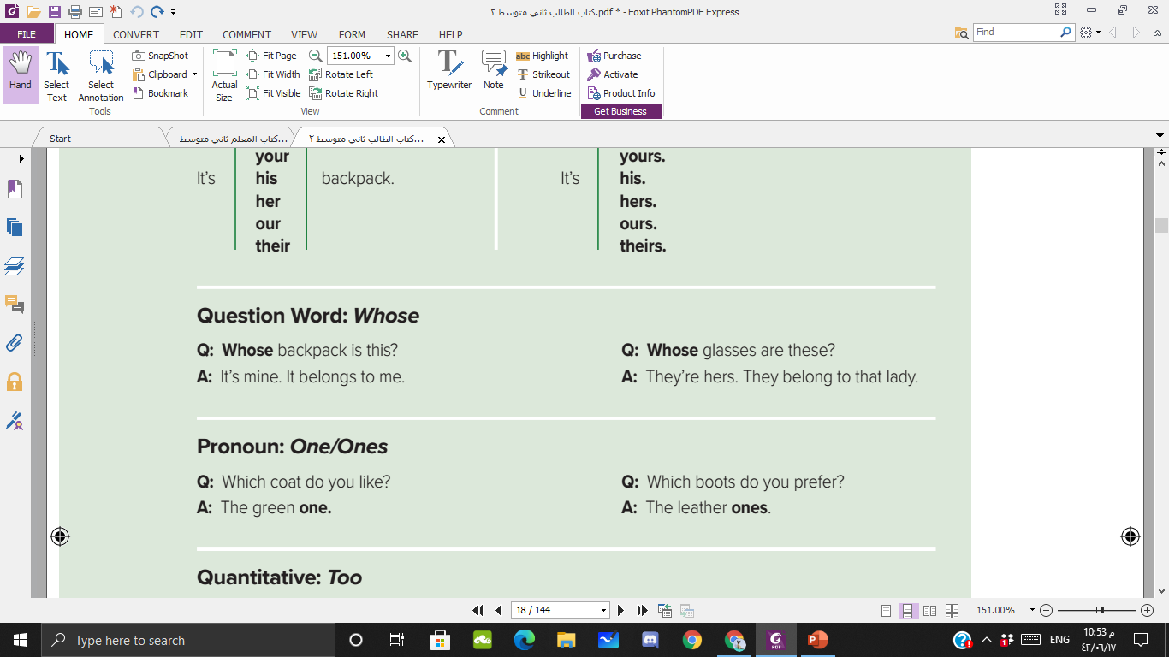


Slide 17
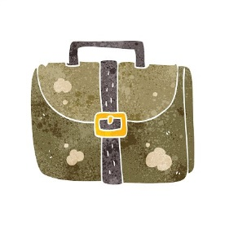





















one or ones
This bag is very old. I need a new___________
Small pineapples are sweeter than big_________
The new smartphones are much faster than the
old____________
Jack has three pens – a red__________ and two
green________________ .

Slide 18


Slide 19

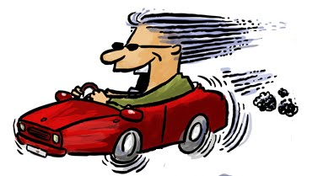
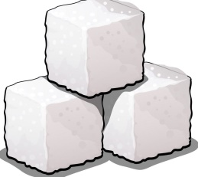
too
Too meaning ‘more than enough’
TOO + ADJECTIVES or TOO + ADVERBS
This coffee is too sweet.
I was driving too fast.

Slide 20
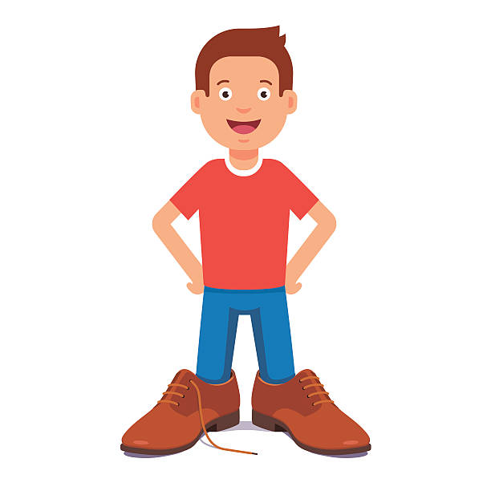
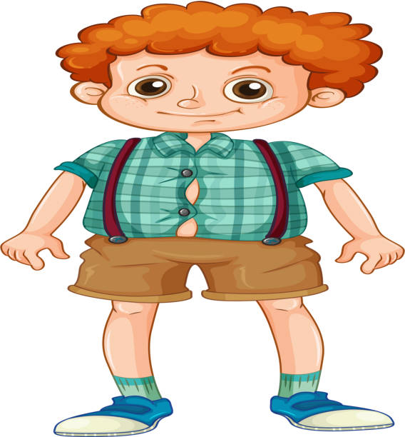
too
This shirt is too small for me.
These shoes are too big for me.

Slide 21
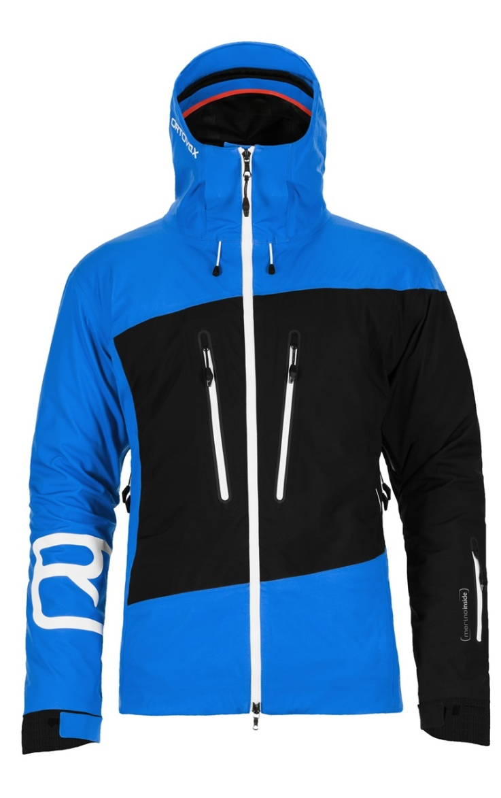
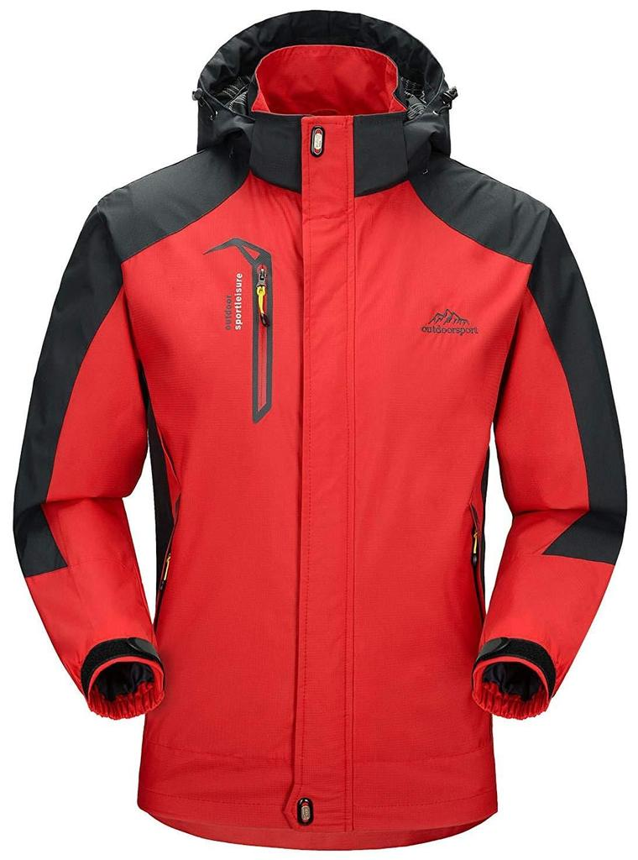
This jacket is too small
This jacket is too big

Slide 22
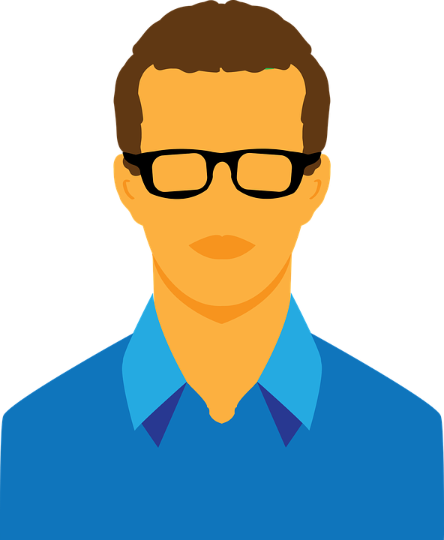
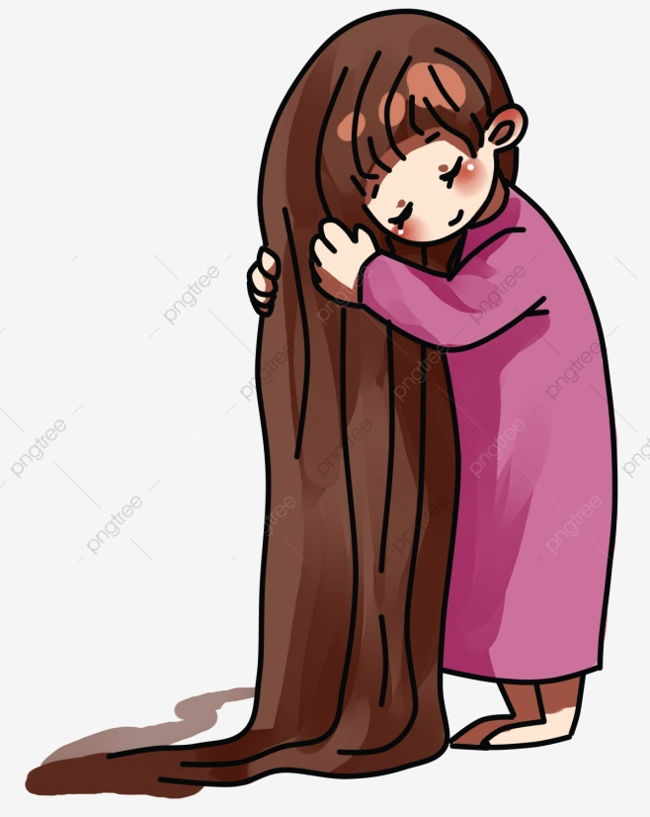
This hair is too long
This jacket is too short

Slide 23
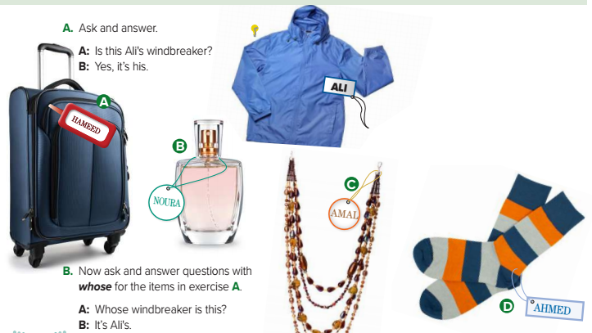
Windbreaker
Necklace
Bag
Socks
Perfume

Slide 24
Whose bag is this?
Whose necklace is this?
Whose perfume is this?
Whose socks are these?

Slide 25
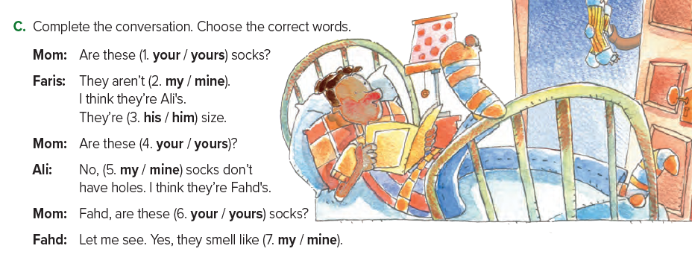





Slide 26








Ask and answer
A: Is this Ali's windbreaker?
B: Yes, it’s his.
Now ask and answer questions with “whose”
A: Whose windbreaker is this?
B: It’s Ali's.
Windbreker /Ali

Slide 27








Ask and answer
Hammed
suitcase
A: Is this _________’s ___________?
B: Yes, it’s _____.
his
Now ask and answer questions with “whose”
suitcase
A: Whose ____________is this?
B: It’s ________'s.
Hammed
Suitcase / Hammed

Slide 28
Ask and answer
Ahmed
socks
A: Are these _________’s ___________?
B: Yes, they`re ___.
his
Now ask and answer questions with “whose”
are
socks
these
A: Whose ____________ ____ ______?
B: They`re _________'s.
Ahmed
socks / Ahmed

Slide 29

T.Hanan Allaheeb

