Slide 1



WE CAN 2
Unit 4 lesson1
Talk Time
2nd Term 2024

Slide 2


to
there
from
here

Slide 3




Role play the dialogue
How do you go to school?
I walk . How about you?
I take /ride the bus to school.

Slide 4

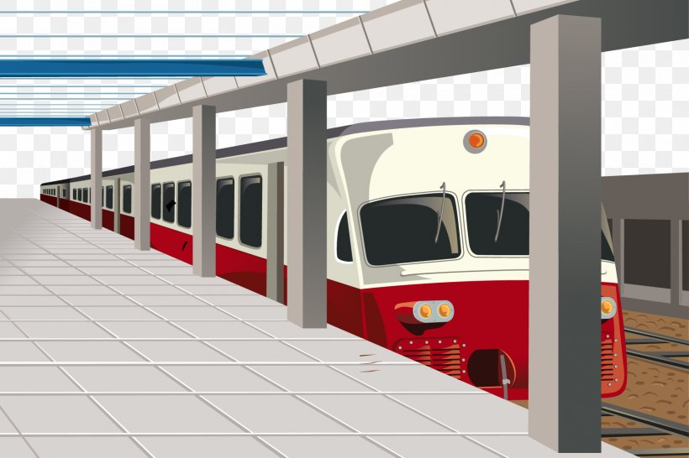


Role play the dialogue
Excuse me, Where`s the train station?
Walk straight and turn left

Slide 5

Signs
Turn left
Turn right
Walk/go straight

Slide 6


Steps

Slide 7






Listen and say
station
step
stop
write the missing letters.
Walk straight two ___eps and ___op

Slide 8

Awesome

