Slide 1



Slide 2
Mega goal.3.2
Against The Odd
Form, Meaning & Function

Slide 3
Objectives:
Describe an action with past progressive
Write a sentence about specific time
Express temporary state or action
Write sentences about two actions happened at the same time
Illustrate actions that didn't happen
Form correct sentence with past perfect tense
Use the suitable tense according to the sentence
Write a sentence about specific time
Illustrate actions that didn’t happen

Slide 4



Refresh Your Memory:
Past Progressive? Yes | No
Key Words
He was teaching.
They have eaten the launch.
They were arresting the criminal.
They were stealing a car last year.
They are playing football right now.
The criminal was escaping.
Sara will see her teacher at the library.

Slide 5
Past Progressive
Was/Were Going To and Was/Were About To
Past Perfect Tense
Past Perfect Progressive and Past Simple Tense

Slide 6
Past Perfect Tense

Slide 7


As Figlock was walking down a Chicago Street, a baby fell from a fourth-story window.
A year later, while he was passing by that same building, the same baby fell out of the same window and landed on Mr. Figlock.

Slide 8
Use the past progressive (be + present participle) to describe a long action that is interrupted by a short action.
Was / Were + Ving
fell
was walking
now
As Figlock was walking down a Chicago Street, a baby fell from a fourth-story window.
A year later, while he was passing by that same building, the same baby fell out of the same window and landed on Mr. Figlock.

Slide 9


Q: What were you doing at three o’clock today?
A: I was driving home from work

Slide 10
Use the past progressive when we describe what was happening at a specific time in the past.
Was / Were + Ving
Q: What were you doing at three o’clock today?
A: I was driving home from work

Slide 11


Q: Have you always lived in Riyadh?
A: No. A few years ago, I was living in Dubai.
Q: What were you doing in Dubai?
A: I was studying for my degree.

Slide 12
Use the past progressive when we talk about a temporary state or action
Was / Were + Ving
Q: Have you always lived in Riyadh?
A: No. A few years ago, I was living in Dubai.
Q: What were you doing in Dubai?
A: I was studying for my degree.

Slide 13

Use the past progressive with always to describe a repeated or annoying action
Was / Were + always + Ving
My old car was always breaking down so I bought a new one.

Slide 14



Use the past progressive to describe two actions that were happening at the same time
Was / Were + Ving
On June 6, 1980, Edwin Robinson was out walking and looking for his pet chicken during a thunderstorm when he was struck by lightning

Slide 15
Was/Were Going To and Was/Were About To

Slide 16


I was going to study Engineering, but my father advised me otherwise.
They were just about to leave when the phone rang.

Slide 17
Use to refer to actions that were intended but probably didn’t happen
was/were + going to + base form
I was going to study Engineering, but my father advised me otherwise.
was/were + about to + base form
They were just about to leave when the phone rang.

Slide 18


Slide 19
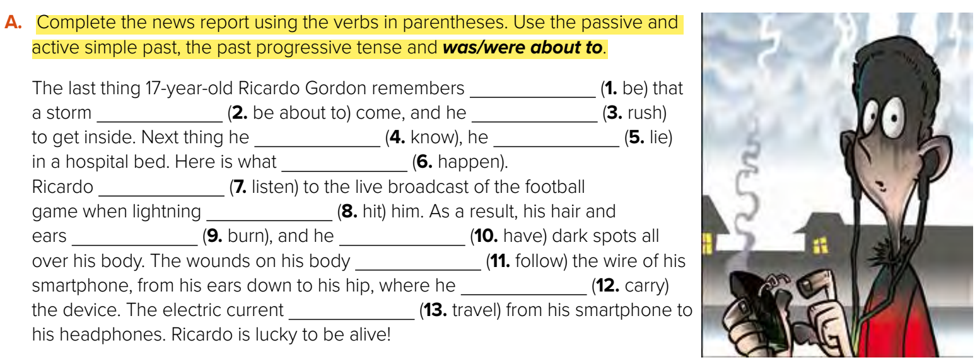
was
was about to
rushed
knew
was lying
happened
was listening
hit
were burned
had
followed
was carrying
traveled

Slide 20



Slide 21
Past Perfect Tense

Slide 22
Use the past perfect tense to indicate an action that happened before another action in the past
had + past participle
When Edwin Robinson was struck by lightning he had been blind and deaf for almost 10 years.
was struck
had been
now

Slide 23
Past Perfect Progressive and Past Simple Tense

Slide 24
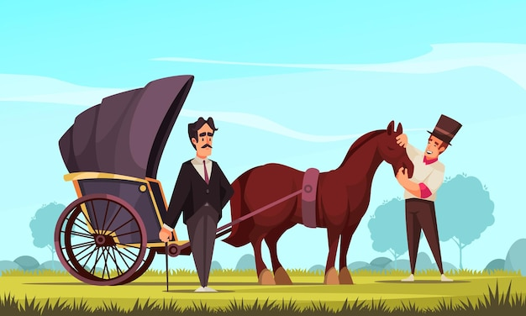
We use the past perfect progressive when the activity was in progress at the time another activity or event happened in the past.
had + been+ Ving
King Umberto of Italy had been climbing into his carriage when he was assassinated
was
had been climbing
now

Slide 26
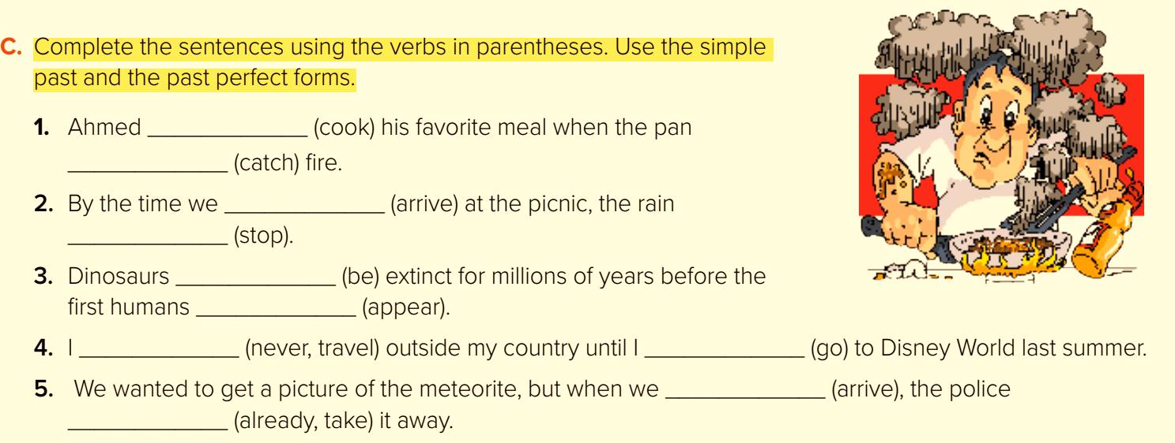
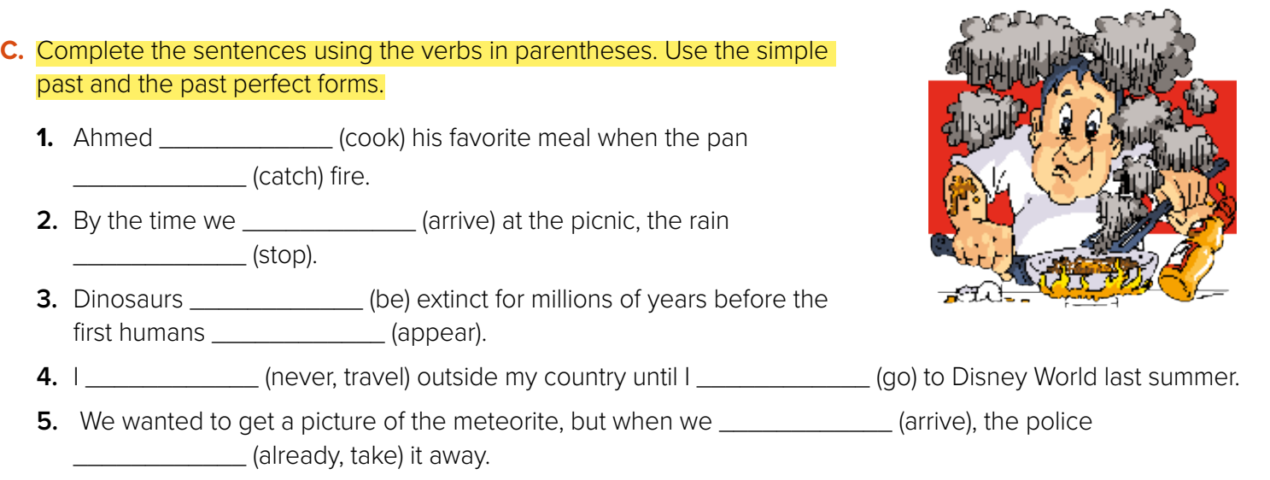
had cooked
caught
arrived
had stopped
had been
appeared
had never traveled
went
arrived
had already taken

Slide 27
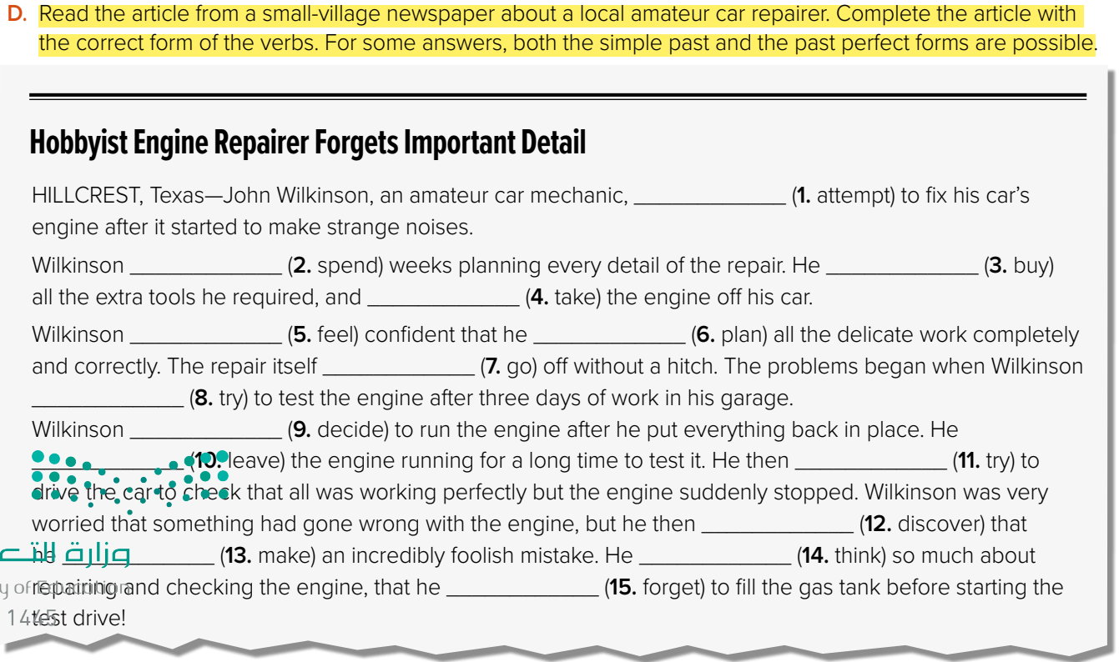
attempted
spent/had spent
bought / had bought
took
felt
had planned
went
tried
decided
left
tried
discovered
had made
thought / had thought
forgot /had forgotten

Slide 28
Brace Map
Form Sentence in Present Perfect Tense
-------------------------------
-------------------------------
--------------------------------------------------
-------------------------------
-------------------------------

