Slide 1



Slide 2
Mega goal.3.2
Against The Odd
Writing

Slide 3
Objectives:
Answer the questions about Vision 2030
Read the text
Skim & Scan the text
Write an essay about any area of vision 2030

Slide 4
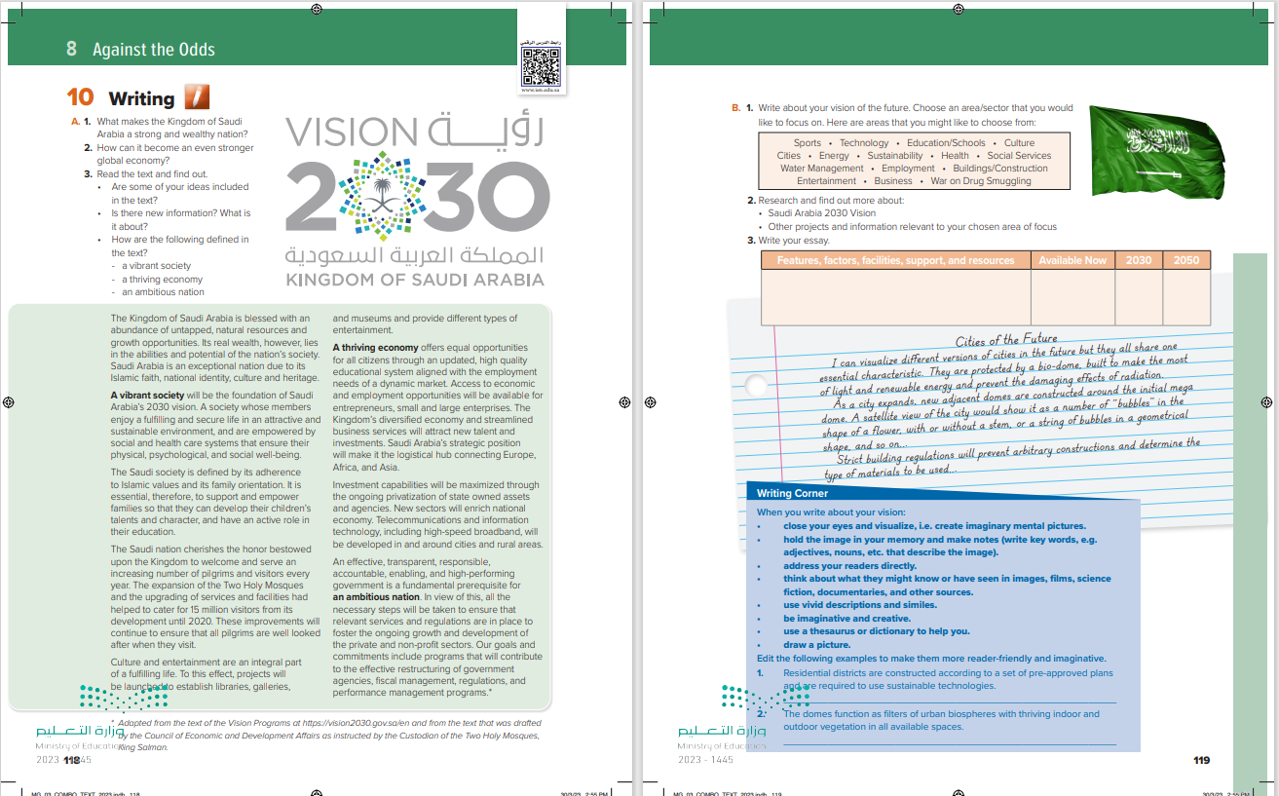

Students Book
P.118-119

Slide 5



what know about the Kingdom’s Vision for 2030.
Define vision

Slide 6
A.
1. What makes the Kingdom of Saudi Arabia a strong and wealthy nation?
2. How can it become an even stronger global economy?

Slide 7
3. Read the text and find out.
• Are some of your ideas included in the text?
• Is there new information? What is it about?
• How are the following defined in the text?
- a vibrant society
- a thriving economy
- an ambitious nation

Slide 8
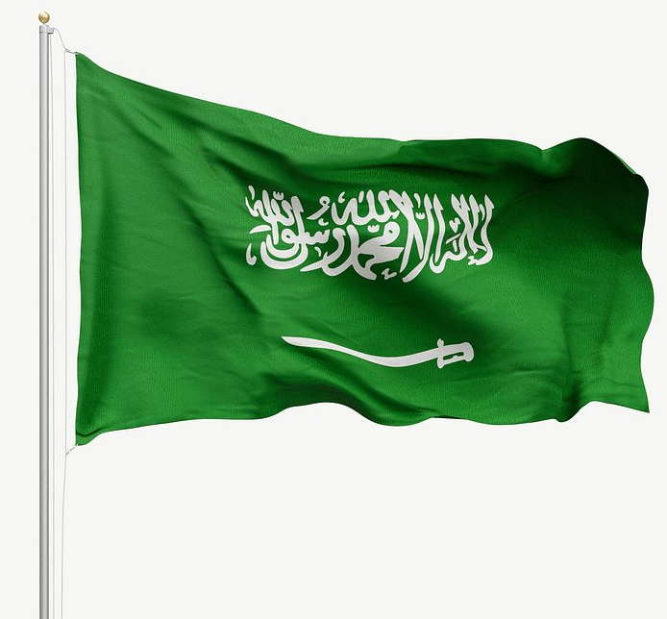
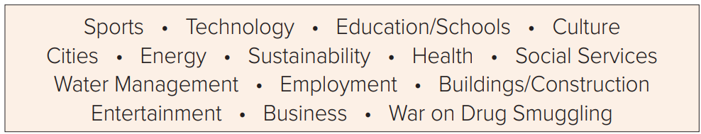
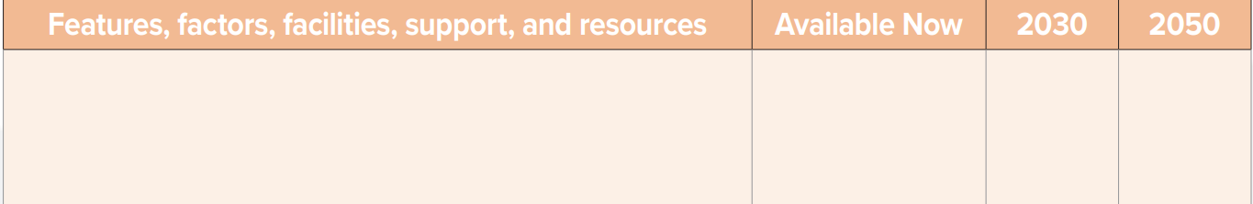
B. 1. Write about your vision of the future. Choose an area/sector that you would like to focus on. Here are areas that you might like to choose from:
2. Research and find out more about:
• Saudi Arabia 2030 Vision
• Other projects and information relevant to your chosen area of focus
3. Write your essay

Slide 9
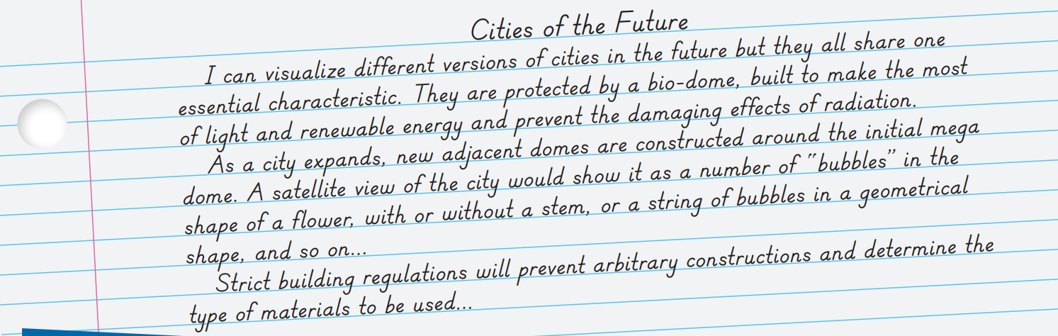
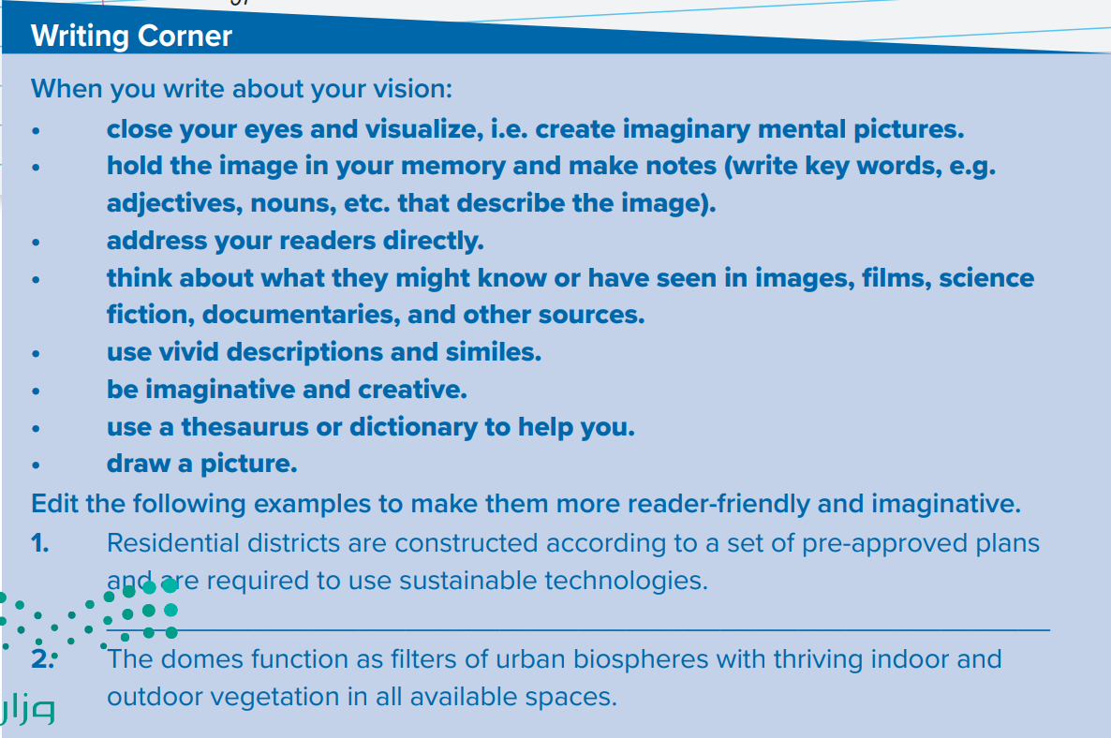

Slide 11


