Slide 1






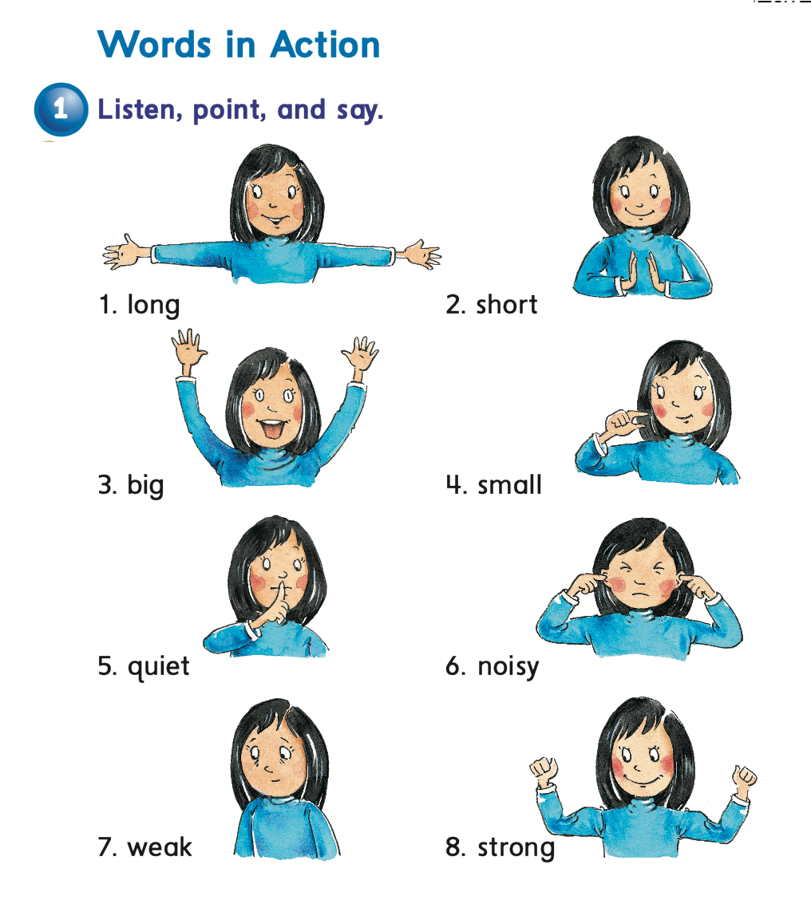




We can 2
Date:
Day:
Lesson:

Slide 2



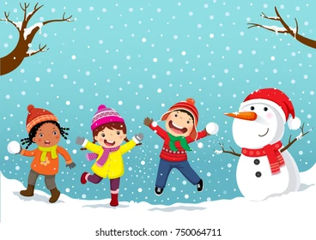



Match the words and pictures
sheep
snake
snow
show
sheep
snow
snake
show

Slide 3





Read
g

Slide 4




Slide 5



Slide 6



short
long

Slide 7

small
big

Slide 8


quiet
noisy

Slide 9
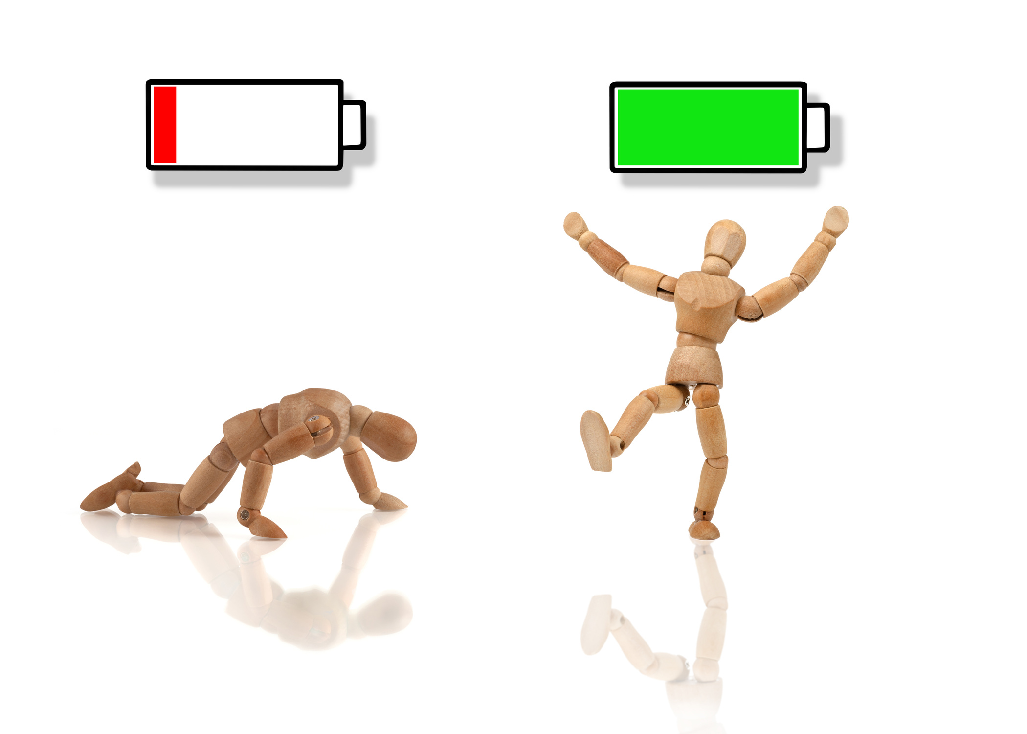
weak
strong

Slide 10




Slide 11

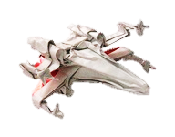
start

Slide 12

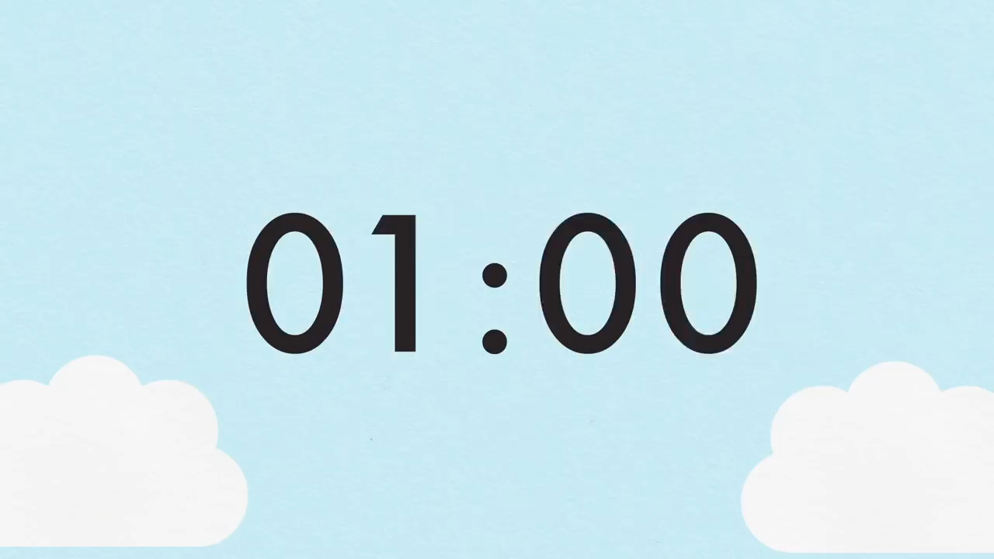





Weak
ENGINE
SPEED
FUEL
LOADING

Slide 13


noisy
ENGINE
SPEED
FUEL
LOADING

Slide 14
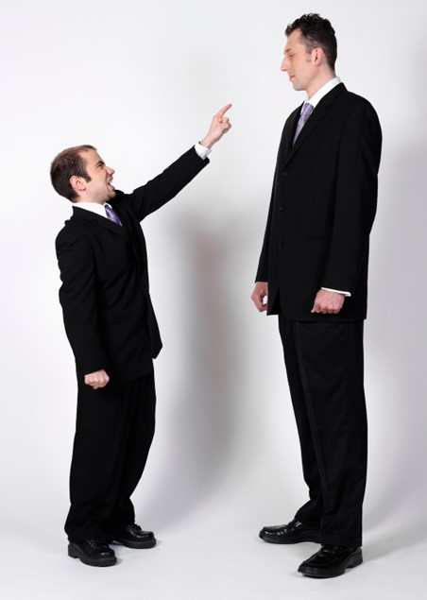

Small
ENGINE
SPEED
FUEL
LOADING

Slide 15


short X ……
noisy
long

Slide 16
weak X …….
big
strong

Slide 17

X
………………….
quiet
small

Slide 18


Slide 19

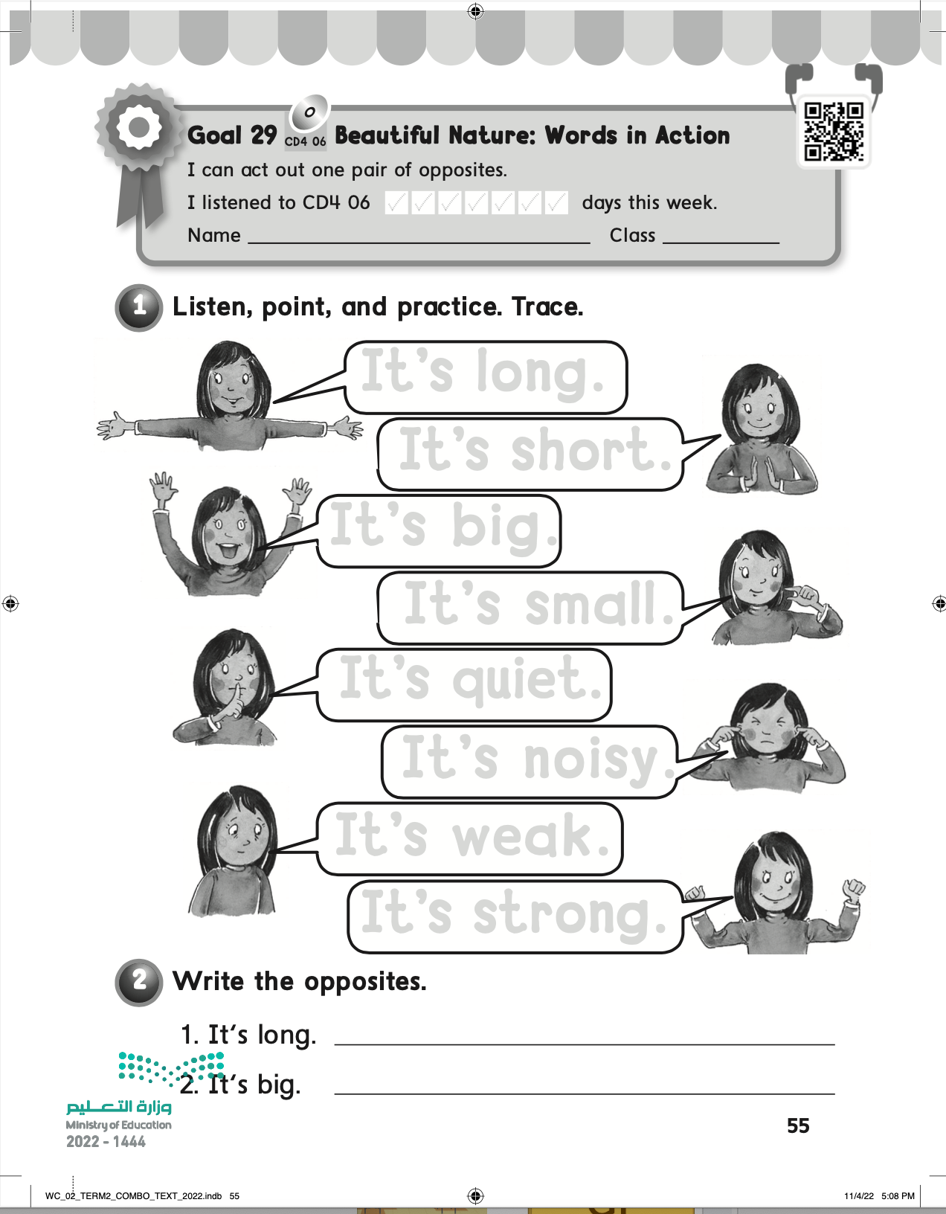
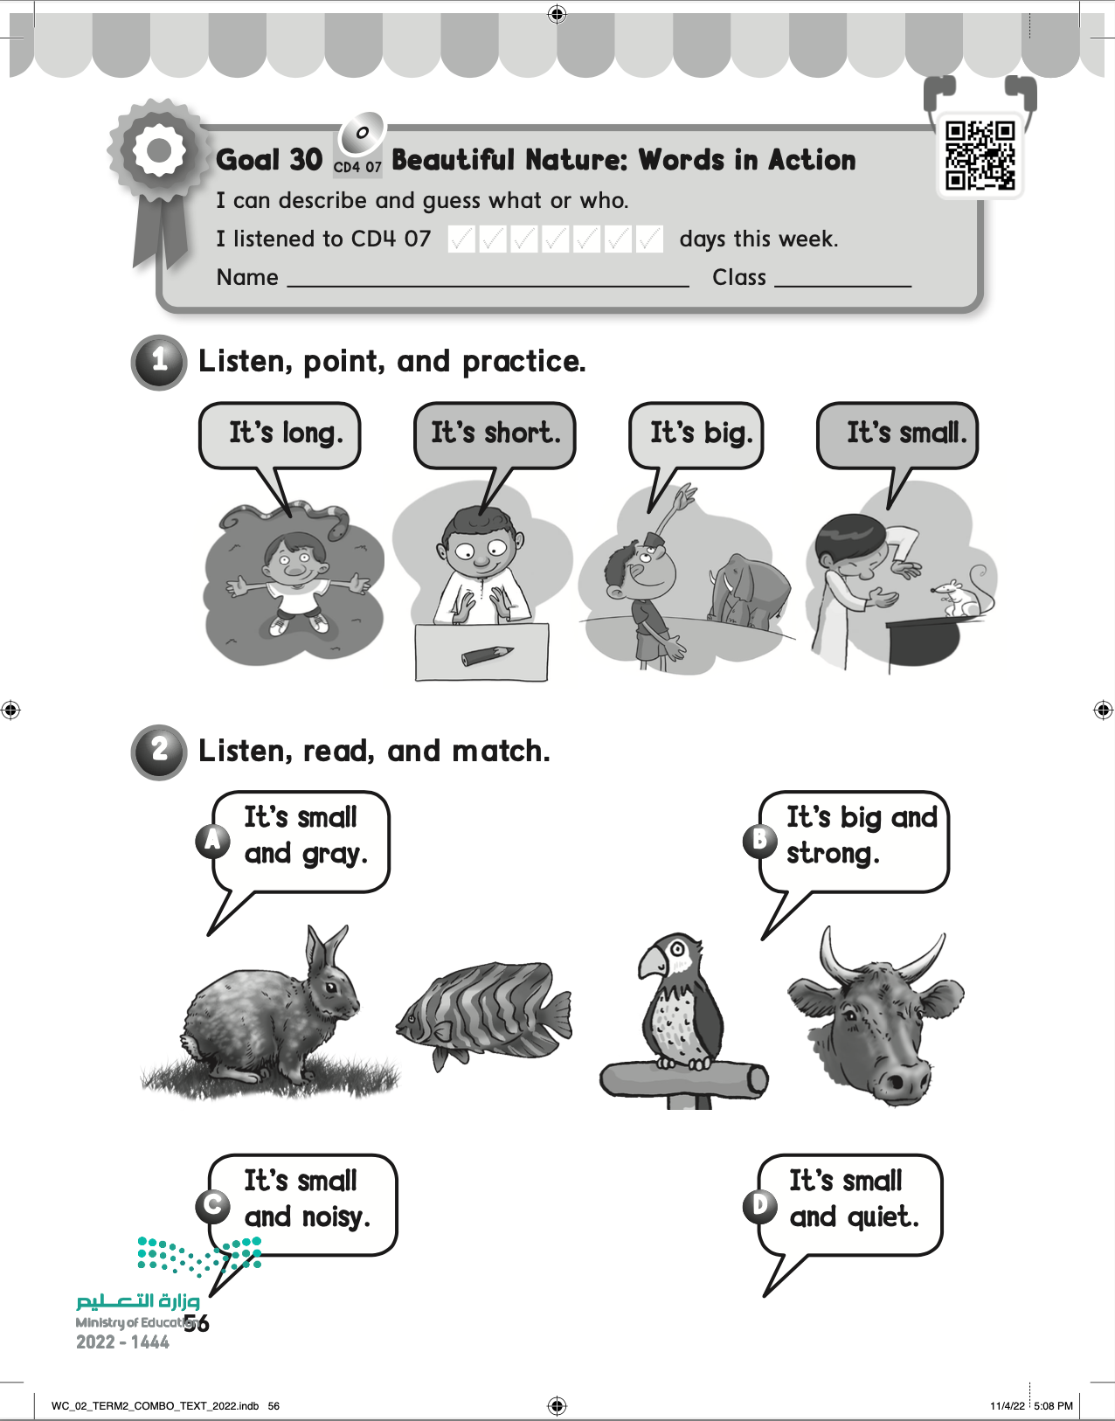
H.W

