Slide 1
Unit 3 There is No Place Like Home Conversation+ Listening
Mega Goal 2.2
Done by:: Entisar Al-Obaidallah

Slide 2
Lesson Objectives
Read the conversation for specific information
Answer some questions about the conversation
Match the new vocabulary with its meaning
Use the “Real Talk”in a sentence.
Stress on two-syllable nouns and verbs

Slide 3
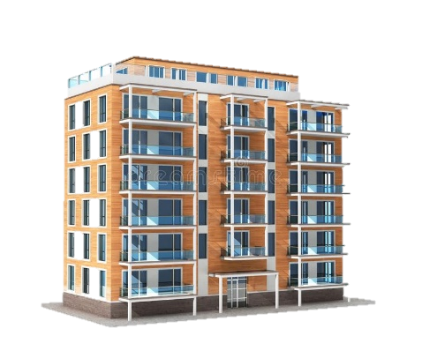
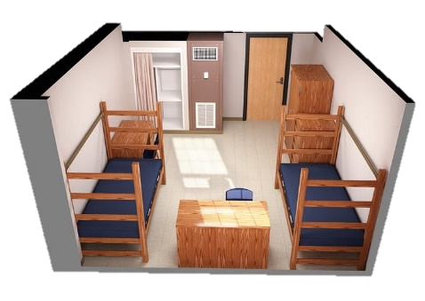
Warm Up
With their families
Where do college and university students in Saudi Arabia live?
in an won apartment
Or on campus in dormitories
Where do they live if they come from another town or city?

Slide 4
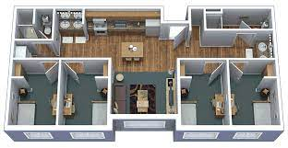
Which Saudi university has dormitory buildings for students?
King Faisal University , King Abdul Aziz University, Um Al-Qura University, King Saud University , Jizan University, Tabuk University and Princess Norah University

Slide 5
Listen to a student talking about where he’s going to live when he starts college.

Slide 6
How many persons are there in this conversation?
Two persons
Who are they?
Ahmed & Hameed
What are they talking about
Where university student live

Slide 8
Find word that means……
great
Cool

Slide 9
Find word that means……
Stop for a moment
hold on

Slide 10
Find word that means……
not realistic
Out of touch

Slide 11
Find word that means……
thousand
grand

Slide 12
Find word that means..
A large amount of money
an arm & leg
megabucks

Slide 13
Read the words and their meaning:
Ahmed is the one who uses
all of these expressions.

Slide 14
He wants a large modern apartment off campus with an extra
bedroom, parking, and a washer and dryer.
2. He will not be able to afford an apartment like that.
3. He decides to keep living at home for another year

Slide 15
Phrases used as an introduction to describe
what you are looking for / seeking

Slide 16
Which expression does Hameed use in the conversation?

Slide 17
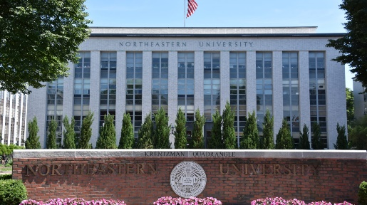

Slide 20
c
b
a
e
d

Slide 21
Remember

Slide 22
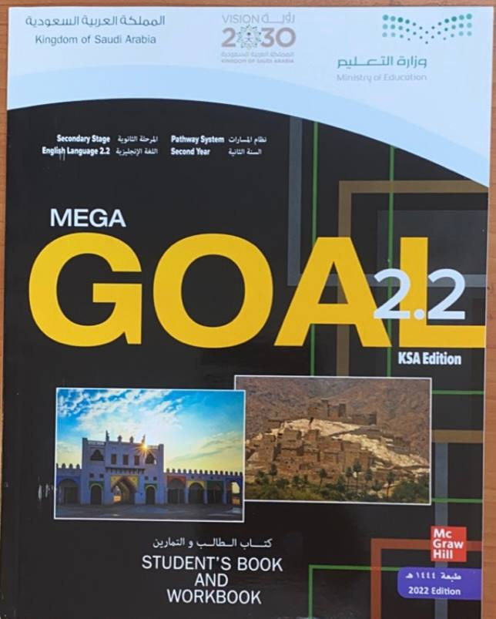
Homework!!
workbook
p. (101) , exercise (i)

Slide 23
Thanks!!

