Slide 1
Unit 4
Sporting Life
Grammar
Mega Goal 2.2
Done by: Entisar Al-Obaidallah

Slide 2
Lesson Objectives
01
02
Use
Use
04
05
Use
Apply
gerunds as subjects
Gerund phrases as subjects
superlative + the present perfect
The rules to do the exercises

Slide 3

Book Open
Pages ( 46 )

Slide 4
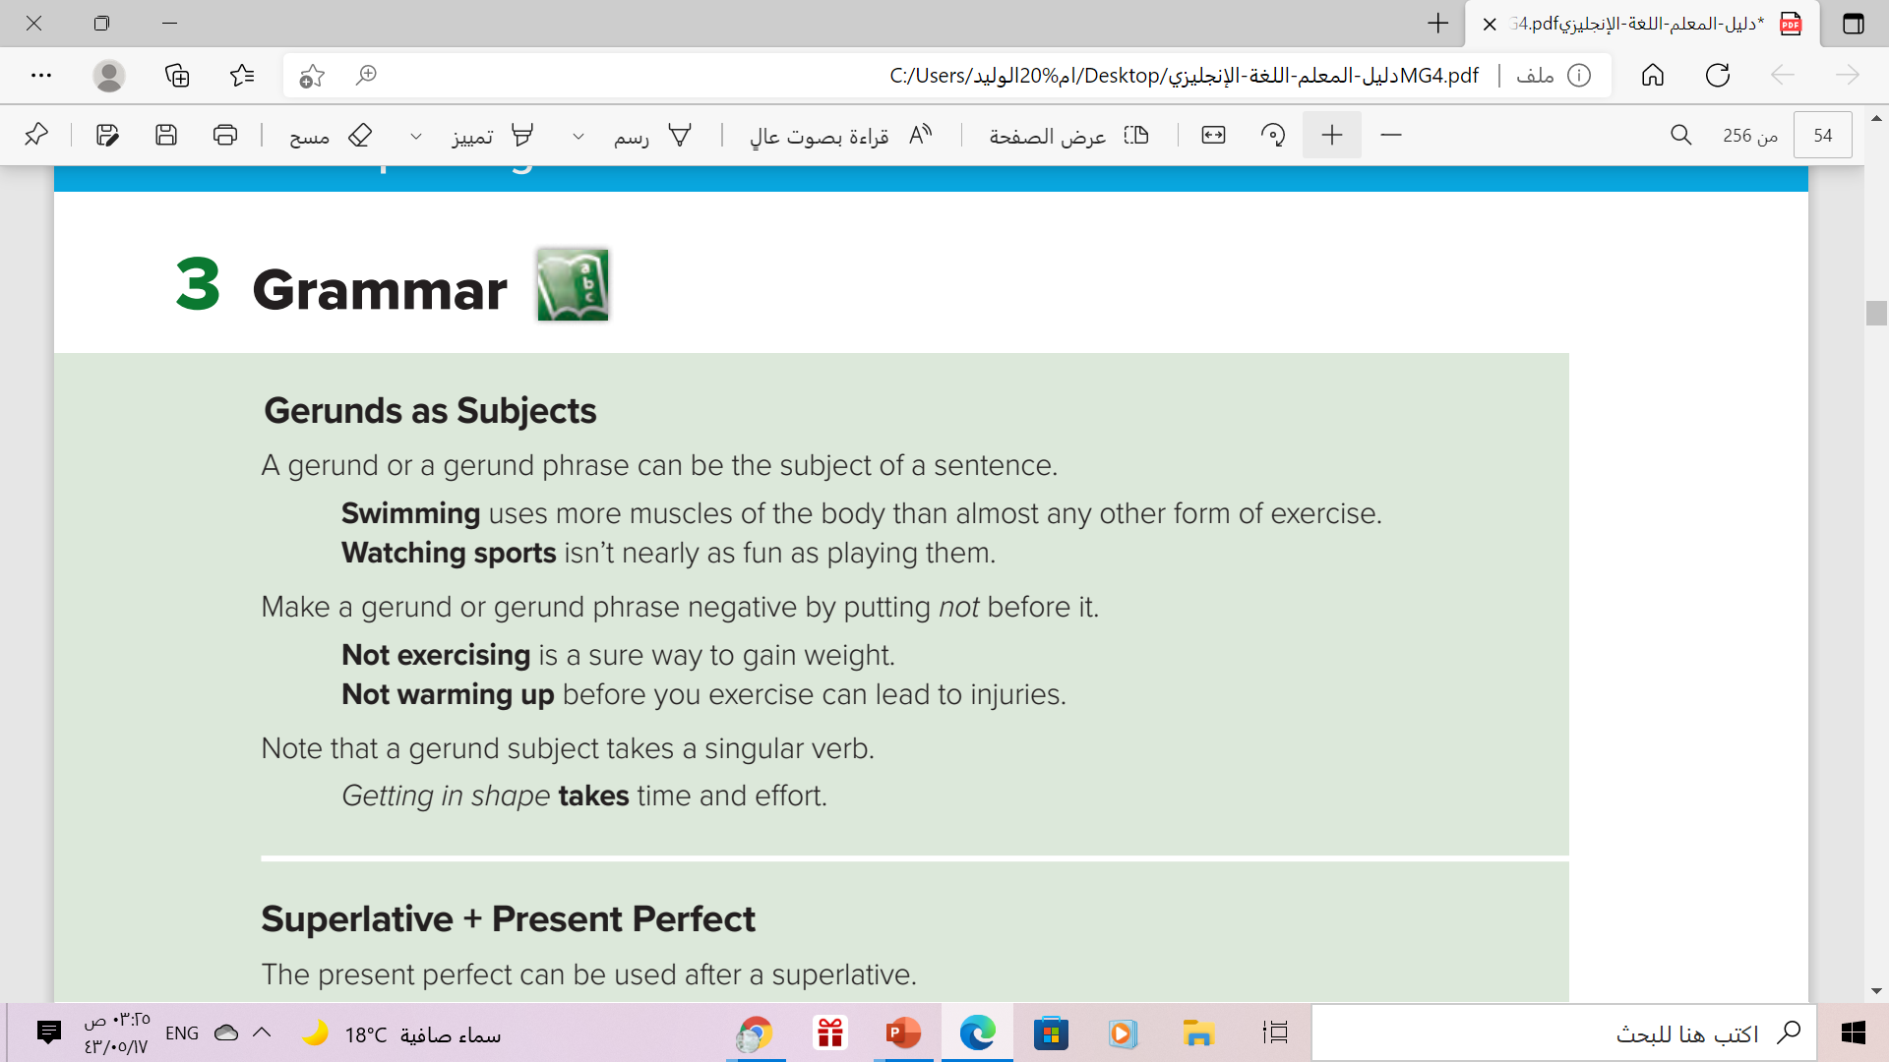

But
Getting in shape take time and effort.

Slide 5
What is Gerunds ?
Gerund = verb + ing
Walk+ ing = walking clean + ing = cleaning
What is Gerund phrase ?
Gerund phrase = gerund + other words
Reading book Sitting at home

Slide 6
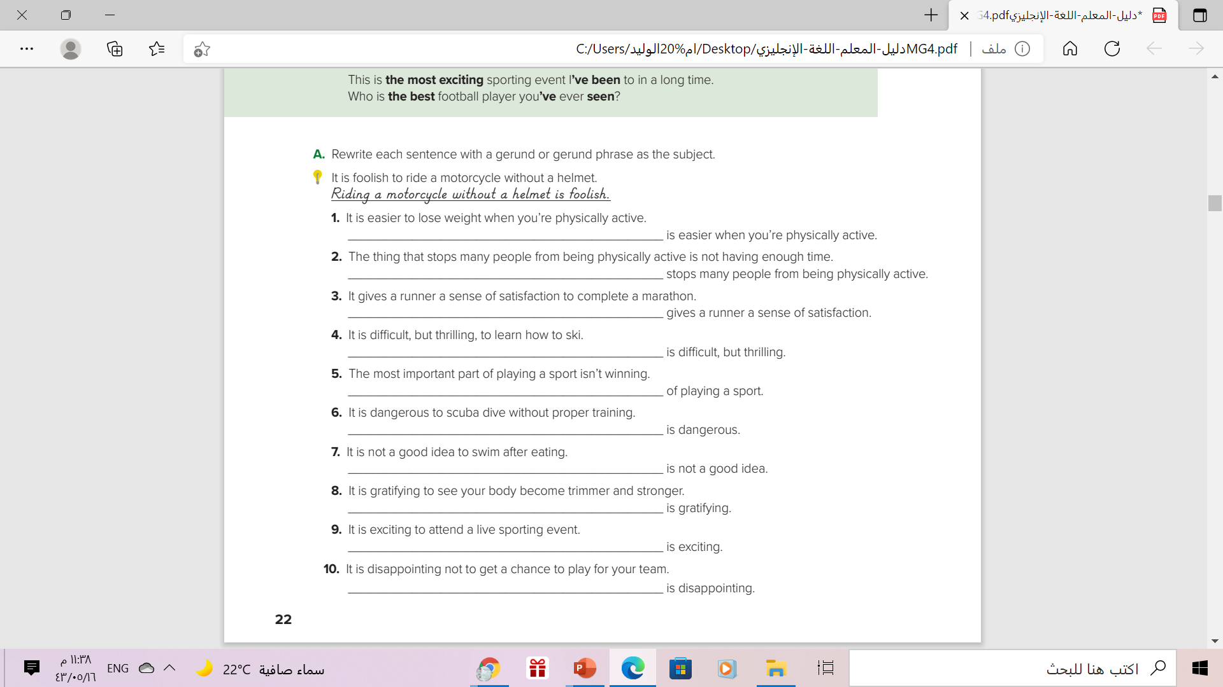
Losing weight
Not having enough time
Completing a marathon
Learning to ski
Winning is the most important part
Scuba diving without proper training
. Swimming after eating
Seeing your body become trimmer and stronger
Attending a live sporting event
Not getting a chance to play for your team

Slide 7


Slide 8

Correct :
___________ ( Download ) videos takes too much time .
Downloading

Slide 9
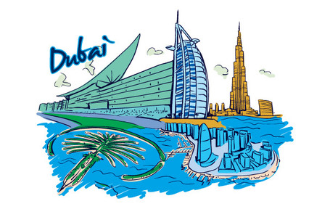
Correct :
______ ( Live ) in Dubai is expensive but fun .
Living

Slide 10
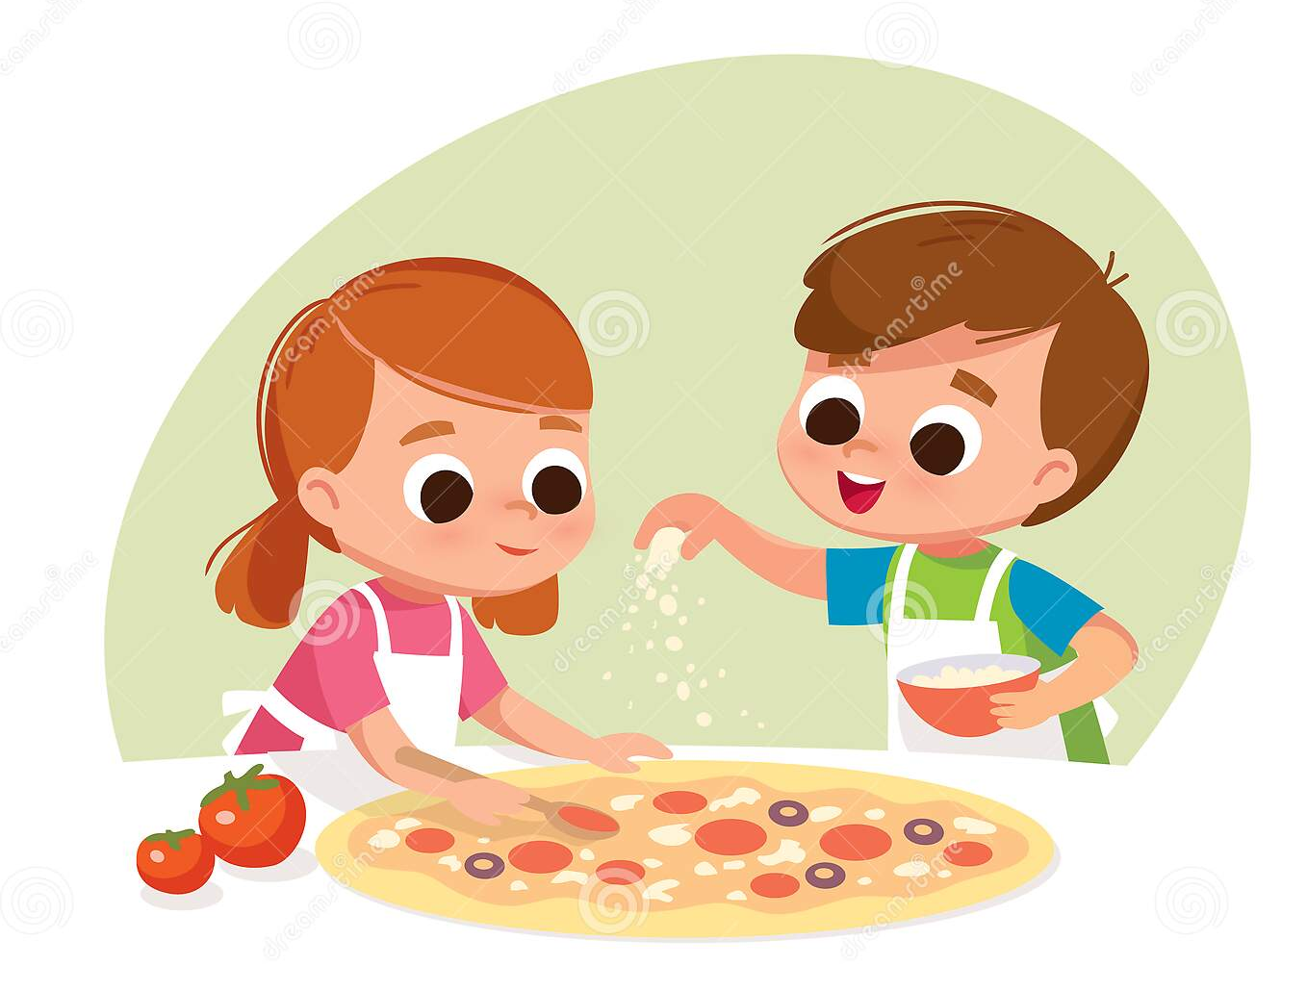
Correct :
________ ( Make) pizza is
very easy .
Making

Slide 11
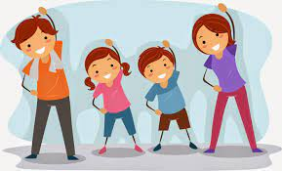
Correct :
___________ ( Exercise)
is fun .
Exercising

Slide 12
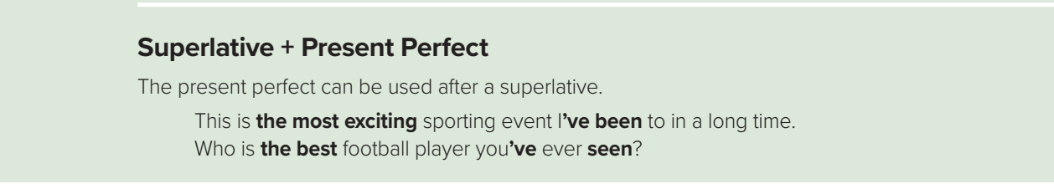
Use:
We often use the Present Perfect with Superlative for the biggest
and the best things in our lifetime .
Examples:
A) What is the most beautiful country that you have visited?
B) Italy is the most beautiful country that I have visited.

Slide 13

More Examples
McDonald’s beef is the best meat that I have eaten.
This book is the worst book that I’ve read.
➔We can also switch the order of the sentence
 The best meat that I have eaten is McDonald’s beef
 The worst book that I have read is this book.
Look:
McDonald’s beef is the best meat that I have eaten.
The best meat that I have eaten is McDonald’s beef

Slide 15

Correct :
the best
That’s _______________( good) cake
I __________________( eat \ ever)
have ever eaten

Slide 16
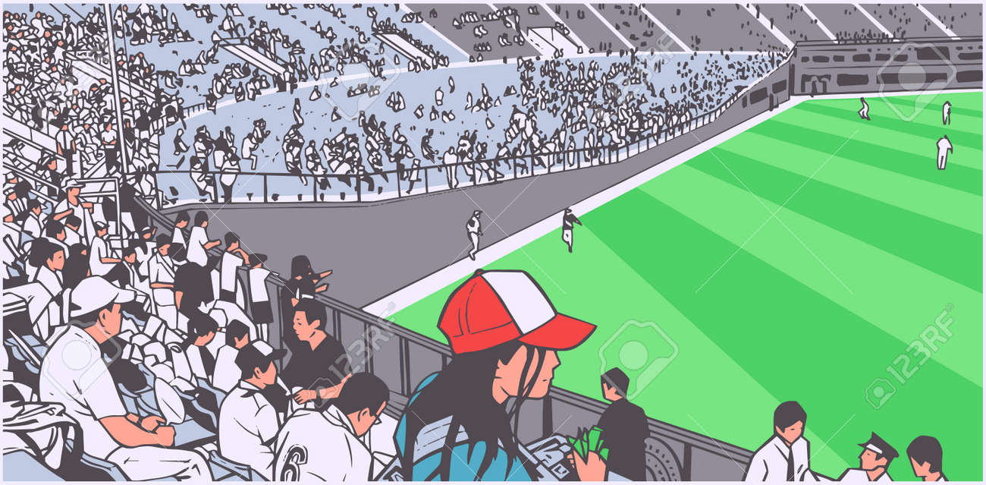
Correct :
What is _______________( exciting)
Sporting event you __________________
( see\ ever)?
the most exciting
have ever seen

Slide 17
Book Open
Pages ( 47 )

Slide 18
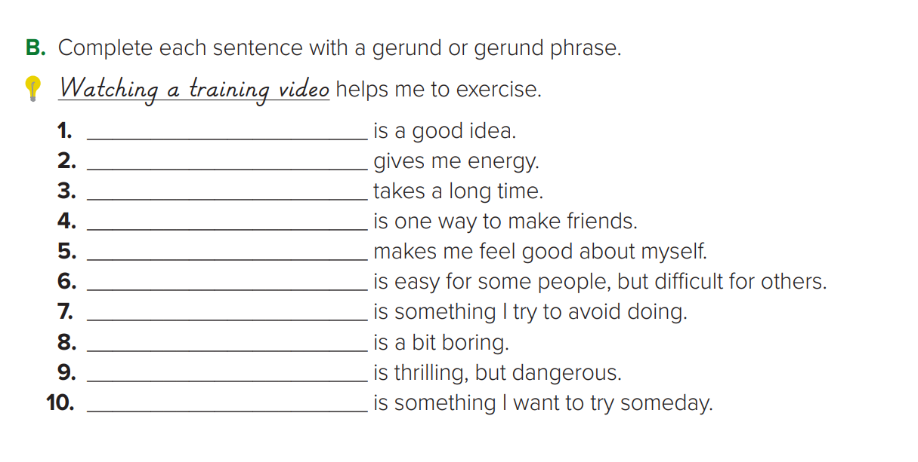
Sleeping eight hours
Exercising
Reading a book
Joining a club
Doing well in school
Making new friends
Buying things I don’t need
Watching TV
Sky diving
Mountain climbing

Slide 19
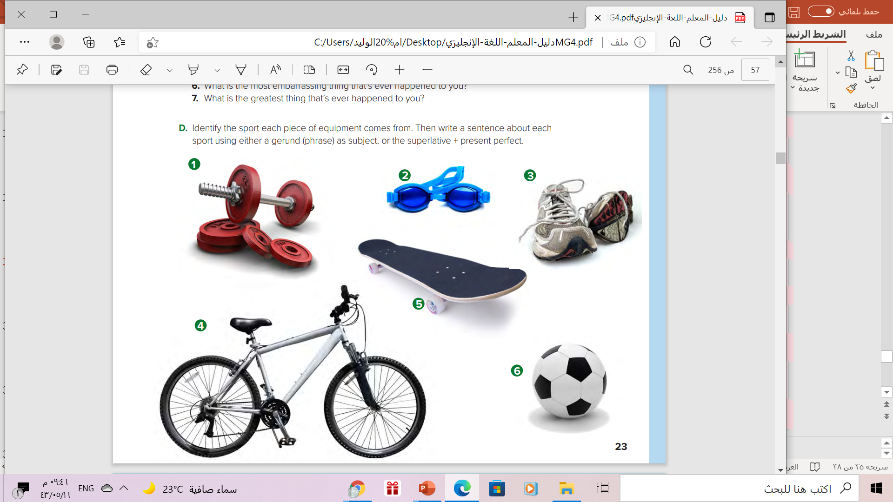
Swimming
Weightlifting
Running
Bicycling
skateboarding
football

Slide 20
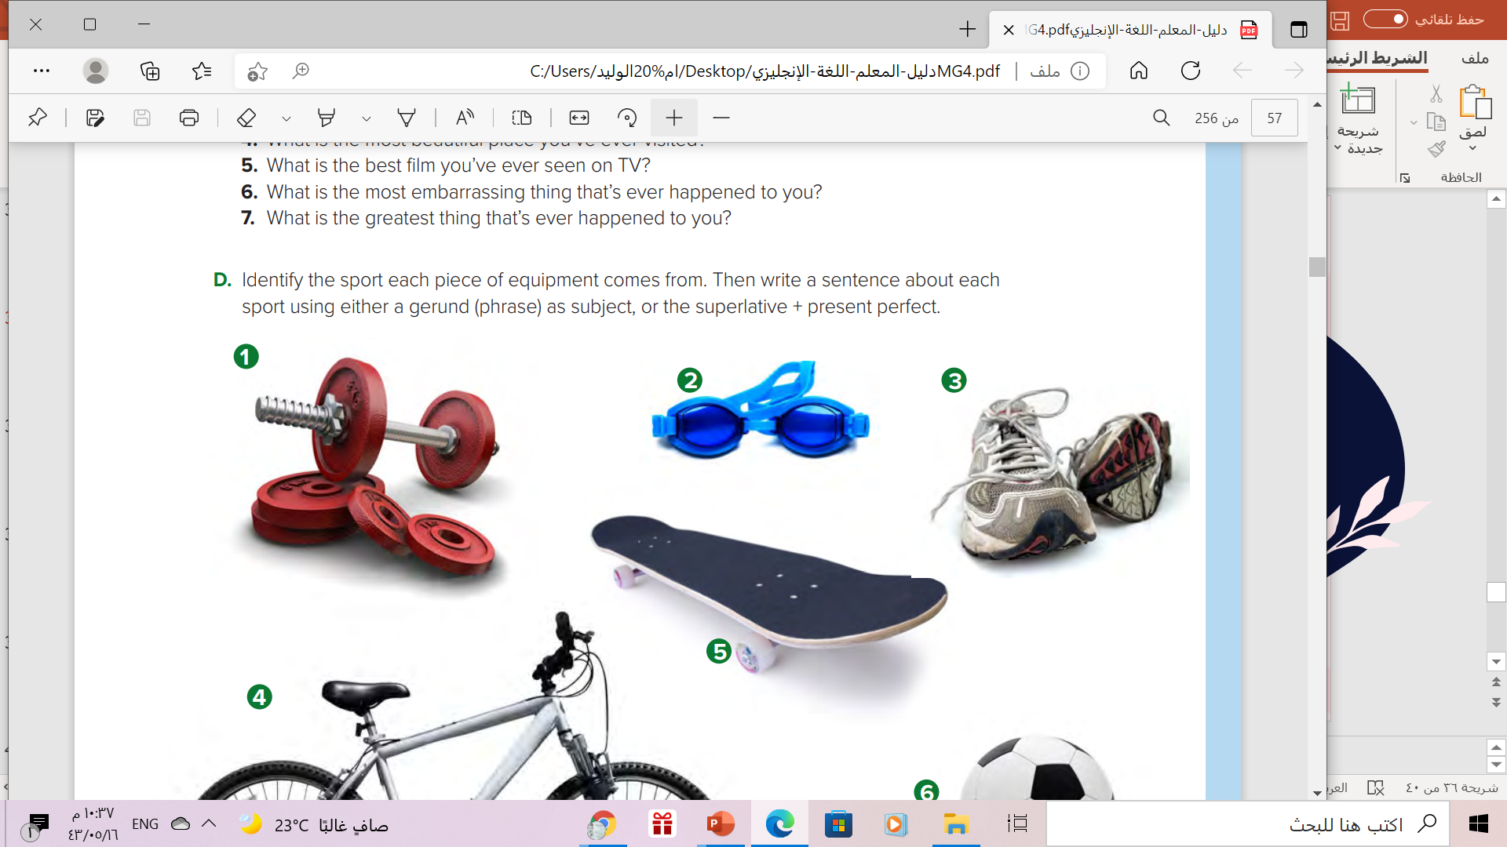
Gerund / Superlative + present perfect | Sport
 | 1) Weightlifting
 | 2) Swimming
 | 3) Running
 | 4) Bicycling
 | 5)Skateboarding
 | 6) Football
Weightlifting is one of the most difficult sports on the world
Swimming is an activity that burns lots of calories
Running every day is good for your heart.
Riding a bicycle is the best way to get around town.
Skateboarding is the most difficult sport I’ve ever tried.
Playing football with friends is a fun thing to do

Slide 21

Remember..

Slide 22
Homework
Work book page ( 108 ), exercise ( C ),
and exercise ( E ) ,page ( 109 )

Slide 23

Thanks

