Slide 1

Drive Slowly
Unit 8
Listen & Discuss

Slide 2
بسم الله الرحمن الرحيم
Day:
Date:

Slide 3
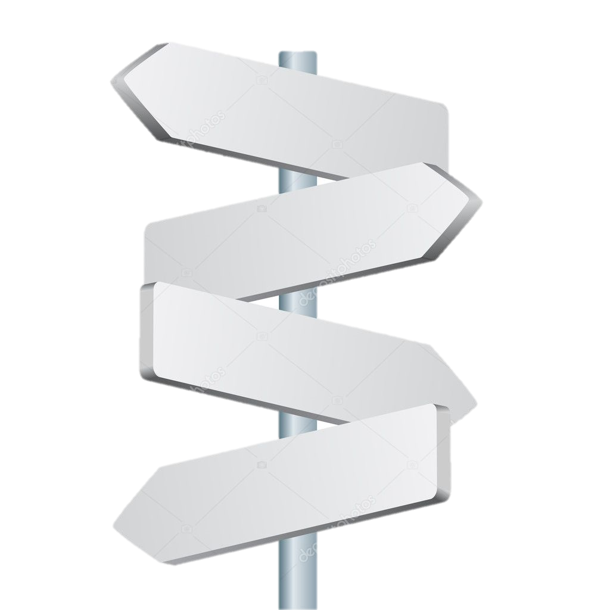

Discuss driving and its rules
Introduce traffic signs
Learning
Objectives
List car interior and exterior parts
Use driving expressions

Slide 4
(بسم الله، والحمد لله سبحان الذي سخر﴿ لنا هذا وما كنا له مقرنين، وإنا إلى ربنا لمنقلبون﴾، (الحمد لله، الحمد لله، الحمد لله، الله
أكبر، الله أكبر، الله أكبر، سبحانك اللهم إني ظلمت نفسي فاغفر لي؛ فإنه لا يغفر الذنوب إلاأنت).
دعاء الركوب

Slide 5
Let’s go on a drive

Slide 6
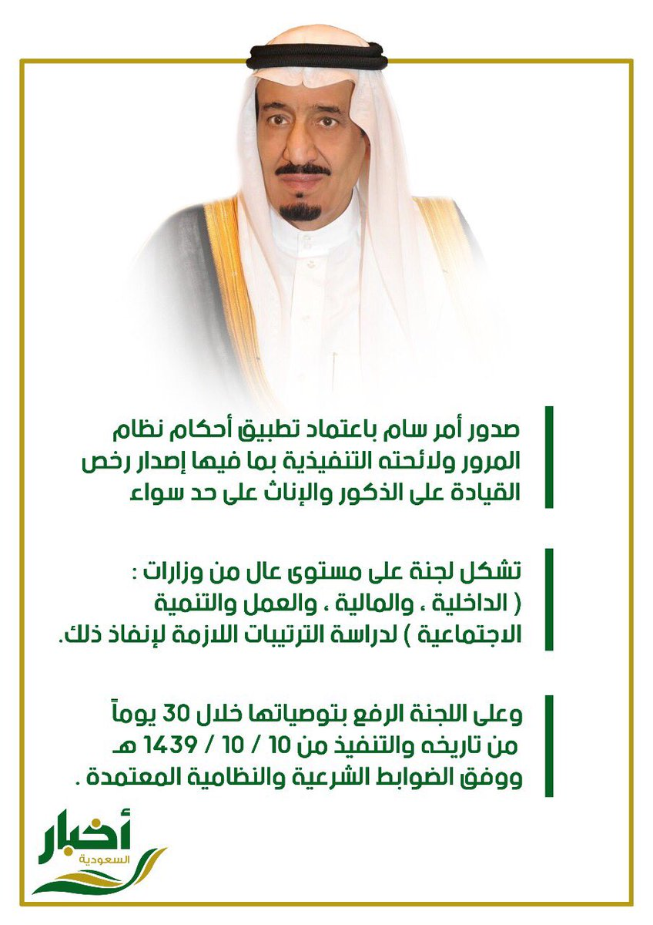
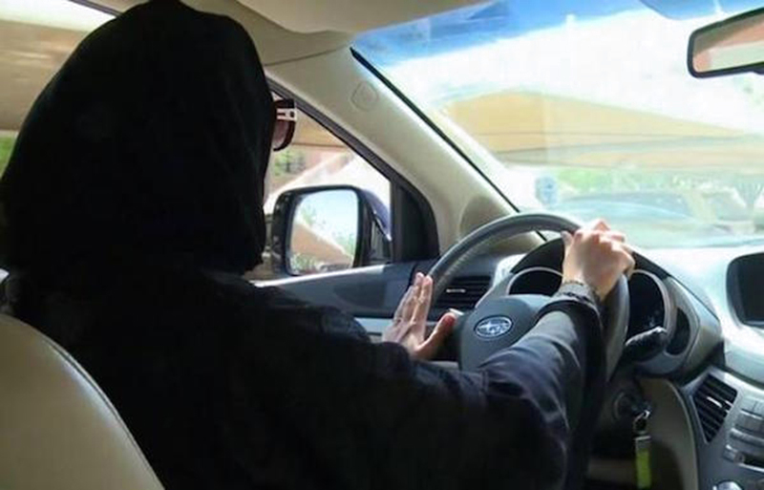
Woman driving
1439- 10 10

Slide 7
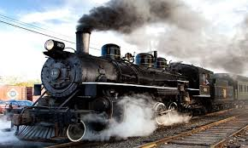
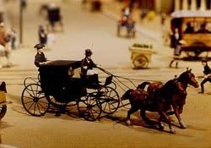
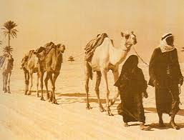
How did people travel in the past?

Slide 8
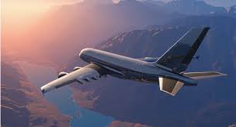
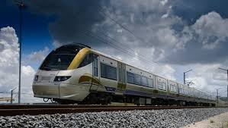
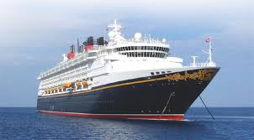
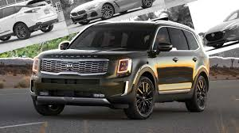
How do people travel now?

Slide 9
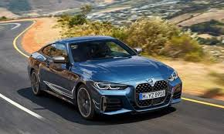
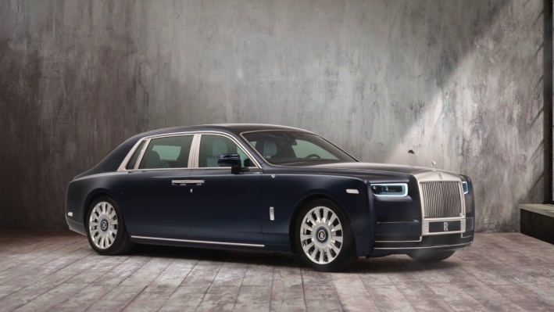
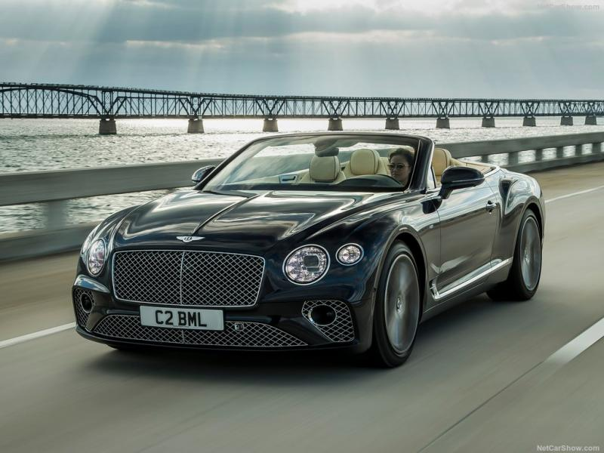
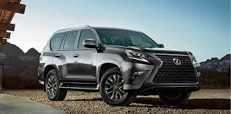
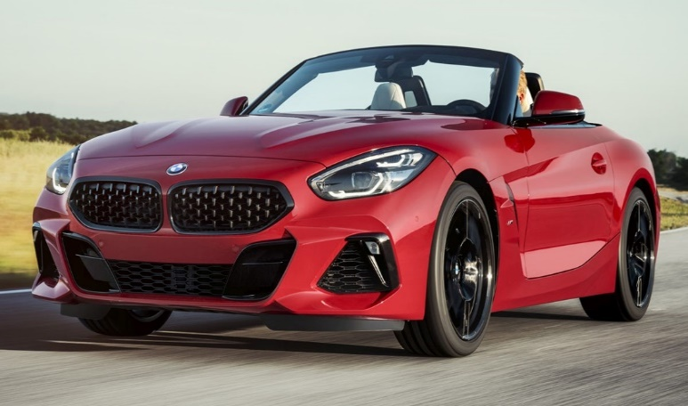
Listen and Discuss

Slide 10
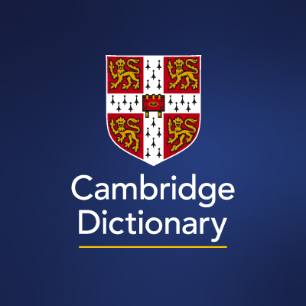


Attention
EXTERIOR = the outside part of something
INTERIOR = the inside part of something

Slide 11
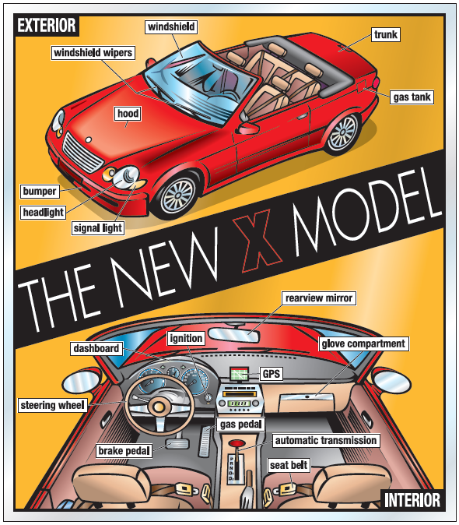

Page 78

Slide 12
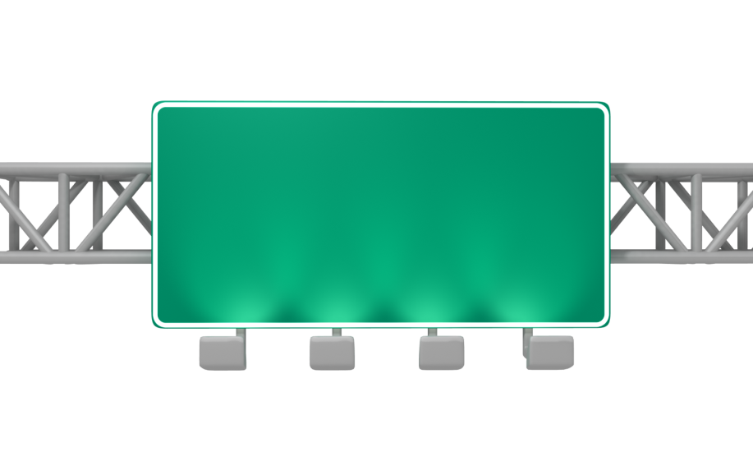
Who am I?
What do you turn on if you want to turn left or right?
(signal light)

Slide 13
Who am I?
What do you turn on if it’s raining?
(windshield wipers)

Slide 14
Who am I?
Where can you see if you need gas?
(dashboard)

Slide 15
Who am I?
What do you hold when you’re driving?
(steering wheel)

Slide 16
Who am I?
What should you wear to be safe?
(seat belt)

Slide 17
Who am I?
Where can you see the cars behind you?
(rearview mirror)

Slide 18
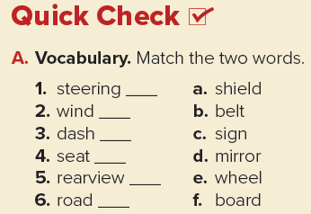
Quick Check
Page 79
e
a
f
b
d
c

Slide 19

Practice

Slide 20
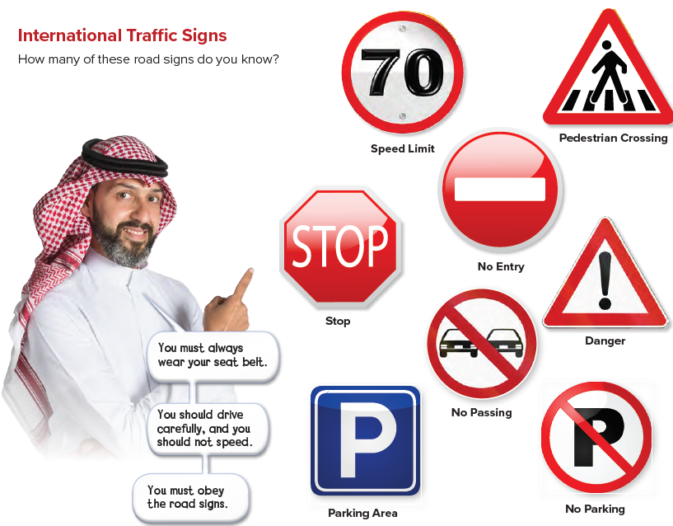
International Traffic Signs
Page 79

Slide 21

Practice

Slide 22
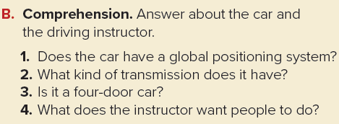
Quick Check
Page 79
Answer
1. Yes, it does.
2. It has automatic transmission.
3. No, it isn’t.
4. He wants people to wear seat belts, to drive carefully, not to speed, and to obey road signs.

Slide 23
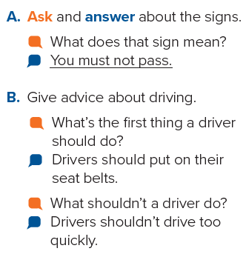
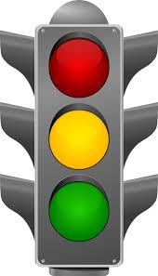
Pair Work
Page 79

Slide 24
Homework
Page 215

Slide 25
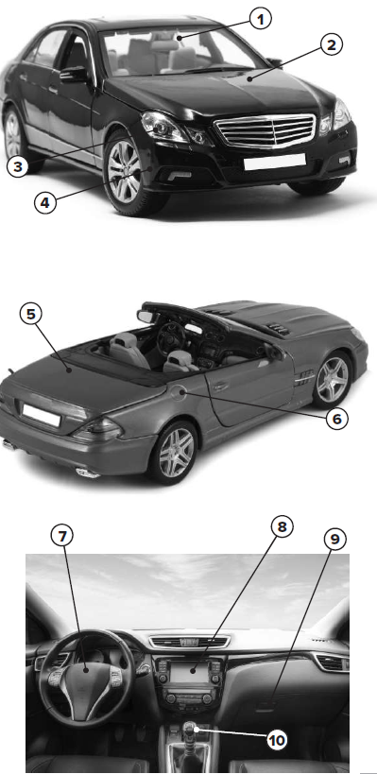
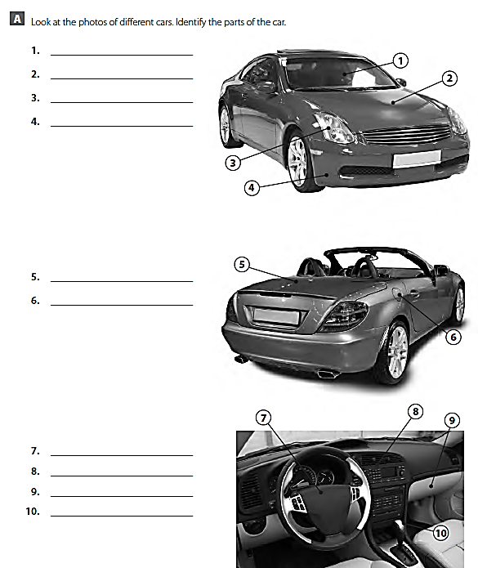
Windshield
Steering wheel
Hood
Trunk
Dashboard
Headlight
Gas tank
Glove compartment
Bumper
Automatic transmission

Slide 26
Thank you

