Slide 1
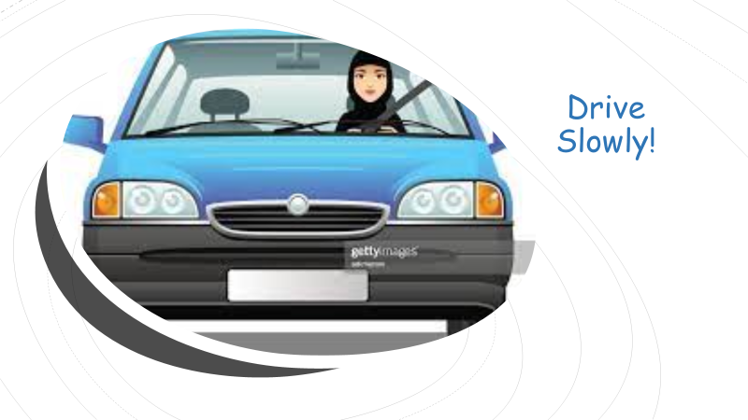

Drive Slowly!
Unit 8

Slide 2
10. Reading
Objectives
Answer questions about a text.
2. Read a text to answer questions.
3. Prepare a list of driving tips.

Slide 3
1. Do you know how to drive?
2. Do all people around the world drive on the same side?
3. On Which side of the world do people drive in Saudi Arabia?
4. On Which side of the world do people usually walk?

Slide 4
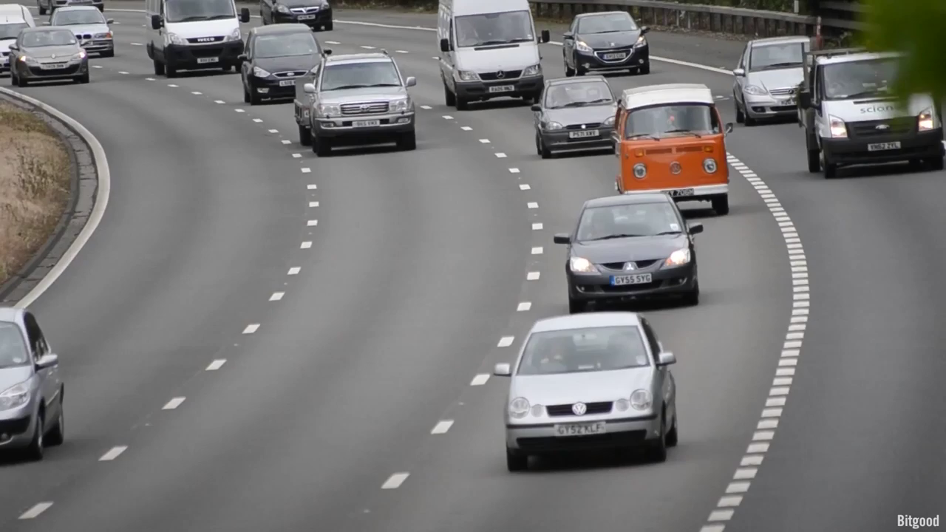

Slide 5
1. How many of the world drive on the left?

Slide 6
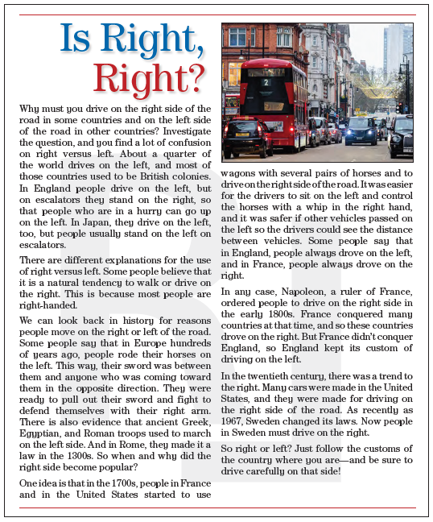

P. B. p. 84

Slide 7
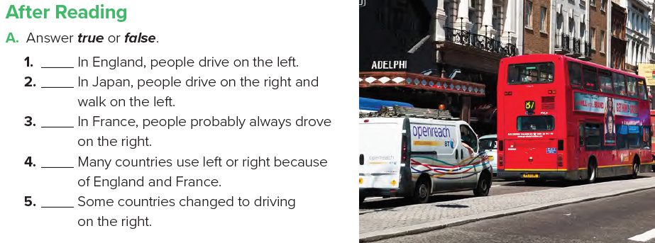
P. B. p. 85
T
F
F
T
T

Slide 8
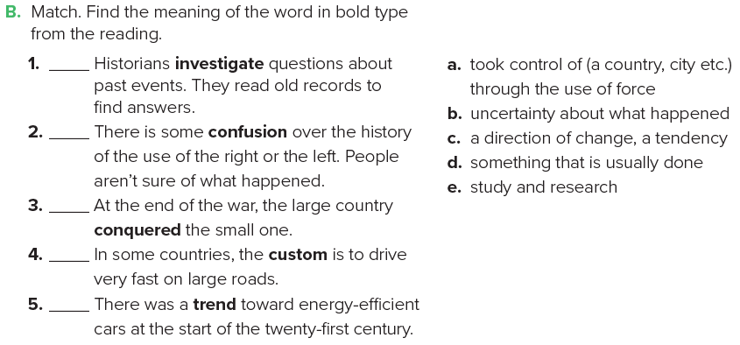
P. B. p. 85
e
b
a
d
c

Slide 9
Discussion
What are some problems due to people driving on different sides of the road in different places?
2. Do you think that there should be one standard for the whole world?
3. What problems do you think Sweden had when it changed from left to right?

Slide 10
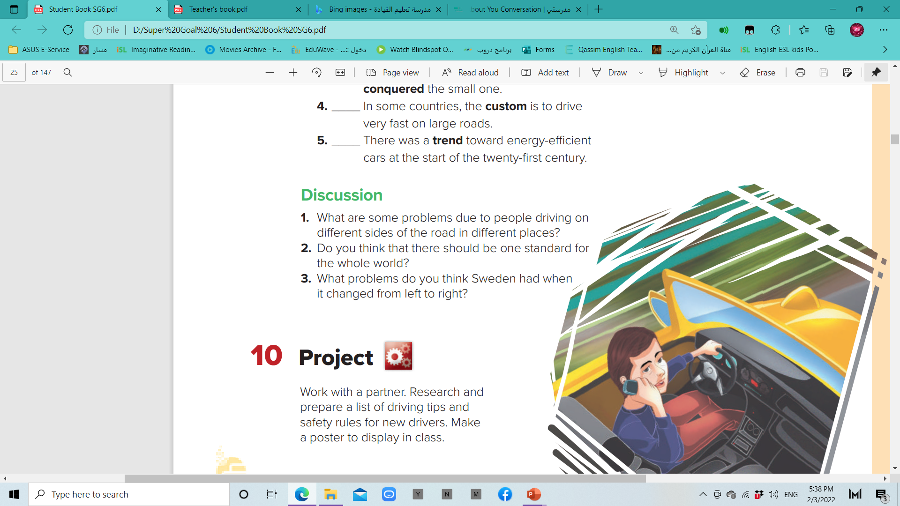

Slide 11
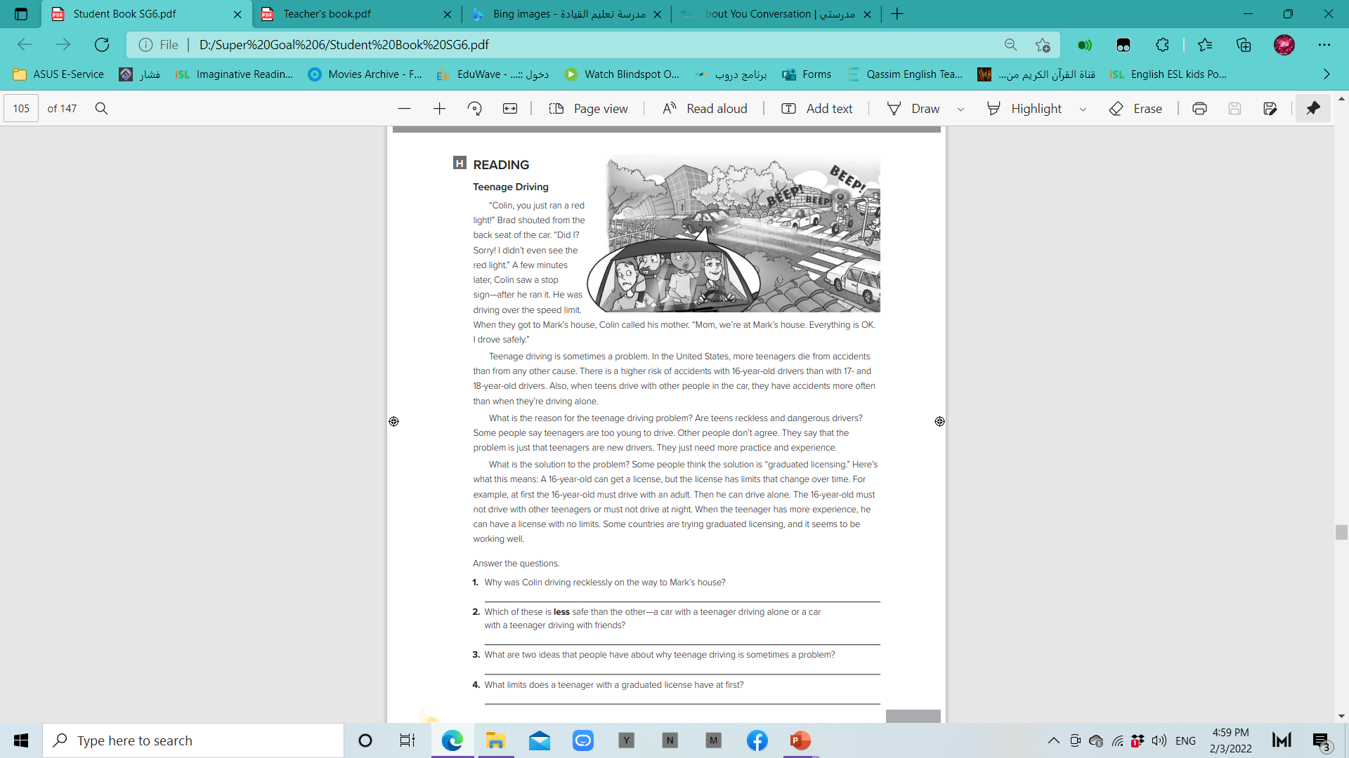
He ran a red light, and he ran a stop sign.
A car with a teenager driving with friends is less safe.
Teenagers are too young to drive.
At first, the teenager must drive with an adult.

Slide 12


