Slide 1

Drive Slowly
Unit 8
Writing

Slide 2
بسم الله الرحمن الرحيم
Day:
Date:

Slide 3


Use phrases to express cause & results
Fill missing words
Learning Objectives
Write an essay about the suitable age of driving
Express their opinion about driving

Slide 4
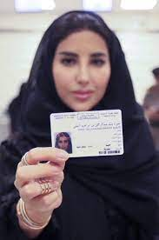
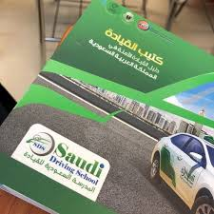

Warm up
How to get a driving license?

Slide 5
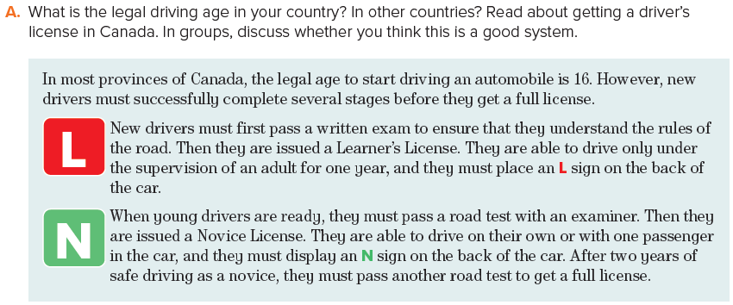
Page 86

Slide 6
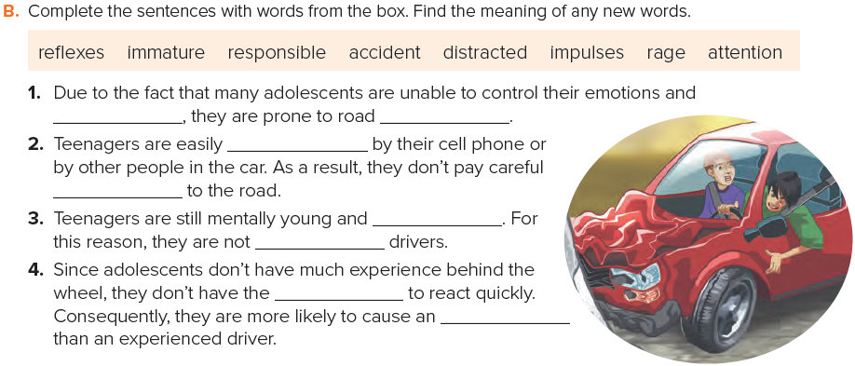
Page 86
impulses
rage
distracted
attention
immature
responsible
reflexes
accident

Slide 7

Page 86
Since they are immature, most teenagers are not responsible drivers.
He caused the accident because he didn’t stop at the intersection.
Most teenagers are immature. For this reason, they are not responsible drivers.
He didn’t stop at the intersection. As a result, he caused the accident.

Slide 8
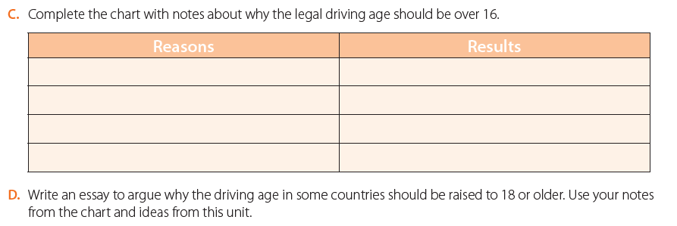
Page 86
raising the driving age to 18 could help lower the overall rate of fatal crashes.
It is safer
If the teenagers can’t drive that will cause more teens to walk, ride bikes, or use other active options to get places. This could cut back on teenage obesity levels.
It will make teens more active
18-year-olds are more emotionally mature than 16-year-olds
18-year-olds are more likely to make smart decisions than 16-year-olds.
Give teens more time to learn how to drive
When teens take lots of supervised driving practice that will enable them to know more about the road risks and laws.

Slide 9
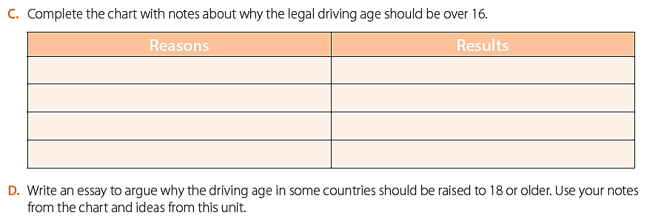
Page 86

Slide 10
Homework
Page 220 (I)

Slide 11
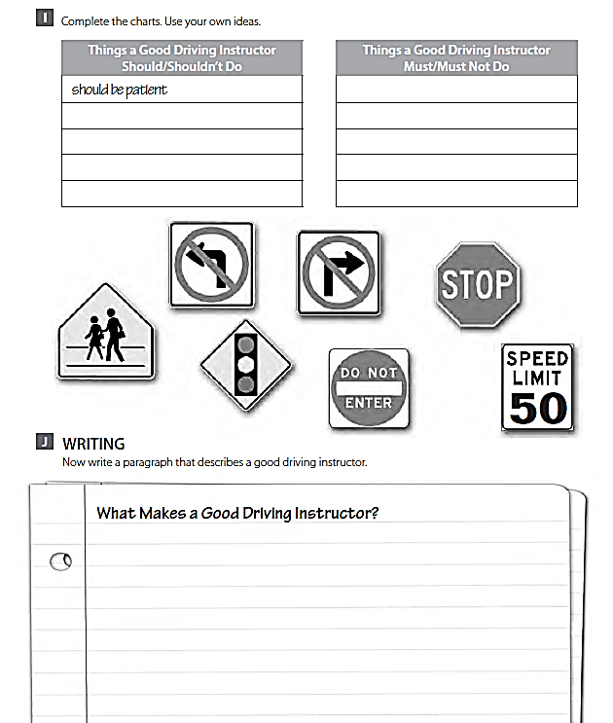
Should be calm
Shouldn’t talk on the phone .
Mustn’t break the law .
Must know the traffic laws .

Slide 12
THANK YOU

