Slide 1

Unit 5
Do You Really Need It?
Form ,Meaning & Function
Done by: Entisar Al-Obaidallah

Slide 2
Language Objectives
01
03
02
04
Use
Practice
Conditional sentences with present and future forms
Some words connected with different ways of shopping
Distinguish
Differentiate
between I’d rather and I’d prefer
Between the use of conditional sentences with when and Unless

Slide 3

Open
Your student’s book
p. 78

Slide 4
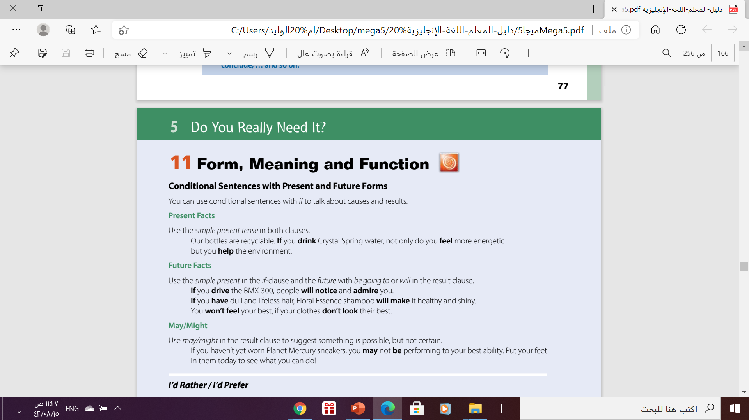

Slide 5
Form
Future Facts
This conditional is used when the result will always happen. It is a fact !
We can make a conditional sentence with two present simple verbs:
(one in the 'if clause' and one in the 'main clause'):
If
Present Simple ,
Present Simple
Example
If you cook an egg in the microwave, it explodes.
If you put water in the freezer, it becomes ice.

Slide 6
Another Example
if water reaches 100 degrees, it always boils.
Present Simple ,
Present Simple
This conditional is used when the result will always happen. It is a fact !
Use the simple present tense in both clauses.
More Examples
If you touch a fire, you get burned.
We can change the order , but the meaning doesn’t change
People die if they don't eat.
If people eat too much, they get fat.

Slide 7

If you heat ice , it melts.
If clause
main clause/result clause
If you heat ice , it melts.
It melts if you heat ice.
PUT COMMA when you put “IF” clause at the beginning
NO COMMA when you put the main clause at the beginning

Slide 8
Form
Future Facts
It's used to talk about things which might happen in the future. Of course, we can't know what will happen in the future, but this describes possible things, which could easily come true.
This conditional has the present simple after 'if', then the future simple in the other clause.
If
Present Simple ,…...
will
infinitive
Example
If it rains, I will stay at home.

Slide 9
Another Example
If you study more, you will get better marks.
Present Simple ,
Future Tense
This conditional is used to talk about possible and probable situations in the future .
More Examples
If you help me, I will help you.
.
We can change the order , but the meaning doesn’t change
She'll miss the bus if she doesn't leave soon.
.
If you tell us the truth, we will forgive you.
.

Slide 10
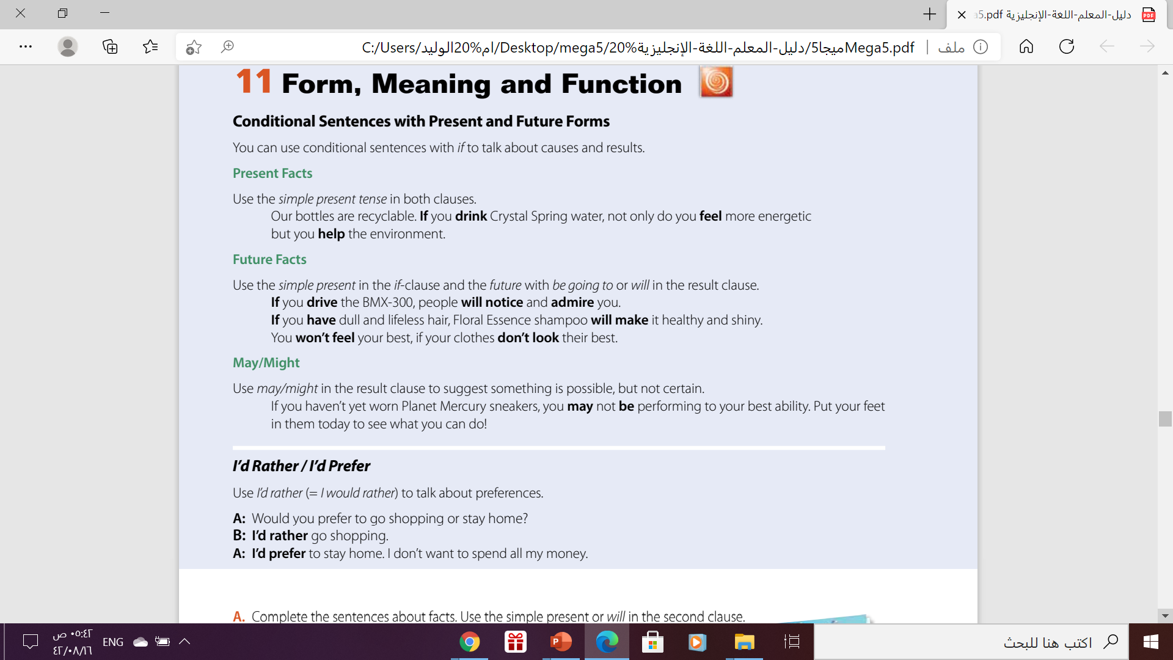

When may / might is used in a conditional sentence, the if clause can be in the present tense.
Form:
If
Present Simple
May/ might
V(infinitive)
Examples
If Sara comes, she might look after the children.

Slide 11



When we speak about a specific preference, would rather and would prefer have the same meaning and are interchangeable.
Would rather can be abbreviated to 'd rather.
Would prefer can be abbreviated to 'd prefer.
I'd rather go to the cinema.
I'd prefer to go to the cinema.
Would rather is followed by the infinitive without to.
I'd rather have fruit juice.
Would prefer is followed by to + infinitive or a noun.
I'd prefer to have fruit juice.
I'd prefer fruit juice.

Slide 12

Open
Your student’s book
p. 79

Slide 13
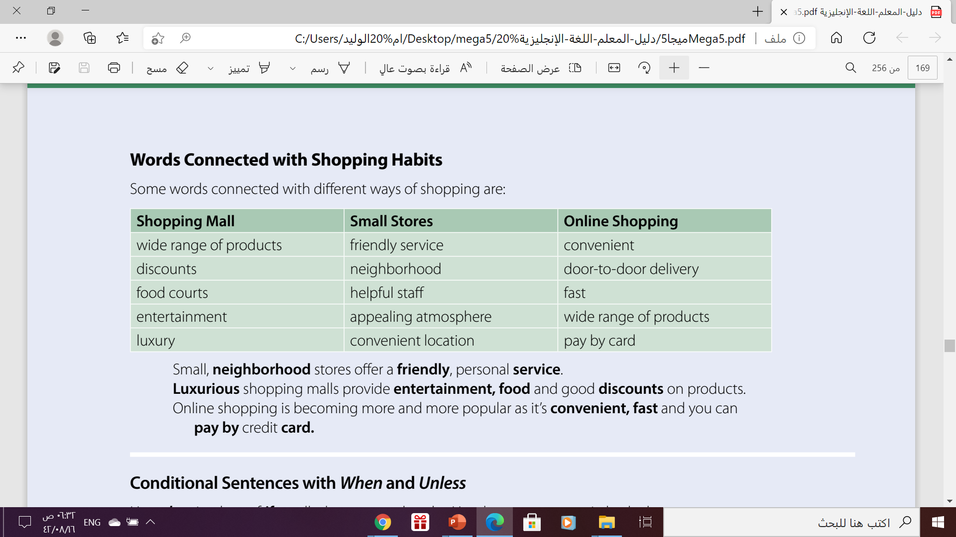
Word Connected with Shopping Habits

Slide 14
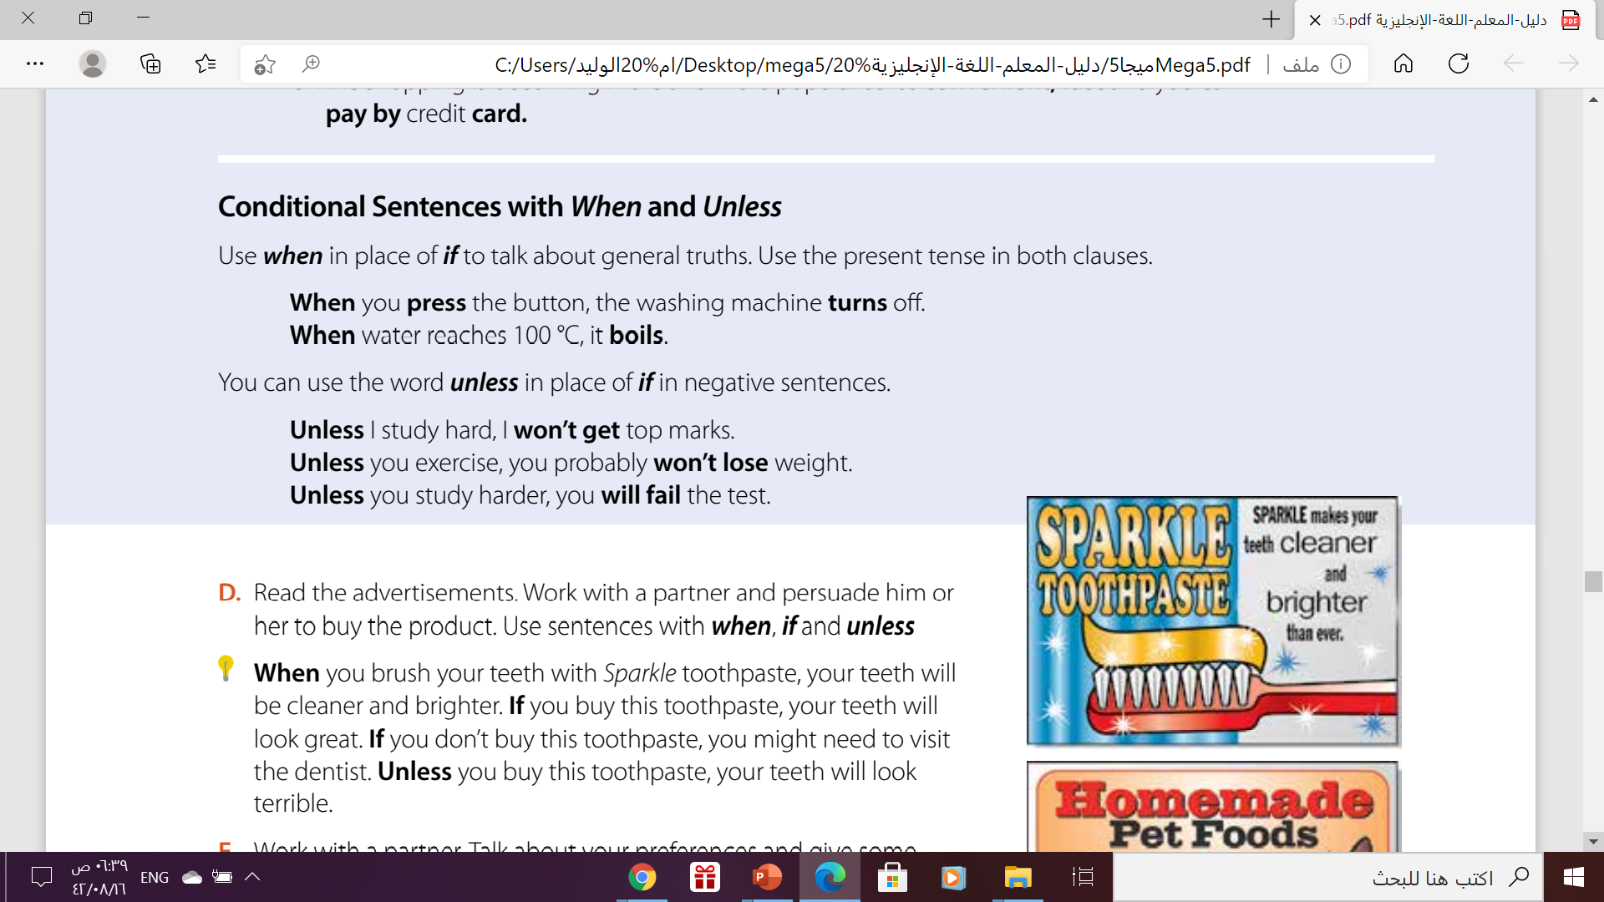
Word Connected with Shopping Habits

Slide 15
Conditional Sentences with When & Unless
The 'if' in conditional with present facts can usually be replaced by 'when' without changing the meaning.
Example
If water reaches 100 degrees, it boils.
We can replace “ if” with “ when”, but the meaning doesn’t change
When water reaches 100 degrees, it boils.

Slide 16
Conditional Sentences with When & Unless
Un less
If… not
Use when in place of if to talk about general truths. Use the present tense in both clauses.
Example
You will be sick if you don't stop eating.
We can replace “ if” with “ unless”, in negative sentences
You'll be sick unless you stop eating.

Slide 17

From The Holy Qura’an

Slide 18

Thanks!

