Slide 1



Slide 2
Good Morning

Slide 3

Unit-4-
What They Said

Slide 4
8-Conversation

Slide 5


Revision
Objectives
The students will be able to :
.Listen to the audio.
Skim & Scan the texts
Use the "real talk" phrases in new conversation .
Answer specific questions based on conversation .
Share positively work.

Slide 6


Revision

Slide 7

Underline that in the conversation. Practice reading the conversation with a partner.
Faisal: I really think that telemarketing shouldn’t be allowed.
Khaled: Yes, I totally agree with you. Telemarketers are a real nuisance
Faisal: Yesterday a man called me up. He said he
was from the Dollar Bank, and he asked if
he could talk to me for a minute.
Khaled: What did he want?
Faisal: He said that someone had given them my name and that
he was calling to offer their services.
Khaled: What services?
Faisal: He tried to persuade me to open an account with them.
So I told him I already had an account elsewhere and that
I wasn’t interested. But he insisted and was very pushy. In
the end, I lost my patience and hung up.
Khaled: Well, I got a call from a man who said he was from a
travel agency. This man said I had won a free trip to the
Bahamas and that he was calling me to give me the good news.
Faisal: Had you entered a contest or anything like that?
Khaled: No. It turned out that everything was for free, but I’d first have to pay a huge amount of
money to become a member of the Jet Set Club. Big hoax!
Faisal: I hate that!
Faisal: I really think that telemarketing shouldn’t be allowed.
Khaled: Yes, I totally agree with you. Telemarketers are a real nuisance
Faisal: Yesterday a man called me up. He said he
was from the Dollar Bank, and he asked if
he could talk to me for a minute.
Khaled: What did he want?
Faisal: He said that someone had given them my name and that
he was calling to offer their services.
Khaled: What services?
Faisal: He tried to persuade me to open an account with them.
So I told him I already had an account elsewhere and that
I wasn’t interested. But he insisted and was very pushy. In
the end, I lost my patience and hung up.
Khaled: Well, I got a call from a man who said he was from a
travel agency. This man said I had won a free trip to the
Bahamas and that he was calling me to give me the good news.
Faisal: Had you entered a contest or anything like that?
Khaled: No. It turned out that everything was for free, but I’d first have to pay a huge amount of
money to become a member of the Jet Set Club. Big hoax!
Faisal: I hate that!

Slide 8
Guest Speaker
Here is our friend Retaj telling us about her experience about telemarketing

Slide 9

Skimming
What is the conversation about ?
Faisal: I really think that telemarketing shouldn’t be allowed.
Khaled: Yes, I totally agree with you. Telemarketers are a real nuisance
Faisal: Yesterday a man called me up. He said he
was from the Dollar Bank, and he asked if
he could talk to me for a minute.
Khaled: What did he want?
Faisal: He said that someone had given them my name and that
he was calling to offer their services.
Khaled: What services?
Faisal: He tried to persuade me to open an account with them.
So I told him I already had an account elsewhere and that
I wasn’t interested. But he insisted and was very pushy. In
the end, I lost my patience and hung up.
Khaled: Well, I got a call from a man who said he was from a
travel agency. This man said I had won a free trip to the
Bahamas and that he was calling me to give me the good news.
Faisal: Had you entered a contest or anything like that?
Khaled: No. It turned out that everything was for free, but I’d first have to pay a huge amount of
money to become a member of the Jet Set Club. Big hoax!
Faisal: I hate that!
Telemarketing calls
What was Faisal’s call about ?
Opening account in a bank .
What was Khalid’s call about ?
Travel agency to offer him free ticket .

Slide 10


Scan
Listen & Read
Faisal: I really think that telemarketing shouldn’t be allowed.
Khaled: Yes, I totally agree with you. Telemarketers are a real nuisance
Faisal: Yesterday a man called me up. He said he
was from the Dollar Bank, and he asked if
he could talk to me for a minute.
Khaled: What did he want?
Faisal: He said that someone had given them my name and that
he was calling to offer their services.
Khaled: What services?
Faisal: He tried to persuade me to open an account with them.
So I told him I already had an account elsewhere and that
I wasn’t interested. But he insisted and was very pushy. In
the end, I lost my patience and hung up.
Khaled: Well, I got a call from a man who said he was from a
travel agency. This man said I had won a free trip to the
Bahamas and that he was calling me to give me the good news.
Faisal: Had you entered a contest or anything like that?
Khaled: No. It turned out that everything was for free, but I’d first have to pay a huge amount of
money to become a member of the Jet Set Club. Big hoax!
Faisal: I hate that!

Slide 11
Scan
---unfamiliar words.
Faisal: I really think that telemarketing shouldn’t be allowed.
Khaled: Yes, I totally agree with you. Telemarketers are a real nuisance
Faisal: Yesterday a man called me up. He said he
was from the Dollar Bank, and he asked if
he could talk to me for a minute.
Khaled: What did he want?
Faisal: He said that someone had given them my name and that
he was calling to offer their services.
Khaled: What services?
Faisal: He tried to persuade me to open an account with them.
So I told him I already had an account elsewhere and that
I wasn’t interested. But he insisted and was very pushy. In
the end, I lost my patience and hung up.
Khaled: Well, I got a call from a man who said he was from a
travel agency. This man said I had won a free trip to the
Bahamas and that he was calling me to give me the good news.
Faisal: Had you entered a contest or anything like that?
Khaled: No. It turned out that everything was for free, but I’d first have to pay a huge amount of
money to become a member of the Jet Set Club. Big hoax!
Faisal: I hate that!
Faisal: I really think that telemarketing shouldn’t be allowed.
Khaled: Yes, I totally agree with you. Telemarketers are a real nuisance
Faisal: Yesterday a man called me up. He said he
was from the Dollar Bank, and he asked if
he could talk to me for a minute.
Khaled: What did he want?
Faisal: He said that someone had given them my name and that
he was calling to offer their services.
Khaled: What services?
Faisal: He tried to persuade me to open an account with them.
So I told him I already had an account elsewhere and that
I wasn’t interested. But he insisted and was very pushy. In
the end, I lost my patience and hung up.
Khaled: Well, I got a call from a man who said he was from a
travel agency. This man said I had won a free trip to the
Bahamas and that he was calling me to give me the good news.
Faisal: Had you entered a contest or anything like that?
Khaled: No. It turned out that everything was for free, but I’d first have to pay a huge amount of
money to become a member of the Jet Set Club. Big hoax!
Faisal: I hate that!
something that is very annoying
to try to get someone to do something
somewhere else, some other place
so determined to succeed that the person is rude

Slide 12
Real Talk
really/totally
used to make a statement stronger
He’s really going to do it this time .
In the
end
used to introduce a statement with the final event or result
In the end, he chose to go to Harvard University .
or other similar things; used so that the speaker doesn’t have to give a complete list or explain things in more detail
or anything like that
He wasn’t involved in drugs or anything like that .
a plan that is designed to trick someone else
hoax
The bomb threat turned to be a hoax .

Slide 13
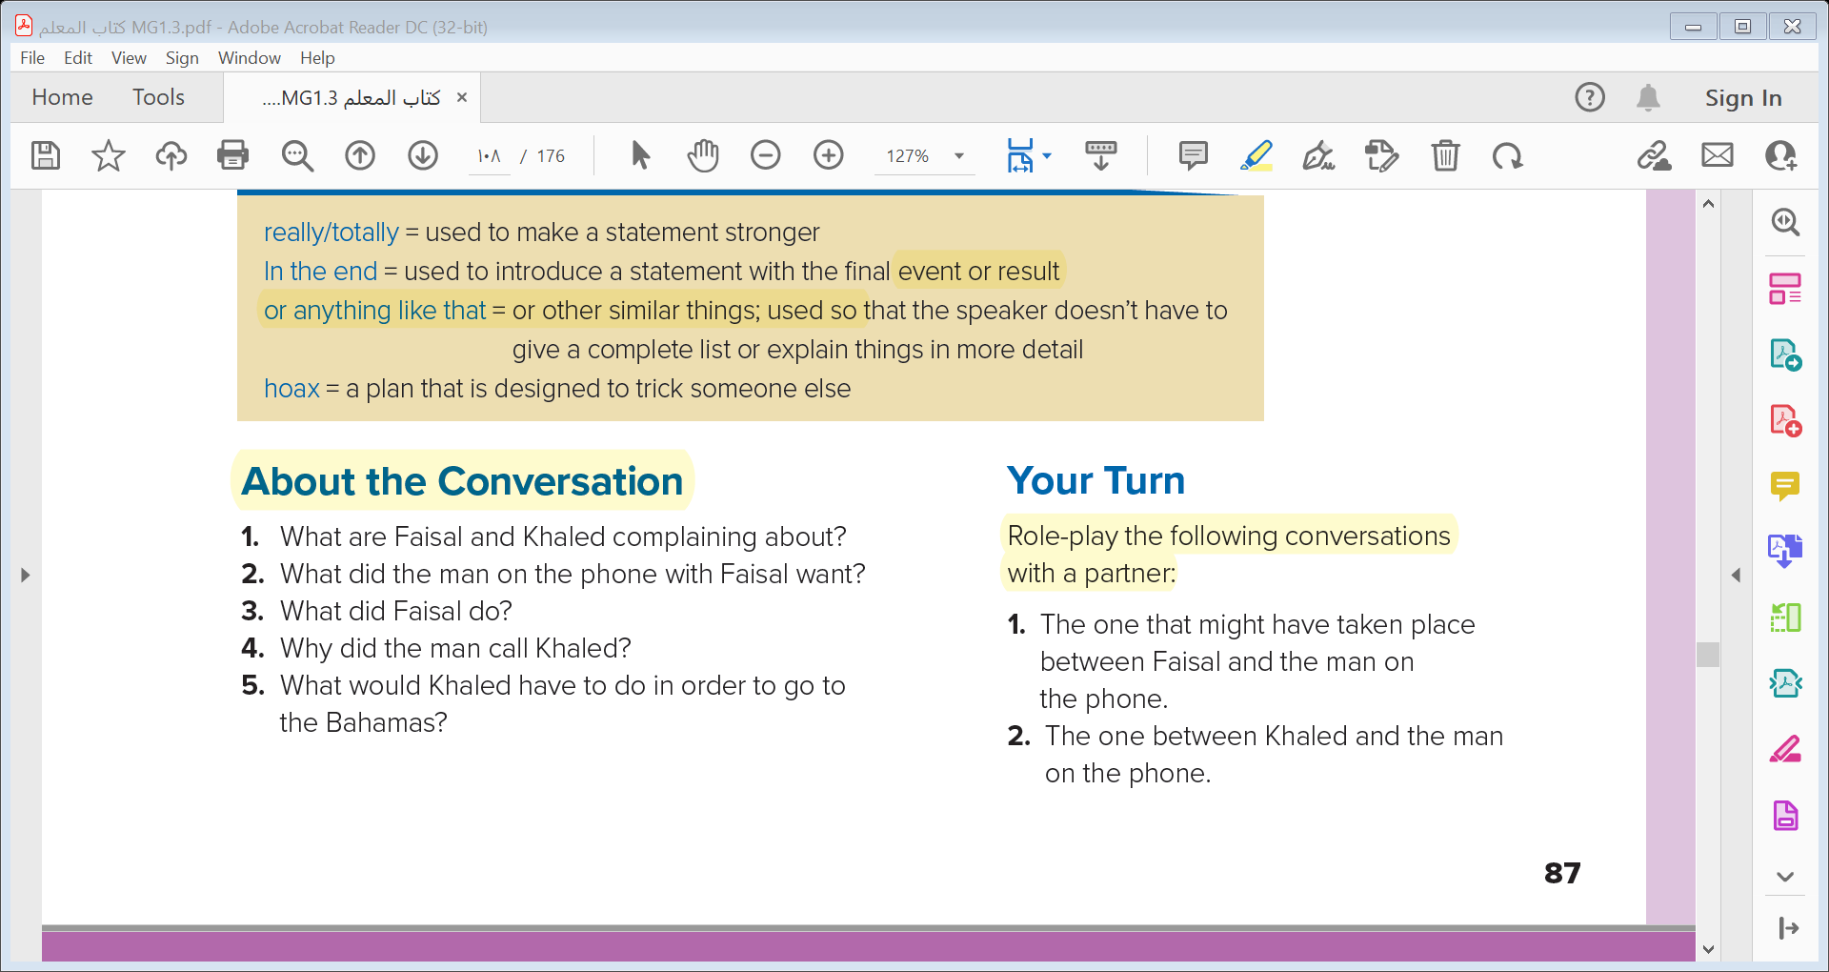
1- Faisal and Khaled are complaining about telemarketers .
2- The man on the phone with Faisal tried to persuade him to open an account at a bank .
3- Faisal lost his patience and hung up .
4- The man told Khaled that he had won a free trip to the Bahamas .
5- Khaled would have to pay a huge amount of money to join a club to go on the trip .

Slide 14



Slide 15
Quick Check

Slide 16


