Slide 1
Unit:
Lesson:1
Date:
We can
English
My school
is cool
Day:
6th grade
Finding Out
Time

Slide 2
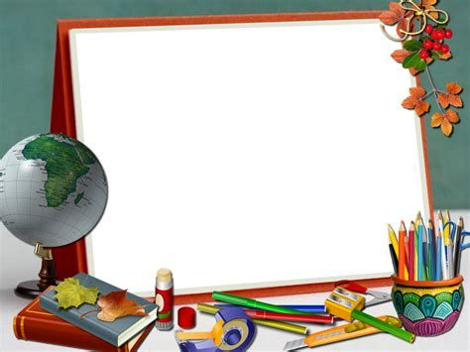

Slide 6
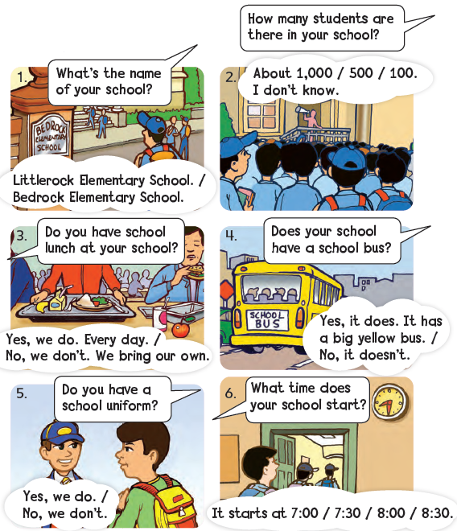

Slide 7
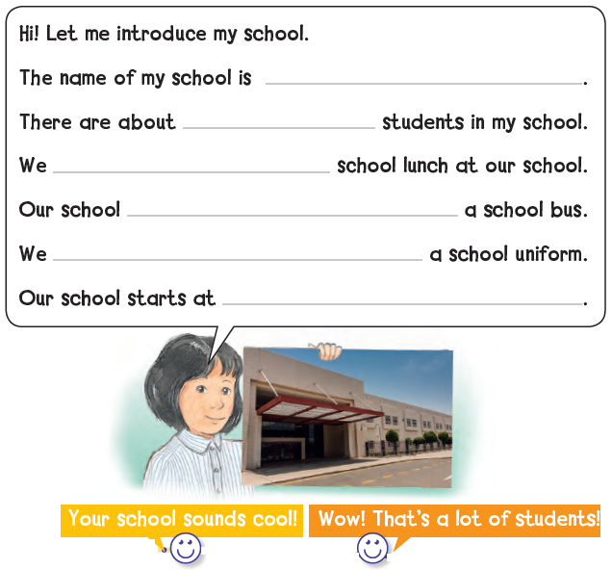
13th elementary school
600
don’t have
doesn’t have
have
8:00 a.m.

Slide 8
What‘s the name of your school?

Slide 9
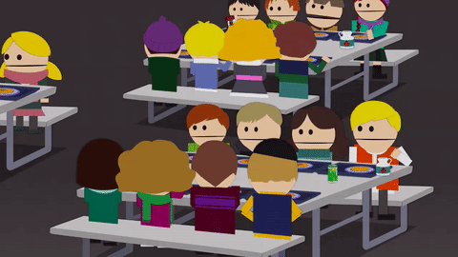
Do you have school lunch at your school?

Slide 10
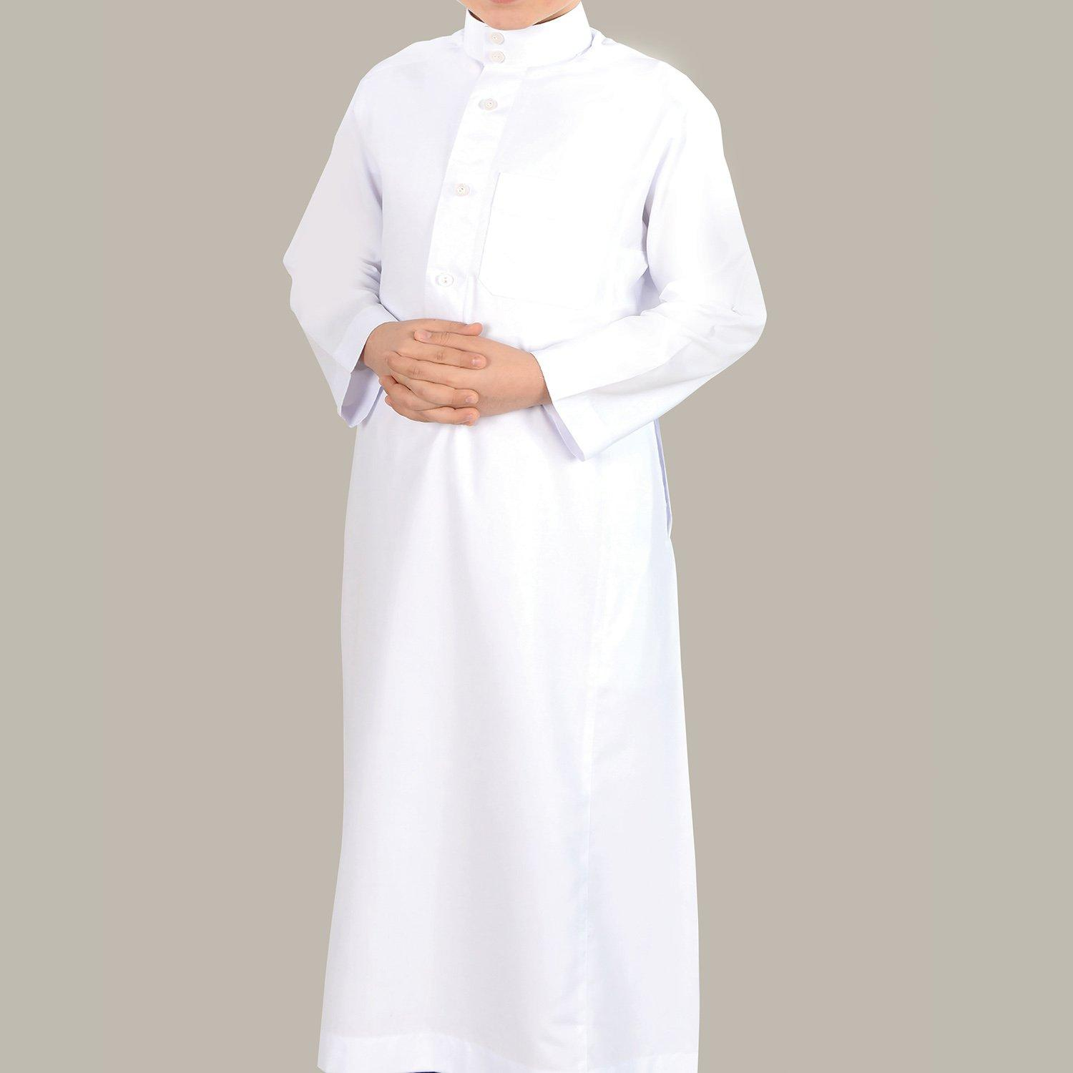
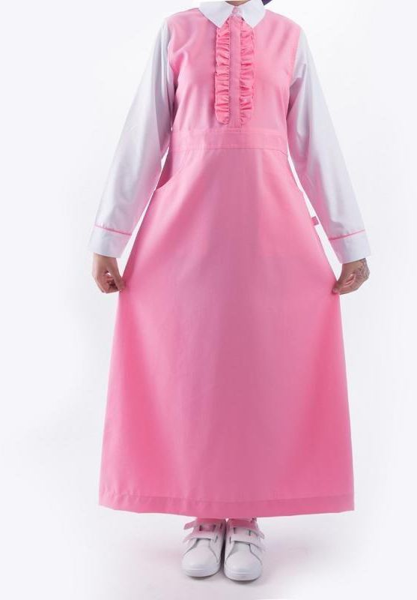
Do you have a school uniform?

Slide 11
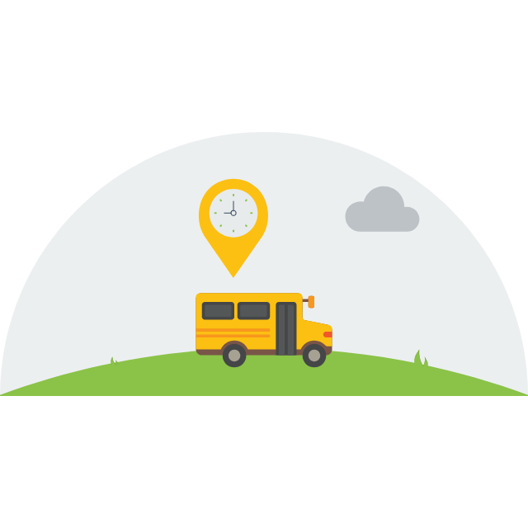
Does your school have school buses?

Slide 12
Homework:
87+88

