Slide 1





Slide 2







Slide 3

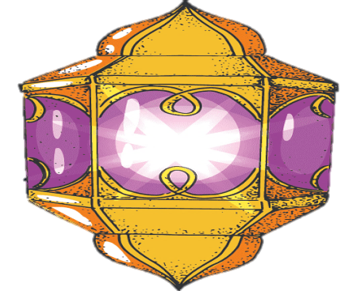


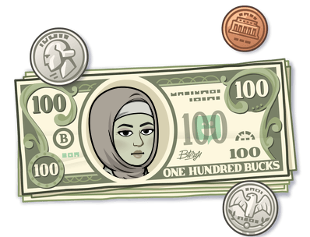
Sing a song for Eid
Did you gather with your family in Eid?
How was your Eid?
Did you pray Eid prayer?
To Whom do you give present to in your class ?
How much did you collect in Eid?
Give Eideah To your favorite friend
Greet your friends with Eid greetings

Slide 4


Unit -2-
I Wonder What Happened
10- Writing

Slide 5
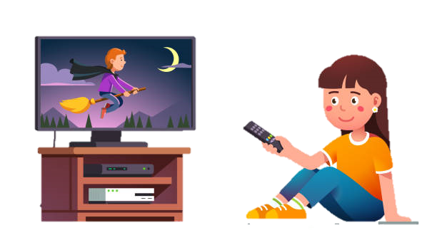
Lesson Objectives
The students will be able to :
breakdown the text into stages .
find the topic sentence of each paragraph .
debate the conclusion of the paragraph .
search for a voyage or an expedition .
write a description of a vessel .

Slide 6
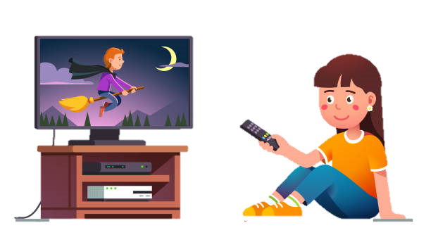
What does she use for searching channels on her TV ?

Slide 7
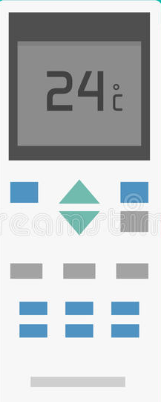
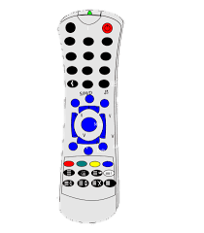
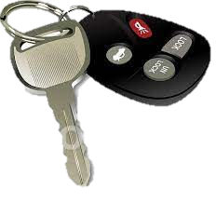
A. 1. How many remote controls do you have at home? What kind of devices are they used for?

Slide 8
2. Read the article and identify the different stages that remote controls went through.
Functions | Main characteristics | People involved | Years/decade

Slide 9

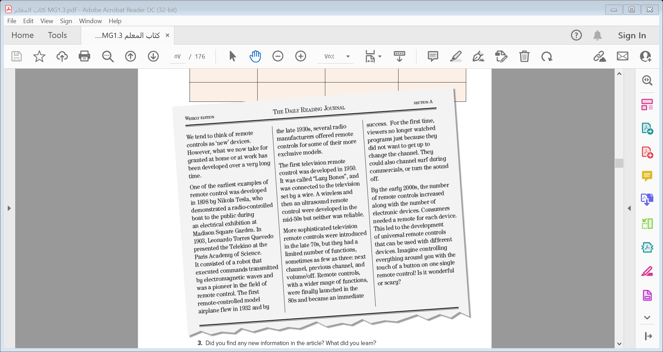
Functions | Main characteristics | People involved | Years/decade
1
3
1- What is the article about ?
2
5
Remote control
4
2- How many paragraphs ?
Follow the history of remote control

Slide 10
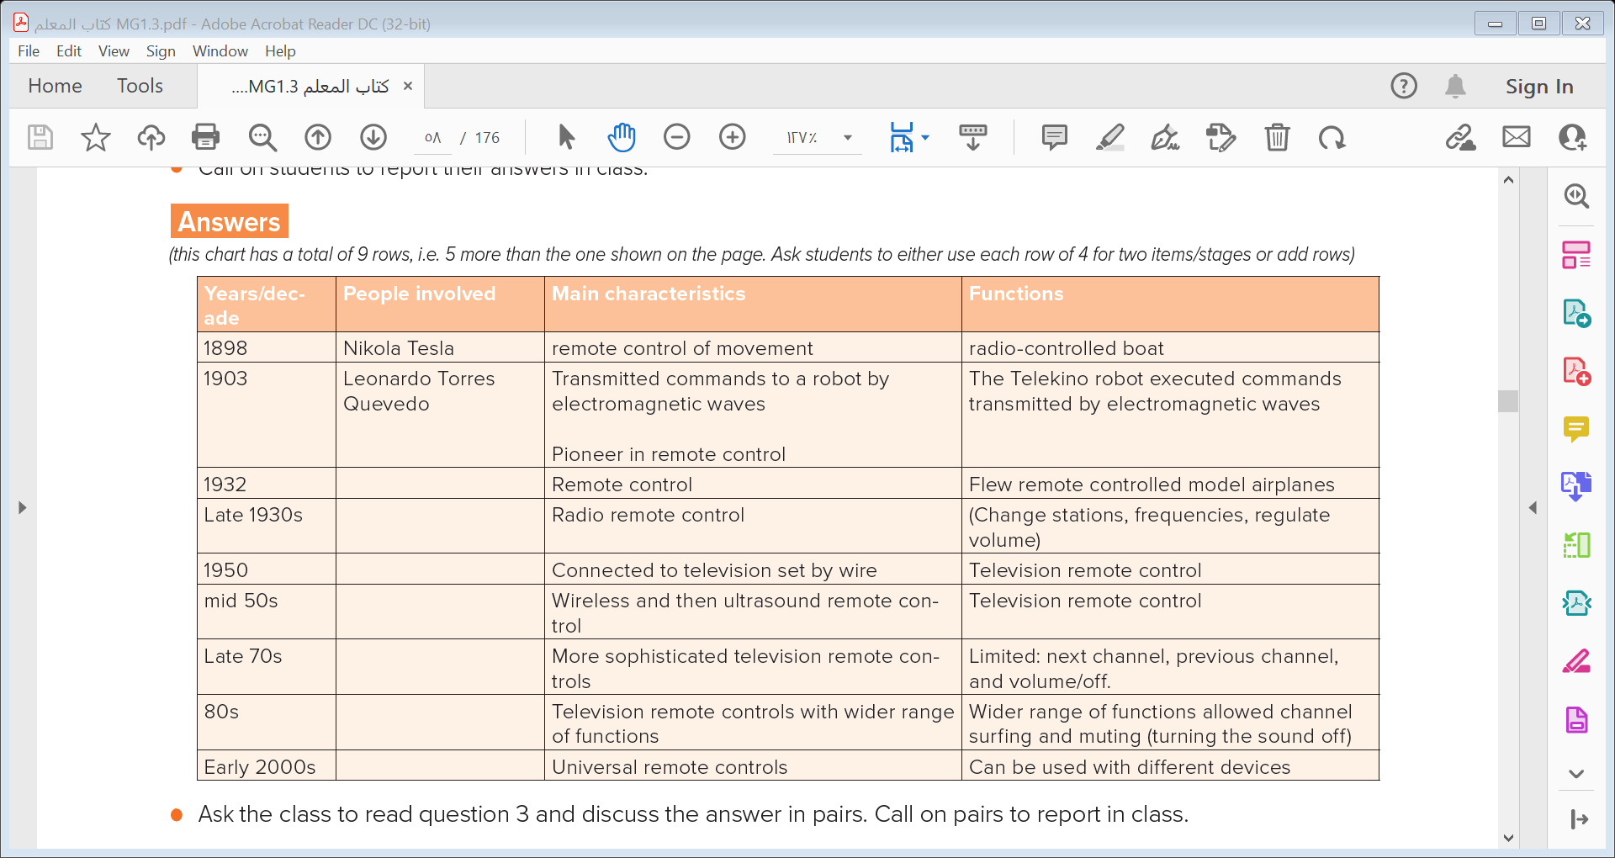

Slide 11
3. Did you find any new information in the article? What did you learn?
4. Read the article again and decide what the focus/topic of each paragraph is.
Work in pairs and compare your answers. Then report in class.
5. Read the last lines of the article. What do you think? Is it wonderful or scary? Why?
introduce article theme/remote control
The first television remote control
Early examples of remote control
Developments in the 2000s,universal remote control
More sophisticated remote controls,70 onwards

Slide 12
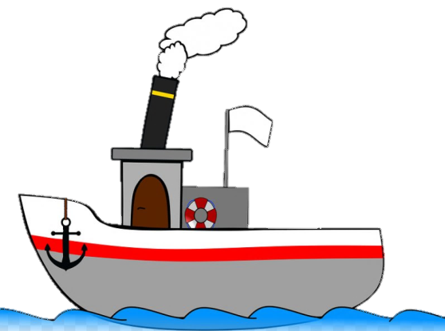
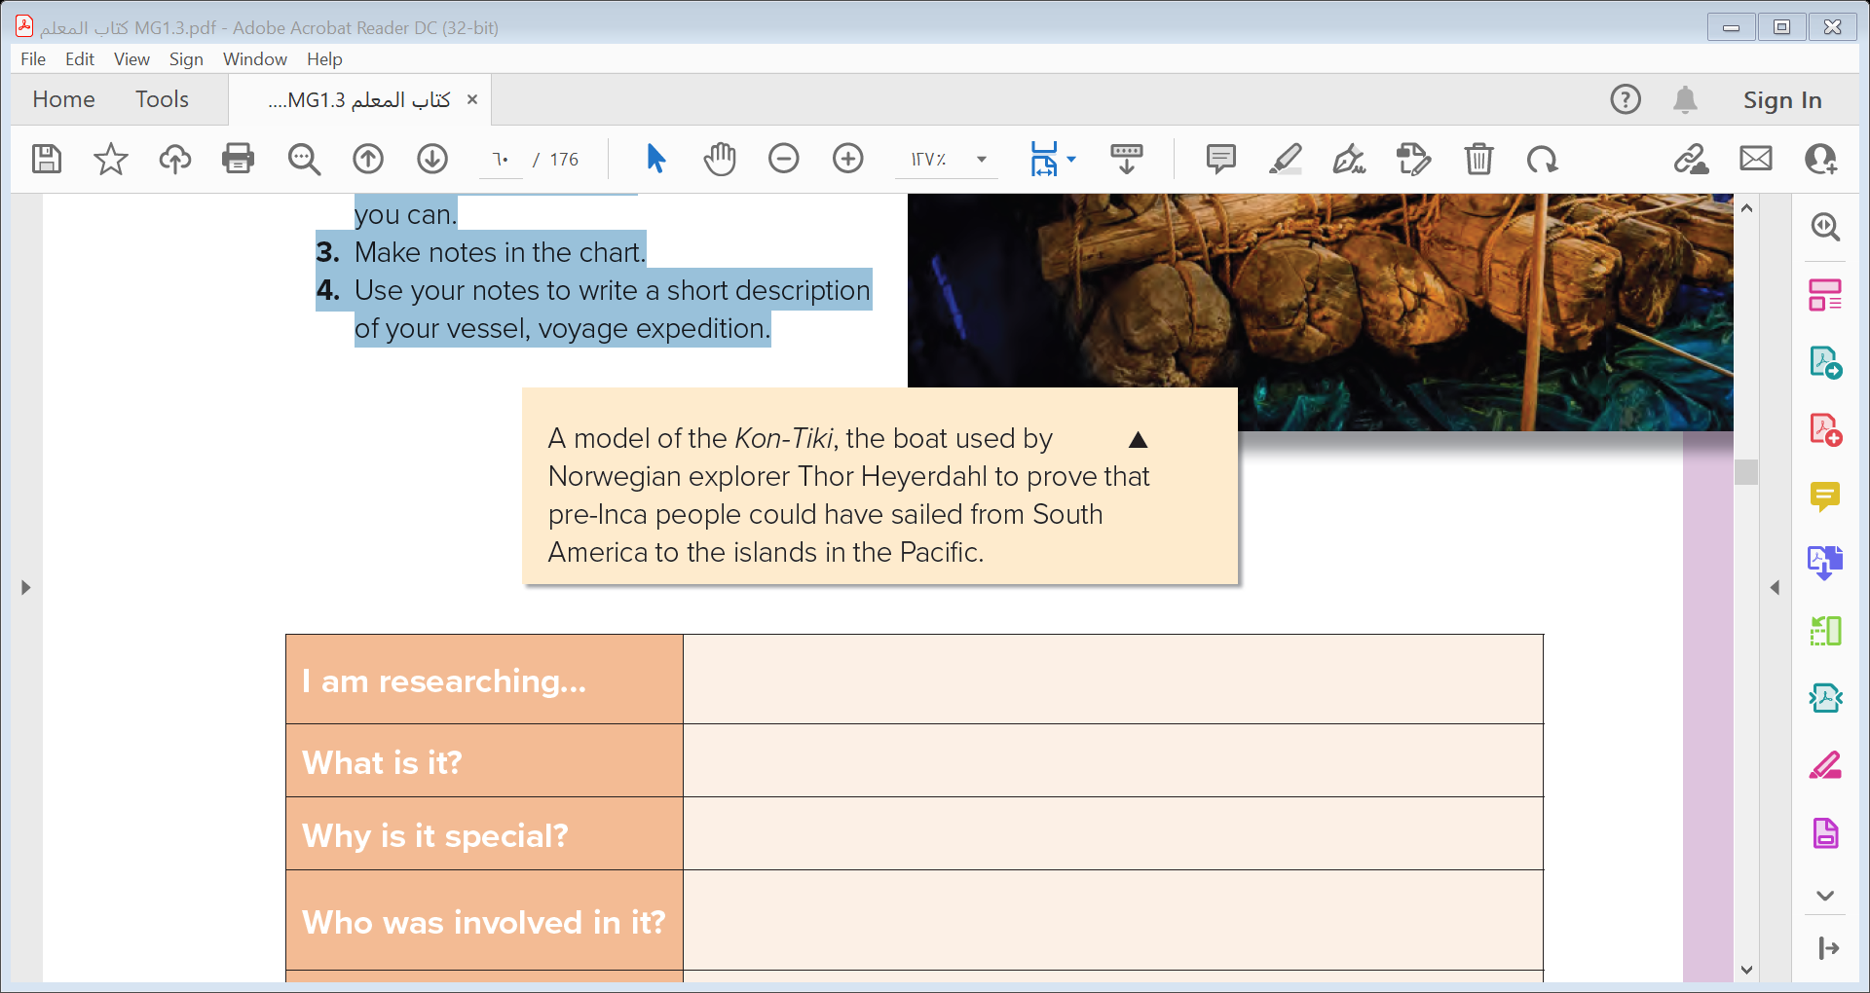
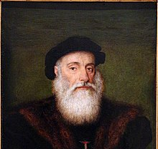
B. 1. Look at the picture of the Kon-Tiki. Does it
remind you of a contemporary sailboat that
you have seen in a picture or in real life?
2. Find out about the Kon-Tiki or choose
another vessel, well-known voyage or
expedition. Use the Internet,
or search for information in your school
library to find out as much information on
your chosen subject as
you can.

Slide 13
3. Make notes in the chart.
Vasco da Gama | I am researching…
Portuguese explorer | What is it?
the first European to reach India by sea. | Why is it special?
Vasco da Gama And his crew | Who was involved in it?
wood | What is the vessel made of?
around Africa to India | Where did the voyage or expedition take place?
Yes , it was | Was it successful?

Slide 14

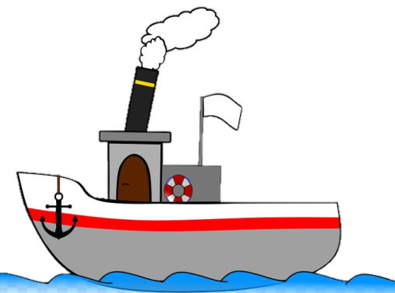
4. Use your notes to write a short description of your vessel, voyage expedition
 | I am researching…
 | What is it?
 | Why is it special?
 | Who was involved in it?
 | What is the vessel made of?
 | Where did the voyage or expedition take place?
 | Was it successful?

Slide 15
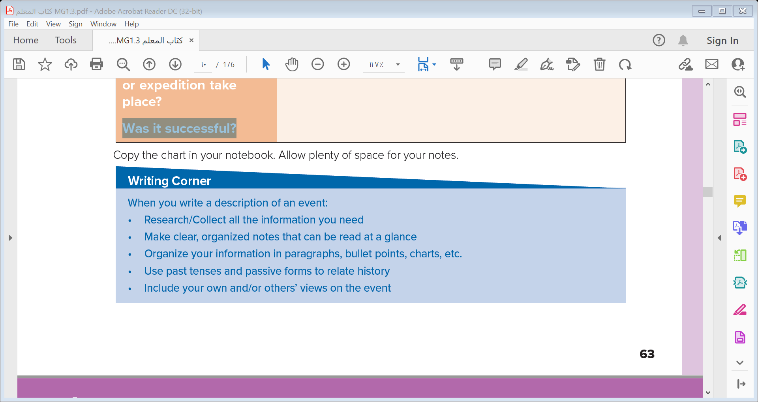
The introduction
Writing Corner
The body
The conclusion

Slide 16


