Slide 1


Slide 2

Good Morning

Slide 3
Unit -3-
If It Hadn’t Happened

Slide 4
1- Listen & Discuss
2- Pair work

Slide 5
1- Listen & Discuss

Slide 6



Objectives
The students will be able to :
discuss the top inventions .
give a reason for a good invention .
decide a life regret according to a list .
ask about a life regret .
use new expressions .
imagine the result of going back in the time to correct a mistake .

Slide 7
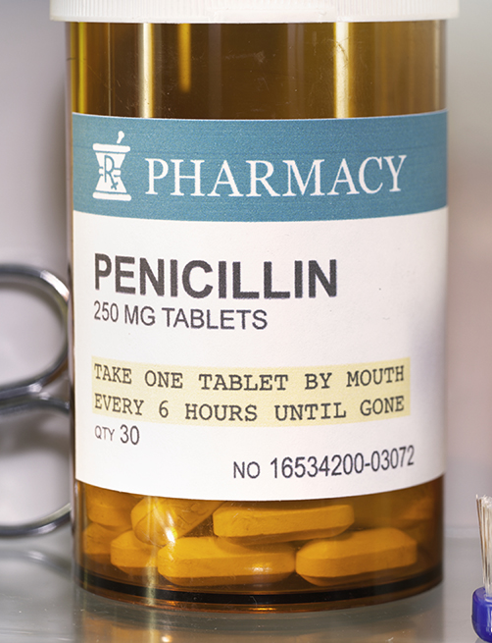
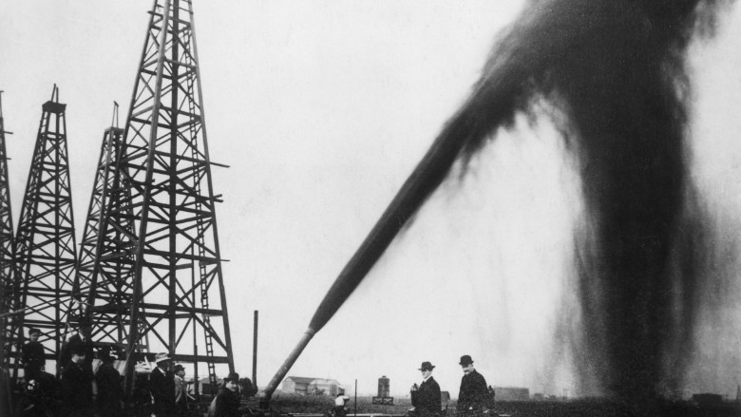

Invention
something that is created

Slide 8
Discovery
(something that is found, or found out about

Slide 9

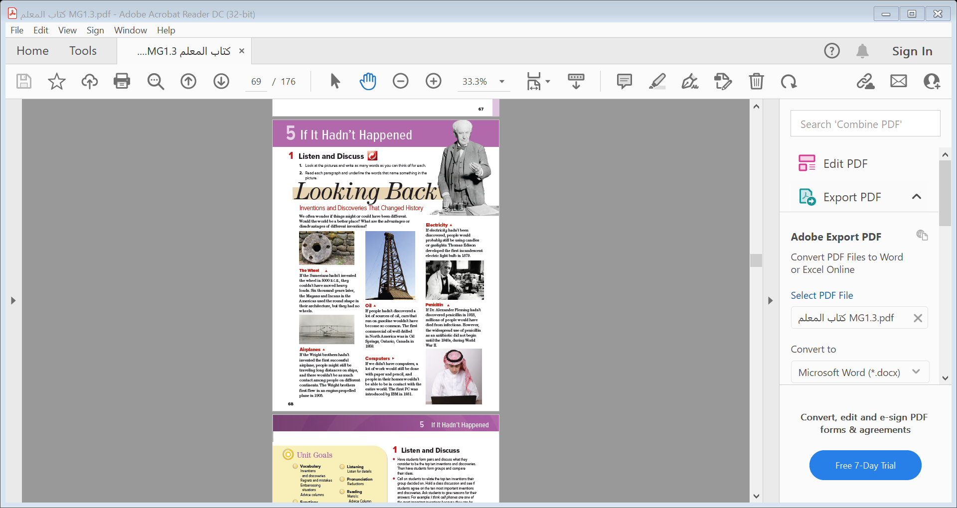
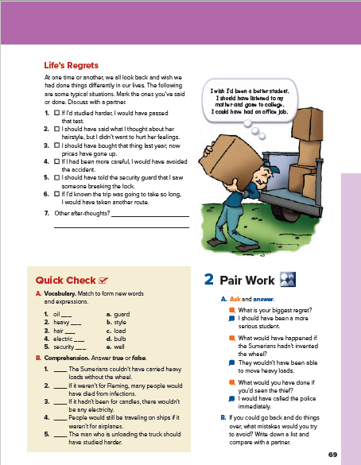
skimming
Students Book P. 34-35

Slide 10

Listen
skimming
What’s the title ?
How many subtitles ?
How many pictures ?

Slide 11

Listen
Which of these inventions and discoveries do you
think are the most important?

Slide 13
Who invented the wheels ?
When ?
What could happen if the Sumerians hadn’t invented the wheels ?
What shape did the Mayans & Incans use in their architecture ?

Slide 14
Who invented the first successful airplane ?
What might happen if the wright brothers hadn’t invented the first successful airplane ?
When did the Wright brothers first fly ?

Slide 15
What do we use oil for ?
Factories , cars , machines and lots of things .
What would happen if people hadn’t discovered oil ?
Where did the first commercial oil drill in North America ?
When ?

Slide 16
What do we use computer for ?
Doing our work, learning, surfing the net and send messages .
What would happen if they hadn’t invented computers ?
When was the first PC introduced ?

Slide 17
Who is he ?
What would happen if electricity hadn’t been discovered ?
What did Thomas Edison develop ?
When ?

Slide 18
Who is he ?
What did he discover ?
When ?
What would happen if he hadn’t discovered penicillin ?

Slide 19



Quick Check

Slide 20
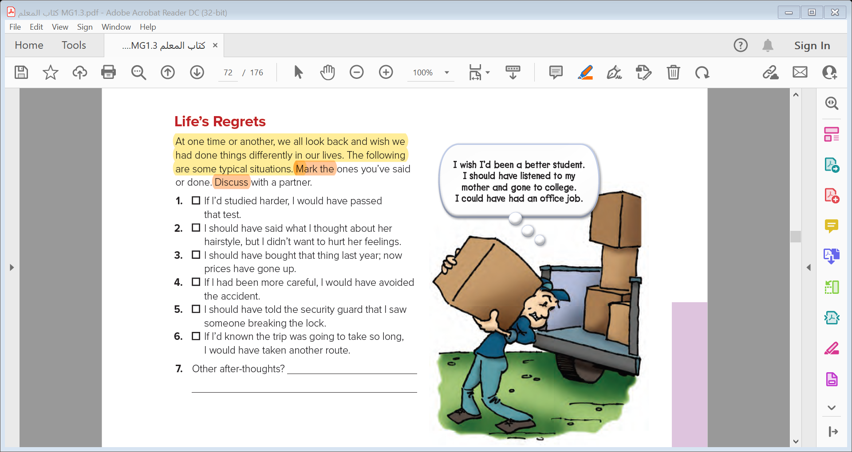

Slide 21
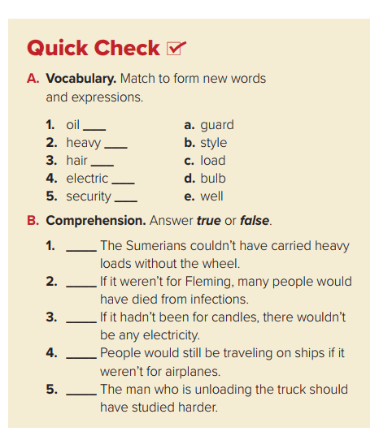
e
c
b
d
a
true
true
false
true
true

Slide 22
2- Pair work

Slide 23
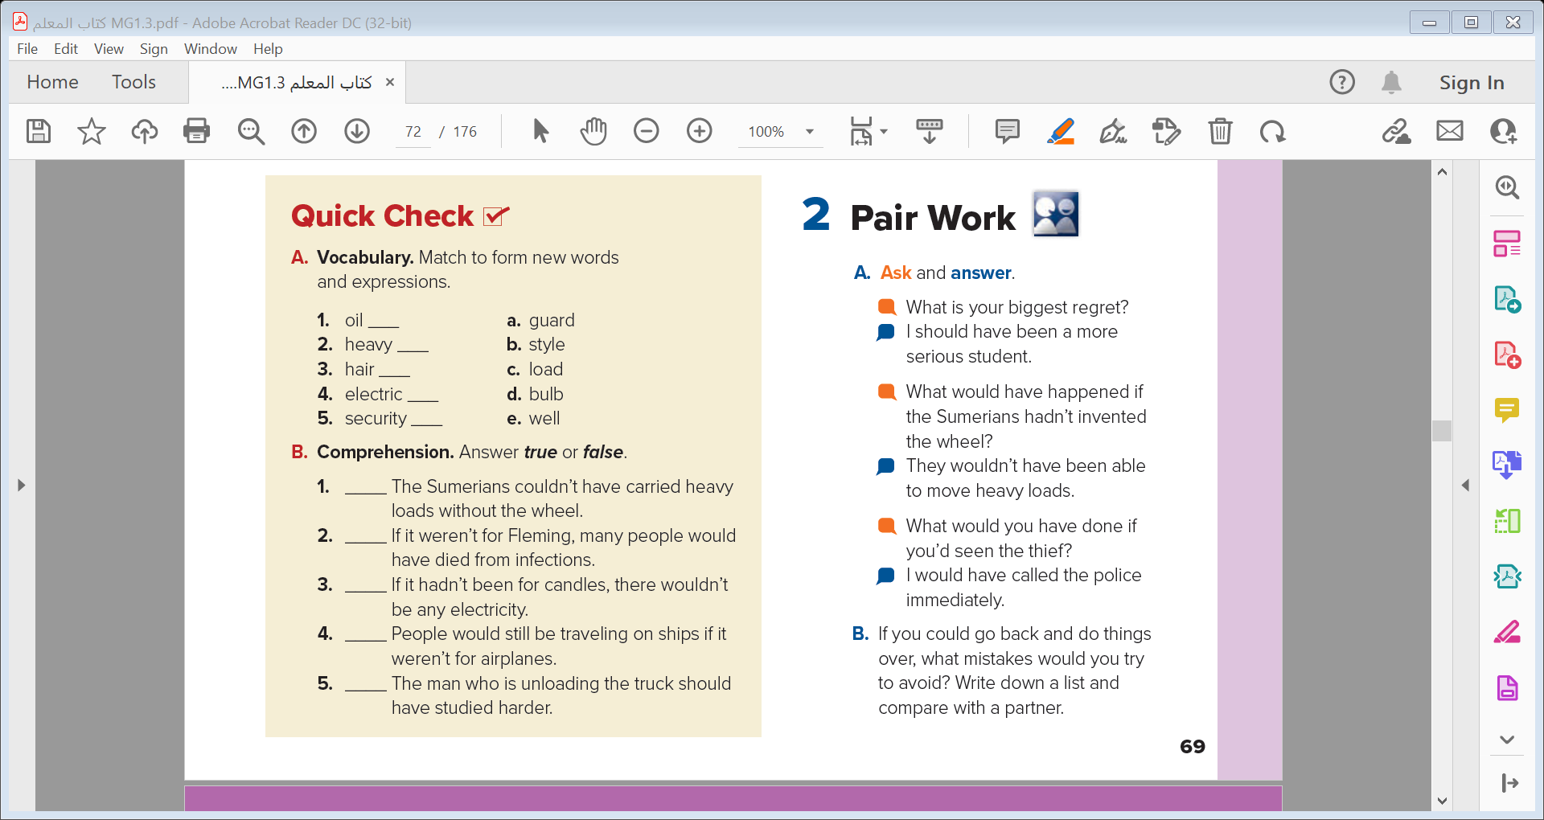


Slide 24
Quick Check

Slide 25
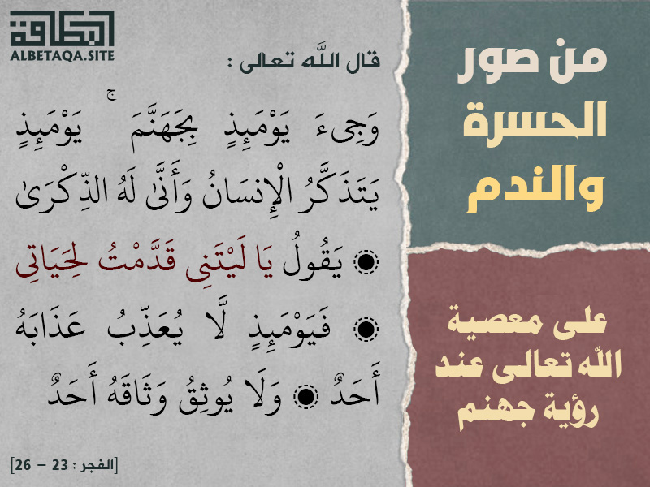

Slide 26


