Slide 1


Welcome to class
T.

Slide 2

1
Unit 2

Slide 3




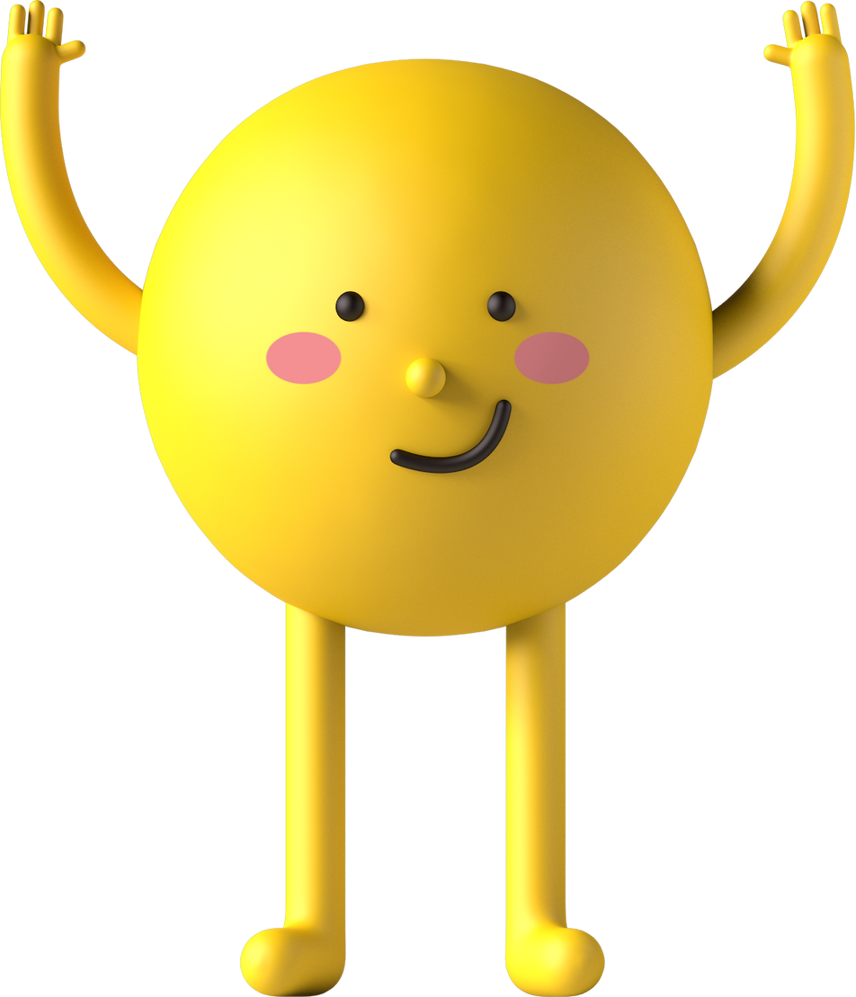
workbook
Pages 49 , 50

Slide 4
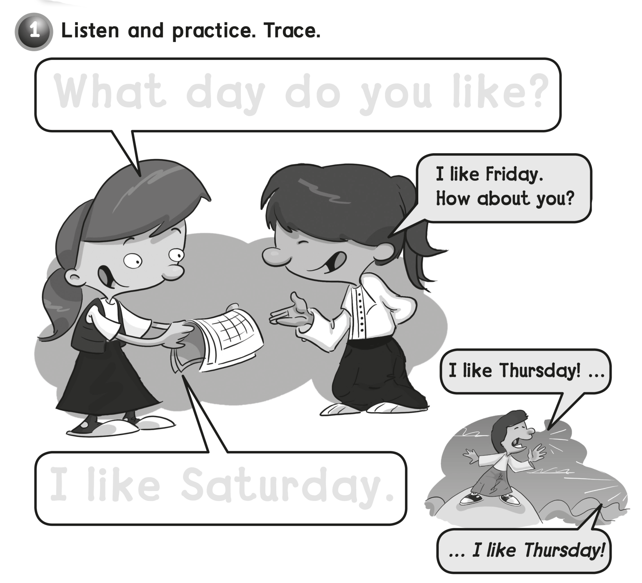
What day do you like?
I like Saturday .

Slide 5
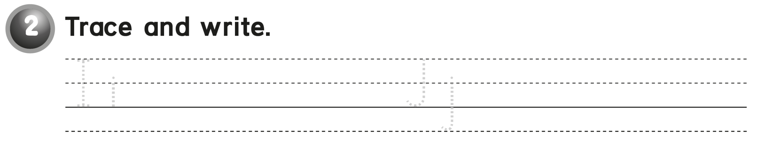
Ii Ii Ii Jj Jj Jj

Slide 6
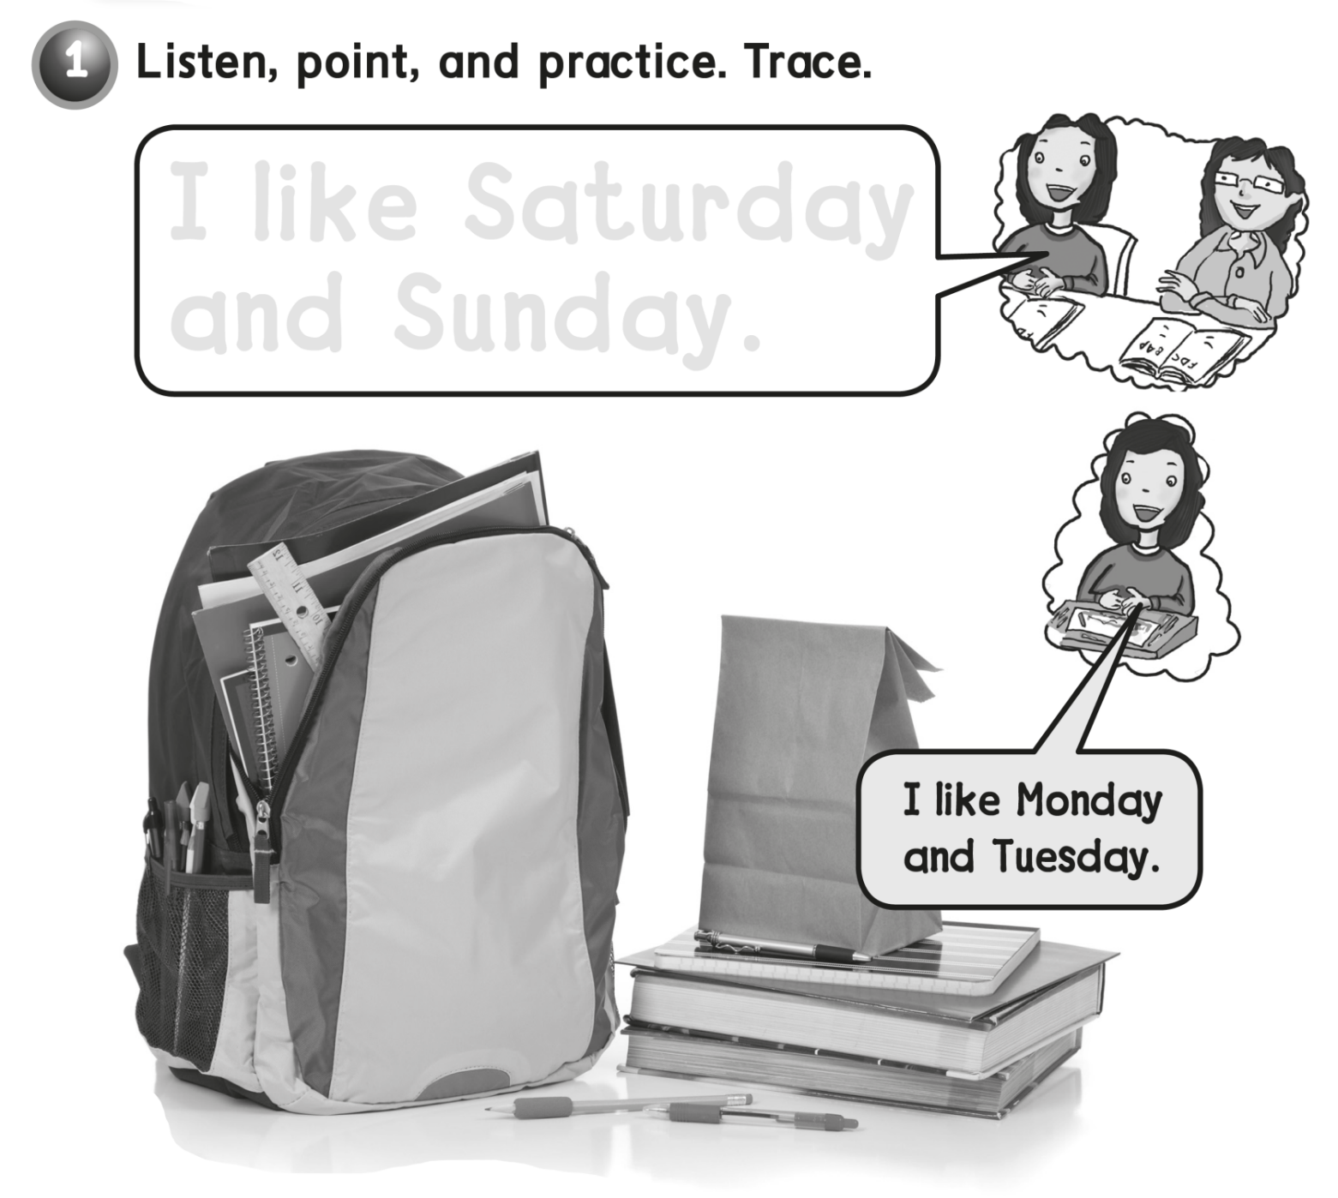
I like Saturday
and Sunday .

Slide 7
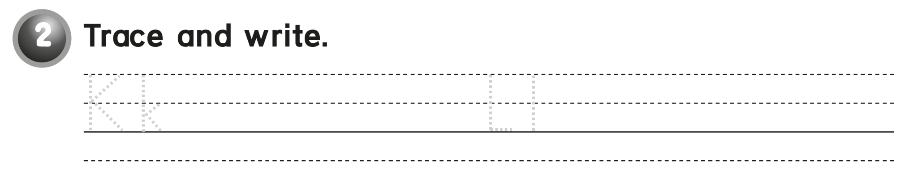
Kk Kk Kk Ll Ll Ll

Slide 8
workbook
Pages 51 , 52

Slide 9
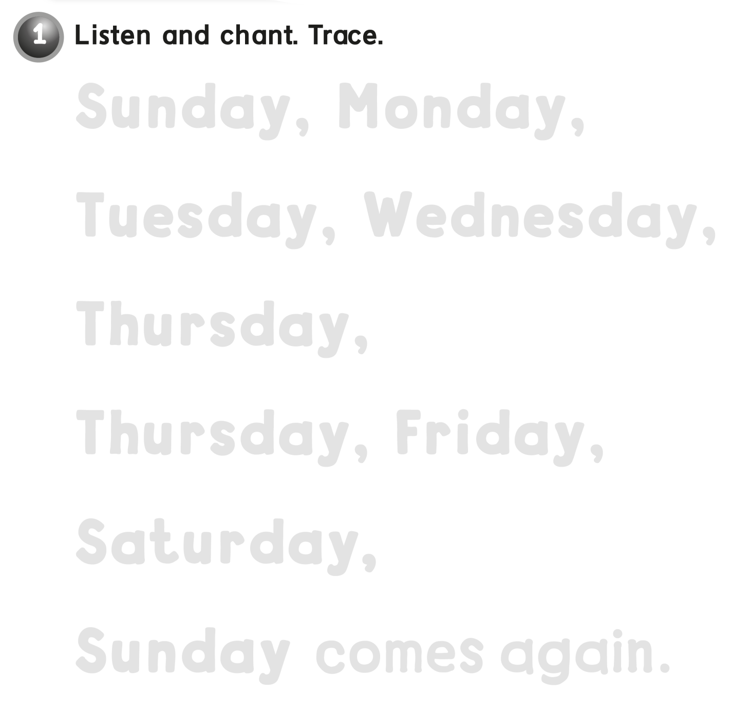
Sunday, Monday,
Tuesday Wednesday,
Thursday,
Thursday, Friday,
Saturday,
Sunday, comes again

Slide 10
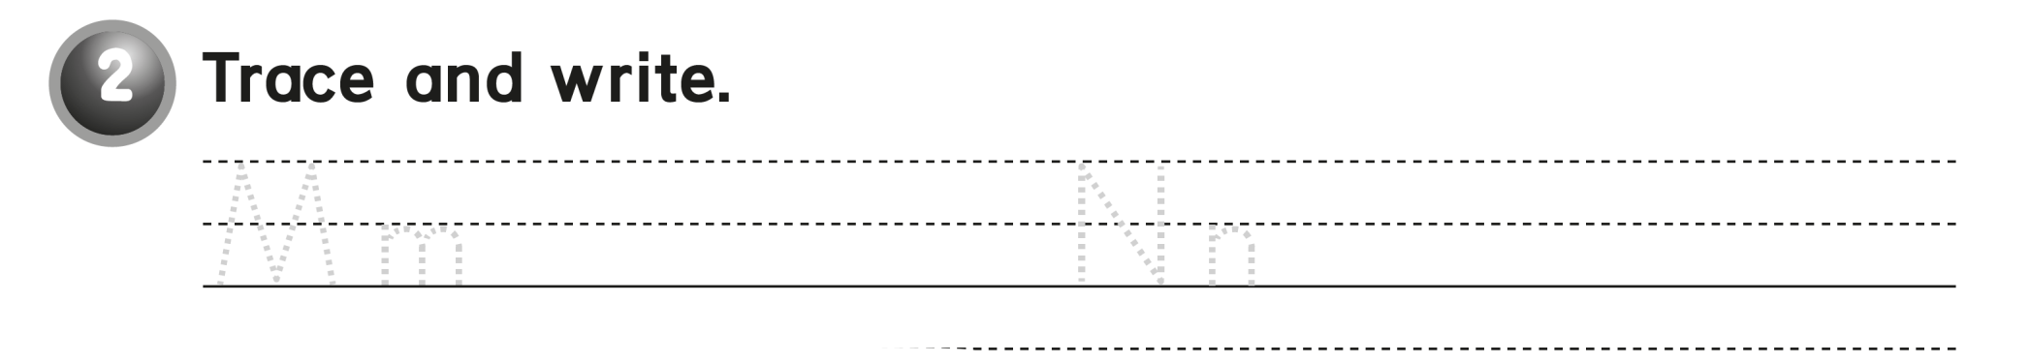
Mm Mm Nn Nn Nn

Slide 11
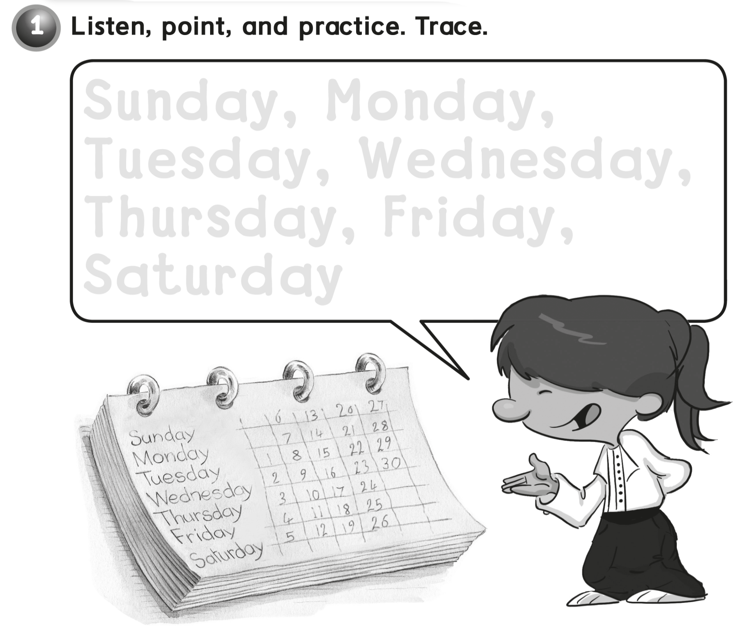
Sunday , Monday,
Tuesday , Wednesday ,
Thursday , Friday ,
Saturday

Slide 12
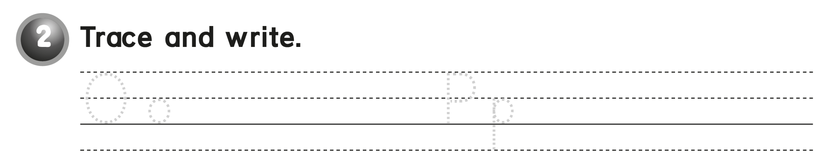
Oo Oo Oo Pp Pp Pp

Slide 13
workbook
Pages 53 , 54

Slide 14
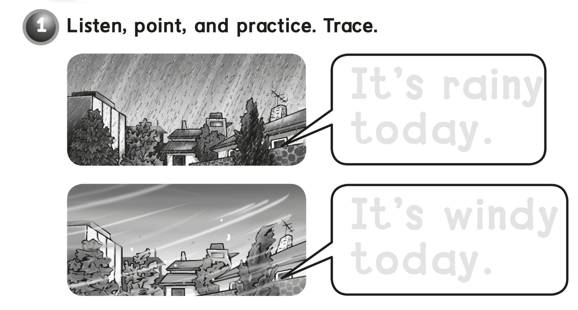
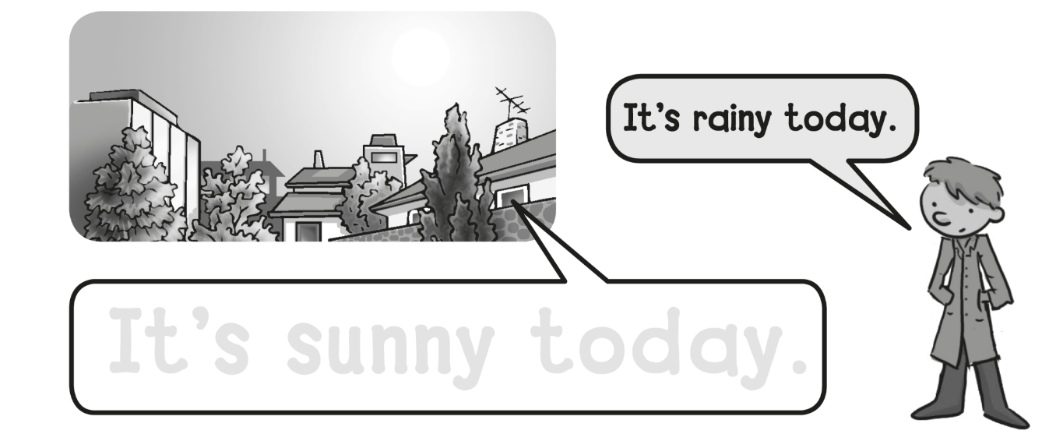
It’s rainy
today .
It’s windy
today .
It’s sunny today .

Slide 15
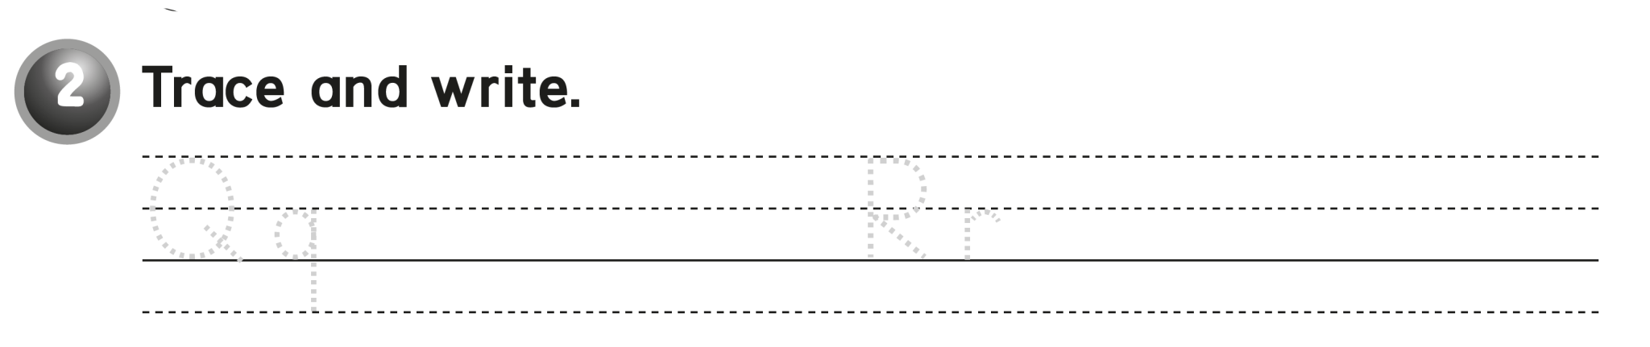
Qq Qq Qq Rr Rr Rr

Slide 16
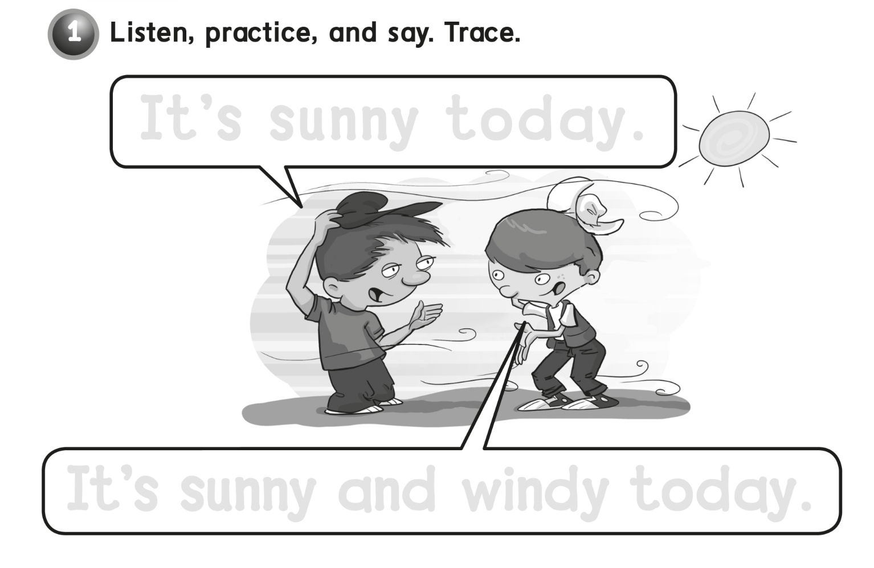
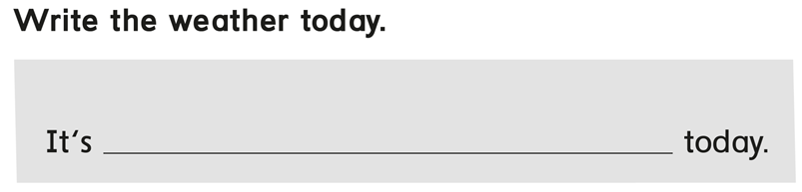
It’s sunny today .
It’s sunny and windy today .
Sunny

Slide 17
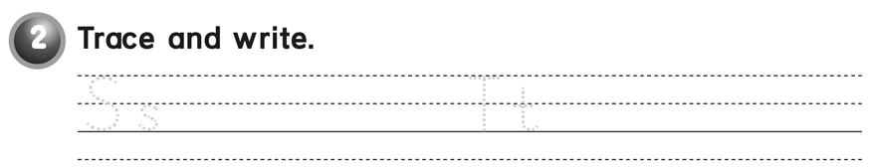
Ss Ss Ss Tt Tt Tt

Slide 18
workbook
Pages 55 , 56

Slide 19
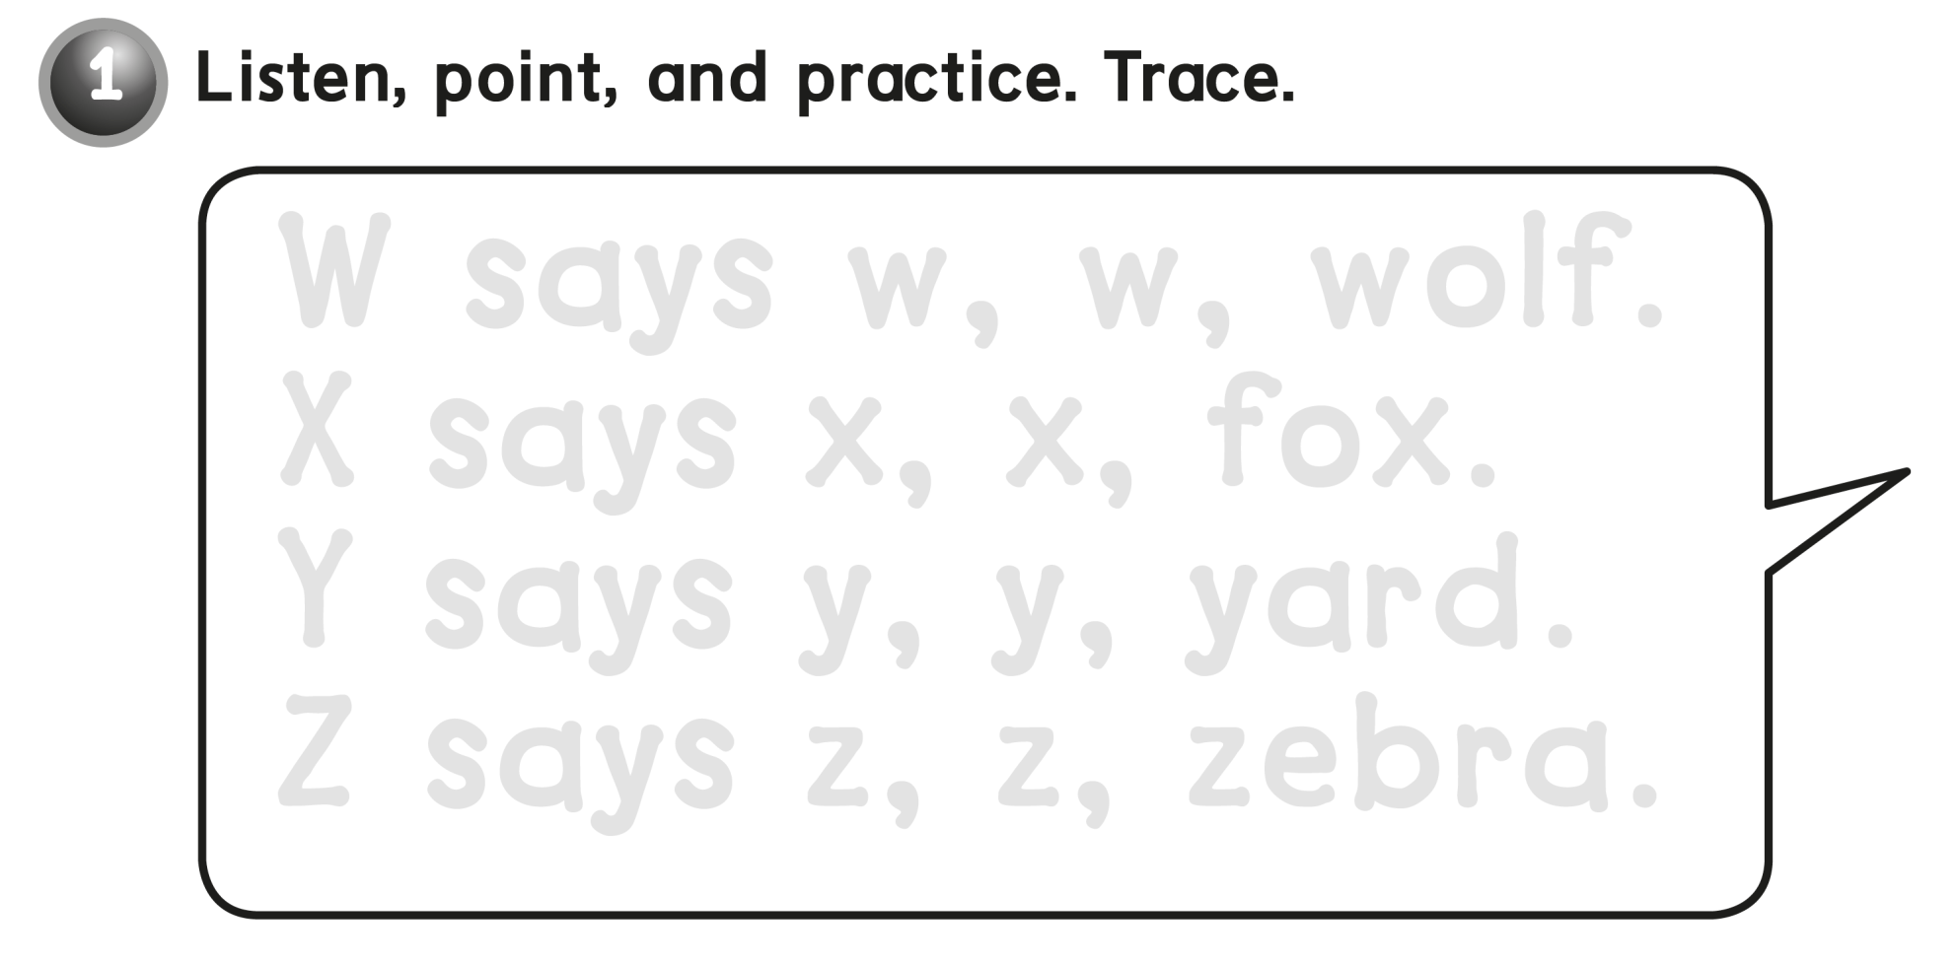
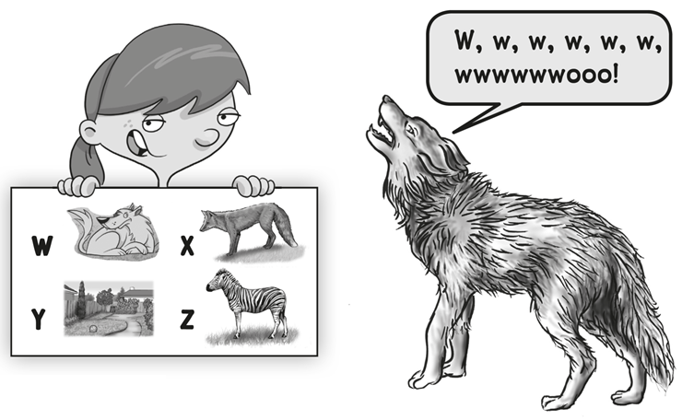
W says w, w, wolf .
X says x, x, fox .
Y says y , y, yard .
Z says z , z, zebra .

Slide 20
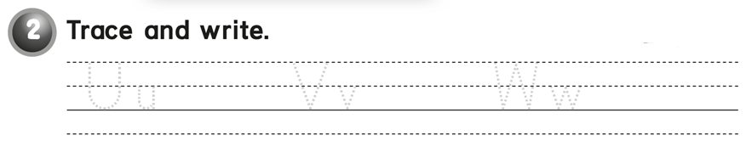
Uu Uu Vv Vv Ww Ww

Slide 21
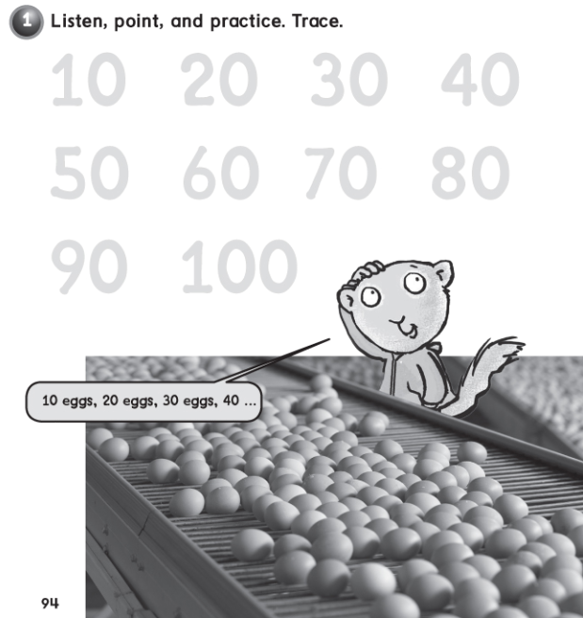
10 20 30 40
60 70 80
90 100

Slide 22


