Slide 1


Welcome to class
T.

Slide 2

3
Unit 10

Slide 3


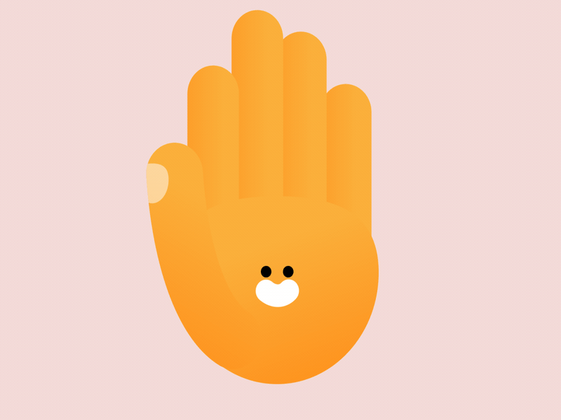

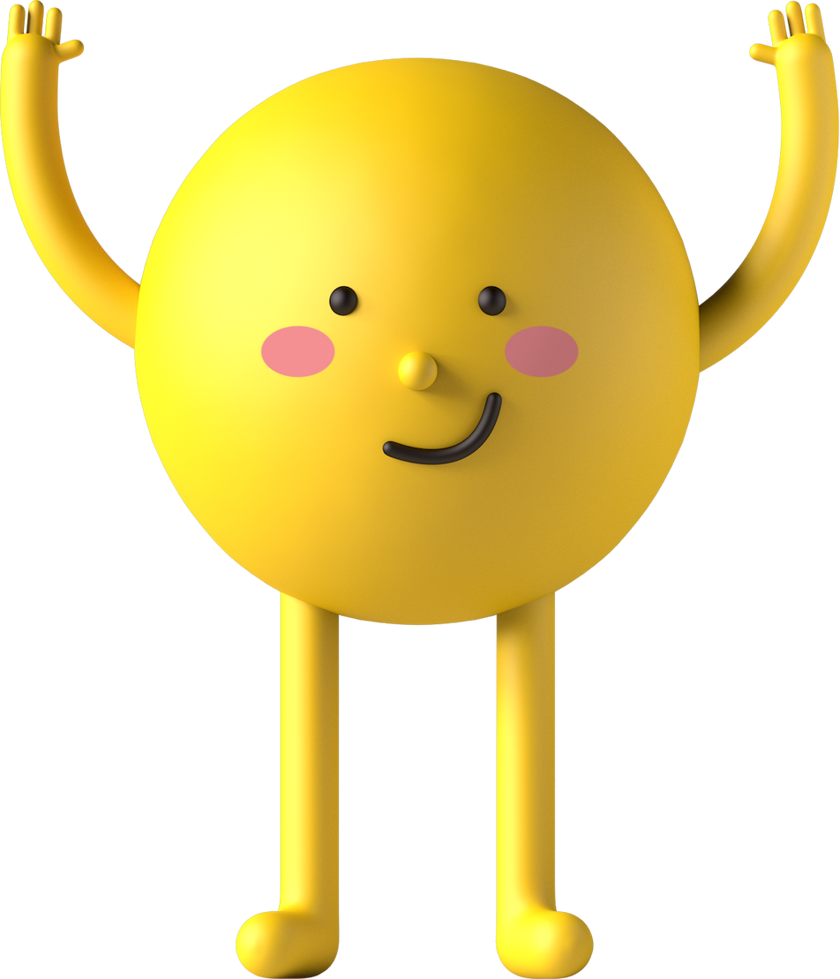
workbook
Pages 211 , 212

Slide 4

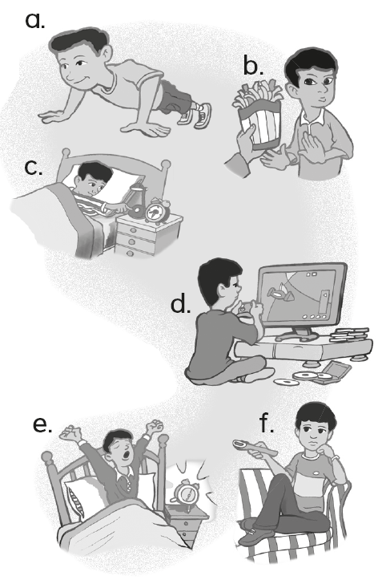
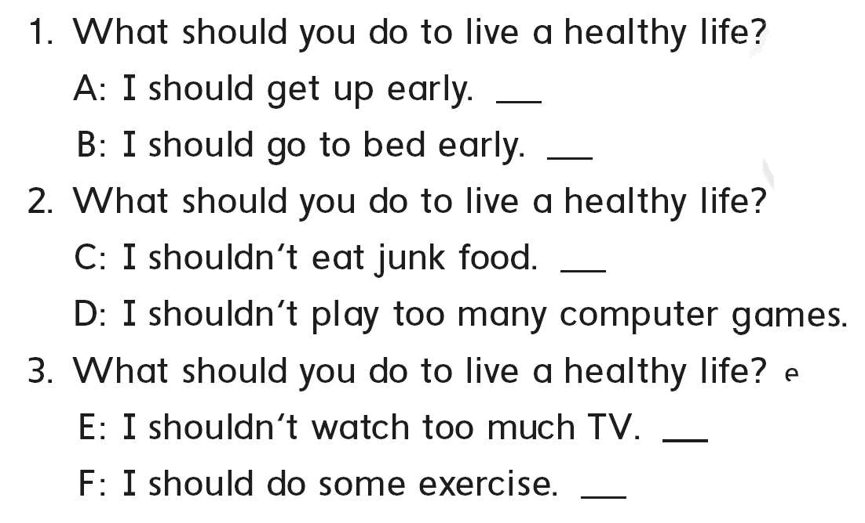
e
c
b
d
f
a

Slide 5
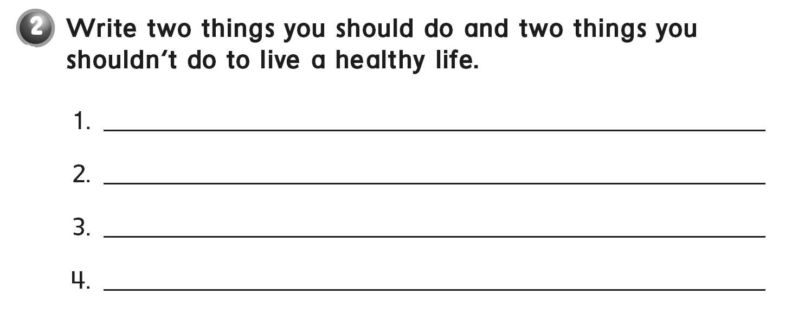
I should eat three meals a day.
I should do some exercise.
I shouldn‘t watch too much TV.
I shouldn‘t play too much computer games.

Slide 6

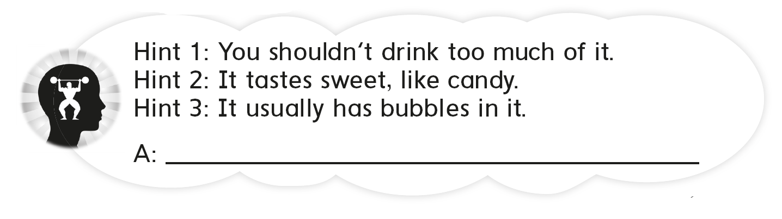
soda

Slide 7
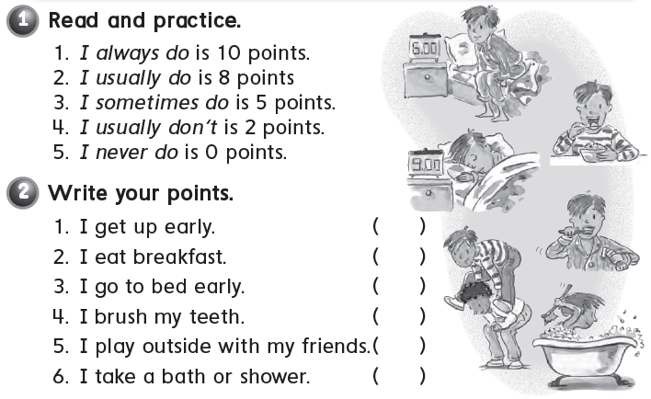

Slide 8
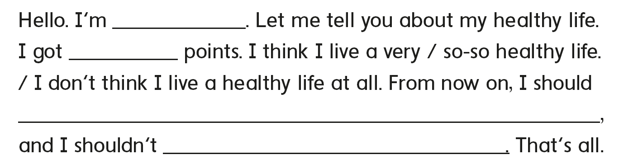

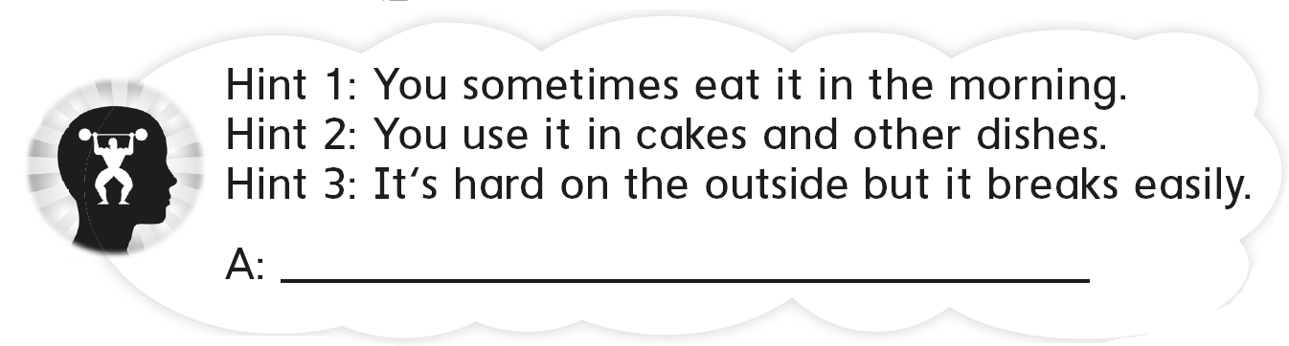
Charlie
52
do some exercise
eat too much junk food
an egg

Slide 9
workbook
Pages 213 , 214

Slide 10
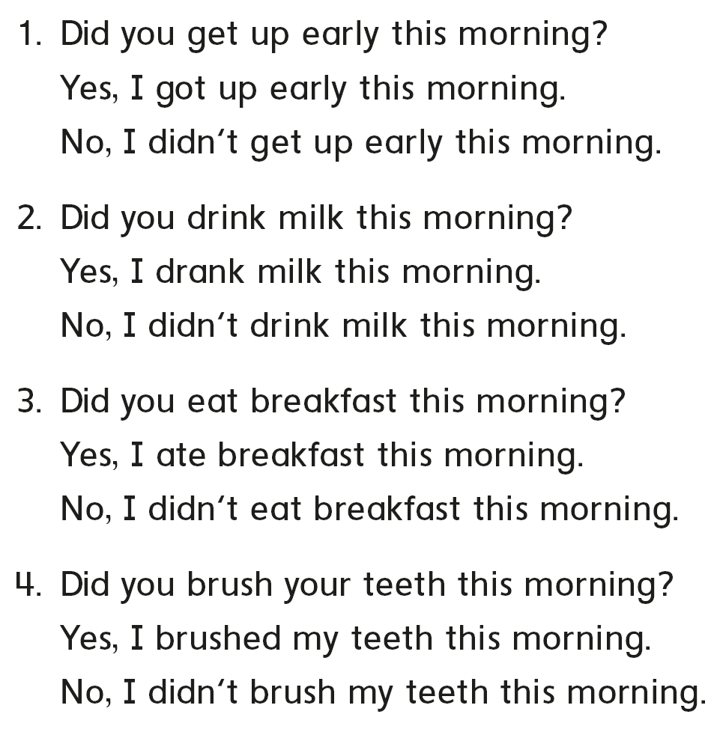
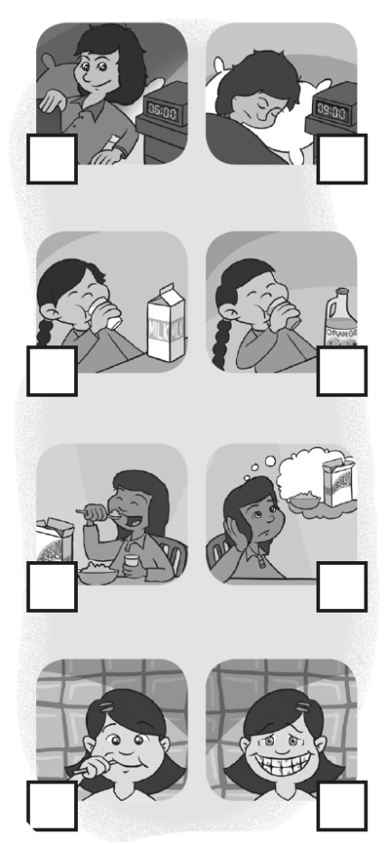
√
√
√
√

Slide 11
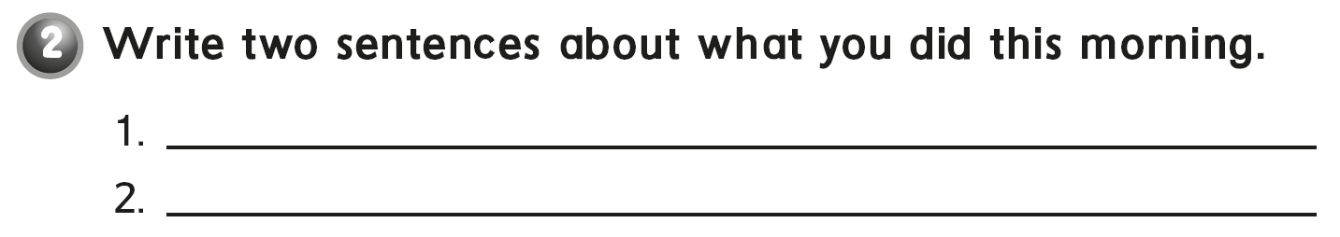
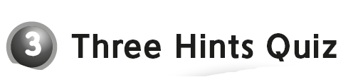
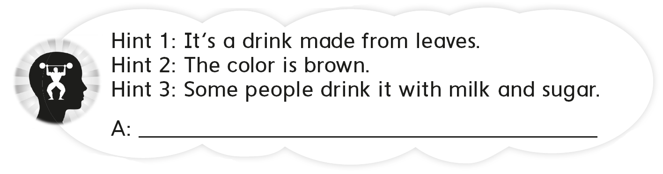
I prayed at the mosque .
I eat breakfast .
tea

Slide 12
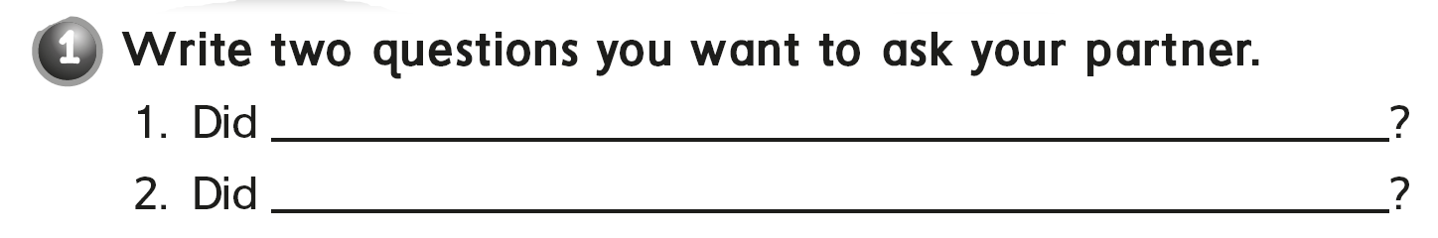

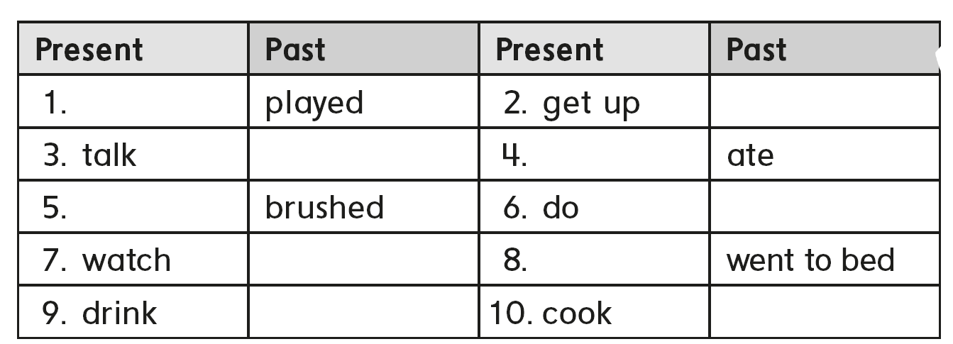

you eat breakfast this morning
you watch the movie last night
play
got up
talked
eat
brush
did
watched
go to bed
drank
cooked

Slide 13
you eat breakfast this morning
you watch the movie last night
play
got up
talked
eat
brush
did
watched
go to bed
drank
cooked

Slide 14

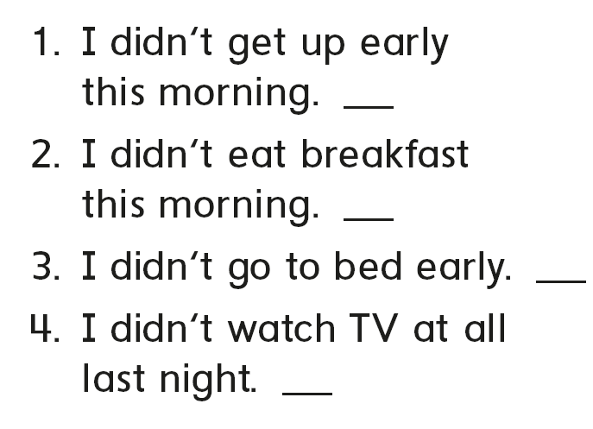
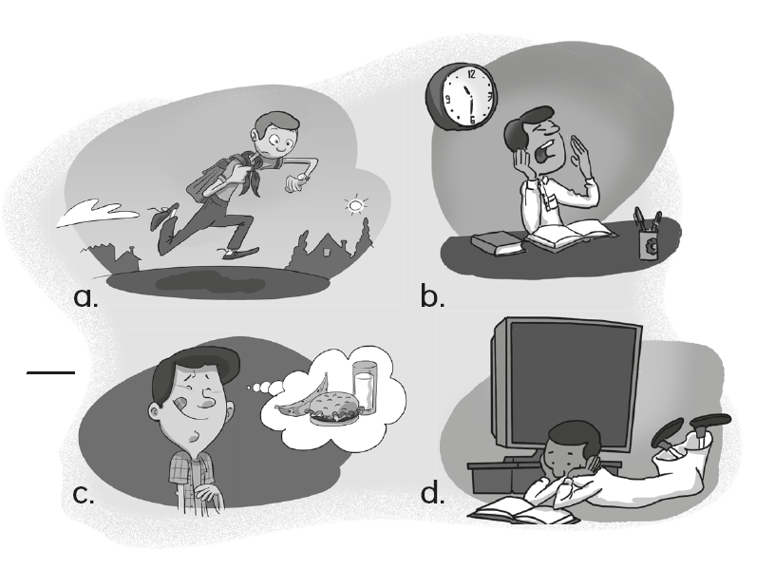
a
c
b
d

Slide 15

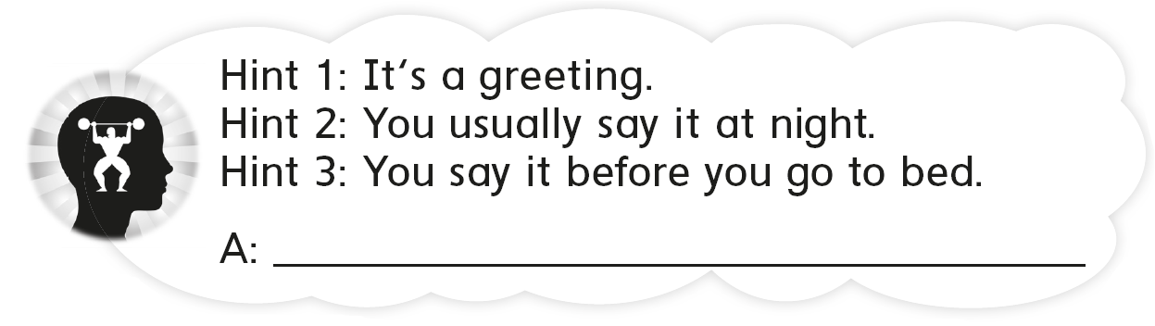
Good night

Slide 16
workbook
Pages 215 , 216

Slide 17

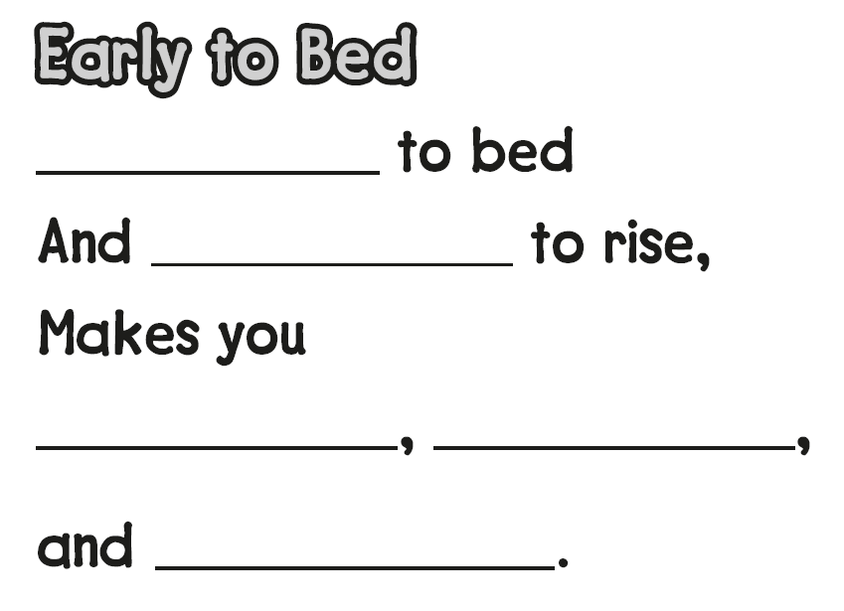
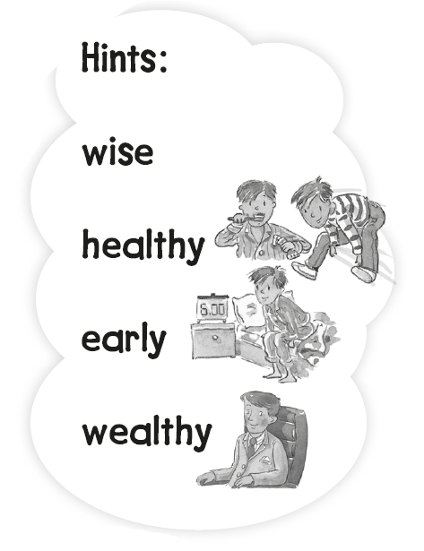
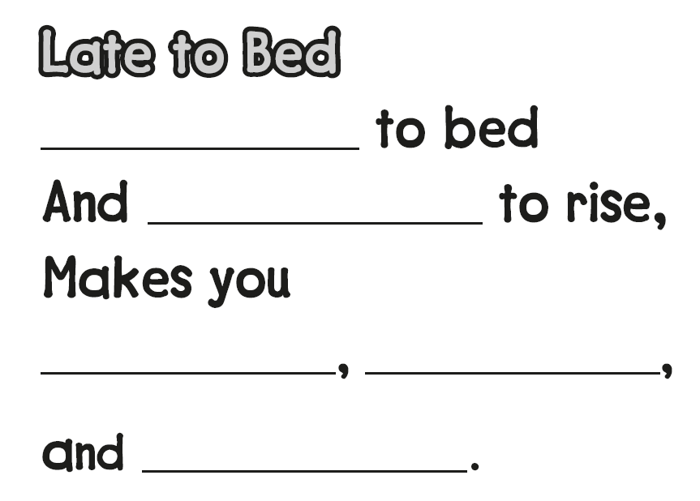
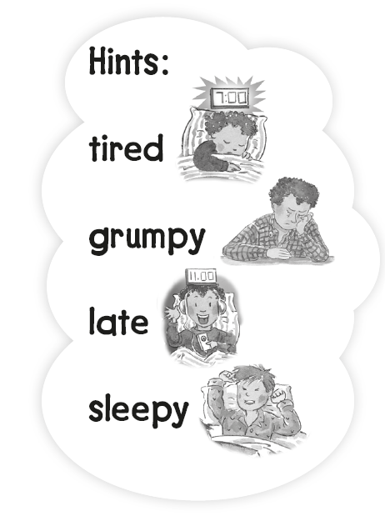
Early
early
healthy
wealthy
wise
Late
late
sleepy
grumpy
tired

Slide 18

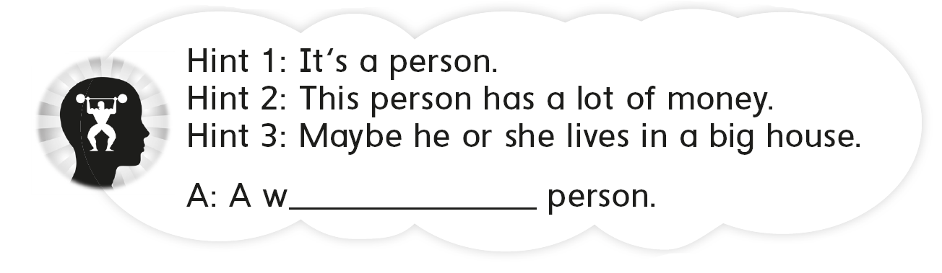
ealthy

Slide 19

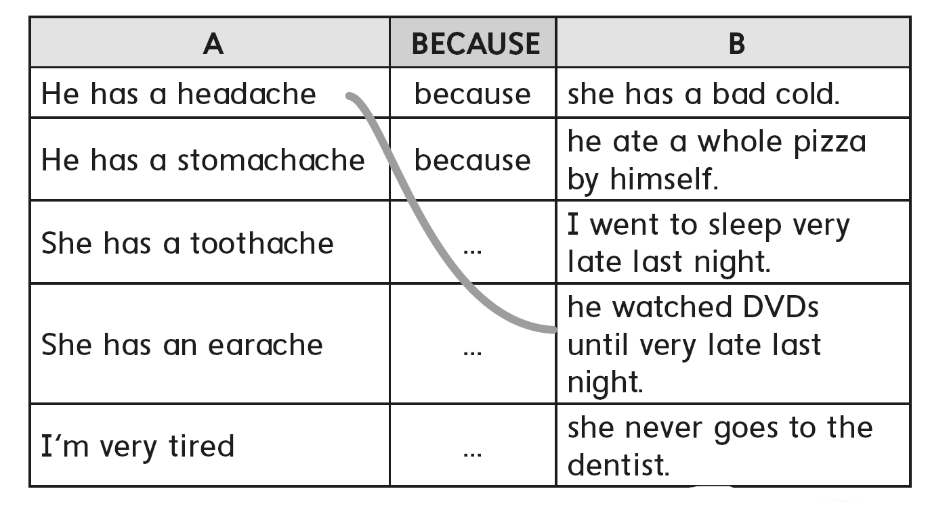

Slide 20
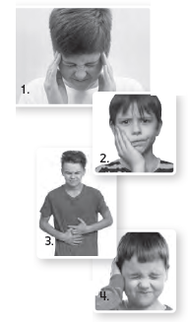
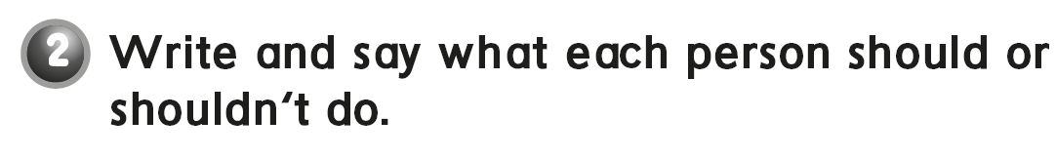
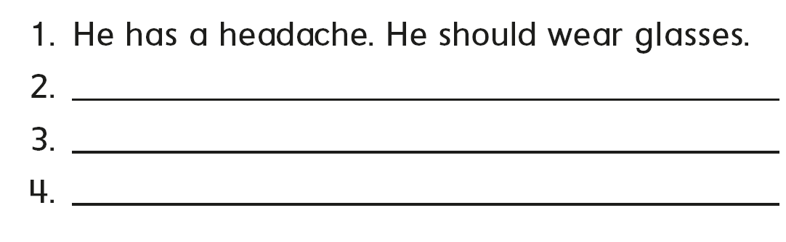
He has a toothache. He should brush his teeth everyday
He has a stomachache. He shouldn’t drink too much soda
He has a earache. He should not listen music too much

Slide 21

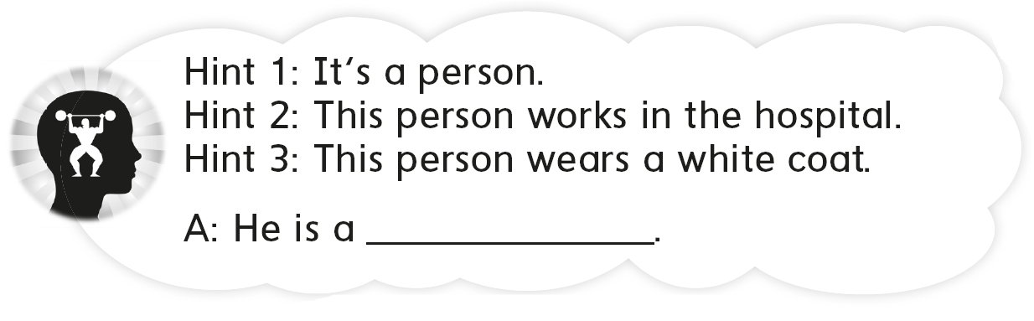
doctor

Slide 22
workbook
Pages 217 , 218

Slide 23
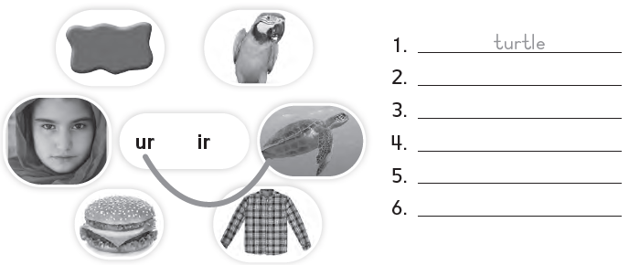
shirt
burger
girl
purple
bird

Slide 24


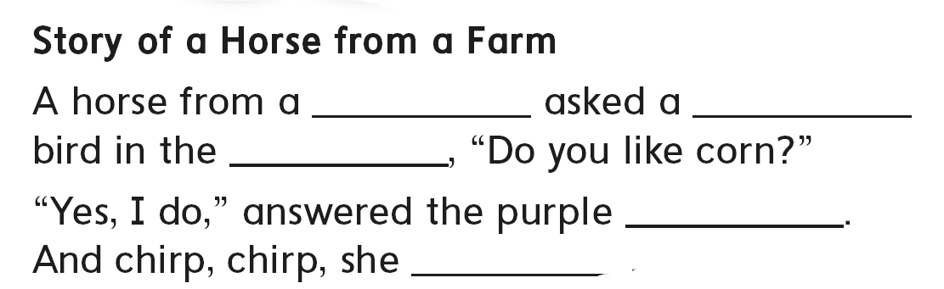
farm
purple
park
bird
Flew away

Slide 25

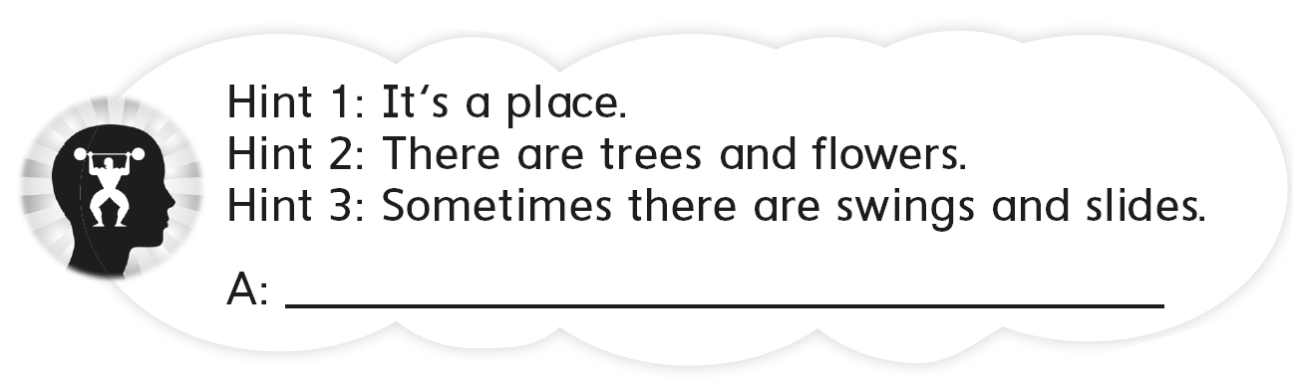
It’s a garden

Slide 26

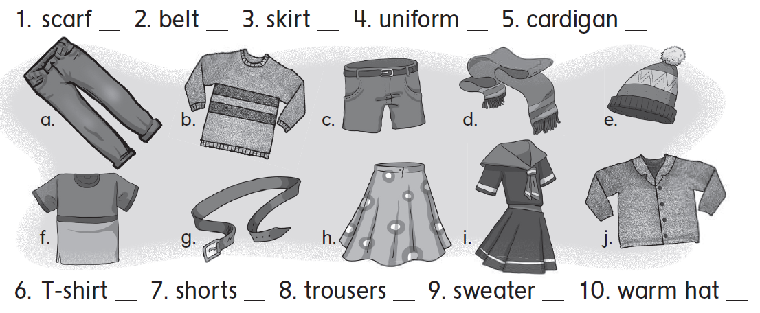
d
g
h
i
j
f
c
a
b
e

Slide 27
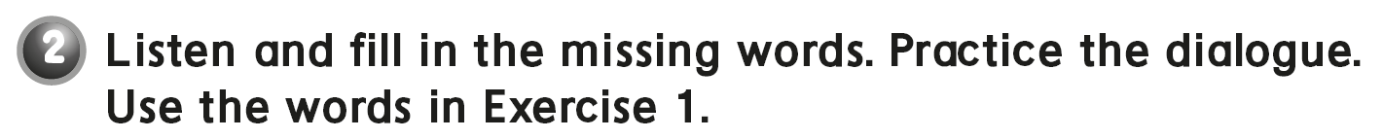
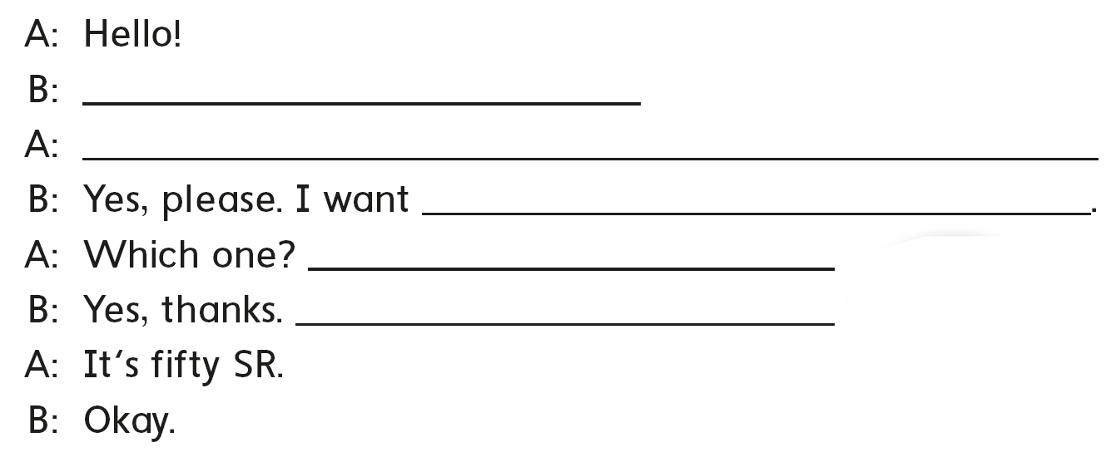
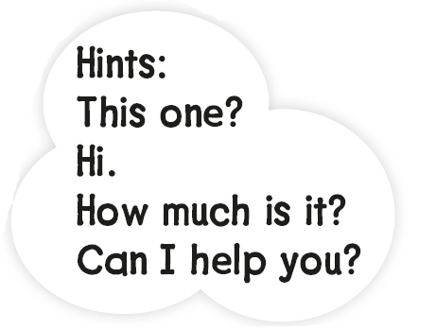
Hi
Can I help you ?
a scarf
This one ?
How much is it ?

Slide 28
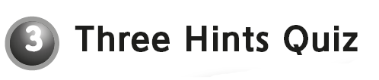
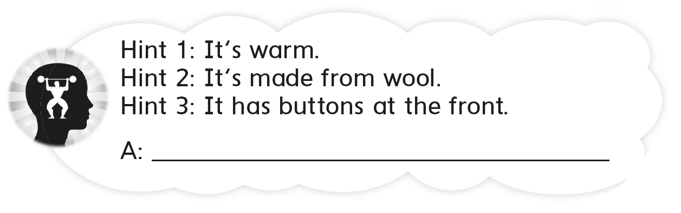
a cardigan

Slide 29


