Slide 1


Welcome to class
T.

Slide 2

3
Unit 11

Slide 3





workbook
Pages 219 , 220

Slide 4

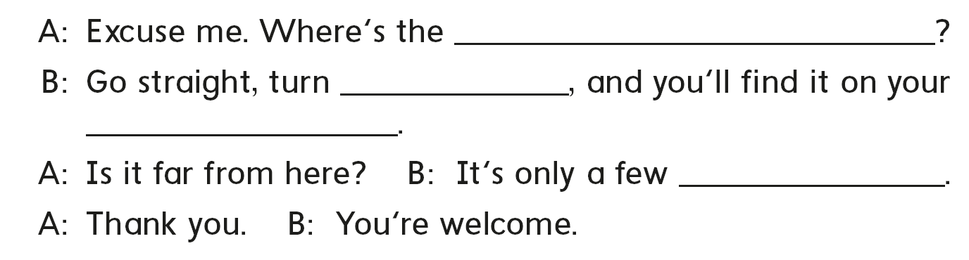
post office
left
right
minutes

Slide 5
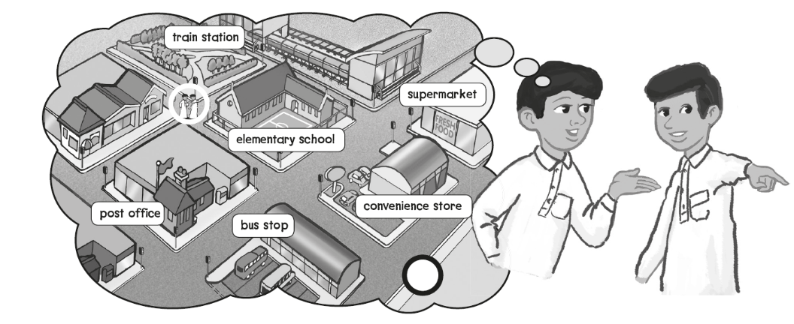
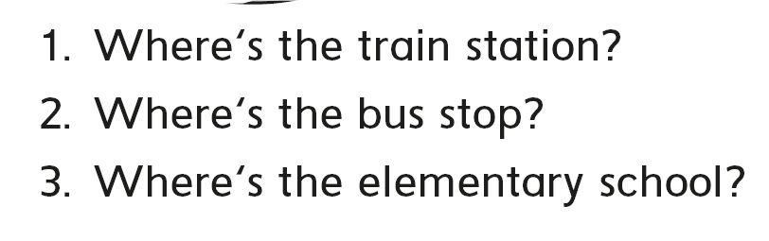
Turn left and go straight
Go straight then turn right
It’s right over there

Slide 6

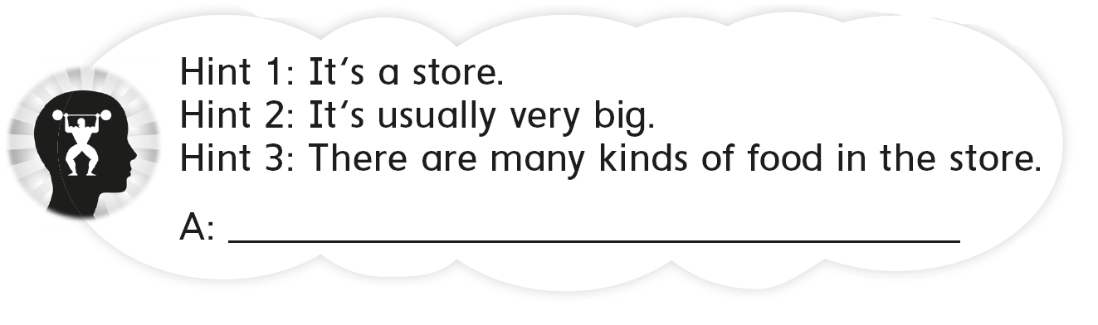
It’s a supermarket

Slide 7

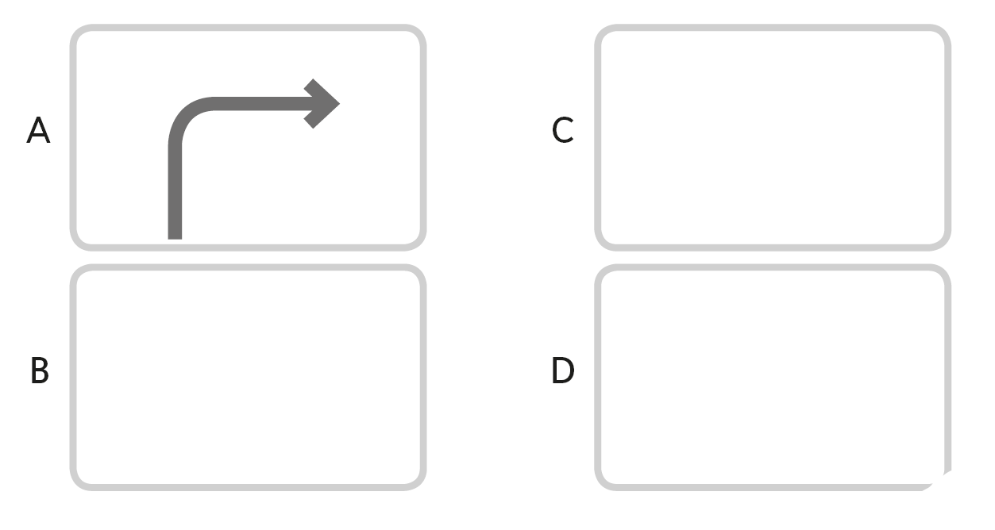

Slide 8

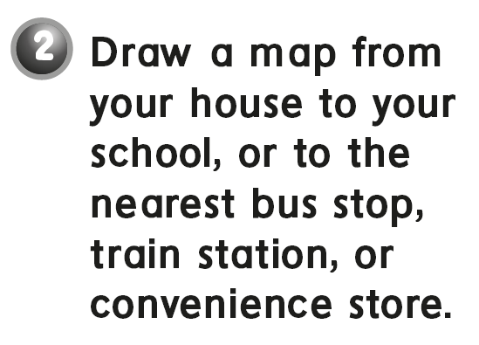


Slide 9

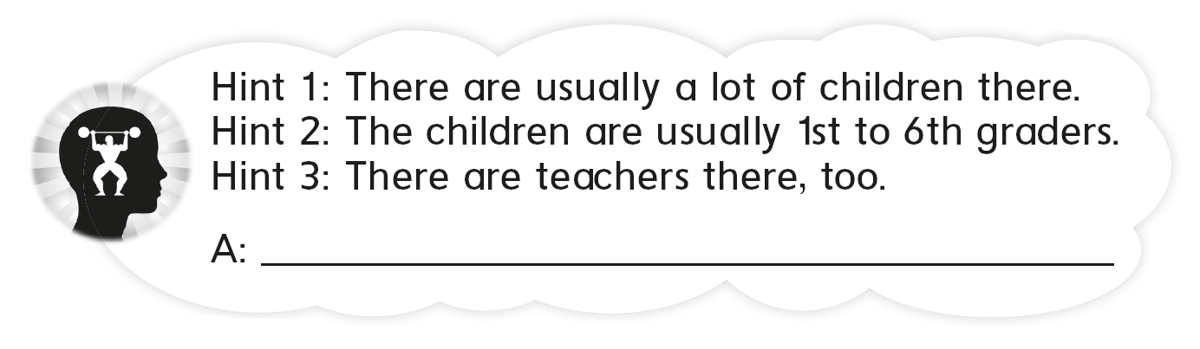
A school

Slide 10
workbook
Pages 221 , 222

Slide 11
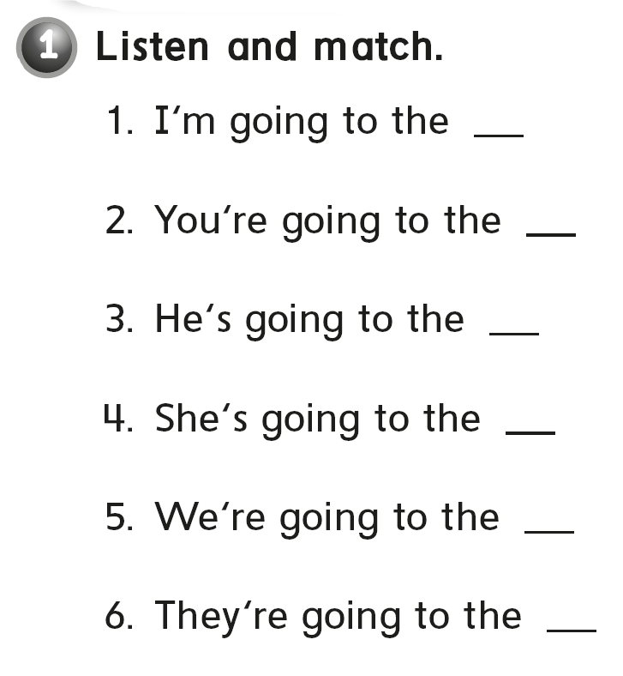
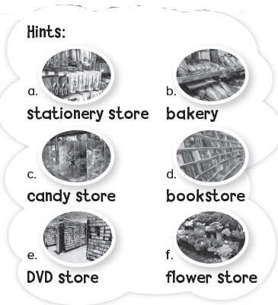
b
d
a
f
e
c

Slide 12

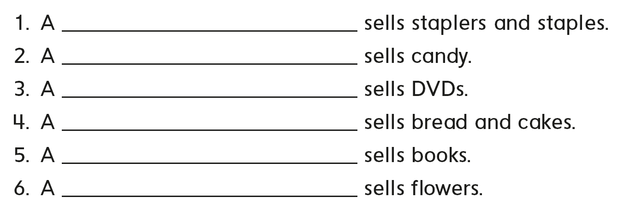
stationery store
candy store
DVD store
bakery
bookstore
flower store

Slide 13

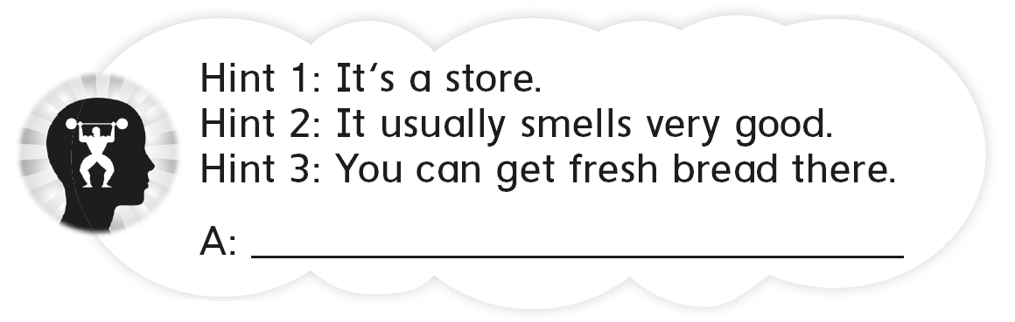
the bakery

Slide 14

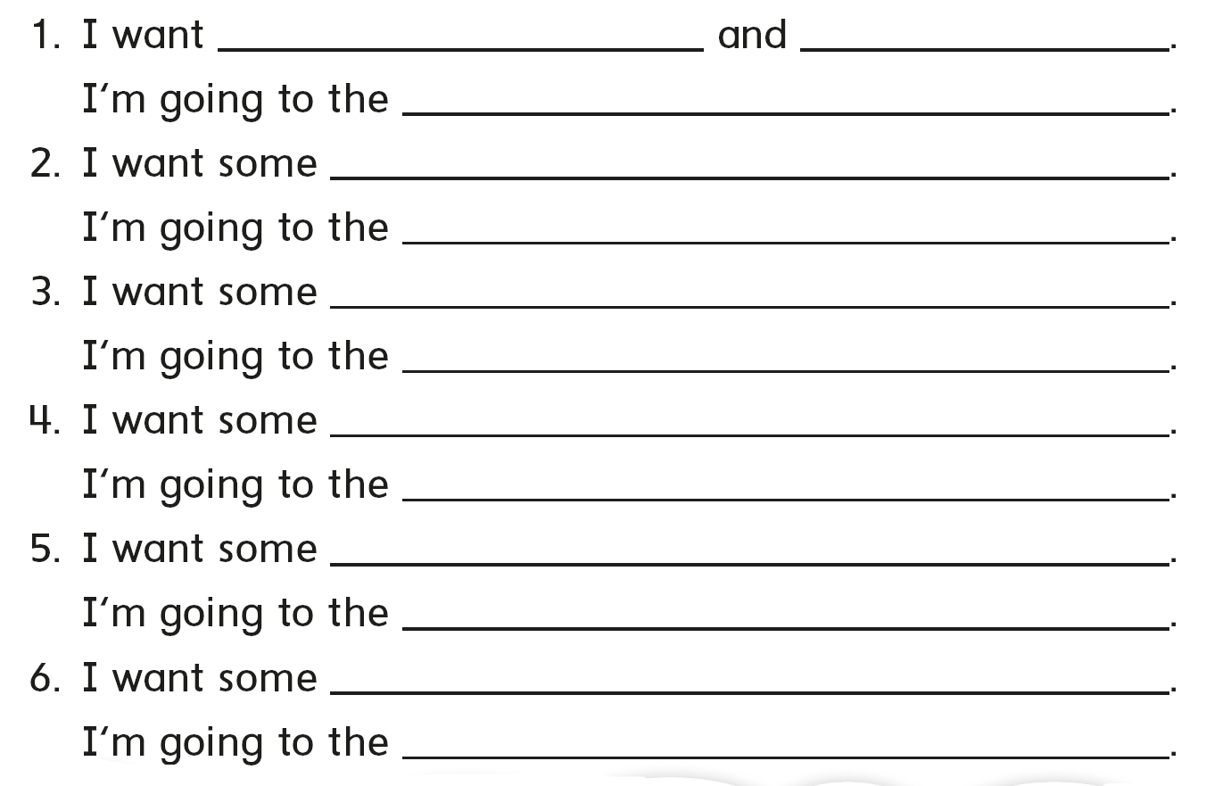

pens pencils
stationary store
chocolate
candy store
DVD’s
DVD store
bread
bakery
magazines
bookstore
plants
flower store

Slide 15
pens pencils
stationary store
chocolate
candy store
DVD’s
DVD store
bread
bakery
magazines
bookstore
plants
flower store

Slide 16

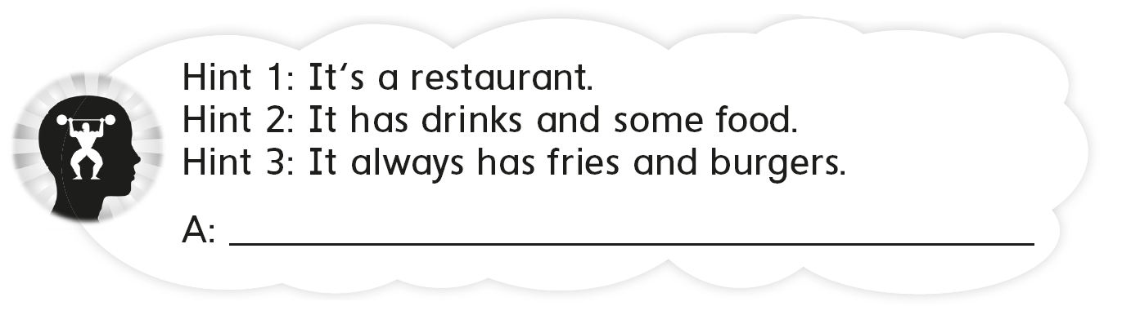
It’s a fast food restaurant

Slide 17
workbook
Pages 223 , 224

Slide 18
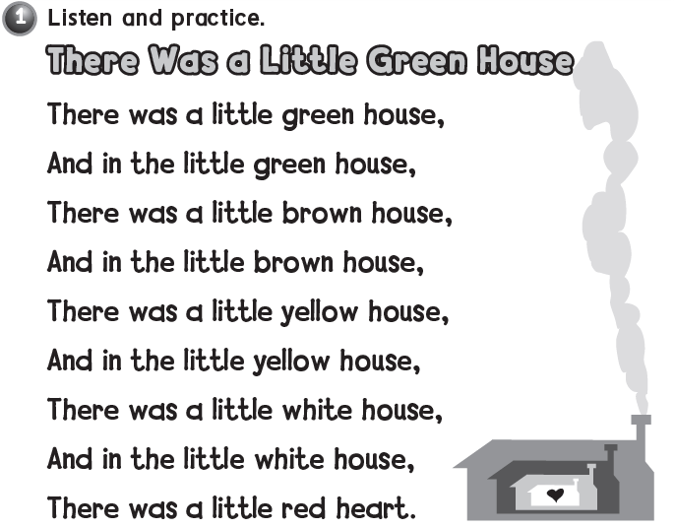


Slide 19
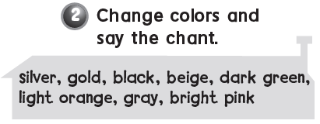
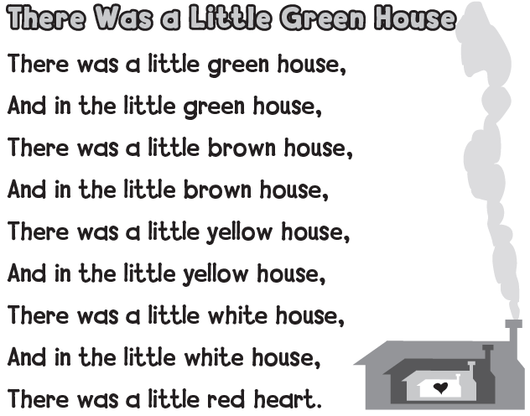

Slide 20

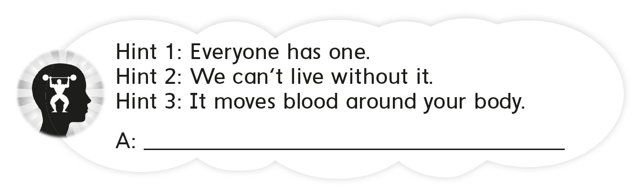
The heart

Slide 21
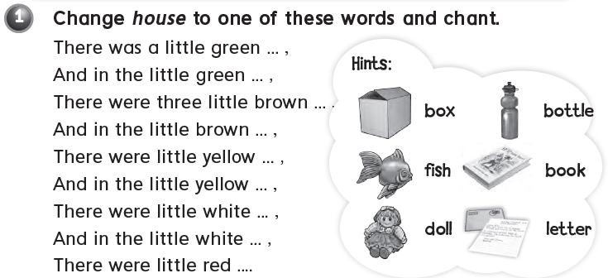

Slide 22

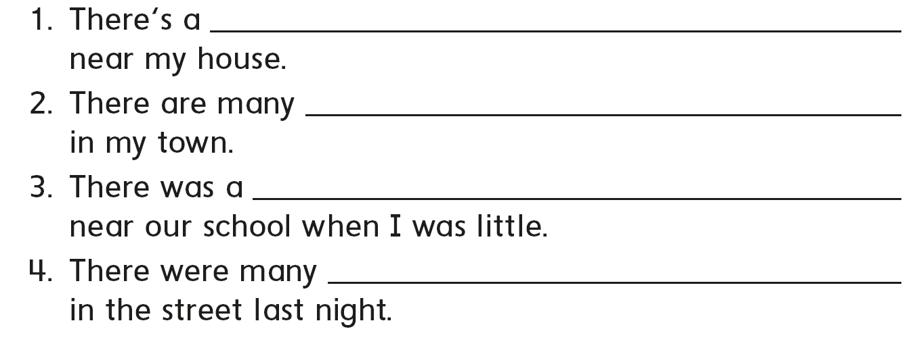
post office
convenience stores
candy store
people

Slide 23
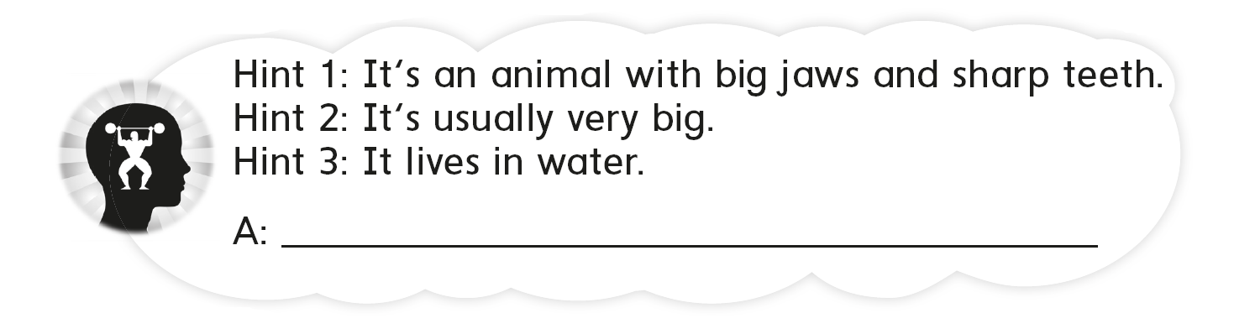
A crocodile

Slide 24
workbook
Pages 225 , 226

Slide 25

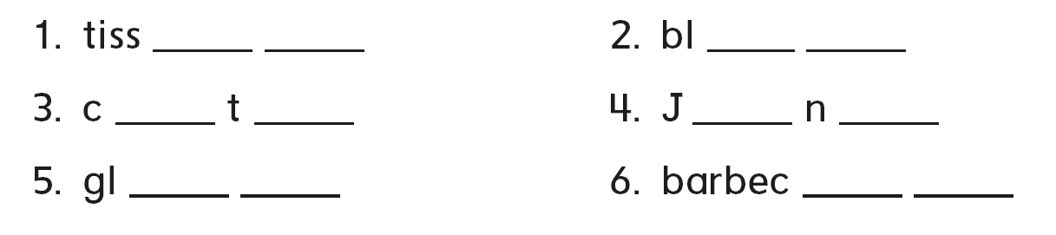
u e
u e
u e
u e
u e
u e

Slide 26
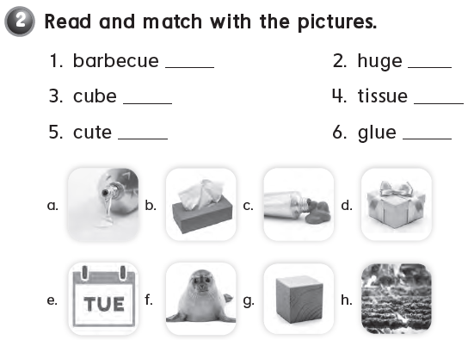
h
d
g
b
f
a

Slide 27

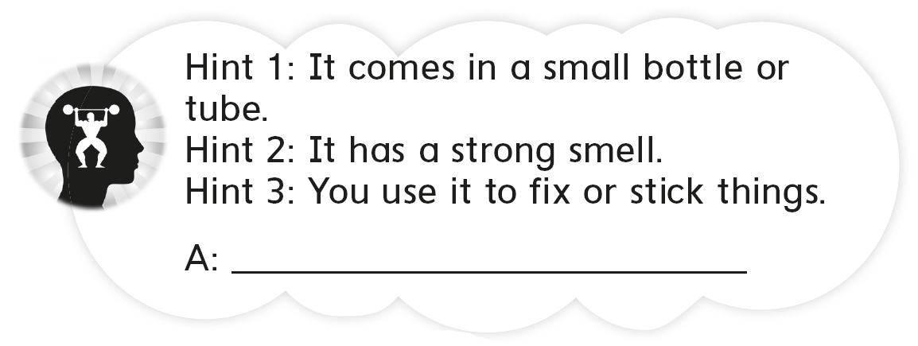
A glue

Slide 28

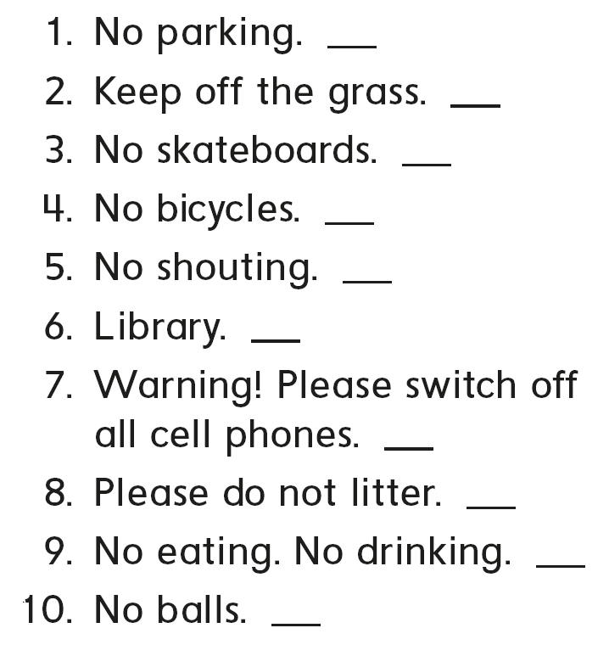
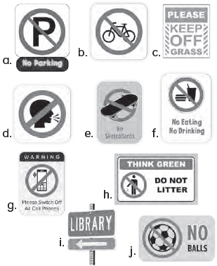
a
c
e
b
d
i
g
h
f
j

Slide 29

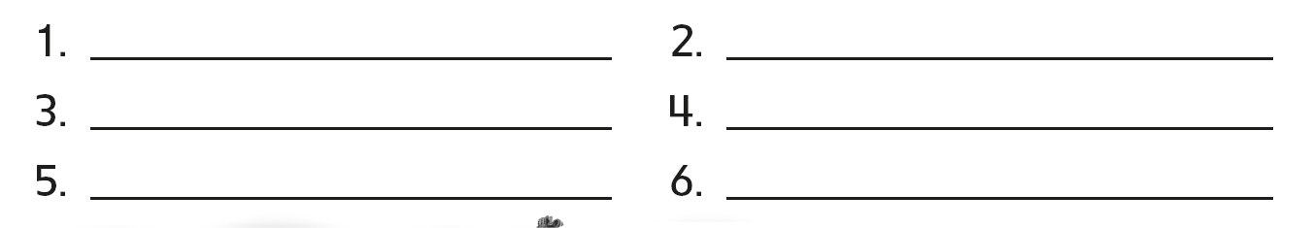

Entrance
Police station
Exit
Bus stop
Library
Train station

Slide 30

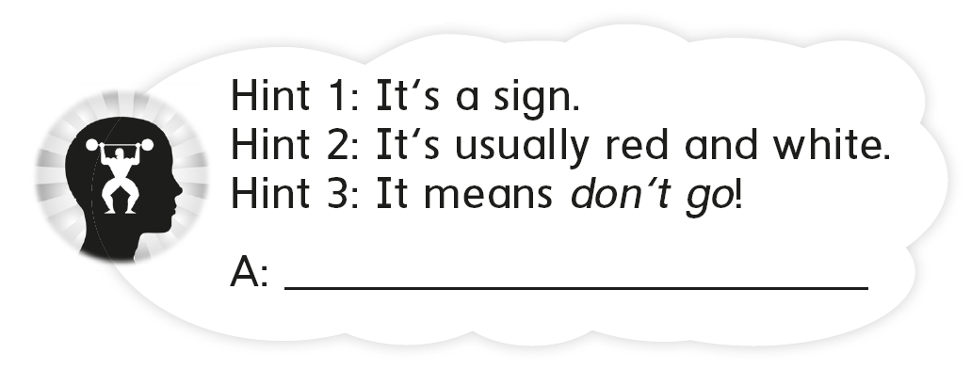
stop

Slide 31


