Slide 1


Welcome to class
T.

Slide 2

3
Unit 12

Slide 3




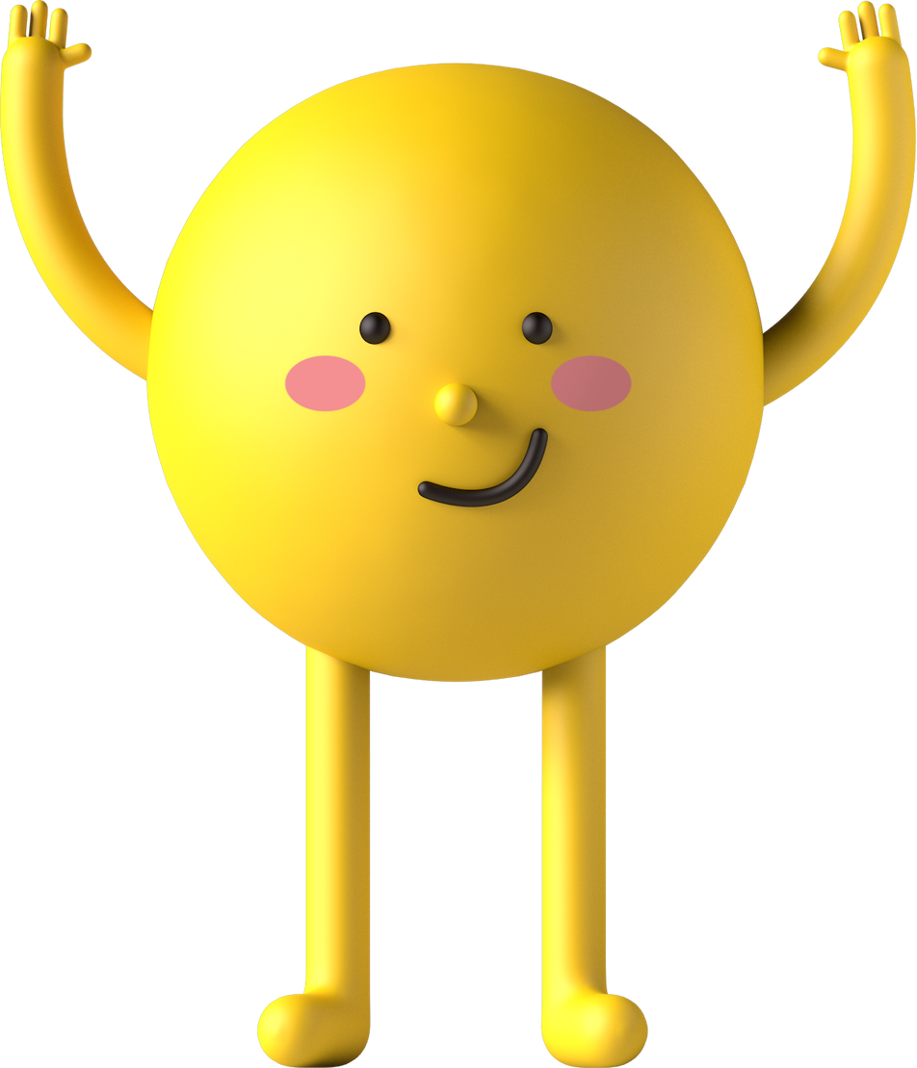
workbook
Pages 227 , 228

Slide 4
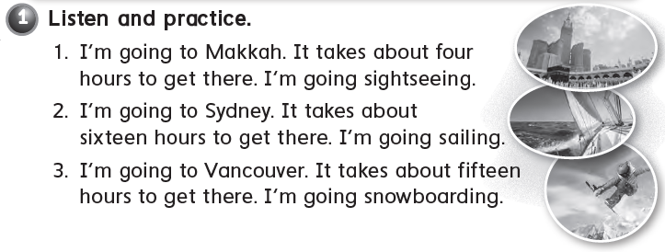

Slide 5
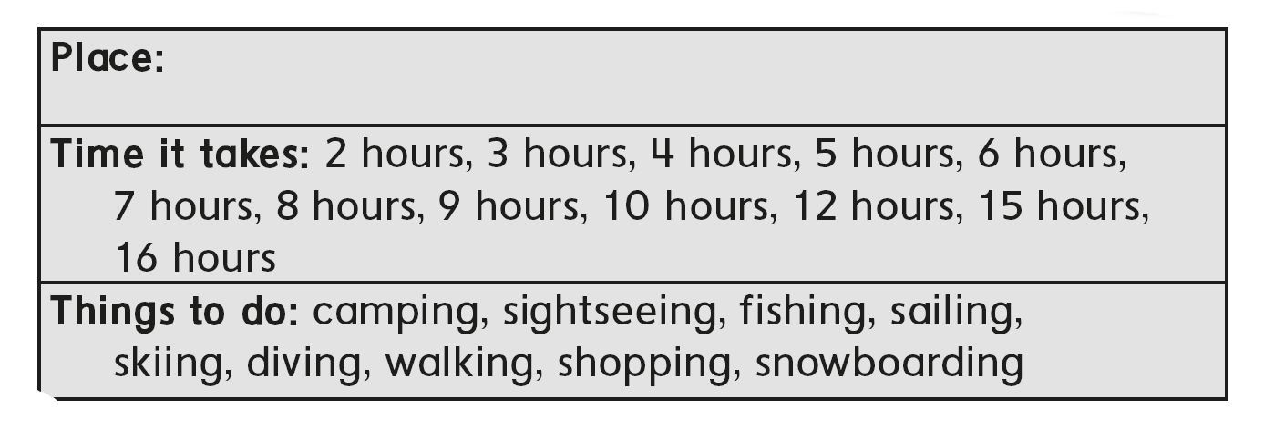
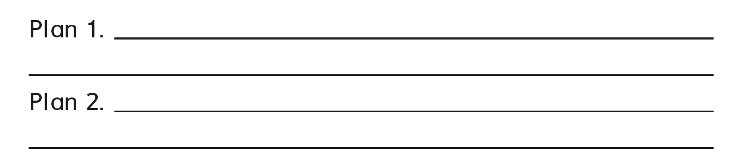
I’m going to the mall
It takes about 3 hours
I’m going to park
It takes about 5 hours

Slide 6
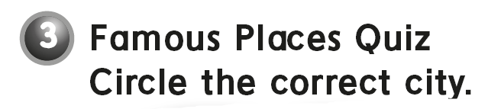
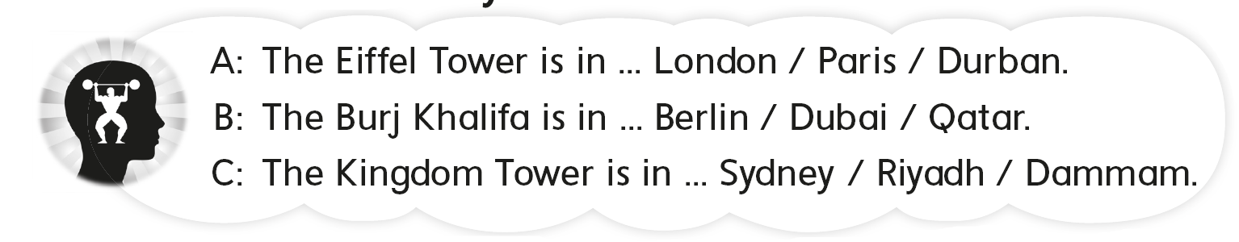

Slide 7

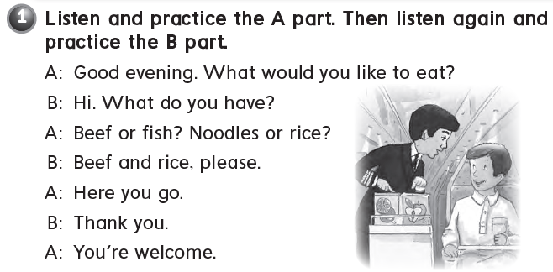

Slide 8
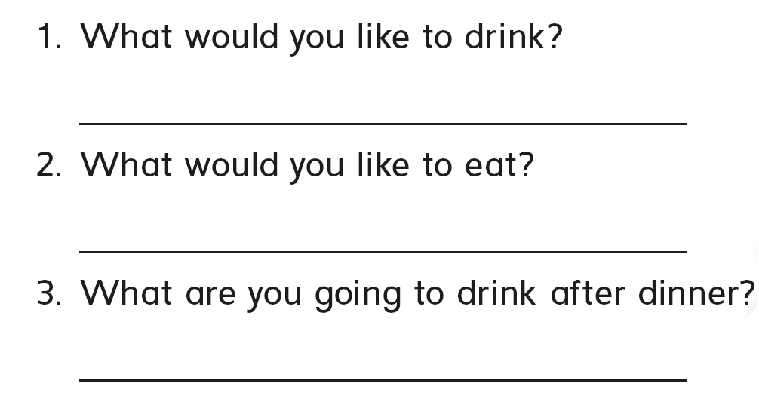
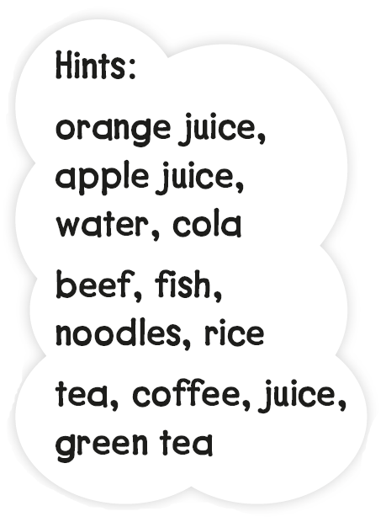
I would like some orange juice
I would like some rice
I would like some tea

Slide 9

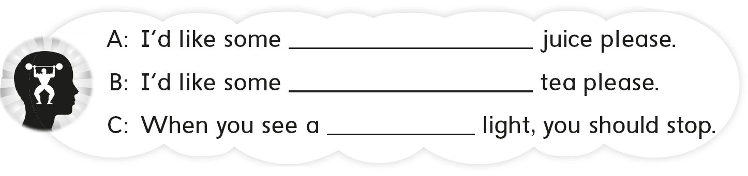
orange
green
red

Slide 10
workbook
Pages 229 , 230

Slide 11

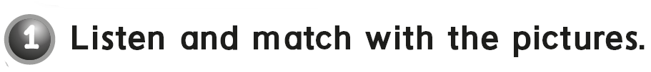
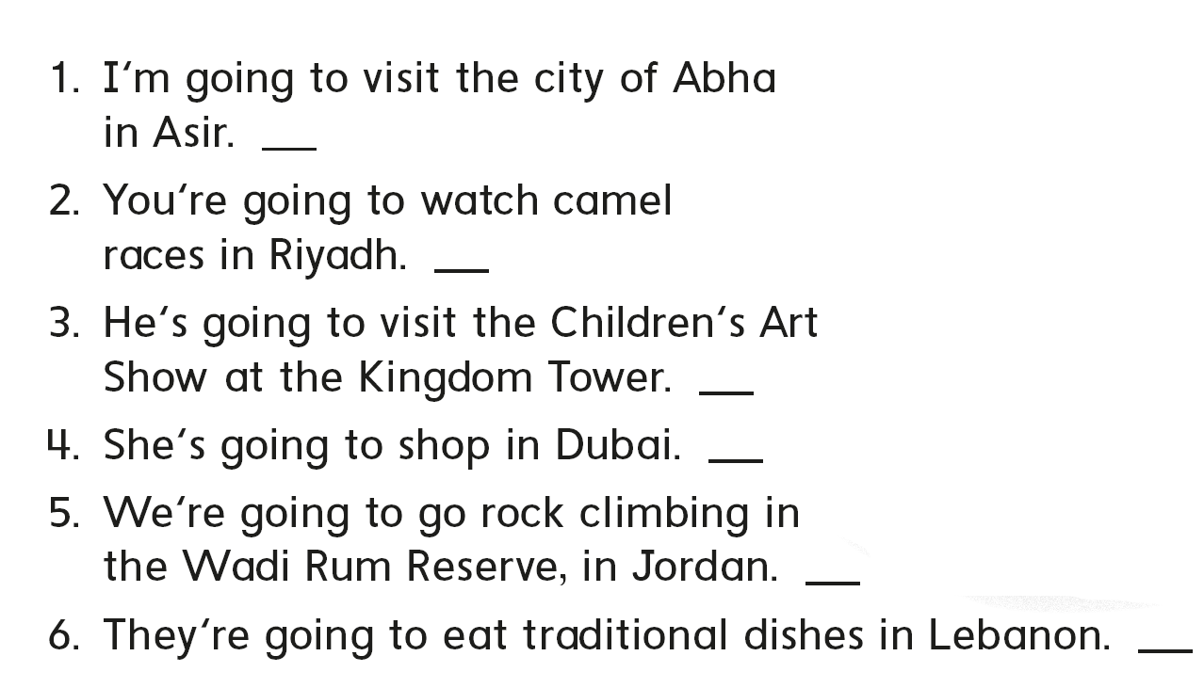
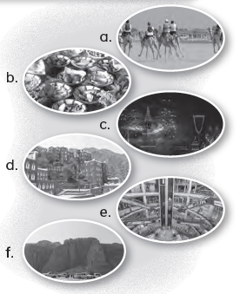
d
a
c
e
f
b

Slide 12

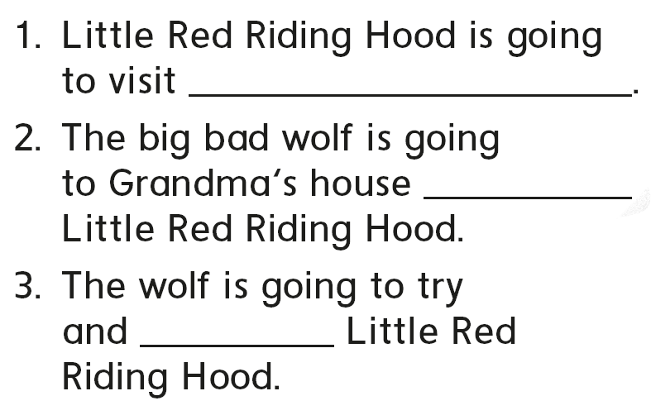
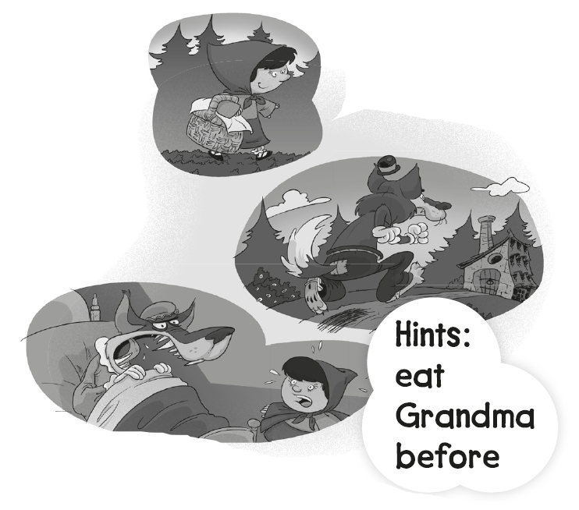
grandma
before
eat

Slide 13
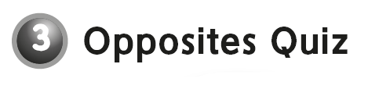
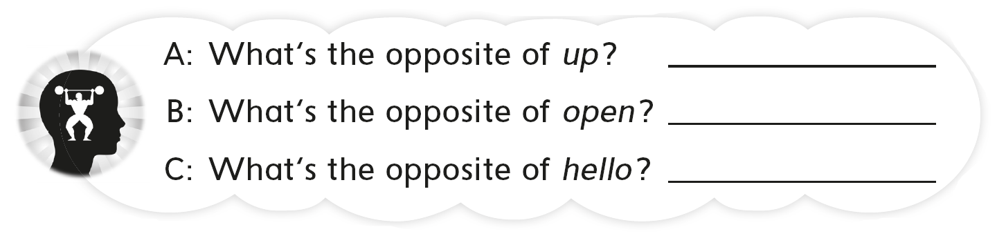
Down
Close
Goodbye

Slide 14

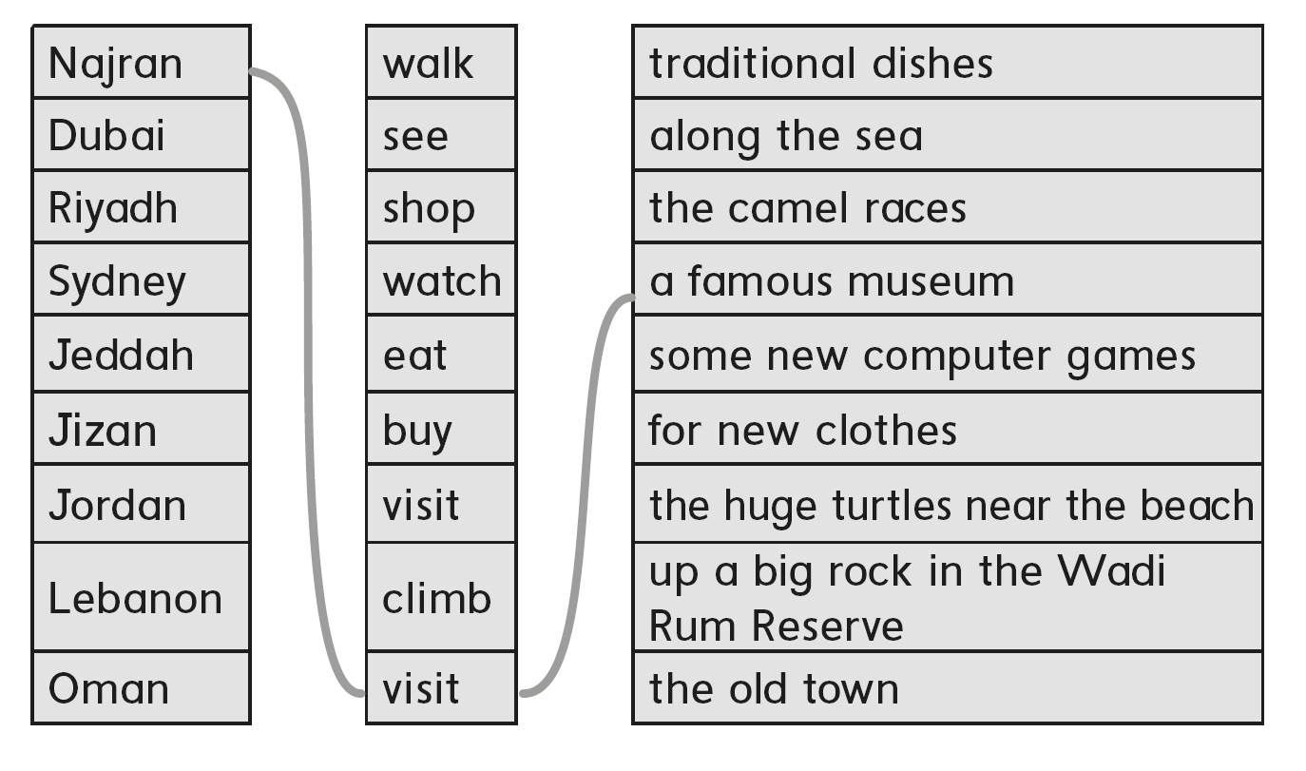

Slide 15
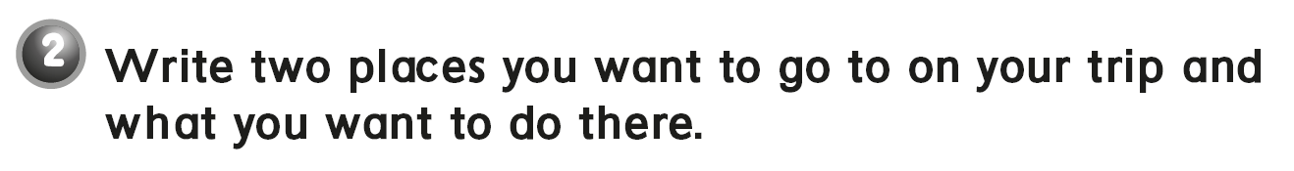
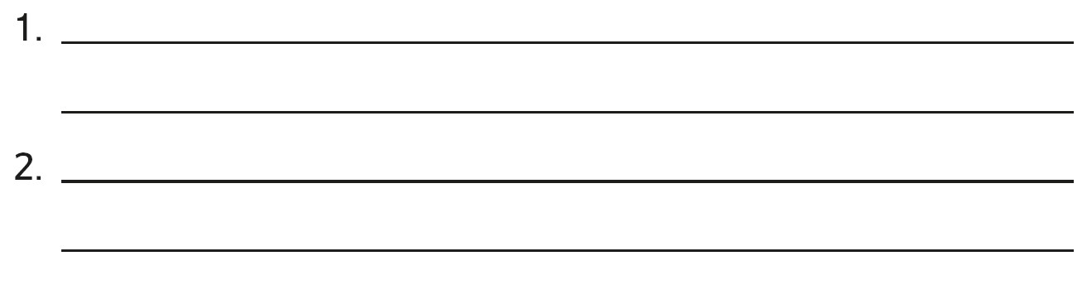
I’m going to the museum in Al-Bahah
I’m going to Al-Balad in Jeddah

Slide 16

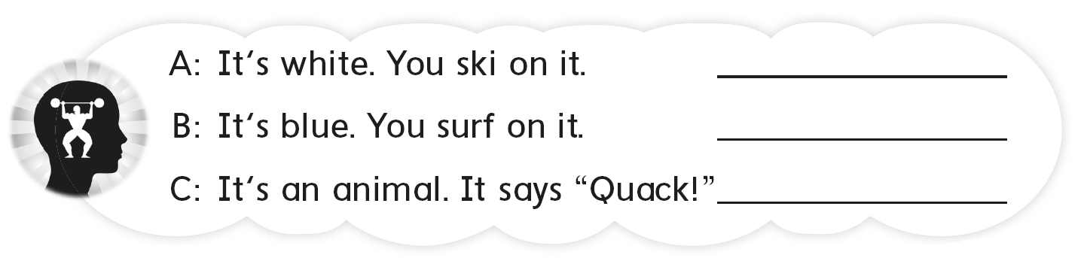
Snow
Sea
Duck

Slide 17
workbook
Pages 231 , 232

Slide 18
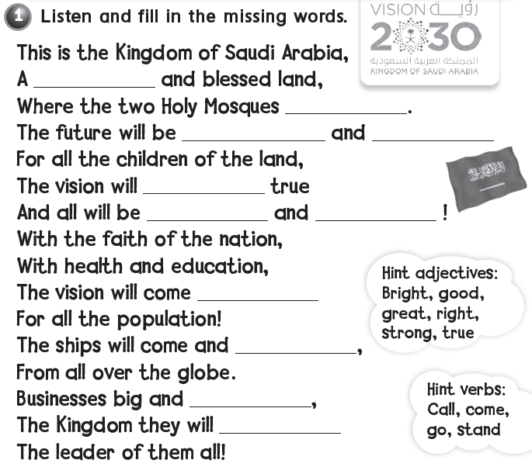

great
stand
strong
bright
come
good
right
true
go
small
call

Slide 19
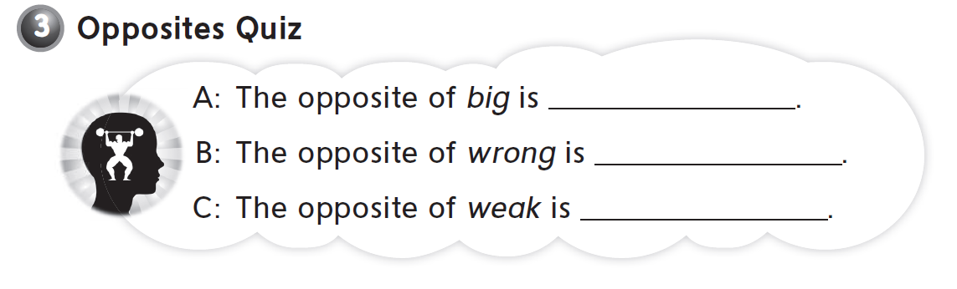
small
right
strong

Slide 20


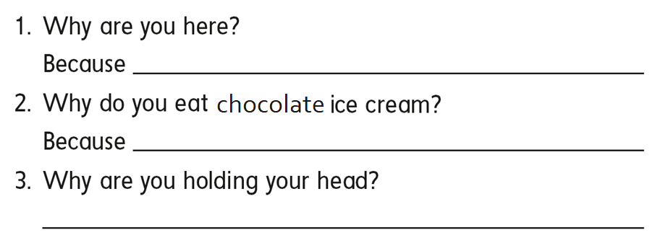
I want to learn English .
it is my favorite .
Because I have a headache .

Slide 21
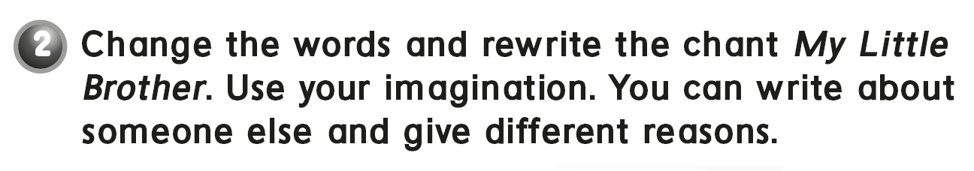
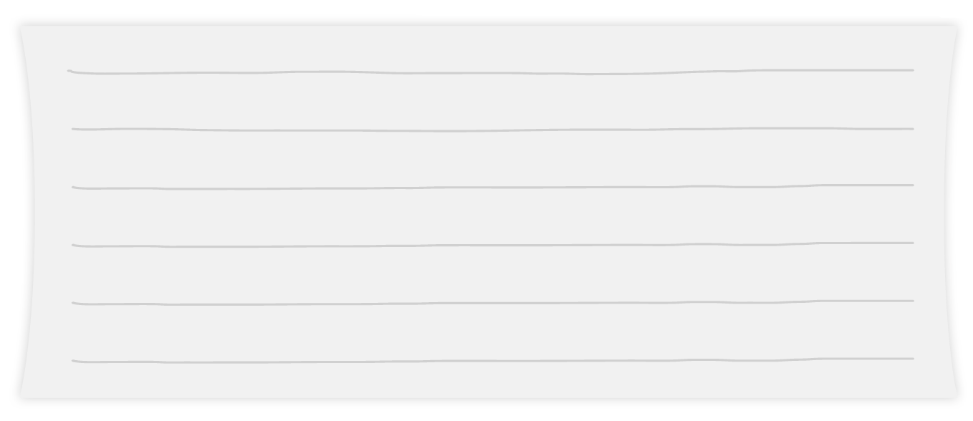
Why did you take my cell phone ?
Because I wanted to watch YouTube
Why did you go out side ?
Because I wanted to see the rain

Slide 22

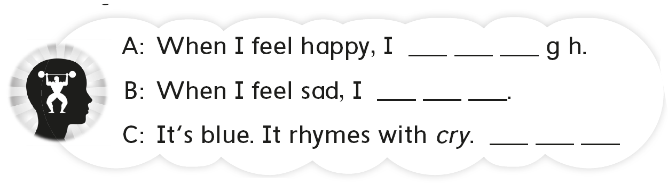
l a u
c r y
S k y

Slide 23
workbook
Pages 233 , 234

Slide 24

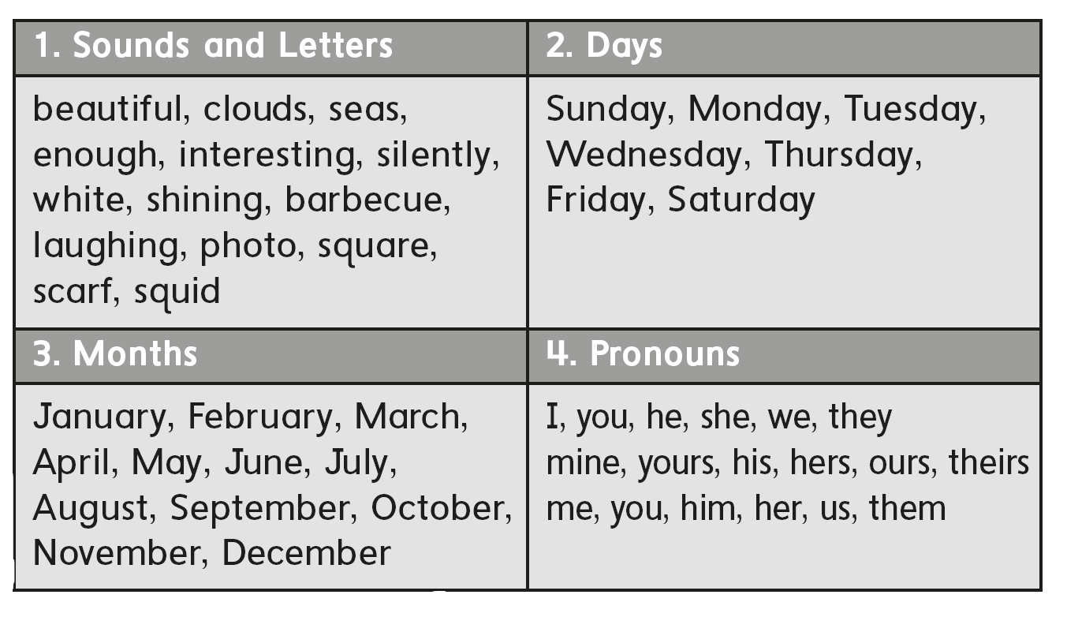

Slide 25

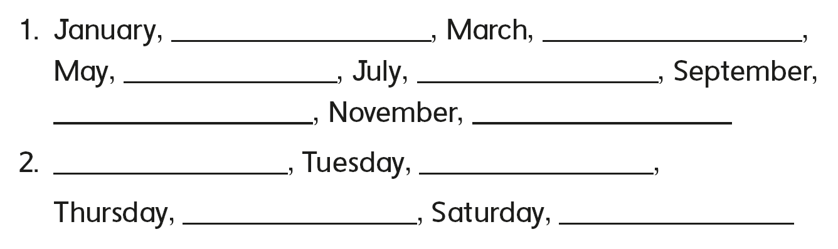
February
April
June
August
October
December
Monday
Wednesday
Friday
Sunday

Slide 26

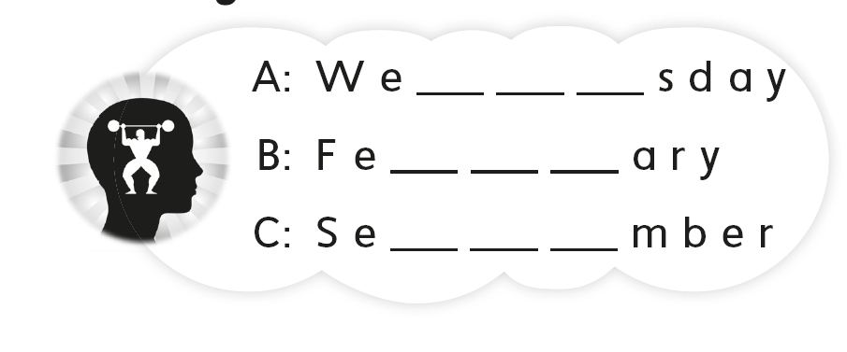
n e s
b r u
p t e

Slide 27
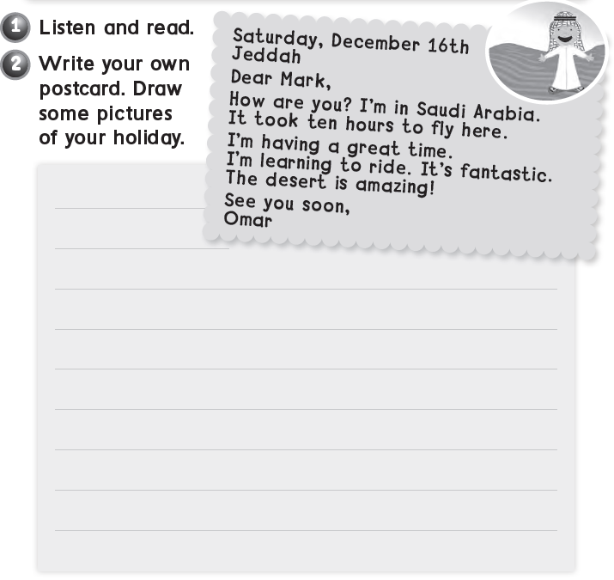

Sunday , March 10th
Abha
Dear Ali ,
How are you ? I’m in Abha . It took 2 hours to get here . Wish too see you soon
Faisal

Slide 28

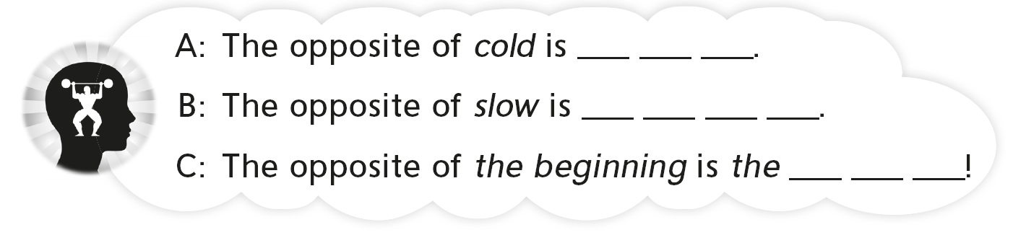
h o t
f a s t
e n d

Slide 29


